Slide 1
Hypothyroidism
Prepared By: Angel Shwaihat
Enas Khamaiseh
Supervised By: Dr. Khalil Al Soutari

Slide 2
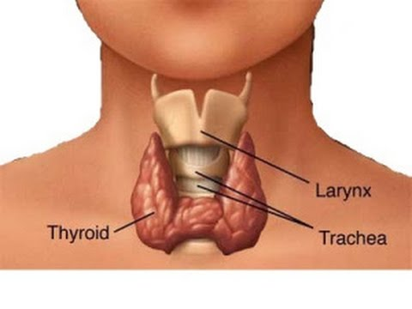
The thyroid
The thyroid gland is a butterfly-shaped organ consisting of two lobes connected by an isthmus, its located at the base of the neck (spanning between the C5 and T1 vertebrae). It releases hormones ,including:
Triiodothyronine (T₃).
thyroxine (T₄).
calcitonin. ↓ CA+2

Slide 3
Thyroid function :
The thyroid's hormones control metabolism and regulate vital body functions, including:
Breathing.
Heart rate.
Body weight.
Muscle strength.
Menstrual cycles.
Body temperature.
Cholesterol levels.
Central and peripheral nervous systems.

Slide 4
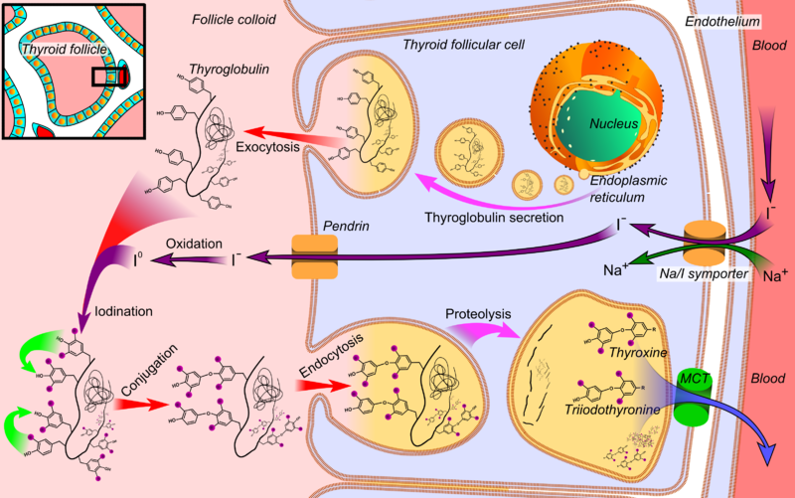
Hormone production :
Notes:
The thyroid hormones are created from thyroglobulin. Thyroglobulin contains 123 units of tyrosine, which reacts with iodine within the follicular space.
Iodine is essential for the production of the thyroid hormones. Iodine (I⁰) travels in the blood as iodide (I⁻), which is taken up into the follicular cells by a sodium-iodide symporter. Iodide then travels from within the cell into the follicular space. In the follicular space, the iodide is then oxidized to iodine. This makes it more reactive,^{[32]} and the iodine is attached to the active tyrosine units in thyroglobulin by the enzyme thyroid peroxidase. This forms the precursors of thyroid hormones monoiodotyrosine (MIT), and diiodotyrosine (DIT).^{[2]}
When the follicular cells are stimulated by thyroid-stimulating hormone, the follicular cells reabsorb thyroglobulin from the follicular space. The iodinated tyrosines are cleaved, forming the thyroid hormones T₄, T₃, DIT, MIT, and traces of reverse triiodothyronine. T₃ and T₄ are released into the blood. The hormones secreted from the gland are about 80–90% T₄and about 10–20% T_{3.}

Slide 5
Thyroid regulation

Slide 6
Hypothyroidism
More common in elderly.
6 times more common in women than in men.
Its often mistaken for signs of other illnesses, menopause or aging.
goitre or goiter is a swelling in the neck resulting from an enlarged thyroid gland.
A goitre is associated with a thyroid that is not functioning properly , and is associated with hypothyroidism or hyperthyroidism, over 90% of goitre cases are caused by iodine deficiency.

Slide 7
Hypothyroidism:
Or underactive thyroid, develops when the thyroid gland fails to
produce or secrete as much thyroxine(T₄) as the body needs.
Causes:
Primary:
is the failure of the thyroid to produce sufficient thyroid hormone. This accounts for about 95% of all cases.
characterized by a high serum thyrotropin (TSH) concentration and a low serum free thyroxine (T4) concentration.
Autoimmune hypothyroidism: Hashimoto’s thyroiditis, atrophic thyroiditis.
Iatrogenic: treatment, subtotal or total thyroidectomy, external irradiation of neck for lymphoma or cancer.
C. Drugs.

Slide 8
Con.
D. Congenital hypothyroidism.
E. Iodine deficiency.
F. Infiltrative disorders: amyloidosis, sarcoidosis,
hemochromatosis, scleroderma.
2- Secondary:
Hypopituitarism: tumors, pituitary surgery or irradiation, Sheehan’s syndrome and trauma.
Isolated TSH deficiency or inactivity .
Bexarotene treatment (antineoplastic) ↓TSH.
Hypothalamic disease (tertiary) : tumors, trauma, infiltrative disorders, idiopathic.
Charectarized by a low free T4 and low TSH levels.

Slide 9
Con.
3-Transient:
Silent thyroiditis; including postpartum thyroiditis .
Subacute thyroiditis.

Slide 10
AUTOIMMUNE HYPOTHYROIDISM :
The autoimmune process gradually reduces thyroid function.
there is a phase of compensation because normal thyroid hormone
levels are maintained by a rise in TSH, Although some patients may
have minor symptoms, this state is called
subclinical hypothyroidism. Later, unbound T4 levels fall and TSH
levels rise further; symptoms become more readily apparent ,
which is referred to as clinical hypothyroidism or overt
hypothyroidism.

Slide 11
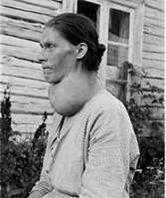
A-Hashimoto’s thyroiditis
there is a marked lymphocytic Infiltration of the thyroid with germinal center formation, atrophy of the thyroid, and mild to moderate fibrosis.
In atrophic thyroiditis,(the later stages of Hashimoto’s) the fibrosis is much more extensive, lymphocyte infiltration is less
pronounced, and thyroid follicles are almost completely absent.
Patients with Hashimoto’s thyroiditis may present because of goiter rather than symptoms of hypothyroidism.
Patients with atrophic thyroiditis present with
symptoms and signs of hypothyroidism.
In Hashimoto’s we look for other Autoimmune
Diseases like (DM type 1 and Coeliac disease
and others).

Slide 12
B- Drugs:
Iodine excess (including iodine-containing contrast media), lithium, antithyroid drugs, p-aminosalicylic acid, interferon α and other cytokines, aminoglutethimide, tyrosine kinase inhibitors (e.g., sunitinib).
Amiodarone: iodine-rich compound with some structural similarity to thyroxine (T4)
The effects may be either :
amiodarone-induced thyrotoxicosis (AIT)
amiodarone-induced hypothyroidism (AIH).
Amidarone induced hypothyroidism due to inhibition of peripheral conversion of T4 to T3.

Slide 13
Postpartum Silent Thyroiditis:
Postpartum Silent Thyroiditis is termed ‘silent’, because the thyroid gland is painless in spite of the inflammation.
A previous episode of Postpartum Silent Thyroiditis and a family history of the condition are the common risk factors associated with it.
In majority of the cases, the signs and symptoms of Postpartum Silent Thyroiditis are mild, and hence, the condition can go unnoticed or undiagnosed.
The common signs and symptoms of Postpartum Silent Thyroiditis include weight loss, increased sweating, fatigue, irritability, and nervousness.
The signs and symptoms of the condition usually resolve within 3 months.

Slide 14
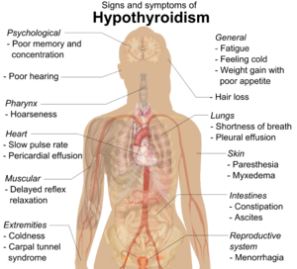
Signs and Symptoms of Hypothyroidism (Descending Order of Frequency) :
Signs | Symptoms
Dry coarse skin cool peripheral extremities Puffy face, hands, and feet (myxedema) Pallor Diffuse alopecia Brittle, dry hair Bradycardia , HTN Peripheral edema Carpal tunnel syndrome Serous cavity effusions. Loss of the outer third of the eyebrows | Tiredness Feeling cold Difficulty concentrating and poor memory Constipation Weight gain with poor appetite. Dyspnea. Hoarse voice. Menorrhagia (later oligomenorrhea or amenorrhea) Paresthesia. Impaired hearing.
Notes:
Increased dermal glycosaminoglycan content traps water, giving rise to skin thickening without pitting (myxedema).
There is pallor, often with a yellow tinge to the skin due to carotene accumulation
Other common features include constipation and weight gain (despite a poor appetite). In contrast to popular perception, the weight gain is usually modest and due mainly to fluid retention in the myxedematous tissues.
On examination, there may be slow relaxation of tendon reflexes and pseudomyotonia.
The hoarse voice and occasionally clumsy speech of hypothyroidism reflect fluid accumulation inthe vocal cords and tongue.
Rare neurologic problems include reversible cerebellar ataxia, dementia, psychosis, and myxedema coma
Myocardial contractility and pulse rate are reduced
Increased peripheral resistance may be accompanied by hypertension, particularly diastolic.

Slide 15
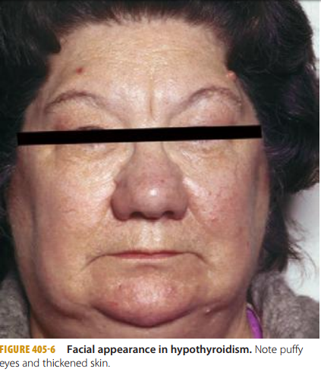
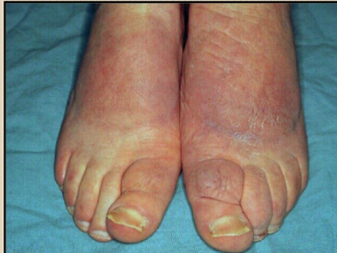

Slide 16
Myxedema coma
It is a rare life-threatening clinical condition that represents severe hypothyroidism The condition usually occurs in patients with long-standing, undiagnosed hypogthyroidism.
Patients with myxedema coma are generally severely-ill with significant hypothermia and depressed mental status.
Cardiovascular: Cardiac contractility is impaired, leading to reduced stroke volume, low cardiac output, bradycardia.
Neurological :Despite the term myxedema coma, many patients do not present in coma, but manifest variable degrees of altered consciousness due to reduction in oxygen delivery.

Slide 17
Pulmonary: The main pulmonary effect is hypoventilation,
which results from central depression of ventilatory drive.
Other contributing factors to hypoventilation include respiratory muscle weakness, mechanical obstruction by a large tongue and pleural effusion.
Renal: Kidney function may be compromised with reduced glomerular filtration rate because of low cardiac output and peripheral vasoconstriction.
Hematologic : associated with a higher risk of bleeding caused by coagulopathy related to an acquired von Willebrand syndrome
and decreases in factors V, VII, VIII, IX, and X. Patients may also have microcytic anemia secondary to hemorrhage, or macrocytic anemia
caused by vitamin B12 deficiency, or normocytic normochromic anemia, which may be secondary to decreased oxygen requirement and
reduced erythropoietin.

Slide 18
Diagnosis blood test
1- Initial screening is by measuring the thyroid stimulating hormone (TSH) level. If this is elevated, the TSH should be repeated within 2–8 weeks with a free T4 level to confirm the diagnosis.
A free T4 level should be ordered if there is a convincing clinical picture for hypothyroidism, despite the absence of TSH elevation, to exclude the (much less common) possibility of central hypothyroidism due to pituitary or hypothalamic pathology .

Slide 20
Low TSH , Low T4 : secondary or tertiary
High TSH , Low T4 : primary
High TSH , normal T4 : subclinical

Slide 21
Clinical clues for central hypothyroidism include other features of pituitary failure (eg. amenorrhoea, hypotension, fine wrinkling of the skin, abnormal pallor, hyponatraemia or hypoglycaemia) or features suggestive of a pituitary mass lesion (eg. visual impairment or headache). If central hypothyroidism is suspected, the function of the hypothalamic-pituitary-adrenal axis should be tested and a magnetic resonance imaging (MRI) scan of the pituitary gland

Slide 22
2- Thyroid autoantibodies:
-antithyroid peroxidase
-antithyroglobulin antibody
They are positive in 95% of patients with autoimmune thyroiditis. A condition known as Hashimoto's Thyroiditis is associated with a high level of these thyroid antibodies in the blood. Whether the antibodies cause the disease or whether the disease causes the antibodies is not known; however, the finding of a high level of thyroid antibodies is strong evidence of this disease.

Slide 23
3-Thyroid Binding Globulin Most of the thyroid hormones in the blood are attached to a protein called thyroid binding globulin (TBG). If there is an excess or deficiency of this protein it alters the T4 or T3 measurement but does not affect the action of the hormone.
If a patient appears to have normal thyroid function, but an unexplained high or low T4, or T3, it may be due to an increase or decrease of TBG.

Slide 24
Abnormalities in CBC and metabolic profile that may be found in patients with hypothyrodism:
-Anemia
-dilutional hyponatremia
-hyperlipidimia
-reversible increase in creatinine

Slide 25
Iodine Uptake Scan A means of measuring thyroid function is to measure how much iodine is taken up by the thyroid gland . Hypothyroid patients usually take up too little iodine The test is performed by giving a dose of radioactive iodine on an empty stomach. The iodine is concentrated in the thyroid gland or excreted in the urine over the next few hours. The amount of iodine that goes into the thyroid gland can be measured by a "Thyroid Uptake".

Slide 26
Treatment
Hypothyroidism cannot be cured, but is easy to treat
Thyoxine (levothyroxineT4) replacement therapy is the mainstay of treatment for hypothyroidism and is usually lifelong. However, it is important to recognise when the cause of the hypothyroidism is transient or drug induced because this may require no treatment or only short term thyroxine supplementation

Slide 27
The average daily dose of thyroxine is 1.6 µg/Kg. However, lower initial doses should be considered in patients who are elderly, frail or who have symptomatic angina, as thyroid hormone increases myocardial oxygen demand with the risk of inducing angina or a myocardial infarction.

Slide 29
Side effects
Treatment side effects are rare when the correct dose is given.
Fatigue, increased appetite, diarrhoea, nervousness, palpitations, insomnia and tremors are indicative of overtreatment.

Slide 30
Poor complianc Occasionally, where a patient has been noncompliant for a period of time and takes a large dose of thyroxine before their blood test it results in a pattern of TSH elevation with high to normal or elevated free T4

Slide 31
Drug interactions
There are a number of drugs that increase thyroxine requirements include:
ferrous sulphate
multivitamins
cholestyramine
proton pump inhibitors.
the oral contraceptive pill
anti-epileptic medication (eg. carbamazepine, phenytoin)
some antibiotics (eg. rifampicin)
the new tyrosine kinase inhibitors (eg. imatinib).

Slide 32
Refrences :
harrison's principles of internal medicine
Davidson's Principles and Practice of Medicine
Kaplan for Internal medicine
Step-up to medicine
Medscape

Slide 33
THANK YOU!

