Slide 1
Behçet's disease
Ghaith Zaidan
Hamzah Alajarma

Slide 2
Behçet's disease, or Behçet's syndrome, is a rare and poorly understood condition that results in inflammation of the blood vessels and tissues.
It’s a chronic, relapsing-remitting, occlusive vasculitis affecting multiple organ systems
First described in the 1930’s by the Turksih dermatologist Hulusi Behcet who noted the triad of aphthous oral ulcers, genital lesions, and recurrent eye inflammation.

Slide 3
Who gets Behcet’s Disease
The disease is most common along the “Old Silk Route,” which spans the region from Japan and China in the Far East to the Mediterranean Sea.
• Predominant age: 3rd to 4th decades.
• Predominant sex: M > F and with more severe disease in some Mediterranean areas.
• Turkey has the highest prevalence: 80 to 370 cases per 100,000 population.

Slide 4
What causes Behcet’s Disease
Etiology and pathogenesis – Unknown
Immunogenetics, immune regulation, vascular abnormalities, or bacterial and viral infection may have a role.
The presence of the gene HLA–B51 is a risk factor for this disease (but it isn’t enough).
Viral and bacterial infection:
HSV-1
Hepatitis virus
Streptococcal infection

Slide 5
Behcet’s disease is both auto inflammatory and autoimmune disorder.
Auto inflammatory :refers to inherited disorders with episodes of recurrent inflammatory reactions of the innate immune system without remarkable provocation.
Autoimmunity :refers to significant levels of high titer auto antibodies or antigen specific T cells.

Slide 6
History
• Signs and symptoms may be recurrent, may precede onset of mucosal membrane ulcerations by 6 months to 5 years.
• Prior to onset of disease, patients may experience a variety of symptoms.
• Malaise
• Anorexia
• Weight loss
• Generalized weakness
• Headache
• Perspiration
• Decreased or elevated temperature
• Lymphadenopathy
• Pain of the substernal and temporal regions
A history of repeated sore throats, tonsillitis, myalgias, and migratory erythralgias without overt arthritis is common.

Slide 7
Clinical findings
Recurrent oral & genital ulcers, ocular lesions skin manifestations & arthritis / arthropathy most frequent clinical manifestations.
Behcet’s may occur at many sites throughout the body but the disease has a predilection for certain organs and tissues:
Eye
Mouth
Skin
Lungs
Joints
Brain
Genitals
Gastrointestinal Tract

Slide 8
spectrum of organ involvement

Slide 9
Oral ulcers (100%)
Indistinguishable from common aphthae (canker sores).
Aphthae may be more extensive, more painful, more frequent, and evolve quickly from a pinpoint flat ulcer to a large sore.
Lesions can be shallow or deep (2-30 mm in diameter) and usually have a central, yellowish, necrotic base and a punched out, clean margin.
Appear singly or in crops, located anywhere in the oral cavity, persist for 1-2 weeks, and subside without leaving scars.
M/c sites - tongue, lips, buccal mucosa, and gingiva.
Tonsils, palate, and pharynx are less common sites.
Interval b/w recurrences ranges from weeks to months.

Slide 10
3 types:
Minor ulcer
Consists of 1-5 small, moderately painful ulcers persisting for 4- 14 days
Major ulcer
1-10 very painful ulcers, measuring 10-30 mm, persisting up to 6 weeks, and possibly leaving a scar upon healing
Herpetiform ulcer
Recurrent crop of as many as 1000 small and painful ulcers

Slide 11
Genital manifestations
Genital ulcers (90%, M>F) resemble their oral counterparts but cause greater scarring.
In males, usually occur on scrotum, penis, and groin.
In females, occur on vulva, vagina, groin, and cervix
Ulcers may be found in urethral orifice and perianal area.
Epididymitis may arise in men

Slide 12
Cutaneous manifestations(58.6-97%)
A variety of skin lesions may appear :
Erythema nodosum–like lesions.
Papulopustular eruptions.
Sweet syndrome–like lesion.
Erythema multiforme–like lesions
Ulcers
Pyoderma gangrenosum

Slide 13
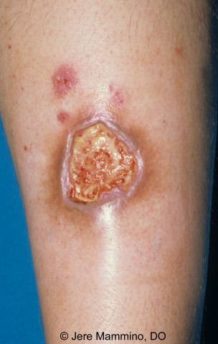
Papulopustular eruptions.
Pyoderma gangrenosum
Erythema nodosum
Sweet syndrome

Slide 14
Ocular manifestations(47-65%)
Major cause of morbidity.
Ocular lesions are:
Anterior uveitis
Posterior uveitis (Retinal vasculitis)-lead to blindness.
Hypopyon.
Secondary complications (Cataract,Glaucoma,Tractional retinal detachment,chronic,cystoid,macular edema,vision loss & Neovascular lesions)
Blindness occur within 4-5 years from onset of ocular

Slide 15
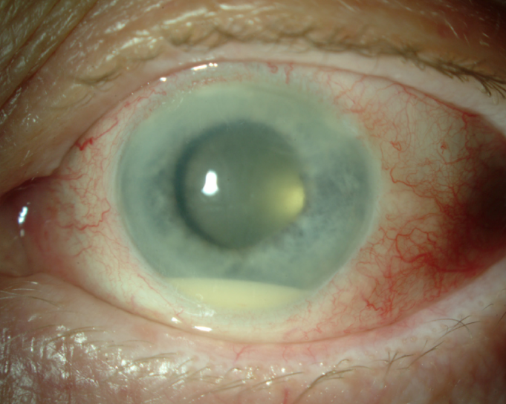
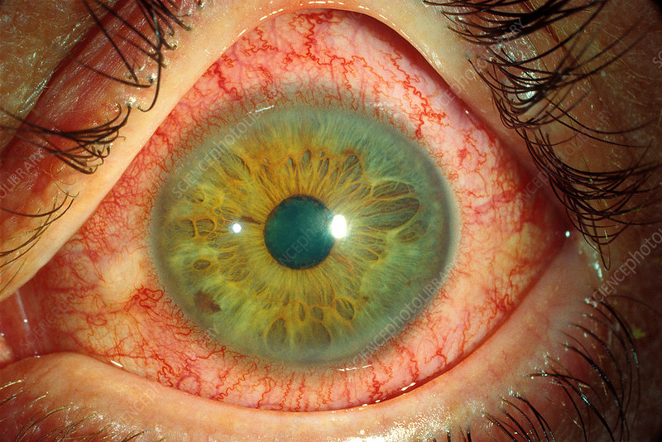
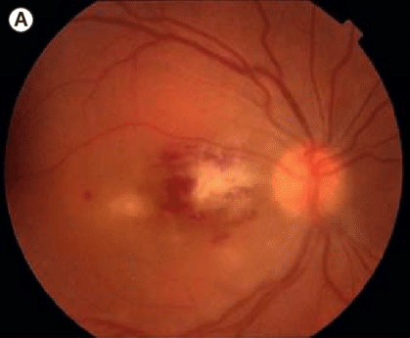

Slide 16
Vascular involvement
Occurs in 30-50%, mostly men.
H/P- media thickening, elastic fiber splitting, and perivascular round cell infiltration.
4 types of vascular lesions –
• Arterial and venous occlusions, aneurysms, and varices.
Venous inv. M/C occlusion, rarely varices.
M/C sites - SVC,IVC, deep femoral vein, and subclavian vein.

Slide 17
Arterial complications, 7% , M/C Aneurysm and occlusion
Subclavian and pulmonary artery, Most commonly occluded.
Pulseless disease -subclavian artery occlusion.
Hypertension - renal artery stenosis.
Femoral artery stenosis - intermittent claudication, AVN of femoral head.
Pulmonary vasculitis - dyspnea, chest pain, cough haemoptysis.
Aneurysm accounts for most vascular deaths.
Common sites- abdominal aorta, femoral and thoracic artery.

Slide 18
Gastrointestinal involvement (>10%)
Clinical spectrum is enormously varied • Anorexia, vomiting, dyspepsia, diarrhoea, abdominal distension, abdominal pain and intestinal ulcers, occurring primarily in the ileum and colon and closely resembling Crohn disease, may occur.
Cardiac manifestations (5-17%)
Coronary vasculitis and thrombosis, pericarditis, myocarditis, endocarditis with granulomatous changes or fibrosis, regurgitation, and diastolic dysfunction
Lung involvement (up to 18%)
Pulmonary vasculitis, hypertension, pleural effusions and Aneurysms

Slide 19
Joint manifestations (30 - 40%)
More than half patients develop signs or symptoms of synovitis, arthritis, and/or arthralgia during course of disease.
Most frequent minor feature in childhood-onset BD is reported to be arthritis, occurring in 11 of 40 patients.
Multiple-joint involvement is common.
Clinical features have been reported as pain, tenderness, swelling, limitation of joint movement, warmth, and morning stiffness.
Knee,Ankle & Elbow joints commonly affected.

Slide 20
Neurologic manifestations (3.2-49%)
May present as meningoencephalitis, a multiple sclerosis–like illness, acute myelitis, stroke, or pseudotumor cerebri. Cerebral venous sinus thrombosis, Cranial nerve palsies, Brainstem lesions
Most serious, leading to severe disability and a high fatality rate.
Usually occur within 5 years of disease onset.
Severe headache is most frequent initial symptom.

Slide 21
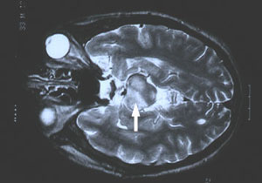
The disease tends to involve the “white matter” portion of the brain and brainstem, and may lead confusion, strokes, personality changes, and (rarely) dementia.
The meningitis of Behcet’s disease is not associated with any known infection, it is often referred to as “aseptic” meningitis.
(MRI) study of a Behcet’s patient demonstrating central nervous system involvement (white matter changes in the pons).

Slide 22
How is Behcet’s Disease Diagnosed
Diagnostic Criteria.
SYMPTOM - POINTS
Ocular lesions (recurrent) 2
Oral ulcers (recurrent) 2
Genital ulcers (recurrent) 2
Skin lesions (recurrent) 1
CNS symptoms 1
Vascular manifestations 1
Pathergy test (+ve) 1
Total - 10
BCD scoring: Score>4 indicates Behcet disease

Slide 23
• Major features
• Recurrent aphthous ulceration of oral mucous membrane
• Skin lesions -Erythema nodosum – like lesions, subcutaneous thrombophlebitis, folliculitis (acne like lesions), cutaneous hypersensitivity
• Eye lesions - Iridocyclitis, chorioretinitis, retinouveitis, definite history of chorioretinitis or retinouveitis
• Genital ulcers
• Minor features
• Arthritis without deformity and ankylosis
• Gastrointestinal lesions characterized by ileocecal ulcers
• Epididymitis
• Vascular lesions
• Central nervous system lesions
Diagnosis
Complete –
Four major features
b) Incomplete –
3 major features,
2 major and 2 minor features,
Typical ocular symptom and 1 major or 2 minor features
c) Possible –
2 major features
1 major and 2 minor features

Slide 24
Laboratory Investigation
Complete blood count: neutrophilia
C –reactive protein- raised
Beta 2 microglobulin- raised
Serum myeloperoxidase- raised
LFT-raised(if liver involved)
Skin Biopsy
Urine analysis, Proteinuria, hematuria (if kidney involved)
Barium studies
CSF analysis
MRI/CT Scan
Chest X ray
Endoscopy
Pathergy test

Slide 25
PATHERGY TEST:
Site: Commonly volar aspect of forearm.
Intradermal injection of 0.1 ml isotonic salt solution using 20 G needle without prior disinfection of the injection site.
3-5 mm intradermally at an angle of 45 degree.
Reading – after 24-48 hours
+ve result- Erythematous papule or pustule (>2 mm) at prick site.

Slide 26
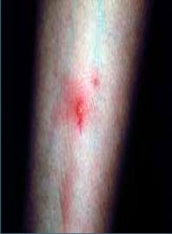
Pathergy test is not pathognomic.
+ve results can also occur in patients with,
Pyoderma gangrenosum
Rheumatoid arthritis
Crohn disease
Genital herpes infection

Slide 27
Treatment
Choice of treatment depends on site and severity of clinical manifestations.
Mucous membrane inv:
Topical glucocorticoids.
Triamcinolone , prednisolone
Topical anaesthetics.
Lidocaine
Topical immunosuppressant
Cyclosporine solution
Serious cases- thalidomide

Slide 28
Arthritis:
Colchicine
Azathioprine
Thrombophlebitis:
Aspirin
Uveitis:
Systemic steroids( Methyl prednisolone )
Azathioprine
Cyclosporin

Slide 29
Pulmonary or peripheral arterial aneurysms
Anti– TNF
Neurological involvement:
Azathioprine
Prognosis:
Behcet's disease has an undulating course of exacerbations and remissions, and may become less severe after approximately 20 years.
Appears to be more severe in young male, and Middle Eastern or Far Eastern patients
Risk of death is highest for young men and patients with arterial disease or a high number of flare-ups. Many patients eventually go into remission.

