Slide 1
Infantile gastroesophageal reflux
Backer rawashdeh , md

Slide 2
Definitions
GER :- passage of gastric contents into the esophagus with or without regurgitation or vomiting
NASPGAN 2009
Retrograde movement of gastric contents across the lower esophageal sphincter (LES ) into the esophagus
Nelson 19 th

Slide 3
GERD :-
Presence of troublesome symptoms and / or complications of persistent GER .
NASPGHAN
Or
GER becomes pathological when it causes troublesome symptoms and physical complication , hence the term gastro esophageal reflux disease GERD
Nelson

Slide 4
Definition
Regurgitation “spitting up” :
effortless movement of stomach contents into the esophagus and mouth .
Vomiting :-
forceful expulsion of gastric contents out of the mouth.

Slide 5
Defintions
GER
GERD
Secondary GERD

Slide 6
GER is common
½ of infants less than 3 months vomits at least once daily
2/3 of infants by age of 4 months ( peak )
By 12 months only 5% of infants .

Slide 8
Pathophysiology
Notes:
Obtuse

Slide 9
Pathophysiology
LES in infants is very short <1 cm. In adults, the LES ranges from 3-6 cm
LES in infants is located more superiorly than in adults and is subjected to negative intrathoracic pressure during inspiration
The LES lengthens and moves more inferiorly during the first year of life

Slide 10
Pathophysiology
GER results from relaxation of the lower esophageal sphincter (LES) .
In healthy infants and children, relaxation of the LES is transient. In infants, gastric distention associated with large volume feeds portends more frequent transient LES relaxations.
Delayed gastric emptying also can increase the frequency of transient LES relaxations. Esophageal clearance and mucosal defense (secretions) play a signiﬁcant role in prevention of esophagitis .
In neurologically impaired children, decreased basal LES tone also is likely to contribute to GER.

Slide 11
Most of the infantile reflux is NON acidic reflux :-formula

Slide 17
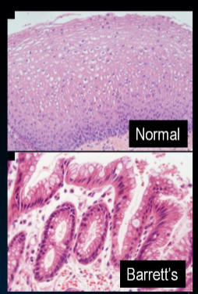
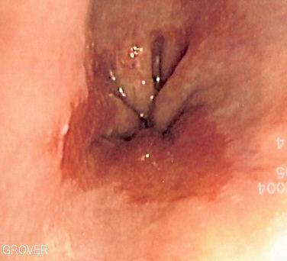
GIT
Reflux esophagitis
Frequency and severity of symptoms does not predict development of esophagitis
Barrett esophagus
Rare in pediatric
0.25% of endoscopies of pediatrics
1-3% progress to adenocarcinoma
Familial
Esophageal stricture 5% .

Slide 18
Respiratory
Pneumonia
Asthma
Upper airway symptoms

Slide 19
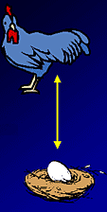
Asthma
Does GERD cause asthma?
Aspiration to lungs and hyperresponsiveness
Vagal mediated bronchial spasm
Doses asthma cause GERD?
High negative intrathoracic pressure, LES relaxation
Increased abdominal pressure
Drugs

Slide 23
ALTE
Rarely caused my GERD

Slide 24
DDX ..

Slide 26
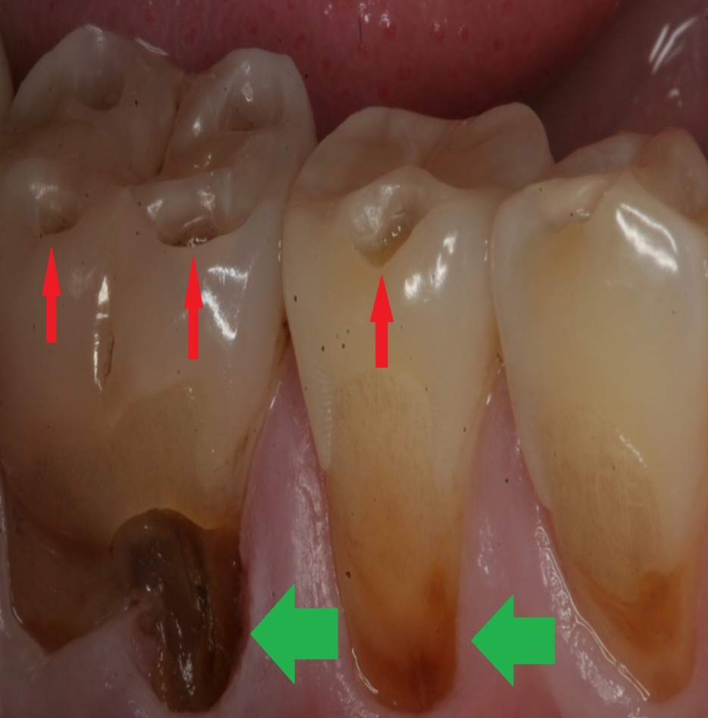
Dental erosion

Slide 27
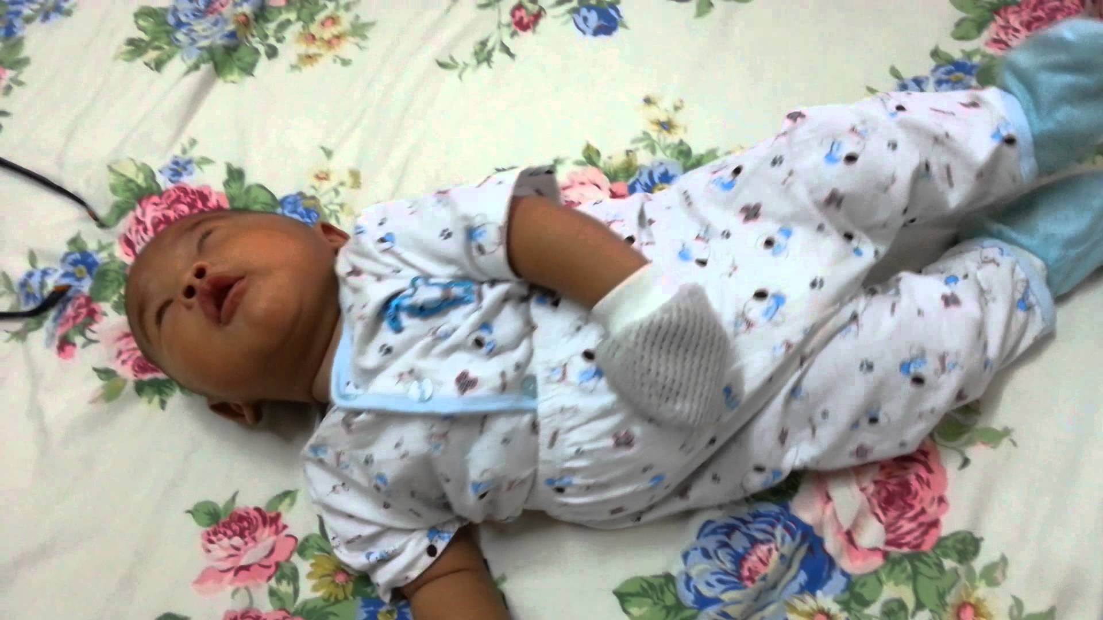
Sandifer syndrome = GERD + opsthatnous position
Vagal reflex
Responds to acid supression

Slide 28
Differential Diagnosis
Neurologic Meningitis Increased intracranial pressure Migraine Respiratory Post tussive emesis Pneumonia Renal Obstructive uropathy Renal insufﬁciency Cardiac Congestive heart failure Behavioral Overfeeding Self-induced emesis Metabolic galactosemia fructosemia Urea cycle defects congenital adrenal hyperplasia | Infection Sepsis Meningitis Gastroenteritis Urinary tract infection Otitis media Anatomic/Obstructive Foreign body Pyloric stenosis Malrotation Intussusception Gastrointestinal Eosinophilic esophagitis Pill esophagitis Infectious esophagitis Achalasia Hepatitis Pancreatitis

Slide 29
Diagnosis
The history and examination alone may be sufficient to diagnose benign GER
Investigations are reserved for infants and children who have complications related to GERD and to evaluate for other causes of vomiting.

Slide 30
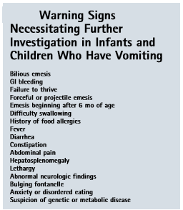
History and exam
Vomitting
Age of onset
Bile stained
Forceful or effortless
Fever
Feeding history
Past medical history
Prematurity
Neurologic problems,
Growth or developmental
Food allergy CMPA .
Growth parameters
A thorough examination
Notes:
should include volume and frequency of feedings, type of formula,preparationofformula,andpositioningoftheinfant during the feeds.

Slide 31
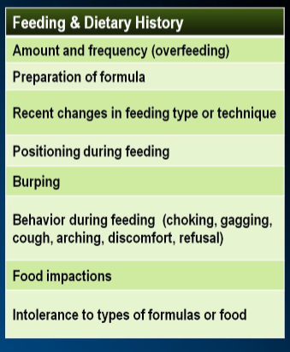

Slide 32
History of GER \GERD
Starting soon after birth
Non bilious vomiting
most of the time non projectile vomitus
After feeding
Milk or food content
Most of the time small amount
No fever , diarrhea or Jaundice,

Slide 33
GERD
Irritability and crying (esophagitis)
FTT
Not improved over time
Family history might be present
Associated with complications
May be secondary to another disease or problems
Vomitus might be bloody (esophagitis)

Slide 34
Secondary GERD
Neurologic impairment
Cystic fibrosis
Esophageal atresia
Malrotation
Hiatal hernia
Prematurity
TEF
Family history of GERD
Notes:
bedifﬁculttodiagnoseGERDinneurologicallyimpaired children

Slide 36
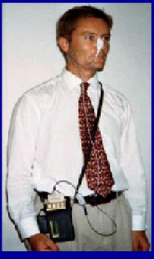
pH probe
To records the number and duration of acid reflux episodes
If the infant has > 12 episodes in 24-hours with decreased pH as detected by the probe, the infant is at risk of esophagitis
A nomal pH study dosen’t role out GER

Slide 39
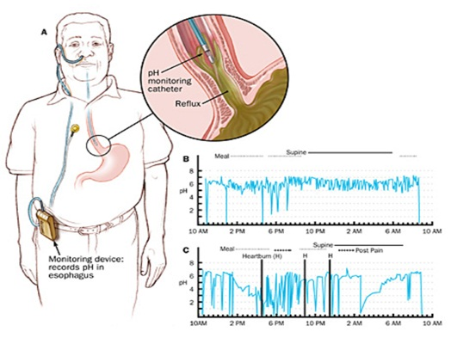

Slide 40
pH probe
Reﬂux index: percentage of study during which the pH is <4.0
Symptom index: the number of times a particular symptom associated with acid reﬂux occurs divided by the total number of times that particular symptom is recorded.

Slide 41
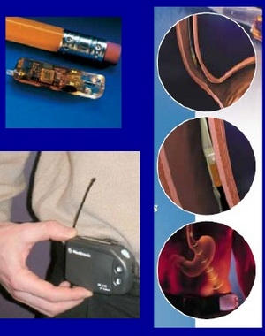
pH probes
Can not detect non-acid reflux episodes
Esophageal pH monitoring is effective also for evaluating the efficacy of acid suppression therapy.

Slide 42
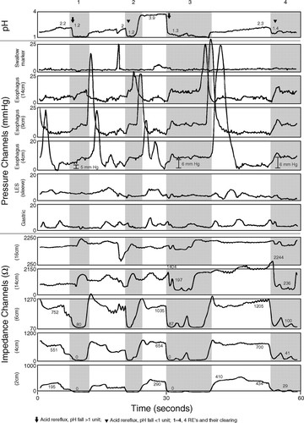
COMBINED MULTIPLE INTRALUMINAL IMPEDANCE AND PH MONITORING. (MII)
Detect acid, weak acids, and non acid reflux

Slide 44
Upper GI exam
To role out anatomic abnormalities in the vomiting child, such as pyloric stenosis, and esophageal stricture
Also shows motility disorders as achalasia
It should not be used to diagnose GERD because nonpathologic reﬂux frequently is detected during this study.

Slide 46
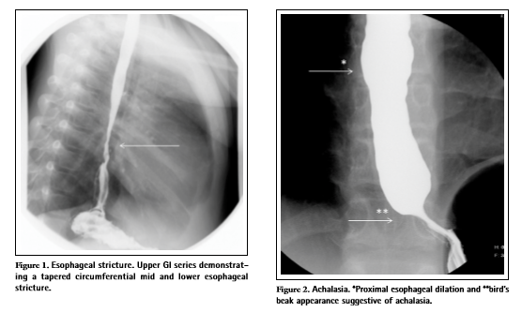

Slide 47
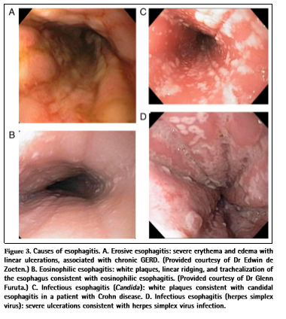
with biopsy Upper endoscopy
Can be used for diagnosis of esophagitis
Also used for diagnosis of PU, and crohn disease

Slide 50
Nuclear scintigraphy
Not routinely used
To see where the formula goes after normal feeding
An isotop labeled formula is given and baby is monitored for GER for 1 hour after feeding
Diagnostic if material is seen in the lung
Also used to assess gastric emptying

Slide 52
Esophageal manometry
Assess esophageal peristalsis and LES pressures
Diagnosis of esophageal motility disorders, such as achalasia
Manometry can not be used to diagnose GERD or predict success with therapy because it cannot determine whether any reﬂux (acid or nonacid) or esophagitis is present.

Slide 55
Treatment of GER
Elevation of head on bed
Don’t encourage sleeping on prone position
Thickening of formula, using 1-2 tablespoon rice cereals, per ounce formula
AR formula
A trial of low allergy formula for 2 weeks ??
Avoid overfeeding

Slide 58
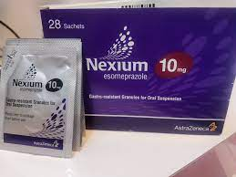
pharmacologic measures for GERD
When previous measures fail
esophagitis
PPI
Omeprazole
Lanzoprazole
Emeprazole
Pantoprazole
Rapeprazole

Slide 59
pharmacologic measures
H2 blockers
Ranitidine
Famotidine
nizatidine
Prokinatics?
Metochlopramide
Erythromycin
Notes:
Bethanechol
crisapride

Slide 60
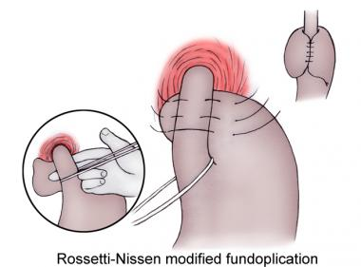
Surgical
FUNDOPLICATION: reserved for neurologically impaired patients
Also for GERD complications refractory to management
Post operative risk of pneumonia is the same as gastrojujenal feeding

Slide 61
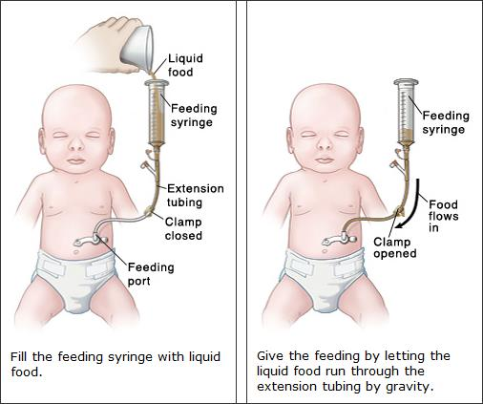

Slide 62
THANK U

