Slide 1
بسم الله الرحمن الرحيم
Prof DR. Waqar Al – Kubaisy

Slide 2
MEASURES OF
DISEASE FREQUENCY
Part 1
Prof DR. Waqar Al – Kubaisy

Slide 3
Aims of epidemiological study:-
1 Controlling or preventing the spread of disease.
preventing re-occurrence of disease.
2- Preventing the introduction of disease not Present in the community.
3- Eradicating disease already present.
4- Detecting means for promoting health & efficiency of population in a community
Uses of Epidemiology:-
1-To Describe the distribution & size of diseases in human population. Age, sex social class…..
2- To Identify etiological factors in the pathogenesis of disease
3-To Provide the data essential for management.
4- To Evaluation and planning of services for the prevention & control and treatment of disease

Slide 4
Uses of Epidemiology:-
To Describe the distribution & size of diseases in human
population. Age, sex social class…..
To Identify etiological factors in the pathogenesis of disease
To Provide the data essential for management.
To Evaluation and planning of services for the prevention
& control and treatment of disease
MEASURES OF DISEASE FREQUENCY
A prerequisite for any epidemiologic
investigation is quantify the occurrence of disease.
The most basic & simplest method of expressing disease frequency simple count. ♀ 25 ♂ 10
However
count data alone have very limited utility for epidemiologists.
No. of student with Tuberculosis(TB)
=20 school A
= 30 school B ????????
To know distributions and determinants of disease,
it is also necessary to know
The size of the population

Slide 5
♀ 25 ♂ 10
♀ 200 ♂ 50
TB=20 school A
TB= 30 school B
100 School A
200 School B
The time period during which the data were collected.
Such measures allows direct comparisons of disease frequencies in two or more groups of individuals. a
Rate
Ratios
Proportion
percentage

Slide 6
Rate
Ratios
Proportion
percentage
Rate
Is the measure of an event, condition (disease, disability or death)
with a unit population and
within a time period.
20 /100school A
30/200 school B
♀ 25/200 ♂ 10/50
a__ a+b
Basic factors needed to develop rate are 3
1- Numerator ( No. of individual affected , diseased
20 school A 30 school B
2-Denominator ;the total population of the study,
the total No. of group among which the
affected(diseased) persons are derived
100 School A
200 School B
♀ 200 ♂ 50
3- Time period usually year

Slide 7
Cont. .. .Rate
Rate derived by
Dividing the number of cases (the numerator) 20,or 30 by the
total number capable of experiencing the event
(denominator, or population at risk) 100 or 200
20/ 100 or 30/200
and
multiplying the result by 100,1000,or 10000 (constant)
a__ a+ b
Rate= Number of cases X 100
Population of the area in specific time period
A .TB = 20/ 100 X 100 = or B.TB= 30/200X 100=
♂ = 10 / 50X100=20%
♀ = 25/200X100= =12.5%
in order to know how many cases accrued for that unit of population

Slide 8
Cont. .. .Rate
Rate= Number of cases X 100
Population of the area in specific time period
In Rate the №. of cases in numerator is
subset of the population №. in denominator
a__ a+ b
Rate= Number of TB cases in Jordan 2017 X 100000
Population of the Jordan in specific time period(2017
Rates are expressed in term of population, also
are expressed in term of subgroups.♀ or ♂.
Rate= № of TB cases among ♂ in Jordan 2019 X 100000
♂ Population in Jordan in specific time period(2019
Rate is defined as the number of cases defined / unit of population / unit of time

Slide 9
There are 3 types of rates
Crud Rates
Adjusted Rates
Specific Rates For subset or subgroup of total population
High rates as well as low rates provide useful information
spread,
transmission.
cause,
control measurements
♀ = 25/200X100= =12.5%
♂ = 10 / 50X100=20%
Example
TB is higher in males than females population in the same community so
TB occurrence in males may related to
Smoking, HIV ,drug abuse or any other factors
a__ a+ b
In Rate the No. of cases in numerator is subset of the population No. In denominator

Slide 10
Ratio
Rate
Ratios
Proportion
percentage
General definition of Ratio
is the relation in: number degree, or quantity
existing between two independent groups
a__ b
Ratio is the result of
one quantity divided by another of a same kind
TB ratio school A/school B
No. of student with (TB)
20 school A
30 school B
20/30= 0.66: 1
TB ♂ ratio to♀
10/25 =0.4 ♂/♀
Ratio
Is a relative No. that express the magnitude of one occurrence
in relation to the other. (2 independents Groups)
Ratio is less useful than rates in epidemiology ??????

Slide 11
Ratio is less useful than rates in epidemiology
as the time element is missing, making the result more generalized finding
All Rates can be viewed as ratios,
but
ratios are not necessarily Rates
a__ b
In Ratio the numerator is not included in the population defined by the denominator
20/30 10/25
In Ratio the numerator is not part of the denominator population

Slide 12
Proportion & percentage
Rate
Ratios
Proportion
percentage
The proportion
Is a relation between the amount , No., size or degree of
one thing and the amount, size, No., or degree of another. ????
In epidemiology
a proportion is a ratio in which the numerator is included as part of denominator. ????
In strict definition the proportion
must fall within the range of 0.0 to 1.0.
The impotent difference between a
ratio and proportion is that
the numerator of a proportion is included in the population defined by the denominator.

Slide 13
Epidemiological Measures of Health Status
Measurements of disease frequency
There are two types of rates:
Rates of morbidity (frequency of illness)
Rates of mortality (frequency of deaths)
Sickness -Morbidity rates
Death -Mortality rates
are used as H. status
indicator
Morbidity

Slide 14
MEASURES OF DISEASE FREQUENCY
Morbidity Rate
Morbidity is the extend of illness, injuries, or disability
in a defined population during specific period of time
In epidemiology three key morbidity
1 Incidence
2-Prevalence
3- Attack Rate
The measures of disease frequency used most frequently in epidemiology fall into two broad categories:
prevalence and
incidence.

Slide 15
morbidity
Incidence
Prevalence
Attack Rate
Incidence
Incidence is the No. of new cases of disease which came into existence within a certain period of time
per specific unit of population.
it is the No. of new cases of a disease occurring in
a specific population in a specified time period
Incidence rate =The number of persons developing a
disease (new cases) in a specific time and locality X1000
total number of population at risk
Incidence of disease is the number of new cases that occur in a defined population in a specific period of time
*The rate at which new cases of a disease arise

Slide 16
Cont. ……Incidence
Incidence =Number of new cases of a disease occurring in the
population during a specified period of time ×1000
Number of persons exposed to the risk of developing the
disease during that period of time
The incidence of a particular disease could therefore be
expressed as, say, 5 per 1000 person per year
The incidence of a disease quantifies the rate of new events or cases of a disease that develop in a population at risk during the specified time interval.
It permits to calculate the probability (risk) of each individuals to become ill in a set period of time.

Slide 17
Example
Cont. ……Incidence
A study done on 1000 school children during 2018 found 20 with TB. By follow up the school children during 2019 the number of students with TB was 28
New cases were 8 = 28-20= 8
Incidence new cases only 2016 = 8/1000 X 1000
Incidence = 8/1000 population
Incidence rate =
№ of new cases of a disease within a
population in a given time period X 1000
№ of persons exposed to risk of developing
the disease in the same time period
Incidence rate:
The rate of developing the disease
It is of value for searching for the causes of the disease.

Slide 18
Cont. ……Incidence
1-An incidence rate can be used to
Estimate the probability of or risk of developing a disease during a specific time period
Incidence = 8/1000 population/year
2-As incidence goes up the risk possibility or probability goes up
Time- Place - Person
Higher Incidence existence of or potential for an epidemic become known and predictable
Incidence rate=absolute risk
Probability of developing a disease

Slide 19
Cont. ……Incidence
A study done on 1000 school children during 2018 found 20 with TB.
By follow up during 2019 the number
of students with TB 28
Numerator & Denominator in incidence
Numerator
Is the No. of new cases within a time period. 8 cases
Denominator
the number of population at risk .or under study in the group or population. 1000
New cases were 8 = 28-20= 8
Incidence new cases only 2016 = 8/1000x 1000
Incidence =8/1000 population/year

Slide 20
Cont. ……Incidence
Population at risk be used as a denominator
The incidence of a disease quantifies the rate of new events or cases of a disease that develop in a population at risk during the specified time interval.
It permits to calculate the probability (risk) of each individuals to become ill in a set period of time.
The midyear population could be used as a denominator
in diseases affecting the whole community. (cholera, TB)
In other diseases, not everyone in a study population may
be at risk for developing diseases. (e.g. some diseases are lifelong
in duration, so that once a person has it, he will not develop it again;
those persons are removed from the denominator)

Slide 21
Population at risk
The people who are susceptible to a given disease are called the population at risk, and can be defined by demographic, geographic or environmental factors.
An important factor in calculating measures of disease frequency is the correct estimate of the numbers of people under study.
Ideally these numbers should only include people who are potentially susceptible to the diseases being studied.
For instance, men should not be included when calculating the frequency of cervical cancer

Slide 22
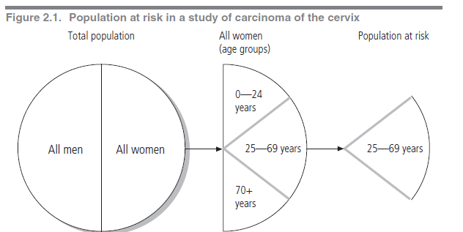
The population at risk is the group of people susceptible to develop a characteristic. For example when studying measles, the population at risk used for the calculation should be the children under five years of age, because measles is rare after that age. The population at risk is used as the denominator when calculating proportions or rates
Population at risk

Slide 23
2 Attack rate:
A specific form of incidence rate in which there is a limited period of risk as in:
cases of epidemics reflecting the virulence of the organisms.
3 Secondary attack rate: = №. of secondary cases x100
№. of susceptible
This rate is used to measure the ease of communicability in case of communicable diseases
*The length of incubation period is important to identify the secondary cases.
*Immune Individuals (whether due to natural infection or immunization) should be excluded from the denominator

Slide 24
Prevalence
morbidity
Incidence
Prevalence
Attack Rate
Prevalence
is the № of All cases of disease,, or condition, present at a particular time , in relation to the size of population from which it is drown.
Prevalence means ALL. (Old+ New)
Prevalence
quantifies the proportion of individuals in a population who have the disease at a specific time
Prevalence: in the number of cases of a disease present in a defined population at a given point of time
*Proportion of a population already affected by a particular disease at a particular time

Slide 25
A study done on 1000 school children at Al-Karak , during 2018 found 20 with TB. By follow up during 2019 the number of
students with TB 28
Incidence new cases only 2019 = 8
prevalence ?? 2018
prevalence ?? 2019
Prevalence 2018 = 20/1000x1000=20/1000population/year
Prevalence 2019 =28/1000X1000=28/1000population/year
Thus, prevalence can be thought of as the status of the disease in a population at a point in time and as such is also referred to as point prevalence

Slide 26
example,
visual examination survey conducted in Al Karak among
individuals , 52 - 85 years of age, during 2017
310 of the 2477 persons examined had cataracts at the time of the survey. ???????
The prevalence of cataract in that age group was
310 / 2477 X100 ,=12.5% prevalence of cataract among population aging 52 - 85 years in Al Karak during 2017
P = № of existing cases of a disease X 100
total population at risk at a given point in time

Slide 27
Prevalence is controlled by two elements
No. of individuals who have been diseased in the past
the length or duration of the illness.
Duration and
Incidence
Prevalence will vary in direct relation
duration of the illness
Prevalence
incidence
Prevalence

Slide 28
Relationship Between Incidence and Prevalence
Recovery
Incidence
Death
Prevalence
Pot
Incidence is all new cases of the disease.
They enter the prevalence pot.
If no cases leave the prevalence pot, it continues to Fill, adding to the number of cases unless
some cases either recover or die reducing the prevalence.

Slide 29
Relationship Between Incidence and Prevalence
Prevalence = I * D
Recovery
Death
Incidence
I = incidence
D = duration
Prevalence
Pot
Duration and
Incidence
Prevalence will vary in direct relation

Slide 30
Factors influencing prevalence rate
Incr by:
longer duration of disease
prolongation of life without cure
Increase in the incidence of the disease
Immigration of cases
out migration of healthy people
improved diagnosis
Better reporting
Better reporting
Prevalence
Decreased by:
short duration of disease
high case-fatality rate from disease
decrease in incidence
in-migration of healthy people
Emigration of cases
improved cure rate
Immunization prevents new cases
Prolongation of non diseased & healthy population
Prevalence

Slide 31
Types of Prevalence
Period Prevalence
Point Prevalence
A study done on 1000 school children at Al Karak during 2018 found 20 with TB. By follow up of school children during 2019 the number of students with TB was 28
prevalence 20 2018
prevalence 28 2019
Period prevalence:
Number of cases that occur during a specified period of time
2018 –2019

Slide 32
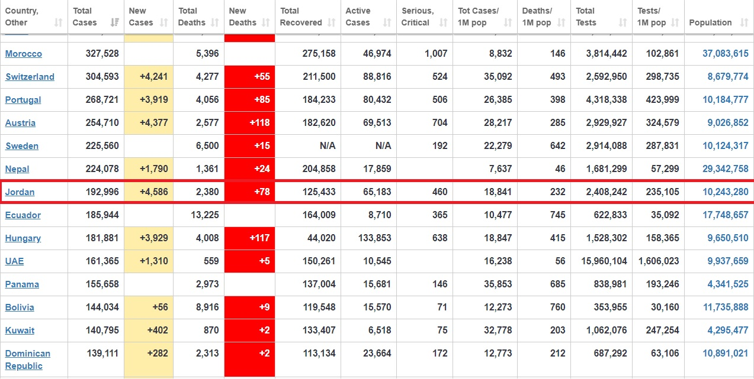

Slide 33
THANK YOU ALL

