Slide 1
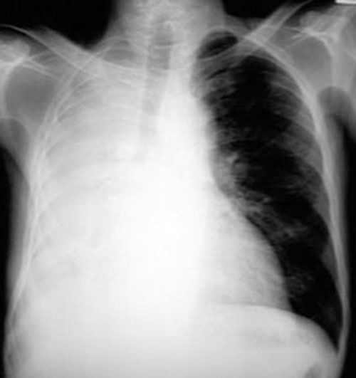
CXR 7

Slide 2
What are the abnormal radiologic findings?
What are the possible differential diagnosis?

Slide 3
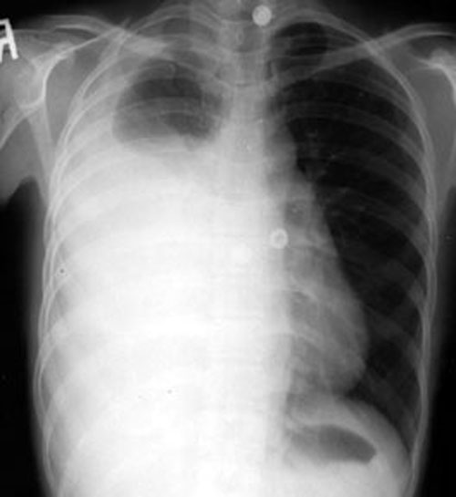
CXR 8

Slide 4
What are the abnormal radiologic findings?
What are the possible differential diagnosis?

Slide 5
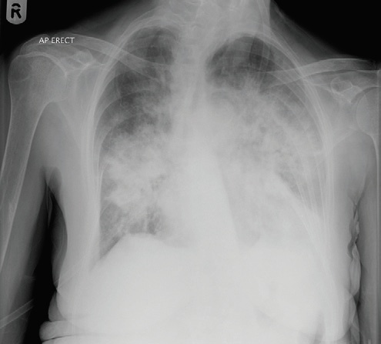
CXR 9

Slide 6
What are the abnormal radiologic findings?
What are the possible differential diagnosis?

Slide 7
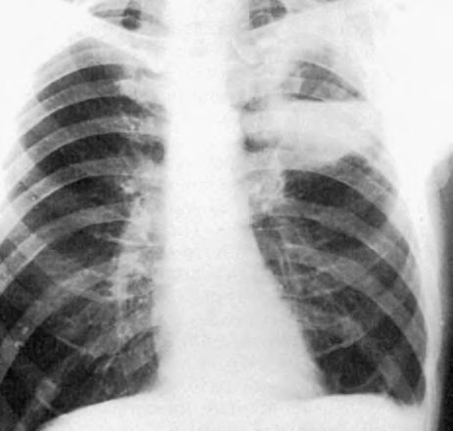
CXR 10

Slide 8
Which micro-organism is unlikely to cause this
Left upper lobe lung abscess?
Mycoplasma pneumoniae
Mycobacterium tuberculosis
Anaerobic bacteria
Klebsiella pneumonia
Staphylococcus aureus

Slide 9
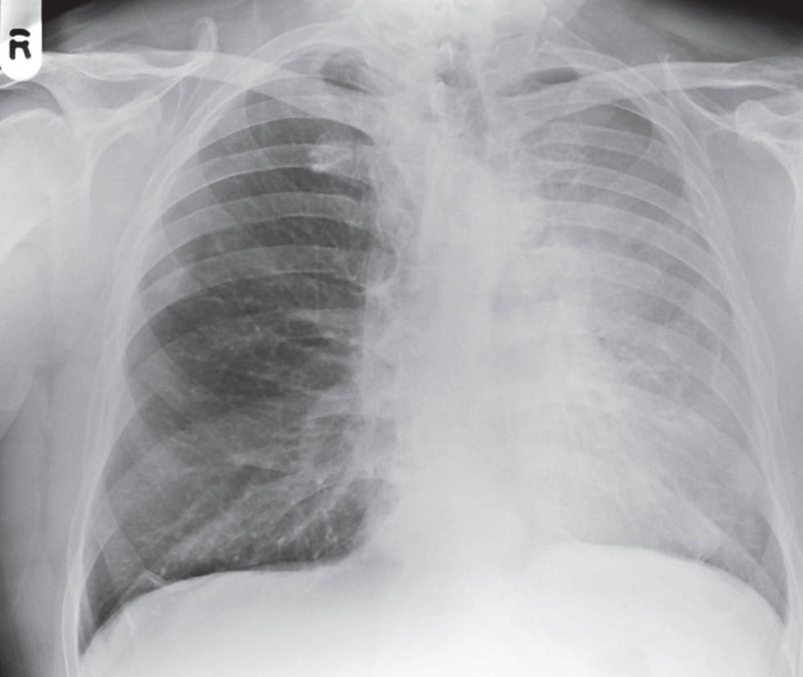
CXR 11

Slide 10
What is the most appropriate diagnosis consistent with these radiologic findings?
A.Left sided Pleural effusion
B. Left sided lung mass
C. Left sided collapse
D. Left sided pleural mesothelioma
E.Left sided pneumonia

Slide 11
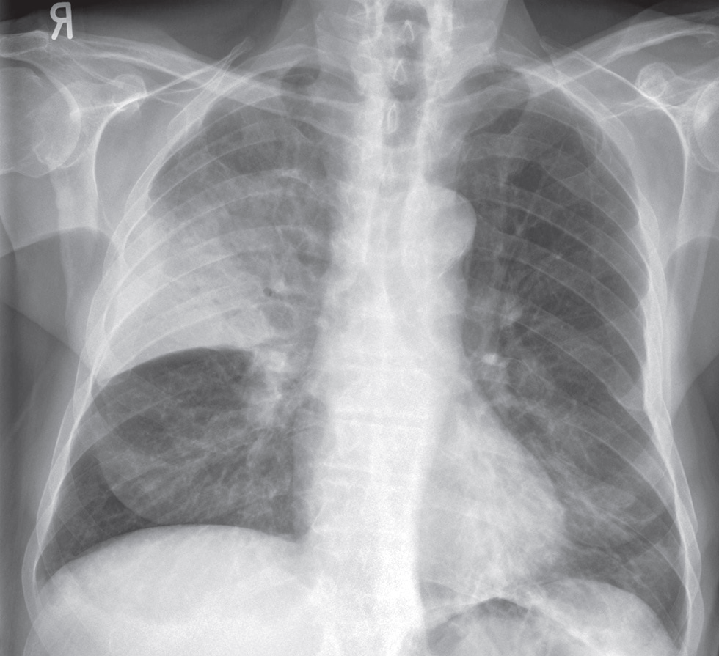
CXR 12

Slide 12
What is the most likely diagnosis?
Right upper lobe collapse
Right upper lobe pneumonia
Right middle lobe collapse
Right middle lobe pneumonia
Right pleural mass

