Slide 1
NASOPHARYNGEAL CARCINOMA
Prepared By : Mohammad Rabai
Supervised By : Dr. Osama Al-Btoush

Slide 2
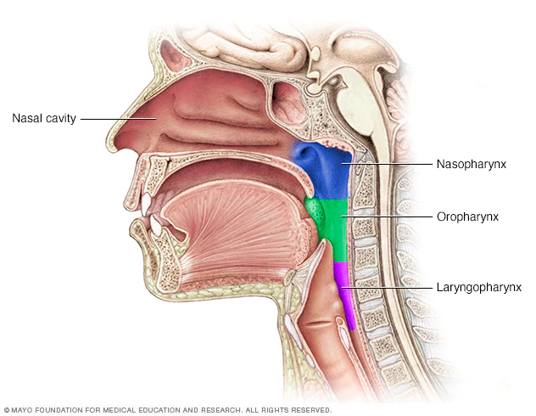
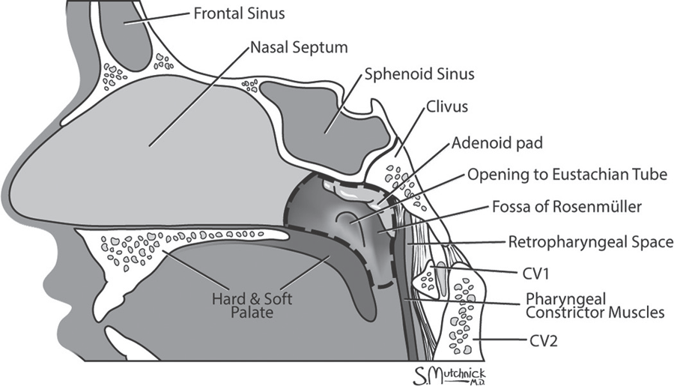
ANATOMY OF THE NASOPHARYNX

Slide 3
Histology ( mucosa/submucous/ adventitia)
1
Mucosa consist of two main types of are squamous epithelium and respiratory epithelium ..
squamous epithelium most common Origin for malignancy ! ( Mostly of Undifferentiated Type )
Salivary and lymphoid tissues .

Slide 4
Generally speaking
2
A rare type of head and neck cancer ( most common is Oral cavity tumors ) ..
Nasopharyngeal carcinoma (NPC) is the most common cancer originating in the nasopharynx area .
most commonly in the postero-lateral nasopharynx or pharyngeal recess (fossa of Rosenmüller)

Slide 5
Nasopharyngeal area malignancies :
SCCA (nasopharyngeal carcinoma)
Lymphoma
Salivary gland tumors
Sarcomas

Slide 6
EPIDEMIOLOGY & Causes
3
It is vastly more common in certain regions of East Asia and Africa than elsewhere , with viral, dietary and genetic factors implicated in its causation !
Can occur at any age ..
caused by a combination of factors: viral, environmental influences, and heredity

Slide 7
The viral influence is associated with infection with Epstein-Barr virus (EBV) .
- well documented viral “fingerprints” in tumor cells !
environmental carcinogens , chronic nasal infection ,
poor ventilation of nasopharynx , …
Genetic : HLA-A2 , HLA-B-Sin2

Slide 8
CLASSIFICATION(WHO)
Based on light microscopy findings ..
Type I - “SCCA” squamous cell carcinoma
- typically found in older adults ..
- 25 % of NPC
- moderate to well differentiated cells
Type II - “non-keratinizing” carcinoma
- 12 % of NPC
- variable differentiation of cells ( mature to anaplastic)
- may resemble transitional cell carcinoma of the bladder
4

Slide 9
Type III - “undifferentiated” carcinoma
60 % of NPC , majority of NPC in young patients ..
- Diverse group :
Lympho-epitheliomas, spindle cell, clear cell and anaplastic variants
- *Difficult to differentiate from lymphoma by light microscopy requiring special stains & markers
Differences between these types :
Long-term risk of recurrence for types II & III
Viral associations :
Type I - HPV
Types II, III - EBV

Slide 10
CLINICAL PRESENTATION :
Neck mass : 50%
Nasal symptoms : 30%
Ears symptoms : 20%
Facial pain - Trigeminal neuralgia
Ophthalmoplegia - CN III, IV, and VI
Horner’s syndrome - cervical sympathetics (rare initial symptom)
CN’s X : vocal cord paralysis
CN’s XI/X : palatal paralysis
- Initially :
Unilateral hearing loss from a middle ear effusion
Painless , slowly enlarging neck mass (regional spread): MOST common presentation . ( 50%)
- Larger lesions :
nasal obstruction
epistaxis
cranial nerve involvement
5

Slide 11
Trotter's syndrome/Triad is a cluster of symptoms associated with advanced nasopharyngeal carcinoma.
1- Unilateral conductive hearing loss due to middle ear effusion
2- Unilateral facial pain (Trigeminal neuralgia)
3- Soft palate immobility (palatal paralysis)
- Trismus/Difficulty opening mouth occurs late (due to further invasion of pterygoid muscles)
(CASE!) A 38-year-old woman , presented to ENT outpatient clinic with a 6-month history of progressive left neck swelling , severe left cheek pain, decreased hearing in the left ear and left-sided blood-stained nasal discharge, and history trismus since 4 months. There was no associated dysphagia, hoarseness, excessive coughing or dyspnoea. On physical examination, she had multiple hard, fixed, non-tender, left cervical lymphadenopathy, left serous otitis media ….. A diagnosis of Trotter’s syndrome secondary to nasopharyngeal carcinoma was made.

Slide 12
<How to diagnose >
History ( suggestive symptoms) & physical examination
Fiberoptic Endoscopic examination/Nasopharyngioscopy
Biopsy
serology (Anti EBV antibodies)
CT scan with bone and soft tissue windows(Extent of tumor)
MRI (soft tissue involvement, recurrences)/ Best
6

Slide 13
INVESTIGATIONS (patient come with neck mass)
1-CBC , chemistry
2-neck ultrasound (may be TB ! Metastatic cancer ! )
3-fiberobtic examination
4-CT/MRI post nasal
5-post nasal space biopsy
6- serology (Anti EBV antibodies)

Slide 14
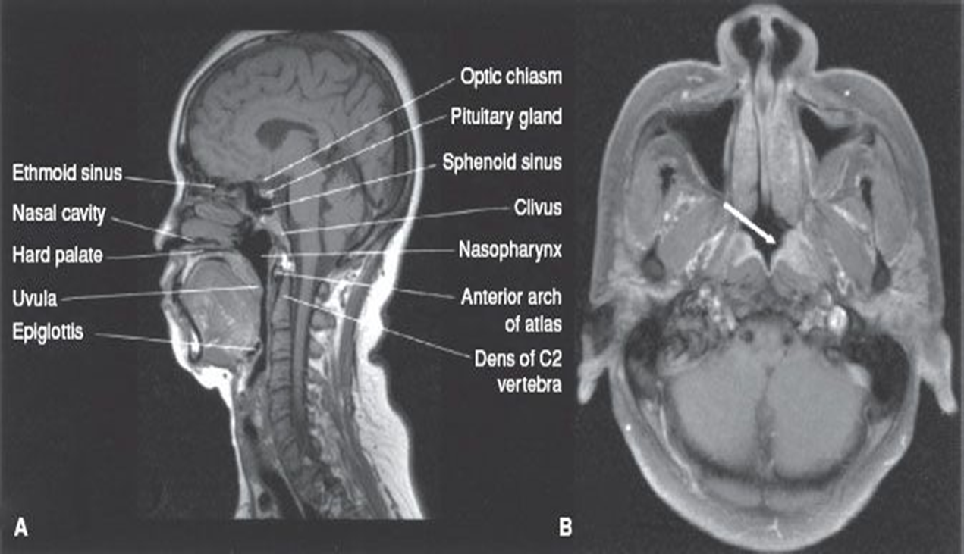
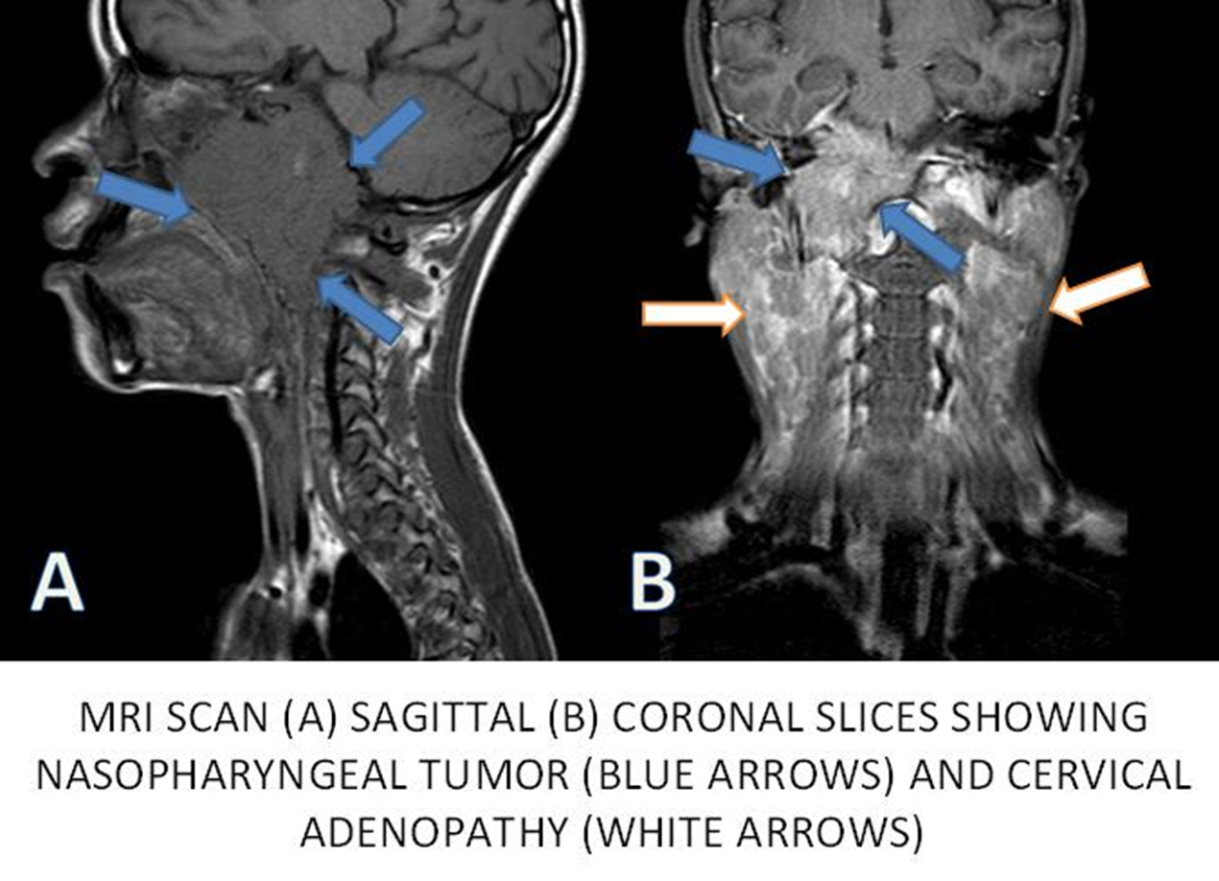
Normal MRI

Slide 15
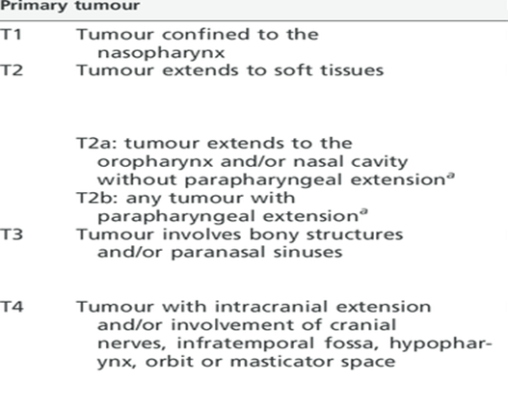
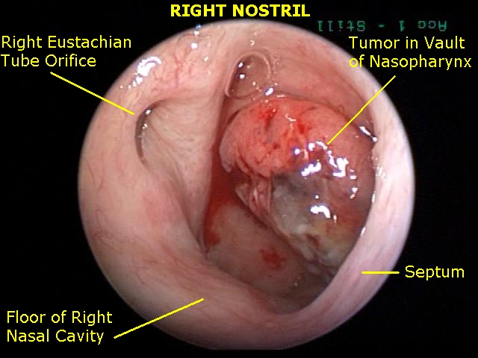

Slide 16
<Treatment >
Radiation & Chemo therapy
Surgical Managment
Mainly diagnostic - Biopsy
primary lesion (residual or recurrent disease)
regional failure with local control
ETD
* Because Very difficult anatomy We don’t prefer surgery
Mainstay of treatment
Stage 1&2 :
Radiation
Stage 3&4 :
Radio-chemo
7

Slide 17
Thank YOU !
Any questions?

Slide 18
Neoplasm of the nose and para-nasal sinuses
Done by: ghazi jadeed – Suha Khalid

Slide 19
Very rare tumors (account for 0.2 to 0.8% of all carcinomas).
Demographically, these tumors occur predominantly in the age range from 50 to 90 years.
Most sinus neoplasms are malignant, while in the nasal cavity, there is a fairly even distribution between benign and malignant disease.
Of the different sites, the maxillary sinus is the most commonly involved site, representing 55 to 80%. It is followed by the nasal cavity (27 to 33%), the ethmoid sinuses (9 to 10%), and the frontal and sphenoid sinuses (1 to 2%).

Slide 20
Risk factors
Up to 44% of these tumors are attributed to occupational exposures. -Wood dust (increases the risk for developing SCC and adenocarcinoma) -Nickel, Isopropyl oil, Organic fibers, Chromium, Volatile hydrocarbons -Environmental pollution
Cigarette smoking
Papillomavirus infection

Slide 21
Patient evaluation
In contrast to many other areas in the head and neck, paranasal sinus tumors are not characterized by an early presentation.
The non-specific complaints such as nasal obstruction, rhinorrhea, and epistaxis rarely receive thorough evaluations outside of offices of otorhinolaryngologists until they have become excessively prolonged or other symptoms develop.
Signs and symptoms are according to the structures involved/invaded
Late symptoms include epistaxis, ocular dysfunction secondary to extraocular muscle invasion or cranial nerve involvement, proptosis, facial pain, facial swelling, facial numbness, loosening of teeth, epiphoria, visual loss, anosmia, trismus, and even facial weakness.

Slide 22
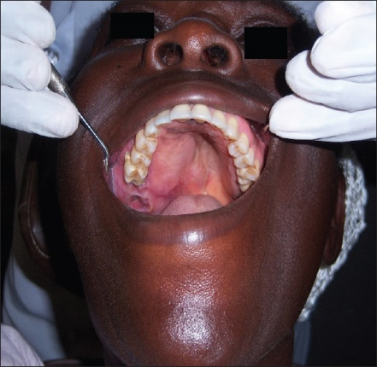
Diagnosis
History & physical examination
Nasal endoscopy
Imaging (CT/MRI)
Biopsy

Slide 23
Pathology
Despite the rarity of nasal and para-nasal sinus neoplasms, many histologically diverse types are described.
Epithelial malignant tumors: Squamous cell carcinomas, Adenocarcinomas, Adenoid cystic carcinomas, Mucoepidermoid carcinomas, Melanomas, Esthesioneuroblastomas, Teratomas, Teratocarcinomas.
Non-epithelial malignant tumors: Rhabdomyosarcomas, Neurogenic sarcomas, Leiomyosarcomas, Fibrosarcomas, Angiosarcomas, Hemangiopericytomas, Osteogenic sarcomas, Chondrosarcomas, Lymphomas, Extramedullary plasmacytomas, Giant cell tumors.
Squamous cell carcinoma is by far the most frequently encountered malignancy, accounting for up to 80% of all neoplasms

Slide 24
Squamous cell carcinoma
Most common tumor (80%)
Location:
-Maxillary sinus (70%)(lateral wall)
-Nasal cavity (20%) (turbinate)
90% have local invasion by presentation
Infiltration of lymph nodes
88% present in advanced stages (T3/T4)
Managed by surgical resection with postoperative radiation

Slide 25
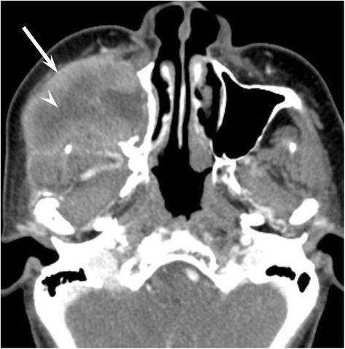

Slide 26
Adenocarcinoma
2nd most common
Most common site is ethmoid sinus
Starts in the gland cells (adenomatous cells)
Strong association with occupational exposures
High grade: solid growth pattern with poorly defined margins. 30% present with metastasis
Low grade: uniform and glandular with less incidence of metastasis.

Slide 27
Adenoid cystic carcinoma
Most common site is the maxillary sinus.
Perineural spread
It is characterized by an intermediate growth rate, low probability of lymphatic spread
Neck metastasis is rare
Postoperative radiotherapy is very important

Slide 28
Mucoepidermoid carcinoma
Extremely rare
Most common site is parotid gland
It is composed of a combination of squamous cells and glandular, mucus-producing, basal cells
They are notable for their propensity toward distant metastases.
local invasion makes resection difficult, therefore radiation is often indicated

Slide 29
Melanoma
1% of melanoma originates from the nasal cavity and paranasal sinuses.
Anterior Septum: most common site.
Treatment is wide local excision with/without postoperative radiation therapy

Slide 30
Olfactory neuroblastoma (Esthesioneuroblastoma)
very rare cancer that develops in the upper part of the nasal cavity originate from stem cells of neural crest origin that differentiate into olfactory sensory cells.
Metastatis in 20-30%
Treatment:
surgical resection with postoperative XRT

Slide 31
Sarcomas
Osteogenic Sarcoma
-Most common primary malignancy of bone.
-Mandible > Maxilla
Fibrosarcoma
Chondrosarcoma

Slide 32
Rhabdomyosarcoma
Aggressive malignant soft tissue tumor that arises from muscle cells called rhabdomyoblasts
Most common paranasal sinus malignancy in children less than 5 years old
Triple therapy is often necessary

Slide 33
Lymphoma
Non-Hodgkins
Hodgkin
Treatment is by radiation, with or without chemotherapy

Slide 34
Sinonasal undifferentiated carcinoma
Aggressive locally destructive lesion
Nasal cavity, maxillary and ethmoid sinus are typically involved
epithelial origin
Symptoms usually develop over a relatively short duration
Preoperative chemotherapy and radiation may offer improved survival

Slide 35
Metastatic tumors
Renal cell carcinoma is the most common
Palliative treatment only

Slide 36
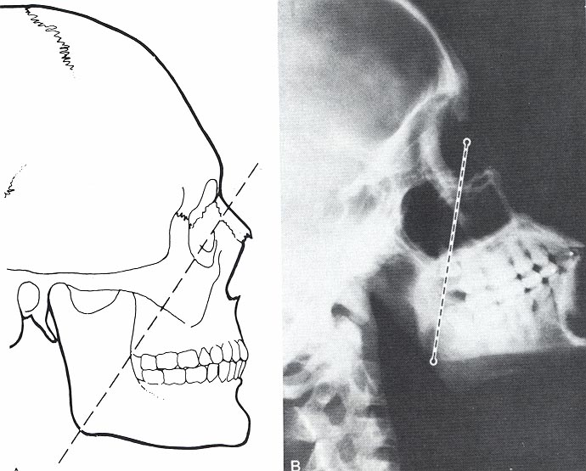
Staging of Maxillary Sinus Tumors Ohngren’s line: connects medial canthus of eye to angle of mandible above—bad prognosis below—good prognosis
above—bad prognosis
below—good prognosis

Slide 37
T1: limited to antral mucosa without bony erosion
T2: erosion or destruction of the infrastructure, including the hard palate and/or middle meatus
T3: Tumor invades: skin of cheek, posterior wall of sinus, inferior or medial wall of orbit, anterior ethmoid sinus
T4: tumor invades orbital contents and/or: cribriform plate, post ethmoids or sphenoid, nasopharynx, soft palate, pterygopalatine or infratemporal fossa or base of skull

Slide 38
Treatment
Triple therapy, Multimodality treatment
Orbital Preservation
Minimally invasive surgical techniques
Surgical + chemo+radio

Slide 39
Tracheostomy
Tracheostomy is unnecessary except in certain circumstances (bulky flap reconstruction , mandibulectomy or concern for posoperative oropharyngeal airway obstruction beacause of edema)
130 maxillectomies only 7.7% required tracheostomy
Of those not receiving tracheostomy during surgery, only 0.9% experienced postoperative airway complications

Slide 40
Benign lesion
Papillomas
Osteomas
Fibrous Dysplasia
Neurogenic tumors

Slide 41
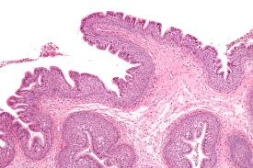
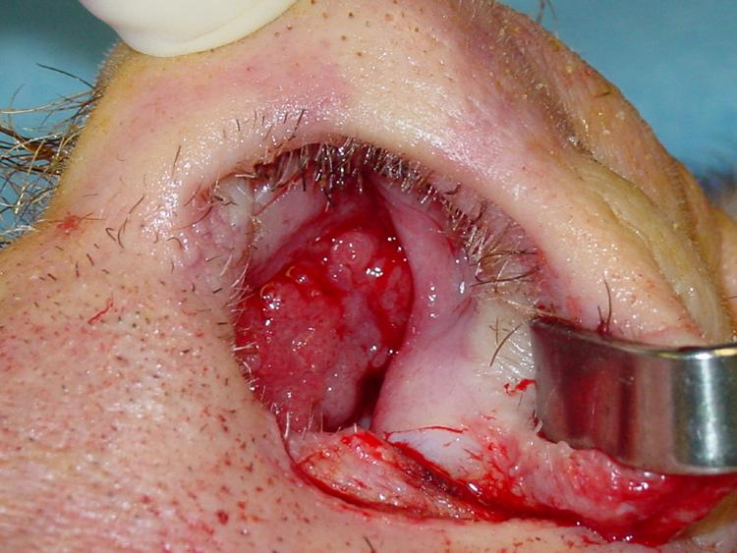
Papilloma
Schneiderian papillomas derived from schneiderian mucosa (squamous)
Fungiform: 50%, nasal septum
Cylindrical: 3%, lateral wall/sinuses
Inverted: 47%, lateral wall

Slide 42
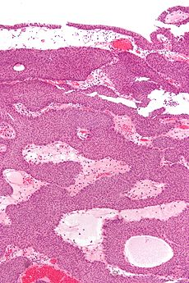
4% of sinonasal tumors Site of Origin: lateral nasal wall Unilateral,,Old age >50 10% premalignant lesion (aggressive resection)
Inverted papilloma
Most common
On C.T?!

Slide 43
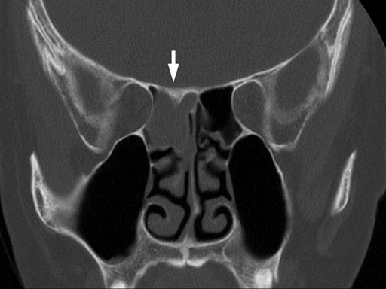
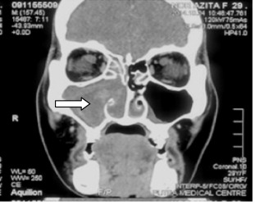
Inverted papilloma
Antrochoanal polyp

Slide 44
Initially via transnasal resection:
50-80% recurrence
Medial Maxillectomy via lateral rhinotomy:
Gold Standard
10-20%
Endoscopic medial maxillectomy:
Key concepts:
Identify the origin of the papilloma
Bony removal of this region
Recurrent lesions:
inverted papilloma has a marked tendency to recure after surgical removal

Slide 45
Osteoma
Benign slow growing tumors of mature bone ,incidental finding
Location:
Frontal(m.c), ethmoids, maxillary sinuses
When obstructing mucosal flow can lead to mucocele formation
Treatment is local excision

Slide 46
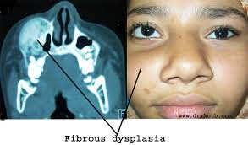
Fibrous dysplasia
Dysplastic transformation of normal bone with collagen, fibroblasts, and osteoid material
Monostotic 70% ,Polyostotic30%
Conservative,,
Surgical excision for obstructing lesions or cosmotic
Malignant transformation to rhabdomyosarcoma has been seen with radiation

Slide 47
Neurogenic tumors
4% are found within the paranasal sinuses
Schwannomas
Neurofibromas
Treatment via surgical resection
Neurogenic Sarcomas are very aggressive and require surgical excision with post op chemo/XRT for residual disease.
When associated with Von Recklinghausen’s syndrome: more aggressive (30% 5yr survival).

Slide 48
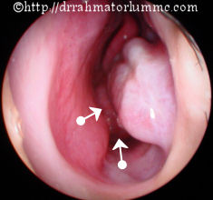
Juvenile Nasopharyngeal Angiofibroma
Benign but locally aggressive vascular tumor of adolescent males
Originate in posterolateral nasal wall near sphenopalatine foramen, blood supply primarily from external carotid artery
Clinical presentation: nasal obstruction, recurrent epistaxis, smooth-lobulated red-gray mass in the nasopharynx
Diagnosis- Contrast CT scan, MRI, diagnostic angiography
Treatment: Primarily Surgical with pre-operative embolization
We don‘t take a biopsy here because it‘s a vascular tumor
Surgical resection with radio

