Slide 1
Autonomic Nervous System
By
Dr. Nour A. Mohammed
MUTAH SCHOOL OF MEDICINE

Slide 2
The Parasympathetic nervous System

Slide 3
The Parasympathetic nervous System
It is the part of the autonomic nervous system, which deals with the anabolic activities and lead to conservation of body energy. It is also called the Cranio-sacral outflow secondary to its origin.

Slide 4
Parasympathetic cranial outflow
Parasympathetic is divided into two main types
Parasympathetic fibers are found in the cranial nerves III «occulomotor», VII «facial», IX «glossopharyngeal» and X «vagus»
Parasympathetic Sacral outflow
Parasympathetic fibers arised from LHCs of sacral 2,3 &4 segments of the spinal cord.

Slide 5
Occluolomotor nerve ( III)
arise
From the Edinger-Westphal nucleus in the midbrain
The preganglionic fibers relay in the ciliary ganglion.
The postganglionic fibers run in the short ciliary nerves. These fibers produce:
a) Contraction of the constrictor pupillae
→ narrowing of the pupil. (miosis).
b) Contraction of the ciliary muscle:
→ relaxation of suspensory ligaments, causing increased power of the lens which is very useful in near vision accommodation.

Slide 7
facial nerve (VII)
Supply : the lacrimal, nasal and submaxillary salivary glands.
Preganglionic fibers: arise from the Superior salivary nucleus in pons.
Relay : Fibers that supply the lacrimal and nasal glands relay in The Sphenopalatine ganglion (collateral).
Fibers that supply the submaxillary gland relay in the Submandibular ganglion (collateral).
Functions:
These fibers supply the salivary glands and produce True secretion (Large in volume, less in enzymes and watery) also produce vasodilatation.

Slide 9
The glosso-pharyngeal (IX)
Supply the parotid salivary gland
Preganglionic fibers
arise from the inferior salivary nucleus (in medulla)
relay in the otic ganglion (collateral)
Postganglionic fibers
supply the parotid (largest) salivary gland.
Functions:
True secretion (Large in volume, less in enzymes and watery)
Vasodilatation.
So, nerve supply to salivary glands arise from facial nerve ( to submaxillary and sublingual glands) and from glosso-pharyngeal nerve (to parotid gland)

Slide 11
-The vagus nerve (X)
Arise from the vagal nucleus in medulla oblongata
The preganglionic fibers
relay in terminal ganglia
situated in the organs supplied
From the terminal ganglia short postganglionic fibers arise and pass to supply the organs.
The vagus nerve have the following functions:
1-Inhibition of all properties of atrial cardiac muscle.
N.B Ventricles receive very few vagal parasympathetic efferent fibers. (this is called the ventricular vagal escape phenomenon)
2- Decrease of the coronary blood flow and O2 consumption of the heart
(indirect v.c in coronary due to the increased O2 concentration & decreased metabolic activity.

Slide 12
Constriction of the bronchi and bronchioles (Bronchoconstriction)
Increased secretion from bronchial glands.
VD of blood vessel. This leads to narrowing of air passages.
Motor to GIT wall (contraction).
oesophagus, stomach, small intestine and proximal part of large intestine.
but inhibitory to sphincters leading to rapid evacuation of food.
(↑) Secretory to digestive glands of stomach, pancreas and liver enhancing (↑) insulin hormone release.
Motor (↑)to gall bladder and inhibitory to sphincter of Oddi .
Vasodilatation to the splanchnic vessels.

Slide 14
Parasympathetic sacral outflow
The sacral parasympathetic fibers arise from L.H.C of 2, 3, and 4th sacral segments of the spinal cord
They run as preganglionic fibers in the pelvic sacral nerve or the nervi erigentes to relay in terminal ganglia in the organs they supply.
The sacral parasympathetic fibers supply :
* the rest of the digestive tract that is the descending colon, the rectum the anal canal.
* The urinary bladder
* the blood vessels of the external genitals.

Slide 15
This Sacral flow have the following functions:-
Defecation
contraction of the wall of the rectum and relaxation of internal rectal sphincter.
Micturition
contraction of the wall of the bladder and relaxation of the internal uretheral sphincter.
Erection
vasodilatation of the blood vessels of the erectile tissue of the penis in the male and clitoris in the female.

Slide 18
Parasympathetic tone
a) Vagal tone to the heart
Decreases the rhythm of the SAN from 110 to only 70 beats / minute.
This greatly spares excess energy & effort in the heart.
b) Vagal tone to the gastrointestinal tract
Prevents GIT distention and maintain basal amount of secretion.
This is very important to complete the digestive process.
c) Vagal tone to the bronchi
Maintains constant distribution of air during ventilation.
Protects the bronchial wall during cough.

Slide 19
N.B. Many structures are supplied by one system only:
Sympathetic: Skin, Suprarenal medulla, Sweat glands, Skeletal muscle blood vessels, Spleen, ventricles, dilator pupillae muscle.
Parasympathetic: constrictor pupillae muscle.

Slide 20
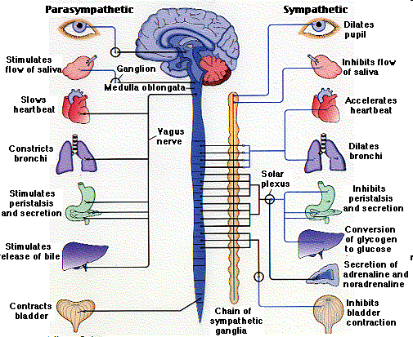

Slide 21
