Slide 1
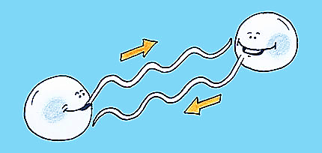
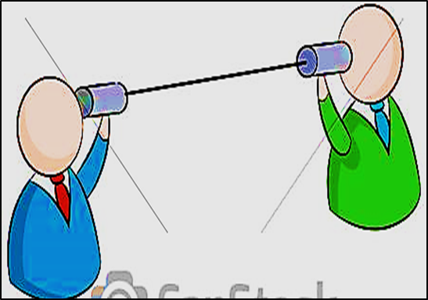
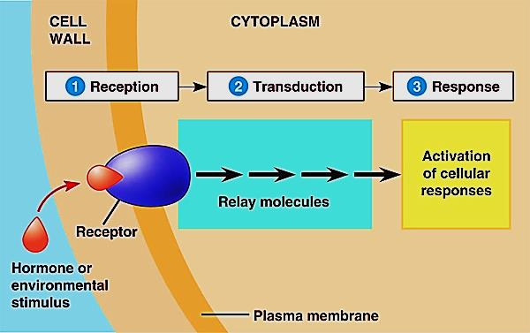
Cell Bio 5
Cell Communication

Slide 2
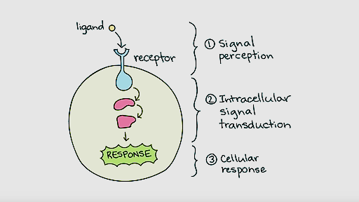
Cell signaling
Living cells in a multicellular organism have to communicate e each others in order to maintain homeostasis & life.
Cells communicate e each through signals which result in responses within the cells
The cell signaling system has 3 parts:
Reception
Transduction
Response

Slide 3
The signal transduction pathway: is a series of steps by which a signal received on a cell’s surface is converted into a specific cellular metabolic activities which result in specific cell response
(1)
(2)
(3)
Steps of signaling system

Slide 4
The signals can be received from either:
External environment:
Sound
Light
Temperature
Odorants
Substances that we taste
Within the body ( hormones):
Epinephrine (Adrenaline)
Insulin
Testosterone
Estrogen
All these factors will
cause the cell to respond
in some way.

Slide 5
Modes of cell signaling
1- Intracrine: hormones or growth factors act
on receptors inside the cell (cytosolic /nuclear
receptors)
2- Autocrine : the cell secretes a
hormone or chemical substance that
binds to receptors on that surface of
same cell, leading to changes in the cell.
(Autocrine signaling plays critical roles in cancer activation)
3- Direct (Juxtacrine signaling): gap junctions
(Cardiac muscles, embryonic development)

Slide 6
Juxtracrine or contact /dependent signaling :is a type of
cell-cell or cell matrix signaling in multicellular organism
Types of juxtracrine signaling:
1- A membrane ligand & a membrane
protein of two adjacent cells interact
2- Communicating junction(gap J) links
the intracellular compartments of two
adjacent cells allowing the exchange of small molecules
3- An extracellular matrix protein & a cell membrane protein interact

Slide 7
4- Short distance: act locally on different nearby cells
@ Paracrine (nearby) signaling (cytokines, histamine)
@ Synaptic signaling (neurotransmitters : AC)
Paracrine: signals are carried by messenger molecules called "local regulators", that are released by one cell and move to make contact with another nearby cells
(e.g.; blood clotting, local allergic skin reaction, wound
healing)
Synaptic: (neurotransmitters). Neurotransmitters are endogenous chemicals that transmit signals from a neuron to another nerve cells or muscle cells across the synapse.

Slide 8
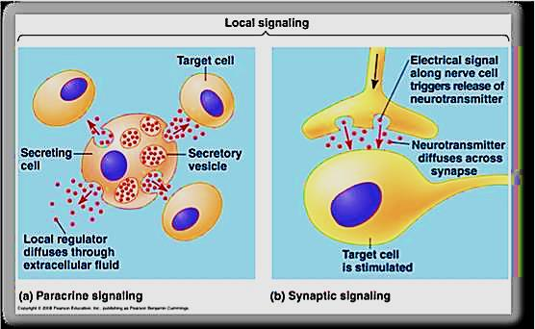
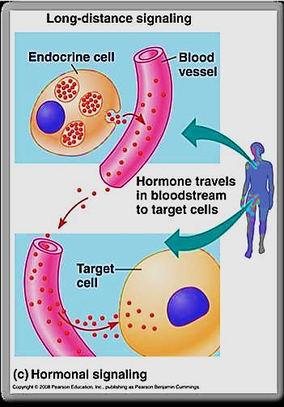
5- Endocrine signaling : act on target cells at distant body sites (long distance )
e.g. (Hormones produced by
endocrine cells, travel
through the circulatory system
to affect other cells all over
the body

Slide 9
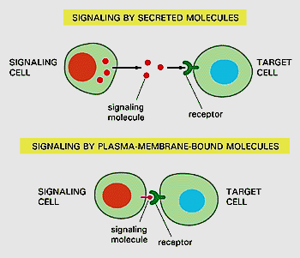
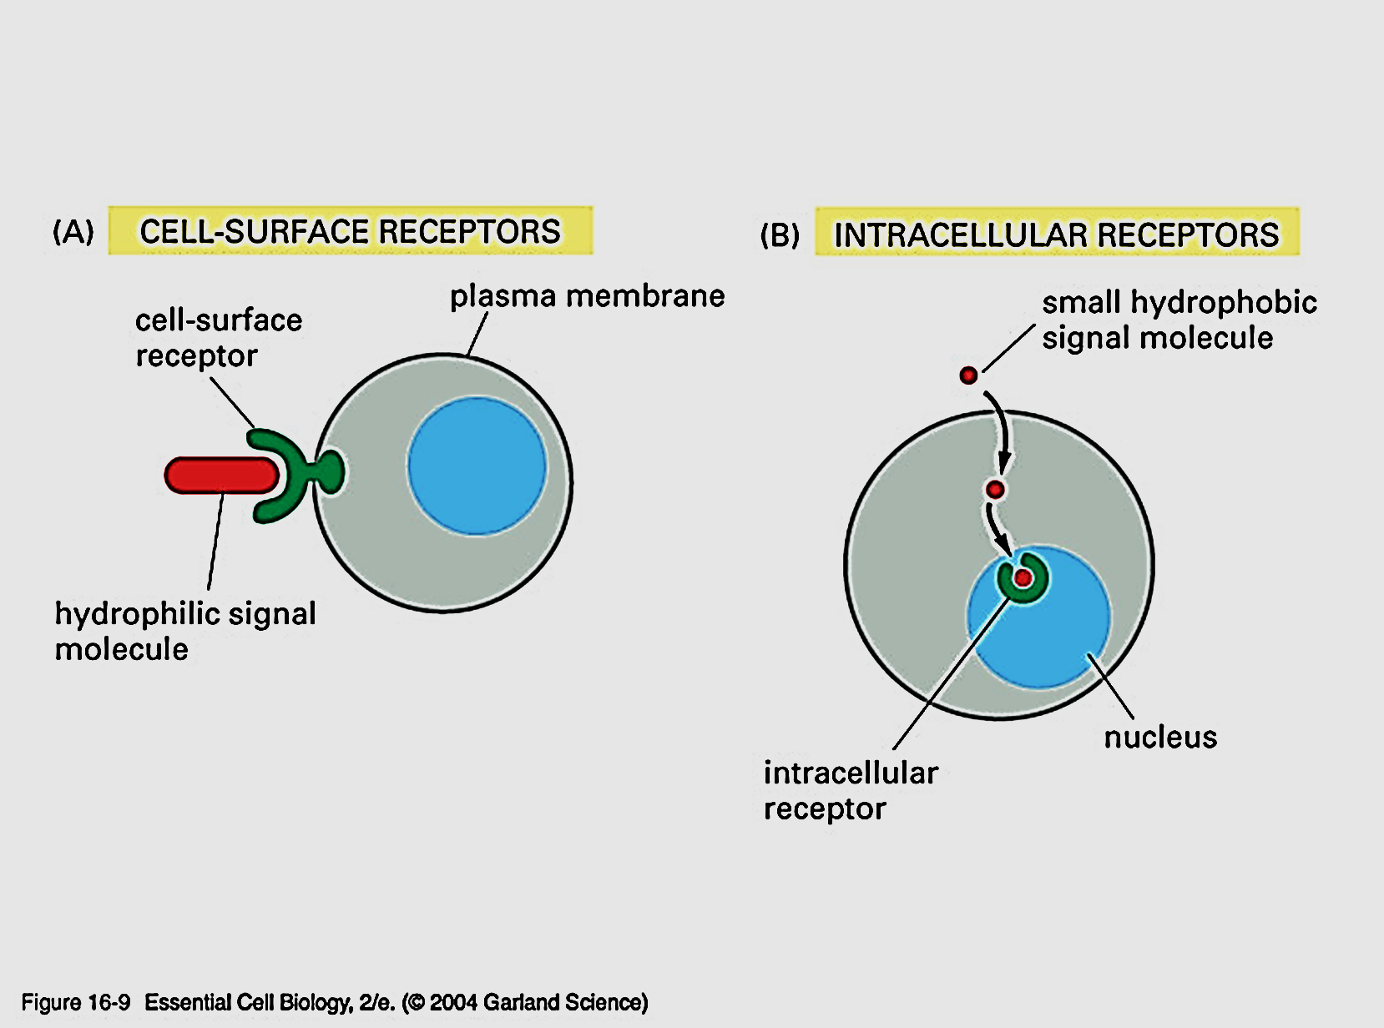
I. Reception
Signaling molecules: are either secreted by or expressed on the surface of some cells will bind to receptors on
other cells causing changes in target cells
Receptors: Protein molecules found either:
On the cell surface (embedded within the cell membrane)
In the cytoplasm ( intracellular)

Slide 10
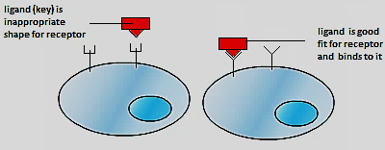
Signaling molecules (Ligands): could be: proteins, small peptides, amino acids, nucleotides, steroids, retinoids (vit. A), fatty acid derivatives, nitric oxide, carbon monoxide…. ( Hormones, neurotransmitters, drugs, toxins, gases)
Ligand: signal molecule with a “key” that fit with the receptor “Lock” → Ligand – Receptor complex →
biological changes in the cell

Slide 11
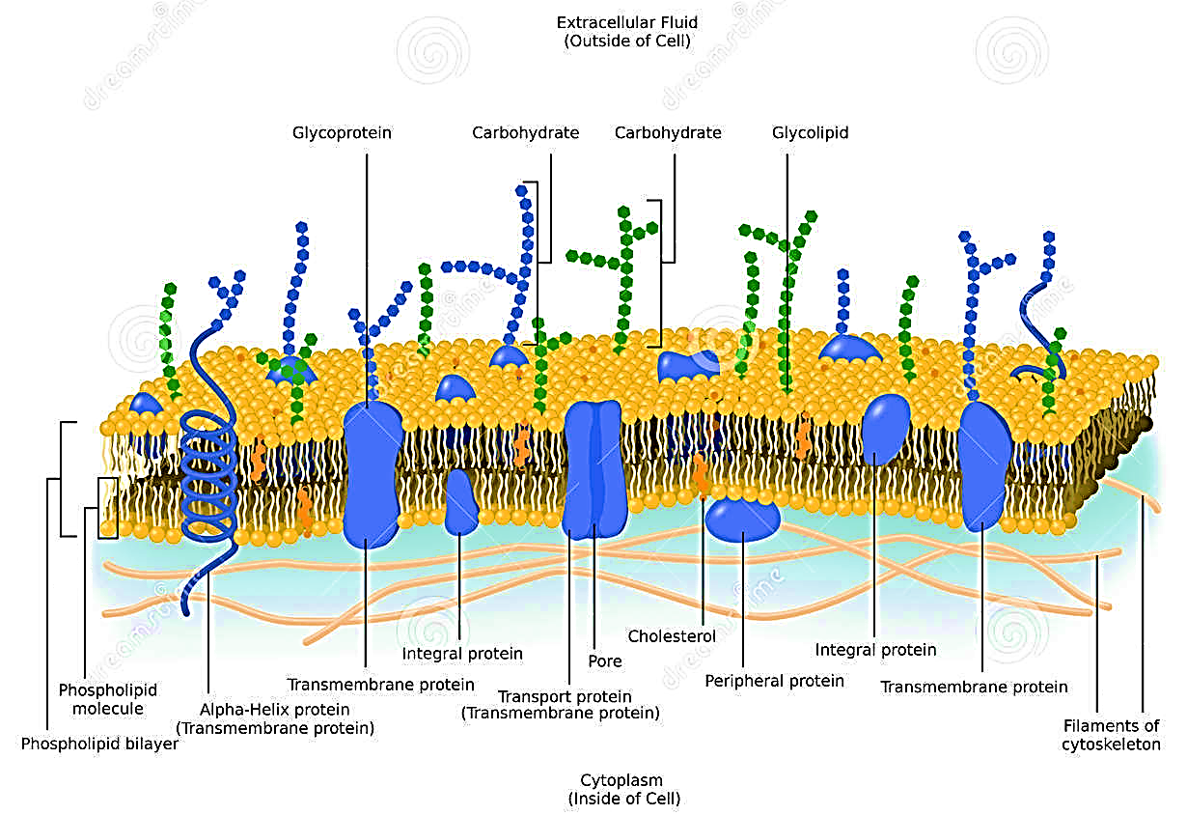
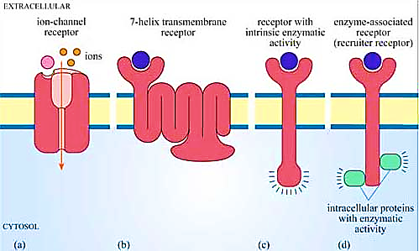
Receptors on the cell membrane
Receptors are integral proteins embedded in The lipid bilayer of the cell membrane

Slide 12
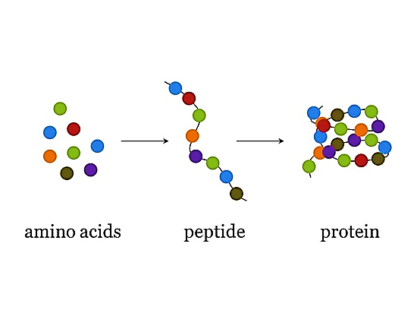
Types /Mechanism of action of hormones
Amino acid derivatives: Melatonin
Peptide/ protien (non-steroid) hormones:
E.g. : Insulin, glucagon, epinephrine, LH,
FSH, Histamine, Ach, ..… etc.
Steroid hormones:
E.g. Estrogen, Testosterone , Aldosterone, Calcitrol, vit D,
cortisol…. etc.
Up to the nature of the signaling molecule the action will be either alteration in protein function or alteration in protein synthesis

Slide 13
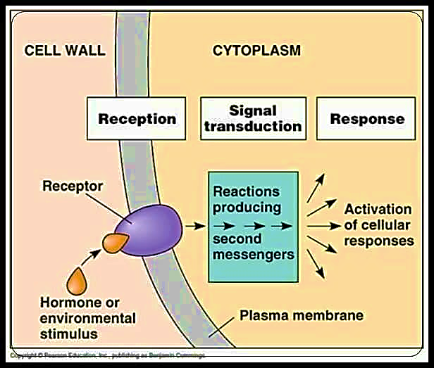
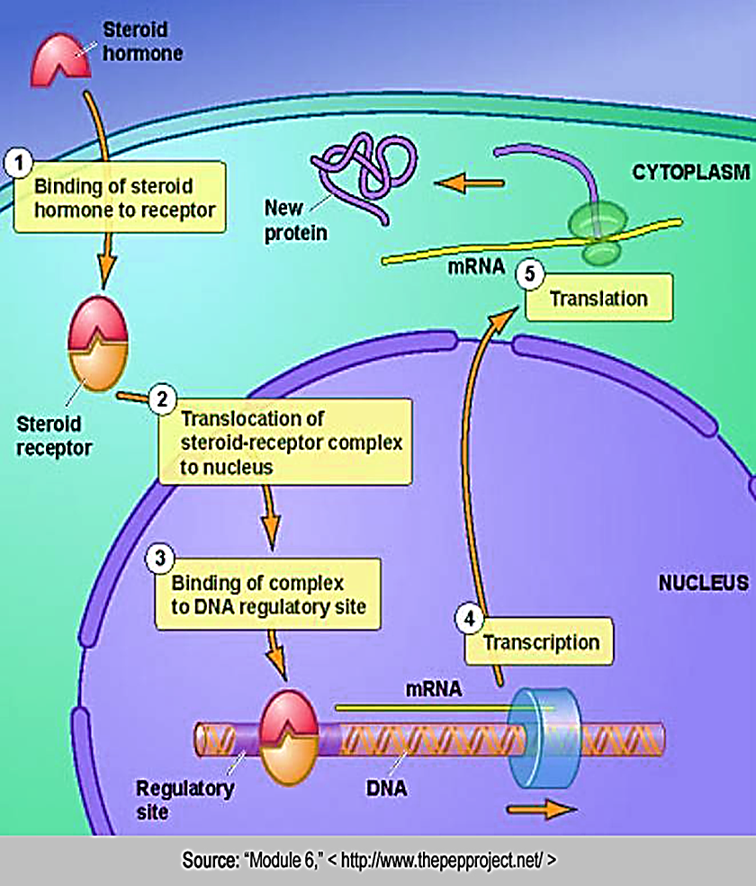
Hydrophilic ligand
Lipophilic ligand
Peptide based hormones are water soluble
Steroid based hormones are
lipid soluble

Slide 14
Intracellular receptors
They are Proteins found
in the cytoplasm or nucleus of
target cells
The small, hydrophobic Ligands can easily cross the lipid bilayer membrane and activate these receptors ,e.g. steroid and thyroid hormones
The ligand –receptor complex moves to the nucleus → binds to specific regulatory regions of the chromosomal DNA → promote the initiation of transcription of m-RNA (mediate gene expression ) i.e. transforming the information on cell’s DNA into a sequence of amino acids that ultimately forms a protein

Slide 15
Extracellular receptors: There are 3 types of membrane receptors
G protein–coupled receptors (7–transmembrane protein)
Tyrosine kinases (enzyme – linked) receptors
Ion channel receptor
1
2
3

Slide 16
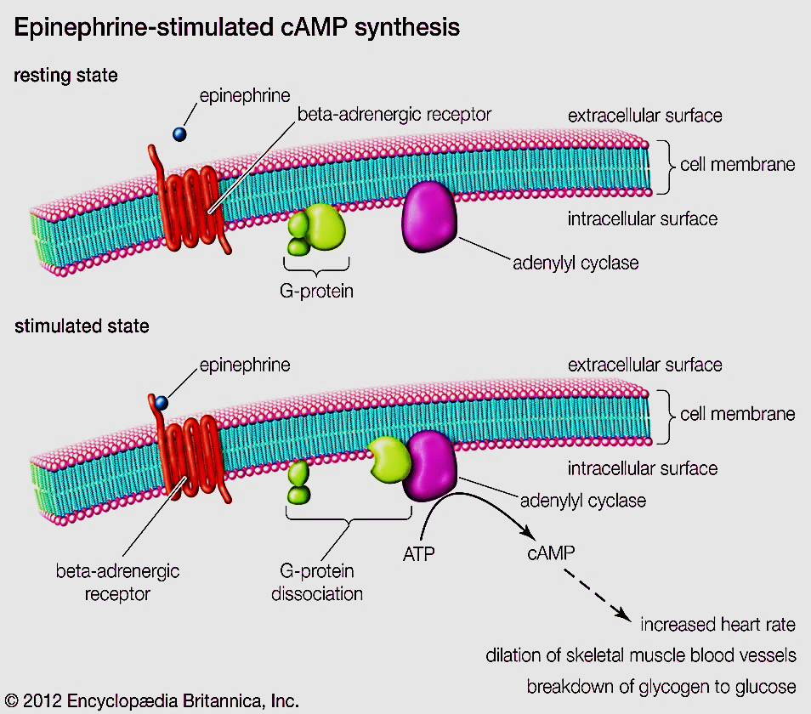
1- G- protein coupled receptors
Step 1:
G protein – linked receptors + ligand → activate a membrane protein called G- protein
Step 2:
Binding of the ligand to the receptor changes the shape of the receptor→ release GTP that attach to the G protein → ON switch → activates G protein
G protein is active

Slide 17
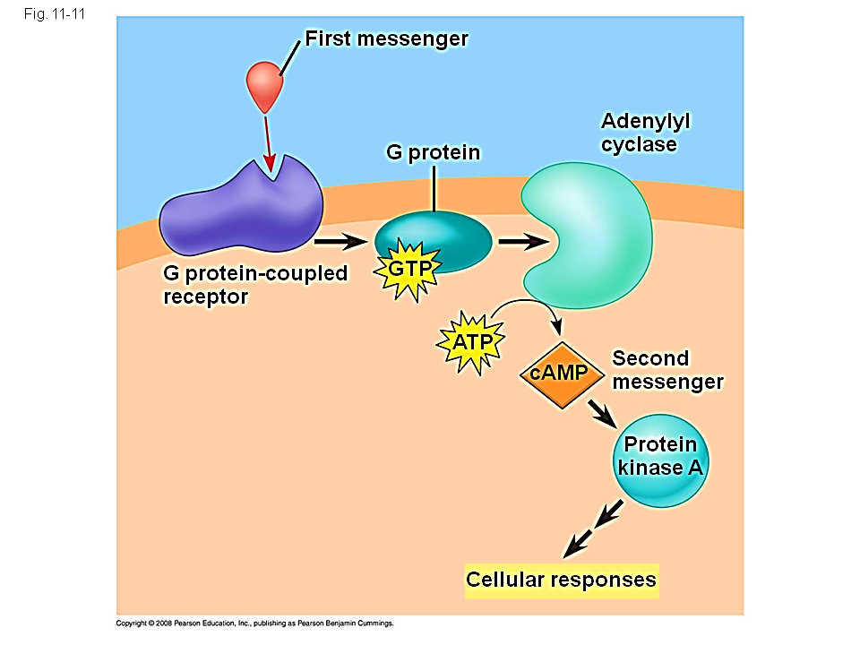
Step 3:
The activated G protein moves to catalyze the Adenylyl cyclase enzyme. The activated enzyme will change ATP→ cAMP → is a 2nd messenger→ phosphorylation cascade → cellular response
Step 4:
G protein returns to the inactive form by moving away from the enzyme & rejoined with GDP. The whole system is ready to receive new signal.

Slide 18
Importance of G protein-coupled receptor system
Most widespread class of receptors in mammals
Regulates the process of transcription, , motility, secretion, embryonic development, homeostasis, memory
Play significant role in controlling vision, smell & taste, hearing sensations
45% of all Pharmaceutical & therapeutics targets & interact e G protein system.
Ligand binding produces signaling to a 2nd messenger

Slide 19
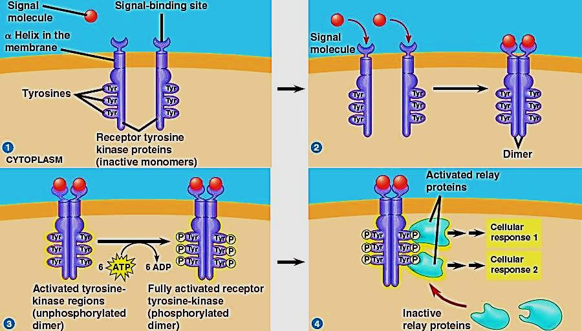
2- Tyrosine kinase receptors
Step 1:
TK are receptor proteins located in the cell membrane.
Its intracellular domains are associated with an enzyme
start out as inactive monomers.
Each has a ligand binding site
The signal molecules are often growth factors
Step 2:
When signal molecules bind with receptor sites, monomers combine to form dimers → shape in change of TK → start activation, yet not phosphorylated

Slide 20
Step 3:
Dimerization activates →
phosphorylation process( it
takes multiple ATPs {6})
Fully phosphorylation → fully active receptors
Step 4:
Fully phosphorylated & active receptor → initiate signal transduction → multiple cellular respons
Each TK system can trigger many separate cellular responses

Slide 21
Importance of Tyrosine kinase receptor system
One receptor tyrosine kinase (DIMER) can activate more different responses, providing a way for cells to regulate growth activities
Kinase: is the enzyme that catalyze the transfer of phosphate group → phosphorylation of the Dimer cause ON or OFF
Many cancers are caused by mutated tyrosine receptors which get activated without a signal molecule ( cells growing out of control)

Slide 22
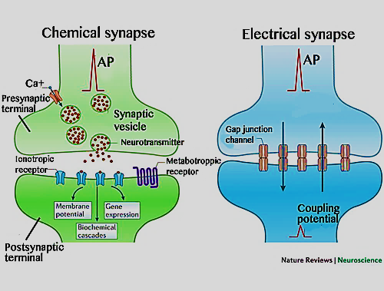
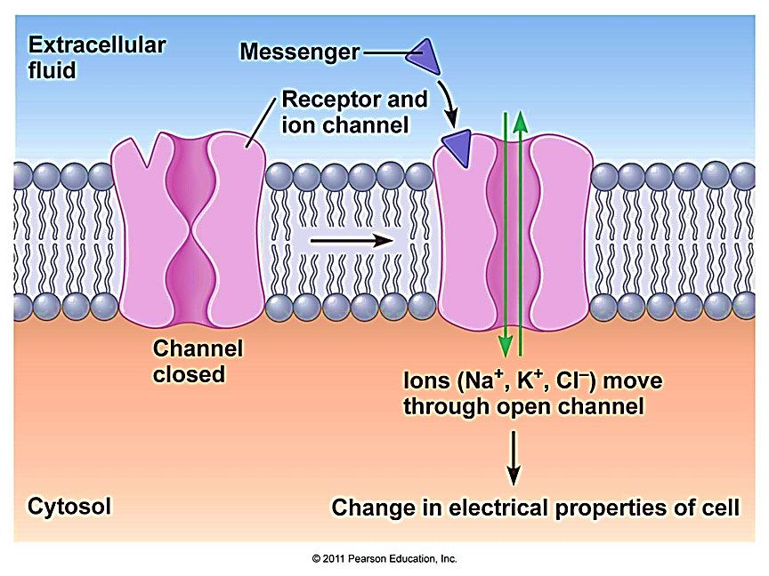
3- Ion channel receptors
Are the simplest form of receptors
Also known as ligand-gated ion channels located on post synaptic membrane in nervous system
Is away to regulate facilitated diffusion

Slide 23
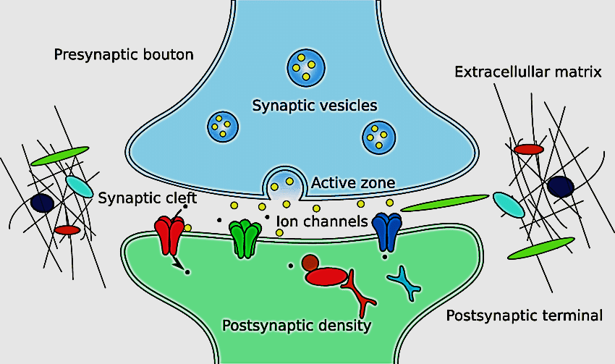
Importance of ion channel receptors
Important in the nervous system
Neurotransmitters function as ligands
which bind to receptors on target cell
These receptors are ion channel
receptors
Once open, ions flow into the target cell
Change in ion concentration triggers a nerve impulse

Slide 24
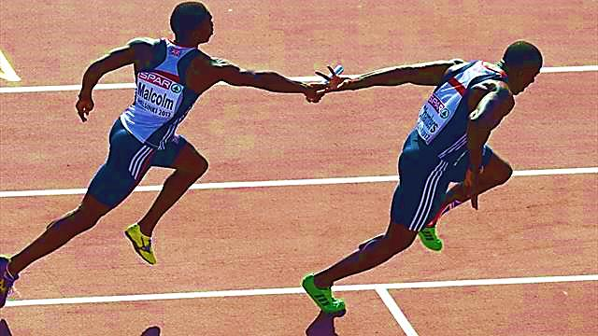
II. Signal transduction
Is the step between receiving of a signal & response of the cell to that signal
is a biochemical chain of events occur inside the cell
Transduction
Signal reception
Cell response

Slide 26
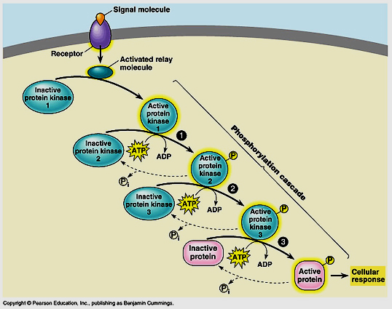
Role of protein kinase
They are protein molecules found in the cytoplasm
Act as catalysts
they are inactive until they
are phosphorylated
Each activated PK activates
the next one in the chain →
Phosphorylation cascade
Finally a protein is activated which generates a cellular response

Slide 27
Second messengers
1st messenger is the extra- cellular signal molecule (ligand)
2nd messengers are non protein molecules that involve in the transduce of signals inside cells (used to relay messages), used to amplify the signal
Examples of 2nd messengers are:
cAMP
cGMP
Calcium ions
Inositol triphosphate (IP3)

Slide 28
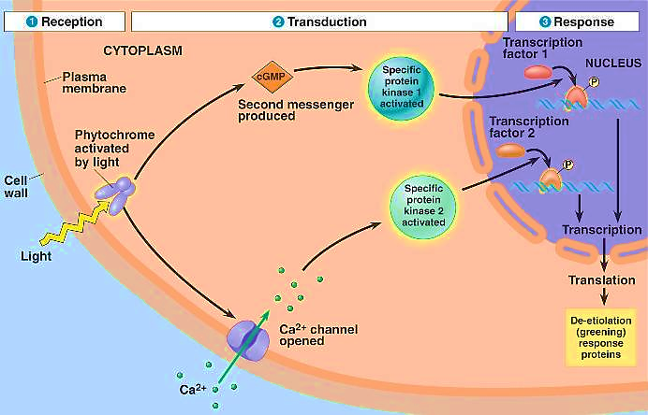
III. Responses
Cells respond to signaling pathways by many ways:
1- Metabolic enzyme→ alter metabolism
2- Regulatory protein→ alter gene expression
3- Cytoskeletal protein → alter cell shape or movement

Slide 29
(Signals can be specific only to different types cells)
Adrenaline
Liver cell
Heart cell
Stomach cell
Breakdown glycogen
Contract fast
No response

Slide 30
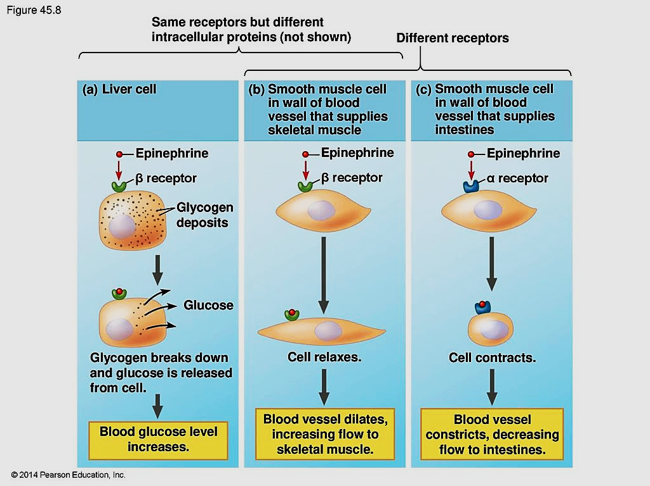

Slide 31
Thank you

