Slide 1
AMENORRHEA
BY DR SAMER YAGHI (MD)
Specialist in infertility & IVF,
BARCELONA UNIVERCITY ,
JBOG.

Slide 2
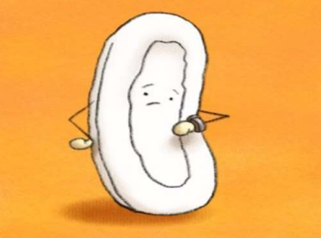
What does Amenorrhea mean?
The Origin → Greek
A = without ;
Meno= Relating to Menstruation ;
rrhea = discharge/flow An absence of menstruation
“Amenorrhea Is A Symptom ; Not a Disease“
The Final Diagnosis should be a Pathological Diagnosis..

Slide 3
*Definition:
Amenorrhea is the absence of menstruation.
• Primary Amenorrhea-
– Absence of menses by age of 15 regardless of
secondary sexual characteristics.
OR
– Absence of menses by age of 13 without
development of secondary sexual
characteristics

Slide 4
Events of puberty
* Thelarche (breast development)
→ Requires estrogen
* Pubarche (pubic hair development)
→ Requires androgens
* Menarche (the first mense)
→ Requires:
1– GnRH from the hypothalamus
2– FSH and LH from the pituitary
3– Estrogen and progesterone from the ovaries
4-- Normal outflow tract

Slide 5
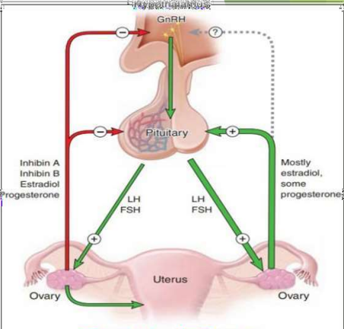
H-P-O-U Axis
Menarche : → Requires:
GnRH from the Hypothalamus.
FSH and LH from the Pituitary.
Estrogen and Progesterone from the
Ovaries.
Normal Uterus & Outflow tract.

Slide 6
CLASSIFICATION OF AMENORRHEA
AMENORRHEA
PHYSIOLOGICAL
PATHOLOGICAL
Pre-Puberty.
Pregnancy Related.
Menopause.
Primary
Secondary
Eugonadotropic
Hypergonadotrophic
Hypogonadotrophic

Slide 7
PRIMARY AMENORRHOEA
EUGONADOTROPIC
Anatomic /genital outflow tract
** Müllerian dysgenesis (Mayer -Rokitansky–Küster–Hauser syndrome)
1.Complete androgen insensitivity syndrome
(testicular feminisation synd.)
Distal genital tract obstruction-
Imperforate hymen, Transverse vaginal septum, cervical atresia, Vaginal atresia
Others
PCOD, constitutional delay

Slide 8
HYPERGONADOTROPIC (follicle–stimulating hormone>40 mIU/mL) hypogonadism (gonadal “failure”):
1. Gonadal dysgenesis with stigmata of Turner syndrome45.OX, mosaics.
2. Pure gonadal dysgenesis.
a. 46,XX
b. 46,XY-swyer
3. Early gonadal “failure” with apparent normal ovarian development.
4. Gonadotropin resistant ovary syndrome, savage syndrome.
5. Galactosemia.
6. Enzyme deficiency:17 alpa hydroxylase deficiency.5 alpha reductase deficiency.

Slide 9
HYPOGONADOTROPIC:
1. Isolated gonadotropin deficiency:
• Associated with midline defects (Kallmann ).
• Independent of associated disorders.
• Prader–Labhart–Willi syndrome.
• Laurence–Moon–Bardet–Biedl syndrome.
• Many other rare syndromes (Frohlich syndrome).
2. Associated with multiple hormone deficiencies.
3. Neoplasms of the hypothalamic–pituitary area:
• Craniopharyngiomas.
• Pituitary adenomas.
• Empty sella turcica.

Slide 10
• Infiltrative processes (Langerhans cell–type histiocytosis).
• After irradiation of the central nervous system.
• Severe chronic illnesses with malnutrition.
• Anorexia nervosa and related disorders.
• Anti-dopaminergic and gonadotropin–releasing hormone–inhibiting drugs (especially psychotropic agents, opiates).
• Primary hypothyroidism.
• Cushing syndrome.
• Use of chemotherapeutic (especially alkylating) agents.

Slide 11
IMPERFORATE-HYMEN:
* May be discovered at birth because of presence of suprapubic mass "mucocolpos or hydrocolpos“.
* More commonly however it remains undetected until puberty (hematocolpos).
* Patient presents with c/o cyclic perineal, pelvic or abd pressure or pain resulting from accumulation of obstructed menstrual blood or urinary retention.
*Genital ex.reveals no obvious vaginal orifice and a thin often bulging, blue perineal membrane.

Slide 12
CRYPTOMENORPHEA
Menstruation occurs but there is obstruction To the outflow of blood.
CAUSES Congenital: imperforate hymen.
Acquired: Vaginal atresia,
cervical stenois.

Slide 13
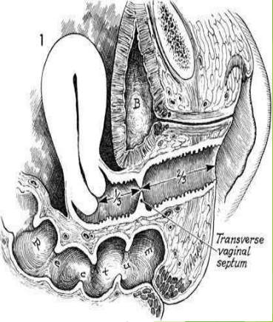
TRANSVERSE VAGINAL SEPTUM
• Failure of vertical fusion SEPTUM (complete cavitation of the vaginal plate between the sinovaginal bulbs and uterovaginal canal).
• More common in the upper portion, that is, at the junction between the sinovaginal plate and the caudal end of the fused müllerian ducts.
• The septum may be obstructive, with accumulation of mucus or menstrual blood, or may be non obstructive, allowing for egress of mucus and blood.

Slide 14
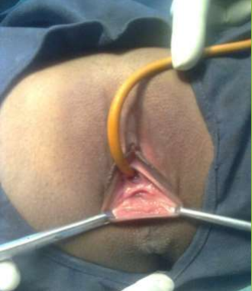
Clinical Manifestations:
• Obstructive Manifestations transverse vaginal septum:-
-- usually present during adolescence with cyclic lower abdominal pain, amenorrhea, and gradual development of a central pelvic mass.
• Nonobstructive or incomplete transverse vaginal septum:-
-- complain of abnormal menstrual flow, pain with intercourse, difficulty in placing or removing tampons, or obstructed labor.

Slide 15
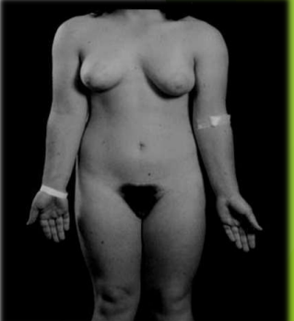
Mayer-Rokitansky-Kuster Hauser (MRKH) Syndrome :Utero-Vaginal agenesis
15% of primary amenorrhea (2nd M/C Cause)
Normal secondary development & external female genitalia.
Normal female range testosterone level Absent uterus and upper vagina & normal ovaries.
Karyotype 46;XX .
15-30% renal, skeletal and middle ear anomalies.

Slide 16
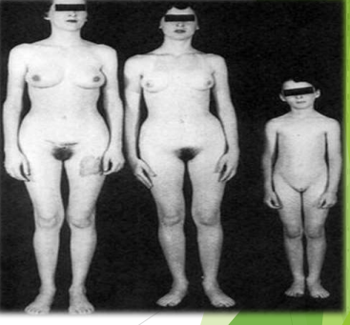
Androgen Insensitivity Syndrome (AIS):
Normal breasts but sparse/absent sexual hair.
Normal looking female external genitalia.
Absent uterus and upper vagina.
Karyotype 46;XY.
Male range testosterone level.
Genotype-Male; Phenotype-Female.
M/C Cause of Male-Intersex.

Slide 17
Gonadal Dysgenesis
** PURE GONADAL DYSGENESIS:
E.g. Swyer’s Syndrome
◆ 46;XY + Defect in SRY Gene
◆ Bilateral Streak Gonads
◆ Geno-Male ; PhenoFemale
◆ Infantile uterus present
◆ Height-Normal/Tall
◆ 1°Amenorrhea
** MIXED GONADAL DYSGENESIS:
Mosaics ( 46;XY + 45;XO).
Testis Present.
Streak Ovary( 1°amenorrhea)
Ambiguous Genitalia

Slide 18
GONADAL DYSGENESIS: 46XX
•Refers to a number of conditions in which abnormal development leads to
streak gonads
•Incidence: <1/10,000 in women less than 30
•Familial inheritance 7-30%.
•Premutations in the FMR1 gene (Fragile X Syndrome).
•15% of carriers have POF.
•Associated with :
•autoimmune diseases (18-30%) like Hashimoto’s Thyroiditis,Addison’s
disease, hypoparathyroidism, vitiligo.
•Acquired: Radiation, chemotherapy, Environmental, Childhood viruses.

Slide 19
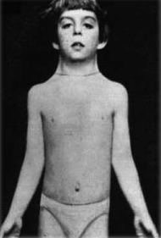
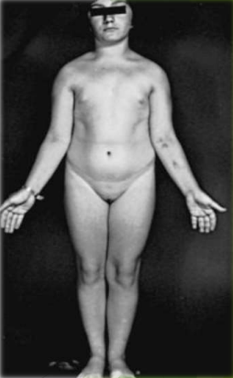
Turner Syndrome (M/C Cause ):
Karyotype 45;XO
Generally grow slowly so shorter inheight
Lymphadema at birth
Webbed neck & Short MetacarpalIV
Pigmented spots on the wholebody
Shield Chest with widely spaced Nipples
DM ; Thyroid disorder
Streak gonads/ovaries (Amenorrhea)
Do not develop breast at puberty
CVS ( Bicuspid aortic valve> Coarctation of aorta) ; Horseshoe Kidney
Cubitus Valgus

Slide 22
46 XY Swyer Syndrome:
Cause: Associated with mutations in the SRY gene.
•Streak gonads present; No testesformation
•Anti-Mullerian hormone and testosterone not produced
•Normal uterus and fallopian tubes, female external genitalia
•Estrogen also not produced from streak gonads therefore breast development does not occur
•Elevated FSH/LH
•Streak Gonads need removal as increased risk for (25%)
germ cell tumors: most common gonadoblastoma

Slide 23
Kallmann Syndrome
Congenital GnRH Deficiency.
Anosmia + Amenorrhea + Colour Blindness.
Poorly developed secondary sexual characters.
Cleft lip/ palate.

Slide 24
RESISTANT OVARY SYNDROME OR SAVAGE SYNDROME:
• Absence or malfunction of FSH receptor in ovarian follicle.
• ↑ (increase) gonadotrophin.
• Apparently normal ovarian tissue.
• Some degree of sec. sexual character.
• Rare cause of primary amenorrhea.
• May resolve spontaneously.
• If hot flushes-Rx with estrogen.

Slide 25
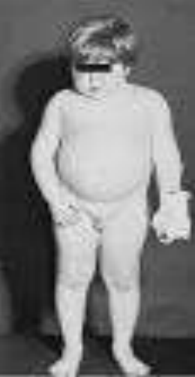
Frohlich Syndrome (Adiposo Genital Dystrophy):
• Broad spectrum of hypothalamic lesions.
• Hyperphagia, obesity, and central hypogonadism.
• Decreased GnRH production results in attenuated pituitary FSH and LH synthesis and release.
• Deficiencies of leptin, or its receptor, cause these clinical features.

Slide 26
Heterosexual development:
• Congenital adrenal hyperplasia –21 hydroxylase deficiency (commonest), 17∞ Hydroxylase deficiency17, 20-desmolase deficiency.
• Androgen secreting tumor –Arrhenoblastoma.
• 5 ∞-Reductase deficiency.
XY, testis, virilization at puberty,
no mullerian structure,
non development of breast,
normal male internal genitalia but non development of external.

Slide 27
Congenital Adrenal Hyperplasia- CAH
Autosomal Recessive Inheritance.
Deficiency of 21-Alpha-Hydroxylase enzyme in >90%cases.
Decreased synthesis of both Cortisol and Aldosterone.
Decrease Cortisol production leads to increased ACTH and hence adrenal cortical hyperplasia.
Accumulated 17-Alpha-hydroxyprogesterone is diverted to Androgen production and Signs of Androgen excess appears.
Aldosterone deficiency leads to Salt wasting.
Most common cause of Ambiguous Genitalia in females (Female Intersex).
Vagina and uterus are present.
Ovaries are usually polycystic in appearance and anovulatory (Amenorrhea).

Slide 28
Weight-related Amenorrhoea: →Anorexia Nervosa
• 1 ° or 2 ° Amenorrhea is often first sign (commonest cause of amenorrhea among teenagers)
• A body mass index (BMI) <17 kg/m² menstrual irregularity and amenorrhea.
• Hypothalamic suppression ,hypogonadotropic state.
• Abnormal body image, intense fear of weight gain, often strenuous exercise
• O/E-hypotension, bradycardia ,hypothermia,dry skin and lanugo hairs.
• Mean age onset 13-14 yrs (range 10-21 yrs).
• Low estradiol → risk of osteoporosis , osteopenia
• Bulemics less commonly have amenorrhea due to fluctuations in body wt, but any disordered eating pattern (crash diets) can cause menstrual irregularity.

Slide 29
Constitutional Delay:
•Puberty occurs at a time greater than 2.5 standard deviations from the mean.
•Family history of delayed puberty.
•Characteristics:
Significantly shorter.
Bone age lags behind age matched controls.
Often present at early Tanner stage 2.
Low gonadotropin levels.
•Diagnosis of exclusion—exclude other reproductive disorders.

Slide 31
OBJECTIVES OF EVALUATION:
1.) Understand the causes of primary amenorrhea .
2.) How to elicit a pertinent history and perform a focused physical exam to evaluate primary amenorrhea.
3.) Understand how to perform and interpret selected diagnostic tests and imaging to evaluate primary amenorrhea.

Slide 33
APPROACH TO A CASE OF PRIMARY AMENORRHOEA:
• CAREFUL MEDICAL HISTORY DM, TB, f/h of pcod ,delayed puberty, testicular feminization.
• PHYSICAL EXAMINATION: → Height, weight, BMI, Skin, Acne, Hirsutism, thyroid.
• Breast: Indicator of estrogen production or exposure to exogenous estrogen
• Abdominal Examination-mass
• External Genitalia and pubic hair, axillary hair PV ex. /PS ex. /PR ex

Slide 34
INVESTIGATION:
HORMONAL PROFILE →
(beta-HCG,FSH,LH,TSH,PROLACTIN, sex hormones).
USG/MRI.
Karyotyping.
Laparoscopy.
Mlscellaneous.

Slide 35
Approach to a case of primary AMENORRHOEA:
History and clinical exam
Asynchronous development breast → Pubic hair
Immature secondary sexual characteristics
Mature secondary sexual characteristics
Androgen Insensitivity
FSH, Prolactin
Distal Genital Tract Obstruction,
Mullerian Genesis

Slide 36
**WHO divides patients into groups based on endogenous oestrogen production, folliclestimulating hormone (FSH) levels, prolactin levels, and hypothalamic-pituitary dysfunction.
This classification is a guide that eliminates several diagnoses based on initial information.
However, further work-up is still required.
• Group I: low oestrogen, low FSH, and no hypothalamic- pituitary pathology, leading to a diagnosis of hypogonadotrophic hypogonadism.
• Group II: normal oestrogen, normal FSH, and normal prolactin, leading to a diagnosis of polycystic ovary syndrome.
• Group III: low oestrogen and high FSH, leading to a diagnosis of gonadal failure.

Slide 38
Tanner Staging:

Slide 39
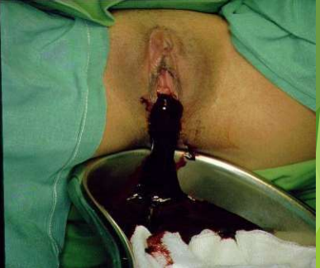
Treatment of imperforate hymen:
-Relief of symptoms.
-Definitive surgery as soon as possible
-a simple cruciate incision in the hymen and to allow drainage of altered menstrual fluid or a sterile puncture of the distended membrane and enlarged to allow insetion of a 16F Foley’s cathter which is placed for 2 weeks.

Slide 40
Diagnosis :
**On physical ex-normal vaginal orifice, shortened vagina of varying length, no visible cervix and a palpable hematocolpos in the proximal vaginal segment or a pelvic mass from hematometra and hematosalpinges.
**Valsalva maneuver distinguishes it from imperforate hymen-in case of imperforate hymen there is distention at the introitus, blue convex vs pink concave.
Pelvic ultrasonography-reveal extent and level.
Abdominal/pelvic MRI defines clearly the length of the atritic segment and septal thickness.
Avoid diagnosis by inserting a needle which may convert a hematocolpos into a pyocolpos.

Slide 41
Mayor Rokatinski Kauser Hauser Syndrome :
MRKH TWO TYPES:
→ type A (Symmetric rudiment uteri ,normal FT)
→ type B (Asymmetric rudiment ut. and absent / hypoplastic FT)
ASSOCIATED ANOMALIES:
•Urologic anomalies (15-40%) -u/l renal agenesis, horse-shoe kidney, duplication of the collecting system.
•Skeletal malformation-vertebra, ribs ,pelvis. (10-15%).
hemivertebra, Cardiac anomalies .
DIAGNOSIS:
•medical h/o, physical ex, karyotype,
• renal usg , spinal x-ray, MRI .
• laparoscopy.

Slide 42
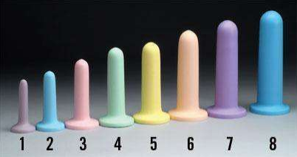
TREATMENT
Surgery is indicated
with symptoms of Hematometra, endometriosis or a hernia into
the inguinal canal.
Primary goal: creation of a functional vagina by progressive.
dilatation (non-surgical) or surgical creation of Neovagina.
(Dilators Frank & Ingnam ):
•Dilate at a 15 degree angle by applying pressure daily for 20 minutes.
•Progressively work up to larger dilators
•Success defined as non-painful intercourse or vaginal length of 7cm.

Slide 43
Androgen Insensitivity Syndrome :
• Enzymatic failure of testis to produce androgen (incomplete)
• Absence of androgen receptor or failure of function (inactivating Mutation in gene encoding androgen receptor)

Slide 44
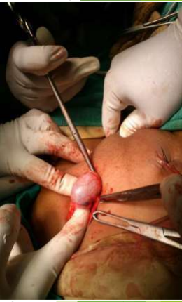
Androgen Insensitivity Syndrome:
Normal breast development.
Normal vulva with short blind vagina.
Uterus and tubes absent, Testes in abdomen/groin.
Male range testosterone, Sr. LH also elevated reflecting androgen insensitivity at hypothalmo- pituitary level.
• Treatment:
• gonadectomy after puberty + HRT(Malignant potential of gonad
(5-10%)– removal after puberty (to smoothen pubertal development and as it is very rare)
• Vaginoplasty-16 TO 18 YRS
• Psychological counselling

Slide 45
Turner Syndrome:
Turner vs mosaic.
Karyotype-45/xo vs 45/xo or 46/xx.
Height-short vs normal.
Ovarian streaks-no follicle vs some follicle.
Menstruation n preg-absent vs present.
Classical features-present vs absent.

Slide 46
Treatment
• GH therapy 0.375mg/kg weekly for about 7 yrs starting at as early as 2-8 yrs for Height
• To promote sexual maturation – exogenous estrogen such as 0.025 mg/day transdermal estradiol or 0.3- 0.625mg CEE orally daily 25 days at about 12-13 yrs of age.
• 5-10 mg MPA added to prevent endometrial hyperplasia after first experience of bleeding or after 6 months of E therapy for last 10 days.

Slide 47
Kallman Syndrome:
***congenital GnRH deficiency with anosmia/hyposmia.
• cyclic estrogen and progestin (to induce sec. sexual character and to prevent osteoporosis).
• Repetitive GnRH administration restores normal ovulation.
• Fertility portable infusion pump to deliver subcutaneous, pulsatile GnRH

Slide 48
Empty sella turcica
characterized by herniation of subarachnoid membrane into the pituitary sella turcica and may exist with pineal gland tumour as prolactin adenoma.
• In all such women, cyclic administration of oestrogen and progestogen to maintain femininity and prevent osteoporosis is essential.
• In case the woman desires to conceive, induction of ovulation with gonadotropins is warranted.
• In women with neoplasms, appropriate neurological consultation followed by treatment with bromocriptine for prolactinomas or surgery should be planned.

Slide 49
Congenital Adrenal Hyperplasia :
• Enzyme defect leading to excessive androgen production.
• Autosomal recessive trait.
• Milder form of disease diagnosed later in life(late onset) and resembles PCOS.
• May present with primary amenorrhea but even more classical: hirsutism, virilization, anovulation.
• Abnormal looking female external genitalia (ambiguous)
• Presence of uterus and upper vagina.
• Diagnosis: Fasting 17-OHP-
Levels >1000 ng/dL are indicative of late-onset CAH.

Slide 50
INVESTIGATIONS:
• • USG internal genitalia shows presence of uterus, fallopian tubes, and vagina.
• The gonads are ovaries. Sex chromatin study reveals positive Barr body.
• Karyotype is 46, XX.
• •17 hydroxy-progesterone (17 OHP)
• “salt loosing syndrome” (sodium and chloride— low, potassium raised
• Urinary excretion of pregnanetriol and 17 Ketosteroids are markedly elevated.
TREATMENT: Hydrocortisone 10–20 mg/m2 body surface area per day is given to suppress the excess ACTH secretion.
**Mineralocorticoid (fluorocortisone) is also given in cases with 21-hydroxylase deficiency and Corrective surgery (reduction clitoroplasty & vaginoplasty).
)

Slide 51
Anorexia Nervosa :
Management.
Psychological .
Psychotherapy .
Nutritional .
GnRH to initiate H-P-O axis.
Hormonal therapy: To initiate or complete H-P-A axis.
Seventy per cent improve with treatment.

Slide 52
Thank You!

