Slide 1
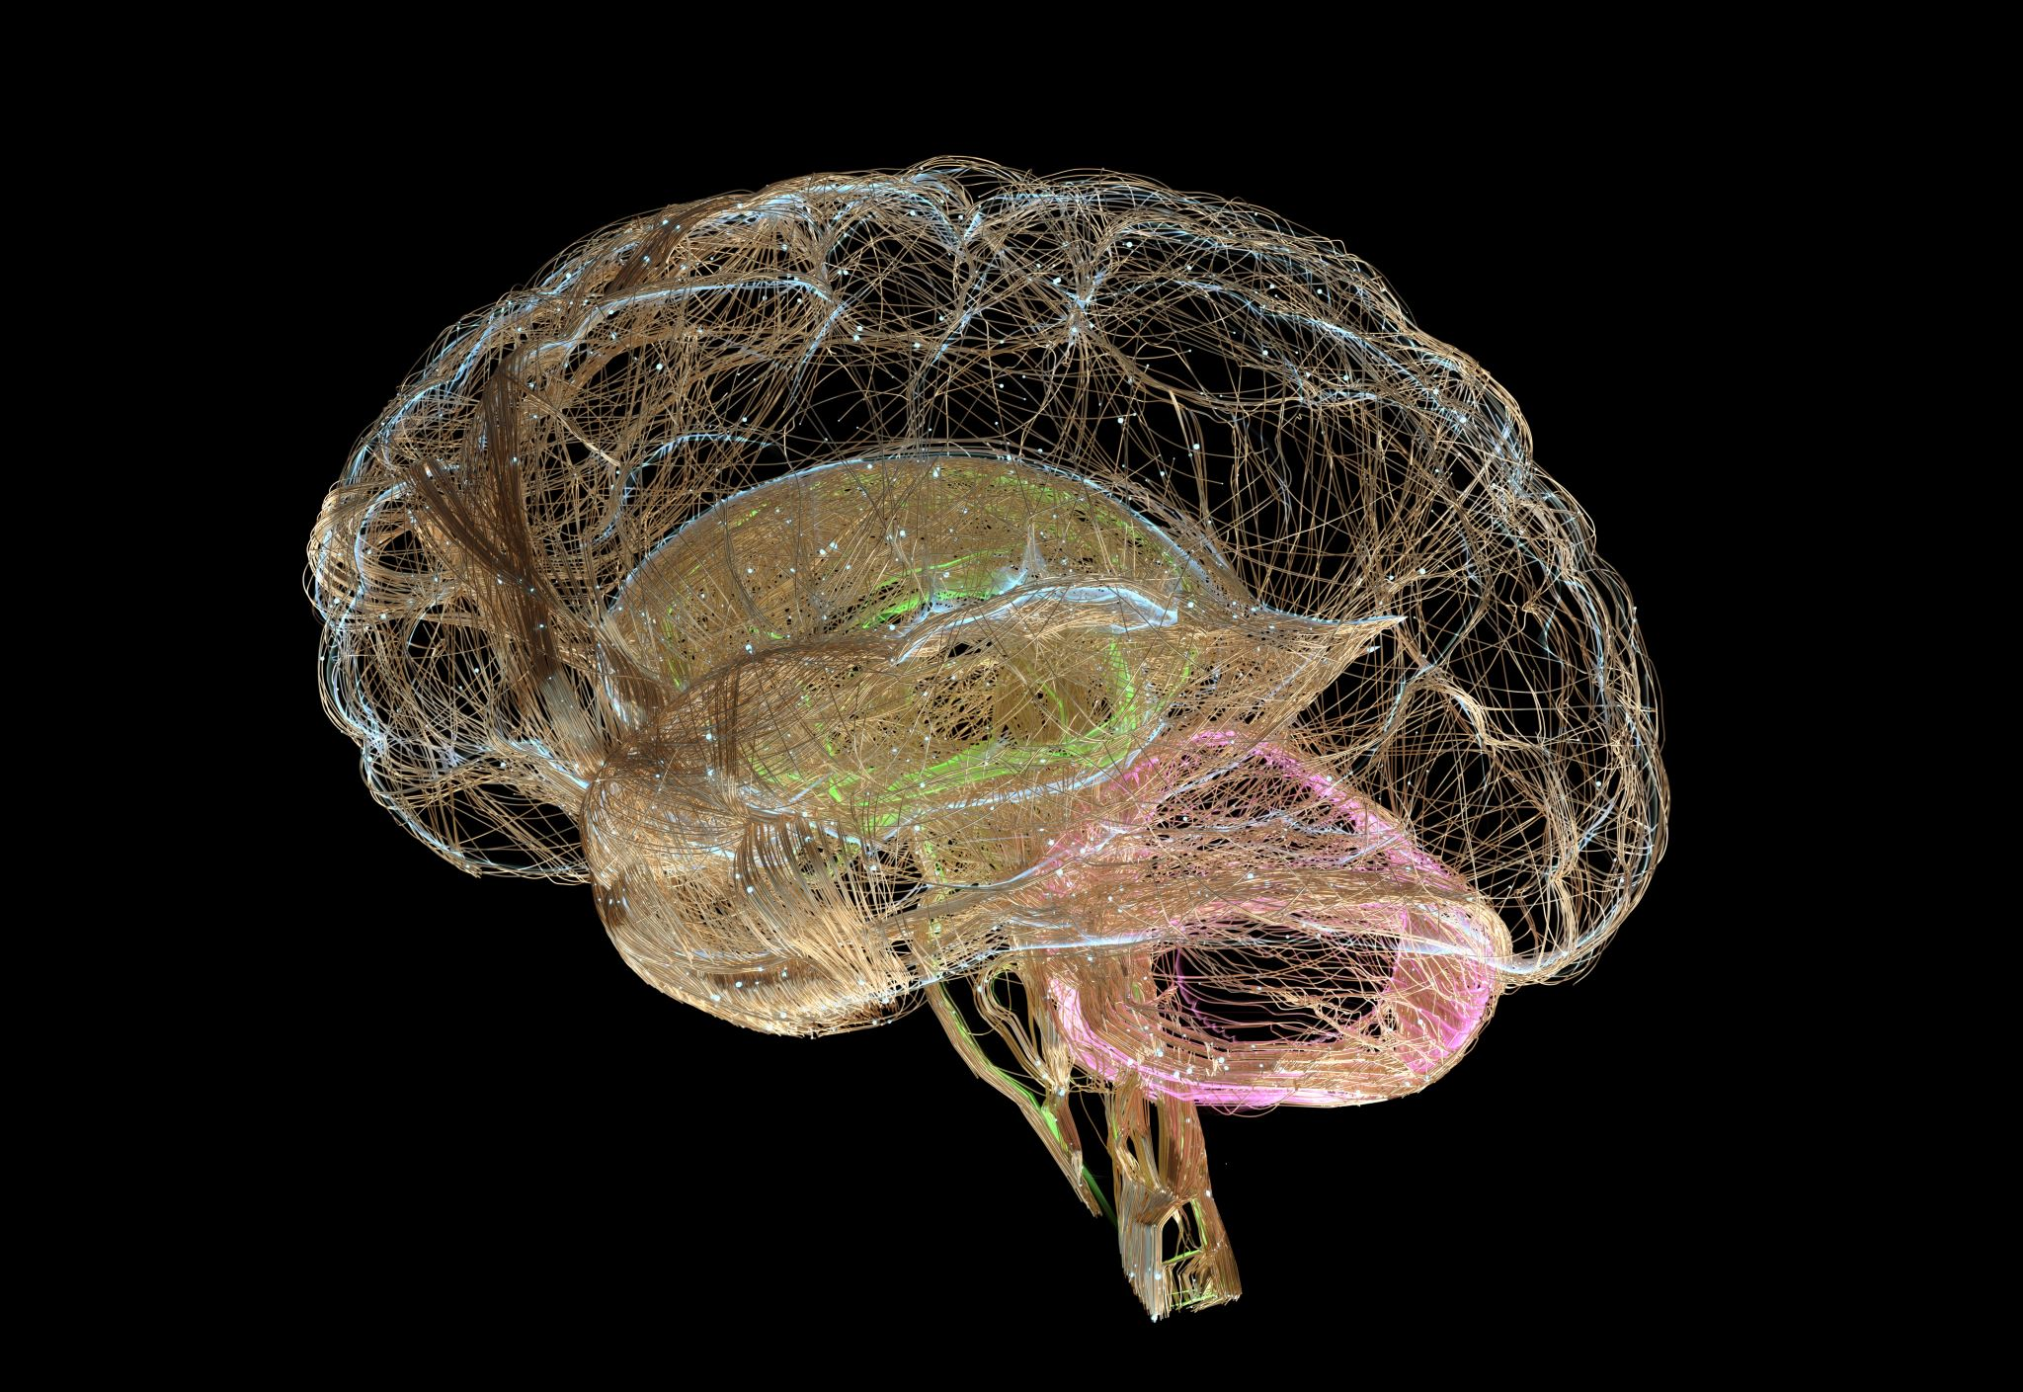
Control movement and posture , motor function of cerebellum and brain
Dr. Arwa Rawashdeh

Slide 2
Neurology controlling the posture system
Brain
Frontal lobe
Motor homunculus
Descending fibers
Stimulating voluntary movement
1. Stimulating contralateral of the skeletal muscle
2. ipsilateral systems via ipsilateral brainstem or PMRF ( postural stabilization)
Parietal lobe
Sensory homunculus self proprioception of our body in space
Ascending fiber

Slide 3
Sensory motor integration
Sense
Perceived information
And then produce an appropriate motor output

Slide 4
Ascending and descending pathways
Spinal cord
Descending motor fibers
Voluntary movement
Corticospinal tracts ( Pyramidal tract)
Postural stabilization
Reticulospinal and Vestibulospinal tracts ( extrapyramidal tract)
Ascending sensory fibers
Dorsal columns in the anterolateral system

Slide 5
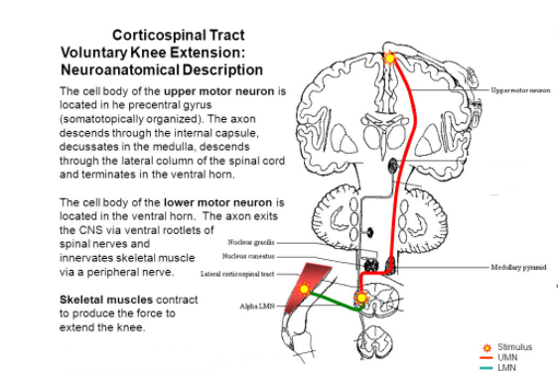
Corticospinal tract

Slide 7
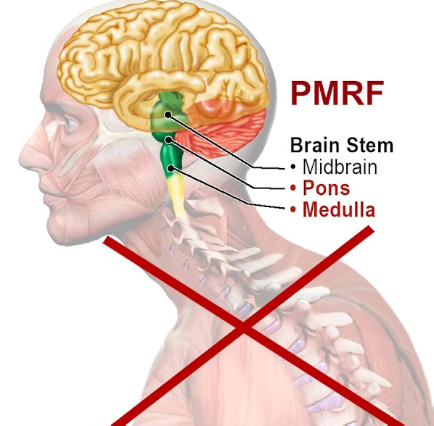
Pontomedullary reticular information (PMRF)
Powerhouse of the posture
The center of upright posture design
Inhibits flexion
Flexor dominant posture ( deficit of the PMRF)
With head forward, anterior rolling the shoulders, anterior chest flexion

Slide 8
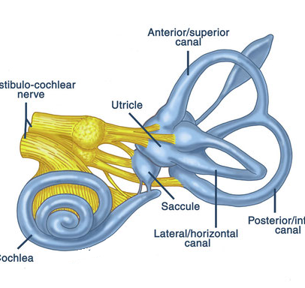
Vestibulospinal tract
Cranial nerves ( VIII) within PMRF
Better extension and better balance
Stimulate Vestibulocochlear nerve
The primary function of the vestibulocochlear nerves (VIII) is a special sensory, but of two types. The vestibular nerve handles balance and equilibrium, while the cochlear nerve is responsible for hearing. The vestibulocochlear nerves originate in the monitoring receptors of the internal ear—the vestibule and cochlea.

Slide 9
Vestibular system
Stimulate upright postural extension
Vestibular nuclei in the PMRF
Proper flexor extensor synergy among the PMRF and the vestibular system responsible for upright postural design

Slide 11
EYE
Motor control
In the brainstem we have nuclei for cranial nerve 3 and 4
In the pones cranial nerve six part of PMRF
Controlling extraocular eyes of the muscle
Sensory control in occipital lobe
Visual and vestibular system keep your head upright with your eyes focused while moving head in space

Slide 12
Medial vestibulospinal tract
Interact with the visual system and the cervical proprioception to coordinate head posture
Visual and vestibular system keep your head upright with your eyes focused while moving head in space
Lateral vestibulospinal tract
Descends the spinal cord and stimulate postural tone of the extrinsic muscle of the spine

Slide 13
Back distention
Going to special structure in the cerebellum
flocculonoduler lobe ( vestibule cerebellum) subconscious balance
fastigial nucleus to vestibular nucleus and modulate vestibulospinal tract movement

Slide 14
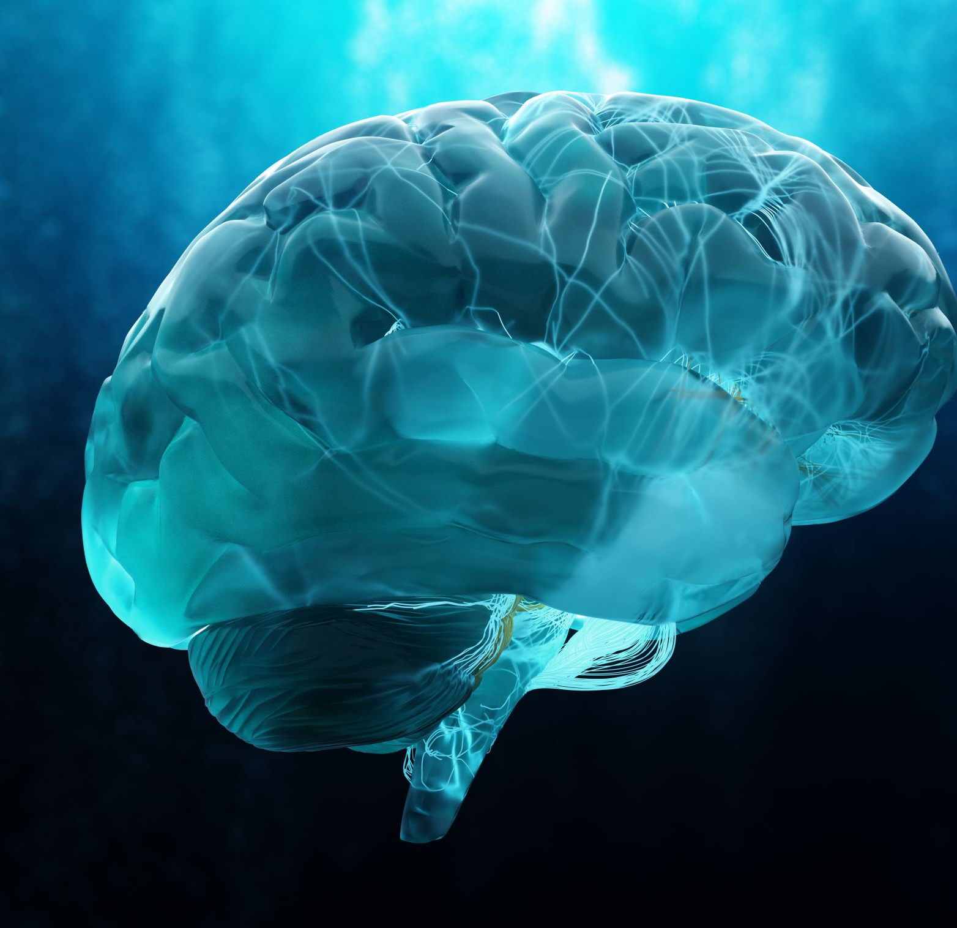
Cerebellum ( little brain)
Nice precise crisp movement ( refine motor output) from the frontal part
Cerebellar lesion
tremor ( excessive motions) not able to hit the target accurately
Communicate with vestibular system so fundamental with postural neurology

Slide 15
Visual and vestibular system
Eye- spine- vestibular model ( posture rehabilitation)
Eye visual system orientation and head posture design
how we orient ourselves within the world
Head posture design
Spine sensory motor integration
Vestibular system inner ear
Balance

