Slide 1
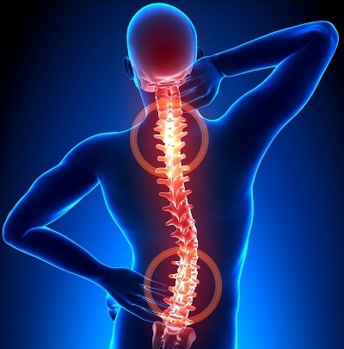
scoliosis

Slide 2
outlines
normal vertebral curvature-1
2-Definition
3-pathology
4-types
5-clinical features
6-investigations
7- treatment and prognosis

Slide 3
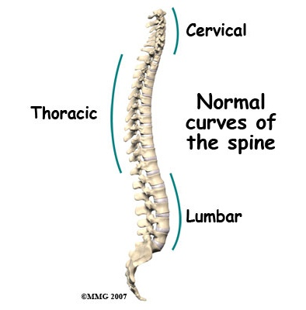
Normal spine
-Primary curves are the natural curves in the spine that we are born with (thoracic/pelvic curves)
-secondary curves develop after birth in response to learned motor skills
Cervical when infant learn to hold his/her head upright
Lumbar develop as child learn to walk

Slide 4
definition
Scoliosis
is an apparent lateral (sideways) curvature of the spine.
does curvature Apparent’ because, although lateral
Scoliosis is actually occur, the commonest form of
a triplanar deformity with lateral ,anteroposterior
.and rotational components

Slide 5
The scoliosis research society has defined scoliosis as a lateral curvature of the spine greater than 10 degrees as measured using the cobb method on standing radiograph
*Pts usually present between the age of 10 and 15.
Mostly occur in female*

Slide 6
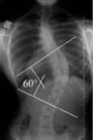
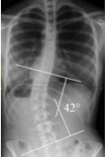
dextroscoliosis
Describes a spinal curve to the right (dextro=right)
Usually in the thoracic spine
This is the most common type of curve
Forming either c shape or s shape
Levoscoliosis
Describes a spinal curve to the left (levo=left)
Common in lumbar spine

Slide 7
Pathology:
- May occur anywhere in the thoracic or lumbar spine.
*The vertebrae that make up the curve are always rotated around the vertebral axis.
*the bodies point to the convexity. And the spinous processes to the concavity of the curve
*coexistence of congenital spine anomalies with congenital cardiac and kidney defects.

Slide 8
types
1- postural
2-structural

Slide 9
type postural
Secondary or compensatory to some condition outside the spine such as short leg, or pelvic tilt , Local muscle spasm associated with a prolapsed lumbar disc may cause a skew back (sciatic scoliosis).
It can become structural if it exceed a certain point.
2 dimensional ( AP only )
The deformity disappear when the patient sits or bend forward.

Slide 10
Structural type
non-correctable deformity.
rib hump on bending forward.
The deformity is liable to increase throughout the growth period. curves greater than 50 degrees may go on increasing by 1 degree per year.
very severe curves ( angle >70-80 degree) accompanied with chest deformity and cardiopulmonary dysfunction

Slide 11
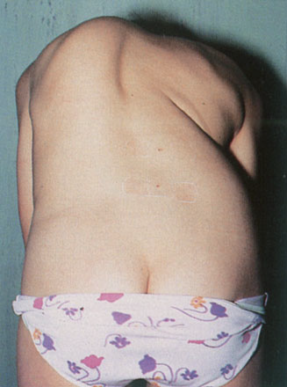
Functional type
Structural type

Slide 12
How to differentiate between functional and structural?
1- bending test (adam’s test)
2- make the patient sit
→ The scoliosis will disappear on conducting the two tests in functional type

Slide 14
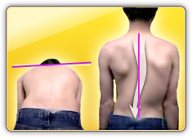
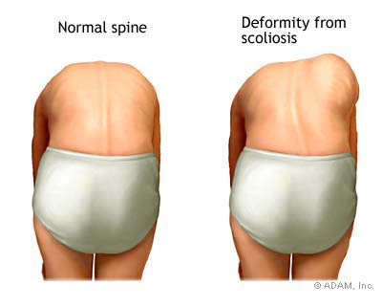
Test for scoliosis
Bending test

Slide 15
Types of structural scoliosis
1- idiopathic scoliosis (80%)
2- Osteopathic scoliosis: due to congenital vertebral anomalies
3- Neuropathic scoliosis: due to asymmetrical muscle weakness (e.g. In poliomyelitis or cerebral palsy).
4- Myopathic scoliosis: in muscular dystrophies.
5- Neurofibromatosis.

Slide 16
Infantile (0-3 years old)
idiopathic
Juvenile(4-9 years old)
Neuropathic and myopathic
Adolescent(10 years to maturity)
Structural scoliosis
Congenital or osteopathic
miscellaneous group of connective-tissue disorders

Slide 17
1- Infantile idiopathic scoliosis:
*Infantile idiopathic scoliosis is the only type of idiopathic scoliosis whose most common curve pattern
is left thoracic.
*is the only type of scoliosis that is more common in males.
90% *the only one to resolve spontaneously

Slide 18
2- Juvenile idiopathic scoliosis
*most closely mimics the epidemiology and
demographics of the adolescent version of the disease.
*It is more common in female. 50% resolve spontaneously
*its most common curve pattern is a right thoracic curve.
*high rate of progression, and need for surgery, juvenile idiopathic scoliosis might be considered to be a malignant subtype of adolescent idiopathic scoliosis.

Slide 19
3- Adolescent idiopathic scoliosis:
*is the most common type of idiopathic scoliosis and the most common type of scoliosis overall.
*Small curves in more mature patients have a substantially lower risk of progression (about 2%) than larger curves in more immature patients, in whom the risk is much higher
*Present before puberty and progresses until skeletal growth ceases.

Slide 20
Infantile thoracic
Adolescent thoracic
Thoracolumbar
Lumbar
Combined

Slide 21
OSTEOPATHIC (CONGENITAL) SCOLIOSIS
The commonest bony cause is some type of vertebral anomaly:
Hemivertebra
wedged vertebra (failure of formation)
fused vertebrae
fractures
bone softening ( rickets or osteogenesis imperfecta)
more aggressive and need early surgery.

Slide 23
NEUROPATHIC AND MYOPATHIC SCOLIOSIS
Poliomyelitis
cerebral palsy
Syringomyelia
Friedreich’s ataxia
*Also aggressive and bracing may fail, need surgery.

Slide 24
SCOLIOSIS AND NEUROFIBROMATOSIS
1/3 of patients with neurofibromatosis develop spinal deformity.
accompanied by skin lesions, multiple neurofibromata and bony dystrophy affecting the vertebrae and ribs

Slide 26
Clinical features
*Deformity is the only symptom.
*skew back and rib hump
*High curves are noticed early, whereas lumber curves may pass virtually unnoticed.
*It always looks worse on flexion.
*The shoulder is elevated on the side of the convexity, and the hip sticks out on the side of the concavity.
*With thoracic scoliosis; the breast are asymmetrical,
and the rib angles protrude.
*pain is rare complaint ( if present should be alert to possibility of neural tumor and need for MRI)
*family history is not uncommon

Slide 27
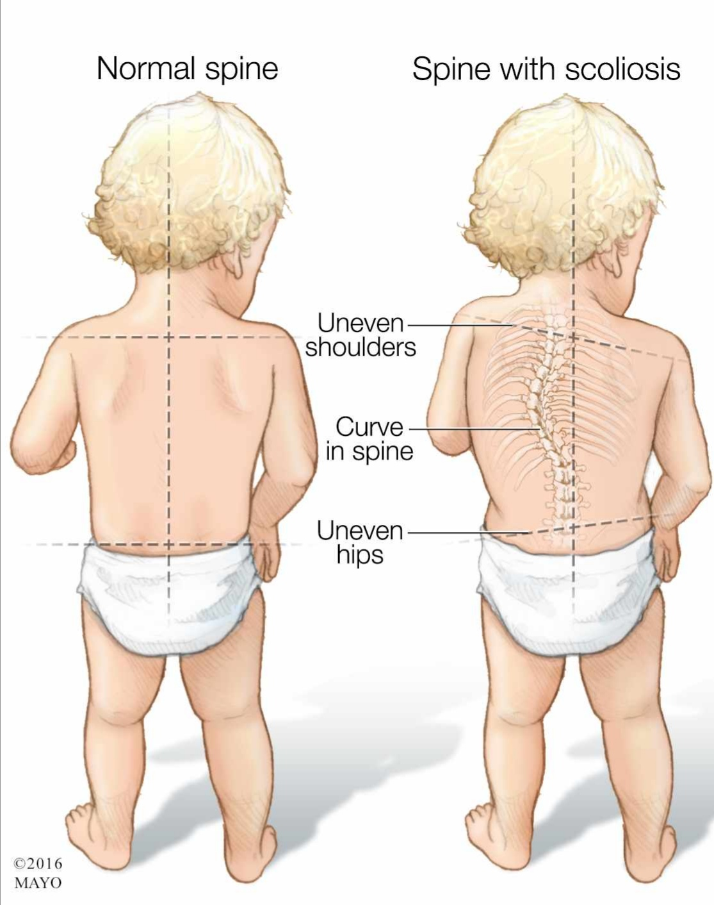

Slide 28
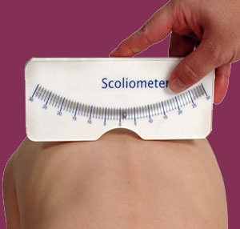
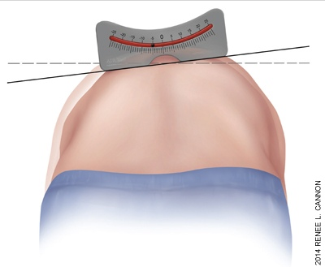
Adams test : deviation when the patient bends forward. … used as a screening test in schools along with scoliometer.
Scoliometer : if the angle below 7 normal … above 7 need further investigations

Slide 29
investigations
Plain X-ray :
Full-length PA and lateral x-rays of the spine and iliac crests must be taken with the patient erect.
Vertebral rotation.
PA x-ray shows asymmetry in vertebra at the apex of the curve

Slide 30
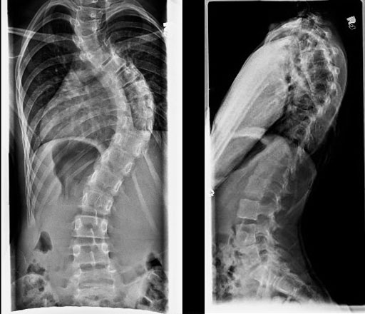

Slide 32
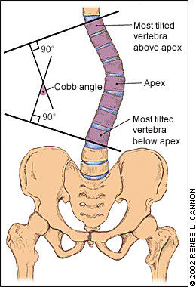
Cobb angle for measuring the spinal curvature.
Choose the most tilted verterbrae above & below apex of the curve.
Angle b/t intersecting lines drawn perpendicular to the top of the
superior vertebrae and bottom of the inferior vertebrae is the Cobb angle

Slide 33
Secondary curve (compensatory) : <25 degree
Primary curve : >25 degree
Treatment :
<25 degree : conservative/ follow up
25-45 degree : bracing and also depend on risser sign.

Slide 34
Risser’s sign :
this is important because the curve often progresses most during the period of rapid skeletal growth and maturation.
iliac apophyses ossification start anteriorly from ASIS & proceeds posteriorly towards PSIS. once the iliac crests are completely ossified ( 14-16 year) further progression of the scoliosis is minimal.
graded as Risser ( 0-5 )
Risser 5 complete fusion of apophysis
Risser 0 (no ossification)
Risser 1 coincide with rapid growth

Slide 35
Ossification of iliac crest starts laterally and proceeds medially toward sacrum
Risser staging
Based on iliac crest apophysis ossification
Type 1= ossification of lateral 25%
Type 2=lateral 50%
Type 3=lateral 75%
Type 4=lateral 100%
Type 5=fusion of ilium

Slide 38
CT and MRI needed in:
Pain
Abnormal neurological examination
Big curves > 50
Rt thoracic curve

Slide 39
Treatment and prognosis
The aim is to prevent severe deformity … usually for cosmetic reasons .
Management differs for the different types of scoliosis.
predictors of bad prognosis are:
Double curves
Kyphoscoliosis
Female
Rt thoracic
> 50 degree

Slide 40
Management differs for the different type of scoliosis:
1- infantile treated by applying serial elongation derotation flexion (EDF) plaster cast until resolve or become big enough for bracing
2-juvenile treated surgically befor puberty except if child is very young so bracing until age of 10
3-adolescent treated by :
A-non operative = exercise (no effect on curve but maintain muscle tone)
And bracing (curve 20-30 degree)

Slide 41
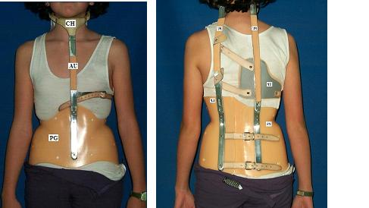
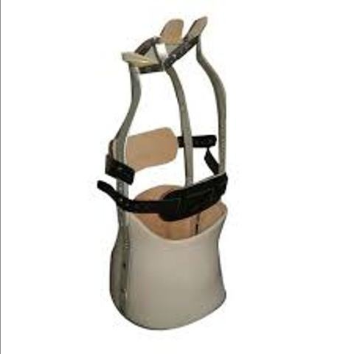
Types of braces
Milwaukee brace
Consist of
1-pelvic corset or girdle
2-uprights (one anterior and two posterior)
3-cervical ring (with throat mold and occipital piece
4- lateral pad (pressure on apical vertebra)

Slide 42
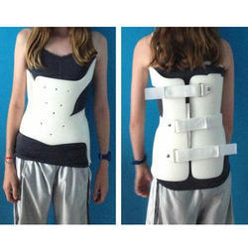
Boston brace
Is snug fitting underarm brace
Corrective pad is added to device to apply pressure at particular site

Slide 43
Operative
Indication of surgery =
1-curve more than 30 degree
2-milder deformity that deteriorating rapidly
3-failure to conservative treatment
4-balanced double primary curve require operation only if greater than 40 degrees and progress

Slide 44
Methods :
1-harrington rod
2-rod and sublaminar wiring(luque)
3-cotrel dubousset system
4-anterior instrumentation(dwyer,zielke)
5-warning

Slide 45
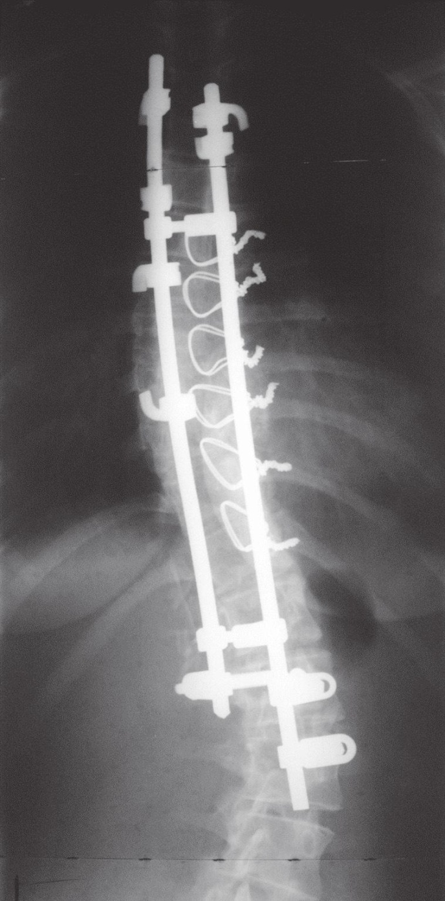
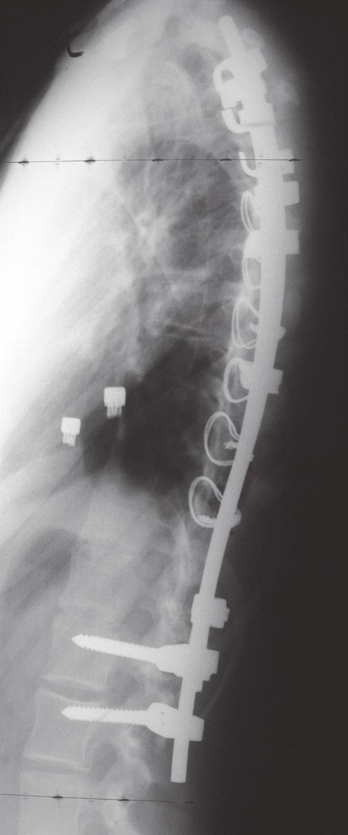
Scoliosis – posterior instrumentation Idiopathic scoliosis treated by posterior double-rod fixation

Slide 46
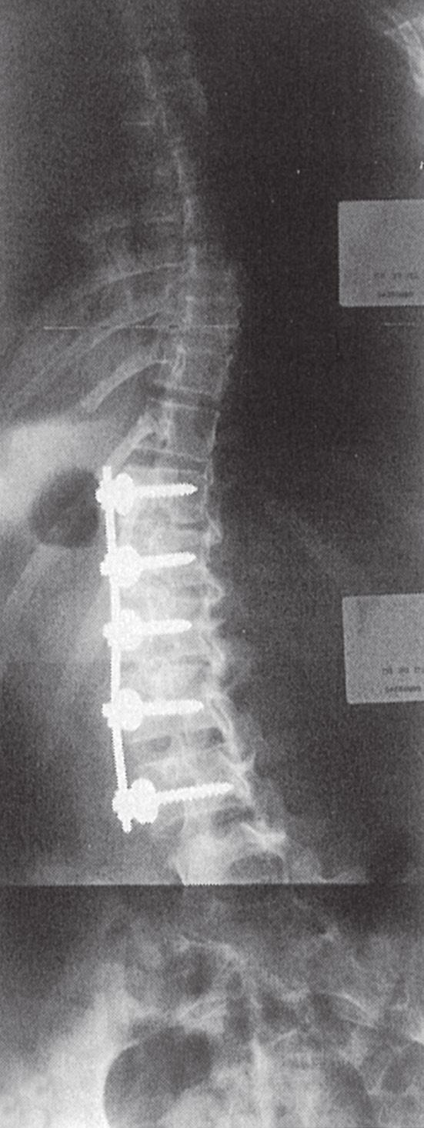
Scoliosis – anterior instrumentation

Slide 47
osteopathic treatment is difficult because risk of cord injury (surgery =staged resection of curve apex followed by instrumentation and spinal fusion)
neuropathic /myopathic
Depend on degree of functional disability
Mild=not treated
Moderate= as idiopathic
Sever=fitting suitable sitting support ,if not sufficient operation which is stabilization of entire paralytic segment by combined anterior and posterior instrumentation puls fusion

Slide 48
Scoliosis with neurofibromatosis
Treatment
Mild =as idiopathic
Sever =anterior and posterior instrumentation plus fusion

