Slide 1
Embryology of the nervous system

Slide 2
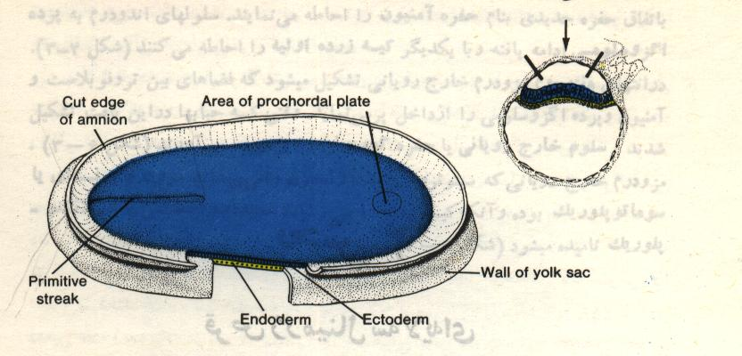

Slide 3
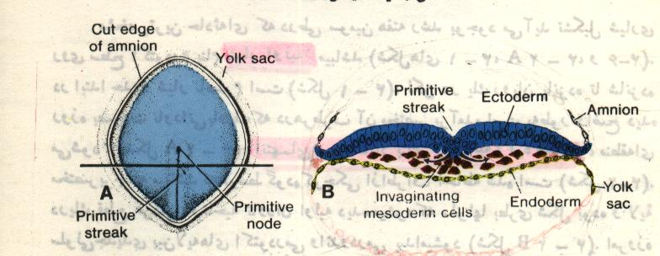

Slide 4
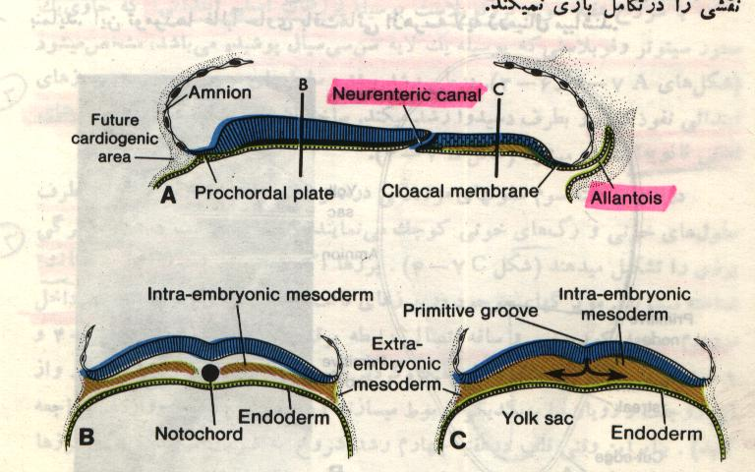

Slide 5
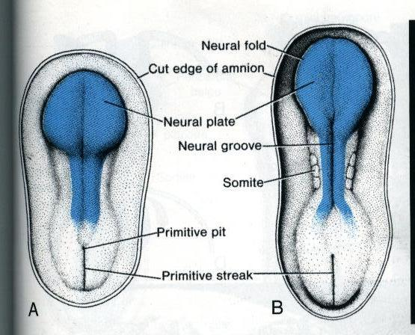

Slide 6
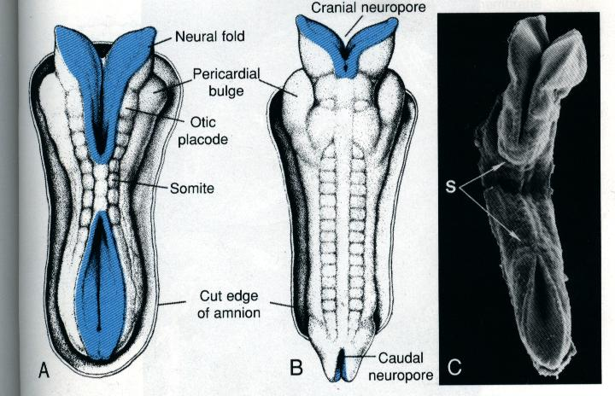

Slide 7
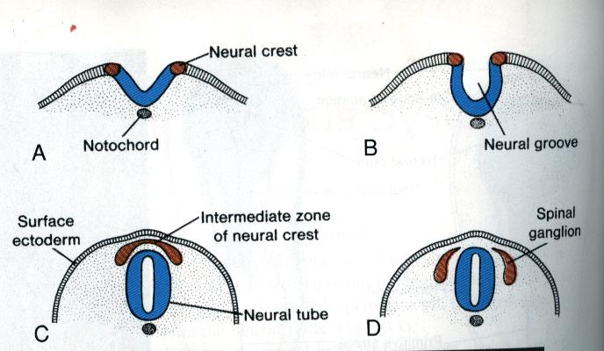

Slide 8
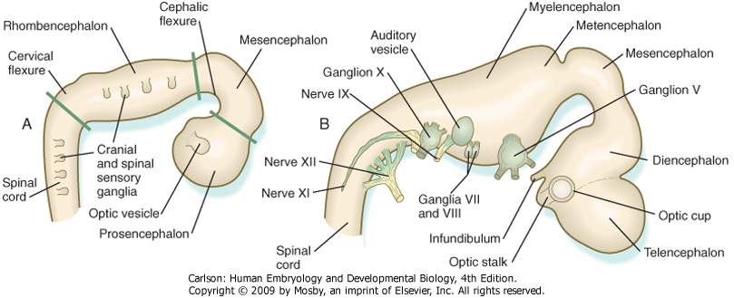
Major divisions of the developing brain: 3 parts, then 5 parts
3 parts: Prosen-, Mesen-, and Rhomencephalon
5 parts: Prosencephalon divides into telen- and diencephalon, Rhombencephalon divides into met- and myelencephalon

Slide 9
THIRD WEEK
Neural Plate :
It is a dorsal midline thickening of the ectoderm overlying the notochord (Neuroectoderm) .
Neural Folds :
They are the elevated lateral margins of the neural plate.
They are on each side of the longtudinal midline (Neural Groove).

Slide 10
NEURAL TUBE
It is formed from the apposition and fusion of the neural folds which seal the neural groove and create the tube.

Slide 11
FOURTH WEEK
The neural tube is completed and transformed into the adult CNS.
This growth is maximal at the rostral part which becomes the brain.
The caudal portion becomes the spinal cord.
The axis of the neural tube (neuroaxis) is straight.

Slide 12
Formation of brain and spinal cord
1- primary brain vesicles:
1) prosencephalon (forebrain) 2) mesencephalon (midbrain) 3) rhombencephalon (hindbrain)
2- Flexures

Slide 13
FLEXURES
The neuraxis is bent by two flexures :
Cephalic ( Mid brain) flexure at the junction of the fore and mid brains.
Cervical flexure :
Between the brain and spinal cord.
Anterior (rostral)
Posterior (caudal)
Metencephalon
Mesencephalon
Midbrain
Flexures
Diencephalon
Cervical
Telencephalon
Spinal cord
Myelencephalon
(a) Week 5
Figure 12.3a

Slide 14
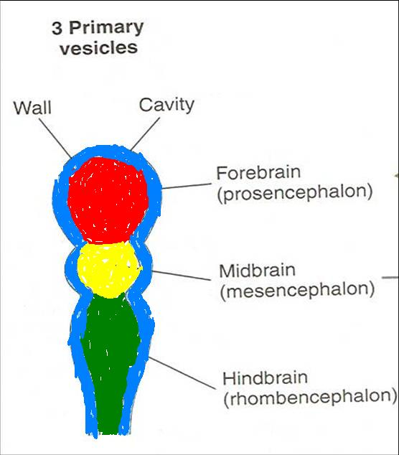
DIFFERENTIATION OF BRAIN
5th week:
Three primary brain vesicles appear :
Fore brain (Prosencephalon).
Mid brain (Mesencephalon).
Hind brain (Rombencephalon).

Slide 15
1. PROSENCEPHALON
Is divided into :
A. Telencephalon.
B. Diencephalon.

Slide 16
A. TELENCEPHALON
Telencephalon consists of :
A median part and
Two lateral pouches
It is the largest brain vesicle.
It has the greatest degree of development.
It forms the two Cerebral Hemispheres.

Slide 17
B. Diencephalon
Thalamus
Epithalamus:
- pineal
- habenular nuclei
Hypothalamus
Subthalamus
- subthalamic nuclei

Slide 18
3. ROMBENCEPHALON
Is divided into :
A. Metencephalon.
B. Myelencephalon.

Slide 19
A. METENCEPHALON
It is differentiated into:
Pons .
Cerebellum.

Slide 20
B. MYELENCEPHALON
It will form :
The Medulla Oblongata.

Slide 21
Ventricular spaces and central canal
1-Telencephalon------ lateral ventricles1&2
2-Diencephalon-------third ventricle
3-Mesencephalon----cerebral aqueduct
4- Rhombencephalon--- forth ventricle
5-Lumen of Spinal cord----- central canal
6- in the end of spinal cord----- terminal ventricle
Monro Foramen (interventricular Foramina)

Slide 22
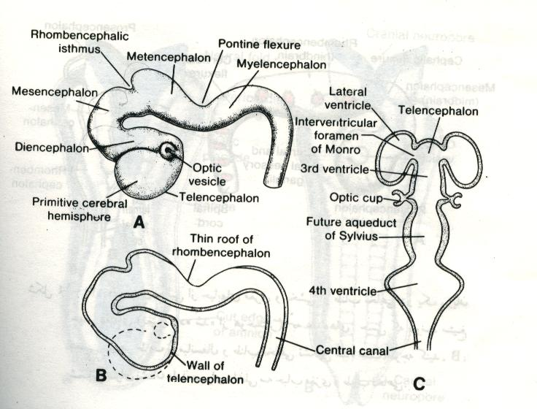

Slide 23
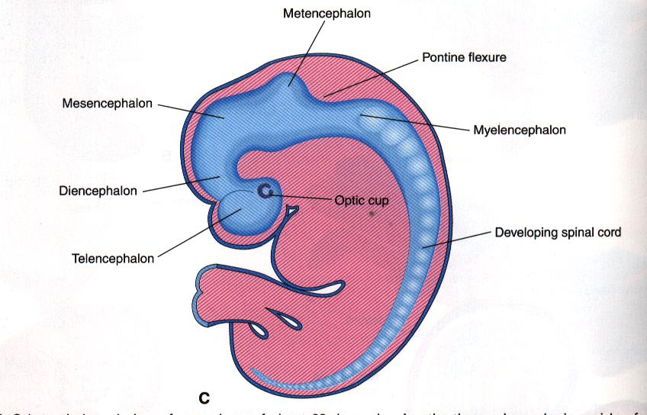

Slide 25
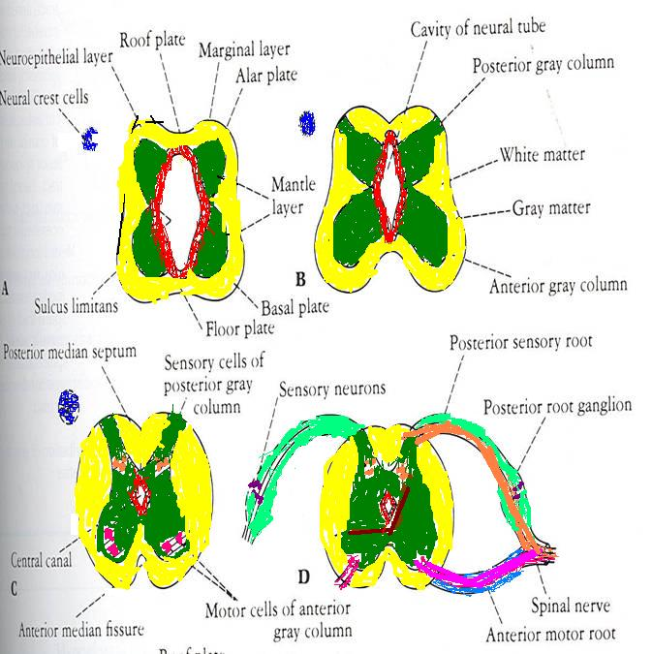
DIFFERENTIATION OF SPINAL CORD
The Grey matter is located centrally around the central canal.
The White matter forms the outer coat.

Slide 26
Spinal Cord
The wall of neural tube consists of neuroepithelial cells.
These cells form a thick pseudostratified epithelium.
They divide rapidly, producing more and more neuroepithelial cells. they differentiate into 3 layers:
1-neuroepithelial (inner or ependymal) layer or neuroepithelium.

Slide 27
Spinal Cord
Neuroepithelial cells give rise to another cell type, these are the primitive nerve cells, or neuroblasts.
They form the
2- mantle layer, a zone around the neuroepithelial layer.
The mantle layer later forms the grey matter of the spinal cord.
The outermost layer of the spinal cord, the
3-marginal layer, contains nerve fibers emerging from neuroblasts in the mantle layer.
As a result of myelination of nerve fibers, this layer takes on a white appearance and therefore is called the white matter of the spinal cord.

Slide 28
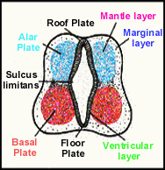
Ventricular layer = ependymal layer = proliferative zone
birthplace of CNS cells
Mantle layer = newly born, post-proliferative cells
Marginal zone = axonal layer

Slide 29
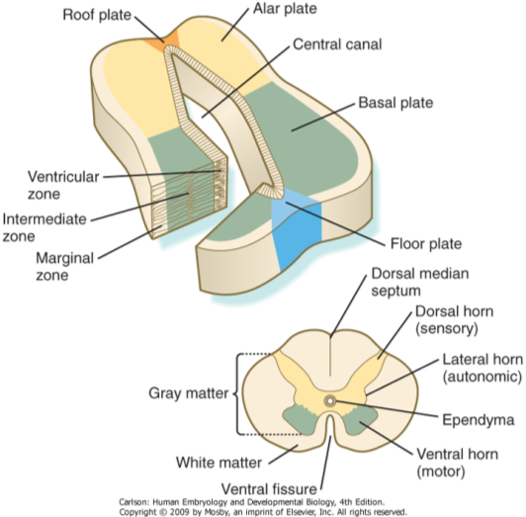
The developing neural tube is divided into 4 plates
Roof plate.
Alar plate: sensory
Basal plate: motor
Floor plate.

Slide 30
DIFFERENTIATION OF SPINAL CORD
Sulcus Limitans :
It is a longtudinal groove along the inner surface of the lateral walls of the developing spinal cord.
It differentiates the grouping of cells (grey matter) into dorsal (Alar) plate and a ventral (Basal) plate.

Slide 31
DIFFERENTIATION OF SPINAL CORD
The Alar plate is predominantly sensory in function (posterior horns).
The Basal plate is predominantly motor in function (anterior horns).

Slide 32
POSITIONAL CHANGES OF THE CORD
In the 3rd month of development the spinal cord extends the entire length of the embryo, and spinal nerves pass through the intervertebral foramina at their level of origin.
With increasing age, the vertebral column and dura lengthen more rapidly than the neural tube, and the terminal end of the spinal cord gradually shifts to a higher level.
At birth, this end is at the level of the third lumbar vertebra.
As a result of this disproportionate growth, spinal nerves run obliquely from their segment of origin in the spinal cord to the corresponding level of the vertebral column.
The dura remains attached to the vertebral column at the coccygeal level.
In the adult, the spinal cord terminates at the level of L1 to L2,
The dural sac and subarachnoid space extend to S2.
Below L1 to L2, a threadlike extension of the pia mater forms the filum terminale, which is attached to the periosteum of the first coccygeal vertebra and which marks the tract of regression of the spinal cord.
Nerve fibers below the terminal end of the cord collectively constitute the cauda equina.

Slide 33
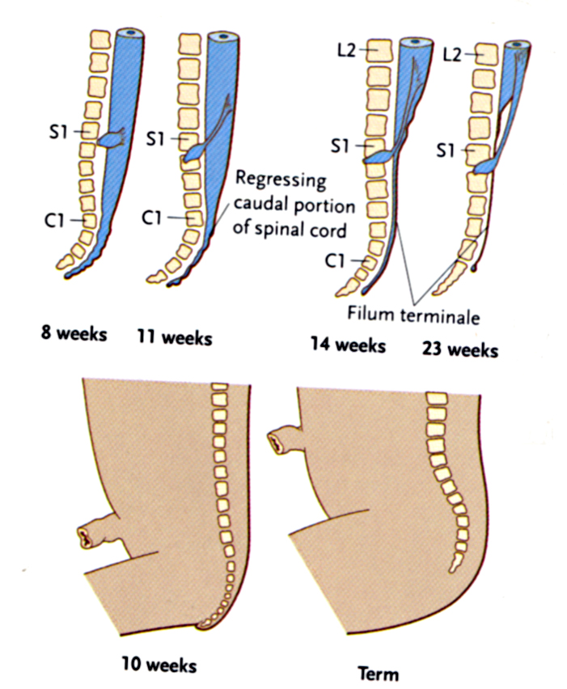

Slide 34
Congenital anomalies of spinal cord Spina bifida and Meningomyelocele
Spina bifida is a defect in the spine resulting from failure of the two halves of the vertebral arch to fuse.

Slide 35
Types:
Spina bifida occulta: The bone only is affected, while the spinal cord and the membranes are intact. There may be a patch of hairy skin or a dimple over the affected area. It has a good prognosis. No treatment is required.
Spina bifida cystica ‘ overta’ which includes:
Meningocele. It is protrusion and herniation of the meninges, through a bony deficit to the skin.
Meningomyelocele: It is a protrusion of heterotopic neural tissue with the meninges. The defect is in the midline and affects the skin of the back, muscles, bones of the vertebral arches and neural tube. The membrane is easily ruptured
Myelocele: No skin or meninges to cover the lesion. It is usually incompatible with life.

Slide 36
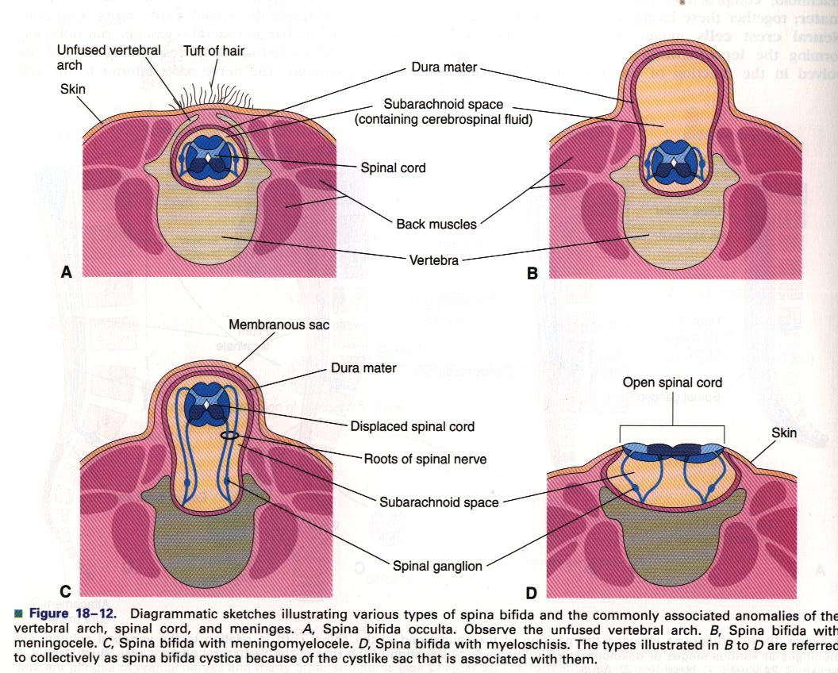
occulta
meningocele
meningomyelocele
myeloschesis

Slide 37
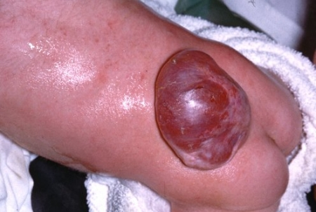

Slide 38
Thank You

