Slide 1
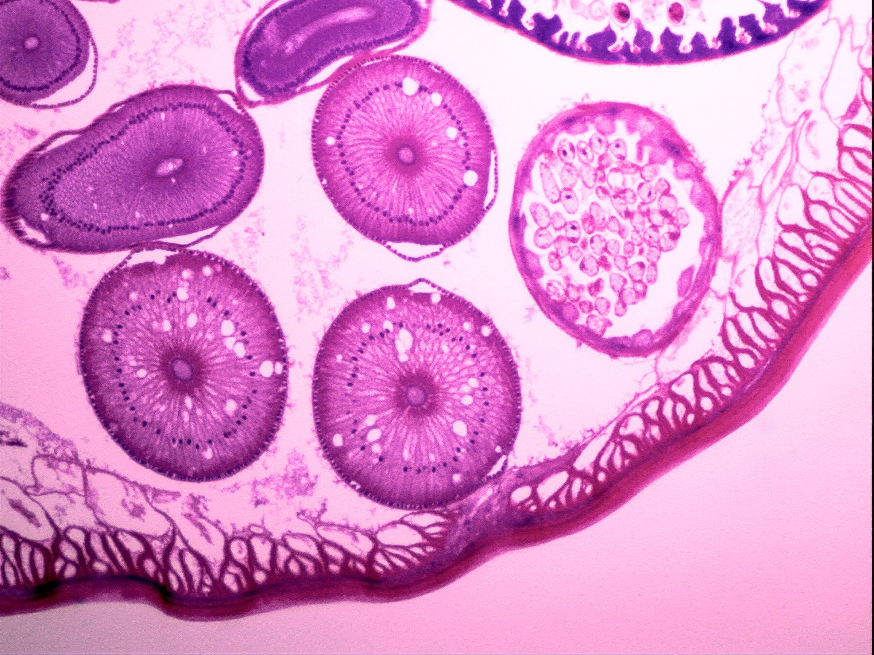
NEPHROTIC SYNDROME
MOHANNAD AL-JA’AWIN
MARWAN HIRZALLAH

Slide 2
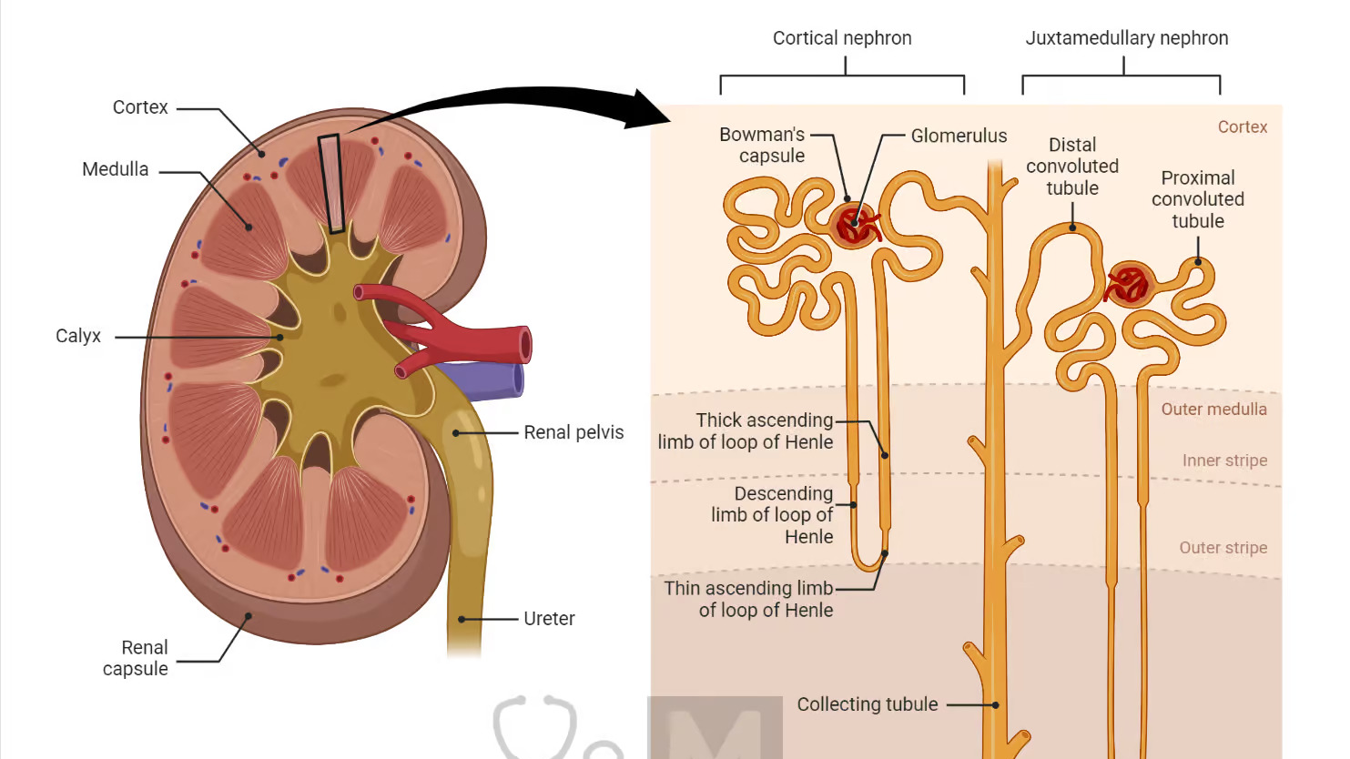
Nephron
Notes:
Each of your kidneys is made up of about a million filtering units called nephrons. Each nephron includes a filter, called the glomerulus, and a tubule. The nephrons work through a two-step process: the glomerulus filters your blood, and the tubule returns needed substances to your blood and removes wastes.
Renal artery -> 5 segmental branches -> Lobar artery -> Inter lobar artery -> Arcuate -> Interlobular -> Afferent Glomerular arterioles.

Slide 3
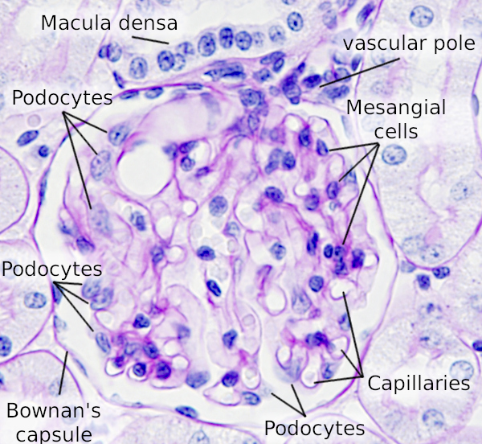
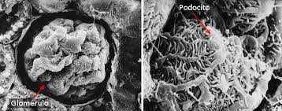
Histology
Podocytes play an important role in glomerular function. Together with endothelial cells of the glomerular capillary loop and the glomerular basement membrane they form a filtration barrier. Podocytes cooperate with mesangial cells to support the structure and function of the glomerulus.
Notes:
podocytes play an active role in preventing plasma proteins from entering the urinary ultrafiltrate by providing a barrier comprising filtration slits between foot processes, which in aggregate represent a dynamic network of cellular extensions.

Slide 4
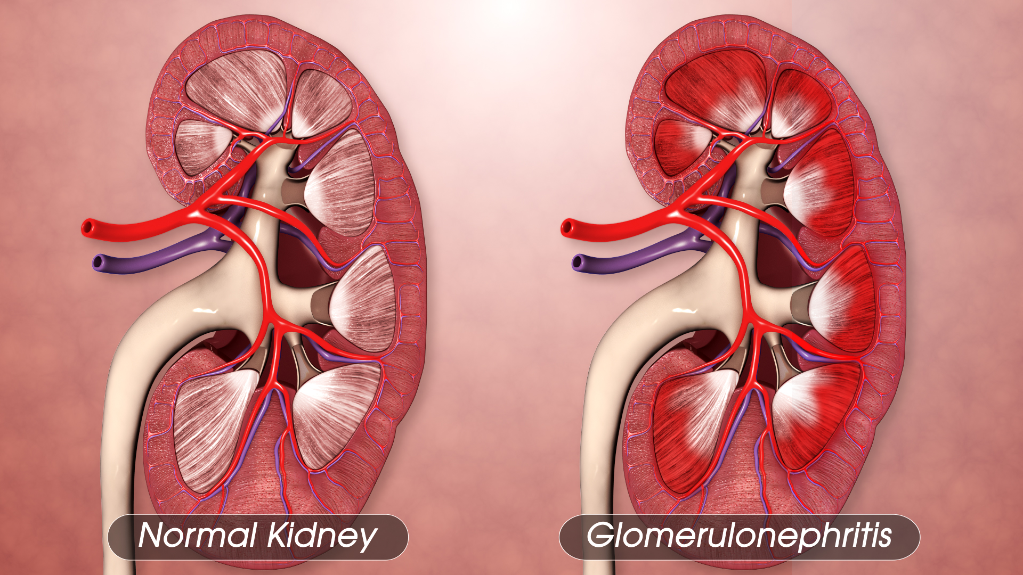
Glomerulonephritis
While glomerulonephritis literally means “Inflammation of Glomeruli”, the term is often used more broadly to describe all types of glomerular diseases.
Most types of glomerulonephritis are immunologically mediated and several respond to immunosuppressive drugs.

Slide 5
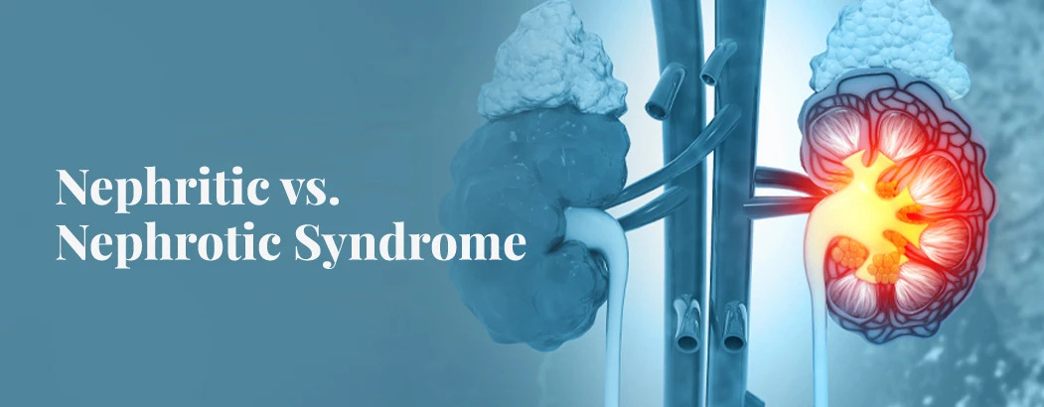
Nephrotic Vs. Nephritic Syndromes
Remember, They are Signs not diseases.

Slide 7
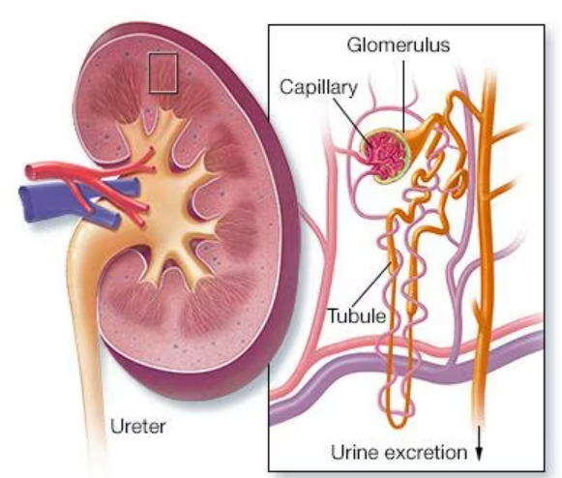
DEFINITION “Nephrotic Syndrome”
Clinical syndrome defined by massive proteinuria “Heavy proteinuria” responsible for hypoalbuminemia, with resulting hyperlipidemia, edema, and various complications.

Slide 8
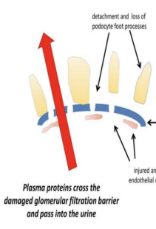
Definition CONT.
Massive Proteinuria, daily protein loss in the urine of = > 3.5 g.
Albumin < 3 g/dL.
Insidious onset.
It’s a sign not a disease, So the diseases that cause nephrotic syndrome all affect the glomerulus either directly, by damaging the podocytes or indirectly, by causing scarring or deposition of exogenous material such as amyloid into the glomerulus.

Slide 9
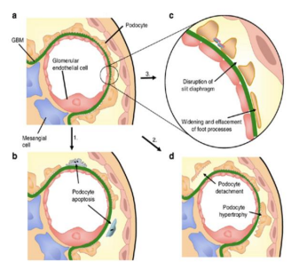
Mechanism
Injury to Podocytes
Changed Architecture:
1- Scarring
2- Deposition of matrix or other elements.

Slide 10
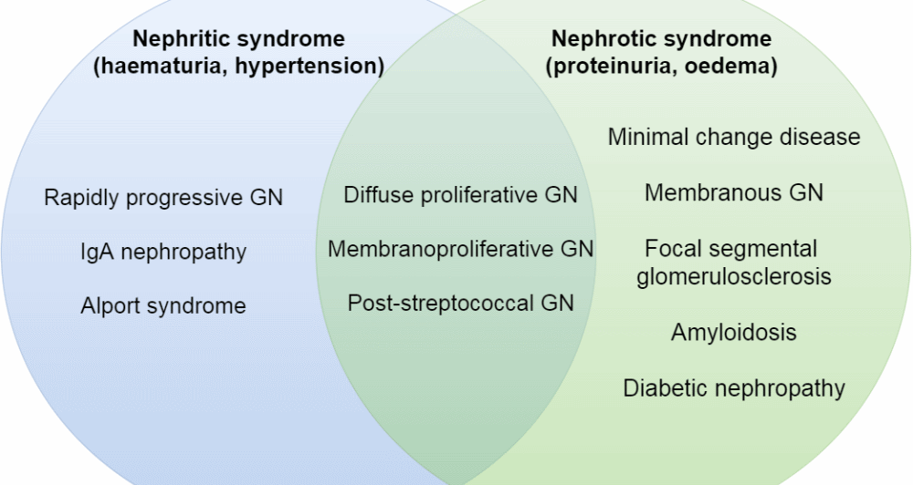

Slide 11
Nephrotic Syndrome can be:
Primary: Being specific to the kidneys. As:
Minimal Change Nephropathy (70-90% in Children, 10-15% in Adults).
Focal Glomerulosclerosis (15% in Adults).
Membranous Nephropathy (30% in Adults).
Mesangial Proliferative Glomerulonephritis.
Rapidly Progressive Glomerulonephritis.

Slide 12
Nephrotic Syndrome can be:
Secondary: Being renal manifestation of a systemic disease. As:
Diabetes Mellitus
Lupus Erythematosus
Amyloidosis & Paraproteinemia
Viral Infections (E.g., Hepatitis B, Hepatitis C, HIV).
Preeclampsia

Slide 13
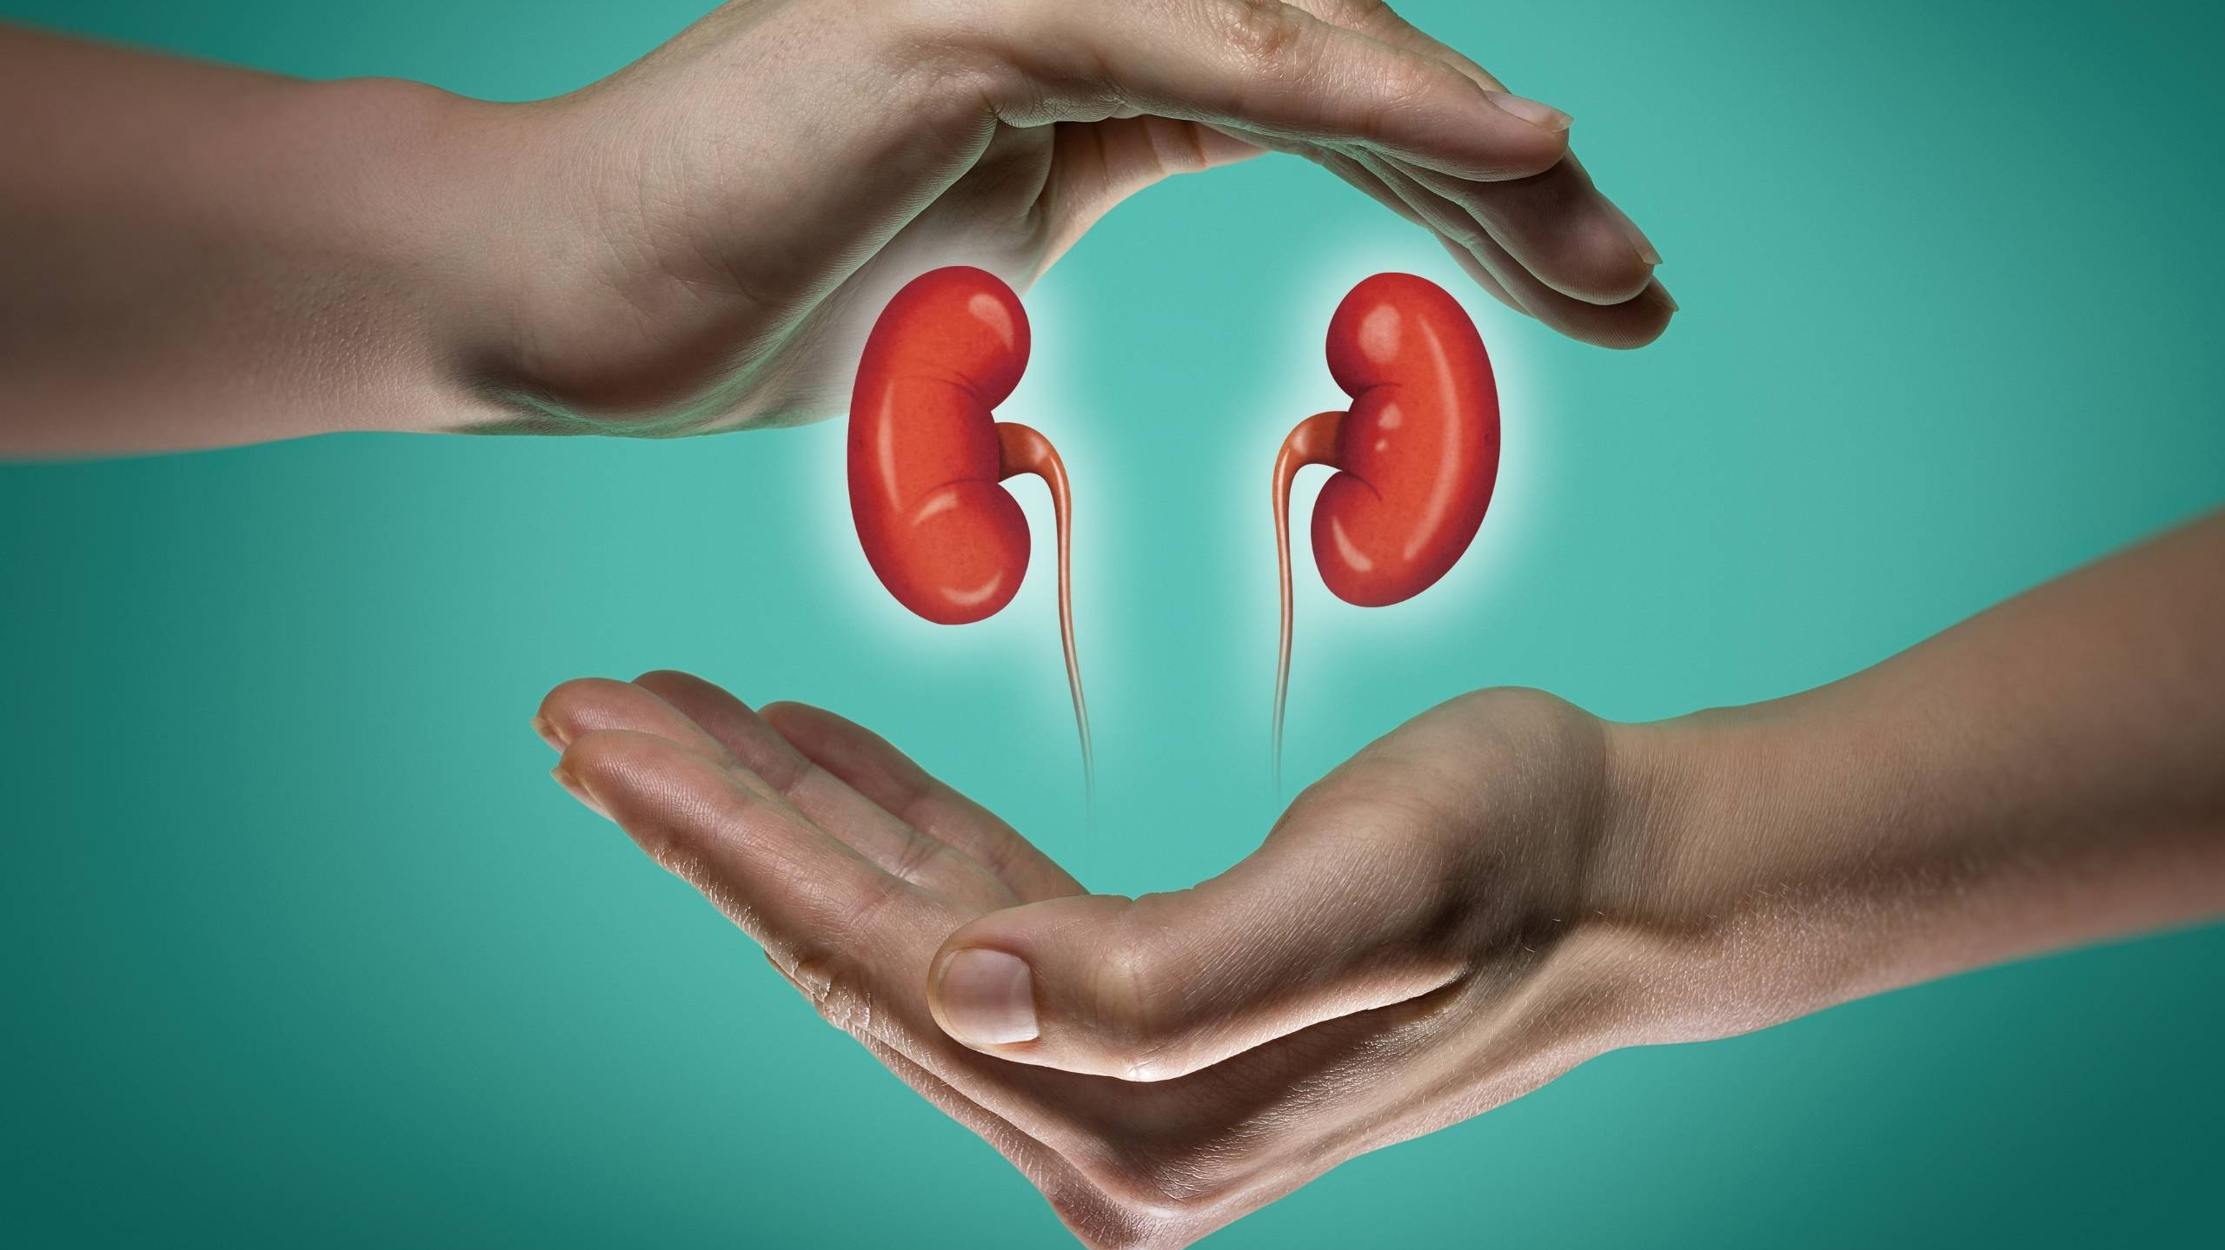
Diseases lead to nephrotic Syndrome
They are classified according to their presentation also:
A- Fulminant presentation:
1- Minimal change disease: Affects children, young adults, occasionally seen in older patients
2- Primary focal segmental glomerulonephritis: Affects young adults
B- Subacute presentation:
1- Membranous nephropathy: Affects Middle-aged to older patients
2- Amyloid: Affects Older patients.

Slide 14
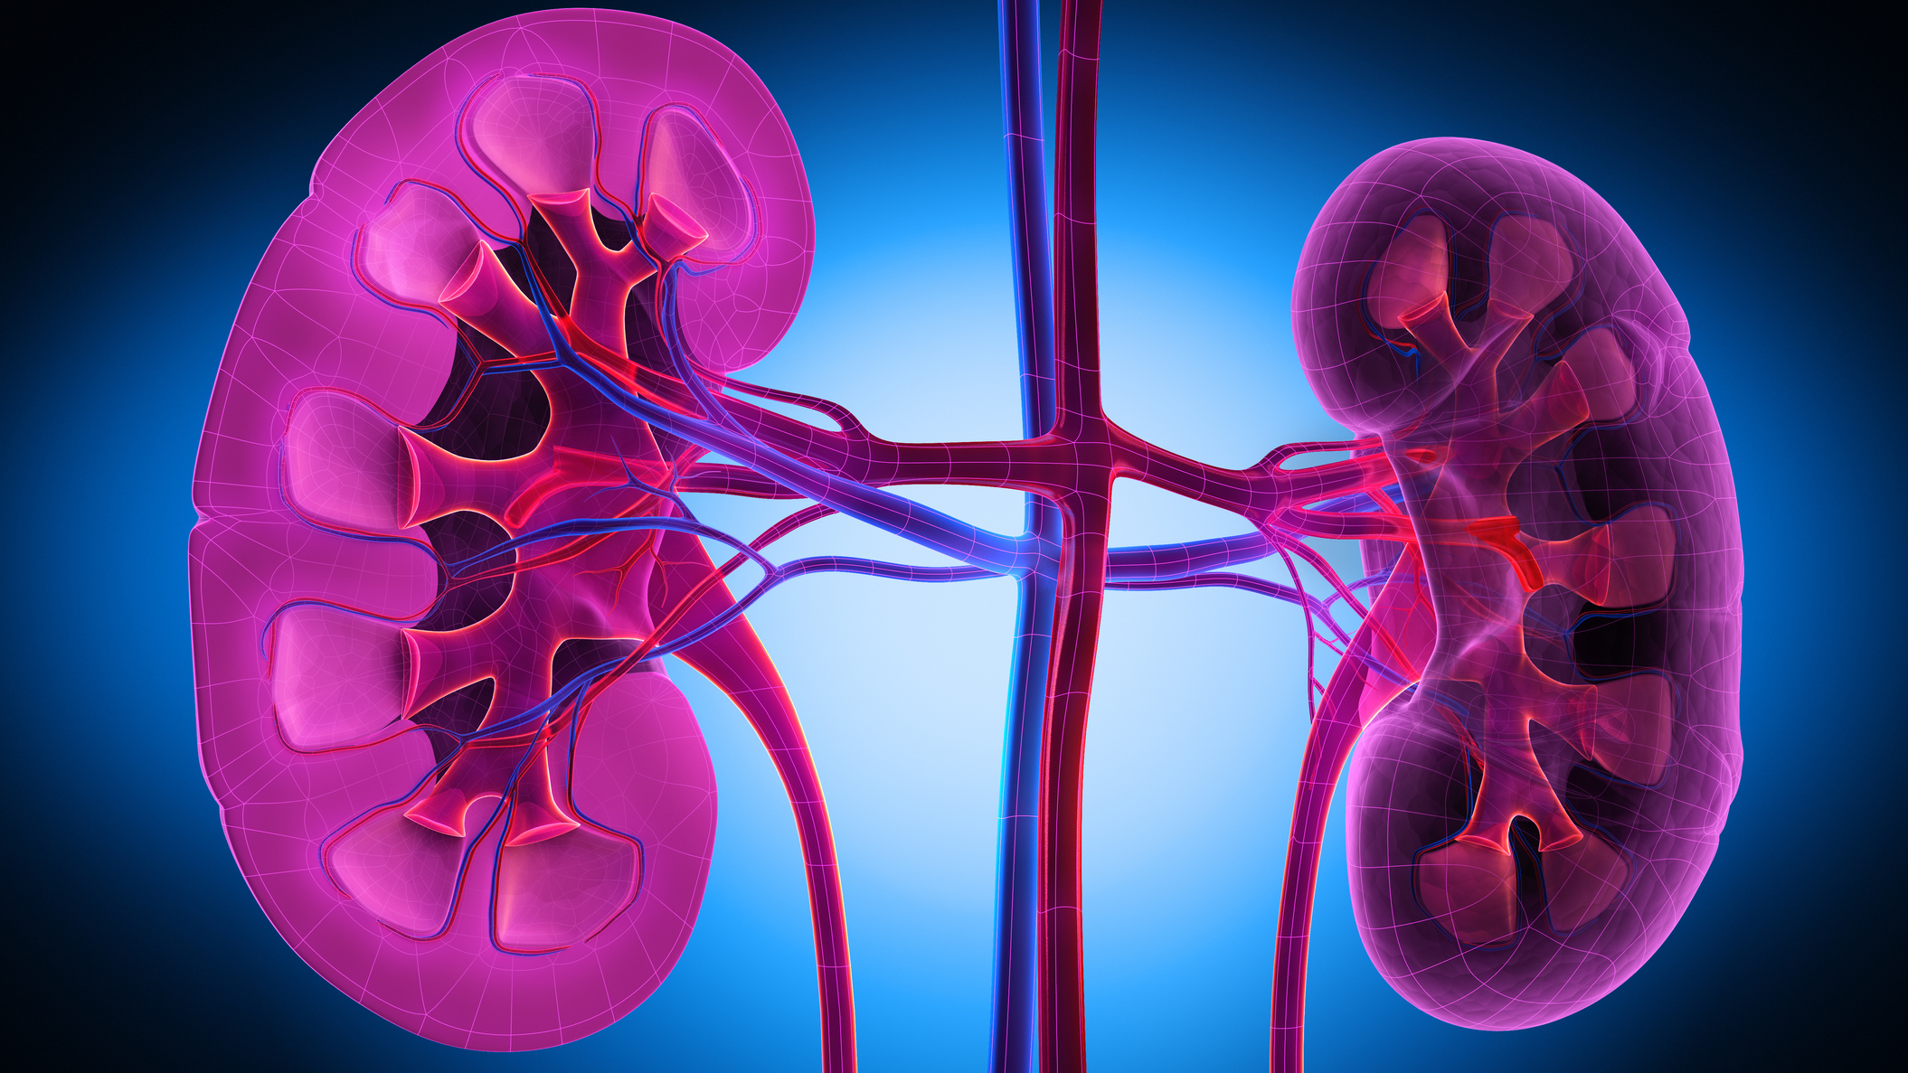
Diseases lead to nephrotic Syndrome CONT.
C- Gradual progression:
1- Diabetic nephropathy:
Diabetic nephropathy is a serious complication of type 1 diabetes and type 2 diabetes. It's also called diabetic kidney disease. In the United States, about 1 in 3 people living with diabetes have diabetic nephropathy.
(Source: Mayo clinic)
Any age, but rarely < 10 years from diagnosis of type 1 diabetes

Slide 15
Children Vs. Adults
Nephrotic Syndrome is 15 times more common in children.
Most cases in children are due to Minimal-Change Disease.
In Adults, the most common form is membranous glomerulonephritis, Followed by FSGS.
Diabetic Nephropathy is emerging as a major cause of Nephrotic syndrome.
Notes:
Focal segmental glomerular sclerosis (FSGS) is a frequently encountered cause of nephrotic syndrome, accounting for 40% of cases in adults and 20% in children. [1] In FSGS, some (not all) glomeruli are sclerosed (focal), and each involved glomerulus is only partially affected (segmental).

Slide 16
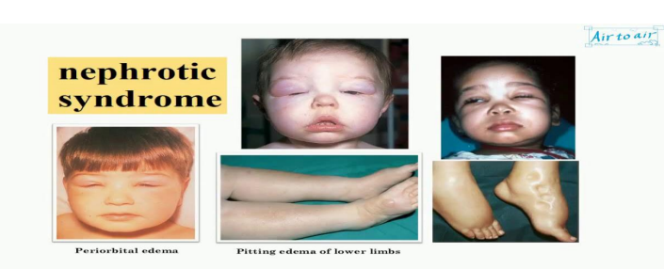
Manifestations
Proteinuria >3.5 gm / 24 hr
Hypoalbuminemia
Edema
Hyperlipidemia
Lipiduria

Slide 17
Cause of Oedema
Nephrotic syndrome would cause heavy proteinuria that would cause low plasma albumin which ultimately leads to LOW capillary oncotic pressure which drags the fluids outside the vessels to be manifested as oedema.

Slide 18
Clinical Assessment of Oedema
Dependent areas, such as the ankles and lower legs, are typically affected first but oedema can be restricted to the sacrum in bed-bound patients. With increasing severity, oedema spreads to affect the upper parts of the legs, the genitalia and abdomen.
Ascites is common and often an earlier feature in children or young adults, and in liver disease.
Pleural effusions are common but frank pulmonary oedema is rare. Facial oedema on waking is common.
Features of intravascular volume depletion (tachycardia, postural hypotension) may occur when oedema is due to decreased at risk of developing CKD and current recommendations are that hypertensive patients should have renal function checked annually.
Control of hypertension is very important in patients with renal impairment because of its close relationship with further decline of renal function and because of the exaggerated cardiovascular risk associated with CKD.

Slide 19
INVESTIGATIONS
Investigation of nephrotic syndrome usually involves renal biopsy, although non-invasive tests may also be helpful in suggesting the underlying cause.
In children, minimal change disease is by far the most common cause of nephrotic syndrome and therefore renal biopsy is not usually required unless the patient fails to respond to high-dose glucocorticoid therapy.
Similarly, most patients with diabetes presenting with nephrotic syndrome will have diabetic nephropathy, and so renal biopsy is usually not performed unless the course of the disease is atypical (rapidly increasing proteinuria or rapid decline in renal function). Instead order Glucose and glycosylated hemoglobin.

Slide 20
INVESTIGATIONS CONT.
If suspected with membranous nephropathy ordering tests for Hepatitis B, C + HIV serology, ANA, dsDNA proved to be useful.
Regarding the investigations of Amyloid nephropathy, tests for Immunoglobulins, PPE, Bence Jones protein, serum free light chains.

Slide 21
Consequences of the nephrotic syndrome and their management

Slide 22
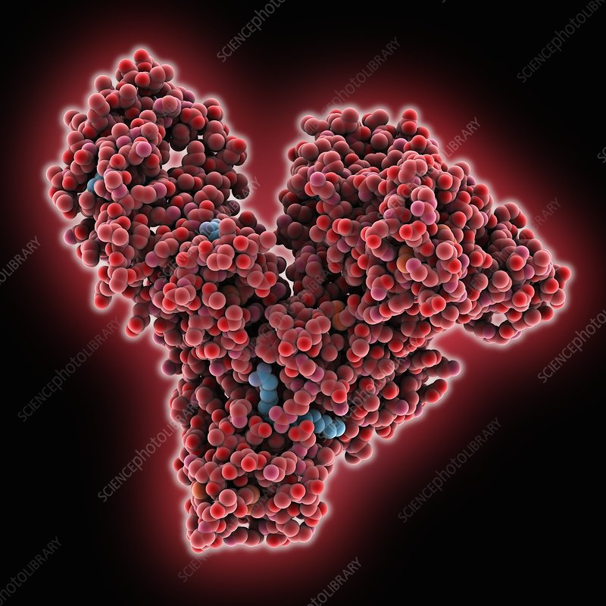
Hypoalbuminemia
Mechanism: Urinary protein losses exceed synthetic capacity of liver
Consequence: Reduced oncotic pressure Oedema
Management: Treatment of underlying cause

Slide 23
Avid sodium retention
Mechanism:
1- Secondary hyperaldosteronism
2- Additional poorly characterised intrarenal mechanisms
Consequence: Oedema
Management: Diuretics and a low-sodium diet

Slide 24
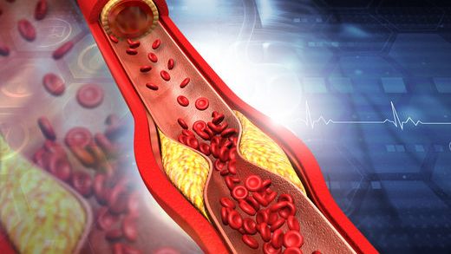
Hypercholesterolemia
Mechanism: Non-specific increase in lipoprotein synthesis by liver in response to low oncotic pressure
Consequence: High rate of atherosclerosis
Management: Statins, ezetimibe

Slide 25
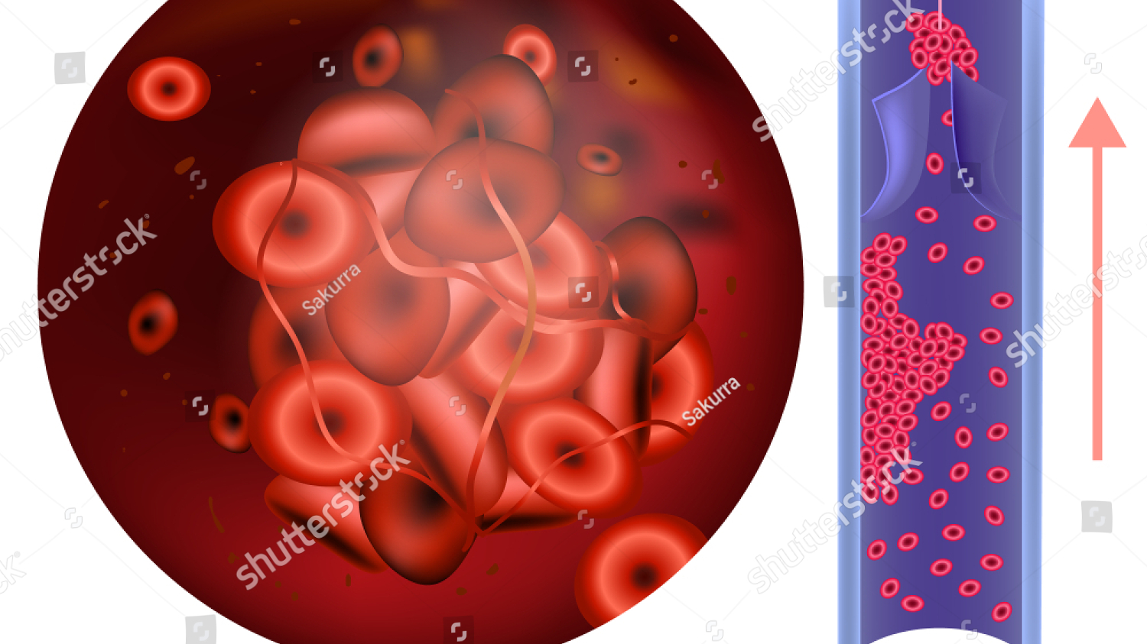
Hypercoagulability
Mechanism: Relative loss of inhibitors of coagulation (antithrombin III, protein C and S) and increase in liver synthesis of procoagulant factors
Consequence: Venous thromboembolism
Management: Consideration of prophylaxis in chronic or severe nephrotic syndrome

Slide 26
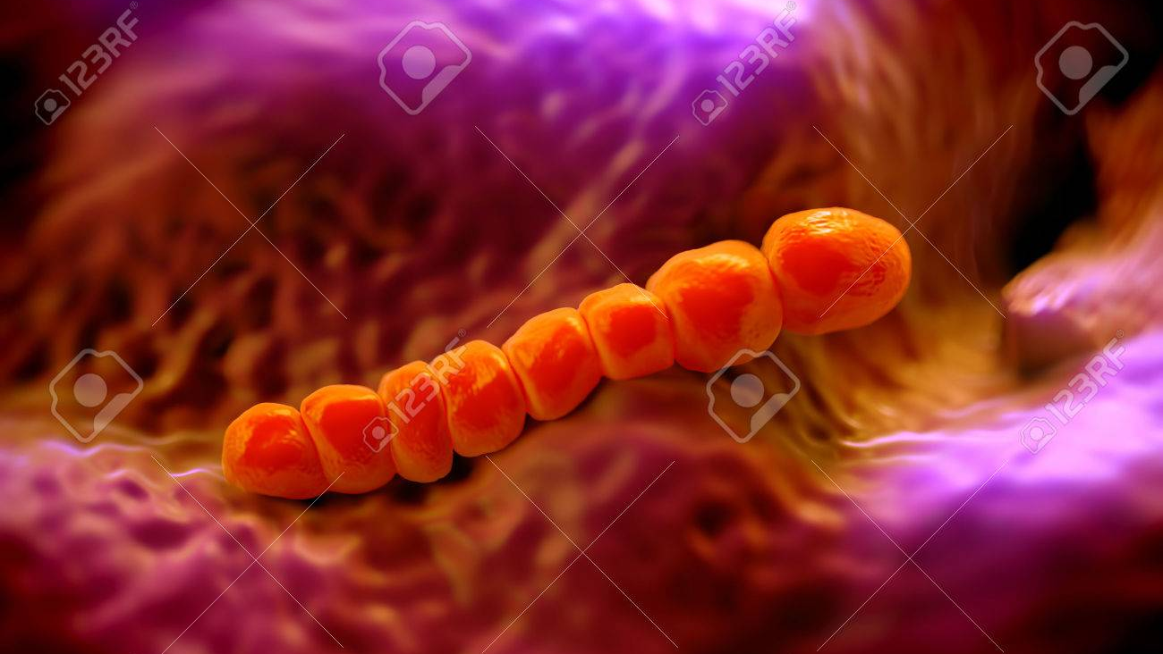
Infection
Mechanism: Hypogammaglobulinemia due to urinary loss of immunoglobulins
Consequence: Pneumococcal and meningococcal infection
Management: Consideration of vaccination

Slide 27
Resources
Davidsons principles and practice of medicine. 23rd edition.
Harrison’s manual of medicine. 18th edition.
Mayo clinic website.

Slide 28
Thank you

