Slide 1
Antepartum hemorrhage
Dr. Ahlam Al-Kharabsheh

Slide 2
Ante-partum hemorrhage (APH ):
Any bleeding from the birth canal occurring after the 24th week
of gestation (some authors define this as the 20th week) and until the second stage
of labor is complete.
● APH complicates 3–5% of pregnancies.
● Causes of APH :
Placental abruption ( 30% )
Placenta Previa ( 20% )
Uterine rupture ( rare )
Vasa Previa ( rare )
Cervical and vaginal pathologies : Ectropion, polyps, tumors,…..
→ In the remaining cases, the exact etiology of the ante-partum bleeding cannot be determined.
→ Show is the term used to describe the small amount of blood with mucus
discharge that may precede the onset of labor by as much as 72
hours.

Slide 3
Placental abruption
● Bleeding at the decidual-placental interface that causes partial or total
placental detachment , after 24 weeks of gestation and prior to delivery
of the fetus.
Placental abruption is the premature separation ( partial or complete ) of a
normally situated placenta from the uterine wall, resulting in haemorrhage
before the delivery of the fetus.
● a significant cause of maternal and perinatal mortality/morbidity.
● Incidence : 0.4-1 % of pregnancies.
● 40-60 % of abruptions occurred before 37 weeks of gestation and 14%
occurred before 32 weeks.

Slide 4
→ The perinatal death rate is approximately 12 % (versus 0.6 % in non-
abruption births). The majority of perinatal deaths (up to 77 %) occur in
utero; deaths in the postnatal period are primarily related to preterm delivery.
Notes:
.

Slide 5
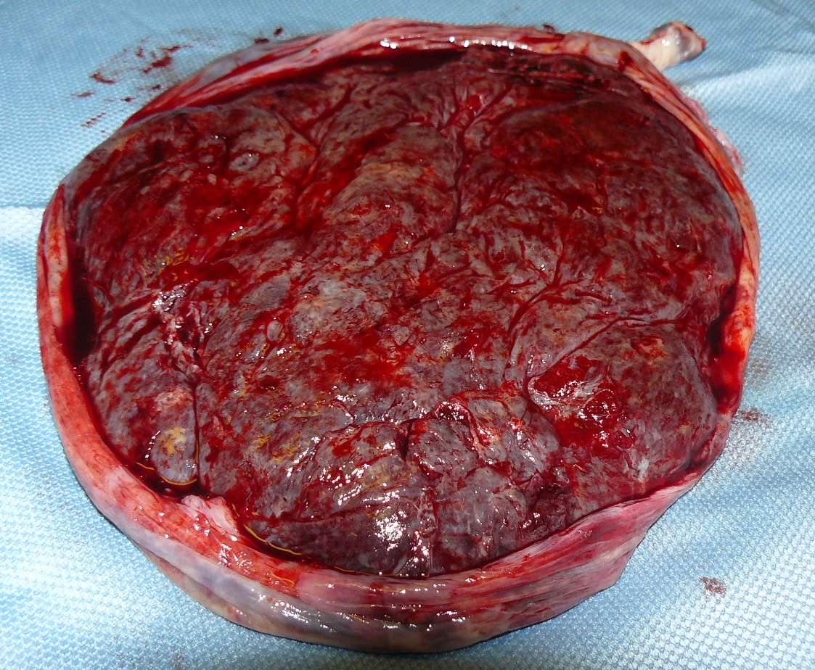
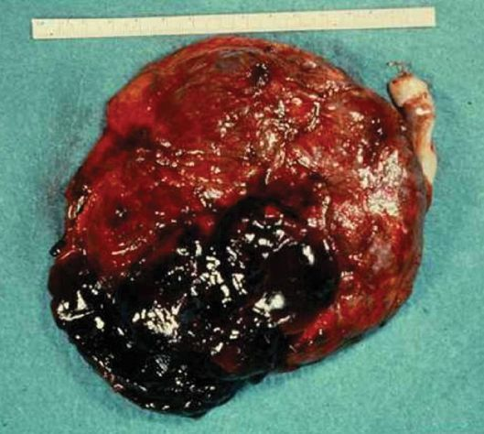
Normal Placenta
Abruptio Placenta

Slide 6
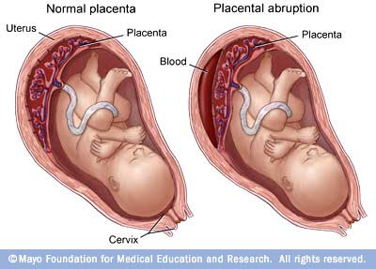

Slide 7
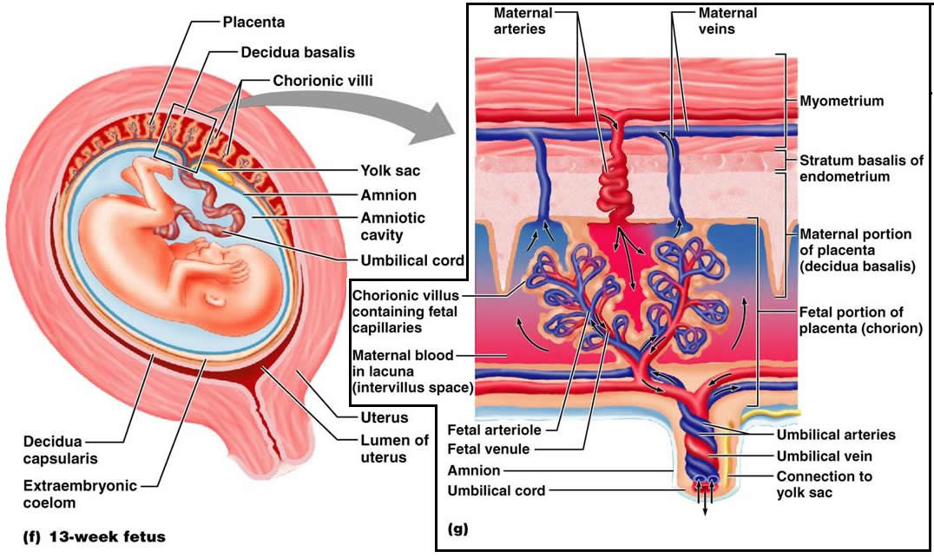

Slide 8
Pathogenesis and Pathophysiology :
● The immediate cause is rupture of maternal vessels in the decidua basalis,
where it interfaces with the anchoring villi of the placenta. The accumulating
blood splits the decidua, separating a thin layer of decidua with its placental attachment from
the uterus. The bleed may be small and self-limited, or may continue to dissect through the
placental-decidual interface, leading to complete or near complete placental separation. The
detached portion of the placenta is unable to exchange gases and nutrients; when the
remaining feto-placental unit is unable to compensate for this loss of function, the fetus
becomes compromised.
● A small proportion of all abruptions are related to sudden mechanical events, such
as blunt abdominal trauma or rapid uterine decompression, which cause
shearing of the inelastic placenta due to sudden stretching or contraction of the
underlying uterine wall.

Slide 9
● Suboptimal trophoblastic implantation may also explain the increased risk
of abruption among women with a prior cesarean, uterine anomalies
(bicornuate uterus), uterine synechiae, and leiomyoma.
● The mechanism underlying the relationship between smoking cigarettes or
cocaine abuse and abruption is unclear. One hypothesis is that the
vasoconstrictive effects of smoking ( or cocaine ) cause placental
hypoperfusion (vasoconstriction ), which could result in decidual ischemia,
necrosis, and hemorrhage leading to placental separation.

Slide 10
Thrombin plays a key role in the clinical consequences of placental abruption,
and may be important in its pathogenesis, as well.
● It is formed via two pathways: Either decidual bleeding leads to release of
tissue factor (thromboplastin) from decidual cells, which generates thrombin.
OR
decidual hypoxia induces production of vascular endothelial growth
factor (VEGF), which acts directly on decidual endothelial cells to induce
aberrant expression of tissue factor, which then generates thrombin.
● The production of thrombin can lead to the following clinical sequelae:
1) Uterine hypertonus and contractions, as thrombin is a potent, direct
uterotonic agent.
2) Triggering of coagulation e.g DIC.

Slide 11
The major risk factors of placental abruption :
Previous abruption : the most important risk factor. The risk of recurrence has been reported to be 5-15 %,. After two consecutive abruptions, the risk of a third rises to
20-25 %.
2) Hypertension : 5 fold increased risk of severe abruption
3) Premature rupture of membranes
4) Chorioamnionitis
5) Abdominal trauma/accidents
6) Cocaine abuse
7) Polyhydramnios
8) Smoking during pregnancy : it is associated with a 2.5-fold increased risk of abruption
9) Maternal age
Parity
Multi-fetal gestation.
Thrombophilias.

Slide 12
Clinical features :

Slide 13
Acute placental abruption : Abrupt onset of :
Vaginal bleeding.
Abdominal pain ( and/or back pain ).
Uterine contractions : usually high frequency and low amplitude, but a contraction pattern typical of labor is also possible and labor may proceed rapidly.
The uterus is often firm, and may be rigid and tender.
- Vaginal bleeding ranges from mild and clinically insignificant to severe and life-threatening. Blood loss may be underestimated because bleeding may be retained behind the placenta and thus difficult to quantify (Concealed). The amount of vaginal bleeding correlates poorly with the degree of placental separation and does not serve as a useful marker of impending fetal or maternal risk. Maternal hypotension and fetal heart rate (FHR) abnormalities, however, suggest clinically significant separation that could result in fetal death and severe maternal morbidity.
- When placental separation exceeds 50 %, acute DIC and fetal death
are common.

Slide 14
● In 10 -20 % of placental abruptions, patients present with only preterm labor,
and no or scant vaginal bleeding. In these cases, termed ‘concealed
abruption,’ all or most of the blood is trapped between the fetal membranes
and decidua, rather than escaping through the cervix and vagina. Therefore,
in pregnant women with abdominal pain and uterine contractions, even a small amount of vaginal
bleeding should prompt close maternal and fetal evaluation for placental abruption. In other
cases, a small concealed abruption may be asymptomatic and only recognized as an incidental
finding on an ultrasound.
● Occasionally, the signs and symptoms of abruption develop after rapid uterine
decompression, such as after uncontrolled rupture of membranes in the
setting of polyhydramnios or after delivery of a first twin. Signs and
symptoms of abruption also may occur after maternal abdominal trauma or a
motor vehicle crash. In these cases, placental abruption generally presents
within 24 hours of the precipitating event and tends to be severe.

Slide 15
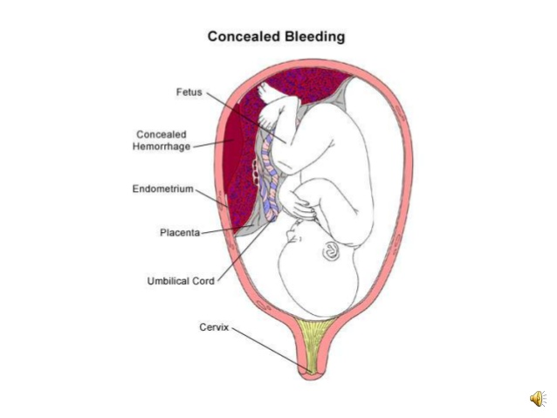

Slide 16
Laboratory findings:
● The degree of maternal hemorrhage correlates with the degree of
hematological abnormality; fibrinogen levels have the best correlation
with severity of bleeding.
Initial fibrinogen values of ≤200 mg/dL are reported to have 100 percent
positive predictive value for severe postpartum hemorrhage, while levels of
≥400 mg/dL have a negative predictive value of 79 percent.
- Mild separation/hemorrhage may not be associated with any abnormalities
of commonly used tests of hemostasis.
Severe abruption can lead to DIC, which occurs in 10-20 % of severe
abruptions with death of the fetus.

Slide 17
Imaging :
● Identification of a retro-placental hematoma is the classic ultrasound finding of
placental abruption. Retro-placental hematomas have a variable appearance; they
can appear solid, complex, and hypo-, hyper-, or iso-echoic compared to the
placenta.
● The sensitivity of ultrasound findings for diagnosis of abruption is only 25-50 %, but
the positive predictive value is high (88 %) when ultrasound findings suggestive of
abruption are present.
● The absence of retro-placental hematoma does not exclude the possibility of severe
abruption because blood may not collect behind the placenta.
● MRI can detect abruptions missed by ultrasound examination, but increased
diagnostic certainty is unlikely to change management or be cost-effective.

Slide 19
Consequences :
For the mother, the potential consequences of abruption are primarily related to the severity of the placental separation, while the risks to the fetus are related to both the severity of the separation and the gestational age at which delivery occurs.
With mild placental separation, there may be no significant adverse effects. As the degree of placental separation increases, the maternal and perinatal risks also increase.
Maternal:
● Excessive blood loss and DIC generally necessitate blood transfusion and
can lead to hypovolemic shock, renal failure, adult respiratory distress
syndrome, multi-organ failure, peri-partum hysterectomy and, rarely, death .
● Emergency cesarean delivery for fetal or maternal indications.
Fetal and neonatal:
● Perinatal morbidity and mortality related to hypoxemia, asphyxia, low birth
weight, and/or preterm delivery.
● Fetal growth restriction FGR (with chronic abruption).

Slide 20
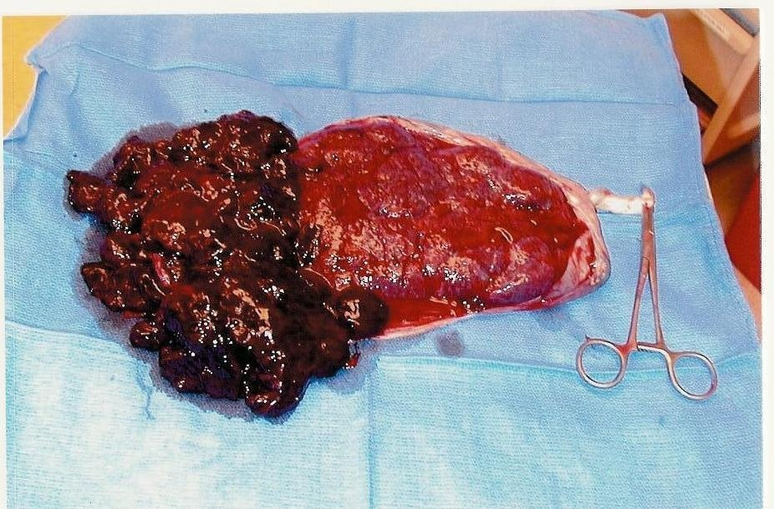
Placental pathology :
● Gross examination of placenta after delivery may reveal the abruption.
● Histopathological examination of the placenta shortly after an acute abruption
may not reveal any abnormality. In less acute cases, an organizing
retroplacental hematoma indenting the parenchyma may be noted.
In addition to features of recent infarct (needs 4-6 hours to develop).

Slide 21
Chronic abruption:
● Women with chronic abruption experience relatively light, chronic, intermittent
bleeding and clinical manifestations of ischemic placental disease that
develop over time, such as oligohydramnios (termed chronic abruption–
oligohydramnios sequence), FGR, and preeclampsia.
They are also at risk of preterm premature rupture of membranes.
● Coagulation studies are usually normal.
● Ultrasound examination may identify a placental hematoma
(retromembranous, marginal, or central), and serial examination may
reveal FGR and/or oligohydramnios.
● Histological examination of the placenta may show chronic lesions, such as chronic
deciduitis (lymphocytes with or without plasma cells), maternal floor decidual necrosis, villitis,
decidual vasculopathy (specifically, in the vessels of the extraplacental membrane roll), placental
infarction, intervillous thrombosis, villous mal-development, and hemosiderin deposition.

Slide 22
Diagnosis :
The diagnosis of abruptio placentae is primarily clinical, but findings from imaging,
laboratory, and postpartum pathologic studies can be used to support the clinical
diagnosis.

Slide 23
Management: Initial interventions for women with potentially severe acute abruption: ( admission to labor room)

Slide 24
A) Stabilization of the mother:
I.V fluid : Secure intravenous access with at least one, and preferably two, wide-bore intravenous lines.
Closely monitor the mother's hemodynamic status (heart rate, blood pressure, urine output). Urine output should be maintained at above 30 cc/hour and monitored with a Foley catheter.
Keep maternal oxygen saturation >95 percent and keep the patient warm.
Draw blood for a complete blood count, blood type and Rh ( preparation of 4 units PRBCs), and coagulation studies. Repeat coagulation tests in patients with clinical signs of severe abruption as coagulopathy may develop or worsen over time.
Call for help.
Notify the anesthesia team. Anesthesia-related issues in these patients include management of hemodynamic instability, technical issues related to bleeding diathesis, and the potential need for emergency cesarean delivery.
Notify the blood bank so blood replacement products (red blood cells, FFP, cryoprecipitate, platelets) will be readily available, if needed.
B) Immediately initiate continuous fetal monitoring.

Slide 25
→ In women with DIC, transfuse blood and blood products to achieve the
following minimum levels:
● Platelet count ≥50,000/microL
● Fibrinogen ≥100 mg/dL
● Prothrombin (PT) and partial thromboplastin time (PTT) less than 1.5 times
control
● Hematocrit 25-30 %
Normal values of DIC profile:
1- Fibrinogen 150-600 mg/dl
2- PT 11-16 se
3- PTT 22-37 sec
4- Fibrin degredation product (FDP) < 10µg/dl

Slide 26
After initial interventions, the management depends on :
1- Severity of abruption ( mild or severe)
2- Gestational age ( mature or immature)
● Severe abruption: characterized by one or more of the following:
A) Ongoing major blood loss ( external vaginal bleeding or concealed
identified by ultrasound).
B) Clinically unstable maternal status
tachycardia/hypotension/tachypnia/oligourea)
C) Coagulopathy.
D) Dead fetus or compromized ( Non reassuring FHR).

Slide 27
(1) In pregnancies complicated by severe abruption → Expeditious delivery ( vaginal or cesarean) (At any gestational age)
→ Vaginal delivery is reasonable if the mother is stable and the fetal heart
tracing is reassuring. With a clinically significant abruption, the patient is
often contracting vigorously, but if she is not in active labor, then amniotomy
and administration of oxytocin frequently result in rapid delivery.
- The fetus should be continuously monitored.
- An attempt at vaginal birth should only be undertaken if there is access to
immediate cesarean delivery, if necessary.

Slide 28
→ Prompt cesarean delivery is indicated if the mother is unstable or the fetal heart
tracing is nonreassuring and vaginal delivery is not imminent, or when vaginal
delivery is contraindicated ( malpresentation, prior classical cesarean delivery) or
unsuccessful (failure to progress).
● Postpartum: Postpartum haemorrhage (PPH) should be anticipated in women who
have experienced APH, so active management of third stage of labour is strongly
recommended.

Slide 29
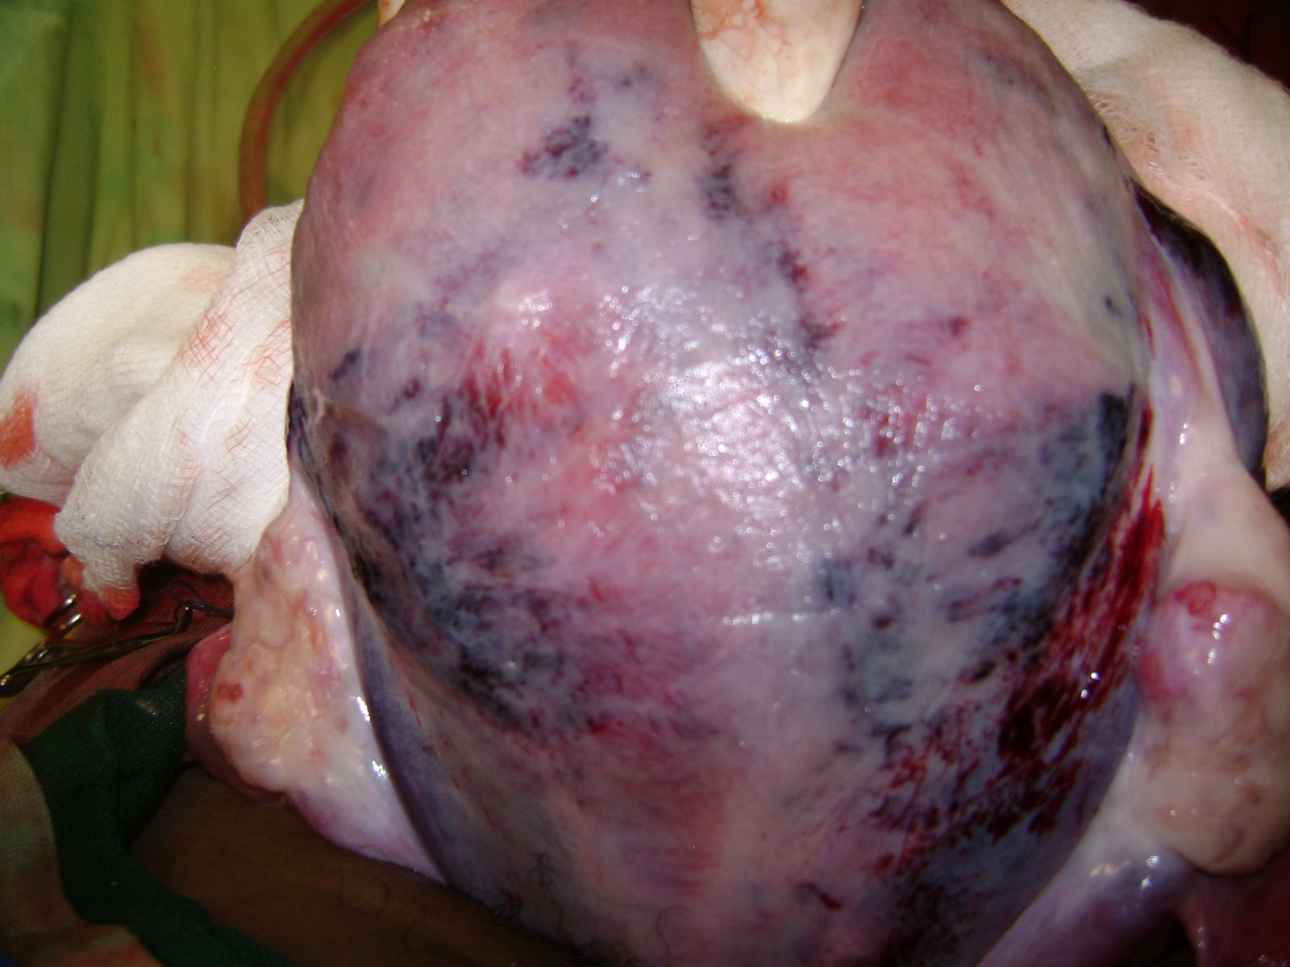
At cesarean delivery, blood extravasated into the myometrium ( called a Couvelaire uterus ) may be observed.

Slide 30
(2) In non severe abruption : depends on gestational age
1- If immature fetus : Expectant management
2- If mature fetus : Delivery
The optimum timing of delivery is not established, A senior obstetrician should be
involved in determining the timing and mode of birth of these women.

Slide 31
Expectant management :
Hospital stay: There are no compelling data to guide the length of a hospital stay in these pregnancies. A reasonable approach is to monitor the patient in the hospital until the bleeding has subsided for at least 48 hours, fetal heart rate tracings and ultrasound examinations are reassuring, and the patient is asymptomatic. At that point, discharge may be considered. Importantly, the patient should be counseled to return immediately should she experience further bleeding, contractions, reduced fetal movement, or abdominal pain.
Single course of antenatal corticosteroid ( 26-35 weeks of gestation).
Serial assessment of fetal well being tests : NST / biophysical profie / doppler studies for fetal blood vessels / sonographic estimation of fetal weight to assess growth.
Anti-D immune globulin for Rh(D)-negative women.
Schedule delivery at 37-38 weeks because of the increased risk of stillbirth.
- Delivery before 36-37 weeks is indicated if additional complications arise ( FGR, preeclampsia, PROM, non-reassuring fetal assessment, recurrent
abruption with maternal instability).

Slide 32
Placenta previa
The presence of placental tissue that extends over or lies proximate to the internal cervical os ( in the lower uterine segment ). Sequelae include the potential for severe bleeding and preterm birth, as well as the need for cesarean delivery.
- Incidence: 3.5-4.6 per 1000 births.

Slide 33
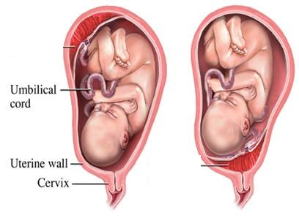
Normal situated Placenta
Placenta Previa

Slide 34
Pathogenesis :
The pathogenesis of placenta previa is unknown. One hypothesis is that the presence of areas of suboptimal endometrium in the upper uterine cavity due to previous surgery or pregnancies promotes implantation of trophoblast in, or unidirectional growth of trophoblast toward, the lower uterine cavity. Another hypothesis is that a particularly large placental surface area, as in multiple gestation or in response to reduced uteroplacental perfusion, increases the likelihood that the placenta will cover or encroach upon the cervical os.
Pathophysiology :
Placental bleeding is thought to occur when gradual changes in the cervix and lower uterine segment apply shearing forces to the inelastic placental attachment site, resulting in partial detachment. Vaginal examination or coitus can also disrupt the intervillous space and cause bleeding. Bleeding is primarily maternal, but fetal bleeding can occur if a fetal vessel is disrupted.

Slide 35
Major risk factors for placenta previa:
1) Previous placenta previa : Recurrence rate is 4-8%.
2) Previous cesarean delivery.
3) Multiple gestation.
4) Multi-parity.
5) Advanced maternal age.
6) Infertility treatment.
7) Previous abortion.
8) Previous intrauterine surgical procedure.
9) Maternal smoking.
10) Maternal cocaine use.

Slide 36
Clinical features: There are two presentations : 1-Antepartum hemorrhage. 2-Ultrasound presentation and course.

Slide 37
Antepartum hemorrhage :
In the second half of pregnancy, the characteristic clinical presentation is unprovoked painless vaginal bleeding, the blood is usually bright red and ranges in volume from scant to heavy, which occurs in 70-80 % of cases.
- An additional 10 -20 % of women present with both uterine contractions and
bleeding. Which is similar to the presentation of abruptio placenta.
In approximately one-third of affected pregnancies, the initial bleeding episode occurs prior to 30 weeks of gestation; this group is more likely to require blood transfusions and is at greater risk of preterm delivery and perinatal mortality than women whose bleeding begins later in gestation . An additional one-third of patients becomes symptomatic between 30 and 36 weeks, while most of the remaining patients have their first bleed after 36 weeks. About 10 % of women reach term without bleeding.
→ Digital vaginal examination is contraindicated in any woman beyond 20 weeks of gestation who presents with vaginal bleeding, until rule out of placenta previa by ultrasound.

Slide 38
Ultrasound presentation and course:
1-6 % of pregnant women display sonographic evidence of a placenta previa between 10 and 20 weeks of gestation when they undergo obstetrical ultrasound examination. The majority of these women are asymptomatic and 90 % of these early cases resolve.
→ Two theories have been put forth to account for resolution of the previa:
1)The lower uterine segment lengthens from 0.5 cm at 20 weeks of gestation to more than 5 cm at term. Development of the lower uterine segment relocates the stationary lower edge of the placenta away from the internal os.
2) Progressive unidirectional growth of trophoblastic tissue toward the fundus within
the relatively stationary uterus results in upward migration of the placenta. This
phenomenon has been termed trophotropism.
- If the previa persists with advancing gestational age, it is less likely to resolve.

Slide 39
Associated conditions : Placenta previa has been associated with an increased risk
of several other pregnancy complications:
1) Placenta accreta: Placenta accreta complicates 1-5 % of pregnancies with
placenta previa and an unscarred uterus.
Malpresentation : The large volume of placenta in the lower portion of the uterine cavity predisposes the fetus to assume a non-cephalic presentation.
Preterm labor and rupture of the membranes : Ante-partum bleeding from any cause is a risk factor for preterm labor and premature rupture of membranes.
Vasa previa and velamentous umbilical cord : they are uncommon, but when present they are often associated with placenta previa.
5) Congenital anomalies : Population-based cohort studies have reported an increase in the overall rate of neonatal congenital anomalies in pregnancies complicated by placenta previa, but no single anomaly or syndrome was associated with the disorder.

Slide 40
Diagnosis of placenta previa :
● Is based on identification of placental tissue covering or proximate to the internal
cervical os on an imaging study, typically ultrasound. (A distance greater than 2 cm
from the os excludes the diagnosis of previa).
Transabdominal U/S examination is performed as the initial examination; if it
shows placenta previa or the findings are uncertain, transvaginal U/S
(TVS) should be performed to better define placental position.
The overall false positive rate of transabdominal U/S for diagnosis of placenta
previa is high (up to 25 %), so the diagnosis should be confirmed by
TVS unless the previa is clearly central.
Superior performance of TVS over transabdominal U/S for diagnosis of
placenta previa. (provides a clearer image of the relationship of the edge
of the placenta to the internal cervical os)

Slide 41
Classifications of placenta previa :
The traditional classification of placenta previa describes the degree to which the placenta encroaches upon the cervix in labour ( opened cervix ) and is divided into :
Grade I ( low lying )(lateral): Placenta is in lower segment, but the lower edge does
not reach internal os
Grade II (marginal ): Lower edge of placenta reaches internal os,
but does not cover it.
- Grade III ( partial )( incomplete centralis): Placenta covers internal os partially.
Grade IV ( complete) (complete centralis) ( total ): Placenta covers internal os
completely
Minor placenta previa : Grade I and Grade II
Major placenta previa : Grade III and Grade IV

Slide 42
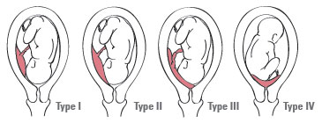

Slide 43
- The previous system for classifying Placenta Previa is imprecise.
Nowadays, the diagnosis and classification of Placenta Previa depends on the actual
distance from the placental edge to the internal cervical OS at TVS, using standard terminology of millimeters away from the OS or millimeters of overlap.
A placental edge exactly reaching the internal os is described as 0 mm.
If the placental edge is more than 20 mm away from the internal os :
No Placenta Previa.

Slide 44
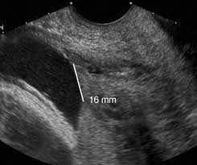
Placental edge is 16 mm away from the os

Slide 45
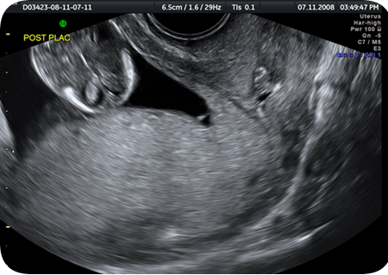
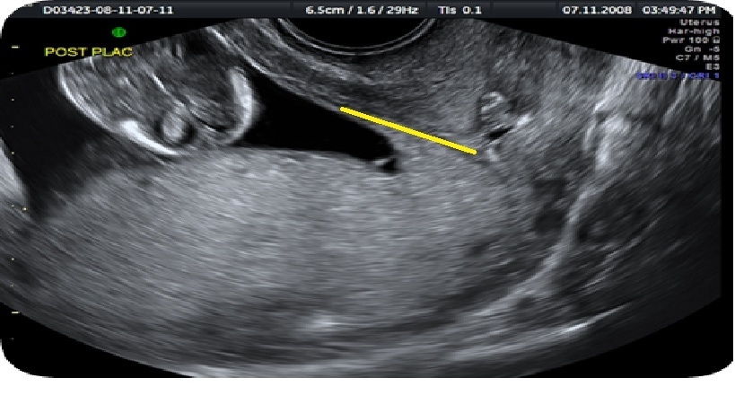

Slide 46
***MRI is well-suited to the assessment of placental-cervical relationships because of
the differing magnetic resonance characteristics of the two tissues. However, it is not
used for diagnosis of placenta previa because of its high cost, limited availability, and
the well-established safety and accuracy of transvaginal sonography . MRI is most
useful for diagnosis of complicated placenta previa, such as previa-accreta
and suspected posterior placenta previa.
- Post diagnostic evaluation :
Exclusion of placenta accreta : Using transvaginal ultrasound ± MRI.
Follow-up ultrasound examination : When the placenta previa was diagnosed in the second trimester, a follow up ultrasound examination for placental location in the third trimester is recommended ( between 32-36 weeks).

Slide 47
Morbidity and mortality :
- Maternal : Placenta previa increases the risk of antepartum (RR 9.8), intrapartum
(RR 2.5), and postpartum hemorrhage (RR 1.9). For this reason, women
with placenta previa are more likely to receive blood transfusions (12
versus 0.8 percent without previa) and undergo postpartum hysterectomy,
uterine/iliac artery ligation, or embolization of pelvic vessels to control
bleeding (2.5 versus 0 percent without previa). The risk is particularly high in
those with previa-accreta.
- Neonatal : The principal causes of neonatal morbidity and mortality are related to
preterm delivery, rather than anemia, hypoxia, or growth restriction.

Slide 48
Management of placenta previa:
The management of pregnancies complicated by placenta previa is best addressed in terms of the clinical setting:
1) Asymptomatic placenta previa
2) Bleeding placenta previa

Slide 49
Asymptomatic placenta previa :
● Follow-up transvaginal ultrasound examination :
- For pregnancies >16 weeks :
- If the placental edge is ≥ 2 cm from the internal os, the placental location is
reported as normal and follow-up ultrasound for placental location is not
indicated.
- If the placental edge is < 2 cm from, or covering, the internal os : follow-up
ultrasonography for placental location is performed at 32 weeks of gestation.
- At 32 weeks follow up ultrasound :
- If the placental edge is ≥2 cm from the internal os, the placental location is
reported as normal and follow-up ultrasound for placental location is not
indicated. And these patients can be delivered vaginally safely.
- If the placental edge is still <2 cm from the internal os or covering the cervical os,
1- Admission to hospital for observation till delivery. (? Outpatient )
2- Avoid sexual intercourse.
3- Single course of antenatal corticosteroid should be administered to
pregnancies at 26 to 35 weeks of gestation.
4- Follow-up TVS is performed at 36 weeks. if placenta previa persists,
schedule cesarean section at 37 weeks of gestation.

Slide 50
Bleeding placenta previa :
initial interventions for women with bleeding placenta previa : (admission to labour room)
A) Stabilization of the mother :
I.V fluid - Secure intravenous access with at least one, and preferably two, wide-bore intravenous lines.
Closely monitor the mother's hemodynamic status (heart rate, blood pressure, urine output). Urine output should be maintained at above 30 mL/hour and monitored with a Foley catheter.
Keep maternal oxygen saturation >95 percent and keep the patient warm.
Draw blood for a complete blood count, blood type and Rh ( preparation of 4 units PRBCs), and coagulation studies.
Call for help.
Notify the anesthesia team. Anesthesia-related issues in these patients include management of hemodynamic instability, technical issues related to bleeding diathesis, and the potential need for emergency cesarean delivery.
Notify the blood bank so blood replacement products (red blood cells, fresh frozen plasma, cryoprecipitate, platelets) will be readily available, if needed.
B) Immediately initiate continuous fetal monitoring.

Slide 51
● Severe bleeding and /or non reassuring FHR → Emergency cesarean
section.
- Anesthesia : General anesthesia is typically administered for emergency cesarean
delivery, especially in hemodynamically unstable women or if the fetal
status is nonreassuring. However, regional anesthesia is an acceptable
choice in hemodynamically stable women with reassuring fetal heart
rate tracings.
● Mild bleeding + Reassuring FHR + G.A < 37 weeks → Conservative
management.

Slide 52
Conservative management :
1- Symptomatic women often remain hospitalized from their initial bleeding
episode until delivery.
2- Correction of anemia.
3- 4 unites of PRBCs should be available.
4- Anti-D immune globulin for Rh(D)-negative women.
5- Schedule cesarean section at 37 weeks.
6- Delivery is indicated emergently if any of the following occur:
● Any vaginal bleeding with a non-reassuring fetal heart rate tracing
unresponsive to resuscitative measures.
● Life-threatening refractory maternal hemorrhage.
● Labor.

Slide 53
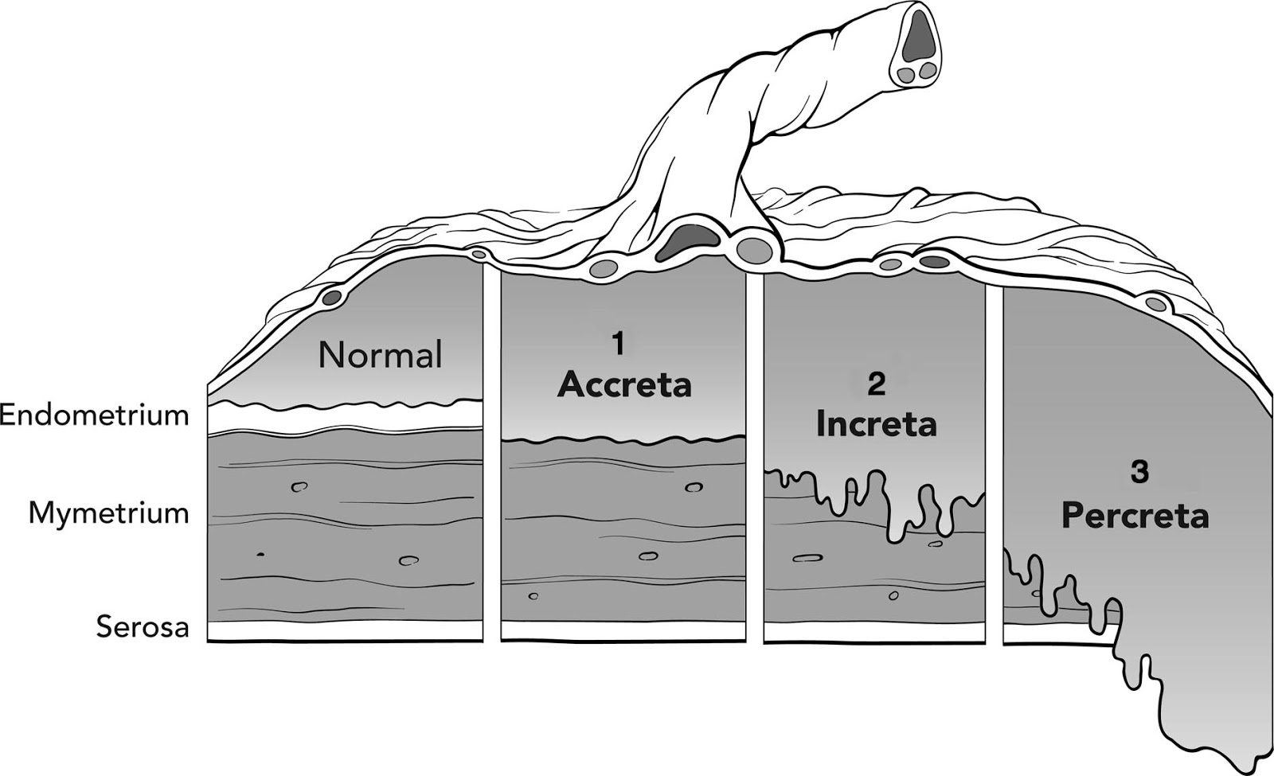
Morbidly adherent placenta
Refers to abnormal deep implantation of the placenta. There are three types according to the depth of invasion :
1)Placenta accreta ( 79% ) : Chorionic villi attach to myometrium rather than
decidua.
2) Placenta increta ( 14% ) : Chorionic villi penetrate into the myometrium.
3) Placenta percreta ( 7% ) : Chorionic villi penetrate through the myometrium to the
uterine serosa or adjacent organs

Slide 54
● The incidence ranging from 1 in 533 to 1 in 2510 deliveries. the incidence is increase
due to the increasing prevalence of cesarean delivery.
● Pathogenesis : The pathogenesis of placenta accreta is not known with certainty.
The most common theory is that defective decidualization (thin, poorly formed, or
absent decidua) related to previous surgery or to anatomical factors (endocervix,
lower uterine segment, endosalpinx, uterine anomaly) allows the placenta to attach
directly to the myometrium. This theory is supported by the observation that 80 %
of these cases are associated with a history of previous cesarean delivery, curettage,
and/or myomectomy.

Slide 55
Risk factors : The most important risk factor for placenta accreta is placenta previa after a prior cesarean delivery. In women with placenta previa, the frequency of placenta accreta increases with an increasing number of cesarean deliveries as follows:
●No previous cesarean birth, 1-5 %.
●One previous cesarean birth, 11-25 %.
●Two previous cesarean births, 35-47 %.
●Three previous cesarean births, 40 %.
●Four or more previous cesarean births, 50-67 %.
In the absence of placenta previa, the frequency of placenta accreta still increases with an increasing number of cesarean deliveries, but the incidence is much lower. In women without placenta previa, the frequency of placenta accreta is :
●One previous cesarean birth, 0.3 %.
●Two previous cesarean births, 0.6 %.
●Three previous cesarean births, 2.4 %.

Slide 56
2- History of uterine surgery. 3- Maternal age >35years. 4-History of pelvic irradiation. 5- Infertility procedures (IVF).

Slide 57
Clinical presentation: there are two presentations :
The first clinical manifestation of placenta accreta is usually profuse, life-threatening hemorrhage that occurs at the time of attempted manual placental separation. Part, or all, of the placenta remains strongly attached to the uterine cavity, and no plane of separation can be developed.
Sequelae : Poorly controlled hemorrhage related to placenta accreta/increta/percreta is the indication for one to two thirds of peripartum hysterectomies. Additional potential sequelae of massive hemorrhage include
DIC, adult respiratory distress syndrome, renal failure, unplanned surgery, and death.
(2) Diagnosed on prenatal sonographic evaluation of the placenta in a woman with risk factors for accreta (previa, previous cesarean delivery).
→ Placenta percreta with bladder invasion can cause hematuria.

Slide 58
Diagnosis :
● Prenatal diagnosis of placenta accreta is typically based upon the presence of
characteristic findings on ultrasound examination.
MRI can be more useful than ultrasound in two clinical scenarios:
(1) Evaluation of a possible posterior placenta accreta because the bladder
cannot be used to help clarify the placental-myometrial interface.
(2) Assessment of the depth of myometrial and parametrial involvement,
and, if the placenta is anterior, bladder involvement
● Postnatal diagnosis is based on histological examination of the placenta or the
placenta and uterus.
→ Women with a placenta previa or a low anterior placenta and prior uterine
surgery should have thorough sonographic evaluation of the interface
between the placenta and myometrium between about 18 and 24 weeks of
gestation. At this gestational age, the diagnosis is suspected or excluded in
virtually all cases. MRI can be useful when the ultrasound findings are uncertain.

Slide 59
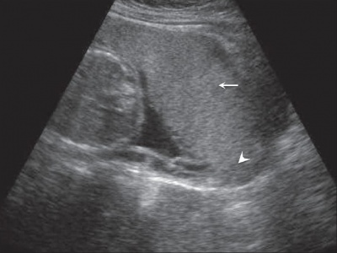
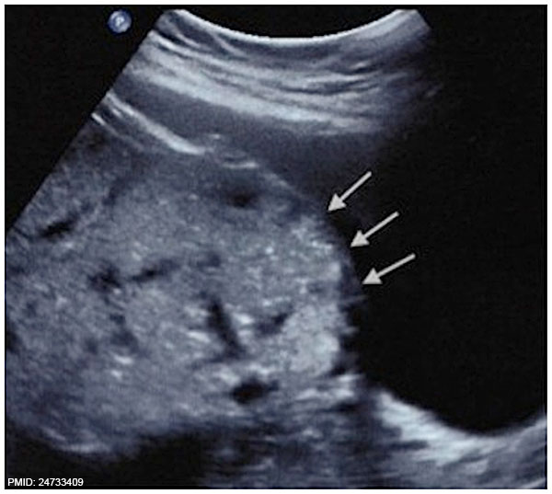

Slide 60
Management of placenta accreta :
There are two options:
Cesrean hysterectomy.
uterine conservation with the placenta left in situ. has high risk of bleeding and sepsis.
All patients with placenta accreta should be counseled about the suspected diagnosis and potential sequelae (Hemorrhage, blood transfusion, cesarean hysterectomy, maternal ICU admission). Consultation with a maternal-fetal medicine specialist is desirable.
Management by a multidisciplinary team and delivery in a tertiary care facility improve outcomes and lower complication rates. The team includes maternal-fetal medicine specialists, anesthesiologists, neonatologists, blood bank and nursing personnel. It is desirable to have a surgeon present who has extensive experience with wide dissection of the lower uterine segment and parametrial areas in the event such dissection or bladder resection is required.

Slide 61
Delivery should be scheduled electively for optimal availability of necessary personnel and facilities. Planned delivery is associated with less intraoperative blood loss than emergency delivery.
The optimum gestational age for scheduled delivery is controversial. Some experts have recommended delivery of previa-accreta at 34 to 36 weeks of gestation.
Adequate blood and clotting factors should be available at the time of delivery. The magnitude of blood loss is difficult to predict antepartum.
Preoperative placement of balloon catheters into the internal iliac arteries. The catheters may be inflated intermittently during hysterectomy, thus potentially decreasing blood loss and providing optimum exposure of the operative field. They may also be used for embolization of persistent bleeders.

Slide 62
Uterine rupture and uterine scar dehiscence
● Complete disruption of all uterine layers, including the serosa. It is a life-
threatening pregnancy complication for both mother and fetus.
Other adverse outcomes include complications related to severe hemorrhage,
bladder laceration, hysterectomy, and neonatal morbidity related to intrauterine
hypoxia. Most uterine ruptures in resource-rich countries are associated with a trial
of labor after cesarean delivery (TOLAC). In resource-limited countries, many uterine
ruptures are related to obstructed labor and lack of access to operative delivery.
● Uterine dehiscence generally refers to an incomplete, and frequently clinically
occult, uterine scar separation where the serosa remains intact and is not usually
associated with hemorrhage or adverse maternal or perinatal outcomes.

Slide 63
● The overall incidence of uterine rupture in women with a prior cesarean
delivery varies between 0.3-1 %.
Patient presentation :
The premonitory signs of uterine rupture include :
1- Fetal heart rate (FHR) abnormalities, there is no FHR pattern pathognomonic of
rupture. The most common FHR abnormality is fetal bradycardia, which may be
sudden or preceded by decelerations.
2- Vaginal bleeding, is not a cardinal symptom, as it may be modest, despite major
intra-abdominal hemorrhage. and patient may become hemodynamically unstable.
3- Sudden or worsening abdominal pain, continuous.
4- Uterine contraction abnormalities, a gradual decrease in the amplitude of
consecutive contractions, the so-called “staircase sign”, then cessation of
contractions.
5- Loss of station of the fetal presenting part.
→ In postpartum women, occult uterine rupture that occurred during delivery
is characterized by pain and persistent vaginal bleeding despite use of
uterotonic agents.

Slide 64
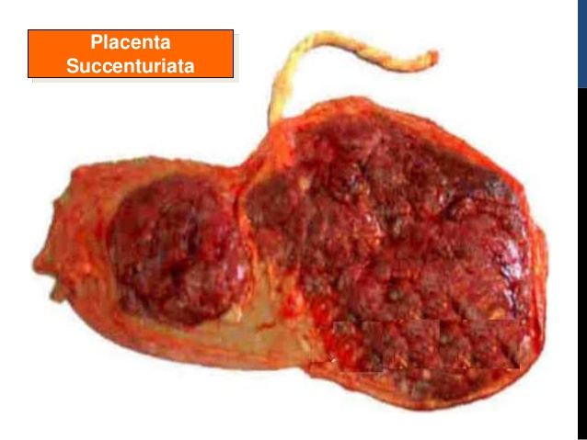
VASA PREVIA
Fetal blood vessels are present in the membranes covering the internal cervical os. The membranous vessels may be associated with a velamentous umbilical cord (type 1 vasa previa) or they may connect the lobes of a bilobed placenta or the placenta and a succenturiate lobe (type 2 vasa previa).
Prevalence: The prevalence of vasa previa is approximately 1 in 2500 deliveries, but is much higher in pregnancies conceived following use of assisted reproductive technologies (prevalence as high as 1 in 202). The prevalence is also increased in second-trimester low-lying placentas or placenta previa (even if resolved), bilobed or succenturiate lobe placentas in the lower uterine segment, and multiple gestations.

Slide 65
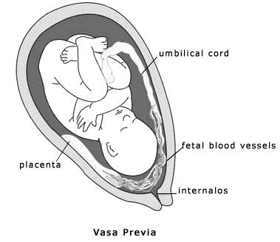

Slide 66
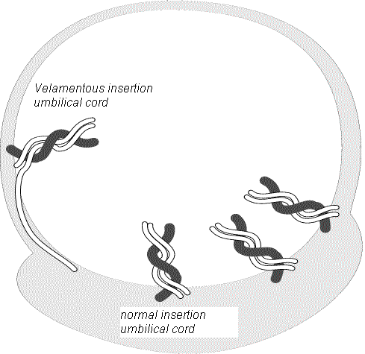

Slide 67
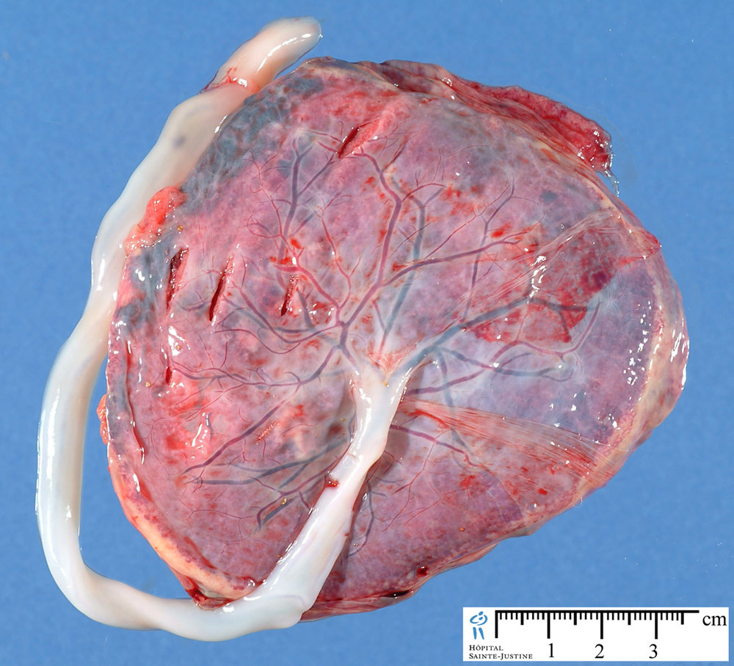
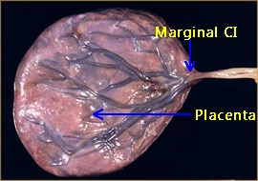
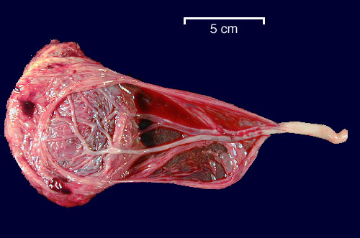

Slide 68
Clinical significance :
Vaginal bleeding after rupture of membranes ( spontaneously or artificially). This is fetal bleeding , results in fetal anemia and hypotension, leading to fetal heart rate abnormalities, such as a sinusoidal pattern; fetal death due to exsanguination can occur within minutes.
The membranous vessels are at risk of compression from the fetal presenting part since they are not protected by the structure of a normal umbilical cord.

Slide 69
● Antenatal diagnosis is based primarily on identification of membranous fetal
vessels passing across the internal cervical os by real-time and color Doppler
ultrasound, and it can be detected as early as 16 weeks GA.
***In the absence of prenatal diagnosis, a clinical diagnosis of vasa previa
should be suspected in the setting of vaginal bleeding that occurs upon
rupture of the membranes and is accompanied by fetal heart rate
abnormalities, particularly a sinusoidal pattern or bradycardia.
Confirmation that the blood is fetal via Apt, Kleihauer-Betke tests, or other
tests (Ogita, Londersloot) supports the diagnosis;
however, there is usually no time to wait for test results before performing an
emergency cesarean delivery for fetal distress.

Slide 70
Management :
Admission in the third trimester till delivery.
Single course of corticosteroids.
Serial fetal assessment : NST two to three times daily.
Scheduled delivery early, between 35-36 weeks.
Emergency cesarean section should be done if any of the following occur :
labour/premature rupture of membranes/fetal distress by NST.

Slide 71
Patient with APH →
History.
Examination : general including vital signs, abdominal examination then vaginal examination (inspection and speculum examination)
- Digital vaginal examination is contraindicated , untill placenta
previa rule out by ultrasound.
Investigations :
- Ultrasound : fetal assessment , placental localisation ,
retroplacental clots,…..
- CTG : to assess fetal heart rate and uterine contractions.
- Blood : CBC, KFT, LFT, coagulation profile,blood group,cross match.

Slide 72
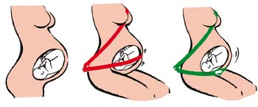
The Pregnant Woman’s Guide to Buckling Up

Slide 73
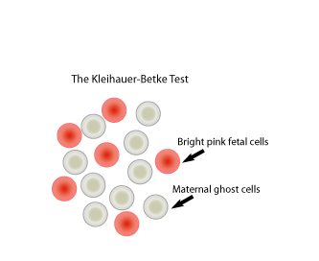

Slide 74
Thank you

