Slide 1
Neoplasm of the nose and para-nasal sinuses

Slide 2
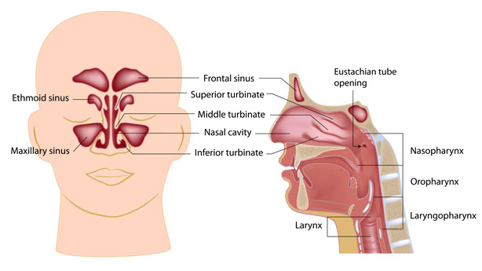

Slide 3
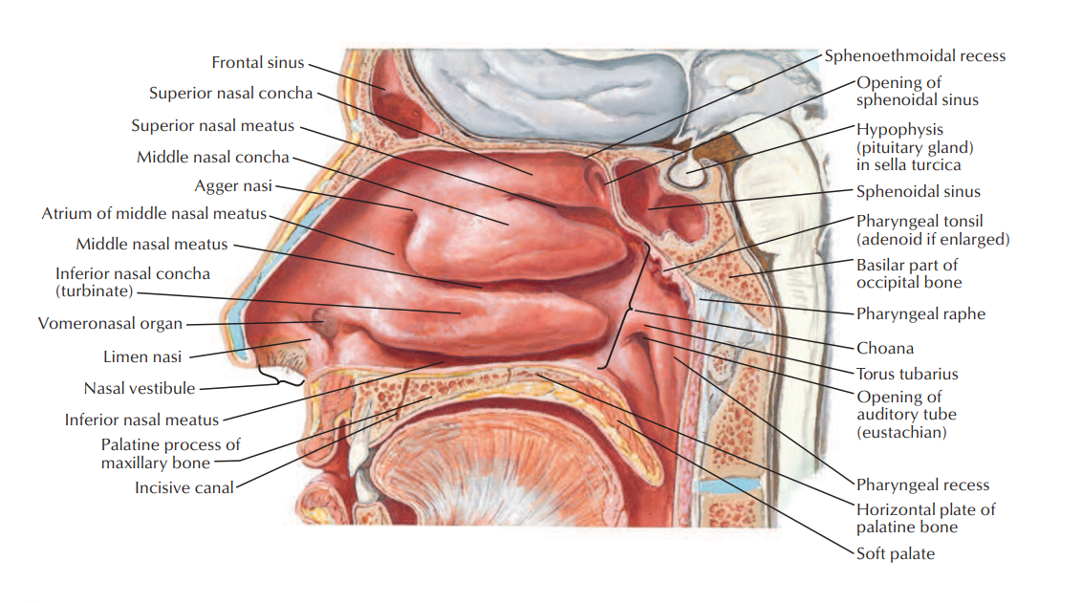

Slide 4
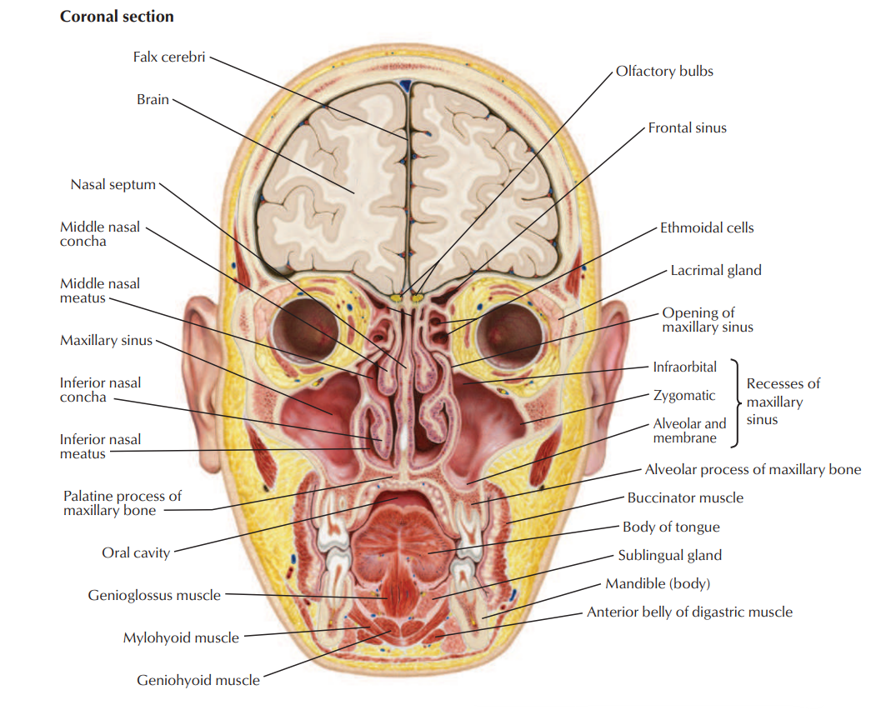

Slide 5
Epdimeology
Very rare tumors (account for 0.2 to 0.8% of all carcinomas).
Demographically, these tumors occur predominantly in the age range from 50 to 90 years.
Most sinus neoplasms are malignant, while in the nasal cavity, there is a fairly even distribution between benign and malignant disease.
Of the different sites, the maxillary sinus is the most commonly involved site, representing 55 to 80%. It is followed by the nasal cavity (27 to 33%), the ethmoid sinuses (9 to 10%), and the frontal and sphenoid sinuses (1 to 2%)

Slide 6
Risk factors
Up to 44% of these tumors are attributed to occupational exposures.
-Wood dust (increases the risk for developing SCC and adenocarcinoma)
-Nickel, Isopropyl oil, Organic fibers, Chromium, Volatile hydrocarbons
-Environmental pollution
Cigarette smoking
Papillomavirus infection

Slide 7
Patient evaluation
In contrast to many other areas in the head and neck, paranasal sinus tumors are not characterized by an early presentation.
The non-specific complaints such as nasal obstruction, rhinorrhea, and epistaxis rarely receive thorough evaluations outside of offices of otorhinolaryngologists until they have become excessively prolonged or other symptoms develop.
Signs and symptoms are according to the structures involved/invaded
Late symptoms include epistaxis, ocular dysfunction secondary to extraocular muscle invasion or cranial nerve involvement, proptosis, facial pain, facial swelling, facial numbness, loosening of teeth, epiphoria, visual loss, anosmia, trismus, and even facial weakness.

Slide 8
Pathology
Despite the rarity of nasal and para-nasal sinus neoplasms, many histologically diverse types are described.
Epithelial malignant tumors: Squamous cell carcinomas, Adenocarcinomas, Adenoid cystic carcinomas, Mucoepidermoid carcinomas, Melanomas, Esthesioneuroblastomas, Teratomas, Teratocarcinomas.
Non-epithelial malignant tumors: Rhabdomyosarcomas, Neurogenic sarcomas, Leiomyosarcomas, Fibrosarcomas, Angiosarcomas, Hemangiopericytomas, Osteogenic sarcomas, Chondrosarcomas, Lymphomas, Extramedullary plasmacytomas, Giant cell tumors.
Squamous cell carcinoma is by far the most frequently encountered malignancy, accounting for up to 80% of all neoplasms

Slide 9
Benign lesion
Papillomas
Osteomas
Fibrous dysplasia
Neurogenic tumors

Slide 10
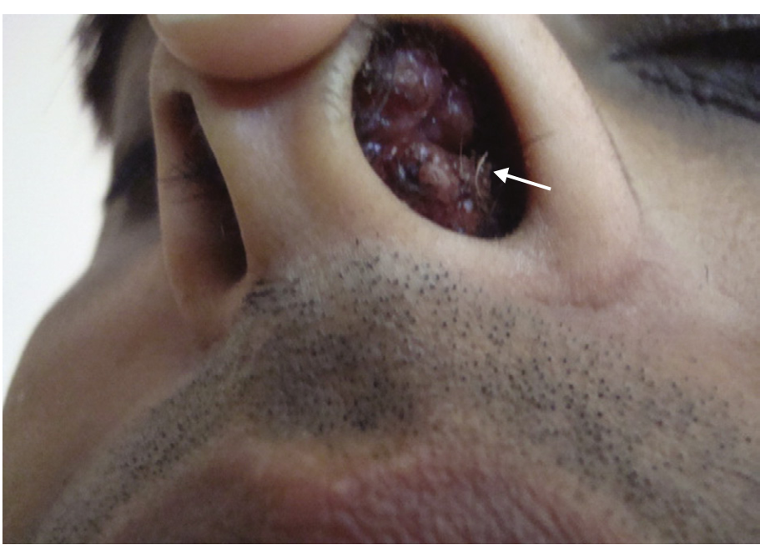
Papilloma
Schneiderian papillomas derived from schneidrian mucosa (squamous)
Fungiform: 50% nasal septum
Cylindrical: 3% lateral wall/ sinuses
Inverted:47% lateral wall

Slide 11
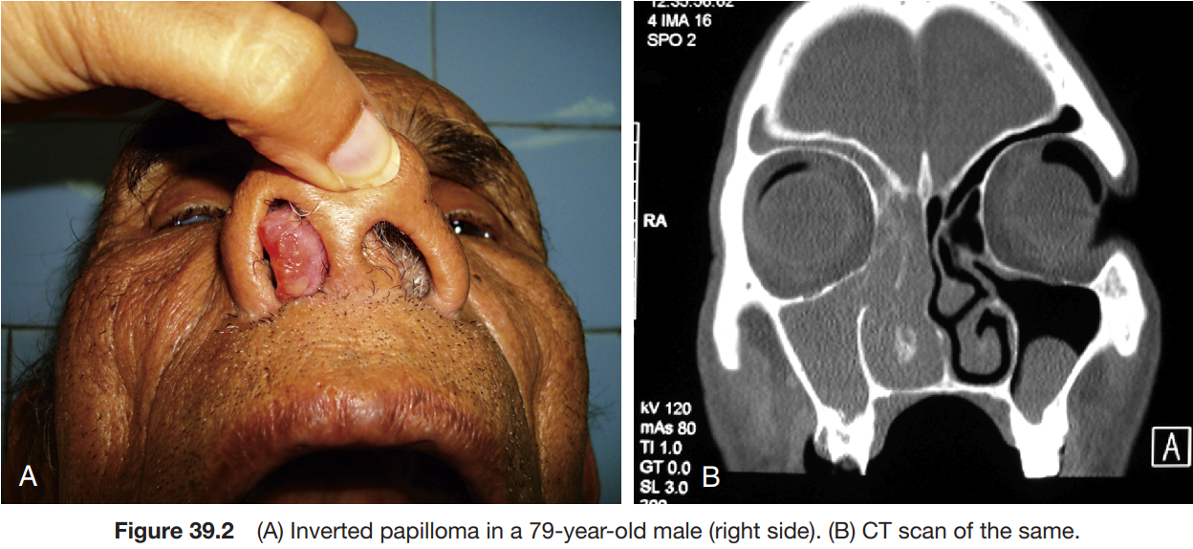
Inverted papilloma (MOST COMMON)
4% of sinonasal tumors
Site of origin: lateral nasal wall, Unilateral, Old age >50
10% premalignant lesion (aggressive resection)

Slide 12
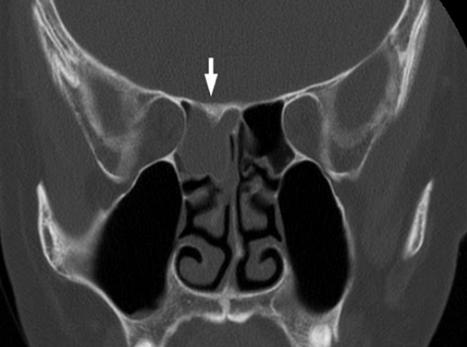
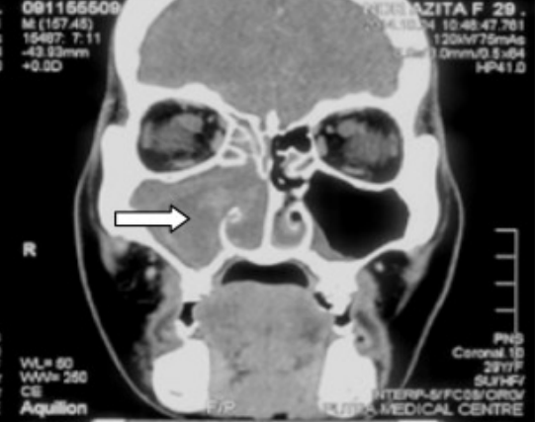
Inverted papilloma
Antrochoanal polyp

Slide 13
Initially via transnasal resection:
- 50-80% recurrence
Medial Maxillectomy via lateral rhinotomy:
- Gold Standard
- 10-20%
Endoscopic medial maxillectomy:
# Key concepts:
Identify the origin of the papilloma
Bony removal of this region
Recurrent lesions:
- inverted papilloma has a marked tendency to recur after surgical removal

Slide 14
Neurogenic tumors
4% are found within the paranasal sinuses
Schwannomas
Neurofibromas
Treatment via surgical resection
Neurogenic Sarcomas are very aggressive and require surgical excision with post op chemo/XRT for residual disease.
When associated with Von Recklinghausen's syndrome; more aggressive (30% 5yr survival).

Slide 15
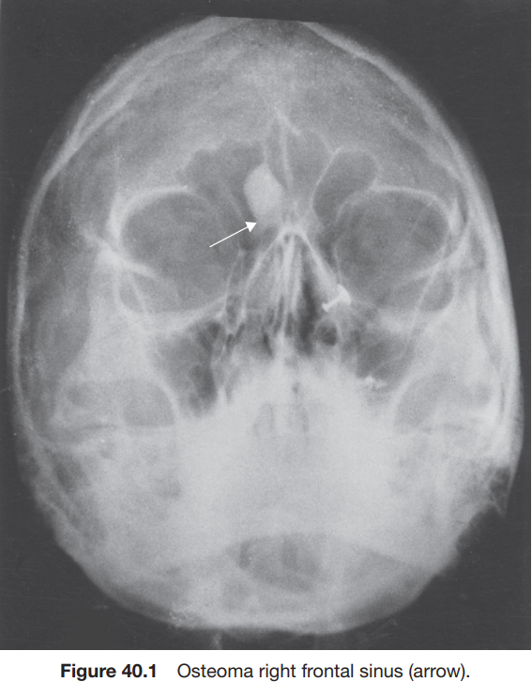
Osteoma
Benign slow growing tumors of mature bone, incidental finding
Location:
Frontal(m.c), ethmoids, maxillary sinuses
When obstructing mucosal flow can lead to mucocele formation
Treatment is local excision

Slide 16
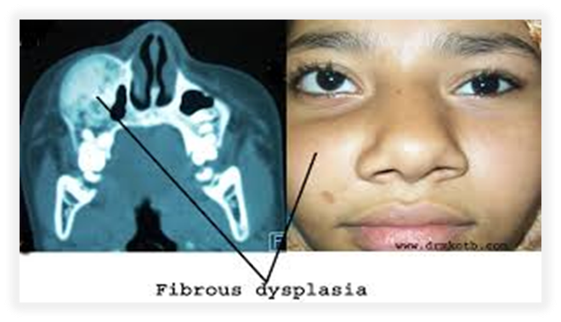
Fibrous dysplasia
Dysplastic transformation of normal bone with collagen, fibroblasts, and osteoid material
Monostotic 70%, Polyostotic30%
Conservative,,
Surgical excision for obstructing lesions or cosmotic
Malignant transformation to rhabdomyosarcoma has been seen with radiation

Slide 17
Malignant Neoplasm
Squamous cell carcinoma
Adenocarcinoma
Adenoid cystic carcinoma
Mucoepidermoid carcinoma
Melanoma
Olfactory neuroblastoma (Esthesioneuroblastoma)
Sarcomas
Rhabdomyosarcoma
Lymphoma
Sinonasal undifferentiated carcinoma
Metastatic tumors

Slide 18
Squamous cell carcinoma
Most common tumor (80%)
Location:
-Maxillary sinus (70%)(lateral wall)
-Nasal cavity (20%) (turbinate)
90% have local invasion by presentation
Infiltration of lymph nodes
88% present in advanced stages (T3/T4)
Managed by surgical resection with postoperative radiation

Slide 19
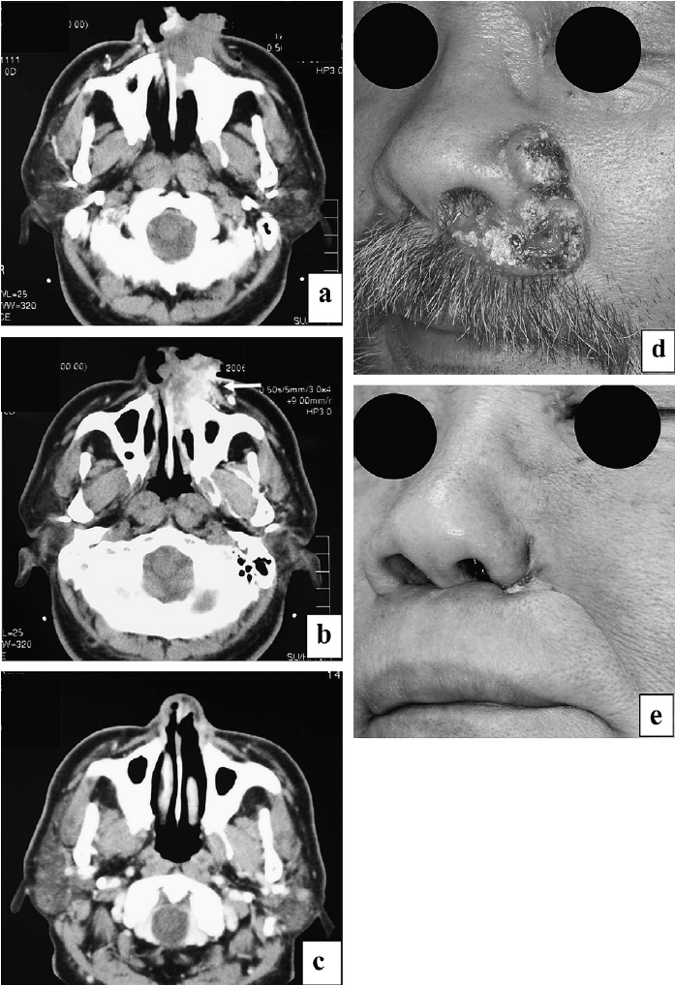
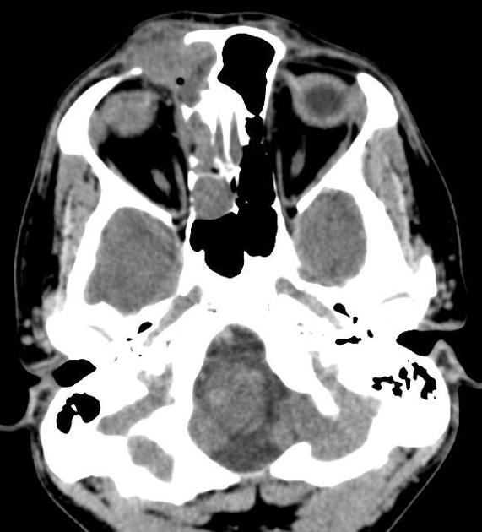
Squamous cell carcinoma of the left nasal cavity
Squamous cell carcinoma of the paranasal sinus

Slide 20
Adenocarcinoma
2nd most common
Most common site is ethmoid sinus
Starts in the gland cells (adenomatous cells)
Strong association with occupational exposures
High grade: solid growth pattern with poorly defined margins. 30% present with metastasis
Low grade: uniform and glandular with less incidence of metastasis.

Slide 21
Adenoid cystic carcinoma
Most common site is the maxillary sinus.
Perineural spread It is characterized by an intermediate growth rate, low probability of lymphatic spread
Neck metastasis is rare
Postoperative radiotherapy is very important

Slide 22
Mucoepidermoid carcinoma
Extremely rare
Most common site is parotid gland
It is composed of a combination of squamous cells and glandular, mucus-producing, basal cells
They are notable for their propensity toward distant metastases.
local invasion makes resection difficult, therefore radiation is often indicated

Slide 23
Melanoma
1% of melanoma originates from the nasal cavity and paranasal sinuses.
Anterior Septum: most common site.
Treatment is wide local excision with/without postoperative radiation therapy

Slide 24
Olfactory neuroblastoma (Esthesioneuroblastoma)
very rare cancer that develops in the upper part of the nasal cavity originate from stem cells of neural crest origin that differentiate into olfactory sensory cells.
Metastatis in 20-30%
Treatment:
surgical resection with postoperative XRT

Slide 25
Sarcomas
Osteogenic Sarcoma
-Most common primary malignancy of bone.
-Mandible > Maxilla
Fibrosarcoma
Chondrosarcoma

Slide 26
Rhabdomyosarcoma
Aggressive malignant soft tissue tumor that arises from muscle cells called rhabdomyoblasts
Most common paranasal sinus malignancy in children less than 5 years old
Triple therapy is often necessary

Slide 27
Lymphoma
Non-Hodgkins
Hodgkin
Treatment is by radiation, with or without chemotherapy

Slide 28
Sinonasal undifferentiated carcinoma
Aggressive locally destructive lesion
Nasal cavity, maxillary and ethmoid sinus are typically involved
epithelial origin
Symptoms usually develop over a relatively short duration
Preoperative chemotherapy and radiation may offer improved survival

Slide 29
Metastatic tumors
Renal cell carcinoma is the most common
Palliative treatment only

Slide 30
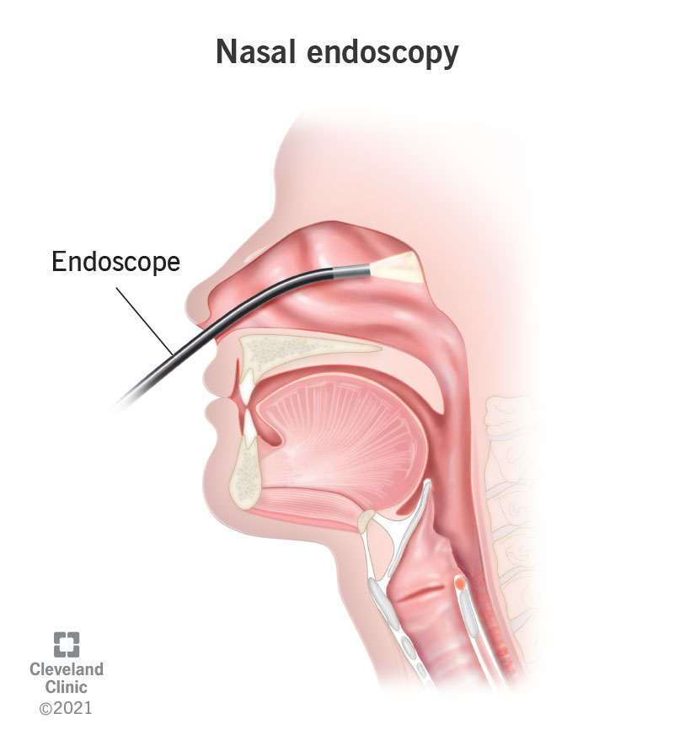
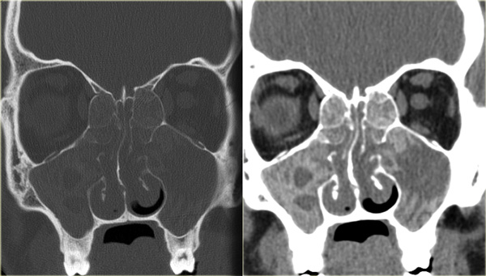
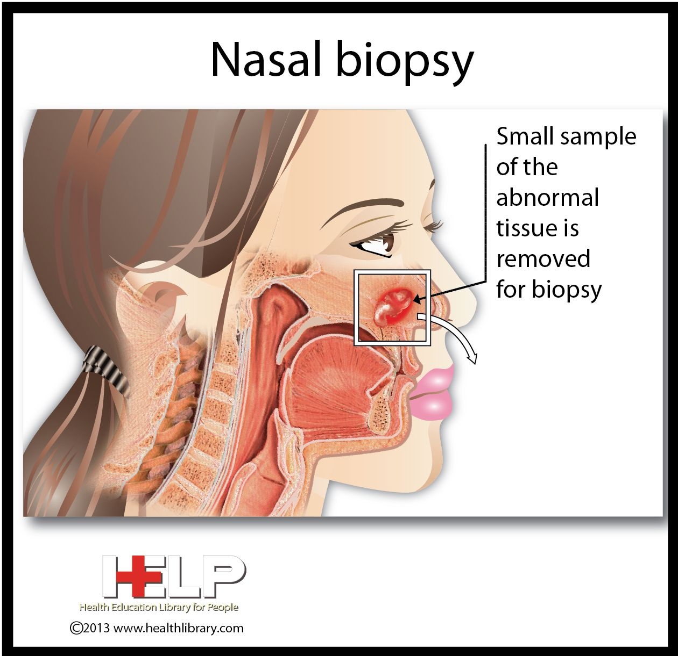
Diagnosis
History & physical examination
Nasal endoscopy
Imaging (CT/MRI)
Biopsy

Slide 31
CLASSIFICATION OF MAXILLARY SINUS CANCER
1. Ohngren’s classification:

Slide 32
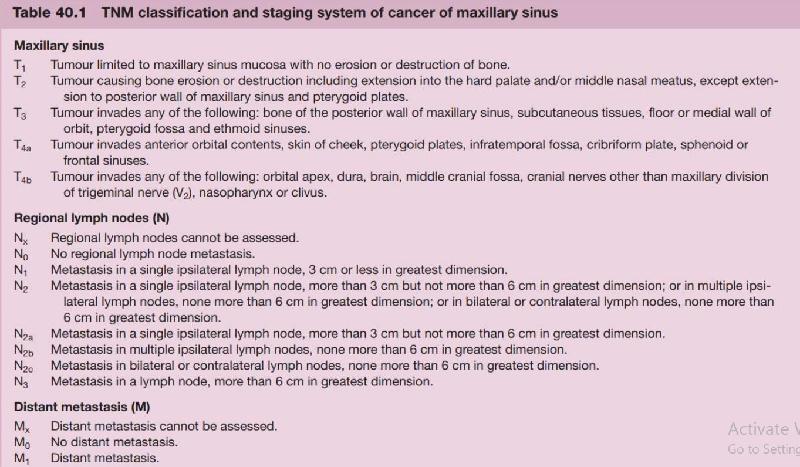
2. AJCC (American Joint Committee on Cancer) classification.

Slide 33
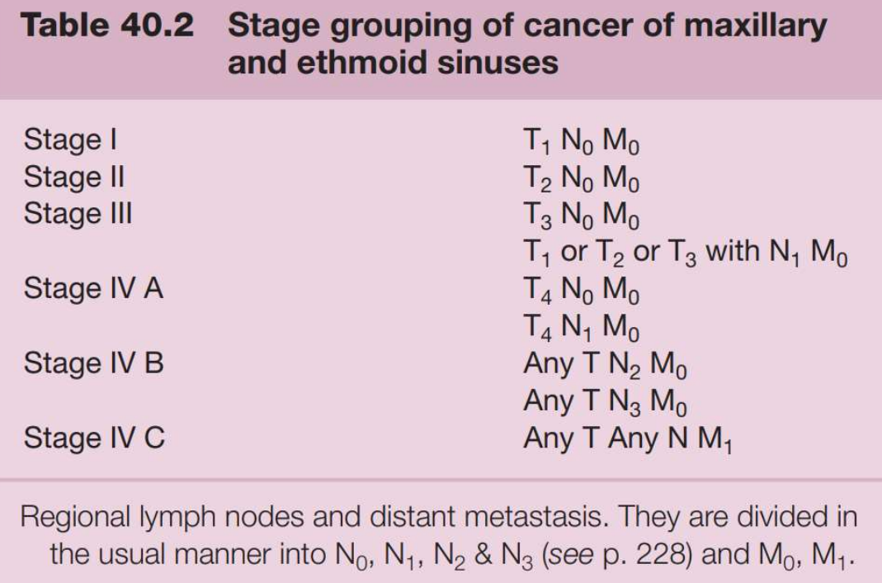

Slide 34
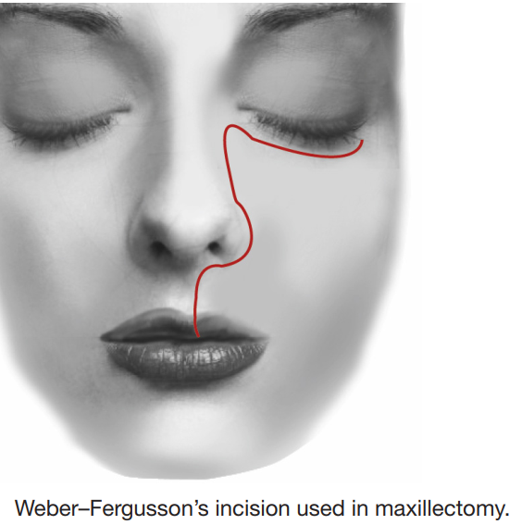
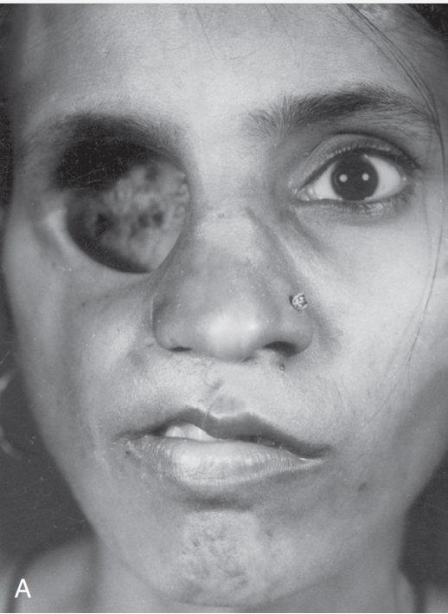
TREATMENT
Early cases with Stage I and II squamous cell carcinomas are treated with surgery or radiation with equal results.
T3 and T4 lesions are treated by combined modalities of radiation and surgery.
PROGNOSIS
Survival diminishes with the stage of tumour. Overall5 year survival is about 40–50%.

Slide 35
Treatment
Triple therapy, Multimodality treatment
Orbital Preservation
Minimally invasive surgical techniques
Surgical + chemo+radio

Slide 36
Neoplasms of Nasopharynx

Slide 37
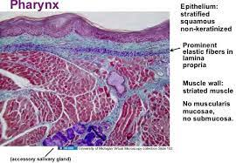
ANATOMY and HISTOLOGY
Pharynx is a conical fibromuscular tube forming upper part of the air and food passages. It is 12-14 c m long , extending from base of the skull (basioccipital and basisphenoid ) to the lower border of cricoid cartilage where it becomes continuous with the esophagus.
Structure of Pharyngeal Wall :
From within outward it consists of four layers: 1. Mucous membrane (ciliated columnar in the nasopharynx and stratified squamous elsewhere ) 2 . Pharyngeal aponeurosis (pharyngo basilar fascia) , fibrous layer , thick at the base of the skull and became thinner inferiorly 3. Muscular coat : External layer: contains superior, middle and inferior constrictor muscles Internal layer: contains stylopharyngeus , salpingeal phryngeus and palatopharyngeal muscles 4 . Buccopharyngeal fascia : covers the muscles

Slide 38
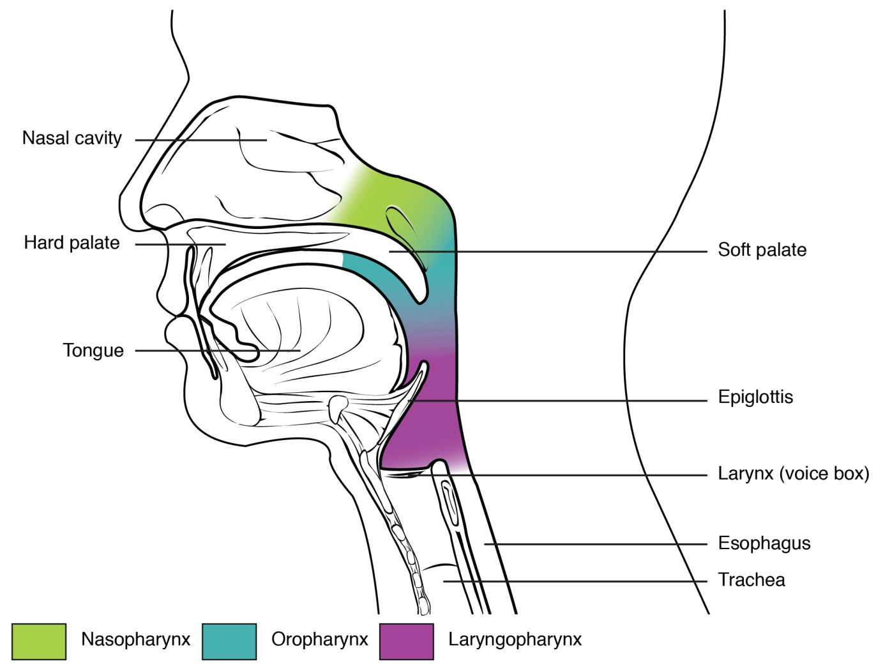
DIVISIONS OF PHARYNX
pharynx is divided into three parts : 1 . Nasopharynx 2 . Oropharynx 3 . Hypopharynx or Laryngopharynx .

Slide 39
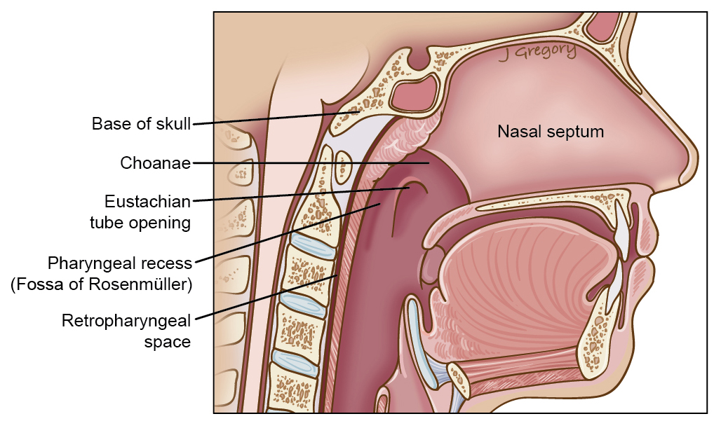
Tumours of Nasopharynx
A rare type of head and neck cancer (most common is Oral cavity tumors ).
Nasopharyngeal carcinoma (NPC) is the most common cancer originating in the nasopharynx area.
Most commonly in the postero-lateral nasopharynx or pharyngeal recess (fossa of Rosenmüller).

Slide 40
Nasopharyngeal Fibroma (Juvenile Nasopharyngeal Angiofibroma)
BENIGIN NEOPLASMS
the commonest of all benign tumors of nasopharynx As the tumor is predominantly seen in adolescent males in the second decade of life , it is thought to be testosterone dependent
Site of Origin and Growth
Earlier it was thought to arise from the roof o f nasopharynx or the anterior wall of sphenoid bone but now it is believed to arise from the posterior part of nasal cavity close to the superior margin of sphenopalatine foramen .
Pathology
Angiofibroma , as the name implies , is made up of vascular and fibrous tissues: the ratio of the two components may vary . Mostly , the vessels are just endothelium-lined spaces with no muscle coat. This accounts for the severe bleeding as the vessels lose the ability to contract, and also the bleeding cannot be controlled by application of adrenaline .

Slide 41
Clinical Features
1 . broadening of nasal bridge , proptosis , swelling of cheek. 2 . Profuse and recurrent epistaxis. This is the most common presentation. Patient may be markedly anemic due to repeated blood loss. 3 . Progressive nasal obstruction and denasal speech due to mass in the postnasal space. 4 . Conductive hearing loss and serous otitis media due to obstruction of eustachian tube .
Investigations
X ray shows any bone destruction CT with enhancement , the investigation of choice
MRI Carotid angiography , investigate the tumor extension
Treatment surgery hormonal radiotherapy chemotherapy

Slide 42
Extensions of Nasopharyngeal Fibroma
Nasopharyngeal fibroma is a benign tumor but locally invasive and destroys the adjoining structures.
It may extend into : 1-Nasal cavity causing nasal obstruction , epistaxis and nasal discharge. 2-Paranasal sinuses. Maxillary , sphenoid and ethmoid sinuses can all be invaded. 3-Pterygomaxillary fossa, infratemporal fossa and cheek. 4-Orbits giving rise to proptosis and "frog-face deformity'' . inferior orbital fissure and also destroys apex of the orbit . It can also enter the orbit through superior orbital fissure. 5-Cranial cavity. Middle cranial fossa is the most common . There are two routes of entry : (i) By erosion of floor of middle cranial fossA. (ii) Through sphenoid sinus , into the sella. Tumor lies medial to carotid artery.

Slide 43
Malignant tumors
SCCA (nasopharyngeal carcinoma)
Lymphoma
Salivary gland tumors
Sarcomas

Slide 44
EPIDEMIOLOGY , Causes
It is vastly more common in certain regions of East Asia and Africa than elsewhere , with viral, dietary and genetic factors implicated in its causation !
The incidence of nasopharyngeal carcinoma is two- to threefold higher in males compared with in females
Can occur at any age ..
caused by a combination of factors:
The viral influence is associated with infection with Epstein-Barr virus (EBV) and Human papillomavirus (HPV)
well documented viral “fingerprints” in tumor cells !
Smoking has also been associated with nasopharyngeal carcinoma
environmental carcinogens , chronic nasal infection , poor ventilation of nasopharynx …
Genetic : HLA-A2 , HLA-B-Sin2

Slide 45
CLASSIFICATION(WHO)
Based on light microscopy findings ..
Type I - “SCCA” squamous cell carcinoma
- typically found in older adults ..
- 25 % of NPC
- moderate to well differentiated cells
Type II - “non-keratinizing” carcinoma
- 12 % of NPC
- variable differentiation of cells ( mature to anaplastic)
- may resemble transitional cell carcinoma of the bladder Type III - “undifferentiated” carcinoma
60 % of NPC , majority of NPC in young patients ..
- Diverse group :
Lympho-epitheliomas, spindle cell, clear cell and anaplastic variants
- *Difficult to differentiate from lymphoma by light microscopy requiring special stains & markers
Differences between these types :
Long-term risk of recurrence for types II & III
Viral associations :
Type I - HPV
Types II, III - EBV

Slide 46
CLINICAL PRESENTATION
- Initially :
Unilateral hearing loss from a middle ear effusion
Painless , slowly enlarging neck mass (regional spread): MOST common presentation . ( 50%)
- Larger lesions :
nasal obstruction
epistaxis
cranial nerve involvement
Facial pain - Trigeminal neuralgia
Ophthalmoplegia - CN III, IV, and VI
Horner’s syndrome - cervical sympathetics (rare initial symptom)
CN’s X : vocal cord paralysis
CN’s XI/X : palatal paralysis
Notes:
Xi 11

Slide 47
Trotter's syndrome/Triad is a cluster of symptoms associated with advanced nasopharyngeal carcinoma.
1- Unilateral conductive hearing loss due to middle ear effusion
2- Unilateral facial pain (Trigeminal neuralgia)
3- Soft palate immobility (palatal paralysis)
- Trismus/Difficulty opening mouth occurs late (due to further invasion of pterygoid muscles)

Slide 48
Diagnosis
Fiberoptic Endoscopic examination/Nasopharyngioscopy
Biopsy ( postnasal )
serology (Anti EBV antibodies)
CT scan with bone and soft tissue windows(Extent of tumor)
MRI (soft tissue involvement, recurrences)/ Best

Slide 50
Treatment
Radiation & Chemotherapy
Surgical Management
Mainstay of treatment
Stage 1&2 :
Radiation
Stage 3&4 :
Radio-chemo
Mainly diagnostic - Biopsy
primary lesion (residual or recurrent disease)
regional failure with local control
ETD
* Because Very difficult anatomy We don’t prefer surgery

