Slide 1
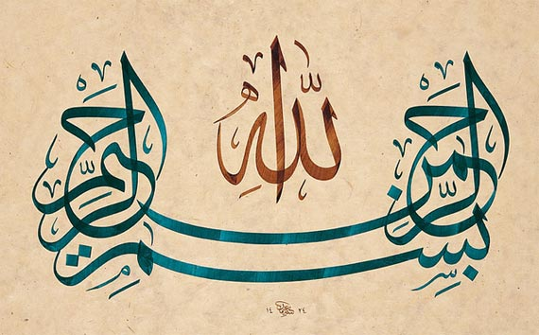

Slide 2
GENERAL Virology
3
Viral Pathogenesis - Host Defenses
&
Viral Genetics
By:
Prof. Dr. Ghada Fahmy Helaly

Slide 3
Viral Pathogenesis
The process of disease production following infection.
It may lead to clinical or subclinical (asymptomatic) disease.
Asymptomatic viral disease (subclinical infection):
stimulate humoral and cellular immunity.
Clinical viral disease:
Direct or indirect viral effects (e.g. cytolysis, immunologic attack)
Size of the viral inoculum.

Slide 4
Viral aspects of pathogenesis:
1. Viral entry into a host (Transmission):
- Touch, saliva, air. - Blood - sharing contaminated needles.
- Contaminated food and water - sexual contact - Insect bite.
2. Viral attachment proteins (VAPs):
- Interact with cellular receptor.
- Neutralizing antibodies.
3. Viral virulence: * Genetically determined- with attenuated strains of virus.

Slide 5
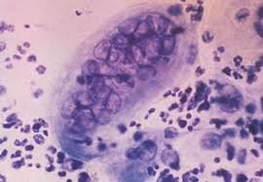
Cellular aspects of pathogenesis:
Cellular receptor sites.
Target organ.
Cell tropism.
Cellular responses to viral infection: may be inapparent or may include:
Cytopathic effects: virus-induced damage to the cell e.g. multinucleated giant cells as in herpes simplex.
Cytolysis: Non-enveloped viruses.

Slide 6
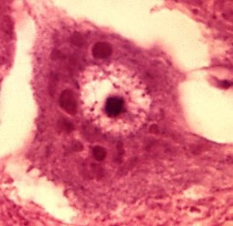
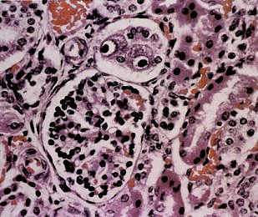
Inclusion body formation: Intracytoplasmic eosinophilic: rabies Negri bodies. Intranuclear basophilic: owl eyes in cytomegalovirus.
Transformation: From normal cells into abnormal ones with properties of cancerous cells, here the cell is not dead.
Immune complex diseases: Antigen-Antibody complex is produced that deposit in different places of body.
Interferon (IFN) synthesis.

Slide 7
Types of infections
1. Inapparent infections (subclinical disease):
can cause immunity from further infections.
virus inoculum is small.
2. Acute infections :
Short IP (Ds/Ws).
localized or disseminated.
Recovery →elimination of the virus.
Persistent or latent infections may follow.

Slide 8
3. Persistent infections :
Clinical symptoms ??.
Carriers.
High antibody titers for some antigens.
4. Latent infections
Periodically reactivate → recurrent disease.
5. Slow infections
Prolonged IP (Ms/Ys).
No clinical symptoms during incubation but can produce some infectious agents.
Chronic, progressive, fatal viral diseases.

Slide 10
Host defense mechanisms
Nonimmune defenses:
Innate immunity: anatomic and chemical barriers.
Cellular resistance: non-permissive cells.
Inflammation.
IFN: inhibits viral replication.

Slide 11
immune defenses:
Humoral immunity: neutralizing (protective) and non-neutralizing antibodies (enhance phagocytosis →opsonins) .
Cell-mediated immunity: Cytotoxic T lymphocytes, NKcells, and activated macrophages→ lymphokines and monokines.
Viral-induced immunopathology: antibody-antigen complexes, …
Viral-induced immunosuppression: lymphocyte infection by the virus.

Slide 12
Viral Genetics
Viral genetics includes:
Mutations : effect on replication and pathogenesis.
Interactions: of two genetically distinct viruses infect the same cell.

Slide 13
Mutations
Types of mutation:
Point mutation ---- Deletion ----- Frame shift mutation.
Examples phenotypic changes seen in virus mutants:
Attenuated mutants.
Antigenic variants.
Drug resistant mutants.
Conditional lethal mutants.
Defective interfering particles.

Slide 14
INTERACTIONS BETWEEN VIRUSES
Recombination/ Re-assortment.
Complementation.
Phenotypic mixing.

Slide 15
Recombination/ Re-assortment:
Exchange of genetic information between two chromosomes that is based on crossing over within regions of significant base sequence homology.
"Classic" recombination: break/join recombination.
Reassortment: viruses with segmented genomes, such as Influenza virus, exchange segments (major antigenic changes).

Slide 16
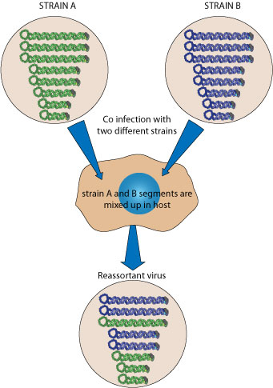
Classic recombination
Reassortment

Slide 17
Complementation:
Interaction at a functional level NOT at the nucleic acid level.
It can occur when either one or both of the two viruses that infect the cell have a mutation that results in a non-functional protein.

Slide 18
Phenotypic mixing:
If two different viruses infect a cell, progeny viruses may contain coat components derived from both parents and so they will have coat properties of both parents.
It involves no alteration in genetic material.

Slide 19
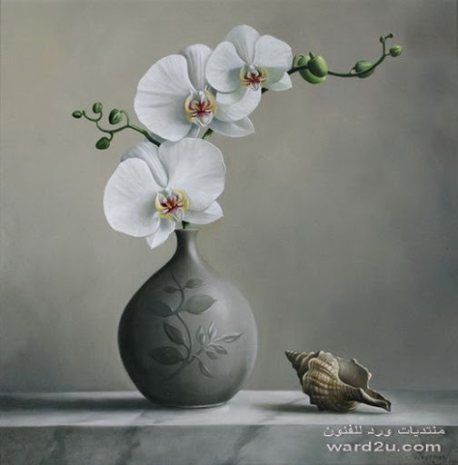
Thank You

