Slide 1
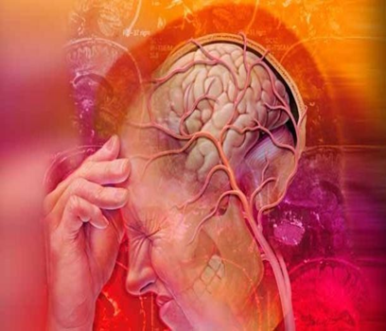
Acute pain Supervised By: Dr. Ashraf Dmour
Areen Gharaibeh
Lana alhusban
Jude alshawabkeh

Slide 2
Definition
Pain: is a sensory stimuli and/or neurologic injury modified by and individual’s memory, expectations, and emotions.
Biocultural model of pain:
Society or ethnicity also influences individual’s pain experience.

Slide 3
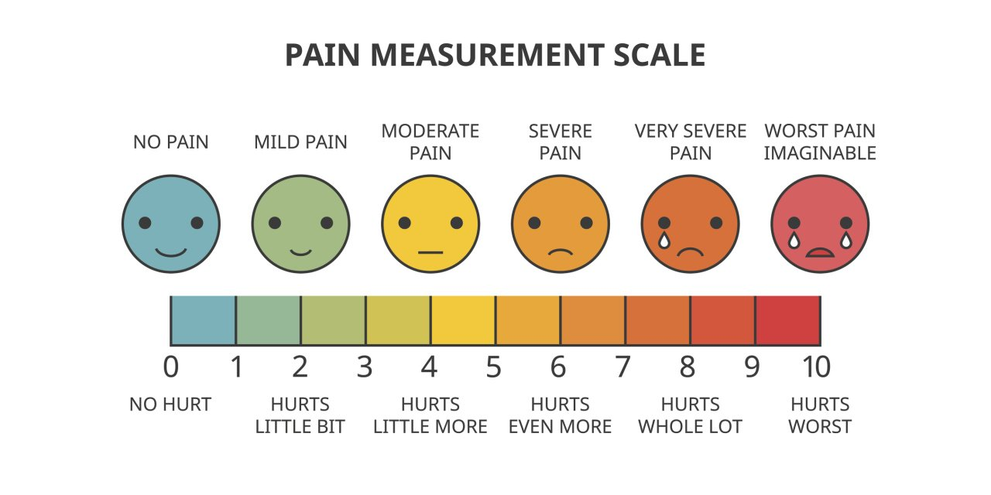

Slide 4
Classes of pain
Acute pain
Chronic pain
acute pain: the normal, predicted, physiological response to an adverse chemical, thermal, or mechanical stimulus that is gone once the stimulus is removed and it lasts less than 6 months
chronic pain: pain that is ongoing and lasts more than 6 months and can continue even after the injury or illness is healed.

Slide 5
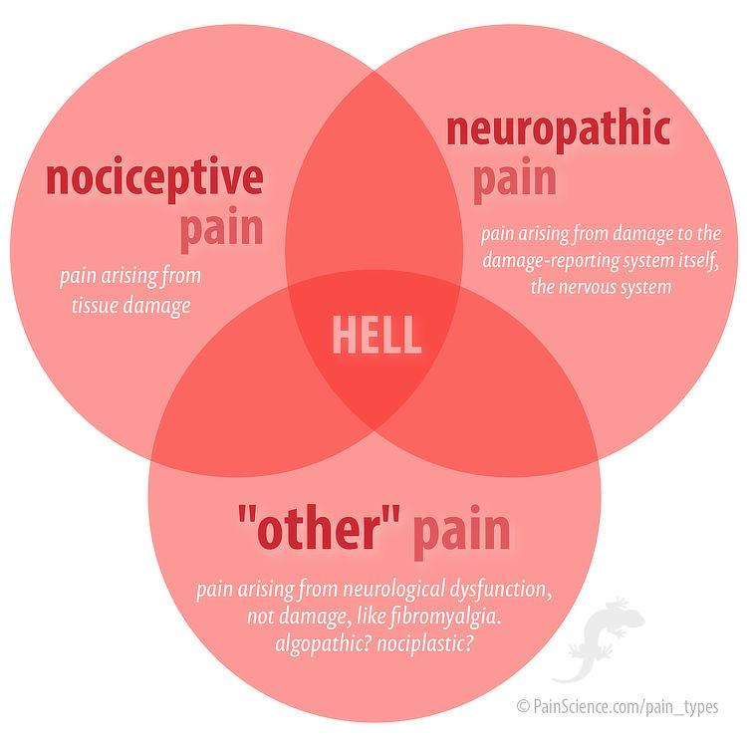
Classes of pain
Pain can also be classified according to the cause:
Nociceptive pain: pain caused by organ or tissue damage and it could be somatic or visceral.
Neuropathic pain: pain resulting from damage or lesion either in CNS or PNS or both

Slide 6
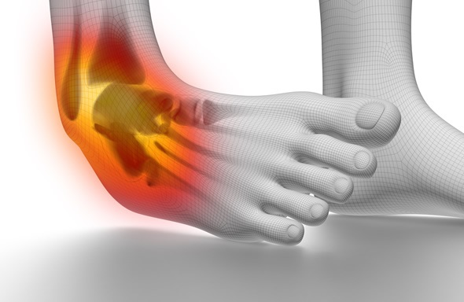
Nociceptive pain
As we said nociceptive pain can be somatic or visceral.
Somatic pain:
Aching, often constant
Dull or sharp
Often worse with movement
Well localized
Example: bone pain or pain in the chest wall

Slide 7
Nociceptive pain
As for visceral nociceptive pain:
Could be constant or crampy
Aching
Poorly localized
And usually referred to other sites.
Examples: bowel obstruction or pancreas cancer

Slide 8
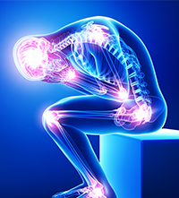
Neuropathic pain
Pain is not usualy at site of lesion
Usually a chronic condition
Respnds poorly to conventional anelgesics.
Common descriptions:
Tingling, electic lightening, hypersensitivity to touch or cold (allodynia which is pain due to a stimulus that does not usually provoke pain).
Examples:post herpetic neuralgia(post shingles) , carpal tunnel syndrome.

Slide 9
History

Slide 10
Consequences of untreated pain
Acute pain:
Increase metabolic rate and blood clotting
Impair immune function
Induces negative emotions
Change in pain receptor sensitivity and permanent damage in neurons

Slide 11
Consequences of untreated pain
Chronic pain may lead to:
Fatigue
Anxiety
Depression
Confusion
Impaired sleep
Decreased physical functioning/deconditioning

Slide 12
Acute pain
Pathophysiology of the pain

Slide 13
Pain-receptors
Nociceptors are special receptors that respond only to noxious stimuli and generate nerve impulses which the brain interprets as “pain
There are two types of fibers that transmit pain : C-fibers and A-delta fibers.
Activated by stimuli (mechanical, thermal, chemical)
Distinguished from other receptors by
their higher threshold, and
they are normally activated only by stimuli of noxious
intensity-sufficient to cause some degree of tissue damage.

Slide 14
nociception
The peripheral nervous system includes primary sensory neurons specialized to detect mechanical, thermal or chemical conditions associated with potential tissue damage.
The signals, when these nociceptors are activated, must be transduced and transmitted to the spine and brain where signals are modified before they are ultimately understood or “felt”.
4 physiologic processed involved ( transduction, transmission, perception, and modulation)

Slide 15
1-transduction
During this stage, noxious stimuli ( with potential to injure tissue) trigger the release of biochemical mediators (prostaglandins, bradykinin, serotonin, histamine, substance P) that sensitize nociceptors. Noxious or painful stimulation also causes movement of ions across cell membranes, which excites nociceptors.

Slide 16
Pain medication can work during this phase by blocking the production of prostaglandin(e.g., ibuprofen or aspirin) or by decreasing the movements of ions across the cell membrane (e.g., local anesthetic).

Slide 17
2-transmission
Includes 3 segments.
First segment- pain impulse travels from the peripheral nerve fibers to the spinal cord Substance P serves as neurotransmitter. Two types of nociceptors cause this transmission to dorsal horn of the spinal cord: C fibres transmit dull pain and Adelta fibres which transmit sharp, localized pain..
Second segment- transmission from the spinal cord and ascension via spinothalamic tracts, to the brain stem and thalamus
Third segment- involves transmission of signals between thalamus and somatic sensory cortex where pain perception occurs.

Slide 18
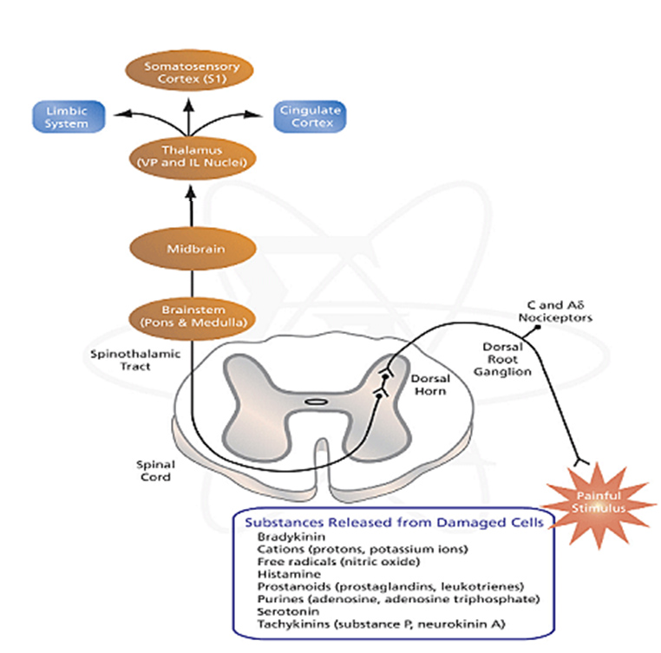
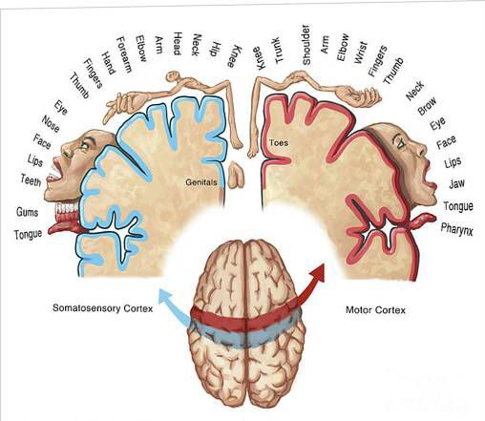

Slide 19
Pain control can take place during this second process. Opioids (narcotic analgesics) block the release of neurotransmitters, particularly substance P, which stops the pain at the spinal level.
Capsaicin may also deplete substance P that could inhibit the transmission of pain signals

Slide 20
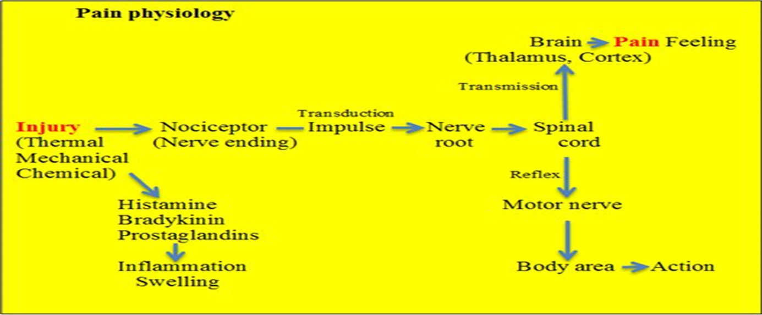
3-perception
Is when the client becomes conscious of the pain. Pain perception is the sum of complex activities in the Central Nervous System that may shape the character and intensity of pain perceived and ascribe meaning to the pain

Slide 21
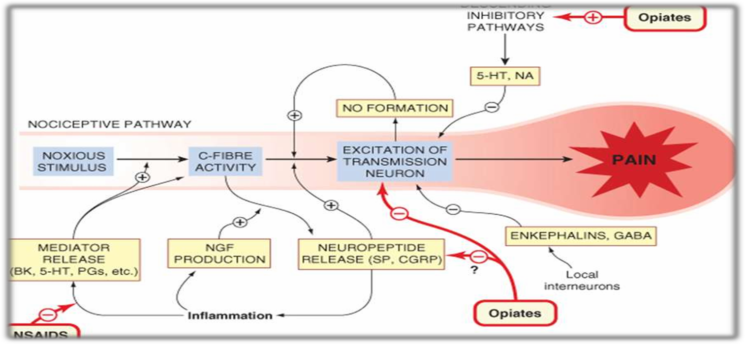
4-modulation
Often descibed as “descending System” Occurs when neurons in the thalamus and brain stem send signals down to the dorsal horn of the spinal cord. These descending fibers release substances such as endogenous opioids, serotonin, and norepinephrine which can inhibit the ascending noxious(painful) impulses in the dorsal horn.

Slide 23
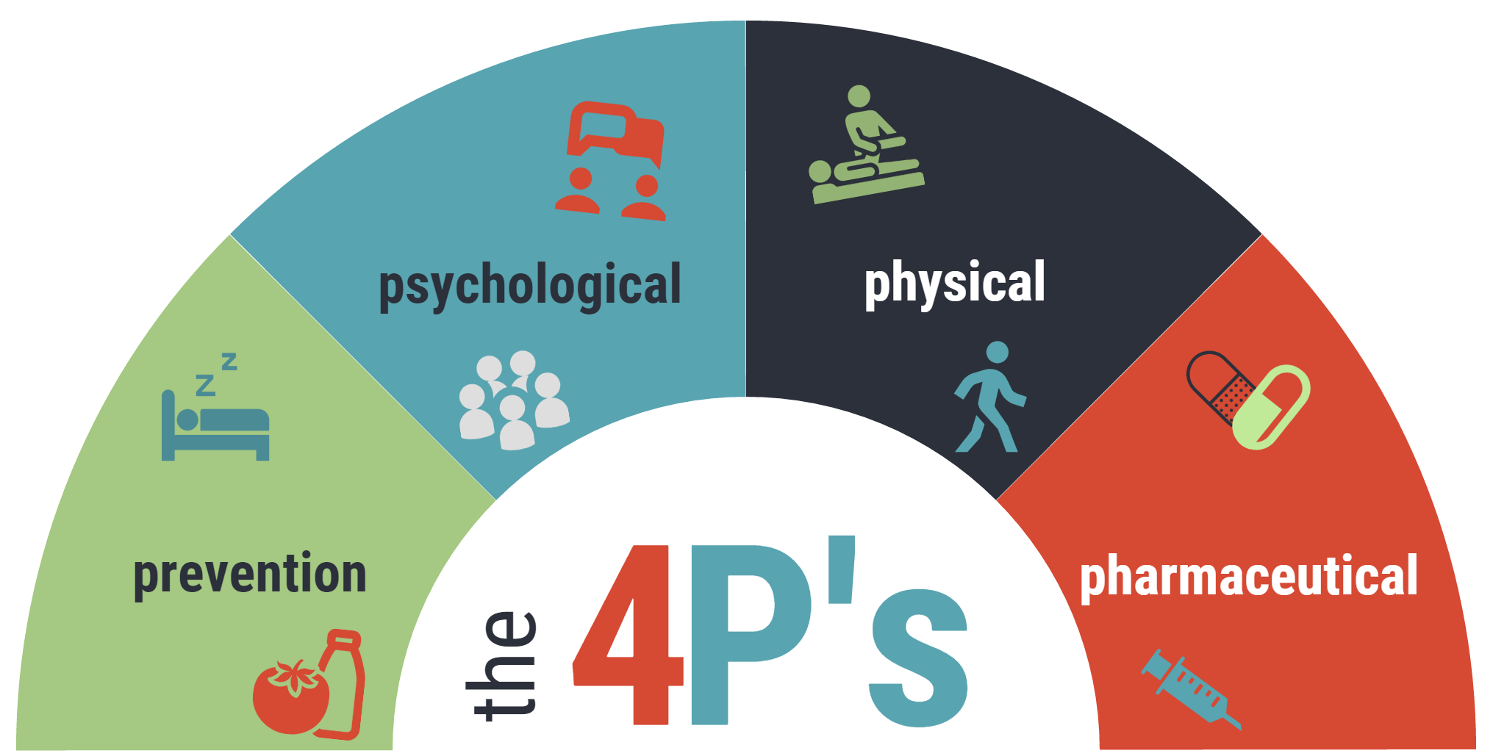
Physical strategies : to reduce pain, improve physical function, and improve sleep.
Psychological strategies : to reduce pain, improve coping, or address depression or anxiety that often accompany pain
Preventative strategies : to reduce risk factors that contribute to pain.
Pharmacologic strategies (medications) : that reduce pain, inflammation, or nerve sensitivity, or improve related symptoms

Slide 24
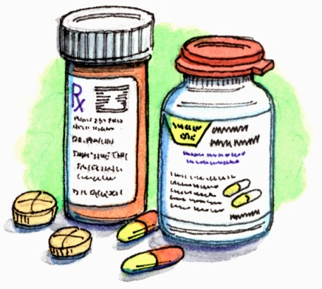
Pharmacological Treatment of Pain
Non-Opioids
Opioids
Adjuvants

Slide 26
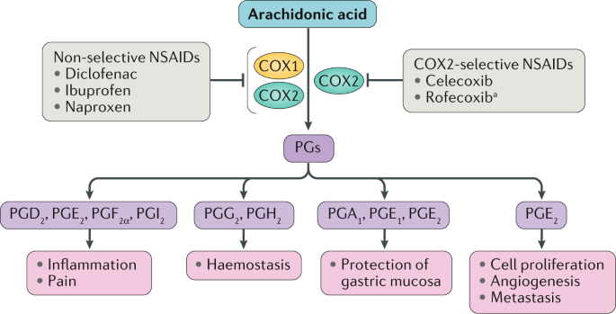
Non-opioids
NSAIDS

Slide 27
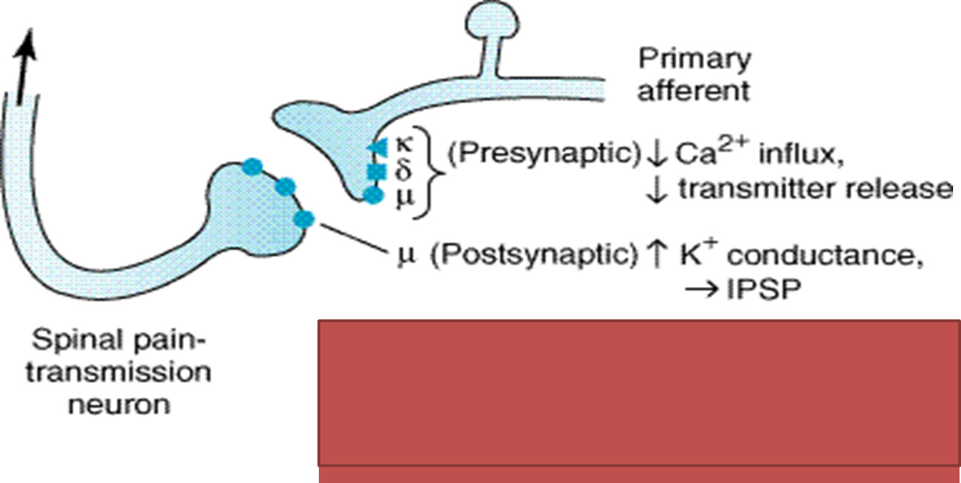
Opioids
• Opioid receptors found in the brain, spinal cord and
peripheral nervous system
• Mu (μ1 and μ2)
• Kappa (k1 & k3)
• Delta (δ)
• Nociceptin/Orphanin (N/OFQ)
So the opioid will bind to these receptors leading to differernt reactions that produce its analgesic effect

Slide 28
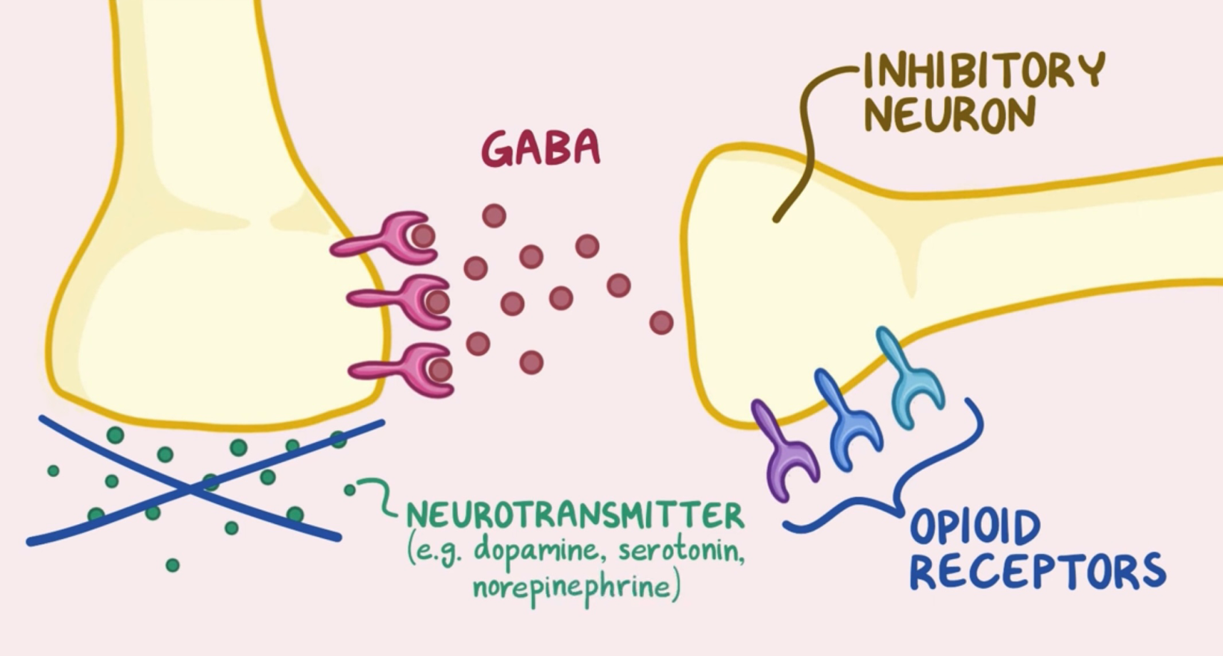
Opioids
In absence of opioids inhibitory neuron secretes neurotransmitter GABA which bind another neuron preventing it from releasing dopamine, sertonin or norepinephrine
Dopamine, serotonin and norepinephrine can decrease sensitivity to pain and it give calming sensation

Slide 29
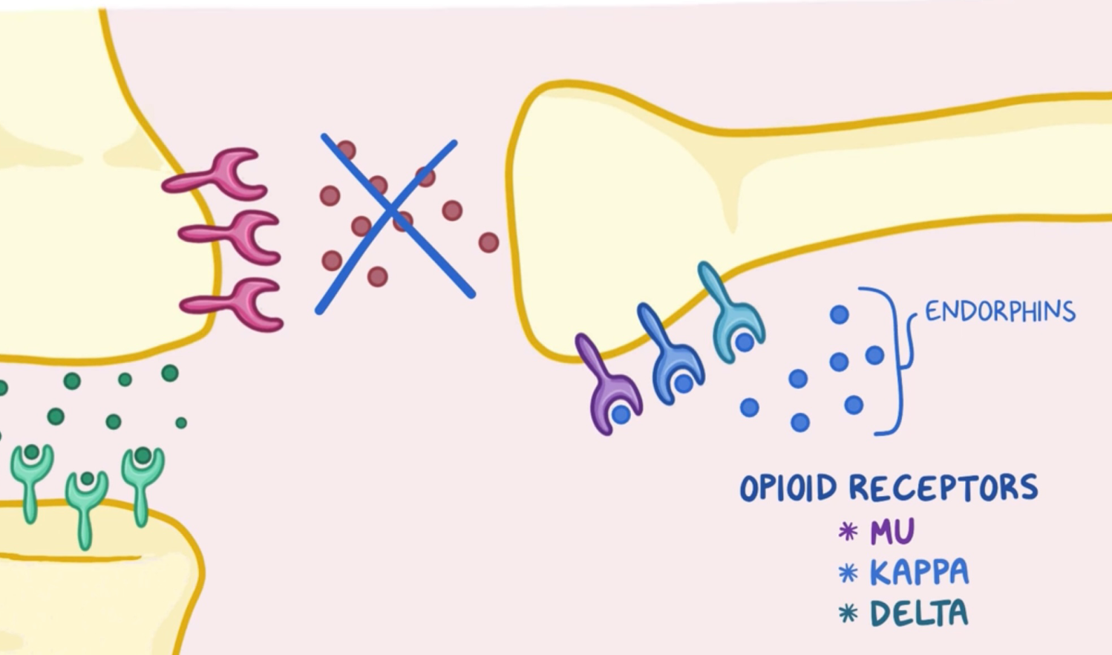
Opioids
When opioids bind its receptors which located in the inhibitory neuron it block the release of GABA allowing dopamine serotonin and norepinephrine to be secreted which causes decreased sensitivity to pain and calming sensation

Slide 30
Opioids
Morphine
Pethidine
Fentanyl
Tramadol
Codiene

Slide 31
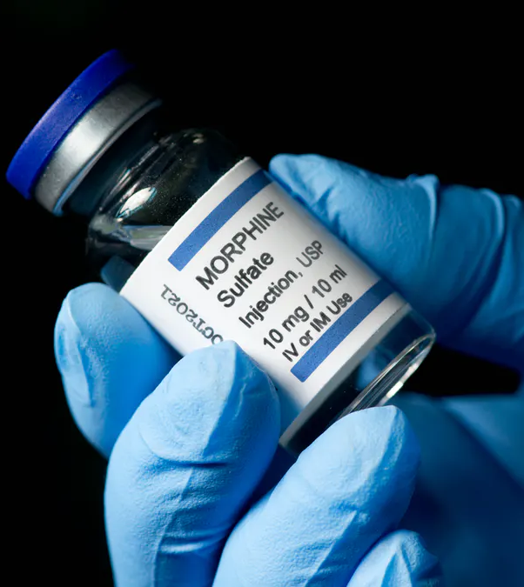
Morphine is a strong analgesic
Higher doses can decrease even severe pain
You should not take this medicine if you have severe asthma or breathing problems or blockage in your stomach
Dose : Bolus: 2-5 mg slowly over 5min (Q 1-3 hrs). IM; 5-10 mg (Q3-4 hrs).

Slide 32
Side effect of morphine
Mood and subjective effects
In patients - Pain relief No addiction
In normal persons dependence and addiction

Slide 33
Codeine
low-efficacy opioid
Pethidine
shorter duration of analgesia (2-3 h)
No antitussive action
Fentanyl
Fentanyl is 80-100 times potent than morphine in analgesia
High lipid solubility
principal use:mild to moderate pain & cough

Slide 34
Adjuvants agents used to induce analgesic effect indirectly
Local anesthetics
Antidepressants
Anticonvulsants
Corticosteroids
Muscle relaxants
Anti histamines

Slide 35
