Slide 1
Chronic Otitis Media

Slide 2
Definition :
Otolaryngologists : a persistent inflammation of the middle ear & mastoid process associated with tympanic membrane perforation , otorrhea and hearing loss (> 12 weeks).
CSOM differs from chronic serous otitis media in that chronic serous otitis media may be defined as a middle ear effusion without perforation that is persist for more than 1-3 months

Slide 4
Classification
Chronic otitis media
Suppurative
Attico-antral type
(Bony)
Tubo-tympanic type
(Mucosal)
Non suppurative
Mucoid or serous
Notes:
Mucosal
1. Affecting the mucosa
2.Less liable to produce complication
3. Muco-purulent discharge
4. Permanent perforation
Otitis media with effusion
Bony
1-Life threatening
2-Perforation is posterio-superior
3Complicated by mastoiditis
4-Associated with chlesteatoma
4-Perforation is posterio-superior

Slide 5
Chronic suppurative otitis media

Slide 6
Chronic suppurative otitis media
Chronic infection of the middle ear with a non-healing perforation of the tympanic membrane
Otorrhea (ear drainage) for 6-12 weeks
Middle ear mucosa becomes edematous, polypoid, or ulcerated
The tympanic cavity usually contains granulation tissue

Slide 7
CSOM Types :

Slide 9
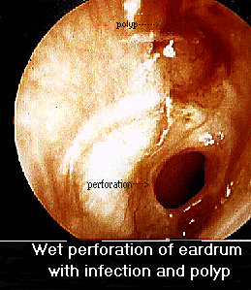
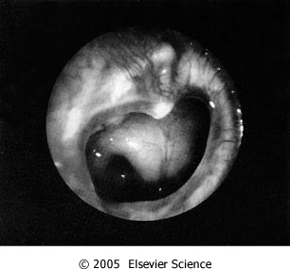
Chronic suppurative otitis media
Patients present with hearing loss and otorrhea
Maybe asymptomatic
Pain, vertigo, fevers, facial nerve palsy, mental status changes or signify impending intra-temporal or intra-cranial complications

Slide 10
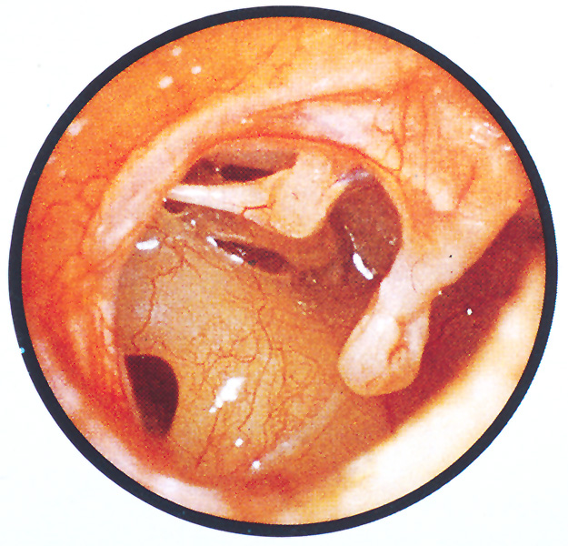
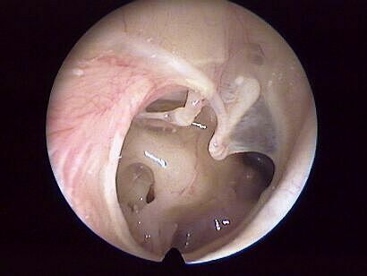
Near Total TM Perforation
Notes:
These more severe perforations. The middle ear structures can be easily seen. Note the malleus handle, umbo, incudostapedial joint, stapedius muscle, stapes in the oval window, and round window. A perforation of this size is likely to require surgical repair.

Slide 11
Pathophysiology
CSOM is initiated by an episode of acute infection.
Irritation and subsequent inflammation of the middle ear mucosa.
The inflammatory response creates mucosal edema.
Ongoing inflammation eventually leads to mucosal ulceration and consequent breakdown of the epithelial lining.
The host's attempt at resolving the infection or inflammatory insult manifests as granulation tissue, which can develop into polyps within the middle ear space.
The cycle of inflammation, ulceration, infection, and granulation tissue formation may continue, destroying surrounding bony margins and ultimately leading to the various complications of CSOM.

Slide 12
Microbiology
Pseudomonas aeruginosa 48%-98% of cases.
S. aureus is the second most common.
Anaerobes make up 20-50% ; tend to be associated with cholesteatoma.
5 to 10% of infections are polymicrobial in etiology, often demonstrating a combination of gram-negative organisms and S. aureus.

Slide 13
Mucosal infection
. Associated with underlying nasal or pharyngeal sepsis that will require attention if the ear is to heal.
copiously mucoid discharge
the perforation is in the pars tensa, large or small that is difficult to be seen.
Serious complications are very rare.
Remember—mucoid discharge from an ear must mean that there is a perforation present, even if you cannot identify it.
The ear may become quiescent from time to time, a feature less likely to happen with bony CSOM, and the perforation may heal. If healing does not occur, surgical repair may be necessary.

Slide 14
signs
Otoscopy :
profuse mucopurulent odorless discharge.
perforation
* Middle ear mucosa:
thin pale & dry (inactive)
congested (active)
granulations
polyps(peduncelated mucosa)

Slide 15
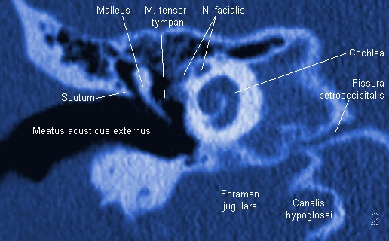
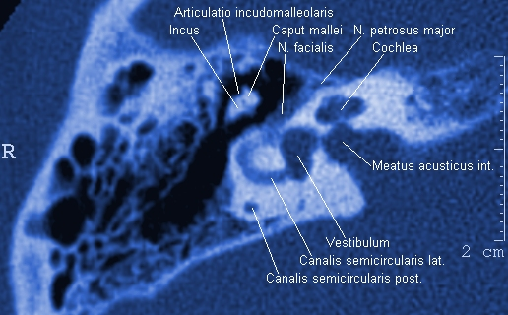
COM Diagnosis
Coronal Section
Axial Section
History, physical examination, high resolution CT scan of the temporal bone

Slide 16
TREATMENT OF MUCOSAL-TYPE CSOM
Ear discharge
1- a swab should be sent for bacteriological analysis.
2- The mainstay of treatment is thorough and regular aural toilet.
3- Ototopical antibiotics in most cases the ear will rapidly become dry. The perforation may heal, especially if it is small.
4- If the ear does not rapidly become dry, admission to hospital for regular aural toilet is often effective.

Slide 17
Dry perforation
When there is a dry perforation, surgery may be considered but is not mandatory.
Myringoplasty is the repair of a tympanic membrane perforation
Success rates for this procedure are very high
repair of the tympanic membrane may be combined with ossicular reconstruction, if necessary, in order to restore hearing— the operation is then referred to as a tympanoplasty.

Slide 18
BONY OR ATTICO-ANTRAL TYPE OF CSOM
The bone affected by this type of CSOM comprises the tympanic ring, the ossicles, the mastoid air cells and the bony walls of the attic, aditus and antrum.
The perforation is postero-superior or in the pars flaccida (Schrapnell’s membrane) and involves the bony annulus.
The discharge is often scanty but usually persistent, and is often foul smelling.

Slide 19
Cont…
Other features:
Granulations as a result of osteitis- bright red and bleed on touch.
Aural polyps- formed of granulation tissue, hich may fill the meatus and present at its outer end.
Cholesteatoma

Slide 20
Cholesteatoma
Cholesteatomas are epidermal inclusion cysts of the middle ear and/or mastoid with a squamous epithelial lining starting as a retraction pocket in the tympanic membrane.
Contain keratinized desquamated epithelium
Can be congenital or acquired
progressive growth with erosion of surrounding bone due to pressure effects and osteoclast activation
The cholesteatoma expands and damages vital structures, such as dura, lateral sinus, facial nerve and lateral semicircular canal.
Cholesteatoma is potentially lethal if untreated

Slide 21
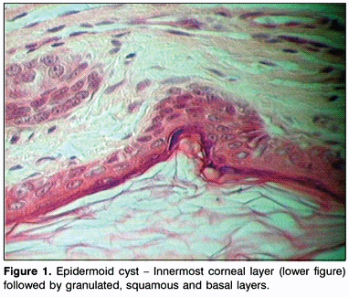
Cholesteatoma

Slide 22
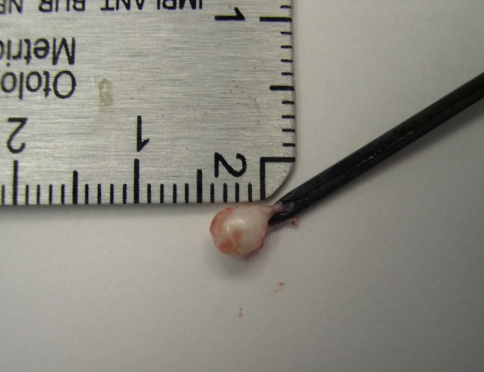
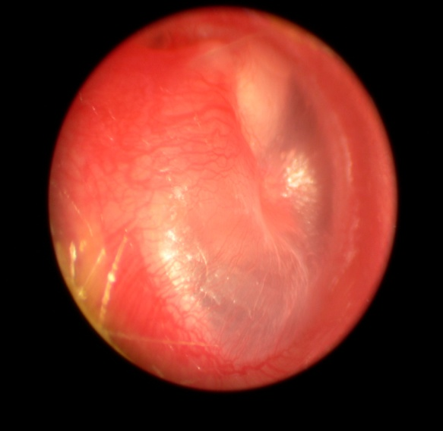
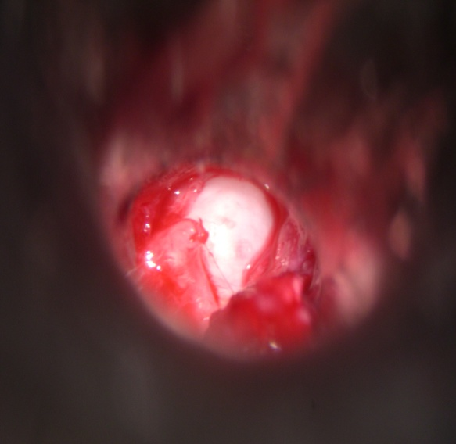
Congenital cholesteatoma
Epidermal inclusion cysts usually present in the anterior superior quadrant of the middle ear near the Eustachian tube orifice
Diagnosed as a pearly white mass behind an intact tympanic membrane in a child who does not have a history of chronic ear disease

Slide 23
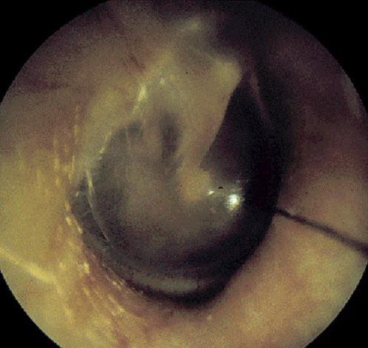
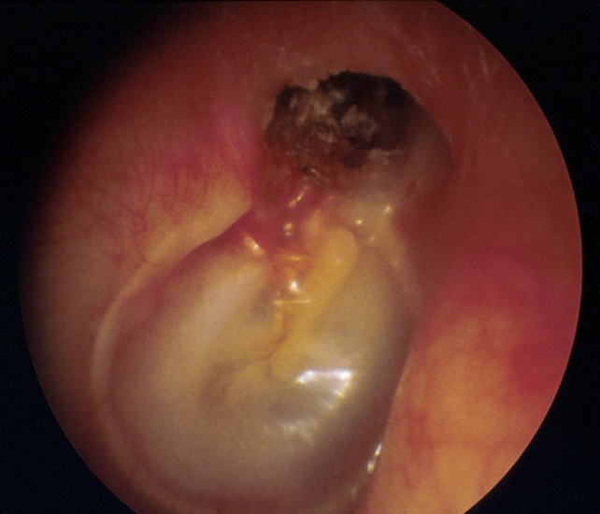
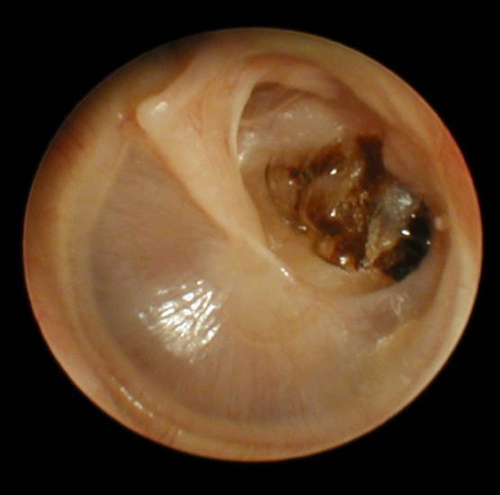
Primary acquired cholesteatoma
Primary called primary as there is no history of previous otitis media or perforation
Retraction pocket cholesteatoma usually within the pars flaccida or posterior superior tympanic membrane
Secondary to ETD
Keratin debris collects within a retraction pocket
Normal TM
Mucoid effusion and primary
acquired cholesteatoma
Mesotympanic cholesteatoma

Slide 24
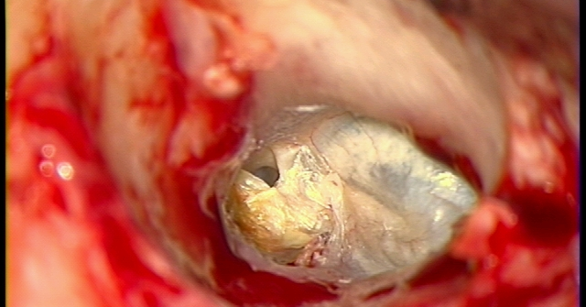
Primary acquired cholesteatoma

Slide 25
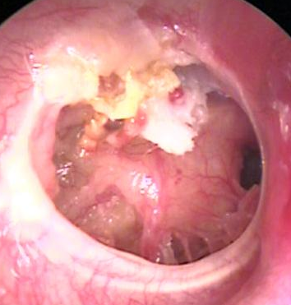
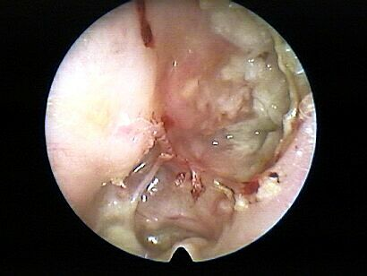
Secondary Acquired Cholesteatoma
Secondary in these cases there is a pre existing perforation
and it’s often associated with posterosuperior marginal perforation or sometimes large central perforation
As the edges of the TM try to heal, the squamous epithelium migrates into the middle ear

Slide 26
Erosion of the attic bone to reveal cholesteatoma.

Slide 27
Clinical features
The main complaint in an uncomplicated ear is of discharge and deafness
The discharge is purulent, foul smelling and scanty in amount,occasionally blood stained
deafness is of slow onset, progressive, and may be associated with tinnitus
However, the development of earache, vertigo, vomiting and headache signify the onset of complications.
The fistula sign may be positive

Slide 28
Investigations

Slide 29
TREATMENT OF BONY-TYPE CSOM
1 Regular aural toilet in early cases of annular osteitis may be adequate to prevent progression, but such a case should be watched closely.
2 Suction toilet under the microscope may evacuate a small pocket of cholesteatoma, and a dry ear may result.
3 Mastoidectomy is nearly always necessary in established cholesteatoma and takes several forms, depending on the extent of the disease

Slide 30
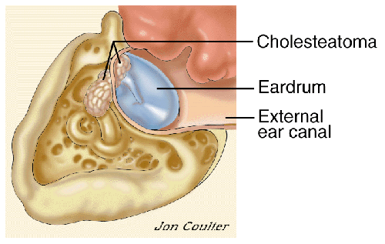
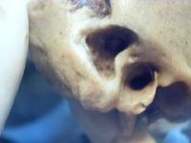
Mastoidectomy
Simple mastoidectomy
Radical Mastoidectomy
Modified Radical Mastoidectomy
Mastiodectomy with tympanoplasty

Slide 31
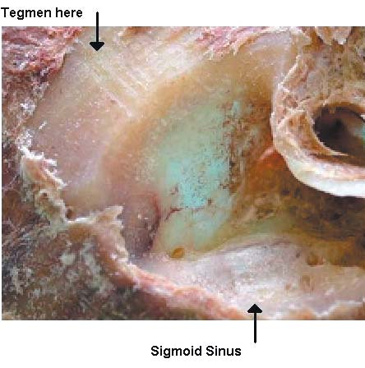
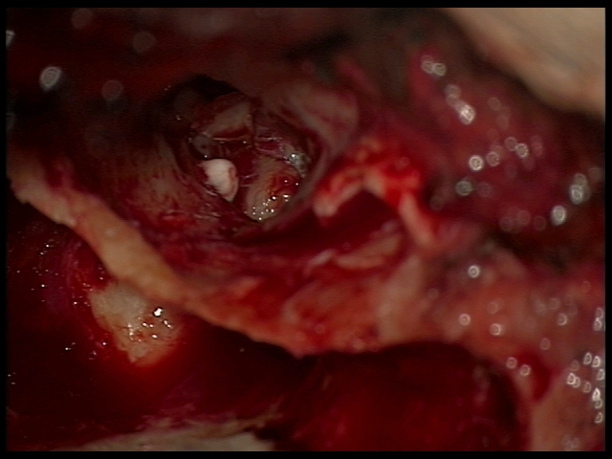
Mastoidectomy
Tympanoplasty with mastoidectomy and hydroxyapatite bone cement ossicular reconstruction

Slide 32
Complications of Otitis Media
Meningeal Nonmeningeal
1. Extradural abscess 1. Mastoiditis
2. Perisinus abscess 2. Petrositis
3. Venous sinus 3. Facial nerve paralythrombosis
4. Otitic hydrocephalus 4. Brain abscess
5. Meningitis 5. Labyrinthitis
6. Subdural abscess 6. Retropharyngeal abscess

Slide 33
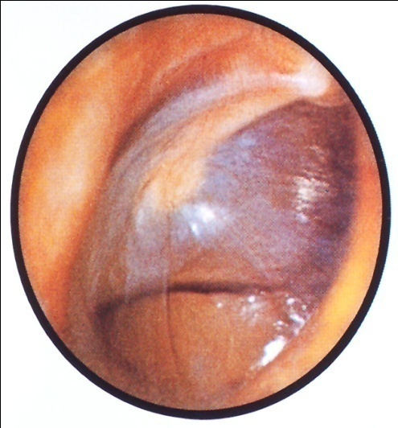
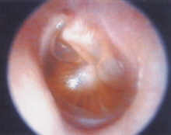
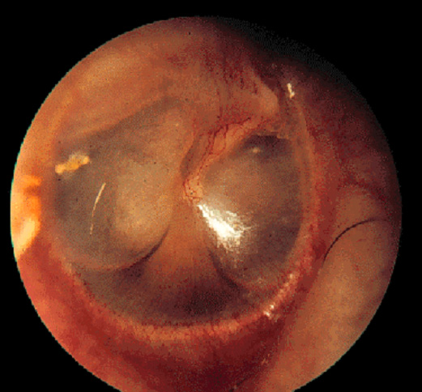
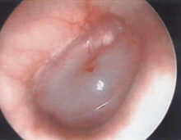
Otitis Media with Effusion (Chronic non-suppurative Otitis Media)
Middle ear filled with serous or mucoid fluid
No purulence
Intact TM
Often present after acute otitis media is treated appropriately with antibiotics
Most will clear within 3 months

Slide 34
Medical Treatment of OME
Observation
Antibiotics
Audiogram at 3 months with persistent effusion to determine impact on hearing

Slide 35
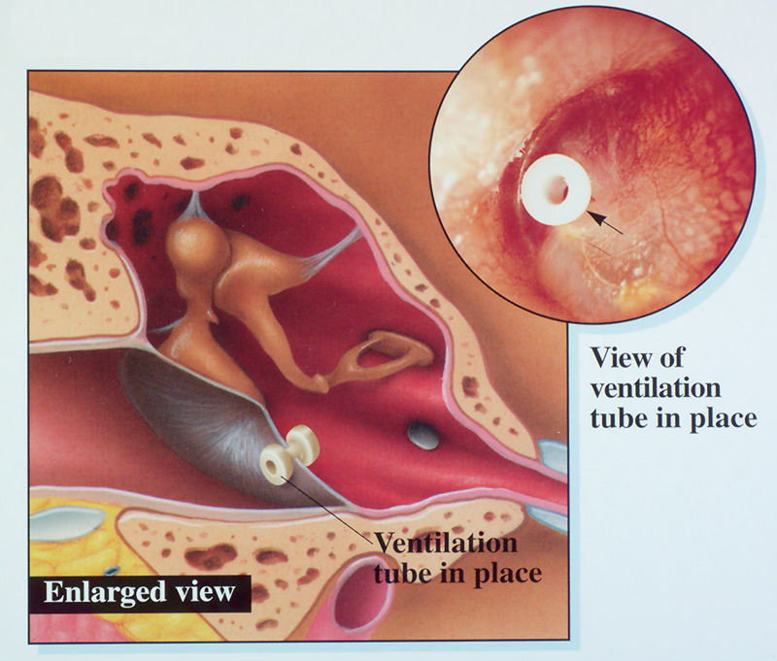
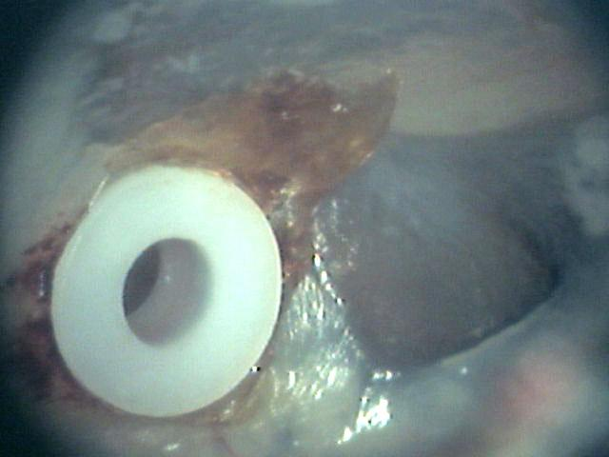
Tympanostomy Tubes
In the US, chronic OME >3mos with hearing loss and/or speech delay is an indication for tympanostomy tube placement
Not just there to “drain fluid”
Bypass Eustachian tube to ventilate middle ear

