Slide 1
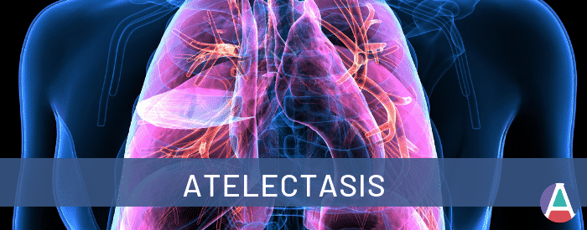
Lung Collapse (Atelectasis)
Majida Akayleh
Karam AlShamayleh
Raheeq fisal

Slide 2
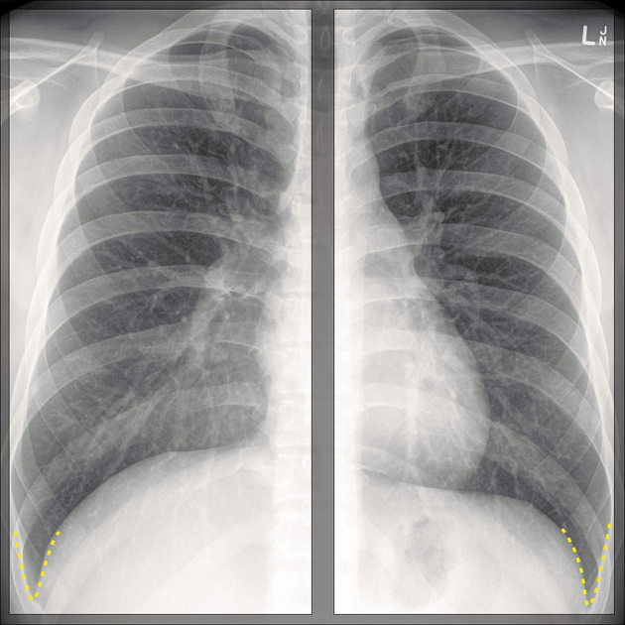
Normal PA Chest X-Ray
Name : S. A.
Sex : male
Age : 20y
Date : 22-5-2020
Projection : PA
Image Quality :
Centralized position ( no rotation )
Full inspiration
First ribs | costophrenic angles | lateral edges of the ribs are all visible
Optimum exposure

Slide 3
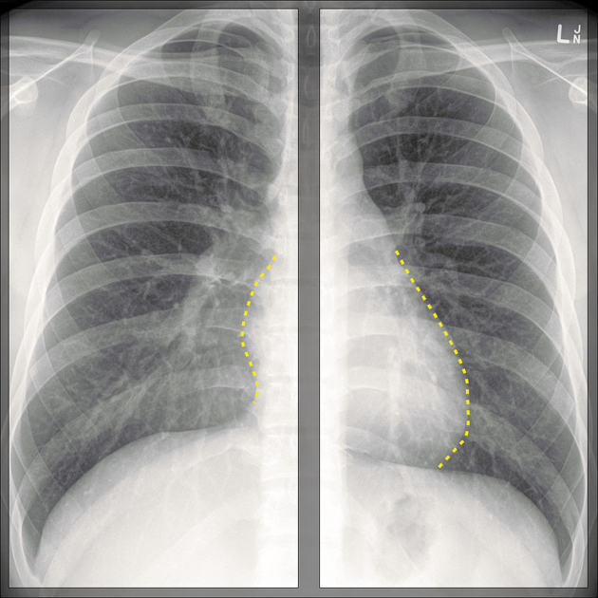
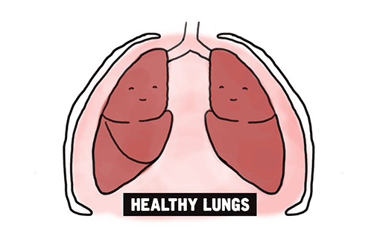
Normal PA Chest X-Ray
Normal equally sized inflated clear lungs
Patent costophrenic angles
Centrally located trachea
Normal cardiothoracic ratio
No bone fractures
clear heart contour
Normal bronchovascuar tapering

Slide 4
R
L

Slide 5
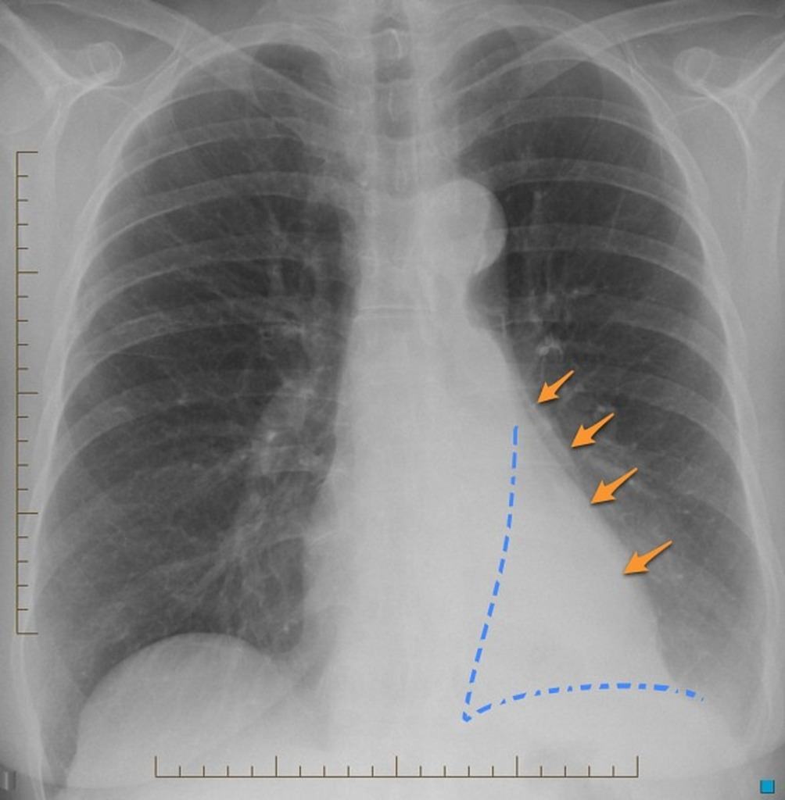
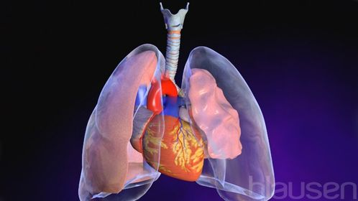
Definition
L
Atelectasis :
Definition : a condition in which alveoli are deflated, collapsed or inadequately expanded resulting in air-devoid alveoli and thus decreased normal parenchymal volume.
Laterality : usually unilateral.
Left lower lobe atelectasis
Note the normal appearance of left heart border (orange arrows) | note the collapsed lobe is triangular or pyramidal in shape, with the apex pointing inwards ( blue triangle).

Slide 6
Direct signs include:
displacement of the interlobar fissures.
crowding of bronchi and vessels within the area of atelectasis.
Indirect signs include:
pulmonary opacification.
signs related to shift of other structures to compensate for the loss of volume (trachea and mediastinum).
hilar shadow displacement.
diaphragm elevation (tenting).
L

Slide 7
1. Resorptive (obstructive) Atelectasis
Atelectasis Types :
2. Compression Atelectasis
The synonym “collapse” is used interchangeably with “atelectasis” in these slides.
3. Contraction (cicatrisation) Atelectasis

Slide 8
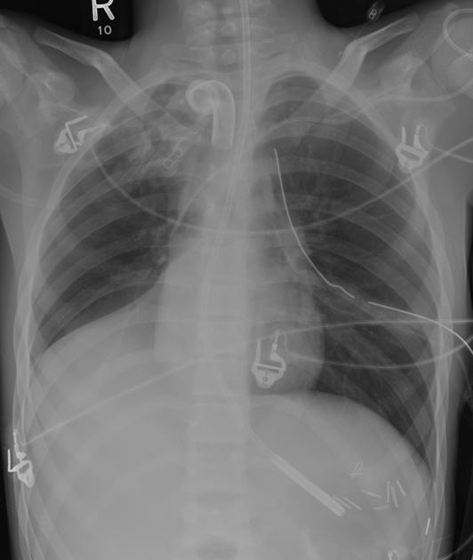
1. Resorptive Atelectasis (obstructive)
Resorptive or obstructive atelectasis is a form of lung collapse that is due to obstruction of the airways supplying a lung segment or lobe.
Obstruction is often :
Mucus plug (asthma, pneumonia, postoperative, post anesthetic)
Foreign body
Neoplasm (mass)
Pus (bacterial pneumonia)
Blood (post-traumatic lung injury)
Fibrotic stricture
Malpositioned endotracheal tube.
RLL Collapse (red arrow)

Slide 9
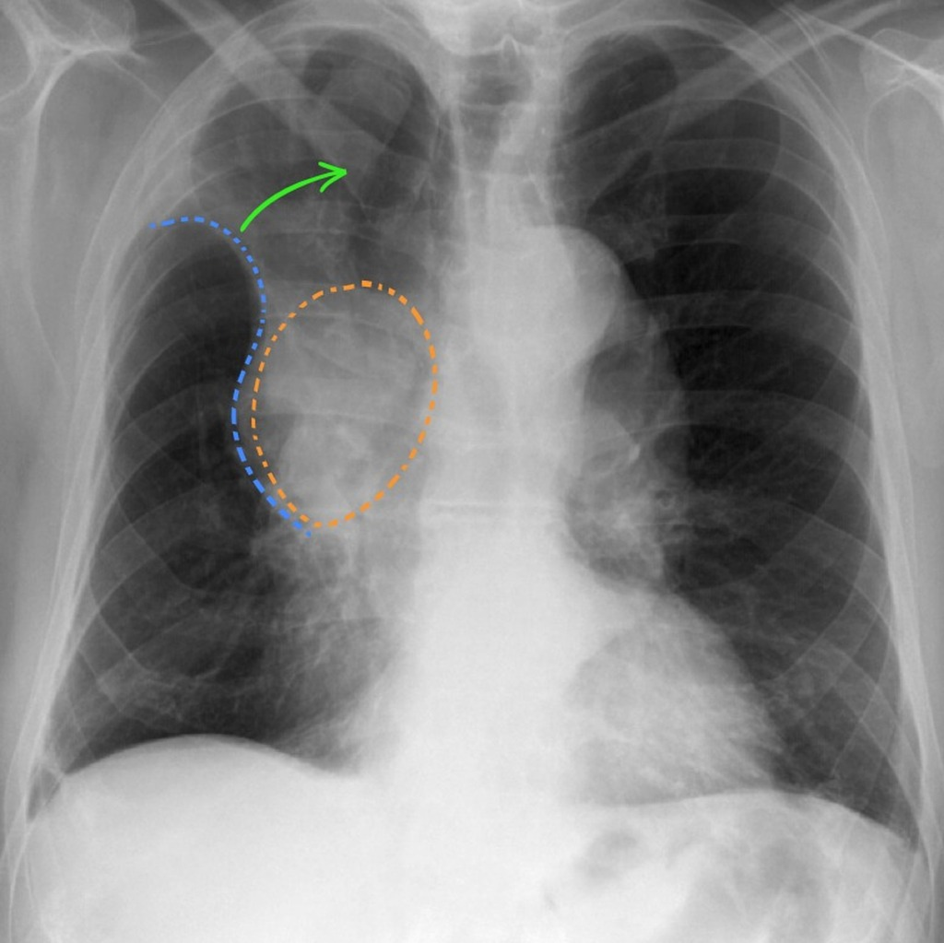
Example 1
R
S-sign of Golden
Right hilar mass (orange) obstructing the right upper lobe bronchus results in collapse of the right upper lobe (green arrow). This results in a reverse S shape to the pleural edge.
Note the ipsilateral tracheal deviation (the trachea is deviated to the right).
RUL Collapse (green arrow)

Slide 10
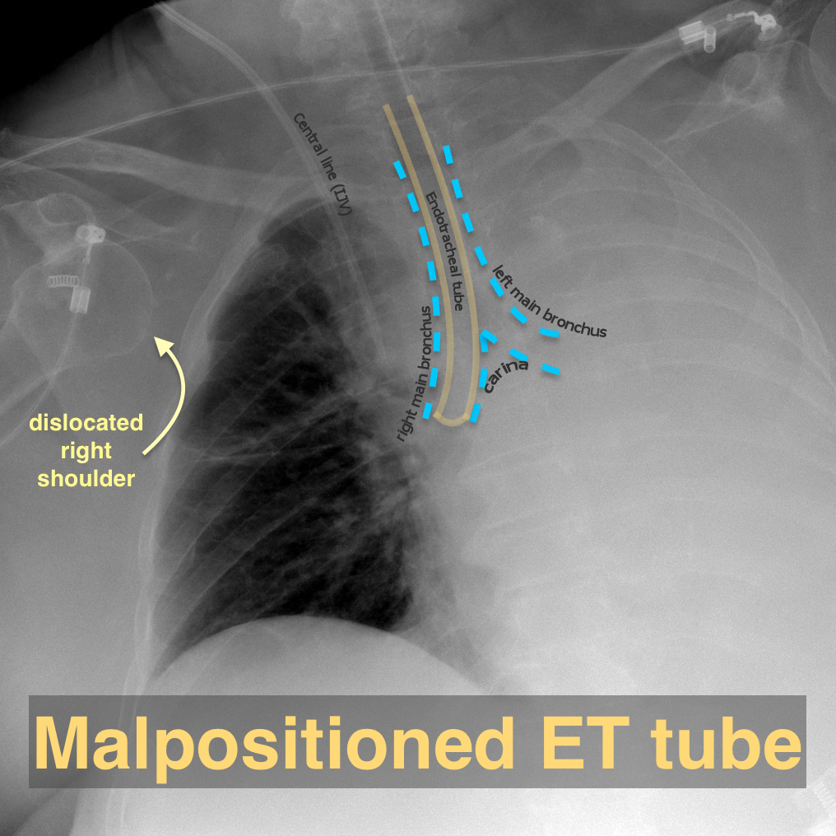
Example 2
R
Resorptive Atelectasis. Malpositioned Endotracheal tube in right main bronchus. Totally atelectatic left lung.
Note how the cardiac shadow was not seen in the right hemithorax as the central mediastinal structures have all shifted to the left due to the total atelectasis of the left lung.

Slide 11
Example 3
L
Although the descending aortic contour is distinct superiorly (straight arrows), the distal descending aortic silhouette is obscured (curved arrow) because of the adjacent collapsed left lower lobe.
Chest x-ray of a patient with asthma and a mucus plug shows lower left lobe collapse

Slide 12
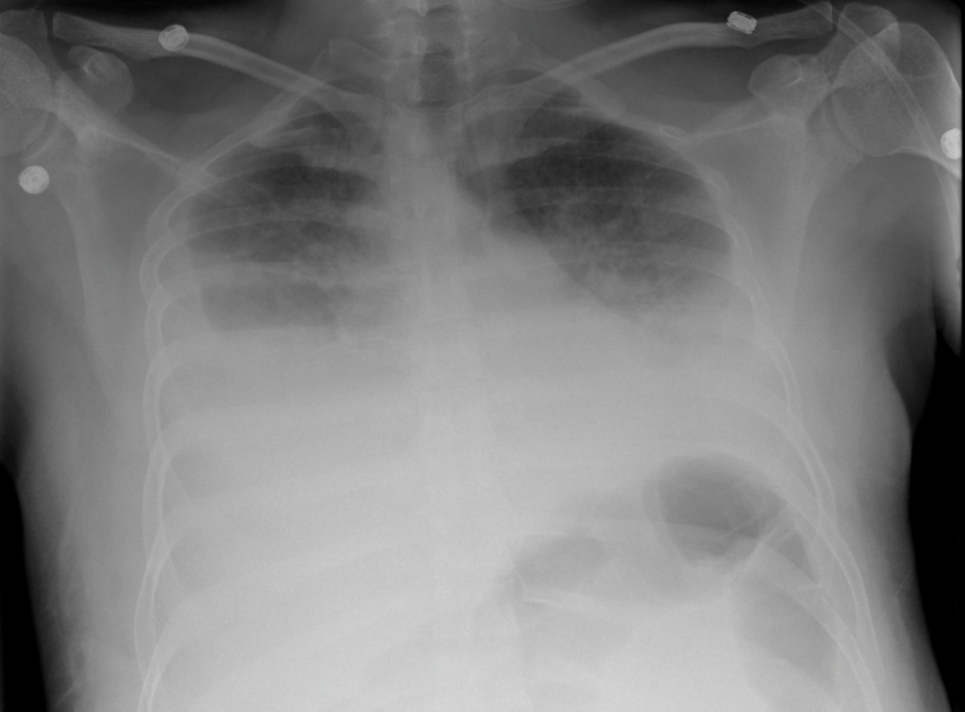
2. Compressive Atelectasis
Compressive atelectasis refers to a form of lung atelectasis due to compression by a space-occupying process.
Aetiology :
Extrapulmonary (pleural effusion, empyema, haemothorax, pneumothorax, pleural tumor, chest wall mass lesion)
Intrapulmonary (lung cancer)
Abdominal distension (hepatosplenomegaly, massive ascites, large intra-abdominal tumor, morbid obesity, pregnancy)
R
Large Pleural Effusions : compressive atelectasis

Slide 13
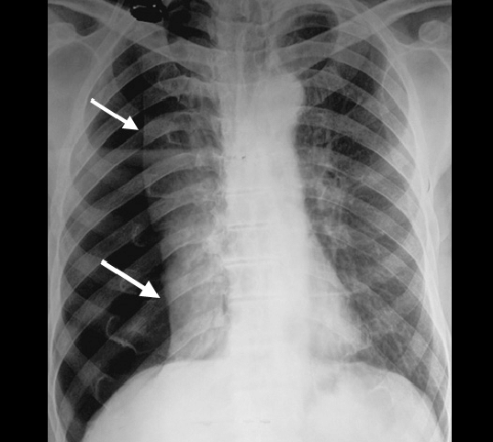
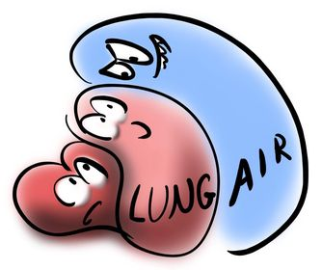
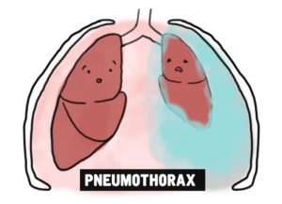
Example 1
Right sided pneumothorax. Collapsed lung is demarcated by arrows
L
Note the Positive silhouette sign (disappearance of right heart border) due to collapsed lung

Slide 14
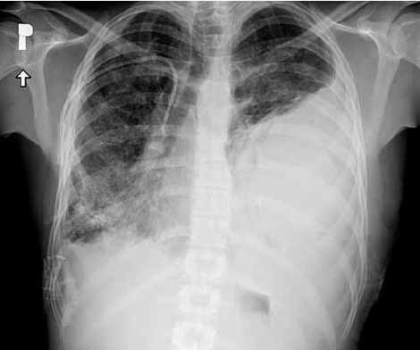
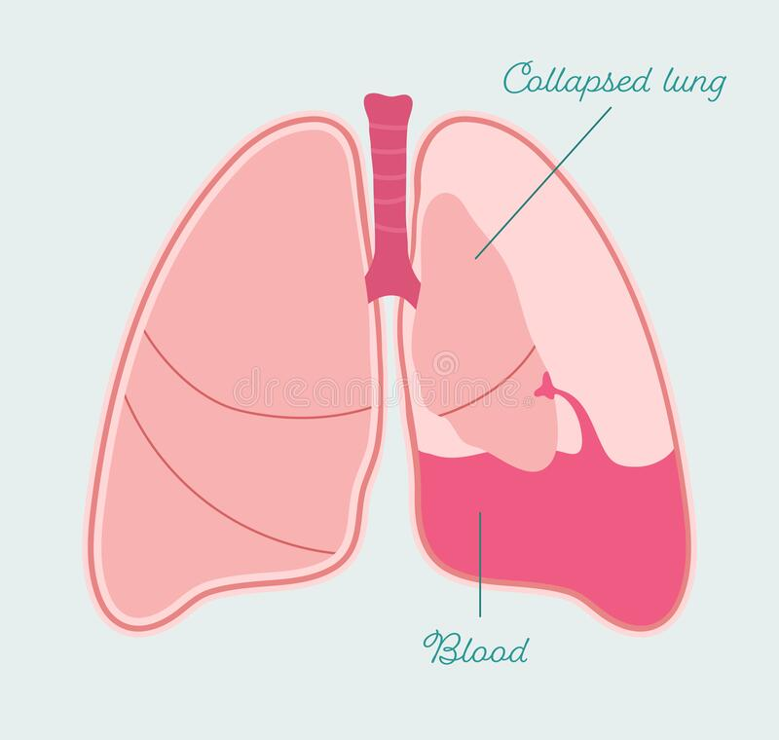
Example 2
L
Chest X-ray – left-sided massive haemothorax resulting in progressing left lung collapse

Slide 15
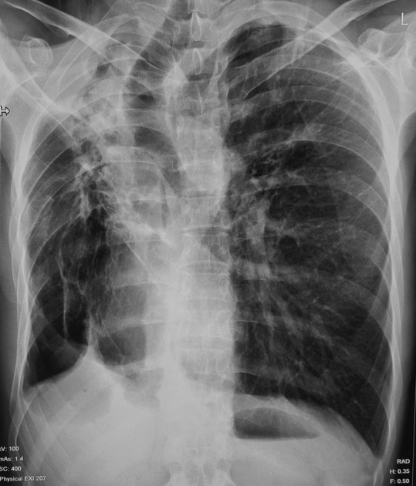
3. Contraction (Cicatrisation) atelectasis
Contraction or Cicatrisation atelectasis : is a form of lung atelectasis which occurs as a result of scarring or fibrosis that reduces lung expansion. Cicatrisation atelectasis is classic in tuberculosis.
Aetiology
granulomatous disease especially tuberculosis
necrotizing pneumonia
any fibrosing process (silicosis, scleroderma, idiopathic pulmonary fibrosis)
chronic pulmonary tuberculosis resulting in contraction atelectasis.

Slide 16
Example 1
Cicatrisation collapse of right upper lobe in a patient with chronic pulmonary tuberculosis.
Right upper lobe collapse (red arrow) due to fibrosis and pleural thickening with right sided tracheal (yellow arrow) and mediastinal shift (blue arrow), crowding of right upper ribs, uplifting of right hilum (not well demarcated in figure)
The left lung is hyperinflated compensating the mediastinal shift (note the large shadow of left lung).

Slide 17
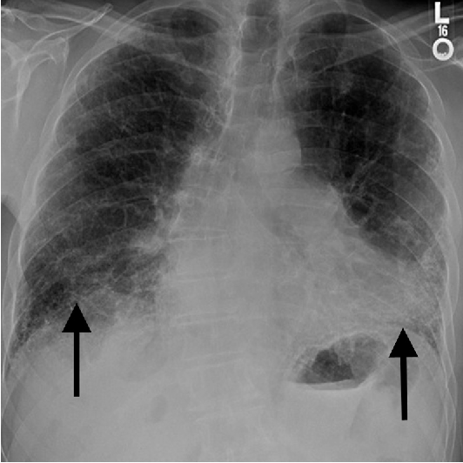
Example 2
Interstitial pneumonitis (scleroderma):In contrast to tuberculosis this diseases do not usually result in segmental or lobar opacities. The volume loss tends to be bilateral in the radiologic appearance and increased basilar opacity, crowding of vessels, and elevation of the diaphragm.
Chest x-ray in a patient with advanced interstitial lung disease and pulmonary fibrosis shows coarse interstitial markings at the lung bases (arrows) and volume loss (clear in left lung)

Slide 18
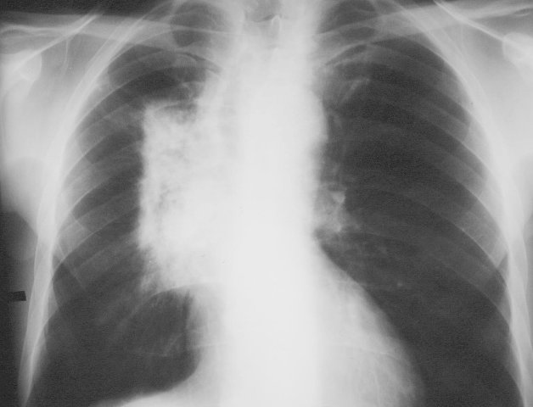
Example 3
L
Radiation pneumonitis (radiation therapy induced fibrosis) leaves scarring in the lung with significant volume loss during its later stages
L
It is frequently localized by sharply defined lines (red arrows) that coincide with the portals of the radiation therapy beam to which the patient was exposed.

Slide 19
NOTES
Sign and symptoms :
1.Difficulty breathing
2.Rapid, shallow breathing
3.Wheezing
4.Cough
Both obstructive resorptive & compression atelectasis are reversible | on the contrary contraction (cicatrisation) atelectasis is irreversible
Mediastinal and tracheal shift to the affected side in obstructive atelectasis, to the counter side in compressive atelectasis and mostly (not always) absent in contraction atelectasis.

Slide 20
Complication
[ ] 1.systemic hypoxia if atelectasis is significant enough (affected ventilation/perfusion ratio).
[ ] 2.increased incidence of pneumonia (infections due to settled secretions that accumulate in the affected area).
- [ ] 3. Respiratory failure.

Slide 21
Case study
A 62-year-old man is dyspneic 24h after cholecystectomy. His respiratory rate is 22/min and pulse 112/min. He has a mild fever, and decreased breath sounds are noted in the left lower lobe. Complete blood count shows leukocytosis 27,000/mm^3.
This is typical post operative lung atelectasis, most commonly seen in immediate post operative period, often secondary to poor inspiration or lack of coughing, large quantities of bronchial secretions, increased aspiration incidence and dimensioned surfactant activity with diaphragm dysfunction.

