Slide 1
Secondary Hypertension
Presented by:
Hala AL-Tarawneh
Esra’a Jamal

Slide 2
Definitions
▪ 2017 ACC/AHA: persistent systolic blood pressure (SBP) ≥ 130 mm Hg and/or diastolic blood pressure (DBP) ≥ 80 mm Hg
▪ 2020 International Society of Hypertension (ISH) and 2014 JNC 8: persistent SBP ≥ 140 mm Hg and/or DBP ≥ 90 mm Hg

Slide 3
Types of Hypertension
Primary Essential Hpertension; - Essential hypertension is the term applied to the 80-95% of hypertensive patients in which elevated blood pressure results from complex interaction between multiple genetic and environmental factor
2. Secondary Hypertension - It accounts for only 5-20% of hypertensive patients
- A specific underlying disorder causing the elevation of blood pressure.

Slide 4
Causes of Secondary Hypertensio
Most common causes in adults include:
O < 40 years of age: thyroid dysfunction, fibromuscular dysplasia, and renal parenchymal disease
o 40–64 years of age: hyperaldosteronism, thyroid dysfunction, and obstructive sleep apnea
o ≥ 65 years of age: renal artery stenosis ▪
Most common causes in children and adolescents (< 18 years of age) include renal parenchymal disease and coarctation of the aorta

Slide 5
RECENT: Renal (e.g., renal artery stenosis, glomerulonephritis), Endocrine (e.g., Cushing syndrome, hyperthyroidism, Conn syndrome), Coarctation of the aorta, Estrogen (oral contraceptives), Neurological (raised intracranial pressure, psychostimulants use), and Treatment (e.g., glucocorticoids, NSAIDs) are the causes of secondary hypertension.

Slide 6
Signs Suggestive of Secondary Hypertension
Severe hypertension
Unusual onset of hypertension
Unprovoked or significant hypokalemia
o Resistant hypertension o Target organ damage disproportionate to the degree of hypertension
o Hypertensive emergency
o Abrupt onset
o Onset at < 30 years of age
o Onset of diastolic hypertension at > 65 years of age
o Exacerbation of previously controlled hypertension
o Drug-induced hypertension

Slide 7
Renal Hypertension
Renal Parenchymal Disease
Renal diseases is the most common causes of secondary hypertension. ▪ Secondary HTN is more severe in glomerular diseases than in interstitial diseases.
causes:
Pyelonephritis
Neprocalcinosis
Glomerulonephritis
Polycystic kidney disease
Neoplasm
Analgesic nephropathy
Gout with renal failure
Obstructive nephropathy

Slide 8
Renovascular Hypertension

Slide 9
▪ Renal artery stenosis is a common cause of secondary hypertension with 2% prevalence ▪ Hypertension is mainly due to renal artery stenosis which can be unilateral or bilateral ▪ The most common cause of renovascular disease in Western population are atherosclerotic disease in 60% of elderly population and fibromuscular dysplasia in 35% of young ▪ Fibromuscular dysplasia sometimes produce total occlusion and can be associated with renal artery aneurysm. ▪ Atherosclerotic disease cause the proximal segment renal artery stenosis and fibromuscular dysplasia involves the distal segment of renal artery.

Slide 10
▪ Potential indications for further workup in renal artery stenosis :
o Resistant hypertension
o Recurrent flash pulmonary edema
o Abdominal bruit
o ↑ Serum creatinine (by ≥ 50%) within 1 week of starting an ACEI or ARB
o Hypokalemia o Asymmetric kidney size
Workup and findings: Duplex ultrasonography or MRA or CTA of the renal arteries
3.Chronic kidney disease

Slide 11
Endocrine Hypertension
1. Primary Hyperaldosteronism (Conn Syndrome)
▪ Definition: Primary aldosteronism is due to excess aldosterone secretion by the adrenal cortex, secreted generally by adenomas and occasionally due to bilateral adrenocortical hyperplasia. ▪
The prevalence varies from <2% - 15% of hypertensive individual. This is potentially
curable form of hypertension.
▪ In these pt. increased aldosterone production is independent of renin-angiotensin
system and the consequences are;
1. Sodium retention
2. Hypertension
3. Hypokalemia
4. Low Plasma renin activity(PRA)
▪ suspected in a case of hypertension showing persistent hypokalemic metabolic alkalosis
in the absence of diuretic therapy.
▪

Slide 12
▪ Potential indication for further workup
o Resistant hypertension o Stroke at < 40 years of age
o Family history of early-onset hypertension and/or primary hyperaldosteronism
o Adrenal incidentaloma
o Possible hypokalemia with consequent metabolic alkalosis

Slide 13
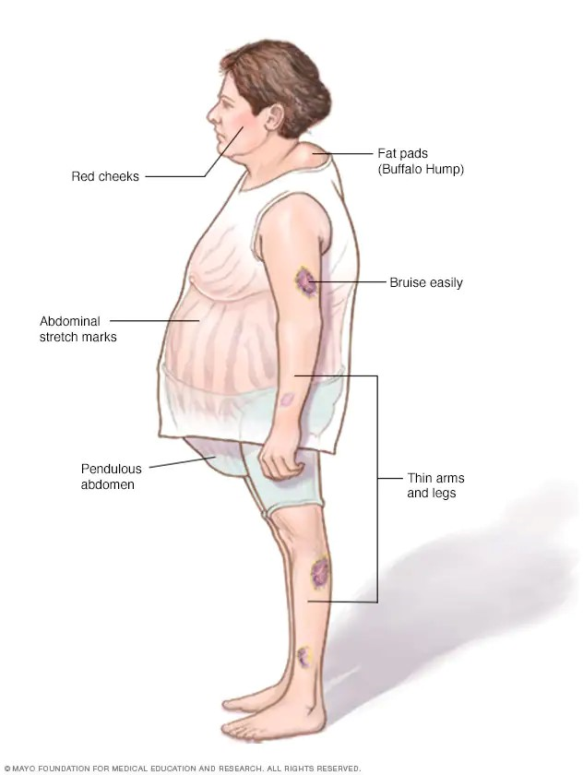
2. Hypercortisolism (Cushing Syndrome)
▪ Hypertension occurs in 75-80% of patients with Cushing syndrome.
▪ The mechanism may be related to stimulation of mineralocorticoid receptor by cortisol and increased secretion of other adrenal steroids.
▪ This syndrome is related to excess cortisol production due to either ACTH secretion (from pituitary tumor or an ectopic tumor) or ACTH independent adrenal production of cortisol as well as administration of exogenous glucocorticoid.
▪ ↑ Serum cortisol following a low-dose dexamethasone suppression test

Slide 14
3. Pheochromocytoma
▪ This is uncommon found in approximately 2 individuals per million population.
▪ Pheochromocytoma is catecholamine secreting tumor of adrenal medulla
▪ Hypertension is primary related to increased circulating catecholamine (norepinephrine, neuropeptide y) and other vasoactive substance but in few cases epinephrine is main catecholamine which produce hypotension rather than hypertension.
▪ ↑ 24-hour urinary fractionated metanephrines , ↑ Plasma metanephrines
▪ Potential indication for further workup
o Resistant hypertension
o Paroxysmal hypertension
o Episodes of headaches, palpitations, and diaphoresis
o Family history of endocrine tumors o Cutaneous features suggestive of NF type 1

Slide 15
Common Causes of Endocrine Hypertension | Potential Indication For Further Workup | Typical Findings
Hyperthyroidism | Heat intolerance, diarrhea, tachycardia, and/or tremor | ↓ TSH, ↑ free T4 ↑ PTH level ↓ Serum phosphates ↑ 17-hydroxyprogesterone
Primary Hyperparathyroidism | Typically asymptomatic ↑ Serum calcium
Congenital Adrenal Hyperplasia | ▪ 11β-hydroxylase deficiency: virilization ▪ 17α-hydroxylase deficiency : Incomplete masculinization (males) Primary amenorrhea (females) ▪ Hypokalemia

Slide 16
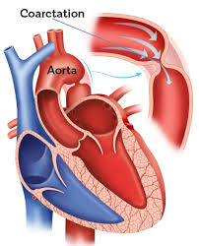
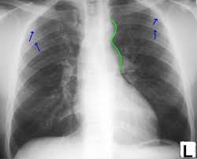
Other Cause of Secondary Hypertension
1. Coarctation of Aorta
▪ most common congenital cardiovascular cause of hypertension
▪ 35% of children is associated with Turner syndrome.
▪ Coarctaion of aorta consists of localized narrowing of aortic arch just distal to the origin of the left subclavian artery.
Clinical presentation :
o differential systolic BP in arms and leg
o diminished/absent femoral artery pulse
▪ Diagnosis may be confirmed by chest x-ray and trans esophageal echocardiography.
▪ Therapeutic options include surgical repair and balloon angioplasty.

Slide 17
2. Obstructive Sleep Apnea
3. Substance-Related
▪ Pathophysiology: ↑ catecholamines during apneic phases → secondary hypertension ▪
Potential indications for further workup
o Resistant hypertension
o Obesity, snoring, and/or daytime sleepiness o Nondipping pattern on 24-hour blood pressure monitoring
▪ Workup and findings: sleep studies often leads to resolution of hypertension. ▪ Continuous positive airway pressure (CPAP)
▪ Potential indications for further workup o Recreational drug use: amphetamines, cocaine, phencyclidine
o Caffeine, nicotine, and/or alcohol use
o Use of certain medications: sympathomimetic drugs (e.g., decongestants), corticosteroids, NSAIDs, oral contraceptives ▪ Workup and findings
o Urine drug screening o Response to withdrawal of suspected culprit 
Management ▪ Management of secondary hypertension depends on the suspected cause

Slide 18
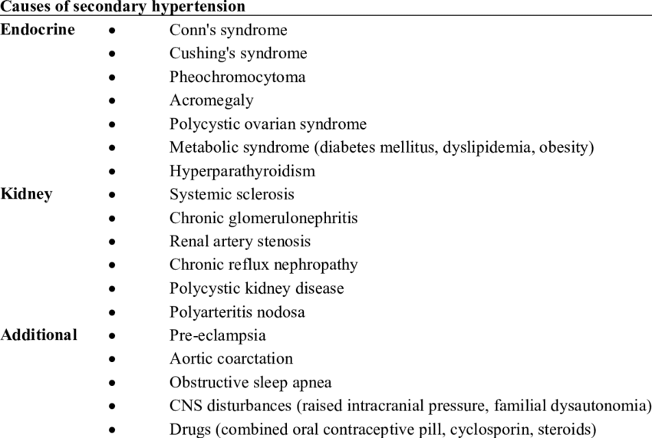
THANKS GOOD LUCK

