Slide 1
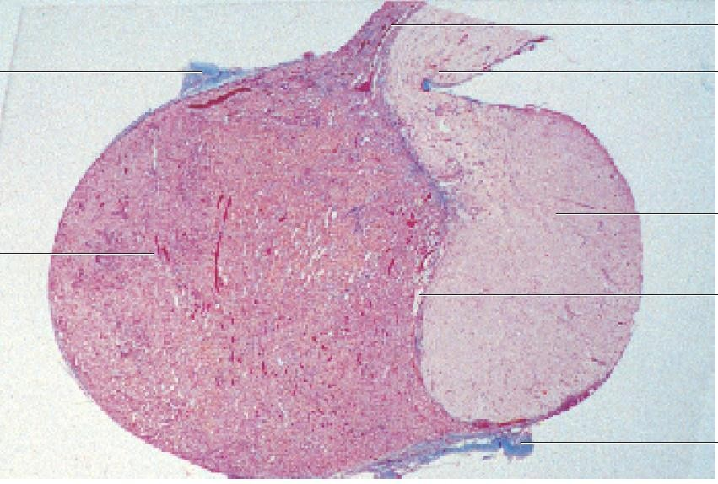
PITUITARY GLAND
Infundibular stalk
Pars tuberalis
B.Vs in parenchyma
Pars nervosa
Pars intermedia
Pars distalis
Adenohypophysis (anterior lob), dark
Neurohypophysis (posterior lob), pale
Nuclei of parenchymal cells

Slide 2
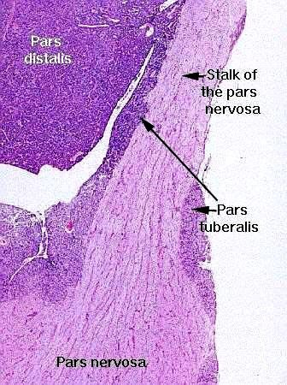
PITUITARY GLAND
Full of cells
Rathke’s pouch
Pars intermedia
Pale, full of fibers (unmyelinated axons) come from supraoptic + paraventricular nuclei to transmit neuro secretions
Highly vascular region containing the veins of the hypophyseal portal system and wraps the infundibulum. Contain chromophobes

Slide 3
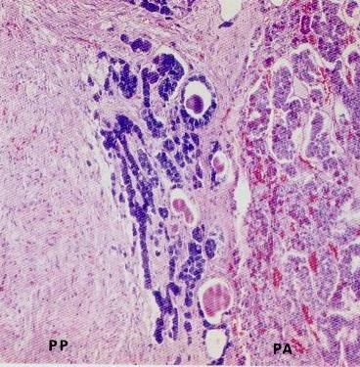
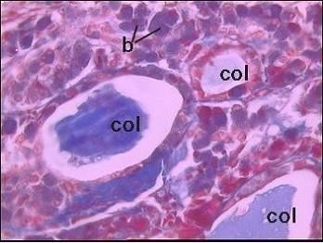
Pars Intermedia
Pars intermedia in animals (presence of colloid)
Human/ unclear function (rudimentary)
animals / the basophilic cells produce melanocyte stimulating hormone (MSH
Posterior lobe (pale)
Pars intermedia (cyst)
Anterior lobe (dark)

Slide 4
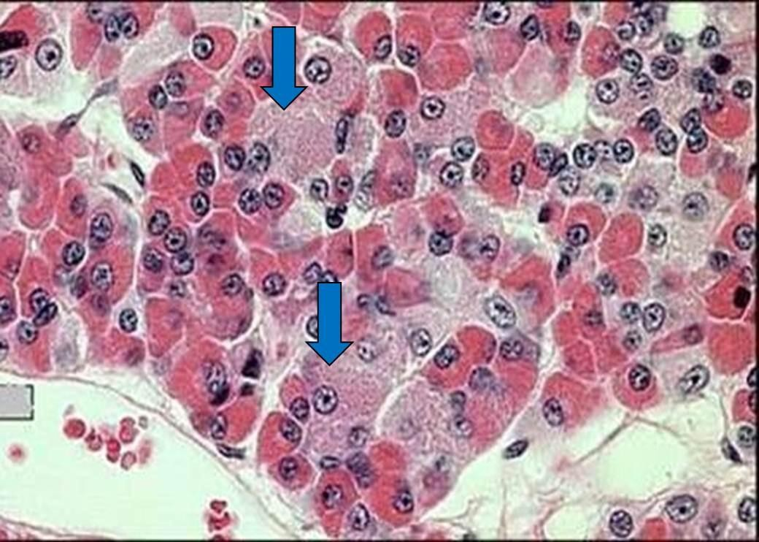
Pars distalis =adenohypophysis
Chromophils
Acidophils 37%
Basophils 11%
Chromophobes 52% mostly found in pars tuberalis
Fenestrated sinusoids
Basophil
Acidophil

Slide 5
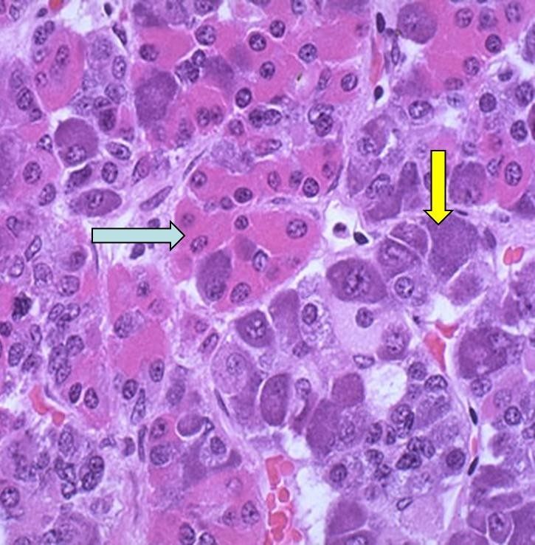
Acidophils
Somatotrophs
Growth H.
Mammotrophs
Prolactin
Small in ♂and non preg ♀
Large irregular in pregnant and lactating
♀(Erdheim cells)
Crinophagy:
when suckling is terminated, lysosomes eliminate the excess secretory granules
Basophils :
TSH
FSH,LH
ACTH
Acidophil
Basophil
شكل السؤال: بتجيب صورة عادية زي اللي فوق و بتأشر على وحدة من الخلايا وبتحكيلك شو بتفرز هاي الخلية بدون ما تحكي اسمها, ف المفروض نكون عارفين اسم الخلية وشكلها وشو بتفرز. الخلايا الحمضية في الها نوعين وكل نوع بفرز هرمون, والخلايا القاعدية الها 3 انواع وكل نوع بفرز هرمون

Slide 6
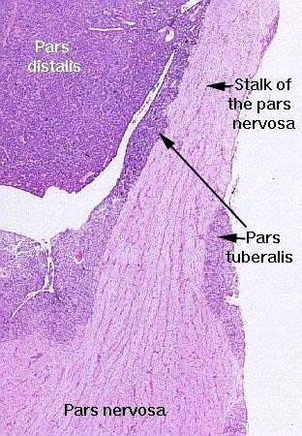
Where is oxytocin stored ?
Pars intermedia
Pars tuberalis
Infundibulum
Pars distalis
Pars nervosa
C
D
1
2
Rathke’s pouch
A
B
E
3

Slide 7
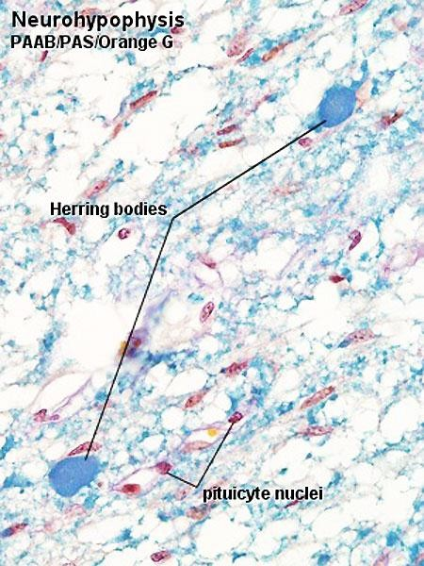
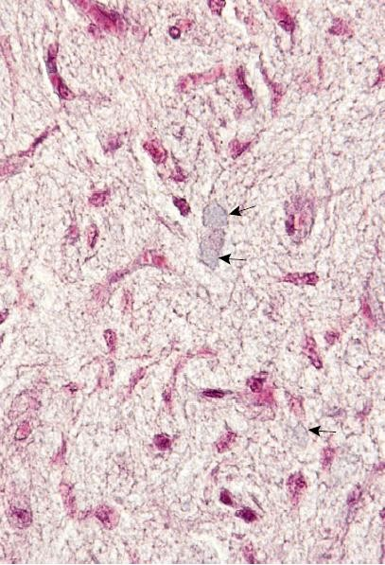
Neurohypophysis
Herring bodies
Unmyelinated axons
Herring bodies (ADH, Oxytocin)
Pituicytes. modified glial cells having supportive , nutritive and insulating function
Rich blood capillary plexus
Pituicyte

Slide 8
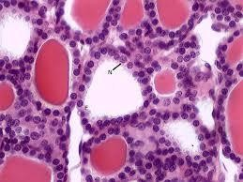
Thyroid
Follicular cells (most numerous produce T3, T4)
Parafollicular (clear) cells (few in num. produce calcitonin)
Interfollicular cell
Thyroid gland→ stroma is double capsule (false + true capsule), contain incomplete lobulation, cells arranged in follicles, secretion of para follicular cells doesn't release directly to blood but stored in colloid until we need it, colloid released to blood by phagocytosis

Slide 9
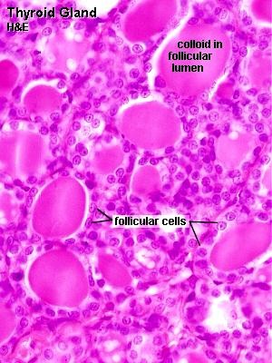
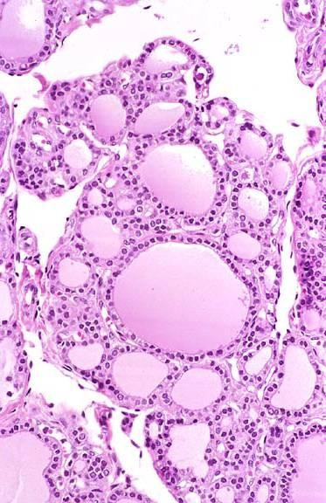
Thyroid

Slide 10
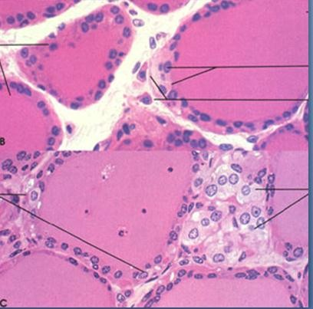
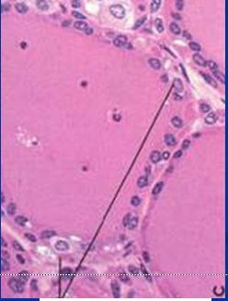
Follicular cells
Interfollicular cells
Parafollicular (clear = pale) cells
Thyroid
Para follicular cells

Slide 11
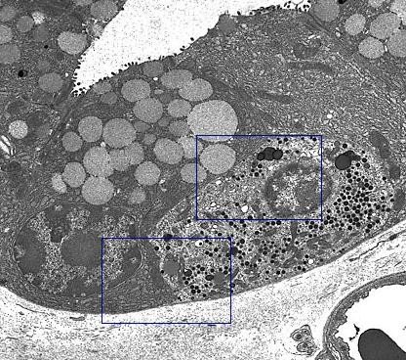
EM of thyroid follicle
Granules of Para follicular cells present at the base near B.V to release its content directly to blood
Follicular cell
Para follicular cell
B.V

Slide 12
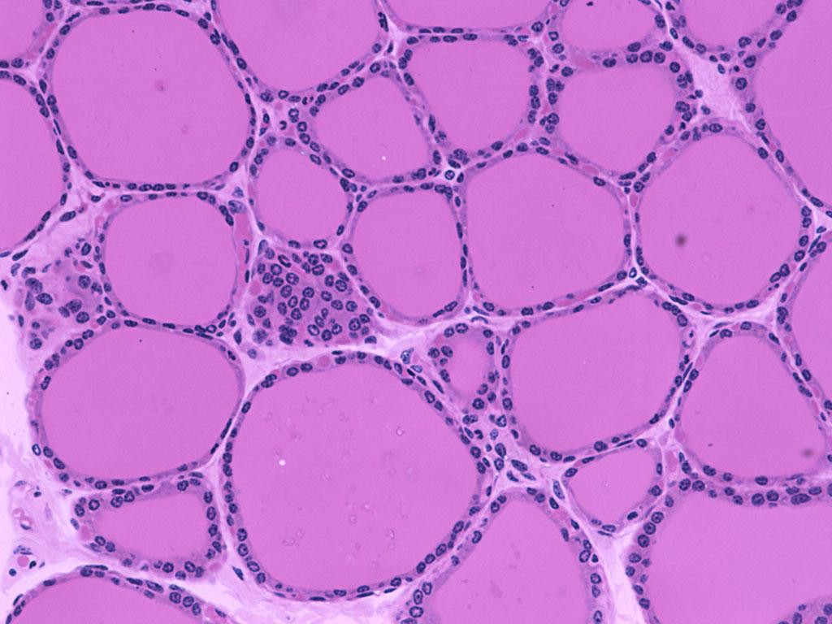
Interfollicular cells
lining epithelium of follicular cells is cuboidal in normal state. in hypoactive state they become columnar in shape, in hyperactive state they become flattened

Slide 13
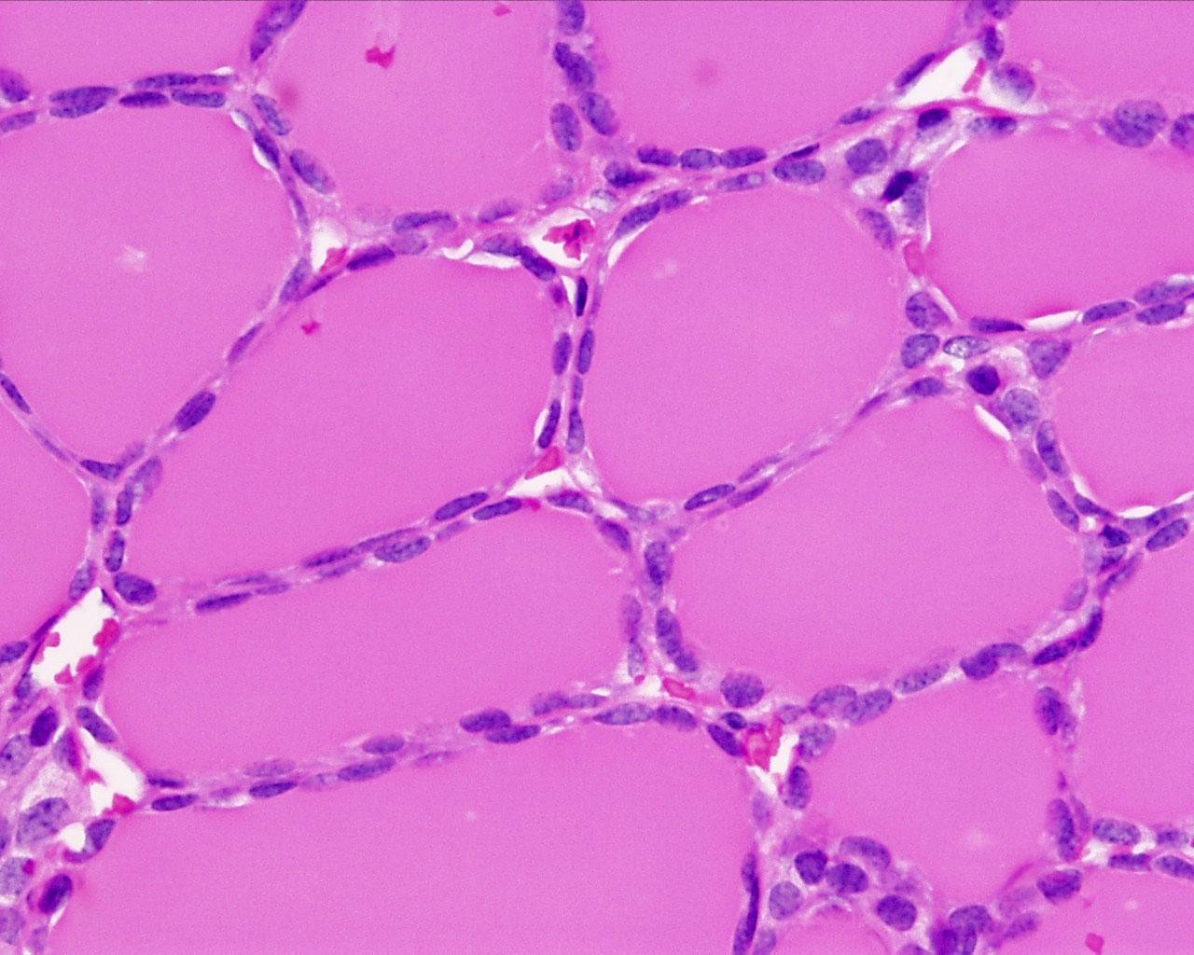
Thyroid
Follicles of thyroid gland

Slide 14
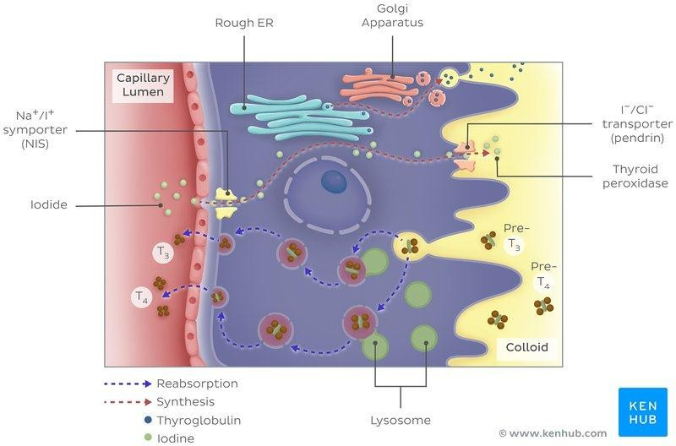
Formation of thyroid hormones
1-organelles of protein synthesis produce thyroglobulin hormone (precursor)
2-Tg transmitted by exocytosis to lumen of follicles to stored as colloid
3-iodine enter from the blood →cell→ lumen, to iodinate the precursor
4-iodinated Tg stored in the lumen until we need it
5-when we need it, the iodinated Tg re-enter the cells by endocytosis
6-inside cells there is numerous lysosomes which will take the precursor and break it down, then it released to blood as T3, T4
1
2
3
4
5
6

Slide 15
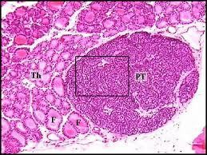
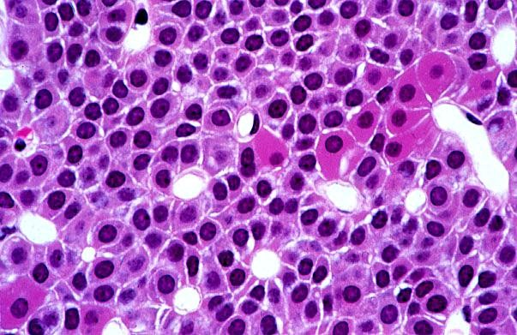
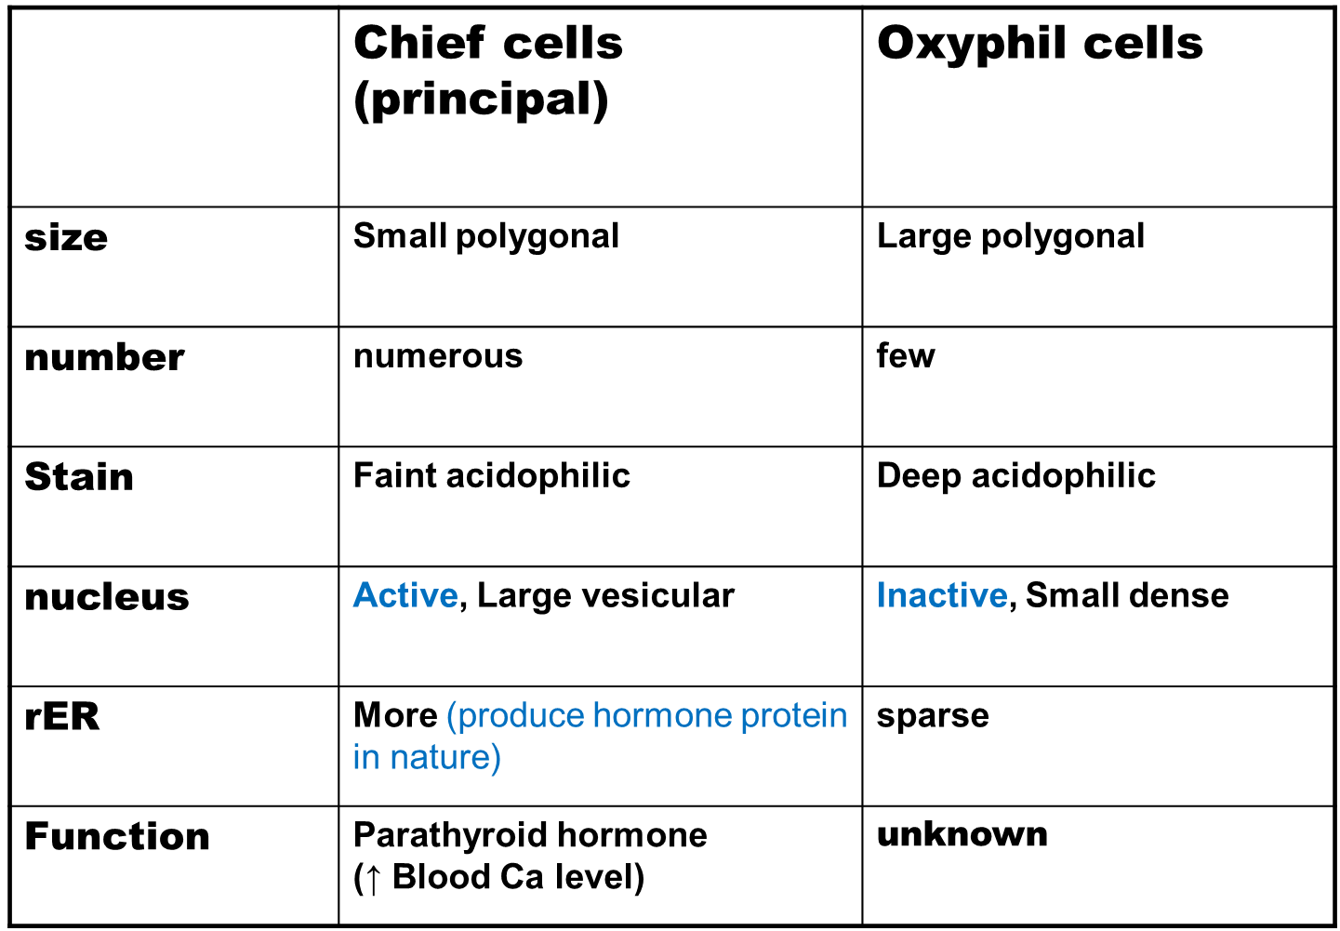
Parathyroid gland
Two types of cells:
Chief cells
Oxyphil cells (degenerated chief cells)
Follicles of thyroid gland
Oxyphilic cells
Capillaries
Chief cells
Parathyroid gland→ surrounded by a thin connective tissue capsule (stroma) + cells surrounded by B.Vs parenchyma

Slide 16
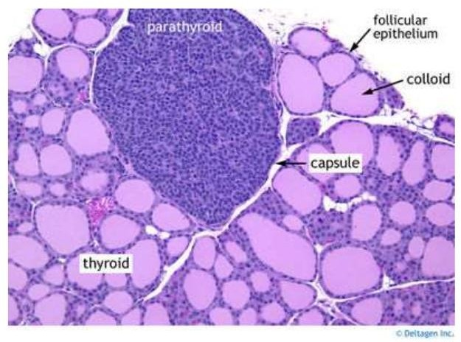
Parathyroid gland
Parathyroid cells arranged in cords separated by B.Vs
Thyroid cells arranged in follicles

Slide 17
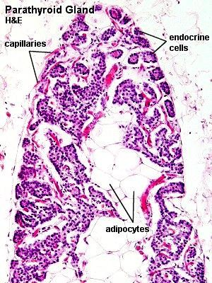
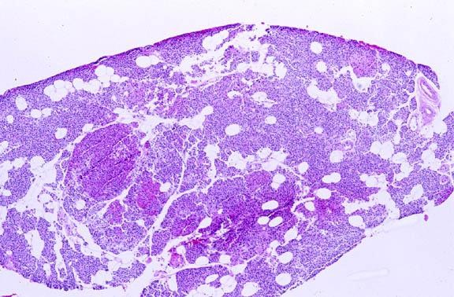
Parathyroid gland in old people
Changes that occur in the gland with age:
1) fibrosis, 2) ↑fat cells, 3) ↑oxyphilic cells, 4) ↓chief cells

Slide 18
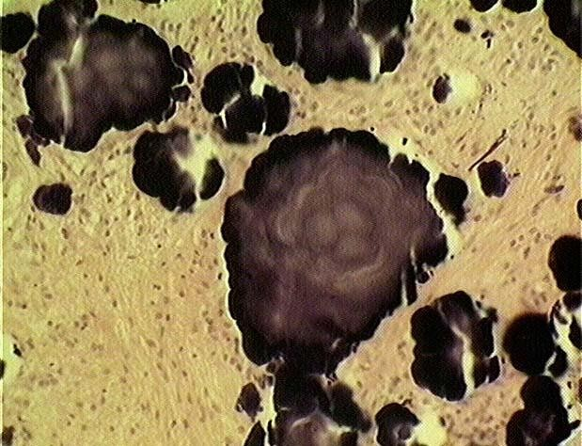
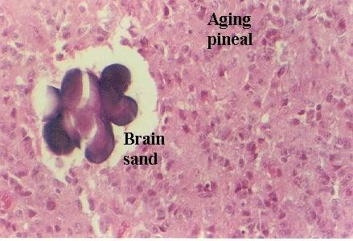
Pineal gland (Epiphysis cerebri)
Pineal gland+ pars nervosa →nervous in origin
Pinealocytes (neurosecretory cells, secrete melatonin)
Astrocytes (glial cells)
Blood vessel
Brain sand with old age (calcification, These are not a degenerative change; not pathological)

Slide 19
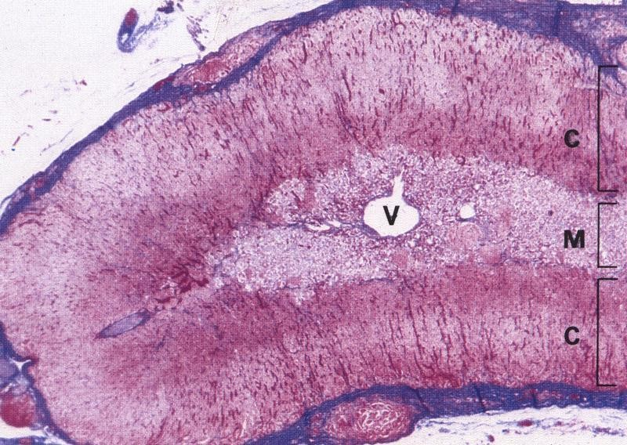
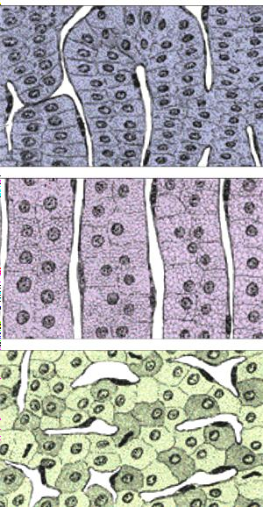
Suprarenal gland
Thick connective tissue capsule.
glomerulosa
fasciculata
reticularis
cortex→ yellow in fresh state , contain cells full of fat droplets (precursor)
Medulla→ Reddish-brown in fresh state, contain B.Vs
كيف اميزالنخاع من القشرة وهو اصلاً ما في حد فاصل واضح بينهم؟
من اختلاف اللون: القشرة لونها اصفر, والنخاع بني

Slide 20
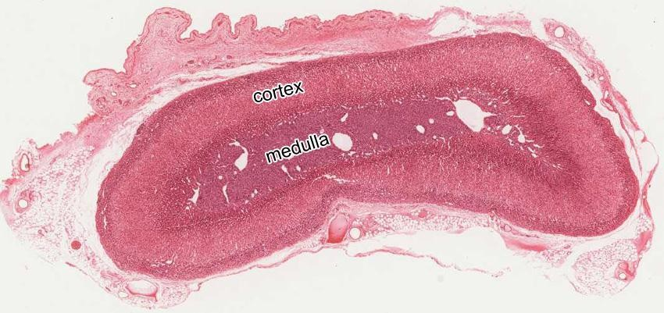
Suprarenal gland

Slide 21
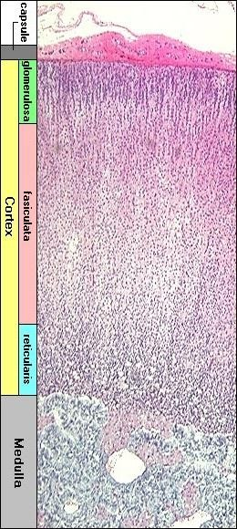
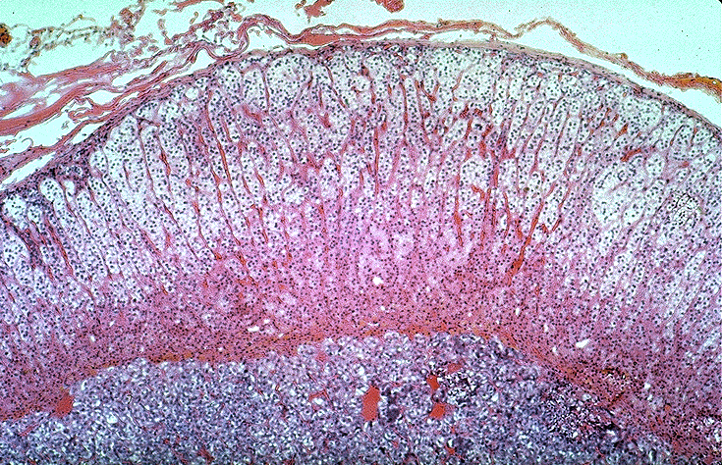
Suprarenal gland
Acidophilic, vacuolated, cortical, steroid producing cells
Capsule
** اسباب تسمية الطبقات:
1)Z. glomerulosa→ presence of arches
2)Z. fasciculata→ highly vacuolated
3) Z. Reticularis→ cells for irregular anastomosing cords (reticulum)
Basophilic medullary cells
Large B.V
**medulla→ highly vascularized

Slide 22
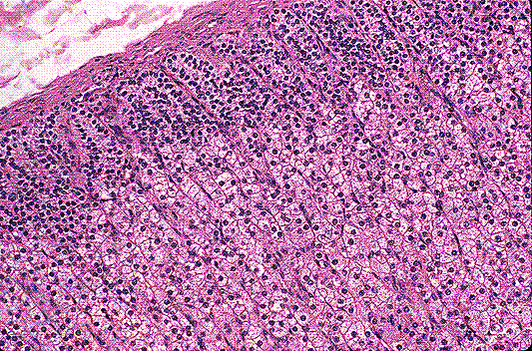
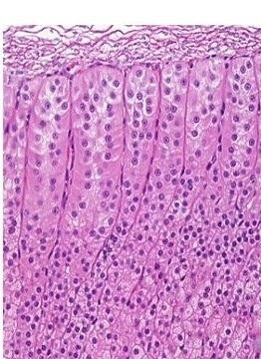
Suprarenal gland
G
G
G
F
G
F
G
F
G
F
G
F
G
F
G
F
F
Zona glomerulosa→ 15%, curved columns, produce aldosterone hormone.
Zona fasciculata → 65%, regular Cords, 1 or 2 cell thickness, separated by B.Vs, highly vacuolated with spongy appearance (lipid droplets) → spongiocytes, produce cortisone hormone

Slide 23
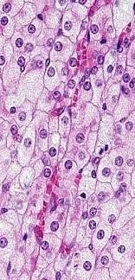
Suprarenal gland
G
F
F

Slide 24
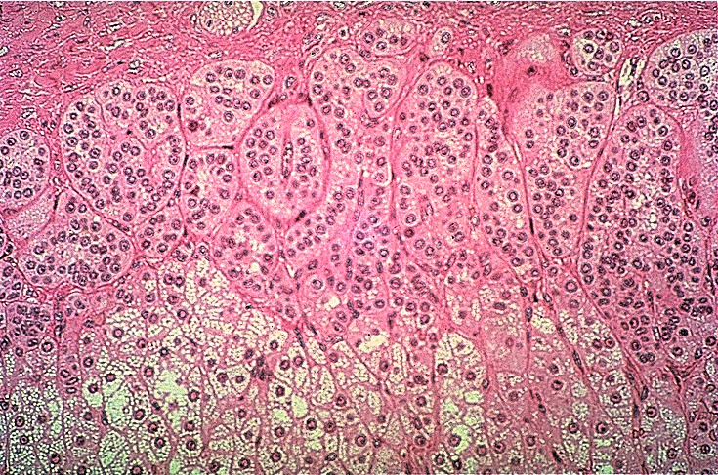
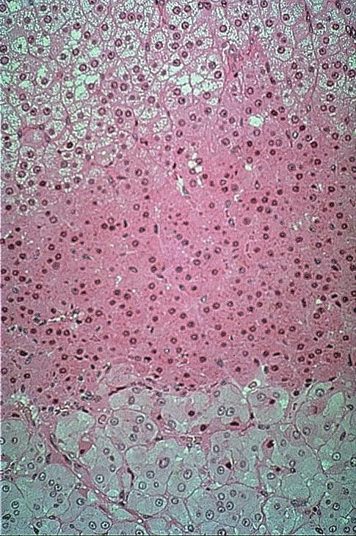
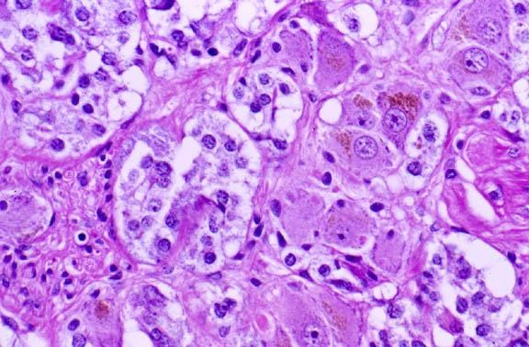
Suprarenal gland
G
R
M
F
Zona Reticularis→ 7%, irregular anastomosing cords, form a reticulum, produce androgen hormone
Medulla→ basophilic cells arranged in groups, contain 1)protein secreting cells called chromaffin cells produce A+ NA, 2)Sympathetic ganglion cells, 3)Lymphocyte like cells

