Slide 1
Female Genital System, Lecture5 Gestational trophoblastic disease
Dr. Bushra AlTarawneh, MD
Anatomical pathology Mutah University School of Medicine- Department of Laboratory medicine & Pathology GUS lectures 2021

Slide 2
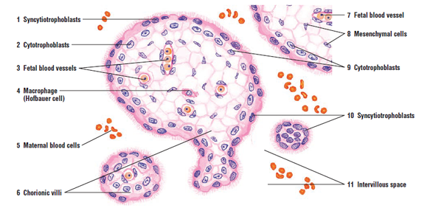
Placental disc histology

Slide 3
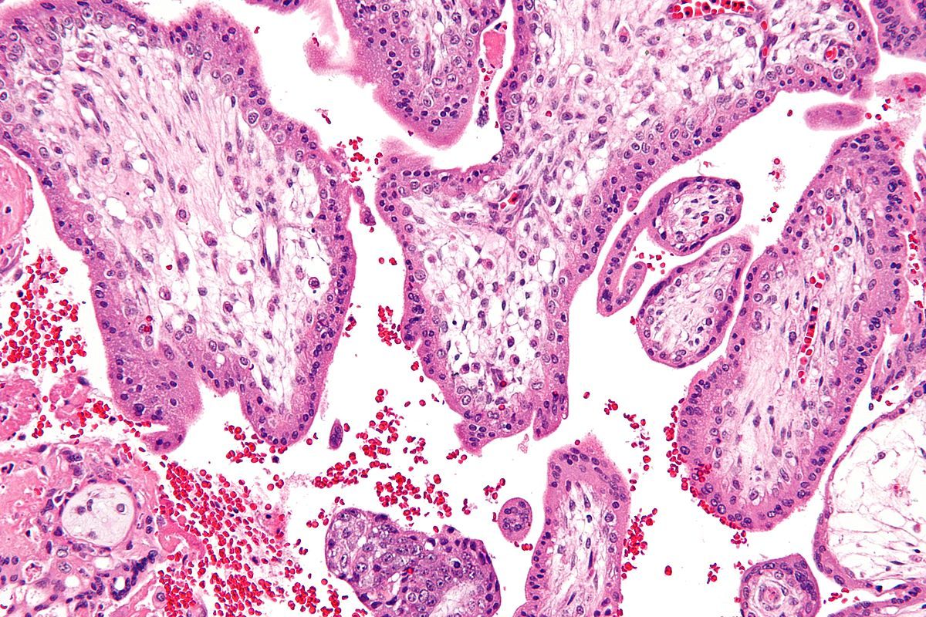

Slide 4
Gestational trophoblastic disease
An abnormal proliferation of fetal trophoblast cells. (normal cells of placenta in pregnancy)
In early embryo trophoblast cells form chorionic villi → in time they make the placenta (provide a large contact area between fetal & maternal circulations to allow gas & nutrient exchange).
All elaborate human chorionic gonadotropins (hCG) → detected in the blood & urine at levels higher than those found during normal pregnancy. (diagnosis, follow up).

Slide 5
Hydatidiform Mole - Pathogenesis
An abnormal gestational process due to abnormal fertilization with an excess of paternal genetic material, two forms:
Complete mole: an empty egg fertilized by two spermatozoa (or a diploid sperm) → diploid karyotype containing only paternal chromosomes.
Partial mole: a normal egg is fertilized by two spermatozoa (or a diploid sperm) → triploid karyotype with a dominance of paternal genes.

Slide 6
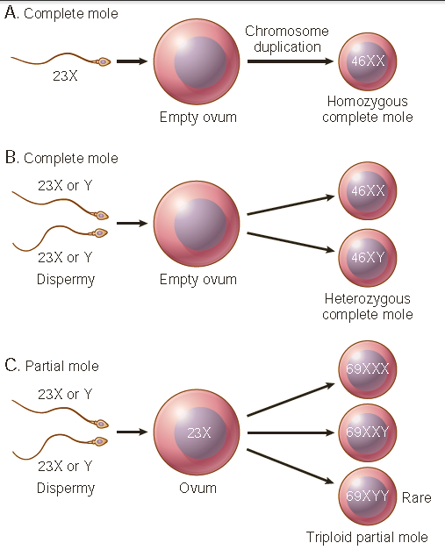

Slide 7
Hydatidiform Mole - Complete
Complete mole are not compatible with embryogenesis & does not contain fetal parts. The chorionic epithelial cells are diploid (46,XX or, uncommonly, 46,XY)

Slide 8
Hydatidiform Mole - Partial
Partial mole is compatible with early embryo formation → may contain fetal parts & some normal chorionic villi. Chorionic epithelial cellsalmost always triploid (e.g., 69,XXY)

Slide 9
Hydatidiform Mole – Epidemiology & clinical
Incidence complete hydatidiform mole is about 1 to 1.5 per 2000 pregnancies(higher in Asian)
Most common before 20 & after 40 years (maternal age)
History of Mole increases the risk for molar disease in subsequent pregnancies.
Presentation: At 12-14 weeks of pregnancy during investigation for a gestation “too large for dates,”. +both moles → Hyperemesis, elevation of hCG in maternal blood & no fetal heart sounds.

Slide 10
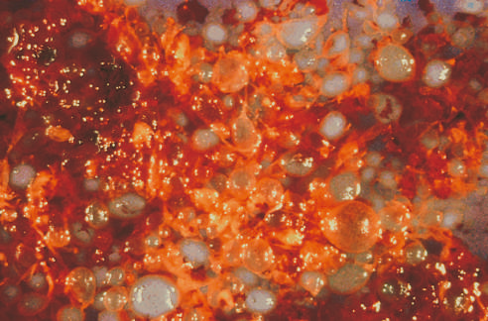
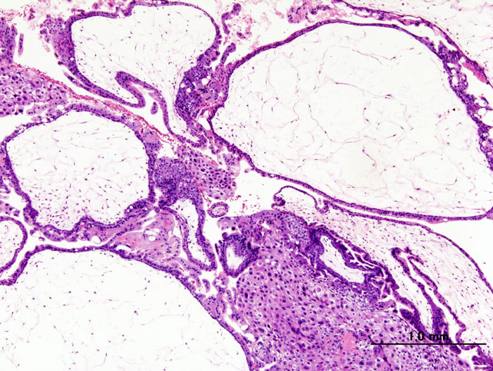
Hydatidiform Mole – Morphology
Uterine cavity is expanded by friable mass (Grape-like villi) composed of thin-walled, cystically dilated chorionic villli covered by varying amount of atypical chronic epithelium.

Slide 11
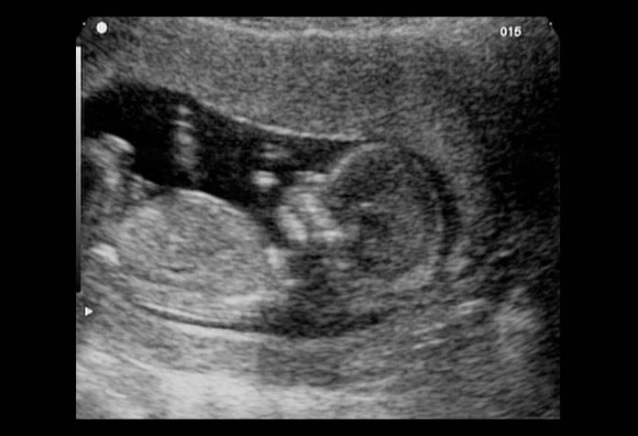
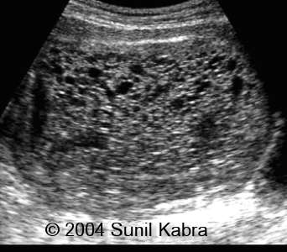
Hydatidiform Mole – Ultrasound snow storm

Slide 12
Hydatidiform Mole – treatment & prognosis
Tx: surgical evacuation of the uterine cavity & close follow up with serum hCG.
The majority of moles do not recur after thorough curettage, 10% of complete moles are invasive
No more than 2-3% give rise to choriocarcinoma (usually complete, rarely partial).
So partial mole has much better prognosis

Slide 14
Gestational Choriocarcinoma
A very aggressive malignant tumor, arises from gestational chorionic epithelium or, less frequently, from totipotential cells within the gonads (as a germ cell tumor).
Rare tumor (higher in Asian)
Most common before 20 & after 40 years (maternal age)
50% from complete moles; 25% after an abortion, 25% after an apparently normal pregnancy

Slide 15
Gestational Choriocarcinoma - morphology
Presentation: a bloody, brownish discharge, very high hCG absence of marked uterine enlargement (not like mole)
Gross: hemorrhagic, necrotic uterine masses.
Microscopic: In contrast with hydatidiform moles chorionic villi are not formed; the tumor is composed of anaplastic cuboidal cytotrophoblasts & syncytiotrophoblasts

Slide 16
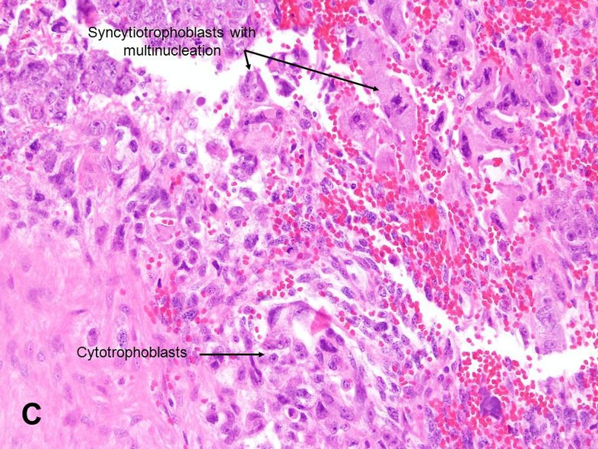

Slide 17
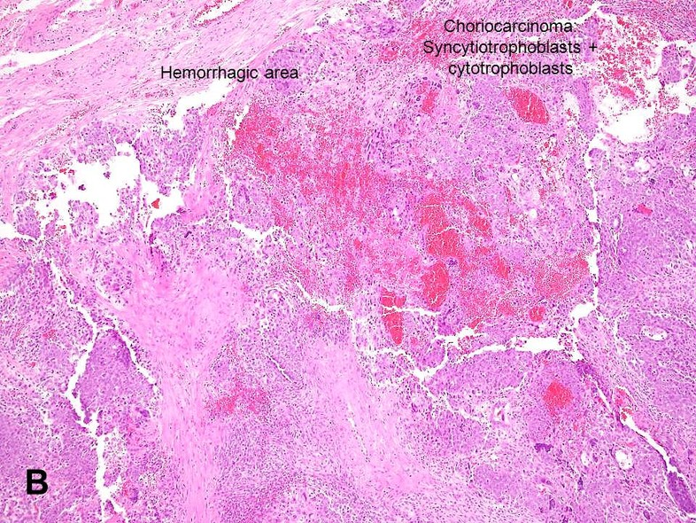

Slide 18
Gestational Choriocarcinoma - prognosis
Very aggressive disease.
At diagnosis widespread vascular (hematogenous) spread usually the lungs & brain.
Lymphatic invasion is uncommon.
Despite the extremely aggressive of placental choriocarcinoma → sensitive to chemotherapy.
By contrast, response to chemotherapy in gonads choriocarcinomas is poor.

Slide 19
Good luck in your exams

