Slide 1
وسهلا
أهلا
الأستاذ الدكتور/ يوسف حسين
أستاذ التشريح وعلم الأجنة
كلية الطب – جامعة الزقازيق- مصر
دكتوراة من جامعة كولونيا المانيا
د. يوسف حسين (استاذ التشريح)

Slide 2
Ascending aorta

Slide 3
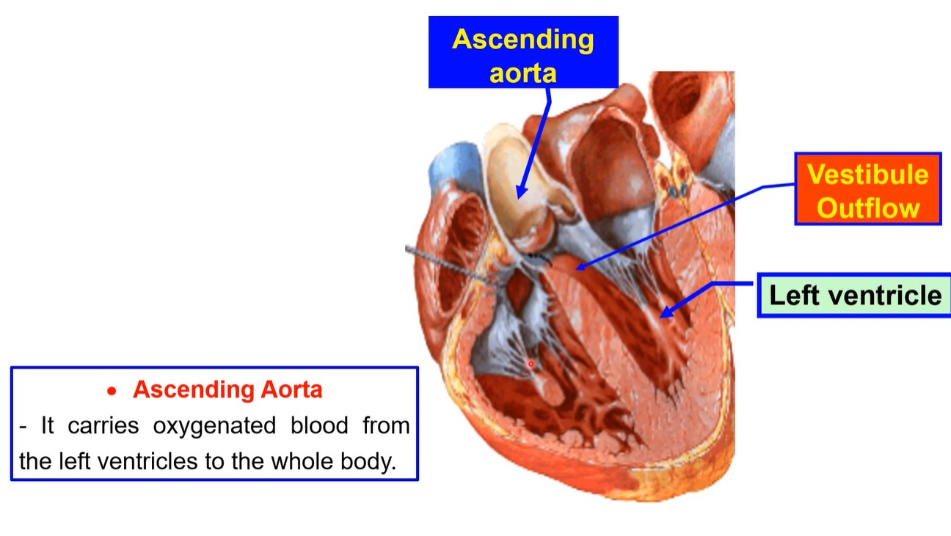

Slide 4
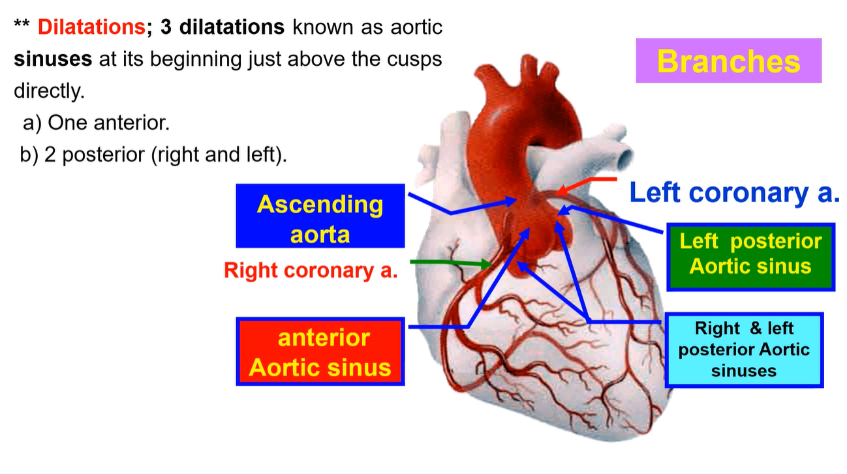

Slide 5
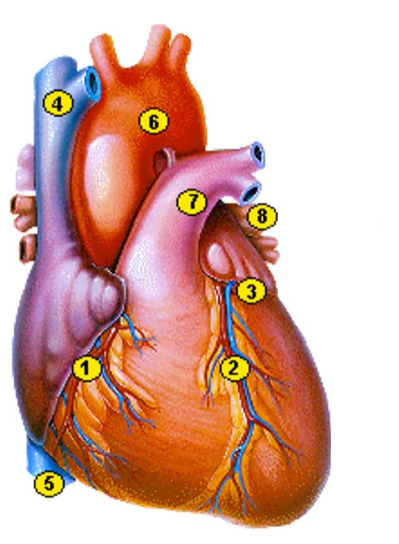
Arch of
aorta

Slide 6
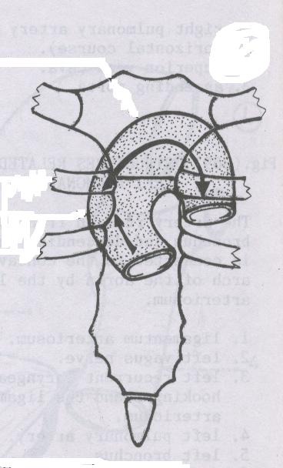
Arch of the aorta
• Arch of Aorta
**Begins: at the right 2nd sternocostal junction.
**End; at the left 2nd sternocostal junction, lower border of T4.
**Direction; It passes upwards, backwards and to the left, and then downward.
Lower of T4
Right 2nd CC
Left 2nd CC
Sternal angle
Left 3rd CC
• Ascending of the aorta
**Begins: From Left 3rd sternocostal junction.
**End; to the right 2nd sternocostal junction.
**Direction; It extends upward, forward and
to the right.
Ascending aorta

Slide 7
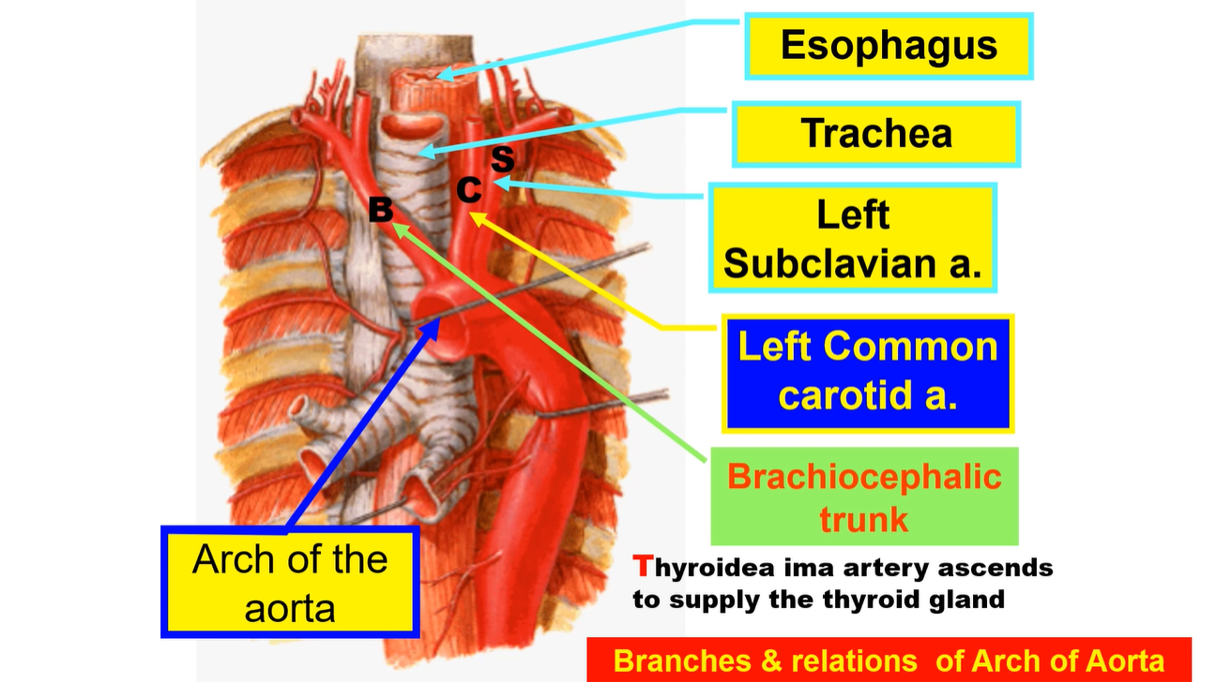

Slide 8
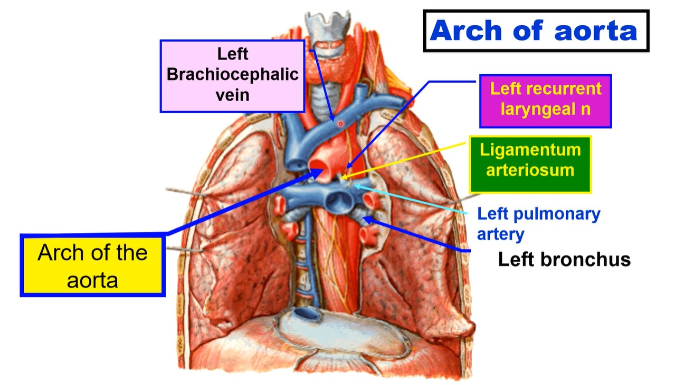

Slide 9
** Relations = contents of the superior mediastinum
1) Superiorly:
1- The three branches of the aortic arch,
a- Brachiocephalic artery.
b- Left common carotid artery.
c- Left subclavian artery.
2- Left brachiocephalic vein crosses in front the 3 arteries.
2) Inferiorly;
1- Left pulmonary artery.
2- Left bronchus.
3- Ligamentum arteriosum.
4- Left recurrent laryngeal nerve.
3) Posterior:
1- Trachea. 2- Oesophagus.
3- Left recurrent laryngeal nerve (between trachea and oesophagus).
4) Anterior,
1- Manubrium sterni and thymus gland.
2- Left pleura and lung 3- Left phrenic nerve.
4-Left vagus nerve 5- Left superior intercostal vein

Slide 10
Descending
thoracic aorta

Slide 11
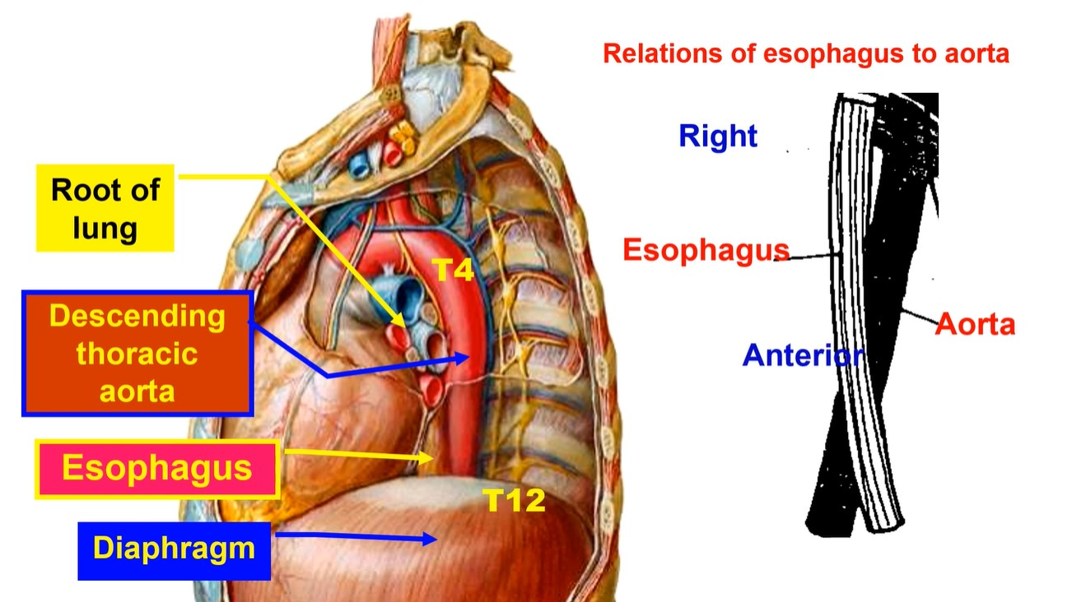

Slide 13
Brachiocephalic
veins & SVC

Slide 14
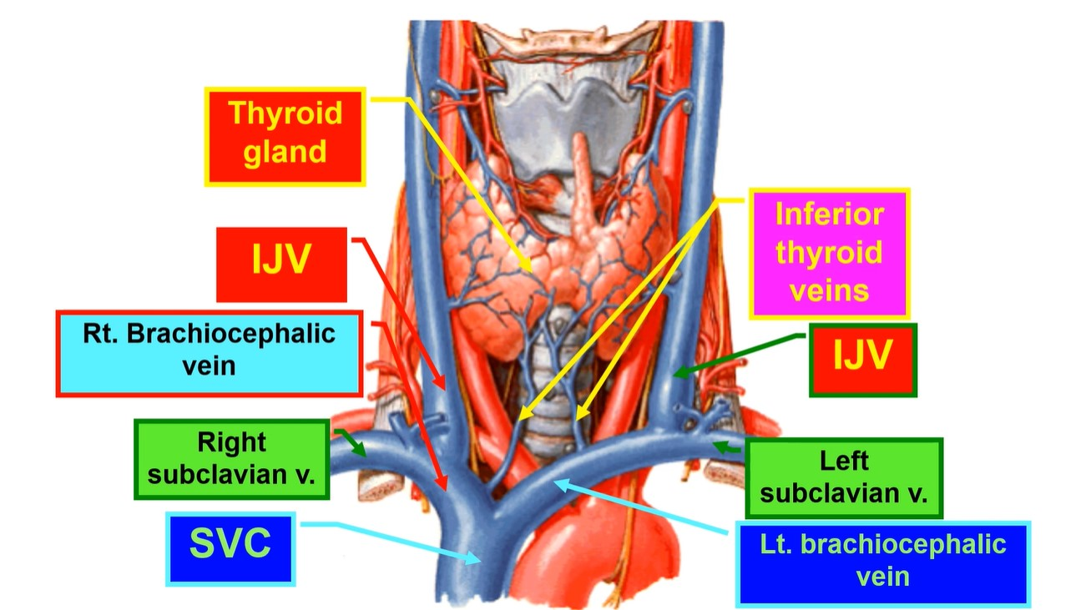

Slide 15
• Tributaries of left
brachiocephalic vein
1. Left subclavian vein.
2. Left internal jugular V.
3. Left internal thoracic (mammary) vein.
4. Left inferior thyroid vein.
5. Left first posterior intercostal
vein.
6. Left vertebral vein.
7. Left superior intercostal vein.
• Tributaries of right
brachiocephalic vein
1. Right subclavian vein.
2. Right internal jugular V
3. Right internal thoracic (mammary) vein.
4. Right inferior thyroid vein.
5. Right first posterior
intercostal vein
6. Right vertebral vein.
N.B; Right superior intercostal vein ends in the arch of azygos vein.

Slide 16
Abdominal aorta

Slide 17
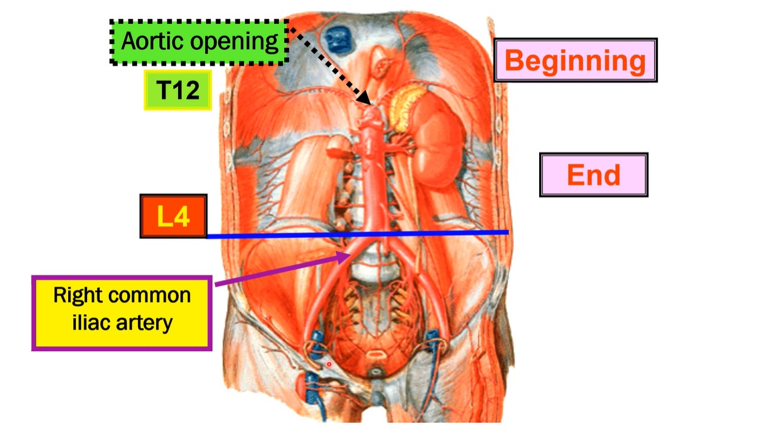

Slide 18
Single branches
Paired branches
Coeliac trunk
T12
Inferior phrenic artery
Superior mesenteric artery
L1
Middle suprarenal artery
L2
Renal artery
Inferior mesenteric artery
L3
Gonadal artery
Lumbar arteries
Median sacral artery
L4
Branches of Abdominal aorta
Common iliac artery

Slide 19
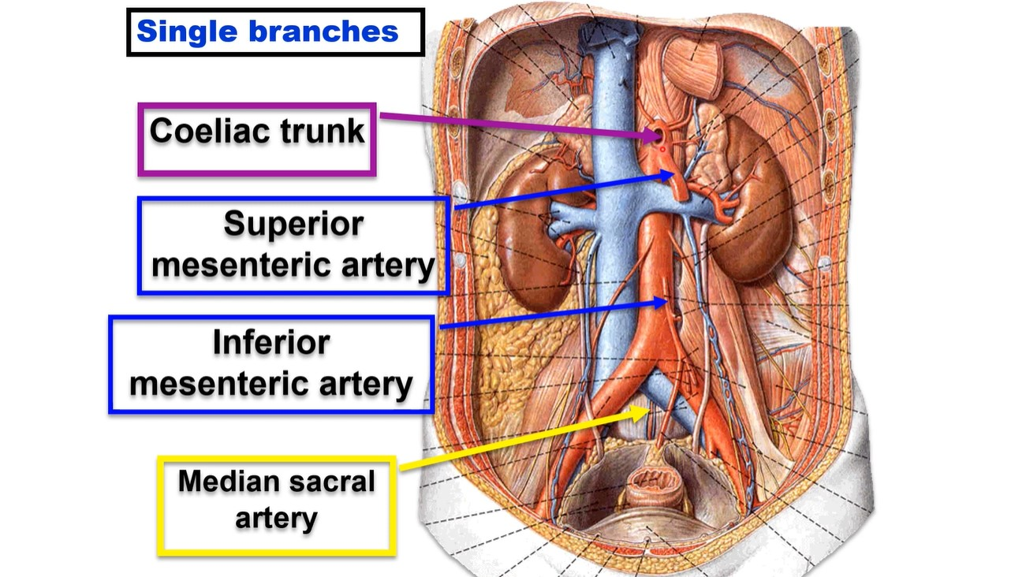

Slide 20
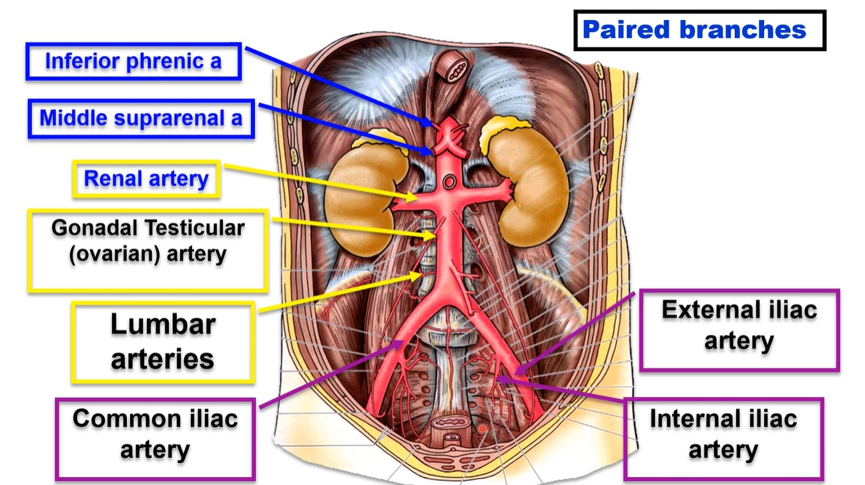

Slide 23
Inferior
vena cava

Slide 24
Inferior vena cava
**Beginning: by the union of two common iliac veins in front L5 vertebra one inch to the right of the median plane.
**Course: It ascends in front of vertebral column to the right side of aorta.
- It pierces the central tendon
of the diaphragm opposite T8.
** end: in the right atrium
T8
L5

Slide 25
** Tributaries of IVC:
1- Inferior phrenic veins (right and left).
2- Right suprarenal vein (the left ends in the left
renal vein).
3- Renal veins (right and left).
4- Right gonadal (testicular or ovarian) vein (the left
ends in the left renal vein).
5- The Lumbar veins (right and left).
6- Common iliac veins (right and left).
7- Hepatic veins (right and left).

Slide 26
• Collateral venous anastomoses between Inferior vena cava and superior vena cava
1- Azygos vein from back of Inferior vena cava to back of
superior vena cava
2- Vertebral venous plexus (valveless) inside vertebral canal.
3- Anastomoses between superior epigastric vein (internal
thoracic vein) and inferior epigastric vein (external iliac
vein) in abdominal rectus sheath.
4- Thoracoepigastric vein runs on lateral side of the trunk
between lateral thoracic vein (axillary vein) and superficial
epigastric vein (femoral vein).

Slide 27
Thank you
Questions
I/Azzam - 2004

