Slide 1
Gestational trophoblastic disease
|PRICE: 0.20 |
Dr. Mohammed Khader
Consultant obstetrician and gynecologist
oncologic gynecologist

Slide 2
INTRODUCTION
It is a proliferative disorder of trophoblastic cells.
It defines a heterogeneous group of interrelated lesions arising from the trophoblastic epithelium of the placenta.
All forms of GTD are characterized by a distinct tumor marker, the beta subunit of human chorionic gonadotropin (hCG)

Slide 3
types of GTD
Hydatidiform mole (complete or partial)
Persistent/invasive gestational trophoblastic neoplasia (GTN)
Choriocarcinoma
Placental site trophoblastic tumors
.

Slide 4
Complete and partial hydatidiform moles are noninvasive, localized tumors that develop as a result of an aberrant fertilization event that leads to a proliferative process.
They comprise 90 percent of GTD cases.
The other three categories of GTD represent malignant disease because of their potential for local invasion and metastases.
Malignant GTD can develop from a molar pregnancy or can arise after any gestational experience: spontaneous or induced abortion, ectopic pregnancy, or preterm and term pregnancy.
Malignant transformation of trophoblastic tissue is probably related to activation of oncogenes and inactivation of tumor suppressor genes

Slide 5
EPIDEMIOLOGY
The incidence of hydatidiform mole ranges from 23 to 1299 cases per 100,000 pregnancies, while malignant GTD is less common.
North American and European countries tend to report low or intermediate rates of disease (1 per 1000 to 1500 pregnancies).
Whereas Asian and Latin American nations often have high rates (1 per 12 to 500 pregnancies)

Slide 6
RISK FACTORS
Extremes of age — The most well-established risk factor for GTD is maternal age, increased in those older than age 35 and slightly increased in those under age 20]. Paternal age does not appear to influence the risk of GTD.
Assisted reproductive technology has enhanced the fertility potential of older women, which may increase the proportion of cases in this age group.
History of previous GTD —approximately 1 percent chance of recurrence in subsequent pregnancies (compared to a 0.1 percent incidence in the general population)]. The recurrence rate is much higher after two molar pregnancies (16 to 28 percent).

Slide 7
Current smoking (>15 cigarettes per day)
Maternal blood type AB, A, or B.
History of infertility, nulliparity.
use of oral contraceptives (however, oral contraceptives do not increase the risk of developing postmolar GTD )

Slide 8
CLINICAL MANIFESTATIONS
Vaginal bleeding
Enlarged uterus
Pelvic pressure or pain
Theca lutein cysts
Anemia
Hyperemesis gravidarum
Hyperthyroidism
Preeclampsia before 20 weeks of gestation
Vaginal passage of hydropic vesicles

Slide 9
Complete hydatidiform mole
A complete mole is a result of fertilization of an empty ovum by two sperms or a single sperm that duplicates, resulting in a 46 XX or 46 XY karyotype.
The presence of a complete mole (which lacks a fetus) often leads to excessive uterine size for the expected "gestational age" (number of weeks since the last normal menstrual period). Uterine enlargement is due to the tumor itself and/or intrauterine hemorrhage with retained clot.
The marked elevation in serum hCG associated with a complete mole can lead to complications. These include ovarian enlargement due to theca lutein cysts; hyperemesis gravidarum; early development of preeclampsia (before 20 weeks of gestation); and hyperthyroidism, which is most often subclinical]. These complications occur in approximately 25 percent of .

Slide 10
Theca lutein cysts are a form of ovarian hyperstimulation resulting from high circulating levels of hCG that are associated with GTD. These cysts are multiloculated, often bilateral, and resolve a few weeks or months after treatment of GT

Slide 11
Partial hydatidiform mole
A partial mole is the result of fertilization of a haploid ovum by two sperm or duplication of one sperm, resulting in a triploid karyotype (69 XXY, 69 XXX, 69 XYY).
Partial moles are the only type of GTD that are associated with the presence of a fetus, and fetal cardiac activity may be detected. However, there is a high rate of intrauterine death related to triploidy.
Thus, a partial mole is often misdiagnosed as an incomplete or missed abortion and the correct diagnosis of GTD is made only after histologic review of the surgical specimen.
These pregnancies are infrequently associated with excessive uterine size, ovarian enlargement, preeclampsia, hyperemesis, or hyperthyroidism because hCG levels are generally lower than those observed with a complete mole.

Slide 13
EVALUATION
Human chorionic gonadotropin
he serum hCG concentration is always elevated in women with GTD and is usually higher than that observed with intrauterine or ectopic pregnancies of the same gestational age.
About 40 percent of complete moles are associated with hCG levels >100,000 mIU/mL (normal nonpregnant <5 mIU/mL and peak normal pregnancy level typically <100,000 mIU/mL).
Compared to other types of GTD, PSTT is associated with lower levels of hCG relative to tumor size because of the lack of syncytiotrophoblastic proliferation.

Slide 14
Ultrasound findings
Complete mole
The absence of an embryo or fetus
No amniotic fluid
Central heterogeneous mass with numerous discrete anechoic spaces, which correspond to diffuse hydatidiform swelling of the hydropic chorionic villi. This has classically been described as a "snowstorm pattern" on older ultrasounds
Theca lutein cysts

Slide 16
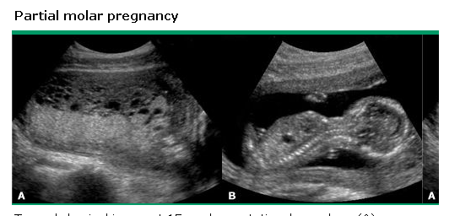
Partial mole
A fetus is present, may be viable, and is often growth restricted
Amniotic fluid is present, but may be reduced
Focal anechoic spaces and/or increased echogenicity of chorionic villi (swiss cheese pattern)
Increased transverse diameter of the gestational sac
Theca lutein cysts are usually absent

Slide 17
DIAGNOSIS
Complete and partial mole
When complete or partial mole is suspected based upon sonographic findings and hCG determination, the diagnosis must be confirmed by histologic examination of tissue. The accuracy of histologic diagnosis is further enhanced by flow cytometry to determine the karyotype.
Tissue is obtained by evacuation of the uterine contents by suction curettage.
Twin pregnancy may be complicated by GTD: either a mole (partial or complete) and a viable fetus or two moles. The diagnosis of mole is suggested by ultrasound examination and confirmed by cytogenetic studies and histopathologic examination.

Slide 18
Pretreatment evaluation
blood tests are obtained to assess renal and hepatic function , thyroid function, peripheral blood counts, and baseline serum hCG levels.
Radiographic evaluation includes pelvic ultrasound, both to look for evidence of retained trophoblastic tissue, and to evaluate the pelvis for local spread.
Chest imaging is also required, as the lungs are the most common site of metastatic disease
In the absence of pulmonary and vaginal involvement, brain and liver metastases are rare.
Asymptomatic patients with normal chest and pelvic imaging do not require further imaging of brain or liver.
CT scan or magnetic resonance imaging (MRI) of the brain is recommended in women with persistent disease who have vaginal or lung metastases and in all patients with choriocarcinoma. Cerebral involvement can also be assessed by measuring beta-hCG levels in the cerebrospinal fluid (CSF)

Slide 19
Management of hydatidiform mole
Initial management of suspected complete or partial mole is evacuation of the uterine contents by suction curettage.
Evacuation is indicated for pathologic confirmation of the diagnosis, relief of symptoms, and to prevent complications related to molar pregnancy.
This procedure is a definitive therapy for most patients
Suction curettage is the preferred approach because it is less likely to result in uterine perforation or intrauterine adhesions than sharp curettage, and evacuates the uterus more completely than medical methods
Patients who have no desire for future fertility may opt for hysterectomy, which eliminates the risk of local invasion, but does not prevent metastasis. The adnexae may be retained; if prominent theca lutein cysts are present, these may be drained at the time of surgery

Slide 20
Procedure
Under adequate anesthesia, oxytocin is administered and the cervix is dilated to allow passage of the suction cannula.
During dilation of the cervix, brisk uterine bleeding is often encountered, which generally slows significantly once suction evacuation has commenced. Heavy bleeding is nearly always self-limited, and inappropriate transfusion should be avoided.
A suction catheter of 12 mm is usually sufficient to evacuate a complete molar pregnancy since there is no fetus. A larger catheter may be needed to evacuate a partial mole with a coexistent fetus greater than 12 weeks of gestation.
The suction curette is not advanced to the fundus; instead, it is placed just inside the internal os.
Vacuum pressures of 50 to 60 cm Hg are then applied and the hydropic placental tissue is drawn into the curette.

Slide 21
As additional tissue is evacuated, the uterus will contract and the suction curette may then be advanced to the fundus.
Suction curettage can be performed under ultrasound guidance if needed to facilitate the procedure and confirm complete evacuation of uterine contents.
Intravenous oxytocin is administered, and for uteri over 14-weeks size, we suggest fundal massage to stimulate myometrial contraction

Slide 23
Malignant GTD
After a molar pregnancy
Persistent GTN is typically diagnosed in asymptomatic women undergoing routine hCG monitoring after evacuation of a molar pregnancy, accounting for greater than 90 percent of malignant GTN.
Rates of persistent disease are 15 to 20 percent after a complete mole, and 3 to 5 percent after a partial mole. While GTN is rare after a partial mole, both localized or metastatic disease can occur.
The most common symptom is vaginal bleeding. Uterine rupture resulting in hemoperitoneum is rare, but may occur in patients who do not comply with recommended follow-up.
Most cases of localized GTN are due to invasive mole, but a few are due to choriocarcinoma, which may be localized at presentation. Metastatic disease is virtually always due to choriocarcinoma as metastasis of invasive mole occurs, but is uncommon. Placental site trophoblastic tumors are rare.

Slide 24
Characteristics that increase the likelihood of GTN after molar evacuation include
Large theca lutein cysts (≥6 cm),
Excessively enlarged uterus for dates,
Age over 40, previous GTD,
Initial hCG >100,000 mIU/mL,
The presence of hyperplasia or atypia on histology.
Heterozygosity (dispermic moles)

Slide 25
After a nonmolar pregnancy
Malignant GTD after a nonmolar pregnancy is diagnosed histologically or clinically by plateau or rise in hCG. The diagnosis is virtually always choriocarcinoma, rarely a placental site trophoblastic tumor (PSTT).
Choriocarcinoma — Choriocarcinoma arising from cytotrophoblast occurs in approximately 1 in 16,000 normal gestations, 1 in 15,000 abortions, and 1 in 40 complete molar pregnancies.
About 50 percent of cases of choriocarcinoma arise from complete hydatidiform mole, an additional 25 percent arise after normal pregnancies, and 25 percent follow spontaneous abortion or ectopic pregnancy .

Slide 26
Choriocarcinoma is the most aggressive GTN, and is characterized by early vascular invasion and widespread metastases. Irregular vaginal bleeding is the most frequent symptom. The typical clinical presentation is late postpartum bleeding, which persists beyond the usual six to eight weeks. Primary or secondary postpartum hemorrhage are other common presentations. However, abnormal vaginal bleeding may develop a year or more after an antecedent pregnancy. Hemorrhage can be severe if the tumor erodes through the myometrium or uterine vessels.
Respiratory symptoms (eg, cough, chest pain, hemoptysis) or signs of gastrointestinal, urologic, and intracerebral bleeding are indicative of metastatic disease. Hepatic involvement from advanced disease may cause epigastric or right upper quadrant pain.
Physical examination often reveals an enlarged uterus and bilateral ovarian cysts. Vaginal metastases are present in about 30 percent of cases; these lesions are very vascular and prone to bleeding; they may also become infected

Slide 27
DIAGNOSIS OF MALIGNANT DISEASE
hCG levels should be monitored serially after treatment of a molar pregnancy. In a representative study, the average times to normalization of serum hCG after a complete or partial mole were 99 and 59 days, respectively
According to FIGO criteria, the presence of persistent (malignant) GTD after evacuation of a complete or partial molar pregnancy should be suspected if any of the following is present :
A serum hCG concentration that plateaus (decline of less than 10 percent for at least four values over three weeks)
A serum hCG concentration that rises (increase more than 10 percent of three values over two consecutive weeks eg, day 1, 7, 14)
Persistence of detectable serum hCG for more than six months after molar evacuation
The histologic identification of choriocarcinoma
The presence of metastatic disease usually implies the presence of choriocarcinoma rather than invasive mole.
Approximately 90 percent of these cases represent invasive mole, and <10 percent are choriocarcinomas; PSTTs are rare.

Slide 28
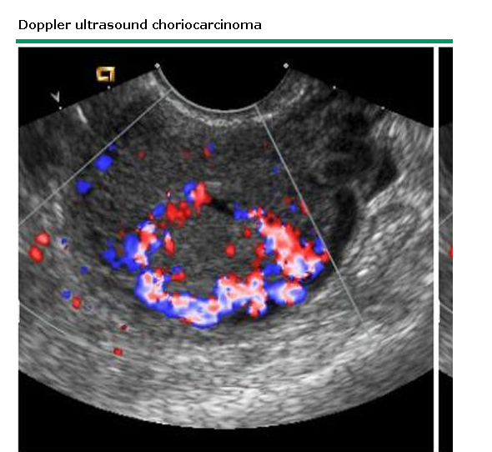
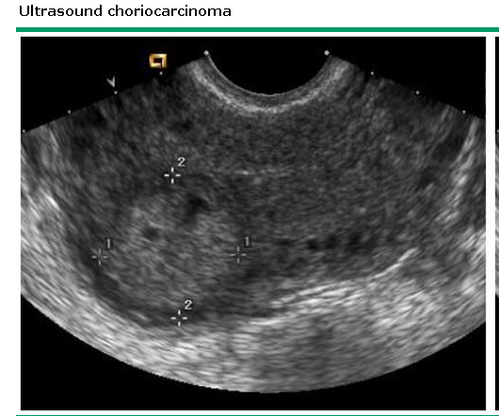
ROLE OF U/S IN MALIGNANT DISEASE
Invasive mole typically appears as one or more poorly defined masses in the uterus with anechoic areas. Color Doppler of the anechoic areas reveals high vascular flow. Invasion into the myometrium may be visualized.
Choriocarcinoma and PSTT — Choriocarcinoma appears as a mass enlarging the uterus, with a heterogeneous appearance that correlates with areas of necrosis and hemorrhage. The tumor is usually markedly hypervascular on color Doppler . The tumor may extend into the parametrium

Slide 30
Staging and prognostic stratification
Stage I — All patients with persistently elevated beta-hCG levels and tumor confined to the uterus.
Stage II — The presence of tumor outside of the uterus, but limited to the vagina and/or pelvis.
Stage III — Pulmonary metastases with or without uterine, vaginal, or pelvic involvement.
Stage IV — All other metastatic sites (eg, brain, liver, kidneys, gastrointestinal tract).
All stages were further stratified as A, B or C depending on the presence or absence of one or both of two risk factors for recurrence (beta-hCG ≥100,000 mIU/mL, or the detection of disease more than six months followed termination of an antecedent pregnancy).

Slide 31
In addition to its prognostic utility, the revised staging system is also capable of predicting which patients are likely to respond poorly to single-agent chemotherapy. A prognostic score of 7 or higher is considered a high-risk score; all of these patients are more likely to be resistant to single agent therapy and require combination chemotherapy. Patients with scores under 7 are considered low-risk and can usually be managed using single-agent chemotherapy

Slide 32
Single-agent chemotherapy
Methotrexate with and without leucovorin
ceveral dosing regimens for single agent MTX with or without leucovorin, are in clinical use,
Infusional MTX is administered as a single IV bolus dose of MTX 100 mg/m ² over 30 minutes followed by a 12-hour infusion of MTX 200 mg/m ² , with or without leucovorin rescue
A regimen of weekly MTX (30 to 50 mg/m ² IM weekly)
An eight-day regimen of MTX (1 mg/kg IM every other day for four doses) and leucovorin calcium (0.1 mg/kg, given once, 24 hours after each dose) is easy to administer and well tolerated
Dactinomycin
Older retrospective series suggested that single agent dactinomycin (actinomycin D) was as effective but more toxic than MTX monotherapy when used for initial treatment of patients with low-risk GTD.
Five-day regimens (12 mcg/kg or 0.5 mg total dose daily for five days, repeated every two weeks)

Slide 33
Multiagent chemotherapy
EMA/CO
Despite the absence of randomized trials to prove its superiority, the combination of etoposide, methotrexate, and dactinomycin followed by cyclophosphamide and vincristine (EMA/CO) has become the preferred regimen for initial treatment of high-risk GTD in most countries. The components of this regimen are :
Etoposide — 100 mg/m ² IV over 30 minutes on days 1 and 2
Methotrexate — 100 mg/m ² IV push followed by 200 mg/m ² IV over 12 hours on day 1
Dactinomycin — 0.5 mg IV bolus on days 1 and 2
Leucovorin calcium — 15 mg orally every 12 hours for four doses, starting 24 hours after start of MTX
Cyclophosphamide — 600 mg/m ² IV on day 8
Vincristine Oncovin®) — 1.0 mg/m ² IV on day 8

Slide 34
Chemotherapy
Assessment of response — All women with GTD should be monitored with weekly serial measurements of serum beta-hCG during therapy. Remission is defined as three consecutive normal hCG values (less than 5 milli-international units/mL) over 14 to 21 days.
When weekly or biweekly single agent chemotherapy regimens are used, the regimen is continued until the third negative result is obtained. When infusional MTX is given as a one-time dose, hCG levels are followed weekly, with additional therapy given only if an inadequate response is observed.
When combination chemotherapy with EMA/CO is used, the regimen is repeated every two weeks until normalization of beta-hCG, and then generally continued for an additional three cycles (six weeks). After remission is achieved, serum beta-hCG should be measured monthly until monitoring has shown one year of normal hCG levels

Slide 35
ROLE OF SURGERY
Uterine evacuation — The utility of repeat suction curettage in patients with persistent postmolar GTN is controversial and remains an area of debate. A second curettage may have a debulking effect and possibly lower the number of chemotherapy courses required for cure
Hysterectomy — For women with choriocarcinoma who do not desire future fertility, hysterectomy is usually performed before chemotherapy. Hysterectomy prevents the persistence of drug-resistant local disease, and can shorten the duration and amount of chemotherapy required to produce remission
Pulmonary metastases — An isolated pulmonary nodule that is resistant to chemotherapy may be treated by thoracotomy with wedge resection
Craniotomy — Craniotomy is reserved for life-threatening complications (eg, hemorrhage and the need for acute decompression). The incidence of intracranial hemorrhage from metastatic malignant GTD is appreciably higher than with other primary and secondary intracranial neoplasms.
Isolated liver metastases --Biopsy of hepatic metastases should be avoided if at all possible. We reserve hepatic resection for control of bleeding or for excision of resistant tumor

Slide 36
Contraception
It is essential that women use contraception both during and for the entire duration of beta-hCG follow-u.
Estrogen-progestin contraceptives are preferred because of their low failure rate and relatively low incidence of irregular bleeding, which may confuse the clinical picture. They are both safe and effective in women with GTD.
Intrauterine contraceptive devices are not recommended because of the risk of uterine perforation.
Pregnancy should be avoided for at least one year following treatment for gestational trophoblastic neoplasia (GTN).
Recurrences are most common within the first year, and the diagnosis of relapse is likely to be delayed in the presence of pregnancy.
Pregnancies that occur within six months of completing chemotherapy may be at increased risk of miscarriage, and possibly stillbirths, and repeat moles.

