Slide 1
Heart Failure Valvular heart disease
Dr. Bushra Al-Tarawneh, MD
Anatomical pathology Mutah University School of Medicine-
Department of Microbiology & Pathology CVS lectures 2022

Slide 2
HEART FAILURE
Heart failure, often called congestive heart failure (CHF), usually progressive condition with a poor prognosis.
Heart failure is defined as the condition in which a heart cannot pump blood to adequately meet the metabolic demands of peripheral tissues, or can do so only at elevated filling pressures.
It is the common end stage of many forms of chronic heart disease, however; acute hemodynamic stresses, such as fluid overload, abrupt valvular dysfunction, or myocardial infarction, can all precipitate sudden CHF.

Slide 3
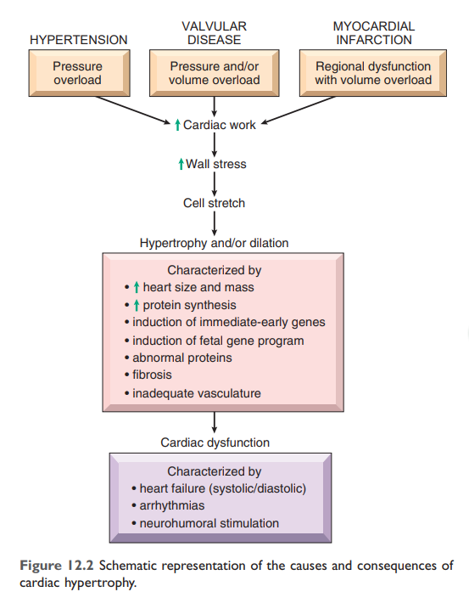
Heart failure can result from progressive deterioration of myocardial contractile function (systolic dysfunction)—reflected as a decrease in ejection fraction (EF, the percentage of blood volume ejected from the ventricle during systole; normal is approximately 45% to 65%).
.

Slide 4
Left-Sided Heart Failure
Left-sided heart failure is most often caused by the following:
• IHD
• Hypertension
• Aortic and mitral valvular diseases
• Primary myocardial diseases
The clinical and morphologic effects of left-sided CHF are a consequence of passive congestion (blood backing up in the pulmonary circulation), stasis of blood in the left-sided chambers, and inadequate perfusion of downstream tissues leading to organ dysfunction.
Left-sided heart failure can be divided into systolic and diastolic failure:
• Systolic failure is defined by insufficient ejection fraction (pump failure) and can be caused by any of the many disorders that damage or derange the contractile function of the left ventricle.
• In diastolic failure, the left ventricle is abnormally stiff and cannot relax during diastole.

Slide 5
Morphology
Heart. The findings depend on the disease process, ranging from myocardial infarcts, to stenotic or regurgitant valves, to intrinsic myocardial pathology.
Lungs. Pulmonary congestion and edema produce heavy, wet lungs.Pulmonary changes
Extravasated red cells and plasma proteins in the alveoli are phagocytosed and digested by macrophages; the accumulated iron is stored as hemosiderin. These hemosiderin-laden macrophages (also known as heart failure cells) are telltale signs of previous episodes of pulmonary edema.
Pleural effusions (typically serous) arise from elevated pleural capillary and lymphatic pressure and the resultant transudation of fluid into the pleural cavities.

Slide 6
Left-sided heart failure symptoms are related to pulmonary congestion and edema
MILD: respiratory manifestations and cardiomegaly: (Initially, cough and dyspnea (breathlessness) may occur only with exertion. As CHF progresses, worsening pulmonary edema may cause orthopnea (dyspnea when supine, relieved by sitting or standing) or paroxysmal nocturnal dyspnea)
MODERATE: Kidney manifestations(a reduced ejection fraction leads to diminished renal perfusion, causing activation of the reninangiotensin-aldosterone system as a compensatory mechanism to correct the “perceived” hypotension. This leads to salt and water retention, with expansion of the interstitial and intravascular fluid volumes, exacerbating the ongoing pulmonary edema. If the hypoperfusion of the kidney becomes sufficiently severe, impaired excretion of nitrogenous products may cause azotemia (called prerenal azotemia).
SEVER: CNS MANIFESTATIONS( cerebral hypoperfusion can give rise to hypoxic encephalopathy with irritability, loss of attention span, and restlessness that can progress to stupor and coma with ischemic cerebral injury.

Slide 7
Right-Sided Heart Failure
Right-sided heart failure is most commonly caused by left-sided heart failure, as any increase in pressure in the pulmonary circulation from left-sided failure inevitably burdens the right side of the heart. Consequently, the causes of right-sided heart failure include all the etiologies for left sided heart failure.
Isolated right-sided heart failure is infrequent and typically occurs in patients with one of a variety of disorders affecting the lungs; hence it is often referred to as cor pulmonale.
The major morphologic and clinical effects of primary right-sided heart failure differ from those of left-sided heart failure in that pulmonary congestion is minimal while engorgement of the systemic and portal venous systems is pronounced.

Slide 8
MORPHOLOGY
Heart. As in left-heart failure, the cardiac morphology varies with cause.
Liver and Portal System. Congestion of the hepatic and portal vessels may produce pathologic changes in the liver, the spleen, and the Gastrointestinal tract.
The liver is usually increased in size and weight (congestive hepatomegaly) caused by passive congestion, greatest around the central veins. Grossly, this is reflected as congested red-brown pericentral zones, with relatively normal-colored tan periportal regions, producing the characteristic “nutmeg liver” appearance . In some instances, especially when left-sided heart failure with hypoperfusion is also present, severe centrilobular hypoxia produces centrilobular necrosis. With longstanding severe right-sided heart failure, the central areas can become fibrotic, eventually culminating in cardiac cirrhosis.
Pleural, Pericardial, and Peritoneal Spaces. Systemic venous congestion can lead to fluid accumulation (effusions) in the pleural, pericardial, or peritoneal spaces (a peritoneal effusion is also called ascites).
Subcutaneous Tissues. Edema of the peripheral and dependent portions of the body, especially foot/ankle (pedal) and pretibial edema, is a hallmark of right-sided heart failure.
Generalized massive edema (anasarca) can also occur.

Slide 9
Valvular heart disease
Calcific Valvular Degeneration
Mitral Valve Prolapse (Myxomatous Degeneration of the Mitral Valve.
Carcinoid Heart Disease
Complications of Prosthetic Valves
Rheumatic Fever and Rheumatic Heart Disease.
Infective Endocarditis (IE)

Slide 10
STENOSIS: Valve orifice is smaller, impending the forward flow of blood and creating a pressure gradient difference across an open valve.
REGURGITATION: Incomplete closure of the valve leaflets results in the backward flow of blood
Generally, valvular stenosis leads to pressure overload cardiac hypertrophy, whereas valvular insufficiency leads to volume overload; both situations can culminate in heart failure.

Slide 11
Abnormal flow through diseased valves typically produces abnormal heart sounds called murmurs.
Severe lesions can even be externally palpated as thrills.
Depending on the valve involved, murmurs are best heard at different locations on the chest wall; moreover, the nature (regurgitation versus stenosis) and severity of the valvular disease determines the quality and timing of the murmur.

Slide 12
The most frequent causes of the major valvular lesions are as follows:
• Aortic stenosis: calcification and sclerosis of anatomically normal or congenitally bicuspid aortic valves.
• Aortic insufficiency: dilation of the ascending aorta, often secondary to hypertension and/or aging.
• Mitral stenosis: rheumatic heart disease (RHD).
• Mitral insufficiency: myxomatous degeneration (MVP), or left ventricular dilation due to ischemic or nonischemic heart failure

Slide 13
Calcific Aortic Stenosis
The most common of all valvular abnormalities, calcific aortic stenosis is usually the consequence of age-associated “wear and tear” of either anatomically normal valves or congenitally bicuspid valves (found in approximately 1% of the population).
The prevalence of aortic stenosis is estimated at 2% and is increasing as the general population ages.
The chronic progressive injury leads to valvular degeneration and incites the deposition of hydroxyapatite (the same calcium salt found in bone).

Slide 14
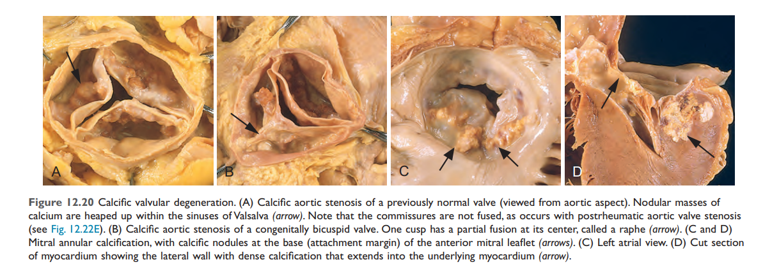
The calcific process begins in the valvular fibrosa on the outflow surface of the valve, at the points of maximal cusp flexion.
. In contrast with rheumatic (and congenital) aortic stenosis commissural fusion is not usually seen.

Slide 15
Mitral Valve Prolapse (Myxomatous Degeneration of the Mitral Valve)
In mitral valve prolapse (MVP), one or both mitral valve leaflets are “floppy” and protrude into the left atrium during systole. MVP affects approximately 2% to 3% of dults in the United States and is more common in women;
it is most often an incidental finding on physical examination,
but may lead to serious complications in a small minority
of affected individuals.
Pathogenesis
The etiologic basis for the changes that weaken the valve leaflets and associated structures is unknown in most cases.

Slide 16
MORPHOLOGY
The characteristic anatomic change in MVP is ballooning (hooding) of the mitral leaflets
The key histologic change in the tissue is marked myxomatous degeneration of the spongiosa layer, reflected by increased deposition of a highly sulfated hydrophilic matrix

Slide 17
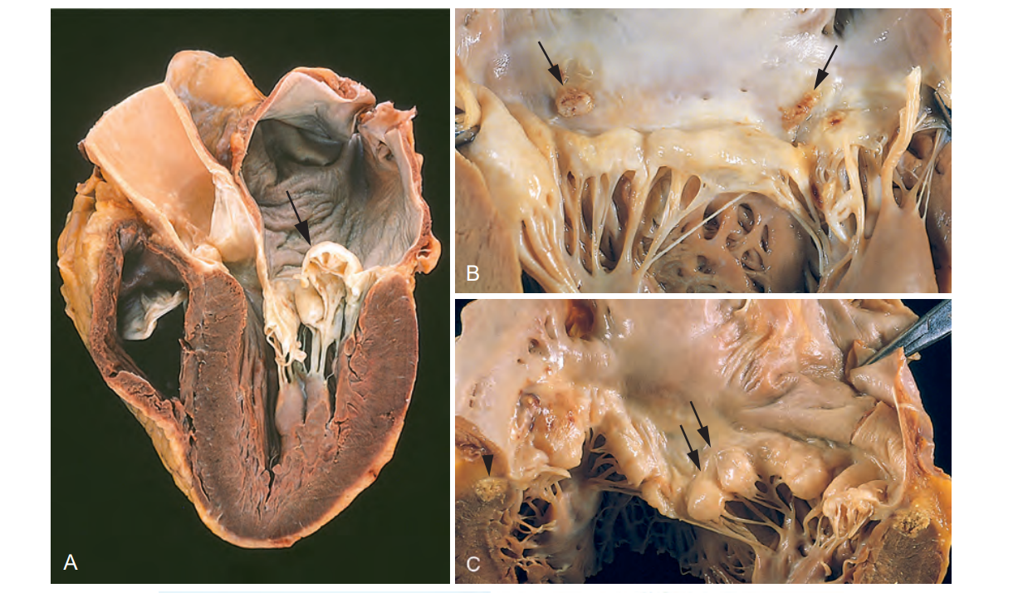

Slide 18
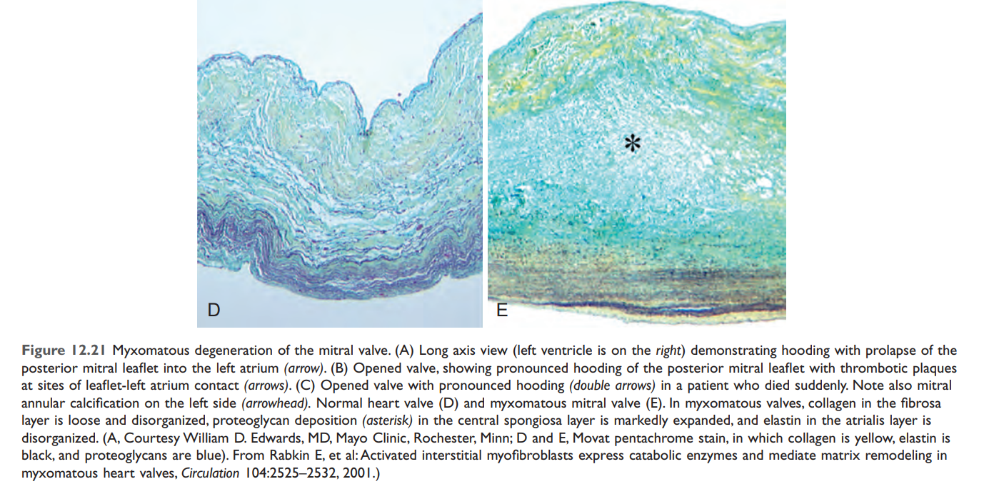

Slide 19
Carcinoid Heart Disease
The carcinoid syndrome refers to a systemic disorder marked by flushing, diarrhea, dermatitis, and bronchoconstriction that is caused by bioactive compounds such as serotonin released by carcinoid tumorS.
Cardiac lesions do not typically occur until there is a massive hepatic metastatic burden, because the liver normally catabolizes circulating mediators before they can affect the heart.
Classically, endocardium and valves of the right heart are primarily affected because they are the first cardiac tissues bathed by the mediators released by gastrointestinal carcinoid tumors.

Slide 20
Complications of Prosthetic Valves
Two types of prosthetic valves are currently used, each with its own advantages and disadvantages:
• Mechanical valves. These consist of different configurations of rigid nonphysiologic material, such as caged balls, tilting disks, or hinged semicircular flaps (bileaflet tilting disk valves).
• Tissue valves (bioprostheses)

Slide 21
