Slide 1
Non-traumatic chest pain
Ahmad Aldhoun
Emergency senior specialist
France and European fellowship
Note : lines in red are very important in the first 40 slides

Slide 2
Causes of chest pain
Cardiac
Noncardiac
Pulmonary
Pulmonary embolism
Pleurisy
Pneumothorax
Pneumonia
Pediatrics
Kawasaki disease
Hypertrophic cardiomyopathy
Congenital heart disease
Gastrointestinal
Esophageal reflux
Esophageal spasm
Esophageal rupture
Peptic ulcer disease
Gallbladder disease
Pancreatitis
Chest Wall Pain
Herpes Zoster
Costochondritis
Cervical radiculopathy
Rib fracture
Anxiety
Ischemic: causes;
Myocardial Infarction (MI), CAD (Angina pectoris), Aortic Stenosis, Coronary Vasospasm, Hypertrophic Cardiomyopathy.
Nonischemic: causes include;
Pericarditis, Dissecting Aortic Aneurysm, Mitral Valve Prolapse.
Think systemically

Slide 3
مهم جدا
Notes:
Because Coronary artery disease is the leading cause of death in Jordan, it is important to diagnose a cardiac etiology in patients presenting with acute chest pain. But don’t forget that certain noncardiac causes may be life threatening as well.

Slide 4
Acute coronary syndrome (ACS) : refers to a spectrum of clinical presentations ranging from those for ST-segment elevation myocardial infarction (STEMI) to presentations found in non–ST-segment elevation myocardial infarction (NSTEMI) or in unstable angina.
It is an umbrella term for situations where the blood supplied to the heart muscle is suddenly blocked.
“This is an absolute medical emergency.
مهم

Slide 5
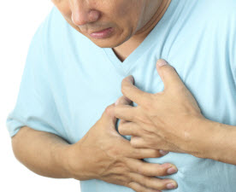
Approach to a patient with chest pain
GOAL-Early detection and safe management of life-threatening diseases
Complete history is very important
Timely and appropriate testing
Do not focus on a benign disease and miss a life-threatening illness

Slide 6
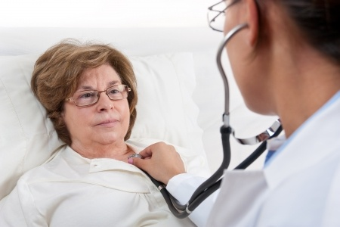
History
HX of pain ( O- onset
Medical , family , drug history , risk factors
Physical examination
ABCs, the vital signs ( should be noted prior to even
Cardiopulmonary and abdominal examination
Diagnostic tests
ECG
CXR
Blood tests
Cardiac biomarkers
FBC ( full blood count )
renal profile
c. Arterial blood gas (ABG).
d. Pulse oximetry
obtaining the history )
P-provocation /palliation
Q- quality/quantity
R- region/radiation
S- severity/scale
T- timing/time of onset

Slide 7
1- Cardiogenic causes
Cardiac causes of chest pain
Ischemic: causes;
Myocardial Infarction (MI), CAD (Angina pectoris), Aortic Stenosis, Coronary Vasospasm, Hypertrophic Cardiomyopathy.
Nonischemic: causes include;
Pericarditis, Dissecting Aortic Aneurysm, Mitral Valve Prolapse.

Slide 8
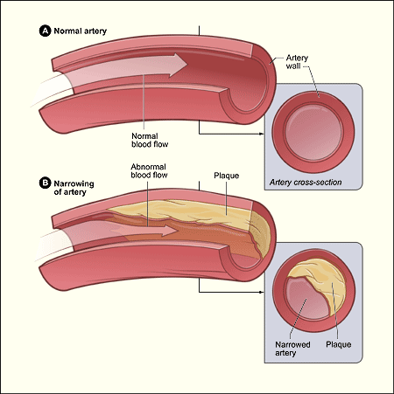
ISCHEMIC HEART DISEASE (IHD)
I. BASIC PRINCIPLES
A; Group of syndromes related to myocardial ischemia;
IHD is the leading cause of death in the US.
B. Usually due to atherosclerosis
of coronary arteries, which decreases blood flow to the
myocardium
I. Risk factors for IHD are similar to those of atherosclerosis; incidence increases
with age.

Slide 9
Risk factors
Age > 40
Male
Post-menopausal female
Hypertension
Hyperlipidemia
Cigarette smoking
Diabetes
Family history
Obesity
Drug abuse-cocaine
The absence of risk factors does not rule out cardiac disease

Slide 10
Angina
Stable
Pain < 20 min
ST-segment depression
Unstable
Pain > 20 min
Prinzmetal angina
ST-segment elevation
Relieved by rest or nitroglycerin
ST-segment depression
Not ( according to previous slides ) Relieved by rest or nitroglycerin
. Relieved by nitroglycerin or calcium channel
Notes:
) Types of angina: stable, unstable, prinzmetal(variant), microvascular(women with DM), syndrome X
Coronary artery disease, the main cause of angina, is due to atherosclerosis of the coronary arteries
Is acute(minutes to hours)
Unstable(coronary artery disease): non mi, nstemi, stemi

Slide 11
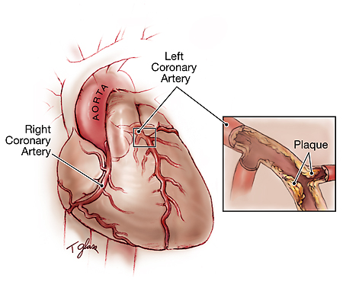
1. Stable ANGINA
Stable angina :
is chest pain that arises with exertion or emotional stress.
Due to atherosclerosis of coronary arteries with > 70% stenosis
2. Represents reversible injury to myocytes (no necrosis)
3. Presents as chest pain (lasting < 10 minutes) that radiates to the left arm or jaw,
diaphoresis, and shortness of breath
4. ECG shows ST-segment depression due to subendocardial ischemia.
5. Relieved by rest or nitroglycerin

Slide 12
2- Unstable angina
Atherosclerosis of coronary artery with thrombus and incomplete oclusion of artery.
Present as chest pain more than 20 minute
Not relived by nitroglycerine ( according to previous slides )
High risk complicated to myocardial infarction

Slide 13
Unstable Angina
Types: Restful, nocturnal, transient, decubitus
Nocturnal and decubitus increase the preload on the heart due to the position in which the patient is in. This will have a negative effect on the heart due to the change in gravity and perfusion/ventilation.
New-onset angina
If it has occurred more than once in less than one month, then we consider it an unstable angina
If the time between two time periods of attacks was more than one month, then we consider it a stable angina.
Crescendo angina increases in severity with a decrease in triggers with time.
مهم جدا
Notes:
Treatment is invasive: angioplast, stenting, coronary artery bypass grafting.
Could occur at rest
New-onset angina
If it has occurred more than once in less than one month, then we consider it an unstable angina
If the time between two time periods of attacks was more than one month, then we consider it a stable angina.

Slide 14
3- Prinzmetal angina
is episodic chest pain unrelated to exertion.
1. Due to coronary artery vasospasm
2. Represents reversible injury to myocytes (no necrosis)
3. EKG shows ST-segment elevation due to transmural ischemia.
4. Relieved by nitroglycerin or calcium channel blockers
Notes:
Typically occurs at night and results from triggers such as stress, smoking or cold weather.
The treatment is usually by relieving spasm such as : nitrates(isosorbide, nitroglycerin) , calcium channel blockers
Associated with migraines—same etiology

Slide 16
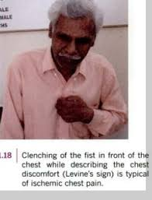
Anginas سلايد من ورقة النوتات مهم ،
Which questions do we ask?
How long has the pain lasted?
<10 minutes → stable
>20 minutes → unstable
Does the pain radiate?
Usually to the jaw, neck, inner aspect of the shoulders and left arm.
Does the patient have any sort of autonomic stimulation?
This includes dizziness, drowsiness, nausea and vomiting. Possibly diarrhea.
Levine's sign is a clenched fist held over the chest to describe ischemic chest pain

Slide 17
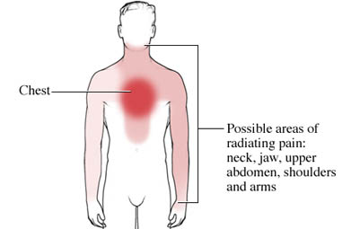
History

Slide 18
Precipitating Factors:
Anything that increases cardiac function , hence increasing O2 demand.
Exercise
Cold weather ( vasoconstriction)
Walking uphill
Heavy-lifting
Emotional excitement
Reliveing factors :
Rest
Glyceryl trinitrate
Walking through the angina
Major risk factors for angina include age ,cigarette smoking, diabetes, high cholesterol, high blood pressure, sedentary lifestyle and family history of premature heart disease.
Notes:
The preliminary diagnosis of angina usually is made by the patient's history. The health care professional needs to understand what the patient is experiencing and may ask similar questions in a variety of ways to gain that understanding. This may be a frustrating process for both patient and professional because the symptoms of angina can range from classic to vague.
Part of the history will be to assess risk factors for heart disease..
There are other diseases that can cause chest pain, abdominal pain, shortness of breath, sweating, and N/v. Questions may be asked to determine whether other possibilities other than angina exist. PE, pneumonia, aortic aneurysm, (GERD), PU disease, and gallbladder disease are bit a few of the potential causes of symptoms other than angina.

Slide 19
Physical examination findings are rarely contributory
The blood pressure and respiratory rate are typically elevated, but otherwise, the vital signs are usually normal.
(2) The patient may be diaphoretic and pale, with cool, clammy extremities.
(3) Signs of CHF may be present
Notes:
Physical examination will help narrow the potential list of diseases but in of itself, will not make the formal diagnosis.

Slide 20
Differential Diagnoses Evaluation
Electrocardiography.
An ECG should be performed to risk-stratify patients.
The ECG is normal in 50% of patients with angina who are pain-free. In patients who are experiencing pain,
acute ischemia may be represented by ST-segment and T-wave abnormalities.
Classically, ST-segment depression and T-wave inversion suggest nontransmural (subendocardial)
Ischemia, whereas Prinzmetal’s angina and transmural ischemia cause ST-segment elevation similar to the pattern of acute infarction.
Notes:
If a patien presents with chest pain and they are above 40 years old you must do an ECG if they are below 40 years old look for other non cardiac signs and if you dont find then do an ECG

Slide 21
Therapy
(1) Oxygen should be provided by nasal cannula at a rate of at least 2 L/min.
(a) It should be given in high concentrations by face mask if the patient is cyanotic or has a pulse oximetry reading of less than 95.
(b) If the patient has a history of chronic obstructive pulmonary disease (COPD), oxygen should not be withheld, but the patient should be monitored carefully for signs of respiratory depression (e.g., somnolence, confusion, lethargy).
(2) Aspirin (325 mg) should be given. The patient should chew the tablets to accelerate the antithrombotic effect. Aspirin can be tolerated by patients with peptic ulcer disease unless they are actively hemorrhaging.
(3) Heparin should be given in a bolus of 80 U/kg and started as an infusion at a rate of 15 U/kg/hour.
Notes:
) Oxygen should be provided by nasal cannula at a rate of at least 2 L/min.
(a) It should be given in high concentrations by face mask if the patient is cyanotic or has
a pulse oximetry reading of less than 95%.
(b) If the patient has a history of chronic obstructive pulmonary disease (COPD), oxygen
should not be withheld, but the patient should be monitored carefully for signs
of respiratory depression (e.g., somnolence, confusion, lethargy).
(2) Aspirin (325 mg) should be given. The patient should chew the tablets to accelerate the
antithrombotic effect. Aspirin can be tolerated by patients with peptic ulcer disease unless
they are actively hemorrhaging.
(3) Heparin should be given in a bolus of 80 U/kg and started as an infusion at a rate of
15 U/kg/hour. The partial thromboplastin time (PTT) should be checked after 6 hours;
the goal is an international normalized ratio (INR) of 1.5 to 2.5. Also consider enoxaparin
(Lovenox) 1 mg/kg subcutaneously every 12 hours.
(4) Nitroglycerin decreases cardiac preload and afterload and dilates the coronary arteries.
Sublingual nitroglycerin is preferred to intravenous nitroglycerin initially because a therapeutic
blood level can be obtained much more rapidly with sublingual administration.
(5) Morphine should be given in 2- to 5-mg aliquots if the patient has persistent chest pain,
elevated blood pressure, or both.
(6) Blockers may be helpful, especially if the patient is tachycardic and hypertensive.
β Blockers are contraindicated in patients with hypotension, severe asthma, emphysema,
CHF, high-grade heart block, severe bradycardia, or peripheral vascular disease with
peripheral cyanosis.
(a) Esmolol is a β1-selective agent with a half-life of 9 minutes.
(b) Metoprolol, also a β1-selective agent, can be given by intravenous push in three separate
5-mg doses, titrating for effect on blood pressure and heart rate.
(7) Calcium channel blockers are indicated in the treatment of Prinzmetal’s angina, but are
otherwise of controversial utility.

Slide 22
(4) Nitroglycerin decreases cardiac preload and afterload and dilates the coronary arteries. Sublingual nitroglycerin is preferred to intravenous nitroglycerin initially because a therapeutic blood level can be obtained much more rapidly with sublingual administration.
(5) Morphine should be given in 2- to 5-mg aliquots if the patient has persistent chest pain, elevated blood pressure, or both.
(6) Blockers may be helpful, especially if the patient is tachycardic and hypertensive. β Blockers are contraindicated in patients with hypotension, severe asthma, emphysema, CHF, high-grade heart block, severe bradycardia, or peripheral vascular disease with peripheral cyanosis.They are also contraindicated in the variant type of angina.
(a) Esmolol is a β1-selective agent with a half-life of 9 minutes.
(b) Metoprolol, also a β1-selective agent, can be given by intravenous push in three separate 5-mg doses, titrating for effect on blood pressure and heart rate.
(7) Calcium channel blockers are indicated in the treatment of Prinzmetal’s angina, but are otherwise of controversial utility.

Slide 23
II. MYOCARDIAL INFARCTION
(( Necrosis of cardiac myocytes ))
Usually due to rupture of an atherosclerotic plaque with thrombosis and complete occlusion of a coronary artery
Other causes include coronary artery vasospasm (due to Prinzmetal angina or
cocaine use), emboli, and vasculitis (e.g., Kawasaki disease).
Clinical features include severe, crushing chest pain (lasting > 20 minutes) that radiates to the left arm or jaw, diaphoresis, and dyspnea;
symptoms are not relieved by nitroglycerin.
Notes:
Myocardial infarction (MI) (ie, heart attack) is the irreversible necrosis of heart muscle secondary to prolonged ischemia.
Myocardial infarction is considered part of a spectrum referred to as acute coronary syndrome.The ACS continuum representing ongoing myocardial ischemia or injury consists of unstable angina, non–ST-segment elevation myocardial infarction (NSTEMI), and ST-segment elevation myocardial infarction (STEMI).

Slide 24
Stable
Pain < 20 min
ST-segment depression
Unstable
Pain > 20 min
Prinzmetal angina
ST-segment elevation
Relieved by rest or nitroglycerin
ST-segment depression
Relieved by rest or nitroglycerin
. Relieved by nitroglycerin or calcium channel
MI
ST-segment or non st elevation
. Not Relieved by nitroglycerin or calcium channel

Slide 25
مهم
Silent MI ( 30% )
→ No chest pain. Occurs in two cases;
Diabetes → comes with hyperglycemia due to ischemia
Elderly → due to bypass and collateral pathway
Notes:
Myocardial infarction (MI) (ie, heart attack) is the irreversible necrosis of heart muscle secondary to prolonged ischemia.
Myocardial infarction is considered part of a spectrum referred to as acute coronary syndrome.The ACS continuum representing ongoing myocardial ischemia or injury consists of unstable angina, non–ST-segment elevation myocardial infarction (NSTEMI), and ST-segment elevation myocardial infarction (STEMI).

Slide 26
Three main types of MI’s:
Anterior, Inferior and lateral.
Anterior MI’s often present with chest pain and dyspnea due to left ventricular involvement.
Inferior MI’s often present with chest pain, N & V, diaphoresis and singultus (hiccups) due to possible Vagus nerve involvement.
Epigastric radiation is only present in cases of inferior MI.
Lateral MI’s often present with chest pain and left arm pain.
مهم
Notes:
MI’s may go unrecognized, sometimes symptoms are delayed for many hours.

Slide 27
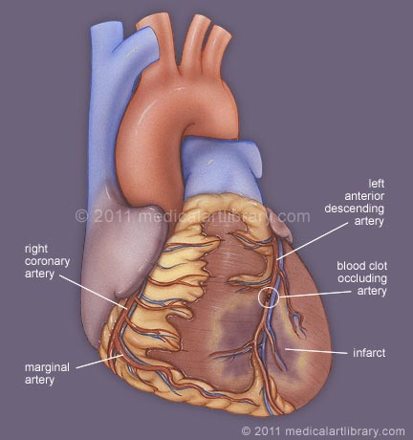
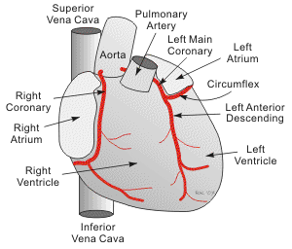

Slide 28
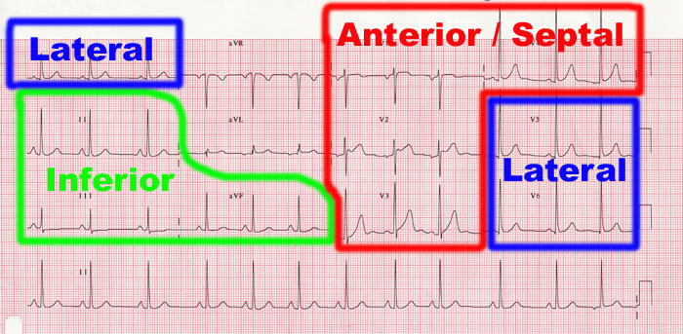
MI location
Anterior infarction in v3+v4
Lateral v5+v6 Septal V1 ,v2
Posterior: V1 (Tall R, ST depression, and inverted T wave); also known as mirror sign

Slide 29
Clinical features
History. The focus of the history is the same as that discussed of angina .
Radiation
Epigastric - only in cases of inferior MI**
Physical examination findings
(1) Vital sign abnormalities are nonspecific but may reflect some of the acute complications
(2) Cardiac examination may reveal a third or fourth heart sound (S3 or S4).
Notes:
In general, the patient's blood pressure is initially elevated because of peripheral arterial vasoconstriction resulting from an adrenergic response to pain and ventricular dysfunction
However, with right ventricular myocardial infarction or severe left ventricular dysfunction, hypotension is seen

Slide 30
Differential diagnoses evaluation:
The patient should be monitored for cardiac arrhythmias and oxygenation status,
and an intravenous line for the administration of normal saline at a KVO rate should be placed.
Continuous blood pressure monitoring is contraindicated with thrombolytic therapy, unless the patient is unstable

Slide 31
. Electrocardiography. An ECG must be obtained immediately
. The ECG abnormalities characteristic
of infarction are :
(in decreasing order of specificity):
A normal ECG does not rule out MI.
ST-segment elevation, “hyperacute”
T waves, Q waves, ST-segment depression
T-wave inversions, and conduction abnormalities.
Notes:
patients with ischemic discomfort may or may not have ST-segment or T-wave changes denoted on the electrocardiogram (ECG). ST elevations seen on the ECG reflect active and ongoing transmural myocardial injury. Without immediate reperfusion therapy, most persons with STEMI develop Q waves, reflecting a dead zone of myocardium that has undergone irreversible damage and death. Those without ST elevations are diagnosed either with unstable angina or NSTEMI―differentiated by the presence of cardiac enzymes. Both these conditions

Slide 32
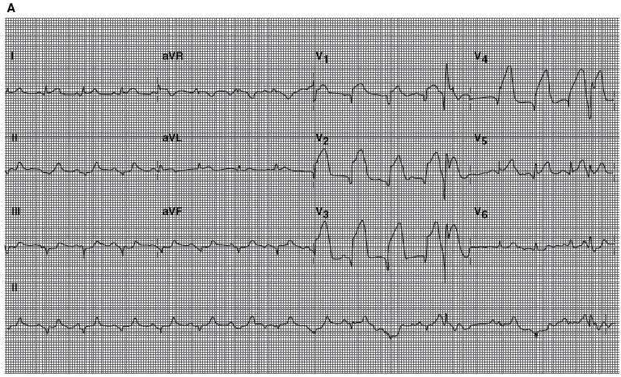

Slide 33
. Cardiac ultrasonography may reveal acute valvular dysfunction, wall motion abnormalities,
or pericardial fluid collections.

Slide 34
مهم
c. Laboratory studies
Cardiac Enzymes and MI Diagnostic markers
Myoglobin
Myoglobin is found in cardiac and skeletal muscle. has high sensitivity but poor specificity.
non-specific but fastest indicator of MI injury (within 1 hour)
Troponin
3-6 hours, stays for 10 days, has a peak of 24-48 hours
most reliable ( the most sensitive and specific marker )
Not found normally in serum , released only when myocardial necrosis occurs
Creatinine Kinase
Has different types of kinase depending on the location
increase within 3-12 hours of the onset of chest pain, reach peak values within 24 hours, and return to baseline after 48-72 hours
Helps in reinfarction diagnosis
Notes:
Troponin levels: Troponin is a contractile protein that normally is not found in serum; it is released only when myocardial necrosis occurs
Creatine kinase (CK) levels: CK-MB levels increase within 3-12 hours of the onset of chest pain, reach peak values within 24 hours, and return to baseline after 48-72 hours

Slide 35
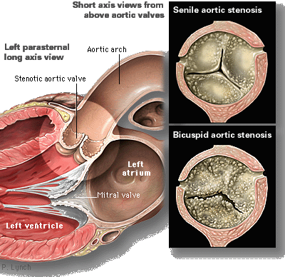
Aortic Stenosis
Narrowing of the aortic valve orifice (Fig. 8.14)
P. Usually due to fibrosis and calcification from "wear and tear".
If the valve narrows enough, blood flow into the coronary arteries located near the valve can be decreased causing pain.
The chest pain is usually exertional.
Notes:
Often caused by congenital valve abnormalities, aortic sclerosis and rheumatic fever. Frequently coexists with CAD. Chest pain is usually exertional. Signs of heart failure may be present. Assess for systolic murmur, unusual carotid pulse.

Slide 36
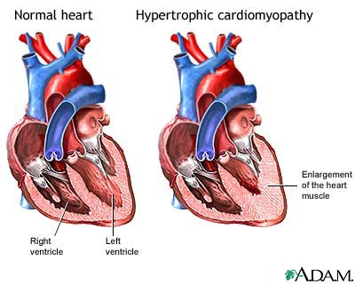
Hypertrophic Cardiomyopathy
Massive hypertrophy of the left ventricle
B. Usually due to genetic mutations in sarcomere proteins;
2. Sudden death due to ventricular arrhythmias; hypertrophic cardiomyopathy is a
common cause of sudden death in young athletes.
3. Syncope with exercise—Subaortic hypertrophy of the ventricular septum results
in functional aortic stenosis.
During activity the thickened muscle walls oxygen demands are not met.
Notes:
Causes overflow obstruction of left ventricle (hypertrophied septum). Assess for dyspnea with chest pain. Syncope can be typical with postexertion. Listen for loud systolic murmur. Pain complaints are similar to angina.

Slide 37
Pericarditis
Inflammation of the pericardium (what is the pericardium?)
Pain is due to irritation of the parietal pleura
It is a sharp, stabbing chest pain
Radiates to the back, neck, or shoulder
Worse with cough, respiration and laying down.
Improves with leaning forward

Slide 38
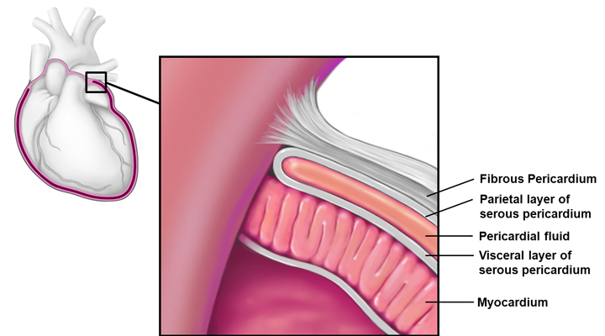

Slide 39
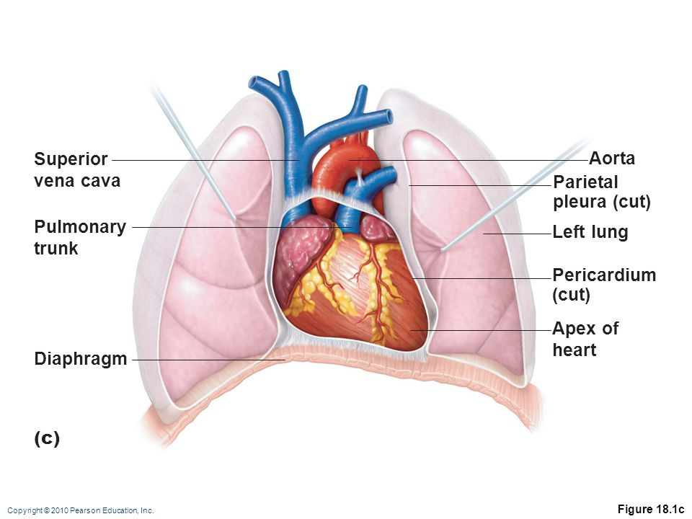

Slide 40
Diagnosis is based on the chest pain, a Pericardial friction rub? , specific (ECG) changes , and fluid around the heart.
Generally, laboratory values are normal but if there is a concurrent myocardial infarction (heart attack) or great stress to the heart , laboratory values may show increased cardiac markers like Troponin , Myoglobin ,CK-MP.
Causes include infections (viral / bacterial / Fungal) MI, valve replacement, post-cardiac surgery, trauma, idiopathic,TB (especially in Jordan).

Slide 41
Pericarditis ECG
Normal
Pericarditis ECG (What stages ?)

Slide 43
Aortic Dissection
Aortic dissection occurs when a tear in the intima of the aorta causes blood to flow between the layers of the wall of the aorta, forcing the layers apart.
Most often occur in the first 10cm of the aorta close to the heart.
Think with me why aortic dissection happens ?
Risk factors
Chronic Hypertension (the major cause)
Pregnancy ?
Trauma
Marfan’s and Ehlers danlos syndromes.

Slide 44
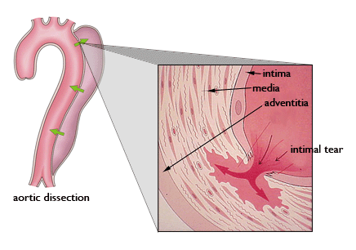
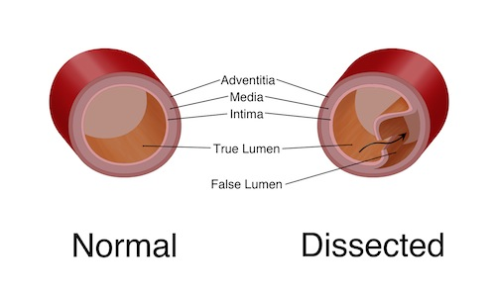

Slide 45
History:
Sudden onset of sharp, tearing, sever pain which radiates to the neck or back , 20% of individuals feel the pain migrate as the dissection extends down the aorta.
- The location of pain is associated with the location of the dissection. Anterior chest pain is associated with dissections involving the ascending aorta, while interscapular (back) pain is associated with descending aortic dissections. If the pain is pleuritic in nature, it may suggest acute pericarditis caused by bleeding into the pericardial sac.
- While the pain may be confused with the pain of a myocardial infarction (heart attack), aortic dissection is usually not associated with the other signs that suggest myocardial infarction, including heart failure and ECG changes.

Slide 46
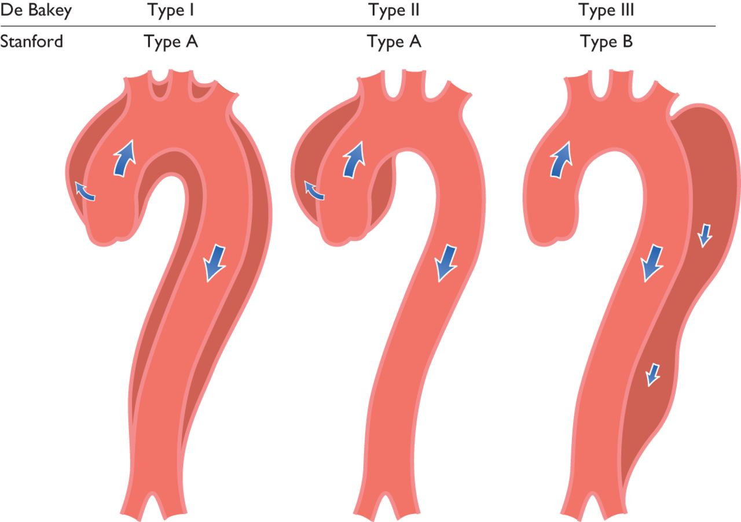

Slide 47
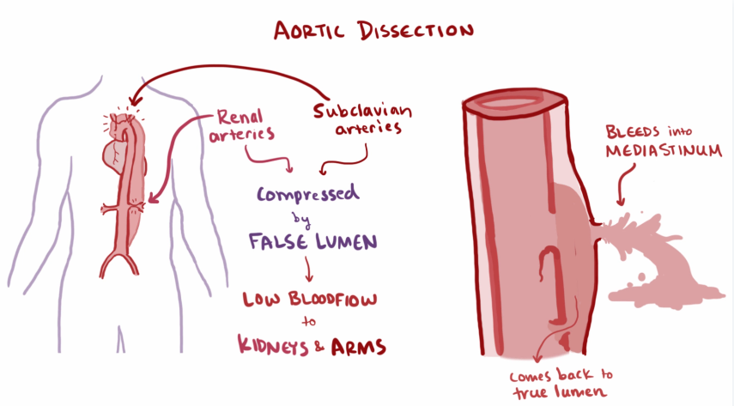
Complications

Slide 48
Cardiac Tamponade
Cardiac Tamponade , also known as pericardial Tamponade, is an acute type of pericardial effusion in which fluid, pus, blood, clots, or gas accumulates in the pericardium (the sac in which the heart is enclosed), resulting in slow or rapid compression of the heart causing constriction of heart contraction.
Diagnosed by ultrasound

Slide 49
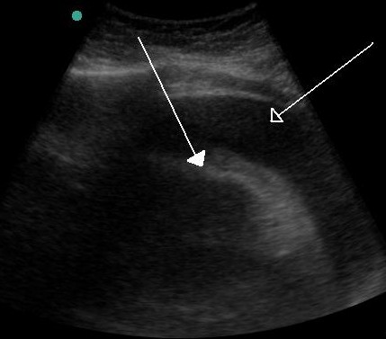

Slide 50
Sign of cardiac Tamponade
Beck’s Triad is a collection of 3 medical signs associated with cardiac temponade:
1- Hypotension
2- Increase JVP and jugular-venous distension
3- Muffled heart sounds
Treatment: Pericardiocentesis (suction of fluid through a needle)

Slide 51
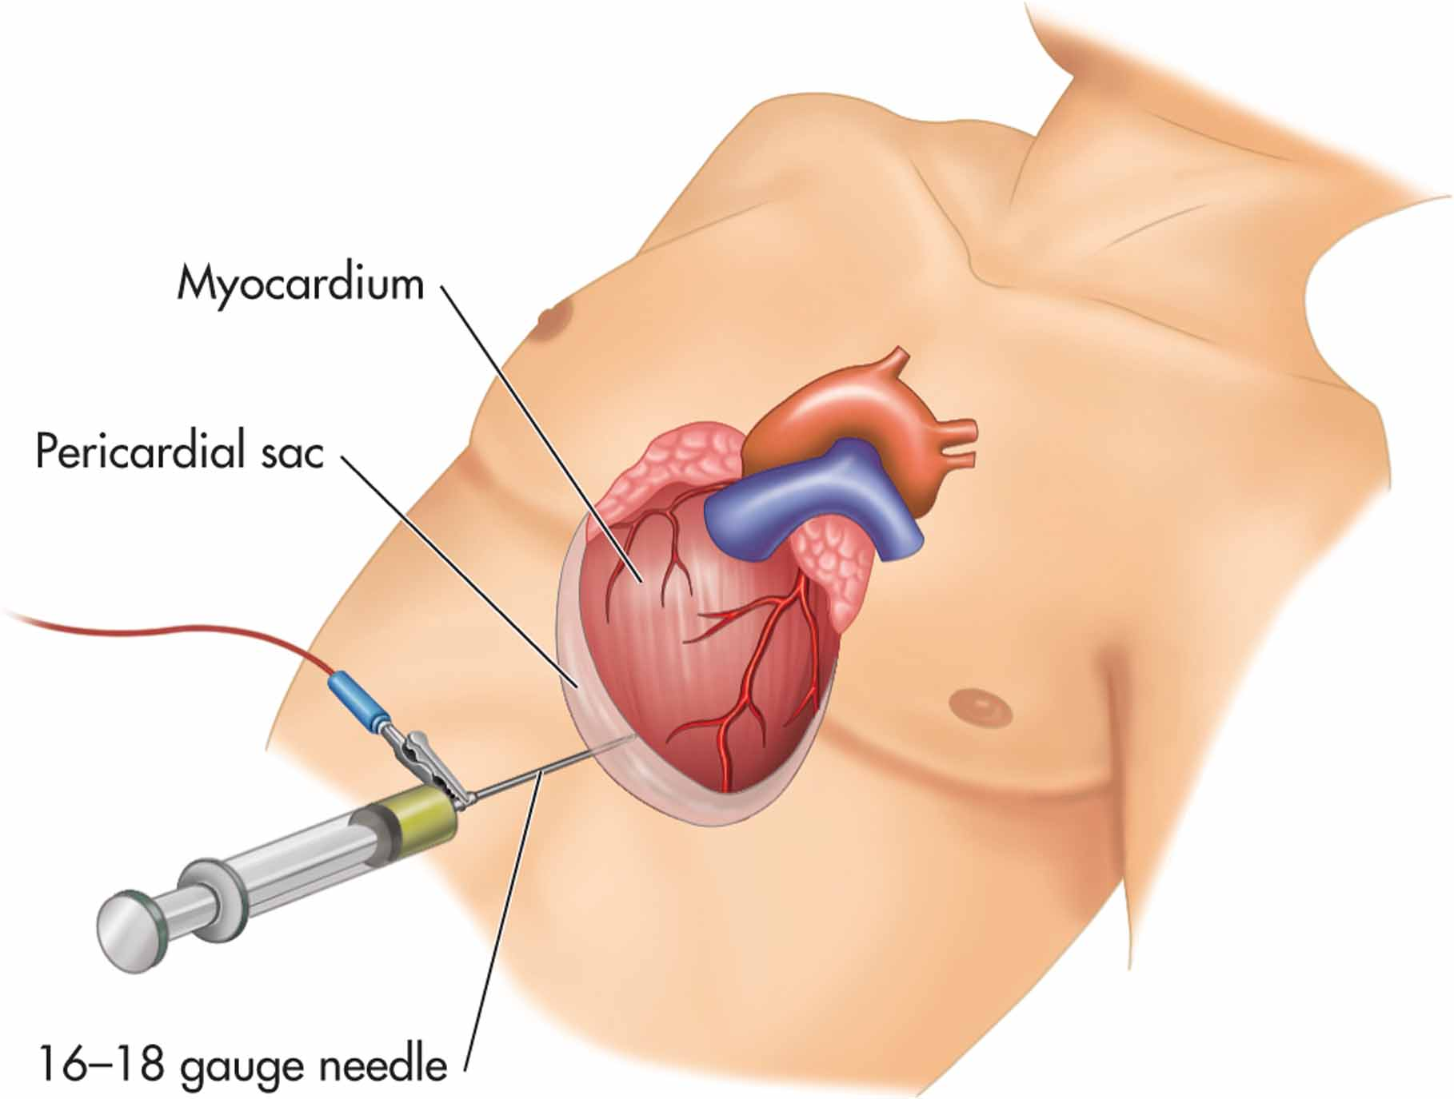

Slide 52
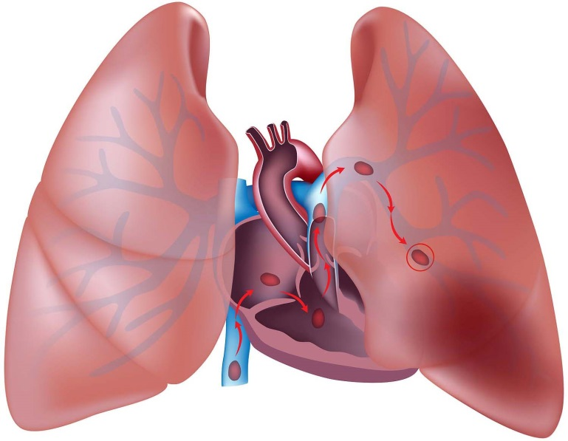
Pulmonary Embolism
a blockage in one of the pulmonary arteries in your lungs by a substance that has travelled from elsewhere in the body through the bloodstream (embolism)
In most cases, pulmonary embolism is caused by blood clots that travel to the lungs from the legs or rarely other parts of the body (deep vein thrombosis).

Slide 53
Because the clots block blood flow to the lungs, pulmonary embolism can be life-threatening.
Common signs and symptoms include:
Shortness of breath This symptom typically appears suddenly and always gets worse with exertion.
Pleuritic chest pain You may feel like you're having a heart attack. The pain may become worse when you breathe deeply (pleurisy), cough, eat, bend or stoop. The pain will get worse with exertion but won't go away when you rest.
Cough The cough may produce bloody or blood-streaked sputum (Hemoptysis)
Fever rarely
Syncope
Evidence of DVT in the extremities

Slide 54
Risk Factors
Previous DVT or PE
Tachycardia
Pregnancy?
Cancer?
Recent surgery
Prolonged bed rest?
Smoking (unknown)
Oral contraceptives ?
Obesity
Inherited blood disorders

Slide 55
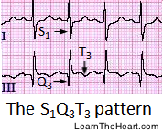
EKG-obtain to rule out cardiac etiology
Sinus tachycardia is the most common abnormality seen in 44% of PE patients.
Non-specific ST and T wave changes.
The most common ECG finding in the setting of a pulmonary embolism is sinus tachycardia, however the "S1Q3T3" pattern which is rare (10% of patients) is considere classic “pathognomonic”. This is termed the McGinn-White sign.
1) Large S wave in lead I 2) Large Q wave in lead III 3) Inverted T wave in lead III

Slide 56
Chest X-ray : This noninvasive test shows images of your heart and lungs on film. Although X-rays can't diagnose pulmonary embolism and may even appear normal when pulmonary embolism exists, they can rule out conditions that mimic the disease.
The diagnostic test is a CT angiography*

Slide 57
Wells Criteria

Slide 58
Gastrointestinal
Etiology in up to 40% of chest pain complaints
Pain described as burning, pressure, or dull.
- Acid Reflux
Substernal, epigastric burning pain
Pain worse with alcohol, caffeine, certain foods
Worse supine and in the morning
Relieved with antacids

Slide 59
- Esophageal spasm
Often associated with reflux disease
painful contractions within the muscular tube connecting your mouth and stomach (esophagus).
Dull, pressure, sub-sternal pain lasting for hours
Can be relieved with Nitroglycerin .
NTG relaxes smooth muscles
- Peptic ulcer disease
- Pancreatitis and gallbladder disease
Include lipase and liver function tests in your workup

Slide 60
- GERD is a chronic digestive disease which occurs when stomach acid or occasionally stomach content flows back into your food pipe (esophagus). The backwash (reflux) irritates the lining of your esophagus and causes GERD. The most-common symptoms of GERD are:
Heartburn
Regurgitation
Trouble swallowing (dysphagia)
GERD sometimes causes injury of the esophagus which leads
Reflux esophagitis – necrosis of esophageal epithelium causing ulcers near the junction of the stomach and esophagus which caused chest pain

Slide 61
Useful investigations may include Esophageal pH Monitoring , barium swallow X-rays, esophageal manometry , and Esophagogastroduodenoscopy (EGD).
The current gold standard for diagnosis of GERD is Esophageal pH monitoring
One practice for diagnosis of GERD is a short-term treatment with proton pump inhibitors, with improvement in symptoms suggesting a positive diagnosis

Slide 62
Boerhaave’s Syndrome
is a rupture of the esophageal wall usually due to medical instrumentation such as an endoscopy or due to forceful vomiting after excessive eating or binge drinking. Are you talking about Mallory-Weiss syndrome ?
In most cases of Boerhaave's syndrome, the tear occurs at the left postero-lateral aspect of the distal esophagus and extends for several centimeters.
It’s the GI indication for ER

Slide 63
The classic history of Esophageal rupture is one of severe vomiting followed by excruciating retrosternal chest and upper abdominal pain. Odynophagia, tachypnea , dyspnea, Sudden onset of severe pain radiating to the back.
Fever, and shock develop rapidly thereafter.
Mortality is 10-50% and directly related to the delay in making the diagnosis and initiating treatment.

Slide 64
Physical examination is usually not helpful, particularly early in the course.
Subcutaneous emphysema (crepitation) is an important diagnostic finding but is not very sensitive.
Mackler's triad includes chest pain, vomiting, and subcutaneous emphysema , and while it is a classical presentation, it is only present in 14% of people.
Mediastinal contamination of stomach contents can lead to mediastinitis and sepsis.

Slide 65
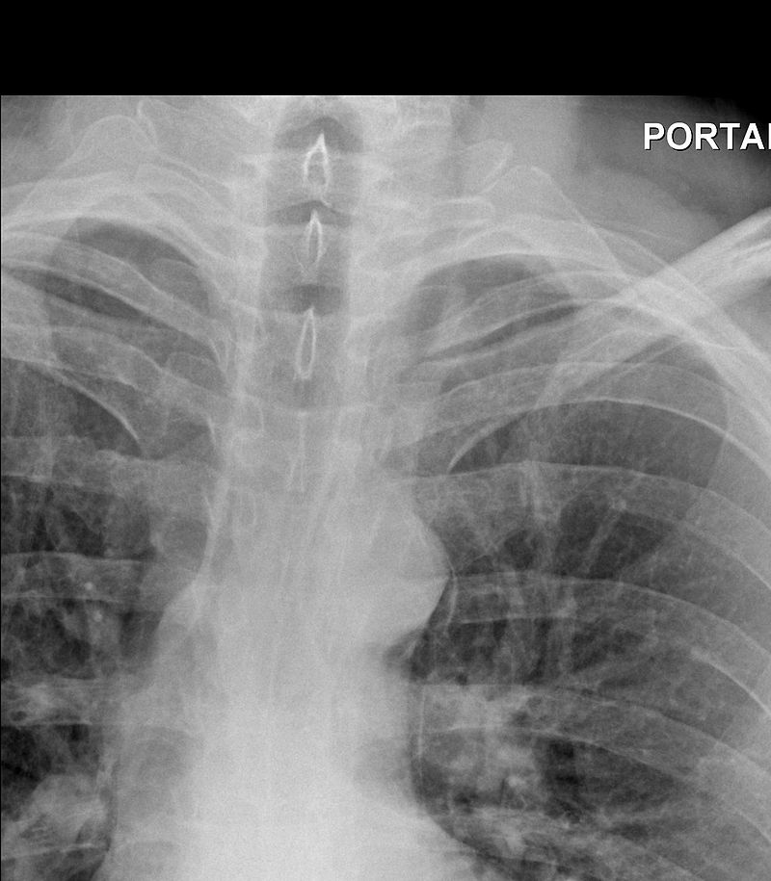
The diagnosis of Boerhaave's syndrome is suggested on the plain chest radiography and confirmed by chest CT scan.
Chest radiograph is almost always abnormal in patients with Boerhaave's syndrome and usually reveals mediastinal air adjacent to the aorta.

Slide 66
Herpes zoster
Shingles is a viral infection that causes a painful rash. Although shingles can occur anywhere on your body, it most often appears as a single stripe of blisters that wraps around either the left or the right side of your trunk.
Shingles is caused by the varicella-zoster virus — the same virus that causes chickenpox. After you've had chickenpox, the virus lies inactive in nerve tissue near your spinal cord and brain. Years later, the virus may reactivate as shingles.

Slide 67
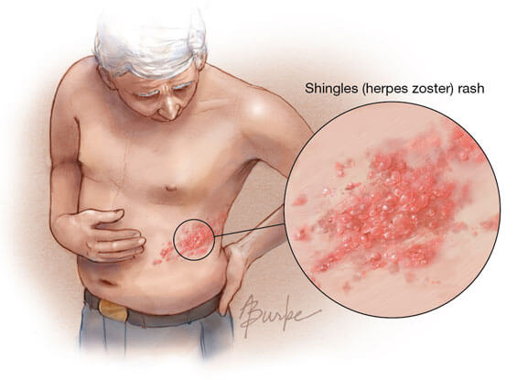
Shingles can present as acute chest pain. The pain is usually burning with sensitivity to touch and with red rash that begins a few days after the pain that itches.

Slide 68
Musculoskeletal Pain
Roughly 28% of patients presenting with chest pain, in whom an MI has been ruled out , suffer from musculoskeletal or chest wall pain.
Causes include:
1- Costochondritis
2- rib fracture and
3- myalgia
- Pain is usually reproducible upon palpation. Passive extension, flexion and rotation of the cervical and thoracic spine can be helpful in reproducing musculoskeletal chest pain.

