Slide 1
Lecture 1 ( 51 slides) Treatment of genetic diseases
Dr. Eman Shaat Professor of Medical Biochemistry and Molecular Biology
Stem cell therapy.
Gene therapy.

Slide 2
I. Stem cells
Stem cells: definition
They are primal cells which are the source, or “stem,” for all of the specialized cells that form organs and tissues.
They retain the ability to produce through mitosis both:
a self-renewing stem cell and
a second cell with the capacity to differentiate into more specialized cells.
Stem cell properties:
1- Self-renewal is the ability to go through numerous cycles of cell division while maintaining the undifferentiated state.
2- Potency is the capacity to differentiate into different cell types.

Slide 3
Why self-renew AND differentiate?
1 stem cell
stem cell
specialized cells
Self renewal: maintains the stem cell pool.
Differentiation: replaces dead or damaged cells throughout life.

Slide 4
Stem cell differentiation
Development begins when a sperm fertilizes an egg and creates a single cell that forms an entire organism.
In the first hours after fertilization, this cell divides into identical cells (morula).
In humans, approximately four days after fertilization and after several cycles of cell division, these cells begin to specialize, forming a hollow sphere of cells, called a blastocyst.
The blastocyst has
an outer layer of cells (trophoblast).
and inside this hollow sphere, there is a cluster of cells called the inner cell mass.
The cells of the inner cell mass will go on to form virtual all of the tissues of the human body.

Slide 5
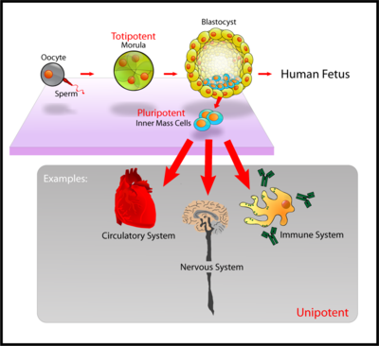
Totipotent, multipotent, unipotent stem cells

Slide 6
Specialization of Stem Cells: Differentiation
Differentiation: unspecialized stem cells give rise to specialized (differentiated) cells in response to external and internal signals
Internal signals: turn on specific genes causing differential gene expression. The decision of a stem to self-renew or differentiate is regulated by a complex set of factors, including:
Transcription factors: as Oct4 (octamer-binding transcription factor 4), Sox2 (sex determining region Y box 2) which play a central role in the maintenance of “stemness”.
Chromatin modifications.
Signaling pathways.
MicroRNAs (miRNAs) which are small, non-coding RNAs regulating gene expression at the post-transcriptional level by: - mRNA degradation or - translational repression.
External signals (stem cell niche):
-Chemicals secreted by other cells such as growth factors, cytokines,..
- Physical contact with neighboring cells.

Slide 7
MicroRNAs regulating ESC self-renewal and differentiation
miRNA 290–295 cluster are highly expressed in ESC. These miRNAs promote ESC proliferation by facilitating the G1 to S transition in the cell cycle, and are therefore considered to have a role in maintaining ESC pluripotency.
miR-145 expression is highly up-regulated during human ESC differentiation. miR-145:
inhibits ESC self-renewal.
induces differentiation.
miR-133 and miR-1 are essential for the differentiation of ESCs into cardiomyocytes.
miR-9 promotes the differentiation into neuronal progenitors

Slide 8
Types: According to their potency (Differentiation capability), stem cells can be classified into:
Totipotent stem cells:
totipotent means entire because it has the potential to generate all the cells and tissues that make up an embryo.
Such cells can construct a complete, viable, organism.
These cells are produced from the fusion of an egg and sperm cell.
Only the cells produced by the first few divisions of the fertilized egg (morula's cells) are totipotent.

Slide 9
Types: According to their potency (Differentiation capability), stem cells can be classified into:
2. Pluripotent stem cells:
Pluri” means several or many.
They are the descendants of totipotent cells, derived from the inner cell mass of the blastocyst
can differentiate into all derivatives of the three primary germ layers: ectoderm, endoderm, and mesoderm.
These include each of the more than 220 cell types in the adult body.
Although the cells of the inner cell mass can form virtually every type of tissue found in the human body, they cannot form an organism.
Pluripotent stem cells undergo further specialization into multipotent progenitor cells.

Slide 10
Types: According to their potency (Differentiation capability), stem cells can be classified into:
3. Multipotent stem cells:
can produce only cells of a closely related family of cells.
e.g.: hematopoietic stem cells differentiate into red blood cells, white blood cells, and platelets or epithelial stem cells that give rise to the various types of skin cells.
4. Unipotent cells:
which means one.
They can produce only one cell type, but have the property of self-renewal which distinguishes them from non-stem cells.
eg.: -Muscle satellite cells that contribute to differentiated muscle tissue.

Slide 11
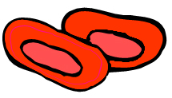
3. Multipotent
Hematopoietic Stem cell
blood stem cell
differentiation
found in
bone marrow
only specialized types of blood cell:
red blood cells, white blood cells, platelets
Adult stem cells

Slide 12
Progenitor cells
They are in the “center” between stem cells and fully differentiated cells.
The most important difference between them is that stem cells can replicate indefinitely, whereas progenitor cells can divide only a limited number of times.
Most progenitors are described as oligopotent.
The characterization progenitor cells, is based on the different cell markers rather than their morphological appearance.

Slide 13
Physiological functions of stem cells
In a developing embryo, stem cells can differentiate into all of the specialized embryonic tissues.
In adult organisms, stem cells act as a repair system for the body, replenishing specialized cells.
Stem cells are required wherever there is a need to replace differentiated cells that cannot divide themselves.
In several tissues the terminal state of cell differentiation is incompatible with cell division.
For example, degeneration of the nuclei of the cell of the outer most layer of the skin or extrusion of nuclei in the mammalian RBC.

Slide 14
Stem cell niche: definition, site
Stem cells depend on local environmental factors to maintain their status as stem cells.
Stem cell niche: it is the microenvironment that regulates the behavior of stem cells (regulating self-renewal and differentiation) and thus can teach us how to control stem cells in culture.
Stem cell niches occur in every organ in the body that can regenerate this organ if damaged (organ specific stem cells).
Niches are highly specialized for each type of stem cell, with a defined anatomical localization.
They are composed by:
stem cells.
supportive stromal cells (which interact each other through cell surface receptors, gap junctions and soluble factors).
ECM in which they are located.

Slide 15
Players in stem cell niche
Niche cells anchor stem cells with adheren junctions and provide cell surface and secreted proteins that regulate the cell cycle of the stem cell.
Some of these factors stimulate division; others inhibit differentiation.
The niche can act on a stem cell by various mechanisms:
1. Direct contact between the stem cell and the niche cells.
2. Soluble factors released by the niche that travel to the stem cell. Biochemically, the ECM:
can act directly by binding cell surface receptors or.
by growth factor presentation.
3. Intermediate cells that ‘communicate’ between the niche and the stem cell.

Slide 16
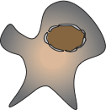
Self-renewal is proliferation coupled to blocking differentiation, controlled by signals.
Niche cell
Differentiated cell
Stem cell
Differentiated cell
In the absence of niche signals, adult stem cells will differentiate, by default

Slide 17
Stem cells & niches
stem cell
niche
Direct contact
Soluble factors
Intermediate cell

Slide 18
Stem cell choice??
The choice of a stem cell to undergo self-renewal is carried out by two cell division mechanisms, which fulfill two different requests by the tissue:
i) Asymmetric self-renewal, in which each stem cell divides into one stem and one differentiated cell, allows maintaining a constant number of stem cells, which is generally sufficient under physiological conditions.
ii) Symmetric self-renewal, in which each stem cell originates two daughter stem cells, leads to an expansion of the stem cell pool, a condition required after tissue injury.
In these niches, the regulation of the balance between symmetric and asymmetric divisions is critical for maintaining proper stem cell number.

Slide 19
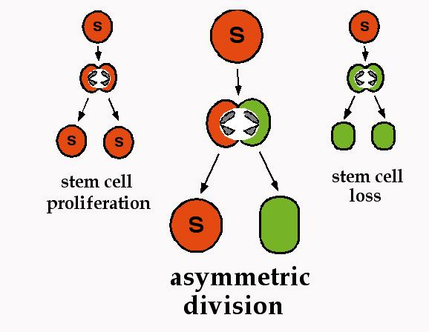
Alternate Stem Cell Fates
Embryonic
Stem Cells
Adult
Stem Cells
specialization
D
D
After tissue injury
D
Under physiological conditions
S: stem cell
D: differentiated cell

Slide 20
Asymmetric division in stem cells and progenitors
Intrinsic factors: involve differing amounts of cell-fate determinants being distributed into each daughter cell.
Extrinsic factors
Single progenitor cell
↓
Asymmetric division
↓
2 daughter Glial cells
1 proginator cell 1 differentiated cell
(Extrinsic factors causes physical displacement of one of the daughter cells out of the original stem cell niche, exposing it to signalling molecules such as chondroitin sulfate which stimulate it to differentiate while the other daughter cell remains in the original niche in a quiescent state)

Slide 21
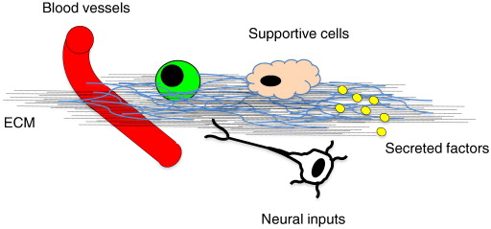
Players in stem cell niche
The stem cell niche is a dynamic microenvironment in which a number of inputs regulate stem cell behavior:
Supportive stromal cells (which interact each other through cell surface receptors, gap junctions and soluble factors).
ECM in which stem cells are located.
Blood vessels carry systemic signals to stem cells.
Neural inputs transmit distant physiological impulses to the stem cell microenvironment.

Slide 22
Stem cells & niche: relation.
Not only the niche components influence stem cell behavior, but also stem cells are able to remodel the niche and secrete ECM components in response to the signals they receive from it.
Stem cell niche: Importance
deregulation of the stem cell niche plays a key pathogenic role in a number of diseases associated with tissue degeneration, aging and tumor.
Ex. (niche & disease): Diabetes impairs hematopoietic stem cell mobilization by altering niche function.

Slide 23
SOURCES OF STEM CELLS FOR clinical application 1. Embryonic stem cells (ES cells):
These stem cells come from embryos that are 4 to 5 days old.
At this stage, an embryo is called a blastocyst.
These are pluripotent stem cells, meaning they can divide into more stem cells or they can specialize and become any type of body cell (e.g. blood cells, heart cells, brain cells, etc).
Embryonic stem cells have the highest potential for use to regenerate or repair diseased tissue and organs in people.
Although ES cells represent an ideal source for tissue regeneration as they are immunologically inactive, yet they are not commonly used in routine stem cell therapy.

Slide 24
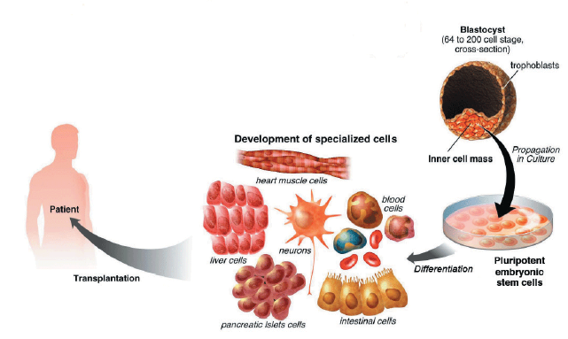
1. Embryonic stem cells:
grow under different conditions

Slide 25
1. Embryonic Stem Cells (ESC): sources:
A. In Vitro Fertilization
The source of blastocysts for stem cell research is from in vitro fertilization (IVF) clinics.
When IVF is used for reproductive purposes, doctors typically fertilize all of the donated eggs in order to maximize their chance of producing a viable blastocyst that can be implanted in the mother.
Because not all the fertilized eggs are implanted, this has resulted in a large bank of "excess" blastocysts that are currently stored in freezers.

Slide 26
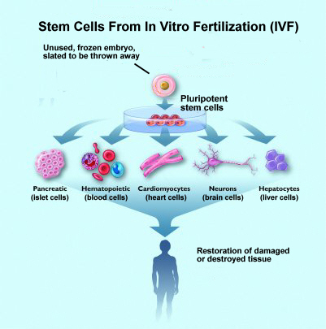
A.
frozen embryos are routinely destroyed when couples finish their treatment.
These embryos can be used to produce stem cells.
Regenerative medical research aims to develop these cells into new, healthy tissue to heal severe illnesses.

Slide 27
1. Embryonic Stem Cells (ESC): sources:
B. Nuclear Transfer
In animals, nuclear transfer has been accomplished by inserting the nucleus of an already differentiated adult cell-for example, a skin cell-into a donated egg that has had its nucleus removed.
This egg, which now contains the genetic material of the skin cell, is then stimulated to form a blastocyst.
The stem cells that are created in this way are therefore copies or "clones" of the original adult cell because their nuclear DNA matches that of the adult cell.
In the future, scientists may be able to create "personalized" stem cells that contain only the DNA of a specific patient.
The embryonic stem cells created by nuclear transfer would be genetically matched to a person needing a transplant, so that the patient's body would not reject the new cells.
Ethical considerations include egg donation, which requires informed consent.

Slide 28
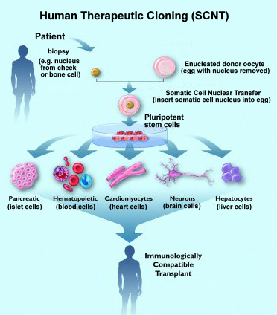
B.
B.Somatic Cell Nuclear Transfer
The nucleus of a donated egg is removed and replaced with the nucleus of a mature, "somatic cell" (a skin cell, for example).
No sperm is involved in this process, and no embryo is created to be implanted in a woman’s womb.
The resulting stem cells can potentially develop into specialized cells that are useful for treating severe illnesses.

Slide 29
Difficulties & Challenges: The limited use of ES cells is due to:
Potential for tumor formation
Questions regarding functional differentiation
Immune rejection.
Genome instability: abnormalities in chromosome number and structure.
Ethical debate:
In favor of ESC research:
Embryonic stem cells are used to alleviate human suffering.
excess IVF embryos will be discarded anyway, isn’t it better that they be used in valuable research?
Against ESC research:
stem cells are taken from a human blastocyst, which is then destroyed. This means “murder.”
There is a risk of commercial use of the human participants in ESC research.

Slide 30
SOURCES OF STEM CELLS FOR clinical application 2. Adult stem cells
Adult stem cells refer to any cell which is found in a developed organism that has the properties of stem cells mentioned above.
Pluripotent adult stem cells are rare but can be found in a number of tissues including umbilical cord blood.
At delivery, cord blood is collected, stored and frozen. (It contains RBC,WBC, lymphocytes, platelets).
b. Most adult stem cells are multipotent and can only produce a limited number of cell types.
These stem cells are found in children, in some adult tissues, such as bone marrow.
Fetal stem cells collected from the organs of fetuses at a somewhat later stage of development.

Slide 31
Tissue stem cells:
Tissue stem cells can mostly make the kinds of cell found in the tissue they belong to.
So,
Blood stem cells can only make the different kinds of cell found in the blood.
Brain stem cells can only make different types of brain cell.
Muscle stem cells can only make muscle cells.
Transdifferentiation:
In culture, certain adult stem cell types can differentiate into cell types seen in organs or tissues other than those expected from the cells' predicted lineage (i.e., brain stem cells that differentiate into blood cells)

Slide 32
SOURCES OF STEM CELLS FOR clinical application Amniotic fluid stem cells:
A type of cell that floats freely in the amniotic fluid of pregnant women has been found to have many of the same traits as embryonic stem cells.
The cells, shed by the developing fetus and are easier to maintain in laboratory dishes than embryonic stem cells.
because the cells are a genetic match to the developing fetus, tissues grown from them in the laboratory will not be rejected if they are used to treat birth defects in that newborn.
the cells could be frozen, providing a personalized tissue bank for use later in life.

Slide 33
SOURCES OF STEM CELLS FOR clinical application Induced pluripotent stem cell (iPS cells)
Adult somatic cells are altered (a process known as dedifferentiation) to have properties of embryonic stem cells.
By altering the genes in the adult cells, researchers were able to reprogram the cells to act similarly to embryonic stem cells.
Principle:
Take cells from the body (like skin cells from a patient).
Make iPS cells.
Use those iPS cells to grow the specialized cells the patient needs to recover from the disease.
These cells would be made from the patient’s own skin cells so the body would not reject them.
This new technique avoids the controversies that come with embryonic stem cell.

Slide 34
Induced pluripotent stem cells (iPS cells)
‘genetic reprogramming’
= add certain genes to the cell
cell from the body
induced pluripotent stem (iPS) cell
behaves like an embryonic stem cell
differentiation
Grow in special media
to differentiate to
a specific tissue
culture iPS cells in the lab
all possible types of
specialized cells
Advantage: no need for embryos,

Slide 35
Embryonic vs Adult Stem Cells
Totipotent or pluripotent
Differentiation into ANY cell type; can become>200 cell types.
Culture: easy to culture, reproduce for long periods.
Source:
frozen embryo (IVF).
SCNT.
Large numbers.
May cause immune rejection
Multi or pluripotent
Differentiation into some cell types, limited outcomes
Culture: difficult to find, hard to culture. Some can be reprogrammed.
Source:
umbilical cord & placenta.
adult/child tissue (bone, teeth, skin, hair, brain, liver, ..).
Limited numbers
Less likely to cause immune rejection, since the patient’s own cells can be used

Slide 36
Stem cells and their clinical applications
1. In transplant therapy: Regenerative medicine
e.g. to replace or restore tissue that has been damaged by disease or injury.
examples of potential treatments include:
regenerating bone using cells derived from bone marrow stroma.
developing insulin-producing cells for type 1 diabetes.
Genetic based disease as Cystic fibrosis.
2. Develop model systems to study normal growth and identify the causes of birth defects.
3. Advance knowledge about how an organism develops from a single cell and how healthy cells replace damaged cells in adult organisms.

Slide 37
II. Gene therapy What is Gene Therapy?
Gene therapy is a treatment or cure for disorders caused by mutated genes.
It involves adding a normally functioning copy of the gene(s) to enough affected cells to restore normal function.
Gene therapy could be very different for different diseases:
Gene transplantation : (to patient with gene deletion)
Gene correction: (To revert specific mutation in the gene of interest)
Gene augmentation: (to enhance expression of gene of interest)

Slide 38
How is gene therapy done?
Vector Carrying Healthy Gene
Vector inserts healthy gene into cell
New gene in the cell along with original genes
Cell with mutated gene(s)
Functional proteins are created from the therapeutic gene causing the cell to return to a normal state.

Slide 39
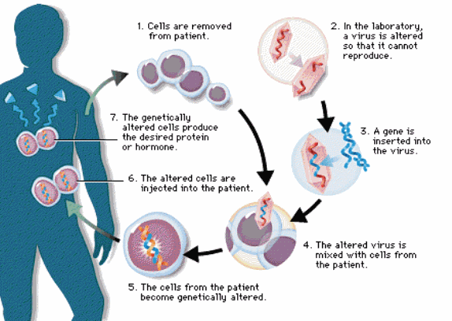
Gene therapy

Slide 40
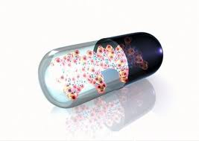
Gene Therapy: principle
To design and carry out a gene therapy treatment, a researcher must:
Identify the gene(s) responsible for the disorder.
Make copies of the normal gene.
Insert the copies into vectors.
“Infect” the affected cells with the vectors.
Activate the gene so that transcription and translation take place. Functional proteins are created from the therapeutic gene causing the cell to return to normal.
Routes of delivery of genes into humans by Vectors.
Vectors are carrier molecules. They deliver the therapeutic gene into a patient’s target cell.
Both viral and non-viral vectors have been used, though non-viral have a decreased transfer efficiency.

Slide 41
Types: Somatic & Germ
Germline gene therapy would be the permanent transfer of a gene into sperm or egg cells.
Future generations would be “cured”.
Somatic cell (body cell) gene therapy is ideally only the transfer of genes to the affected cells. (Somatic cells are cells that form the body and cannot produce offspring).
Only somatic gene therapy is permissible in humans

Slide 42
Gene therapy: techniques
In vivo
Ex vivo

Slide 43
In vivo gene therapy
The genetic material is transferred directly into the body of the patient .
2. More or less random process; small ability to control.
3. Only available option for tissues that can not be grown in vitro.
Ex vivo gene therapy
The genetic material is first transferred into the cells grown in vitro.
2. Controlled process; Genetically altered cells are selected and expanded .
3. Cells are then returned back to the patient.

Slide 44
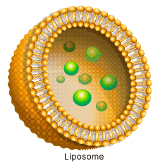
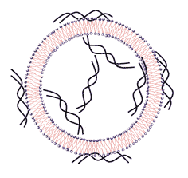
Routes of delivery of genes into humans: 1. Non viral options
Direct introduction of therapeutic DNA into target cells. Can be used only with certain tissues and requires large amounts of DNA. improving the efficiency DNA uptake: by "gene gun", which shoots DNA coated gold particles into the cell using high pressure gas.
b. An artificial lipid sphere (liposome)
which carries the therapeutic DNA and
is capable of passing the DNA
through the target cell's membrane.
DNA delivery of genes by liposomes:
Cheaper than viruses.
No immune response.
Especially good for in-lung delivery (cystic fibrosis).
Less transfer efficiency than viral vector.

Slide 45
Routes of delivery of genes into humans: 2. Viruses as Vectors
different types: Adenovirus, Retrovirus, Herpes Simplex Virus (HSV).
a. Adenovirus:
Are double stranded DNA genome.
The inserted DNA is not incorporate into genome.
Not replicated. So, Has to be reinserted when more cells divide.
How adenoviruses work?
Adenovirus vector binds to target cell membrane.
Vector is packaged in vesicles.
Vesicle breaks down releasing vector.
Vector injects new gene into nucleus.
Target cell forms normal protein from new gene. (normal functioning gene).

Slide 46
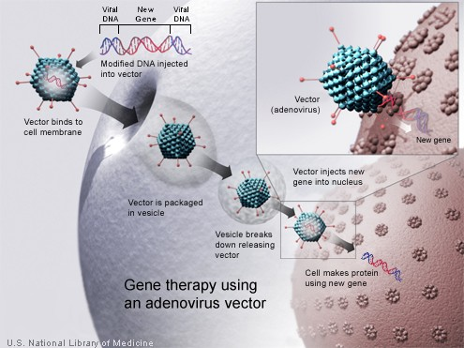

Slide 47
b. Retroviruses
They contain RNA genome.
They form double stranded DNA copies from RNA genome through reverse transcription using reverse transcriptase enzyme.
the double stranded viral genome integrates into the human genome using integrase. Integrase inserts the gene anywhere . So, may cause insertional mutagenesis.
Vectors used are derived from the human immunodeficiency virus (HIV) and are being evaluated for safety.
Viral RNA genome
↓ (RT)
dsDNA
↓ (integrase)
Inserts DNA into human genome

Slide 48
Vector: Advantages and Disadvantages
Adenovirus
Infects many cell types. + efficient.
Does not integrate into host genome and can be lost.
Have immunological response.
Retrovirus
Integrates into host genome and cannot be lost (permanent expression).
Integrates into host genome and can cause cancer
Herpes Simplex Virus (HSV)
DNA stays in nucleus without integrating into host genome.
Only infects cells of the nervous system.

Slide 49
Applications - trials
Although no gene therapies have been approved by the FDA for sale, some diseases have been experimentally successful:
Melanoma (skin cancer).
Severe Combined Immunodeficiencies (SCID).
Sickle Cell Anemia.
The First Case: The first gene therapy was performed on 1990
Ashanti DeSilva was treated for SCID
Doctors removed her white blood cells, inserted the missing gene (Adenosine deaminase) into the WBC, and then put them back into her blood stream.
This strengthened her immune system
Only worked for a few months.

Slide 50
Gene therapy: success
Problem: restenosis of coronary arteries after they have been opened by coronary bypass surgery.
Treatment: 13 patients with restenosis were injected in the heart with DNA encoding vascular endothelial growth factor, which stimulate angiogenesis (vessel formation). Result: all patients had improved heart function.
Gene therapy: failure
Four children have developed cancer due to a retrovirus gene therapy vector.
Bone grafts
Bone cancers, as osteosarcoma, are treated by removing the diseased bone and replacing it with a donated section of bone from a dead body.
In mice. They found that the transplanted “dead” bone did not express two key genes normally expressed in bone, RANKL and VEGF.
To do this, they inserted the RANKL and VEGF genes into a modified, harmless virus. This virus was then applied in a paste directly onto the mouse bone graft during surgery. The viral vector was absorbed into the tissue surrounding the dead bone graft, activating the RANKL and VEGF genes. As a result the mouse’s body began to treat the bone graft as if it was its own tissue. New blood vessels began to grow around the graft and the dead bone was converted to new, healthy bone.

Slide 51
Problems with Gene Therapy
Short Lived
Hard to rapidly integrate therapeutic DNA into genome and rapidly dividing nature of cells prevent gene therapy from long time
Would have to have multiple rounds of therapy
Immune Response
new things introduced leads to immune response
Viral Vectors
patient could have toxic, immune, inflammatory response
also may cause disease once inside
Multigene Disorders
Heart disease, high blood pressure, and diabetes are hard to treat because you need to introduce more than one gene
May induce a tumor if integrated in a tumor suppressor gene because insertional mutagenesis.
Thank you & best wishes
Dr. Eman Shaat

