Slide 1
General Microbiology
Lecture 2
(Bacterial Structure and Classification)
2023-2024
Dr. Mohammad Odaibat
Department of Microbiology and Pathology
Faculty of Medicine, Mutah University

Slide 2
Shapes and Forms of Bacteria
Different shapes have been recognized:
Spherica/Cocci:
Cocci has originated from a greek word; kokkos = seed.
(0.5µ -1.25µ in diameter)
On the basis of arrangements cocci are further classified as follows:
Micrococci: appears singly.
Diplococcus: appear in a pairs of cells.
Streptococci: appear in rows of cells or in chains.
Staphylococci: arrange in irregular clusters like bunches of grapes e.g. Stapllyloccolls aureus.
Tetracoccus: arrange in a sequence of four.
Sarcinae: arrange in cuboidal or in a different geometrical.
Notes:
EllipsoidaVSphericaVCocci
The term cocci has originated from a greek word; kokkos = grain or kernel. It is
the simplest form of bacteria in which bacteria appears like a minute sphere (0.5~ -
1.25~ in diameter) they lack flagella. On the basis of arrangements cocci are further
classified as follows:
1. Micrococci: When a bacterium appears singly e.g. Micrococcus agitis, M. aureus.
2. Diplococcus: When they appear in a pairs of cells e.g. Diplococcus pneumoniae.
3. Streptococci: When they appear in rows of cells or in chains e.g. Streptocoocus
lactis.
4. Staphylococci: When they arrange in irregular clusters like bunches of grapes
e.g. Stapllyloccolls aureus.
5. Tetracoccus: When they arrange in a sequence of four e.g. Neisseria and
MicrocOCCIiS te trogen us.
6. Sarcinae: When they arrange in cuboidal or in a different geometrical or packet
arrangements e.g. Sarcillae lutea.

Slide 3
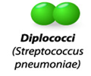
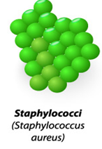
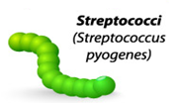
Shapes and Forms of Bacteria

Slide 4
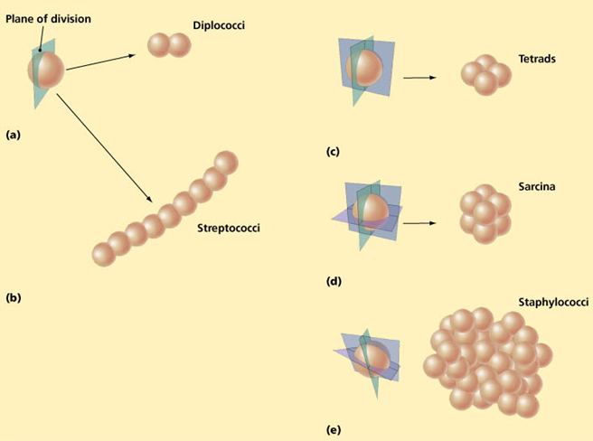
Why do bacterial cells have different arrangement?

Slide 5
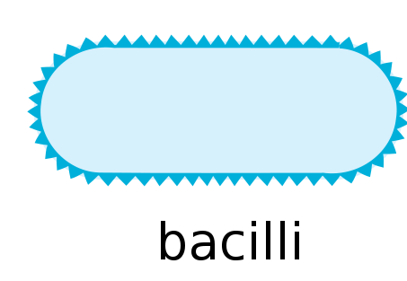
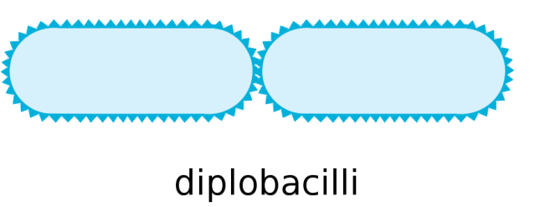
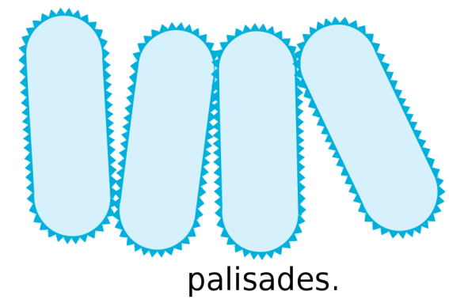
Shapes and Forms of Bacteria
2. Rod Shaped Bacteria or Bacillus:
From greek word, bacilli means rod or stick.
There ends are rounded flat or pointed.
0.5-1.2µ in diameter and 3- 7µ in length.
Flagellated or non-flagellated.
They may be of following types:
Monobacillus: arrange singly.
Diplobacillus: present in a group of two.
Streptobacillus : in chains.
Palisade: Very rarely the bacillus arrange in a palisade arrangement.

Slide 6
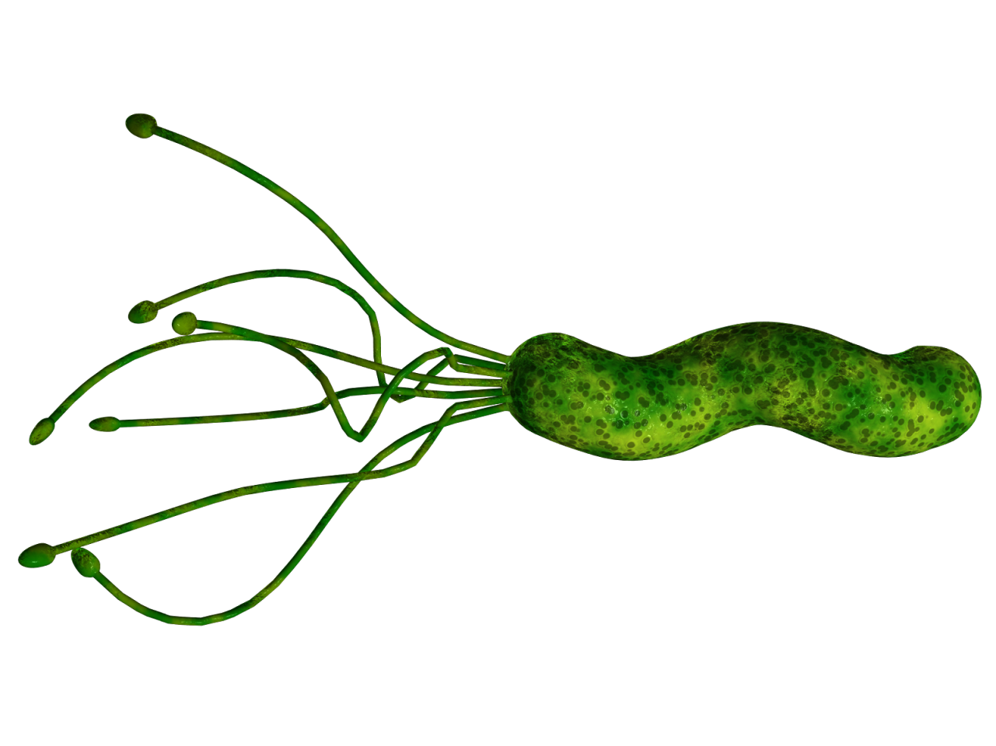
Shapes and Forms of Bacteria
3. Spiral or Helical
From greek word; spira means coiled.
A single spirillum has more than one turn of helix.
10-50µ in length and 0.5 - 3µ in diameter.
They are flagellated

Slide 7
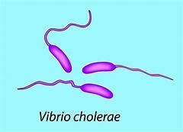
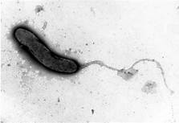
Shapes and Forms of Bacteria
4. Vibrio or Coma:
They bear flagella at their end.
1.5-1.7µ in diameter and upto 10µ in length
e.g. Vibrio cholarae.

Slide 8
Shapes and Forms of Bacteria
5. Spirochaeta:
These bacteria appear like a corkscrew.
Their length is more as compared to their diameter.
Their body is more flexible.

Slide 9
The Ultrastructure of Bacterial Cell

Slide 10
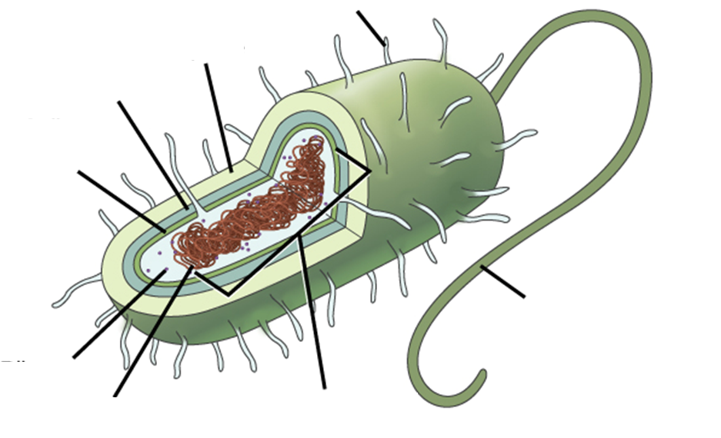
The Ultrastructure of bacterial cell
Structures external to the cytoplasmic membrane:
Cell wall
Capsule
Flagella
Pili (Fimbriae)
Structures internal to the cell wall:
Cytoplasmic Membrane
Mesosomes
Ribosomes
Cytoplasm
Inclusion Bodies
Chromosome (DNA)
Plasmid
Episome
Cytoplasmic Membrane

Slide 11
The cell wall
Functions
Very rigid structure and provide definite shape to the cell
Preventing the cell from expanding and eventually bursting because of uptake of water
Resistant to extremely high pressure.
Essential for the growth and division of bacteria
Cell wall protects against osmotic lysis
Plasma membrane
Cytoplasm
Cell wall

Slide 12
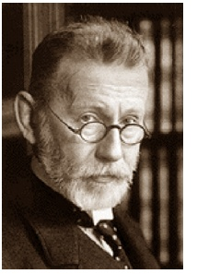
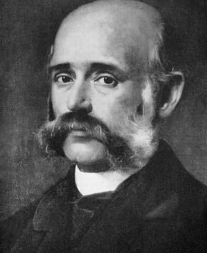
Cell wall and Gram Staining (History)
S. pneumoniae
K. pneumoniae
Danish scientist Hans Christian Gram (1853–1938)
S. pneumoniae
K. pneumoniae
German pathologist Carl
Weigert (1845- 1904)

Slide 13
The Ultrastructure of bacterial cell
The cell wall
Staining bacteria
Two colors (red& blue)
Called the blue ones
Gram positive
Called the red ones
Gram negative

Slide 14
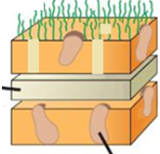
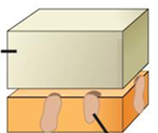
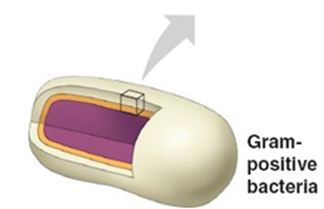
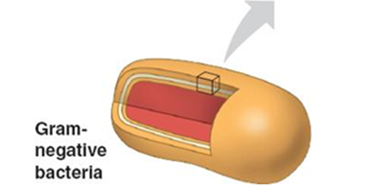
The Ultrastructure of bacterial cell
Gram positive bacteria
Gram negative bacteria
Porins

Slide 15
Gram positive
Gram negative
Inner most plasma membrane
Thick peptidoglycan cell wall
More easily treatable with antibiotics
Stain purple/violet after Gram Stain.
Peptidoglycan forms 40-80% of the cell dry weight.
Inner most plasma membrane
Thin peptidoglycan cell wall
Another outer plasma membrane
Harder to treat with antibiotics
Stain red/pink after Gram Stain
Peptidoglycan forms 5-10% of the cell dry weight.

Slide 16
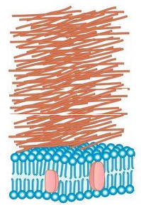
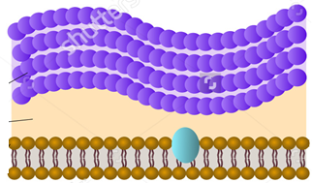
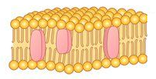
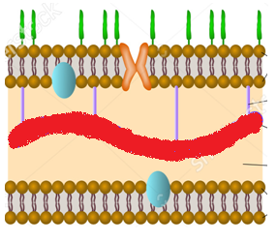
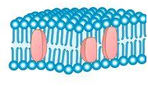
Gram positive
Gram negative

Slide 17
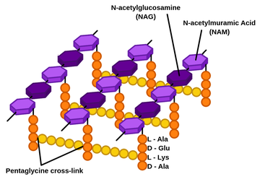
Peptidoglycan
Peptidoglycan is a rigid mesh made up of ropelike linear polysaccharide chains made up of repeating disaccharides of N-acetylglucosamine (NAG) and N-acetylmuramic acid (NAM) .
Tetrapeptide attached to NAM.

Slide 18
Peptidoglycan
NAM
NAG
NAM
NAG
NAM
NAG
NAM
NAG
NAM
NAG
NAM
NAG
NAM
NAG
NAM
NAG
NAM
NAG
NAM
NAG
NAM
NAG
NAM
NAG
NAM
NAG
NAM
NAG
NAM
NAG

Slide 19
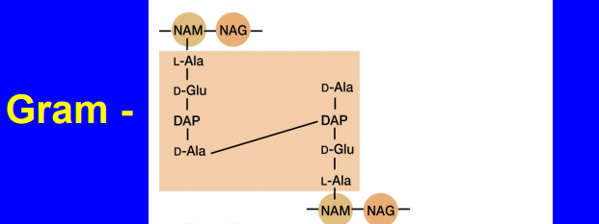
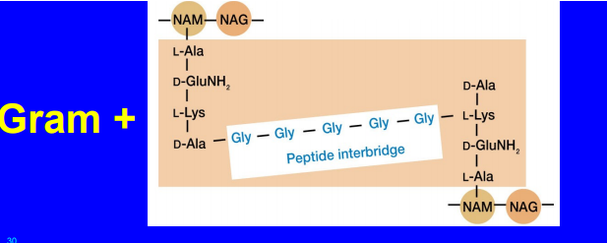
Peptidoglycan

Slide 20
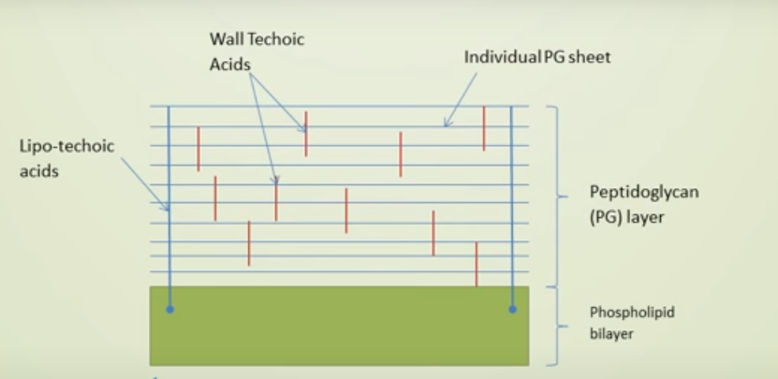
Anchorage of peptidoglycan layers to the plasma membrane

Slide 21
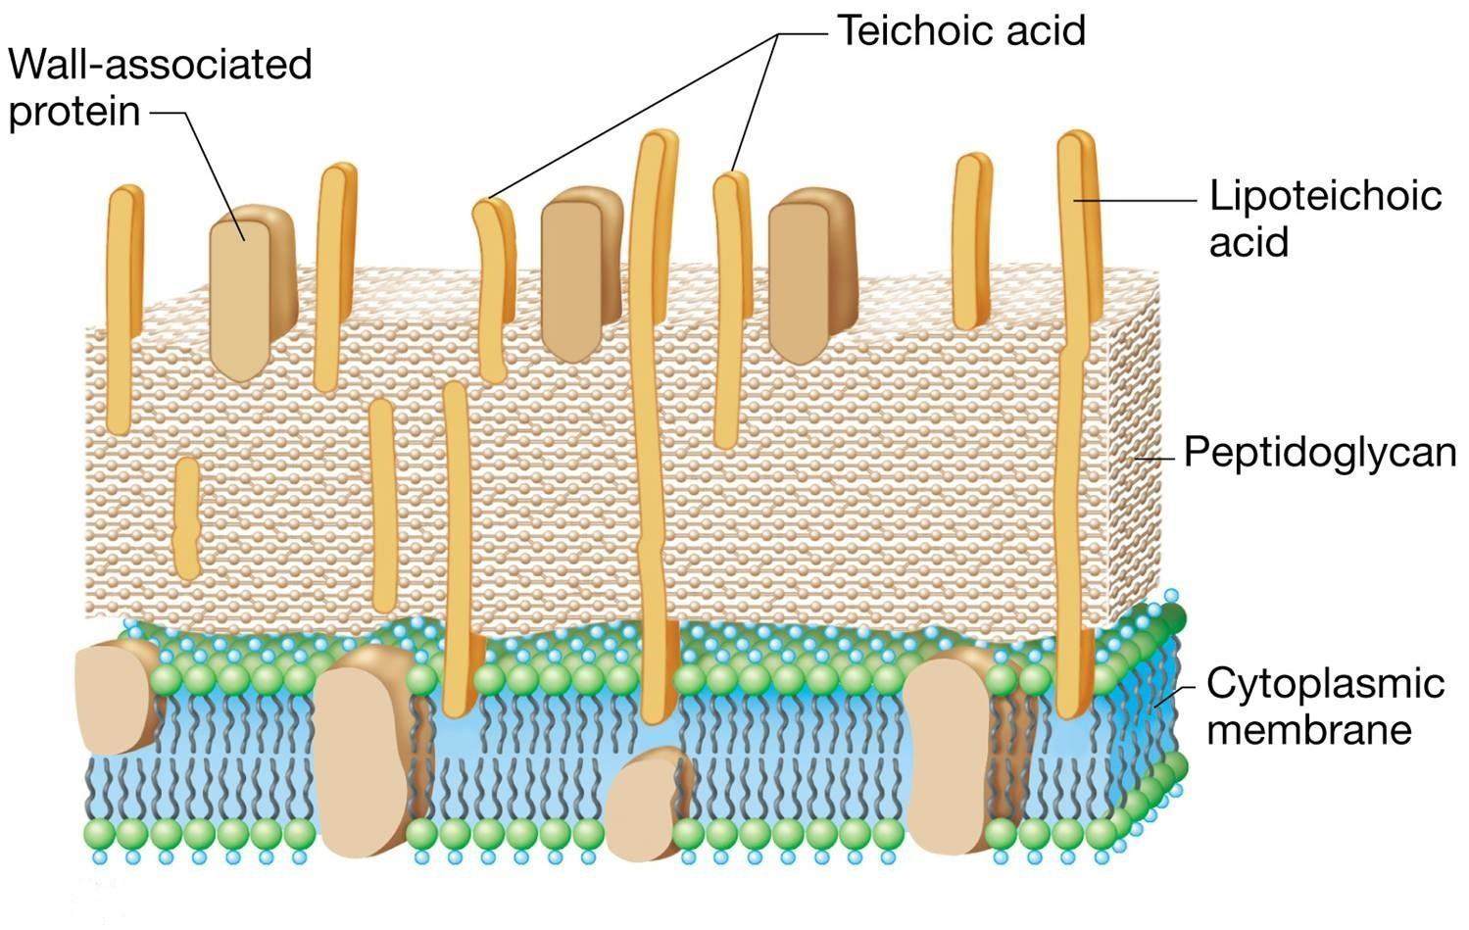
Teichoic Lipoteichoic acids
Teichoic acids are copolymers of glycerol phosphate or ribitol phosphate and carbohydrates linked via phosphodiester bonds.
Lipoteichoic acids (LTA)Long chains of ribitol or glycerol phosphate.
Functions:
Anchor peptidoglycan layers to the plasma memebrane
Attachment to other bacteria and to specific receptors on mammalian cell surfaces.

Slide 22
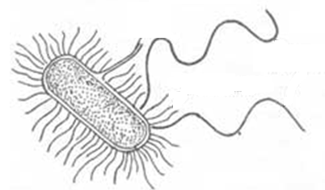
Ultrastructure of Bacterial Cell
Flagella
Pili
Sex Pili
1
2
3

Slide 23
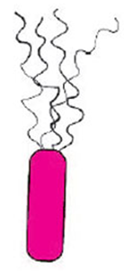
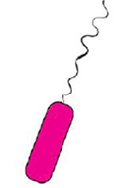
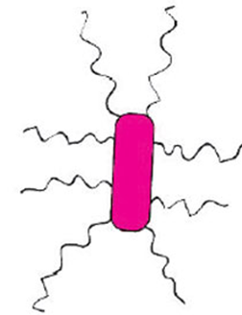
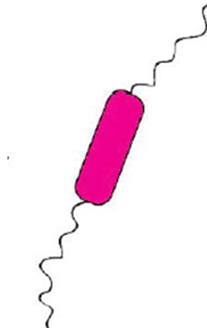
Ultrastructure of Bacterial Cell
Flagella
They are flexible, whip like appendage (singular flagellum).
Measures 4-5 µ long.
They are made up of protein flagellin (MWt , 40,000)
The location of flagella varies in various bacteria.
The bacteria which lack flagella are referred as atrichous.
Bacteria can be divided into following types based on the the location of flagella.
Monotrichous
Peritrichous
Amphirichous
Lophotrichous

Slide 24
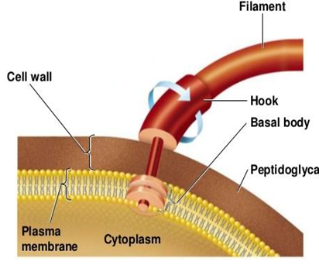
Ultrastructure of Bacterial Cell
Ultrastructure of flagellum
Each bacterial flagellum is structurally differentiated into three parts
basal body.
Hook .
Main filament or shaft.
Notes:
ULTRASTRUCTURE OF FLAGELLUM
Generally a single flagellum is ten times long as compared to their bacterial cell.
There size is variable in different species but average size ranges from 4-10~ in length
and 120 AO - 180Ao in diameter. These flagellum are generally made up of subunits
of flagellin protein. The molecular weight of these subunit is 40,OOt) dalton and 40A °
in diameter. This flagellin protein is synthesized inside the bacterial cytoplasm and are
transferred to the terminal distal part of the flagellum, thus the growth of flagellum
is from apical part inspite of its basal part. About 12 genes are found responsible for
the synthesis of various parts of flagellum. Each bacterial flagellum is structurally
differentiated into three parts (1) basal body (2) hook (3) main filament or shaft.
(1) Basal Body: It is a small rod like structure which is attached deep in the
cytoplasm of the bacterial cell. This cytoplasm provide energy to this flagellum. In gram
-ve bacterium it possesses two sets of rings (i) a proximal set (ii) a distal set. Each
set consist of two pairs of rings. Outer pair is attached to the cell wall while inner
pair is attached to the cell membrane. Thus total 4 rings are present and named as
(i) Membrane (ii) Supermmembrane (iii) Peptidoglycan ring (iv) Lipopolysaccharide ring.
They are arranged from inner side to outerside. M ring is attached to plasma membrane while P and L ring structurally form a bearing for the flagellar rod to pass through
outer membrane. The flagellum of gram positive bacterium lacks the outer set of rings.
The main function of basal body is (i) to synthesize the polymers of flagellum (ii)
regulation of flagellar movement.
(ii) Hook : Hook connects the basal body and main filament or shaft. It originates
from cell wall and the length of hook of gram negative bacterium is shorter than of
gram positive bacterium. The main features of hook are:
They provide specific shape to the flagellum.
Each hook has specific antigenic property in each bacterium.
(3) Filament or Shaft : This is a tubular structure attached to the hook. It is 20J.!
long 0.01-0.13J.! in diameter. It is made up of globular protein subunits. The amino acid
involve in the synthesis of proteins are histidine, cystine and tryptophane. These protein
subunits are arranged helically and form cylindrical fibrils. The protein is called flagellin.
The bacterial flagellum is made up of single thin fibril while eukaryotic motile cells
has a fibrill arranged in 9 + 2 pattern.

Slide 25
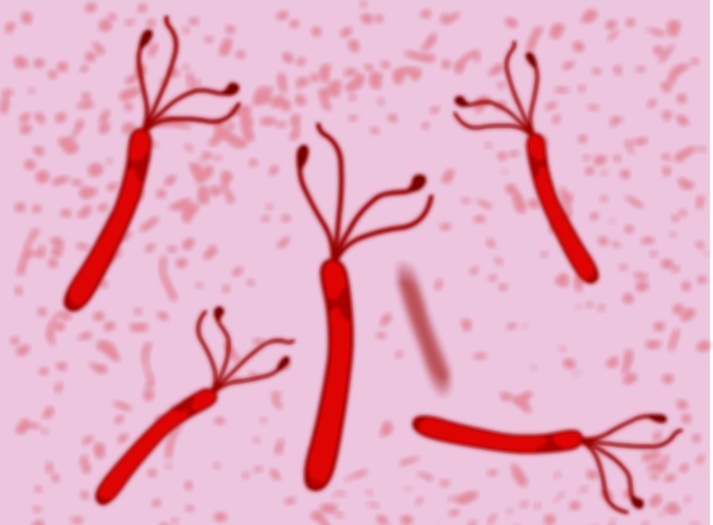
Flagella stain
Rosanalin dye
Silver nitrate + ferric tannate

Slide 26
Pili
These are hair like appendages present on the surface of most of the gram negative bacteria.
They are smaller than flagella, have no role in the motility of bacteria.
A single bacterial cells bears about 100-500 pili which are arranged peritrichously.
There origin is from cytoplasm and penetrate through the peptidoglycan layers of the cell wall.
Two types: Somatic pili and sex pili or conjugate pili
Notes:
These are hair like appendages present on the surface of most of the gram negative
bacteria (Enterobacteriaceae, Pseudomondaceae and Caulobacter). They are smaller than
flagella, have no role in the motility of bacteria. They measure 0.2-20J.! in length and
30-140Ao in width. A single bacterial cells bears about 100-500 pili which are arranged
peritrichously. There origin is from cytoplasm and penetrate through the peptidoglycan
layers of the cell wall. Chemically they are composed of 100% protein named fimbrilin
with a molecular weight of about 16,000. Fimbrilin consist of about 163 amino acids.
Following two types of pili are found in bacteria viz.

Slide 27
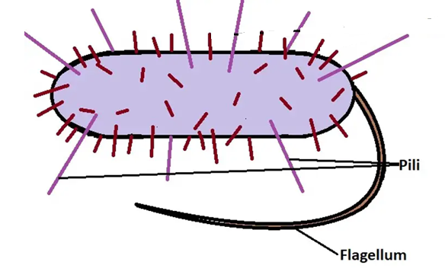
Pili
Somatic pili:
Each bacterial cell bears about 100 somatic pili.
Function: is to help the bacterium for attachment to a substratum.
Notes:
These are hair like appendages present on the surface of most of the gram negative
bacteria (Enterobacteriaceae, Pseudomondaceae and Caulobacter). They are smaller than
flagella, have no role in the motility of bacteria. They measure 0.2-20J.! in length and
30-140Ao in width. A single bacterial cells bears about 100-500 pili which are arranged
peritrichously. There origin is from cytoplasm and penetrate through the peptidoglycan
layers of the cell wall. Chemically they are composed of 100% protein named fimbrilin
with a molecular weight of about 16,000. Fimbrilin consist of about 163 amino acids.
Following two types of pili are found in bacteria viz.

Slide 28
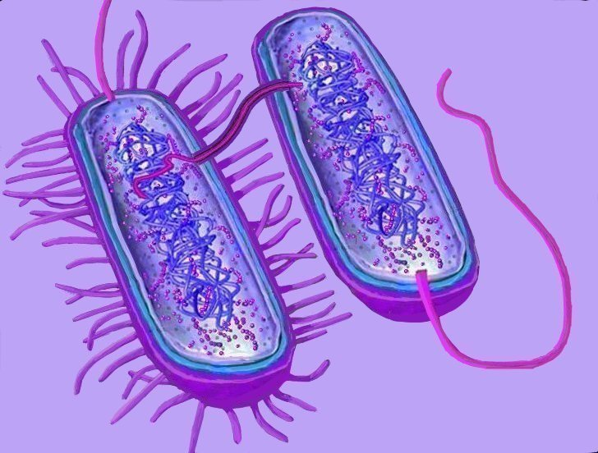
Pili
Sex Pili or Conjugate Pili :
known as F pili.
Allow the transfer of DNA between bacteria, in the process of bacterial conjugation. This can result in dissemination of genetic traits, such as antibiotic resistance, among a bacterial population.
Notes:
(b) Sex Pili or Conjugate Pili : They are also known as F pili and are controlled
by sex factors. These pili are comparatively long (20 ll) and broad in width (65-135AO).
There number ranges from 1-10 in male or donor bacterium, but in some bacterium
it is found in both viz. Male donor (+ factors) or female receptor/ receiver (- factor).
At the time of conjugation the sex pili of male donor recognize the receptor protein
on the surface of female or recipient and get attached with the help ot conjugation tube.
The DNA from the donor to recipient is transferred through this conjugation tube. There
are two types of sex pili in E.coli. They are F. pili and I.pili.
In certain pathogenic bacteria these pili help the bacteria in the attachment of
pathogenic bacterial cell to the host cells. There are generally four types of pili classified
on the basis of their attachment ability to the host cell :
(a) Type I : There diameter is about 90A ° and found in E.coli, Serratia & Salmonella.
(b) Type II : They lack the attachment ability e.g. some species of Salmonella.
(c) Type III : Their attachment ability is effected by mannose sugar. They are about
50 A ° in diameter e.g. Klebsiella and some spp. of Salmonella.
(d) Type IV : They are found in Proteus bacteria.

Slide 29
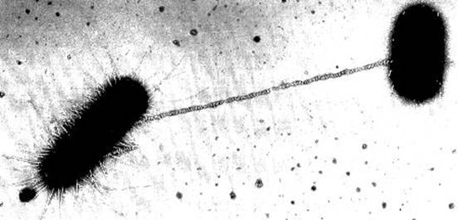
The Ultrastructure of bacterial cell
Pili
Conjugative (sex) pili
Chromosomal
DNA
Extrahromosomal
DNA
(plasmid)

Slide 30
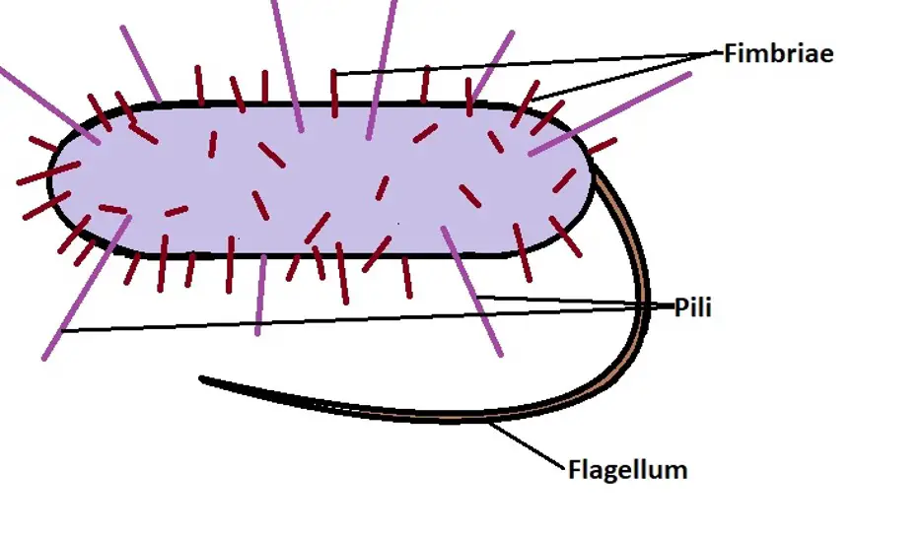
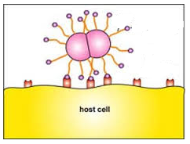
Fimbriae
A fimbria is a short pilus that is used to attach the bacterium to a surface. They are sometimes called "attachment pili".
Fimbriae are either located at the poles of a cell, or are evenly spread over its entire surface.

