Slide 1
FRONT OF THE FOREARM
BY DR. DALIA M BIRAM

Slide 3
FLEXORS OF THE FOREARM The muscles of the forearm are arranged into 2 groups; superficial and deep
I- Superficial group of flexors of forearm:
They are 5 in numbers arranged from lateral to medial are:
Pronator teres.
Flexor carpi radialis.
Palmaris longus.
Flexor carpi ulnaris.
Flexor digitorum superficialis

Slide 4
1- Pronator teres:
Origin:
Superficial (humeral) head: common flexor origin (the front of medial epicondyle).
Deep (ulnar) head: Medial border of coronoid process of ulna.
Insertion:
Into an impression on the middle of the lateral surface of shaft of radius.
Nerve supply: Median nerve.
Pronation of the forearm.
Helps in flexion of the elbow.

Slide 5
2- Flexor Carpi Radialis:
Origin:
Common flexor origin.
Insertion:
Bases of palmar aspect of 2nd and 3rd metacarpal bones.
Nerve supply: Median nerve.
Actions:
Flexion and abduction of the wrist.
Flexion of forearm.

Slide 6
3- Palmaris longus (This muscle may be absent):
Origin:
Common flexor origin.
Insertion:
Apex of palmar aponeurosis which is a triangular thickening of deep fascia of the palm.
Nerve supply: Median nerve.
Action:
Flexion of wrist.
Tension of the palmar aponeurosis.

Slide 7
5- Flexor Carpi Ulnaris
Origin:
Humeral head: from common flexor origin.
Ulnar head: from medial border of olecranon process and posterior border of ulna.
Insertion:
Pisiform bone, pisohamate ligament (to hook of hamate), and pisometacarpal ligament (to base of 5th metacarpal bone).
Nerve supply: Ulnar nerve.
Actions:
Flexion and adduction of wrist joint + Flexion of forearm

Slide 8
4- Flexor Digitorum Superficialis
Origin:
Humeroulnar head: common flexor origin and medial border of coronoid process of ulna.
Radial head: from the oblique line on front of shaft of radius.
Insertion:
By 4 tendons into the middle phalanges of the medial 4 fingers. On reaching the proximal phalanges, each tendon divides into two slips, and finally inserted into the sides of the middle phalanges. It gives passage for the flexor digitorum profundus tendon
Nerve supply: Median nerve.
Actions:
Flexion of proximal interphalangeal and metacarpophalangeal joints of the medial 4 fingers + Flexion of the hand + Flexion of forearm

Slide 10
The superficial group of forearm flexor muscles mainly arises from the common flexor origin (the front of medial epicondyle).
All the superficial flexors have their nerve supply from the median nerve EXCEPT flexor carpi ulnaris that take its supply from ulnar nerve.

Slide 11
II- Deep group of flexors of forearm
They are:
Flexor pollicis longus.
Flexor digitorum
profundus.
Pronator quadratus

Slide 12
1-Flexor pollicis longus
Origin:
Upper ¾ of anterior surface of shaft of radius.
Interosseous membrane.
Insertion:
Base of terminal phalanx of the thumb.
Nerve supply:
Anterior interosseous nerve.
Actions:
Flexion of all joints of the thumb.
Helps in flexion of wrist.

Slide 13
2- Flexor digitorum profundus:
Origin:
1.Upper ¾ of anterior and medial surfaces of shaft of ulna.
2.Interosseous membrane.
Insertion:
Bases of terminal phalanges of the medial 4 fingers.
Nerve supply:
Medial 1/2 by ulnar nerve.
Lateral 1/2 by anterior interosseous nerve.
Actions:
Flexion of all joints of the medial 4 fingers.
Helps in flexion of wrist joint.

Slide 14
3- Pronator quadratus:
Origin:
Lower 1/4 of anterior surface of shaft of ulna.
Insertion:
Lower 1/4 of anterior surface shaft of radius.
Nerve supply:
Anterior interosseous nerve.
Action:
Pronation of forearm.

Slide 16
Radioulnar Joints
1- Superior radioulnar joint
Type of joint:
Synovial,Uniaxial,Pivot.
Articular surfaces
Radial notch of ulna & Annular
ligament.
Circumference of the head of the
radius
Each of the articular surfaces is covered by hyaline cartilage.
The inner surface of the annular
ligament is also lined with hyaline cartilage.

Slide 17
CAPSULE
The capsule is attached to the margins of the
articular parts
Synovial membrane
It lines all the structures inside the joint
EXCEPT the articular surfaces.
Superiorly, it is continuous with the synovial
membrane of elbow joint.
Ligaments related to superior radioulnar joint:
Annular ligament:
It is a strong fibrous band that is attached
the margins of the radial notch of ulna and surrounds the circumference of head of radius
The upper border is continuous with the capsule of elbow joint while the lower border is free surrounding the neck of radius.
Quadrate ligament:
It is a thin fibrous band that extends between the neck of radius and below the radial notch of ulna.

Slide 18
2- Middle radioulnar joint
1- The interosseous membrane
It is a fibrous joint between the radius and ulna.
The direction of its fibers is oblique downwards and medially from radius to ulna.
Its function is to absorb the shock transmitted from the hand through the wrist joint, from radius to ulna, then partly transmits it to elbow.
2- Oblique cord:
It is a fibrous band extends between the ulnar tuberosity and the shaft of radius below the radial tuberosity.

Slide 19
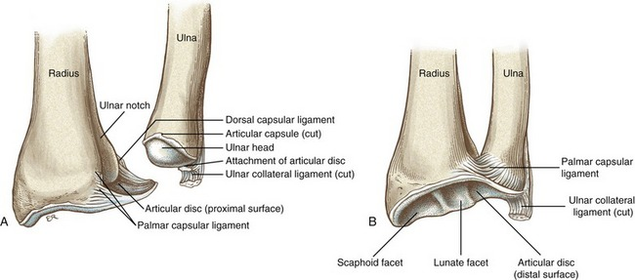
3- Inferior radioulnar joint
It is a uniaxial, pivot synovial joint
between the head of ulna and ulnar notch of radius.
It has the same movements of the superior radioulnar joint.

Slide 20
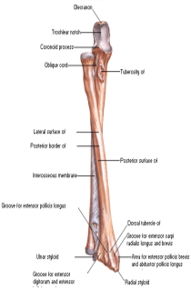
Movements of the superior and inferior radioulnar joints:
Supination: this
movement is produced by
the biceps brachii and the supinator muscles.
Pronation: this movement is produced by the pronator teres and the pronator quadrates muscles

Slide 22
