Slide 1
Maxillofacial injury
spectrum of injuries that affect the soft tissue and the bone of the face
Supervised by :
Dr. Saleh Abu Alhaj
Presented by :
Tamara Zyoud

Slide 2
Mechanism
Most common cause of Severe injuries is motor vehicle collisions ( high energy) , followed by interpersonal and domestic violence (low energy) .
Sports like football, baseball, and hockey account for a high percentage of facial injuries among young adults .
Other mechanisms include:
falls, animal bites
gunshot wounds and other explosive devices .
Facial trauma sustained from gunshot wounds or explosions is associated with greater morbidity and higher mortality rates . Associated head and cervical spine injuries are common in patients with significant facial trauma .

Slide 3
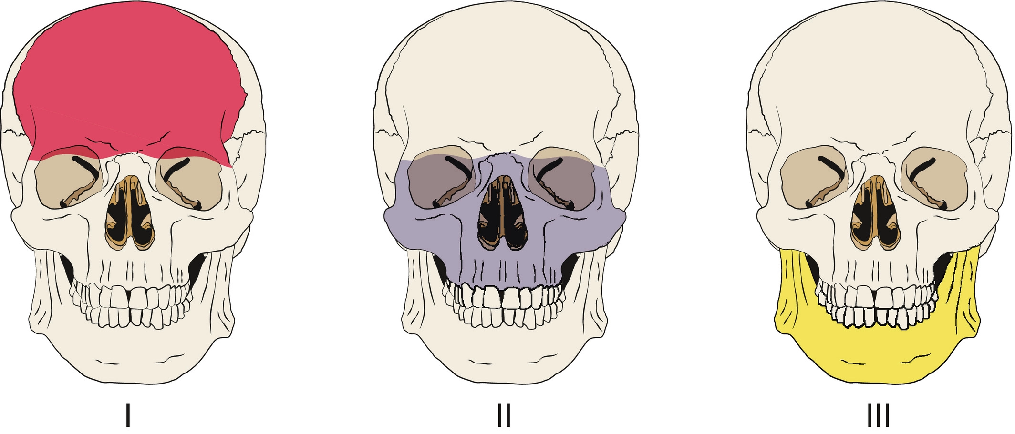
CLASSIFICATION OF FACIAL INJURIES
Bony injuries and fractures
The facial skeleton can be divided into thirds vertically:
● upper face (frontal bone);
● midface (maxilla, zygomas, orbits, nose and naso-orbital ethmoidal complex);
● lower face (the mandible).

Slide 4
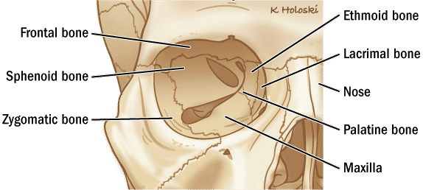
The eye socket can be considered as a separate entity, because orbital fractures can occur in isolation or as part of a constellation of multiple fractures.
the fractures may be displaced or un-displaced and comminuted or non-comminuted.

Slide 5
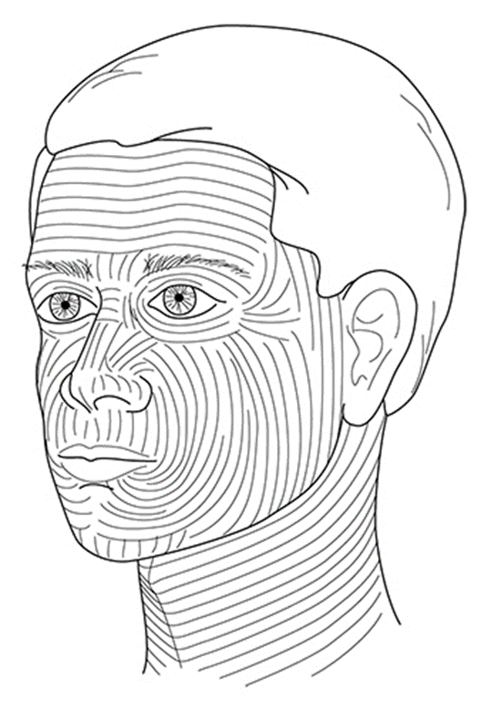
2. Soft tissue injuries
Skin – The skin of the face is among the thinnest of the body. Facial skin develops predictable creases with age, following Langer's lines .
Lacerations that do not run parallel to Langer's lines develop more prominent scarring than those that do.

Slide 6
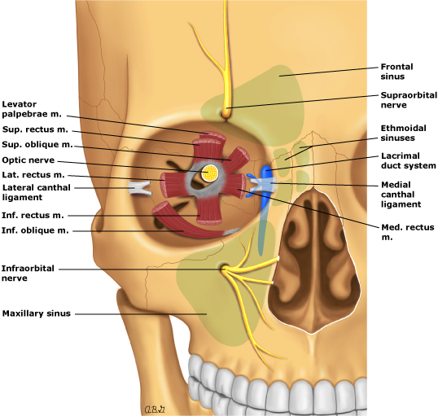
Muscles – Important muscles that may be injured with facial trauma include the extraocular muscles and those surrounding the mouth.
The inferior rectus, primarily responsible for rotating the eye downward, can become entrapped in fractures of the orbital floor.
The orbicularis oris, which encircles the mouth, frequently requires repair with complete perioral lacerations.

Slide 7
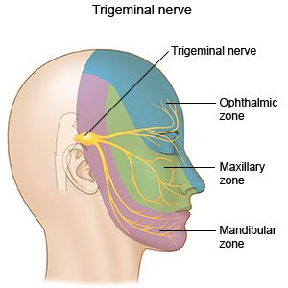
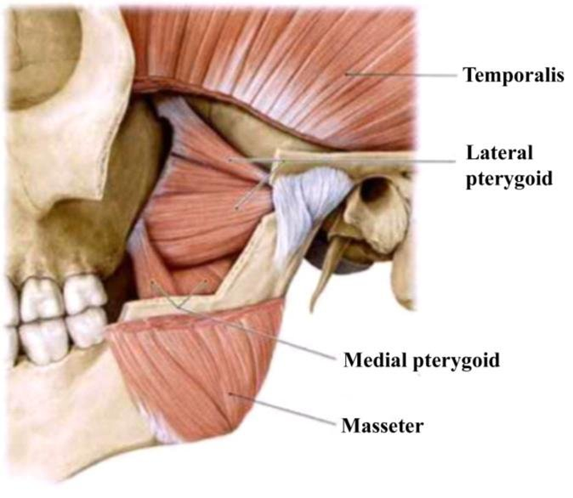
Nerves
Cranial nerve V (trigeminal) supplies sensation to the face through three major divisions ,The ophthalmic division (V1) supplies sensation to the upper third of the face, including the eye and the nose down to the tip. The maxillary division (V2) provides innervation to the midface and includes the infraorbital nerve. The mandibular division (V3) supplies sensation to the lower third of the face.
The muscles of mastication are innervated by cranial nerves V (jaw movement(

Slide 8
cranial nerve VII (facial nerve) : innervate muscles of facial expression . The facial nerve travels through a narrow canal within the temporal bone and is susceptible to injury when the bone is fractured.

Slide 9
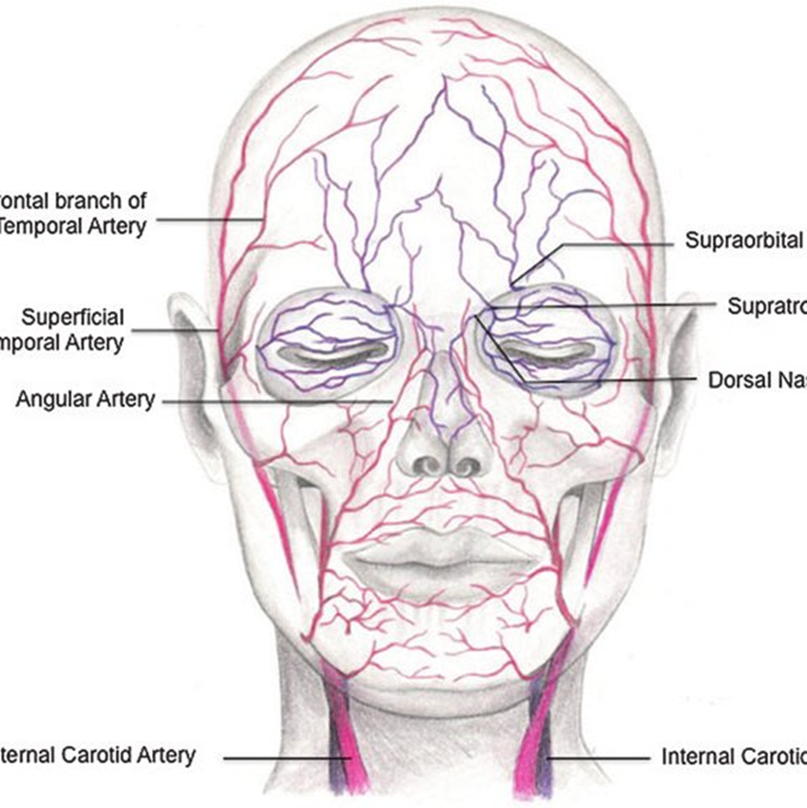
Vasculature – The face is highly vascular. Soft tissue injuries and fractures that involve vessels can cause large hematomas or heavy bleeding. Because the face has extensive arterial anastomoses, including some that cross the face's midline, ligation of major branches is unlikely to cause ischemia
Significant bleeding, usually from the pterygoid venous plexus and/or the rich blood supply of the nose, can be seen in central midface injuries.

Slide 10
PREHOSPITAL MANAGEMENT
Patients with severe oropharyngeal bleeding who do not require spinal immobilization should be allowed to assume a position of comfort. They can sit leaning forward and may be allowed to suction themselves.
If spinal immobilization is required, and provided the patient is alert and bleeding is not severe, the backboard may be tilted with the bleeding side down, to protect the airway and allow suctioning.

Slide 11
Bleeding in many areas of the face can be controlled during transport with external compression.
In an alert patient with intraoral bleeding, 4 x 4 cm gauze packing may be held firmly, with the fingers pressed against the site of bleeding, or clamped between the jaws if the wound lies along the alveolar ridge. Alert patients may be able to perform these maneuvers themselves
Complete (ie, "through and through") lacerations of the buccal space may be packed and compression applied externally. Another method is to soak gauze with lidocaine with epinephrine and press it against the bleeding site using a forceps or similar tool. Gauze may also be impregnated with tranexamic acid and applied with direct pressure to the affected area.

Slide 12
If suspecting a ruptured globe, protection to prevent compression of the eye (eg, eye cup or noncontact shielding) should be placed in the field.
Avulsed tissue, including ears, the tip of the nose, or large skin flaps, should be transported with the patient in saline-soaked gauze. Full-thickness skin flaps are often more readily reattached to the face than other body parts.

Slide 13
Avulsed teeth should be transported with the patient. Patients with normal mental status who are able to protect their airway may be able to carry avulsed teeth in their mouths, held between the gum and buccal mucosa.
Patients who are intoxicated or otherwise altered, complain of nausea or vomiting, and those who require cervical spine immobilization or who cannot be transported upright are at risk of aspiration and should NOT be allowed to carry avulsed teeth in their mouth. In such cases, teeth should be transported in a container of sterile saline. Incompletely avulsed teeth should be left in place and not manipulated.

Slide 14
HISTORY AND PHYSICAL EXAMINATION Initial assessment
Disfiguring facial injuries can be distracting to both the patient and the clinician. Nevertheless, clinicians must focus on the basics of trauma care (ie, the primary survey) and address all life-threatening injuries before performing a complete facial examination.
After problems identified during the primary survey are adequately addressed, a secondary survey, including careful assessment of facial injuries, must be performed. The secondary survey should include a systematic approach and examination of all major facial structures and functions.

Slide 15
History
AMPLE
In addition to it , the clinician should seek answers to the questions below.
Timing of trauma ?
Loss of consciousness ?
Can you breathe through both sides of your nose? Inability to do so is consistent with nasal fracture / septal hematomas .
Are you having any trouble speaking?
Trismus or difficulty speaking suggests a mandibular fracture.
Do you have double vision or any other trouble with your vision?
Hearing loss ?

Slide 16
Are you experiencing any numbness of your face?
Facial paresthesias can occur from a number of facial fractures. As an example, with a zygomatic fracture, a patient could experience numbness related to injury of the infraorbital nerve.
Have you had any previous facial injuries or surgeries, including ocular procedures to correct vision (eg, LASIK, cataract surgery)?
Prior surgery increases the risk for ocular injuries and possible globe rupture.
Do your teeth come together the way they did yesterday? Malocclusion suggests a mandibular fracture.
Are any of your teeth painful or loose?
A positive response should prompt the examiner to evaluate for a mandibular alveolar injury.
Have you experienced any vertigo?
Vertigo is a common symptom in a patient with blunt trauma to the head, face, or neck; but in a patient with significant facial trauma, it raises suspicion for a temporal bone fracture.

Slide 17
ABCD
Airways :
Blood and debris must be removed and the airway secured as necessary. Manual removal of debris and aggressive suctioning with two suction devices may be necessary.
The general indications for airway management remain unchanged in patients with facial trauma. If intubation must be performed in the field, orotracheal intubation is strongly preferred to blind nasotracheal intubation for patients with facial trauma .

Slide 18
Facial fractures can affect airway management in several ways. Mandible fractures may make intubation easier by allowing the mouth to be opened wider and more easily.
However, facial fractures can increase the difficulty of ventilating with a bag-valve-mask, and possibly impede performance of the jaw thrust maneuver. Thus, a cautious approach including proper assessment of the airway should be performed whenever possible prior to performing rapid sequence intubation.

Slide 19
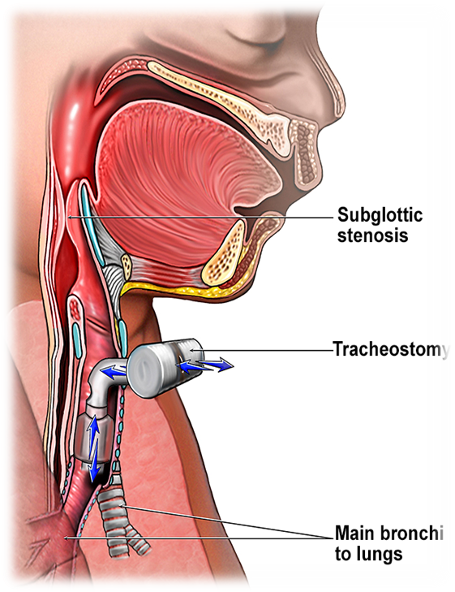

Slide 20
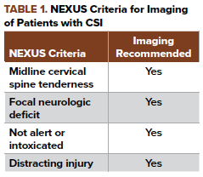
C- Spine
The incidence of MFI–CSI ranges from 0.8 to 12%

Slide 21
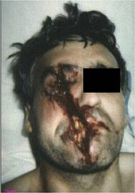
Circulation
*Control of severe bleeding:
1- local pressure with dressing
90% its successful
2- clamping and ligation blood vessels
3- approximation of the wound edges.
4- packing of nasal cavity.
5- packing wounds with gauze or haemostatic material.
6- blood replacement if indicated.
Massive, uncontrollable bleeding from facial fractures occurs rarely .
Notes:
If you two wound edges are close: Approximation of? The wound edges. If not: Packing wounds with? Gauze or hemostatic material.

Slide 22
Disability
Alert ? Verbal and painful stimuli ? Unresponsiveness ?
Pupil symmetry and reaction to light
Cranial nerve examination ( motor and sensory assessment of trigeminal and motor assessment of facial)

Slide 23
General examination
*Inspection :
1-face asymmetry
2- open wounds
3-malocclusion
4-Subtle discrepancies for example: differences in the relative positions of the eyeballs may lead to the diagnosis of orbital fractures.
Orbital fractures can cause:
A- Enophthalmos (sunken eye due to fracture of the orbital floor) .
B-Extraocular muscle entrapment (inability to move the eye properly) .
C-Hypoesthesia ( from nerve entrapment ).
D-Exophthalmos (from retrobulbar hematoma) .
5-telecanthus : Increased intercanthal distance suggests the presence of a naso-orbito-ethmoid fracture , Other findings that may be present with a naso-orbito-ethmoid injury include nasal congestion or epistaxis.
*Palpation : general palpation of all face looking for any asymmetry , step off , facial instability
Roa’a jaradat

Slide 24
Examination of specific body parts
Eyes : 1-visual acuity
2- extraocular movements
3-close inspection for signs of injury (eg, open globe, afferent pupillary defect, hyphema, corneal abrasion, orbital step-off).
Intraocular injuries take precedence over eyelid lacerations or canalicular injuries and should be evaluated emergently by an ophthalmologist.
Lacerations involving the medial canthus or the medial third of the upper or lower eyelid raise suspicion for damage to the canalicular drainage system.

Slide 25
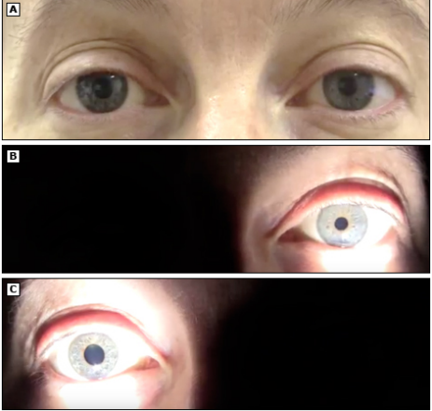
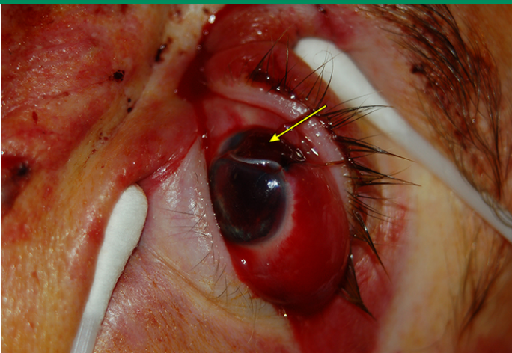
Extraocular muscle entrapment
afferent pupillary defect
open globe

Slide 26
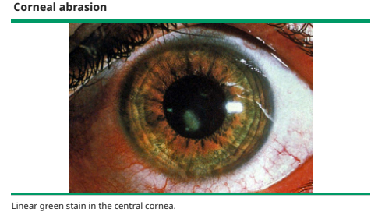

Slide 27
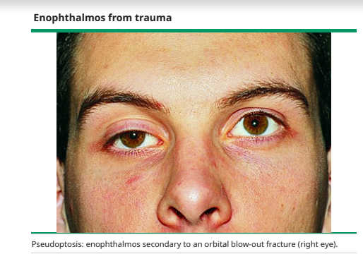

Slide 28
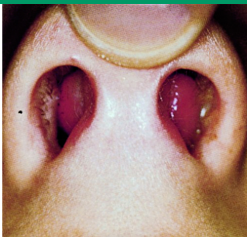
Nose
*inspection (using a nasal speculum) :
1-rhinorrhea, which may represent a cerebrospinal fluid (CSF) leak.
2- septal hematoma( signs of trauma) , appears as a dark purple or bluish mass against the septum, They can be bilateral if blood dissects through a fracture of the nasal cartilage, and thus both nares should be examined closely ,which requires urgent drainage
*Palpation for :
1-tenderness
2- crepitus
3- abnormal movement .

Slide 29
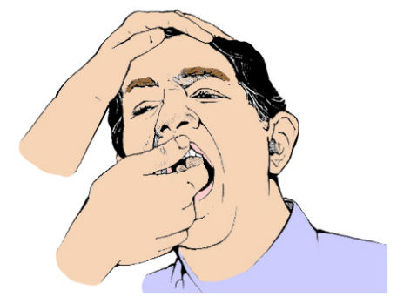
Midface
Midface fractures involving the zygoma may manifest as:
1- a large contusion over the cheekbone
2- enophthalmos
3- malocclusion of the upper teeth.
Anaesthesia of the area supplied by the infraorbital nerve (ipsilateral lower eyelid, lateral nose, upper lip, anterior maxilla) is a subtle sign of an orbital floor fracture. Such patients may manifest periorbital ecchymosis and lose the ability to look up due to entrapment of the inferior rectus muscle.
More forceful trauma can cause extensive fractures, creating midface instability. Assessment involves inspection, palpation, and manipulation . To assess instability, grasp the superior anterior teeth (or alveolar ridge if teeth are absent) between the thumb and index finger and attempt to move the maxilla anteriorly and posteriorly, while stabilizing the patient's forehead with the opposite hand.
Assessments of facial stability should be performed gently to minimize pain and avoid increased bleeding.
findings present with naso-orbito-ethmoid injury include:
facial discrepancies or asymmetry (eg, enophthalmos, increased intercanthal distance), diplopia, nasal congestion or epistaxis, vision abnormalities, dizziness, and anosmia .

Slide 31
Mouth, maxilla, and mandible
Dysphonia or edema of the oropharynx suggests the presence of a significant hematoma or fracture, and each is associated with an increased risk of airway compromise.
Stridor or drooling also suggests airway difficulty. It is best to secure the airway early with endotracheal intubation if it is felt to be at risk of obstruction.
Thorough inspection and palpation of the face and mouth may reveal signs of injury. Lacerations or a gap or step-off in the palate suggests a maxillary fracture. A laceration or step-off at the upper alveolar ridge suggests a mid-face fracture, while such injuries at the lower alveolar ridge suggest a mandible fracture. Broken or loose teeth may be identified, as may tongue or lip lacerations.
A mandible fracture may be present if the patient complains that mouth-opening is restricted or abnormal .Ecchymosis or swelling around the chin or preauricular area is associated with a mandible fracture, as is numbness of the chin or teeth that is present immediately following trauma.

Slide 32
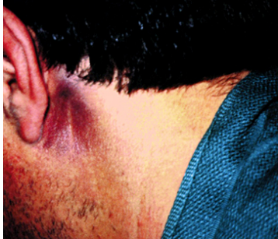
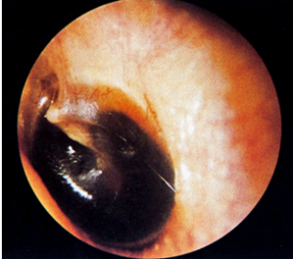
Ears
Battle sign
*inspection
The external ear is examined for :
1-lacerations
2-hematomas
3- Postauricular ecchymosis (Battle sign),while highly suggestive of the presence of a basilar skull fracture, does not develop until two or more days following trauma.
After examining the external ear, the clinician performs otoscopy to evaluate the integrity of the external canal and to look for hemotympanum and otorrhea. Clear fluid draining from the ear following trauma may be cerebrospinal fluid (CSF).To assess this, the clinician can place a drop of the fluid onto filter paper. A rapidly advancing "halo" or ring of clear fluid around red blood defines a positive test.
hemotympanum

Slide 33
*Palapation:
1-palpates for the bony prominences of the face
2-feeling for focal tenderness
3-step- off, crepitus
4-abnormal motion.
Both facial nerve motor function (CN VII) and sensation (CN V1, V2, V3) should be assessed carefully.

Slide 34
DIAGNOSTIC IMAGING

Slide 35
Facial injury
The choice of imaging for facial fractures depends upon the:
1- patient's hemodynamic stability
2-ability to cooperate 3- available resources.
Visualization of fractures among the complex curves of facial bones is best achieved using computed tomography (CT) .

Slide 36
Mandibular injury
The U-shape of the mandible and the presence of adjacent bony structures make it impossible to isolate the mandible on a flat x-ray film. Therefore, simple radiographs of the mandible are less sensitive for detecting fractures than panoramic radiographs (ie, Panorex) and can miss fractures of the condyle. If available, Panorex imaging can be used for isolated mandibular fractures, dental fractures, or fractures of the alveolar ridge.
CT accurately detects mandible fractures. A decision rule to reduce the need for imaging of suspected mandible fractures has been developed

Slide 37
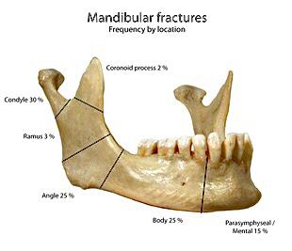
Mandible Fractures
-Is the most frequently facial bone to be fractured , The mandible is like a pretzel: Difficult to break in only one location;look for second fracture(Multiple fractures are seen in greater than 50%)
,Associated cervical spine injuries – 0.2-6% ,
- It is strong bone but has weak areas (thin at angle , slender neck of the mandibular condyle , and the junction between alveolar bone and basal mandibular bone )

Slide 38
Etiology : - RTA , gunshot, crush injury, Falls
Fracture classification :
according to the site
1- Symphyseal/parasymphyseal fractures
2-Body fractures
3-Angle fractures
4- Coronoid fractures
5-Condylar and subcondylar fractures

Slide 39
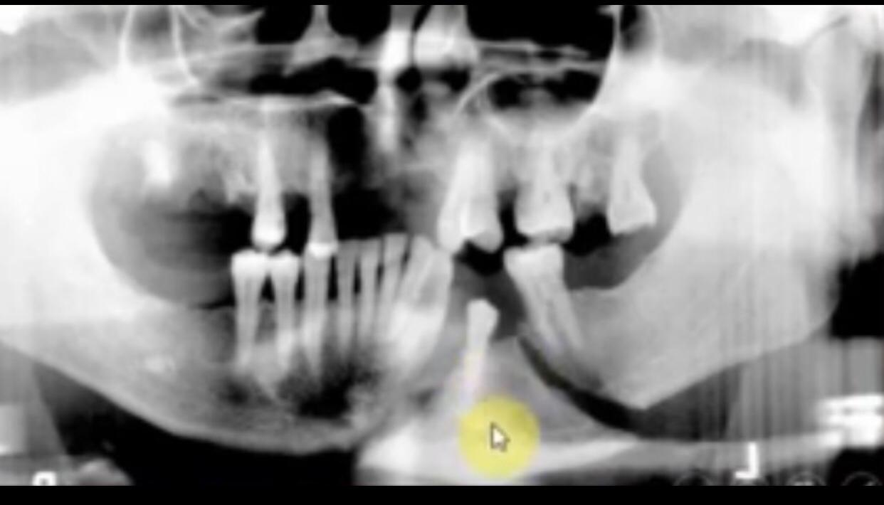
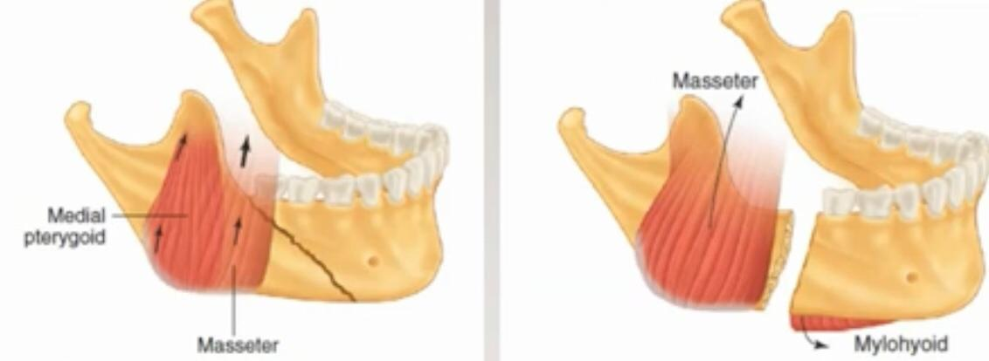
according to action of muscle on fractured fragment
1-displaced
2-nondisplaced

Slide 40
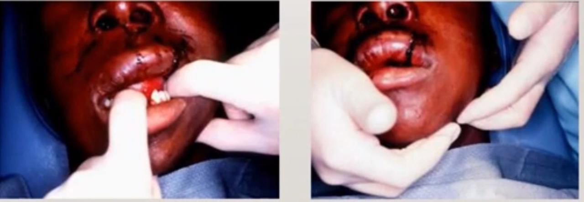
Clinical findings
*change in occlusion (highly sggestive of mandibular fracture )
*Submucosal hematoma may indicate mandible fracture
*Pain on function
*Tenderness at site of fracture
*Disability
*Sublingual ecchymosis
*Oedema
*Deformity , abnormal mobility
*Crepitations
*Salivation due to over activity of salivary gland
*Separation of teeth with intraoral bleeding
*Inability to fully open mouth.
*Positive tongue blade test

Slide 41
radiological study
1-Panoramic view

Slide 42
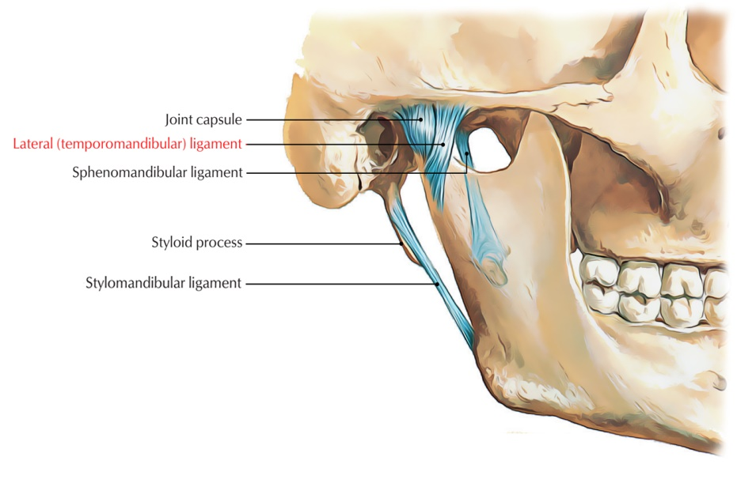
Mandibular Dislocation
-The mandible can be dislocated:
Anterior 70%, Posterior, Lateral, Superior
Dislocations are mostly bilateral.
-Causes of mandibular dislocation are:
Blunt trauma
Excessive mouth opening ( vigorous yawn)
-Risk factors:
Weakness of the temporal mandibular ligament
Over stretched joint capsule
Shallow articular eminence
Neurologic diseases

Slide 43
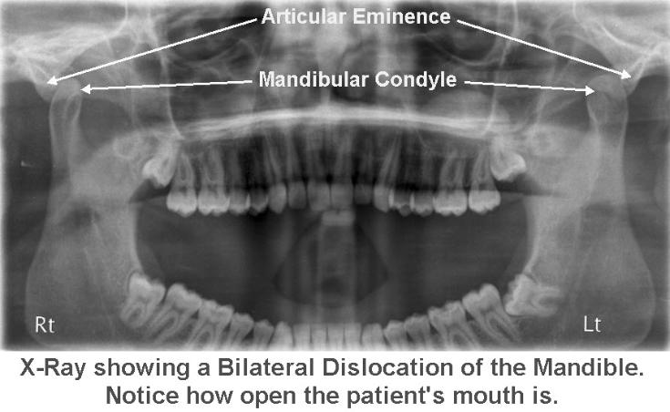
Clinical features:
*Inability to close mouth
*Pain
*Facial swelling
Physical exam:
*Palpable depression
*Jaw will deviate away
*Jaw displaced anterior
Always consider the possibility of an associated underlying fracture
Diagnosis:
*History & Physical exam
*X-rays
*CT

Slide 44
Treatment:
Muscle relaxant
Analgesic
Reduction may be attempted in closed anterior dislocations without fracture in the emergency room
Oral surgeon consultation:
*Open dislocations
*Superior, posterior or lateral dislocations
*Non-reducible dislocations
*Dislocations associated with fractures
After successful reduction:
Avoid excessive mouth opening (cautioned not to open their mouths more then 2 cm for the following 2 weeks)
Soft diet
Analgesics
Oral surgery follow up

Slide 45
. Facing the patient the examiner places his or hers thumbs in the patients mouth, over the mandibular molars as far back as possible. The fingers should curve beneath the angle and the body of the mandible.
The examiner applies downward and backward pressure with his or hers thumbs until the condyle slides back into the articular eminence

Slide 46
Zygoma fractures
-The zygoma has 2 major components: Zygomatic arch Zygomatic body
- Zygoma has a quadrilateral shape: Articulates with maxilla, sphenoid, temporal, and frontal bones; fractures are therefore “tetrapod fractures”
-Blunt trauma most common cause. -Two types of fractures can occur: Arch fracture (most common) Tripod fracture (most serious)

Slide 47
Clinical presentation
1- Flattening of malar eminence with downslanting palpebral fissure:
2- Zygomatic arch fractures may limit the motion of coronoid, resulting in trismus(occur because of masseter spasm or bony impingement of the coronoid process.)
3- Enophthalmos
4- Infraorbital paresthesia and hemorrage ( Binocular diplopia is noted in as many as 30% of zygomatic fractures)0
5-Depressed cheek with tenderness

Slide 48
What is a “tripod” fracture?
Fracture of the zygomaticomaxiilary complex; involves the following fractures:
1. Zygomatic arch.
2. Zygomaticofrontal suture.
3. Inferior orbital rim and floor.

Slide 49
A 'tripod' fracture has 4 visible components - not always all visible
1 - Orbital floor fracture
2 - Fracture of the lateral wall of the maxillary antrum
3 - Zygomatic arch fracture
4 - Widening of the zygomatico-frontal suture
Increased density of the maxillary antrum is due to it filling with blood.

Slide 50
Clinical features:
Periorbital edema and ecchymosis
Hypesthesia of the infraorbital nerve
Palpation may reveal step off
Concomitant globe injuries are common

Slide 64
Nasal bone fracture

Slide 65
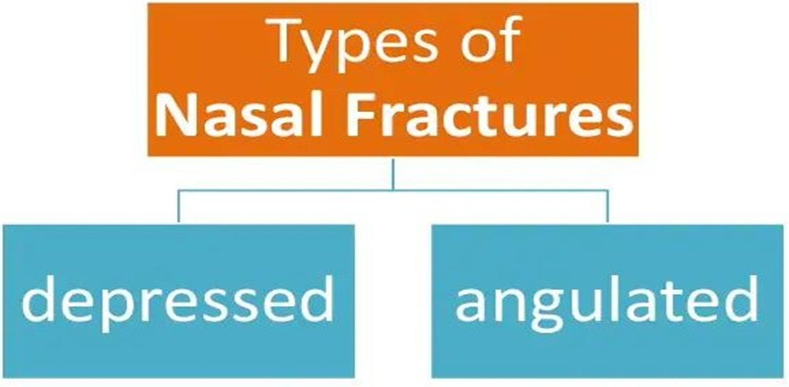

Slide 71
Naso orbital ethmoidal bone fractures

Slide 75
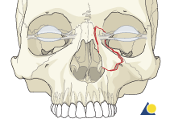
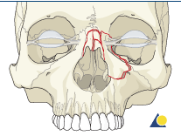
Markowitz type I fractures
In unilateral, there is a single large NOE fragment bearing the medial canthal tendon.
Involvement of the nasal bone
The nasal bone may also be involved and, in cases of comminution, may not provide adequate dorsal support to the nasal bridge.

Slide 76
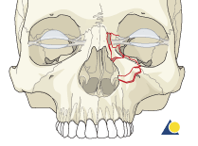
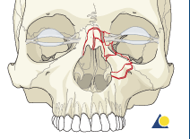
Markowitz type II fractures
In unilateral type II fractures, there is often comminution of the NOE area, but the canthal tendon remains attached to a fragment of bone, allowing the canthus to be stabilized with wires or a small plate on the fractured segment.
Involvement of the nasal bone The nasal bone may also be involved and, in cases of comminution, may not provide adequate dorsal support to the nasal bridge.

Slide 77
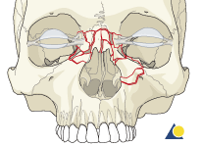
Markowitz type II fractures
Bilateral type II fracture with nasal bone involvement The illustration shows a bilateral NOE type II fracture. In bilateral fractures the nasal bones are commonly involved. In some instances, bone grafting of the nasal dorsum may be necessary

Slide 78
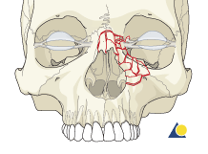
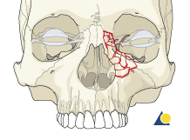
Markowitz type III fractures
there is often comminution of the NOE area (as in type II fractures) and a detachment of the medial canthal tendon from the bone.
Involvement of the nasal bone The nasal bones are usually involved and might not provide adequate dorsal support to the nasal bridge. In such cases bone graft reconstruction often is indicated.

Slide 79
Management is dictated by the fracture type.
Class I fractures are stabilized with miniplates at the
frontomaxillary, zygomaticomaxillary, and medial maxillary buttresses.
for class II fractures
Placement of miniplates
is similar to class I, with the addition of miniplates or microplates for stabilization of the central fragment.
In some class II and all class III fractures
instability of the medial canthal tendon requires transcanthal wiring

Slide 80
Frontal sinus fracture

Slide 84
Maxillary fracture
Felasten Abed

Slide 85
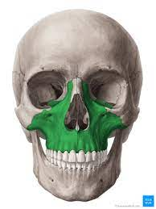
Maxillary Fractures
High energy injuries.
Less common than mandibular fracture and usually caused by direct blow to the head
Mild form is alveolar fracture and lefort classification for more severe form .
Patients often have significant multisystem trauma.
Notes:
Fractures of the maxilla are high energy injuries. An impact 100 times the force of gravity is required to break the midface. These patients often have significant multisystem trauma. Many require resuscitation and admission. The fractures of the maxilla are classified as LeFort Fractures.

Slide 86
Complex fractures of the midface are classified using the LeFort system:

Slide 87
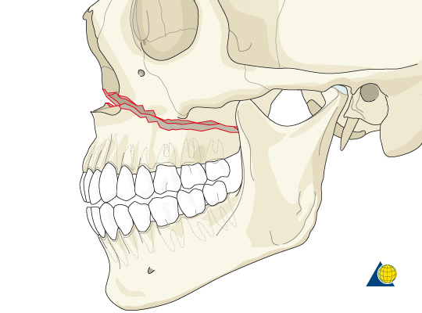
LeFort I
Definition:
Result from a force of injury directed low on the maxillary alveolar rim in downward direction.
injuries involve a transverse Horizontal fracture through the maxilla above the roots of the teeth. The injury may be unilateral or bilateral.
clinician may detect motion in the maxilla when the upper teeth are grasped and rocked, while the forehead is held stationary with the other hand.
Clinically :
Facial edema
Malocclusion of the teeth and open bite deformity .
Motion of the maxilla while the nasal bridge remains stable
Notes:
LeFort I:
Horizontal fracture of the maxilla at the level of the nasal fossa.
Allows motion of the maxilla while the nasal bridge remains stable.
The fracture is below the infraorbital nerve, so there is no hypesthesia.

Slide 89
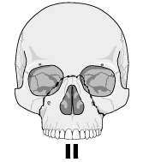
LeFort II
Definition:
(Pyramidal fracture) due to direct blow to upper maxilla and involve the inferior orbital rim
injuries are typically bilateral and involve fractures that extend superiorly in the midface to include the nasal bridge, maxilla, lacrimal bones, orbital floor, and rim.
When examined, the nasal complex moves as a unit with the maxilla when the teeth are grasped and rocked, while the forehead is held stationary.
Clinical findings:
Marked facial edema
Nasal flattening
Periorbital bruising and subconjunctival hg .
A step deformity at infraorbital margin is felt .
Epistaxis or CSF rhinorrhea
Malocclusion with anterior open bite deformity .
Notes:
LeFort II:
Pyramidal fracture which includes a fracture through:
Maxilla
Nasal bones
Medial aspect of the orbits

Slide 90
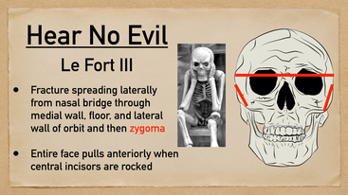
LeFort III
Definition:
(craniofacial dissociation), rare fracture involve fractures that result in discontinuity between the skull and the face.
The fractures begin at the bridge of the nose and extend posteriorly along the medial wall of the orbit and the floor of the orbit, and then through the lateral orbital wall and the zygomatic arch.
Intranasally, they extend through all the lesser bones to the base of the sphenoid and are frequently associated with a cerebrospinal fluid (CSF) leak.
Notes:
Lefort III fractures also known as craniofacial dissociation(separates the face from the cranium) involves fractures through the maxilla, zygoma, nasal bones, ethmoid bones and the bones of the base of the skull.

Slide 91
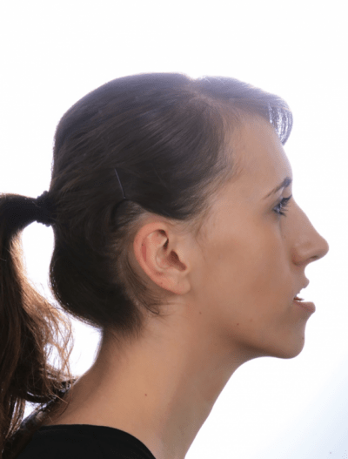
LeFort III
Clinical findings:
Dish faced deformity
Epistaxis and CSF rhinorrhea
Motion of the maxilla, nasal bones and zygoma
Severe airway obstruction
Notes:
Clinical Findings:
Patients with LeFort III fractures on physical exam have what’s known as the dish faced deformity which is facial flattening and elongation with the eyes markedly swollen shut. Since the maxilla is pushed inward, the patients mandible appears forward. Epistaxis and CSF rhinorrhea are usually present. Movement of the entire face is noted with distraction. These patients are also at high risk for airway obstruction.

Slide 92
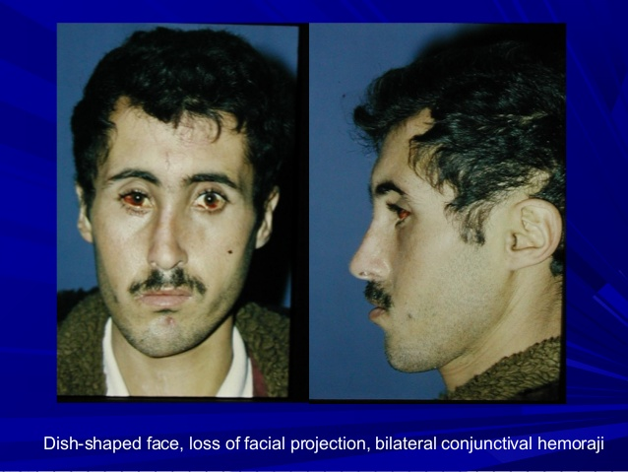

Slide 93
Fractures to the central portion of the ethmoid bone (cribriform plate) are likely to be associated with a CSF leak and commonly result in anosmia (loss of smell), due to injury to the first cranial nerve. If possible, patients with a CSF leak should have the head of their bed elevated 40 to 60 degrees. Head elevation minimizes intracranial pressure purportedly by decreasing arterial inflow and increasing venous outflow, thereby allowing the leak to seal

Slide 94
Complications of fracture maxilla
Early complications:
airway obstruction.
Hemorrhage.
infection contamination of the wound , penetrating injury (maxillary sinus), FB, loose tooth, presence of rhinorrhea, otorrhea.
TREATMENT:
antibiotic ,reduction of fracture, avoid blowing of nose or n. packing

Slide 95
Late complication
nonunion rare occur in comminuted fracture.
Malunion due to? delayed diagnosis.
lacrimal system obstruction.
Infraorbital anesthesia.

Slide 96
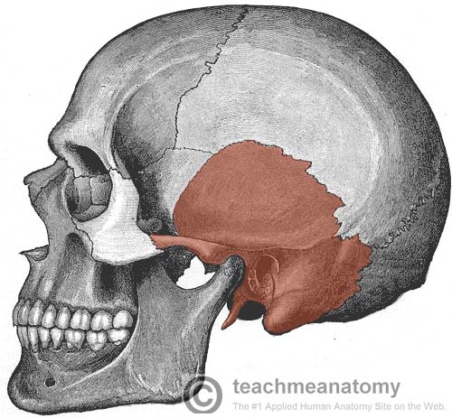
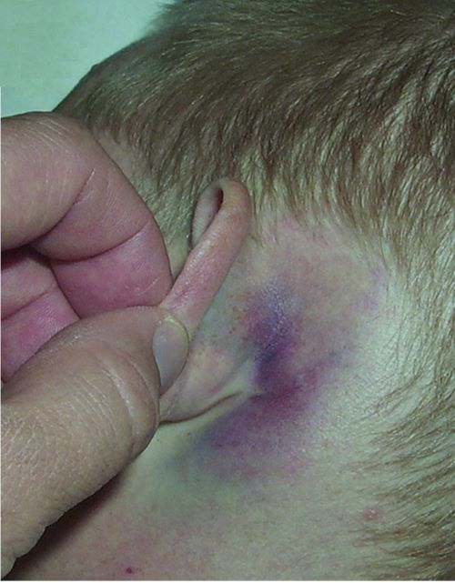
Temporal bone trauma
1. Clinical signs
a. Facial palsy
b. Bruising over mastoid (Battle)
c. Hemotympanum

