Slide 1
Acute vascular disorders
Mu’tah University – Faculty of Medicine
Surgery Course (2) – Sixth Year
Supervisor: Dr. Ali Alkayed
Done by: Michael Al- Madani
Abdullah Alhayek
Ibrahim Jwaied
Mohanad Al-Haddadin

Slide 2
VENOUS THROMBOSIS
Introduction:
Venous thrombosis is thrombosis in a vein, caused by formation of a ”blood clot”.
The most common form of venous thrombosis is a deep vein thrombosis (DVT).
When the thrombus forms in the deep veins (especially of the leg) it may dislodge and cause pulmonary embolism and in this case we call it venous thromboembolism, various forms of venous thrombosis exist and can cause thromboembolism.
It is important to take into consideration that 25 – 50% of surgical patients develop DVTs, and also non surgical patients.
All hospital inpatients should be assessed for DVT\PE risk and offered prophylaxis if appropriate.

Slide 3
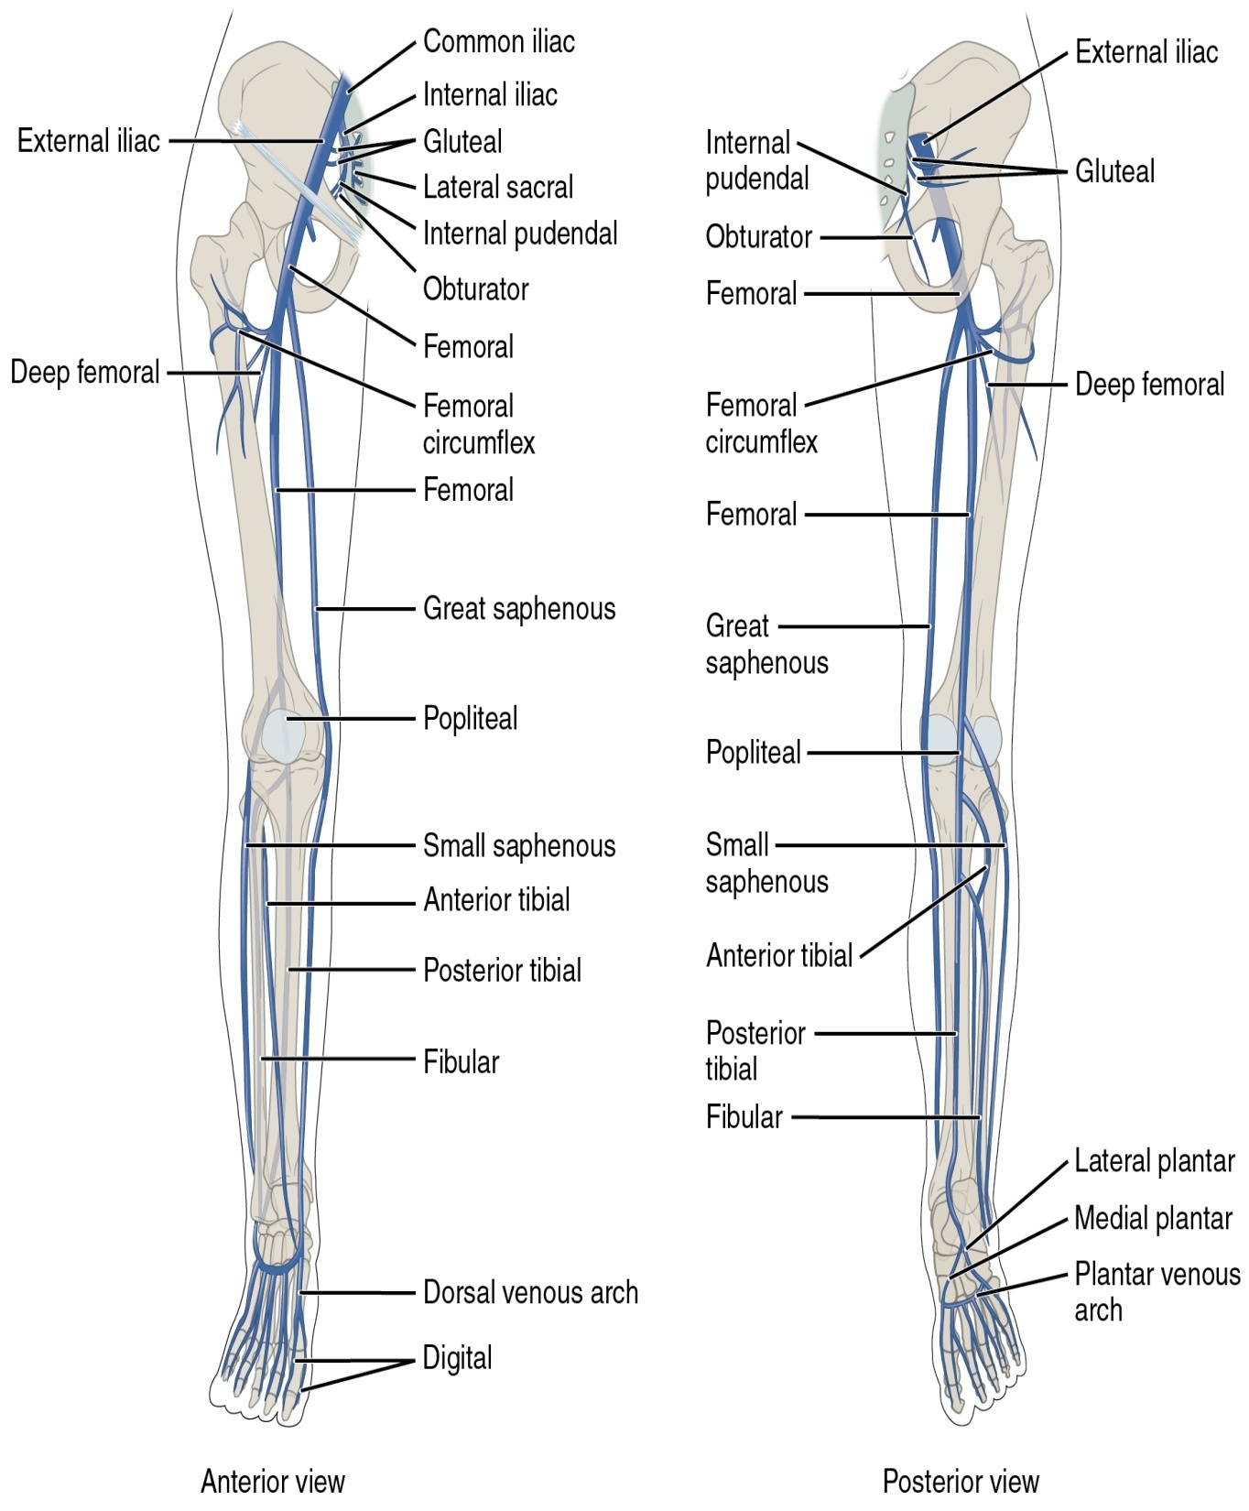
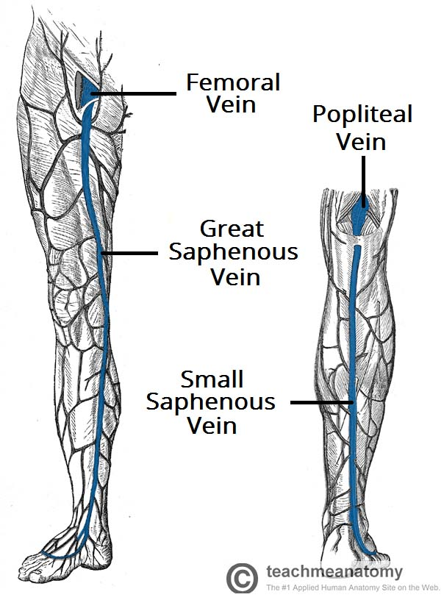
Leg veins Anatomy review

Slide 4
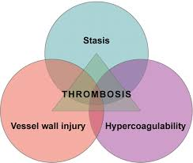
Etiology
The three factors described by Virchow over a century ago are still relevant in the development of venous thrombosis.
Virchow’s Triad:
• Changes in the vessel wall (endothelial damage).
• Stasis, which is diminished blood flow through the veins.
• Hypercoagulability of blood (thrombophilia).

Slide 5
Risk factors
There are many predisposing causes for venous thrombosis. The most important factor is a hospital admission for the treatment of a medical or surgical condition. Injury, especially fractures of the lower limb and pelvis, pregnancy and the oral contraceptive pill are other well-recognised predisposing factors.
Endothelial damage (secondary hypercoagulable state) is now known to be critically important. The interaction of the endothelium with inflammatory cells, or previous deep vein damage, renders the endothelial surface hypercoagulable and less fibrinolytic.
Stasis is a predisposing factor seen in many of the conditions, especially in the postoperative period, in patients with heart failure and in those with arterial ischaemia.

Slide 6
Risk factors
A number of conditions are associated with increased coagulability of the blood (thrombophilia) – Primary hypercoagulable state (mostly inherited conditions).
Causes of thrombophilia: Deficiencies of antithrombin, activated protein C and protein S have all been shown to predispose to venous thrombosis in young patients. Activated protein C deficiency is associated with inheritance of the factor V Leiden gene and may account for the higher incidence of venous thrombosis in Caucasian populations (being present in 6–7 per cent). It results in a small increase in the risk of venous thrombosis, although it may act in concert with some of the other predisposing factors.
A thrombophilic cause should be sought in any patient presenting with an episode of venous thrombosis who gives a family history of deep vein thrombosis or in whom there is no other predisposing factor.
Although the development of deep vein thrombosis is probably multifactorial, immobility (and hence stasis) remains one of the most important factors. Deep vein thrombosis is recognised as a complication of long-haul flights and other forms of travel.

Slide 7
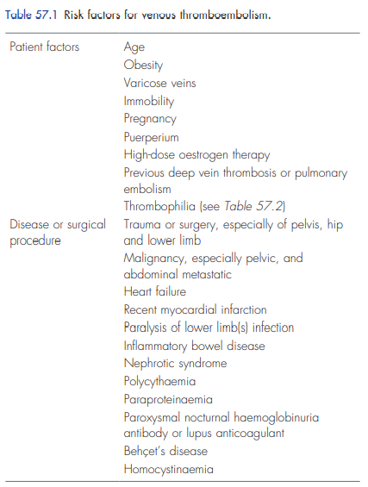
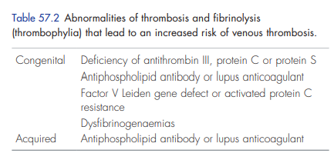

Slide 8
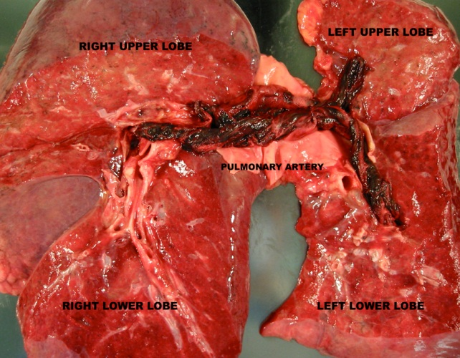
Risk factor(s)
Calf DVT
80-90%
10-20%
Resolves
Spontaneously by fibrinolysis
PROXIMAL DVT
rare
>50%
Pulmonary embolism
Death
Notes:
- VT below the popliteal vein, a proximal vein behind the knee, is classified as distal and has limited clinical significance compared to proximal DVT.
- DVT often develops in the calf veins and "grows" in the direction of venous flow i.e. grows proximally, towards the heart. When DVT does not grow, it can be cleared naturally and dissolved into the blood (fibrinolysis).
- As the DVT grows and involves the proximal vessels the risk of developing PE increases and mortality increases as it is more likely to cause a saddle embolus and death.
- Calf DVTs i.e: distal DVTs involve the small vessels of the calf distal to the knee (popliteal vein not involved). Caused mainly by transient risk factors such as: immobilization, recent surgery, travel
- Proximal DVTs involve the popliteal, femoral, iliac veins and most likely to dislodge and cause complications and late sequalae and increased risk of recurrence. Associated mainly with chronic risk factors: thrombophilia, chronic heart failure, chronic respiratory failure, and very importantly malignancy. More than 50% if left untreated can cause PE
- Rarely distal unstable DVTs may dislodge and cause PE

Slide 9
Clinical presentation :
The most common presentation of a deep vein thrombosis is pain and swelling, especially in the calf – usually in one lower limb
bilateral deep vein thromboses are common (30 %). When the swelling is bilateral, deep vein thromboses must be differentiated from other causes of systemic oedema, such as hypoproteinaemia, renal failure and heart failure.
Some patients may have no symptoms of thrombosis and may first present with signs of a pulmonary embolism, e.g. pleuritic chest pain, haemoptysis and shortness of breath. Patients may also develop shortness of breath from chronic pulmonary hypertension.
Sometimes the leg appears cellulitic and, very occasionally, it may be white or cyanosed: phlegmasia alba dolens and phlegmasia cerulia dolens .
Patients who present with venous gangrene often have an underlying neoplasm.

Slide 10
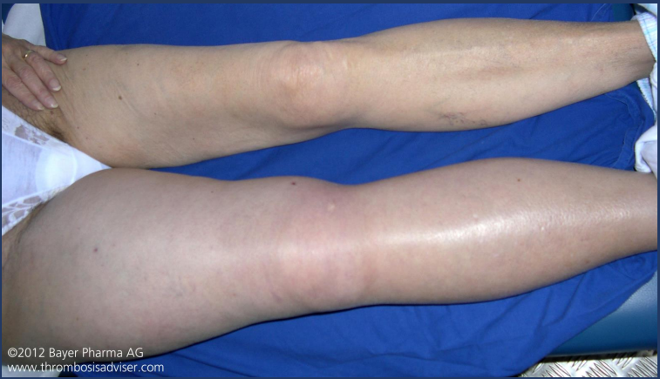
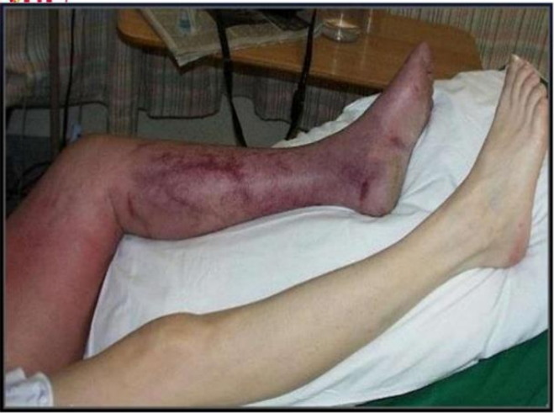
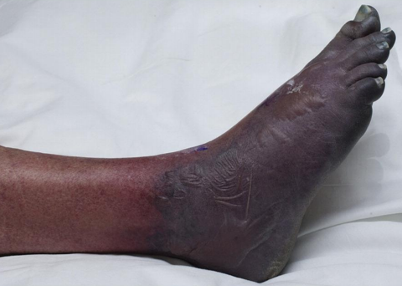
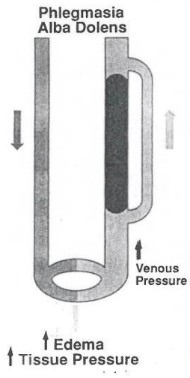
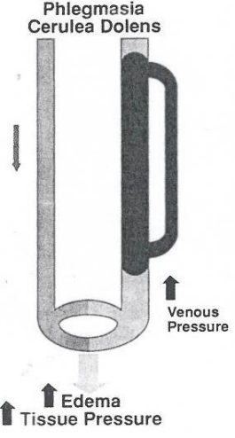
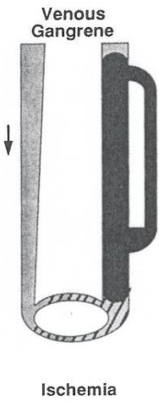
Phlegmasia Alba dolens
Phlegmasia cerulea dolens
Venous gangrene
Venous drainage is maintained via superficial veins
REVERSIBLE
Venous drainage is blocked
50% transform to venous gangrene
REVERSIBLE
Phlegmasia alba dolens ‘White leg’ or ‘Milk leg: Thrombosis involving ONLY the major deep venous channels but SPARING the collateral veins –– patients experience blanching of the extremity, edema, pain and discomfort. No arterial compromise (palpable or dopplerable peripheral pulses)- ass. with pregnancy
Phlegmasia cerulea dolens ‘ painful blue leg’: Thrombosis cause complete occlusion of the deep and superficial veins which increases exudation of fluid into interstitial space. Patients experience ischemic pain, swelling and cyanosis of the limb and may be blistering. (Surgical emergency for faciotomy and venous thrombectomy)
Venous Gangrene: Occlusion of superficial and deep veins with arterial compromise, excruciating limb pain with edema and fluid extravasation, no motor or sensory functions, necrosis and gangrene, Tx.: Amputation (IRREVERSIBLE)
Notes:
This slide depicts how DVT develops into serious irreversible complications
In phlegmasia cerulea dolens we perform faciotomy because there is a very likely chance of compartment syndrome.

Slide 11
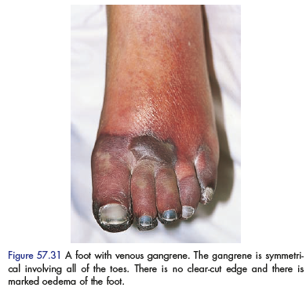
Patients experience excruciating limb pain with necrosis and gangrene. Severe edema and blistering is noted and this is an irreversible complication of venous thrombosis which requires
Amputation
Often suspect malignancy with venous gangrene

Slide 12
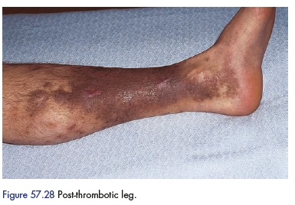
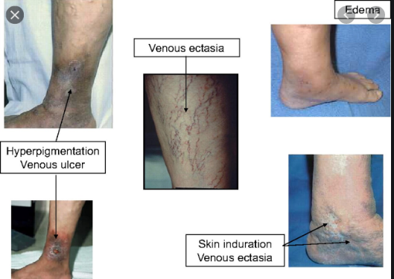
Post Thrombotic syndrome:
Post-thrombotic syndrome is a LATE DVT complication with development of symptoms and signs of chronic venous insufficiency following deep vein thrombosis (DVT) and is an all too common, burdensome, and costly complication.
Notes:
Post-thrombotic syndrome is the development of symptoms and signs of chronic venous insufficiency following deep vein thrombosis (DVT) and is an all too common, burdensome, and costly complication

Slide 13
Clinical examination:
Clinical examination for DVT is unreliable. Physical signs may also be absent. Mild pitting oedema of the ankle, dilated surface veins, a stiff calf and tenderness over the course of the deep veins should be sought.
Leg pain occurs in about 50 per cent of patients with DVT but is non-specific.
Homans’ sign – resistance (not pain) of the calf muscles to forcible dorsiflexion – is not specific and should not be elicited.
Tenderness occurs in 75 per cent of patients but is also found in 50 per cent of patients without objectively confirmed DVT. The pain and tenderness associated with DVT does not usually correlate with the size, location or extent of the thrombus.
Clinical signs and symptoms of pulmonary embolism occur in about 10 per cent of patients with confirmed DVT.
A low-grade pyrexia may be present, especially in a patient who is having repeated pulmonary emboli. Patients may have signs of cyanosis, dyspnoea, raised neck veins, a fixed split second heart sound and a pleural rub if they are having pulmonary emboli causing right heart strain, although these signs may be subtle or lacking.

Slide 14
DDx
The differential diagnosis of a deep vein thrombosis includes a ruptured Baker’s cyst, a calf muscle haematoma, a ruptured plantaris muscle, a thrombosed popliteal aneurysm and arterial ischaemia.
Duplex scanning will detect many of these conditions but often patients present with non-specific pain in the calf that resolves with no firm diagnosis being made.
The differential diagnosis of a pulmonary embolism includes myocardial infarction, pleurisy and pneumonia.

Slide 15
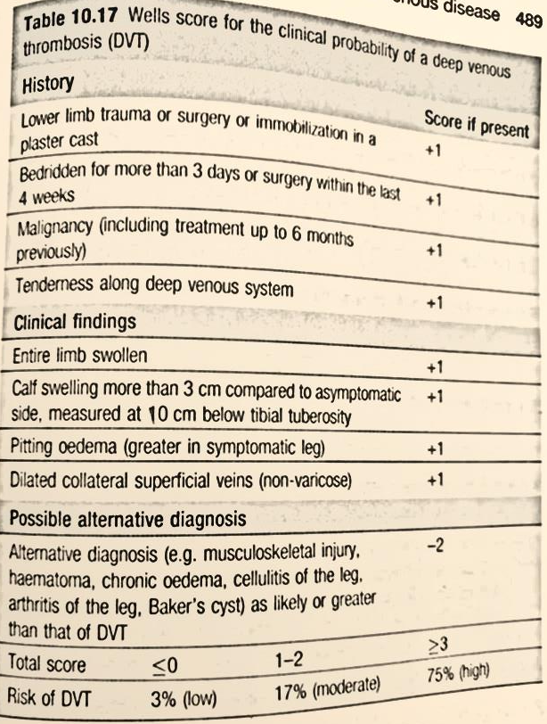
Investigations:
The diagnosis of deep vein thrombosis and pulmonary embolism should be established by special investigations as the symptoms and signs are non-specific and may be entirely lacking.
In addition, treatment with anticoagulation is not without risk and the diagnosis must be made with reasonable certainty.
Patients who present to ER with an idiopathic thrombosis usually have a d-dimer measurement and measurement of the clinical probability of DVT (Wells score).

Slide 16
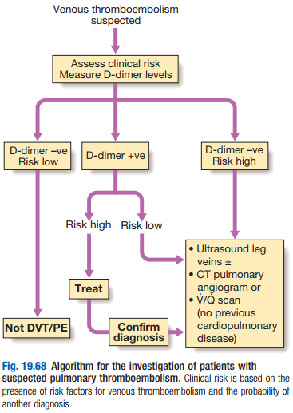

Slide 17
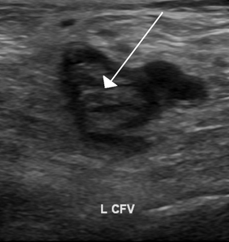
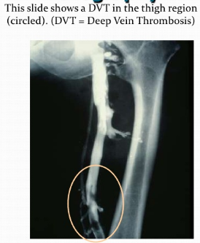
Duplex compression ultrasound examination of the deep veins should be performed. The deep veins of the lower limb are located and compressed. Filling defects in flow and a lack of compressibility indicate the presence of a thrombosis.This is accurate and reliable for femoral and popliteal clots but less certain in tibial vein clots. (highly sensitive 90% for proximal DVTs but less sensitive 50 % for distal DVTs).
2. Ascending venography, which shows a thrombus as a filling defect, is now rarely required unless other measures are being considered
3. Magnetic resonance imaging (MRI) uses a magnet to produce detailed pictures of the inside of the body by aligning hydrogen atoms in the tissues.

Slide 18
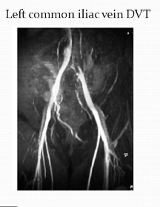
4. Magnetic resonance venography is now as accurate as contrast venography.
5. Pulmonary embolism is diagnosed definitively by computed tomography (CT) scanning of the pulmonary arteries, which can show filling defects in the pulmonary arteries.
6. Pulmonary angiography is rarely required unless interventional treatment is being considered.

Slide 19
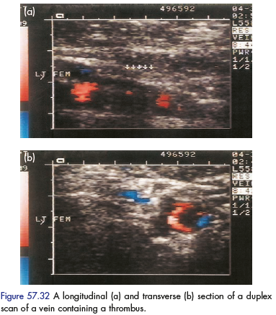
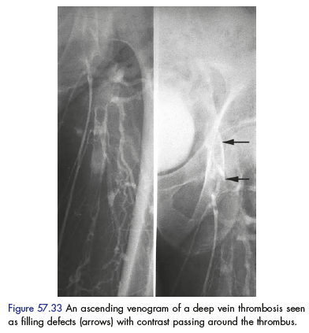
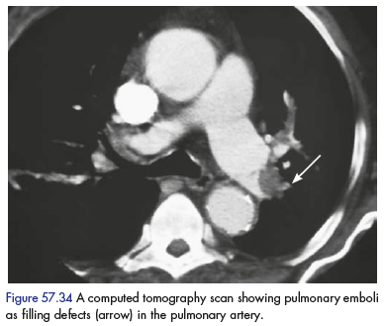

Slide 20
Management:
Once the diagnosis is established treatment aims to:
Prevent extension
Reduce the chance of PE.
Limit the short and long term morbidity in the limb
Take measures to avoid recurrence of thrombosis

Slide 21
Treatment of a DVT
Patients who are confirmed to have a deep vein thrombosis on duplex imaging should be started on subcutaneous LMWH and rapidly anticoagulated with warfarin unless there is a specific contraindication.
Anticoagulation for 6 weeks-3months is sufficient for patients after their first thrombosis with a precipitating cause, provided there are no persisting risk factors. Long-term anticoagulation is required for those with repeated episodes or continuing risk factors.
Elevate limb, and fit compression stocking when mobilizing.
INR should be monitored and don’t stop LMWH unless INR is between 2 – 3, and the introduction of warfarin or modern replacement such as fondaparinux or rivaroxaban ‘they have a quicker onset of action and less bleeding complications’ to maintain the anticoagulated sate of the patient.

Slide 22
Thrombolysis, tissue plasminogen activator (tPA) (or more usually urokinase in the United States) is administered directly into the thrombus, either via the popliteal vein or by direct puncture in the groin. Is used when the limb is threatened and where PE is a danger.
Removal of the thrombus by surgery or percutaneous (catheter-based) methods are used in case of threat to life or limb and failure to respond to non-operative management.

Slide 23
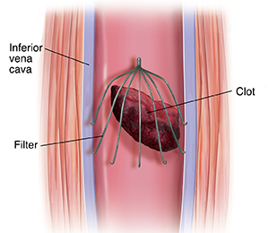
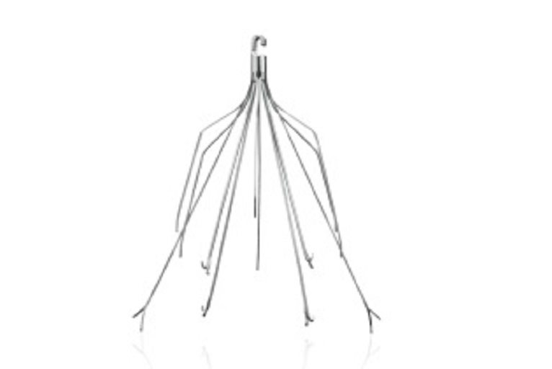
Inferior vena cava (IVC) filter placement:
In patients with proven VTE with a contraindication for anticoagulation, a complication of anticoagulation, or recurrent VTE despite adequate anticoagulation.

Slide 24
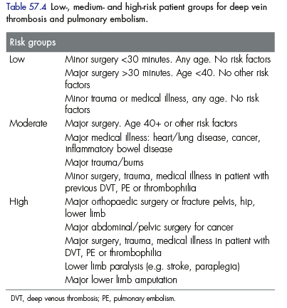
Prophylaxis
Patients who are being admitted for surgery can be graded as low, moderate or high risk.
Patients in the medium or high risk groups should be considered for anticoagulation prophylaxis.
Prophylactic methods can be divided into mechanical and pharmacological.

Slide 25
A variety of mechanical methods have been tried but only the use of graduated elastic compression stockings and external pneumatic compression have been shown to be worthwhile by reducing the incidence of thrombosis.
Pharmacological methods are more effective than mechanical methods at risk reduction although they carry an increased risk of bleeding.
Most patients now start on low molecular weight heparin given subcutaneously, with the dose based on the patient’s weight. Unfractionated heparin and warfarin are now rarely used in the prophylaxis of deep vein thrombosis.
A combination of mechanical and pharmacological treatment with heparin can be used in patients considered at high risk.

Slide 26
Superficial thrombophlebitis
This is a superficial venous thrombosis. The term ‘thrombophlebitis’ implies a major inflammatory component; however, this is rarely seen.
Common causes include:
-Stasis –e.g Varicose veins
-Local trauma and inflammation – IV therapy, The presence of an intravenous cannula for longer than 24–48 hours often leads to local thrombosis.
- Generalised hypercoagulability – e.g. Malignancy (especially of the pancreas) and thromboangiitis obliterans

Slide 27
Clinical features:
-There is usually a red line along the skin over the vein- this is tender and firm to the touch. (palpable cord)
-Pain and tenderness
-There maybe fever and if the process is a pyogenic one, rigors, as bacteria are shed into the general circulation, and leukocytosis.
An obvious cause , such as an IV cannula and infusion, may be present.
Management:
- If there is a precipitating factor this should be removed. Thereafter the condition is self-limiting and is treated symptomatically with NSAIDs e.g: indomethacin.
- Spreading thrombophlebitis with systemic features may require blood culture and antibiotic therapy and occasionally there is suppuration for which drainage is necessary.
- Anticoagulation me be required if it involves or extends to major veins e.g: femoral
A full blood count, coagulation screen and duplex scan of the deep veins should usually be obtained. Any suggestion of an associated malignancy (migratory phlebitis) should be investigated using appropriate endoscopy and imaging studies, such as an abdominal CT scan.
Excision of the vein may be necessary but is usually reserved for patients with systemic symptoms .

Slide 28
Aortic Aneurysm
Ibraheem Jwaied
Supervised by Dr. Ali Kayed

Slide 29
Definition
Enlargement (dilation) of the aorta to greater than 1.5 times normal size (1.4- 2.5 cm).
Arise from the media layer which is responsible for the structural and elastic properties of the artery.

Slide 30
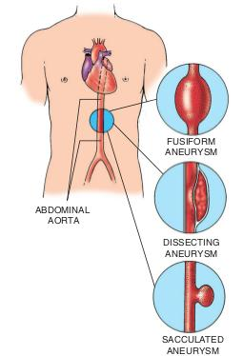
Classification
1. According to the wall : 1- True aneurysm : containing the three layers of the arterial wall. (intima / media /adventitia )
2- False aneurysm : having single layer of fibrous tissue, e.g. aneurysm following trauma.
2. According to the morphology : 3. According to the etiology :
1-Atheromatous degenerative.
2-Inflammatory.
3- Idiopathic.
4- Traumatic.
5- syphilitic

Slide 31
*Aneurysms occur all over the body in major vessels, including the aorta, and the iliac, femoral, popliteal, subclavian, axillary and carotid arteries. They may also occur in cerebral, mesenteric, splenic and renal arteries and their branches.
*The majority are true fusiform atherosclerotic aneurysm

Slide 32
Abdominal Aortic Aneurysm
Normal - Aorta 1.4 -2.5cm & iliac 0.6-1.2cm
Aneurysm - Aorta >3cm & iliac > 2cm
Abnormal dilatation of abdominal aorta more than 3 cm in diameter, involving of the three layers.
Most common type of large vessel aneurysm.
Mostly at infra-renal region.
Occur in 3-9% of people above 50 YO.
90% are atheromatous degenerative in origin.
14% associated with peripheral aneurysms in femoral or popliteal.

Slide 33
Crawford’s Classification
Most Common

Slide 34
Risk factors:
Age > 50 YO, white male.
Hx of Atherosclerosis.
HTN.
Hypertriglyceridemia.
Smoking with COPD.
Positive family Hx.

Slide 36
Clinical Manifestation
Most AAAs are asymptomatic
Patients may describe a pulse in their abdomen or may palpate a pulsatile mass.
Classic presentation “ Triad “ of Ruptured AAA : 1. Abdominal or back pain. 2. Hypotension and shock. 3. Pulsatile abdominal mass.
* Less than 1/3 of the patients will have the triad.

Slide 37
Clinical Manifestation
*Fever Inflammatory aneurysm.
*GI bleeding Aortoenteric Fistula.
*Symptoms of distal embolization blue-toe syndrome.
*Symptoms of compression on urinary, venous supply.

Slide 38
Blue-toe syndrome

Slide 39
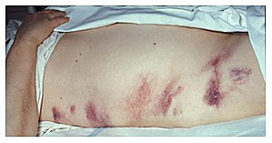
Physical examination:
Palpable pulsatile abdominal mass at or above the umbilicus.
Bruit or stenosis of renal artery or other visceral arteries.
Grey-turner sign >> Retroperitoneal hemorrhage.

Slide 40
Diagnosis :
Plain abdominal radiographs may show the outline of an aneurysm when its walls are calcified
US : is used to screen for aneurysms and to determine the size of any present, free peritoneal fluid can be detected, but the presence of bowel gas or obesity may limit its usefulness

Slide 41
Ct :has a nearly 100% sensitivity for aneurysm and is also useful in preoperative planning, detailing the anatomy and possibility for endovascular repair. In the case of suspected rupture, it can also reliably detect retroperitoneal fluid
Alternative less often used methods for visualization of the aneurysm include MRI and angiography.

Slide 42
INVESTIGATIONS:
Full blood count, electrolytes, liver function tests, coagulation tests and blood lipid estimation are carried out, with a crossmatch if surgery is contemplated within a few days.
Electrocardiography and cardiac assessment by echocardiography is useful.
Chest radiography and pulmonary function tests should also be carried out.

Slide 43
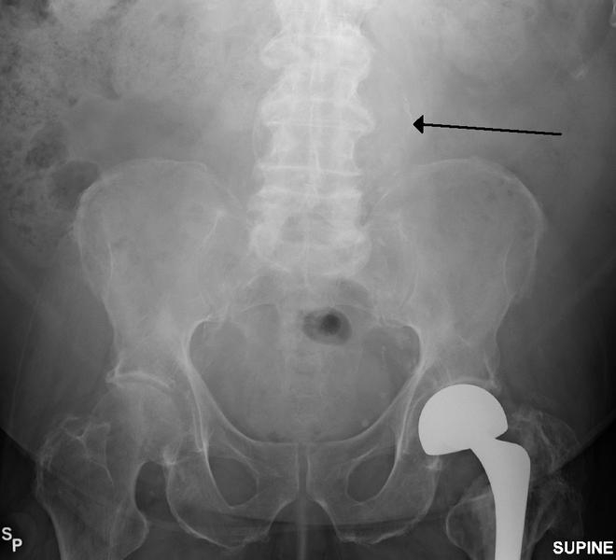
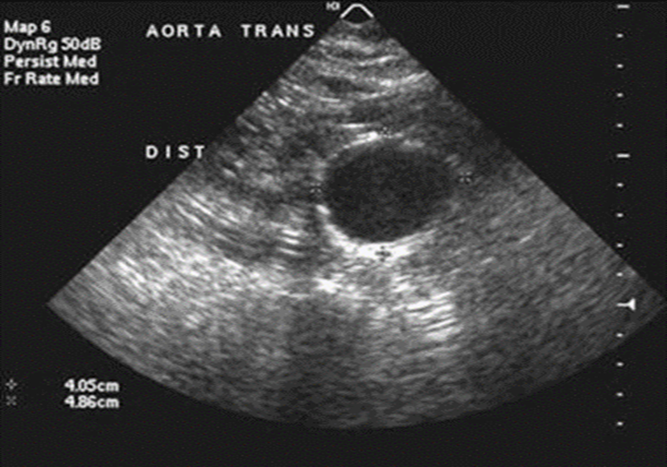

Slide 44
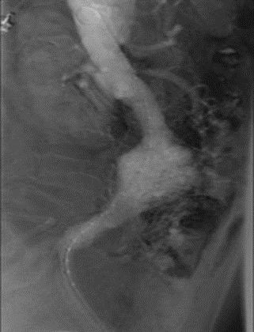
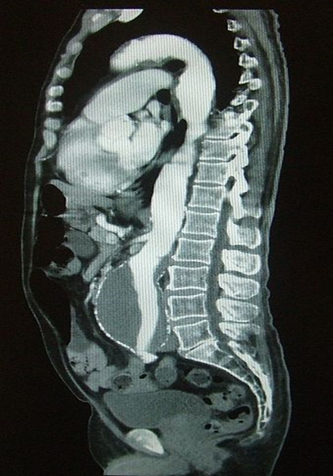
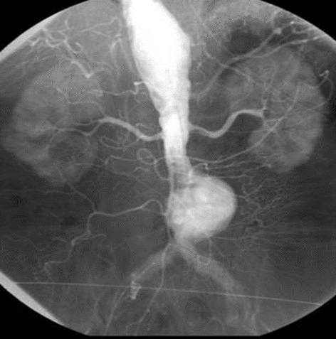

Slide 45
AAA Management :
There are three treatment options for AAA:
Watchful waiting.
Medical
Open surgical procedure or Endoluminal procedure

Slide 46
Watchful waiting
Indicated in :
1. patients where repair carries a high risk of mortality.
2. in patients where repair is unlikely to improve life expectancy
3. Small AAA's (less than 5 centimeters or about 2 inches), which are not rapidly growing or causing symptoms, have a low incidence of rupture and often require no treatment other than "watchful waiting“.
This typically includes follow-up ultrasound exams at regular intervals ( Yearly ) and modifying life-style such as smoking cessation, exercise.

Slide 47
Medical Management of AAA
Smoking Cessation- Single most important modifiable risk factor
Exercise Therapy- Evidence suggests may benefit small aneurysms
Beta Blockers- May decrease the rate of expansion? Important cardiovascular effects thus use advocated.
ACE inhibitors- Evidence is mixed, however, implicated in less aneurysm rupture.
Doxycycline
Antibiotic activity against chlamydia species
Suppresses expression of MMP (matrix metalloproteinase)
Statins - associated with reduced aneurysm expansion rates. Decreases MMP-9 in aneurysm wall.
Notes:
MMP: matrix metalloproteinase cause breakdown of the extracellular matrix in normal physiological processes

Slide 48
Open surgical procedure
Open repair is indicated in:
1. young patients as an elective procedure,
2. in growing or large, symptomatic or ruptured aneurysms.
It involves removing the dilated section of the AA & replacing it with a prosthesis made of synthetic material (also known as a graft) that is sutured into place .This will allow blood to flow normally and the artery wall is used to cover the graft

Slide 49
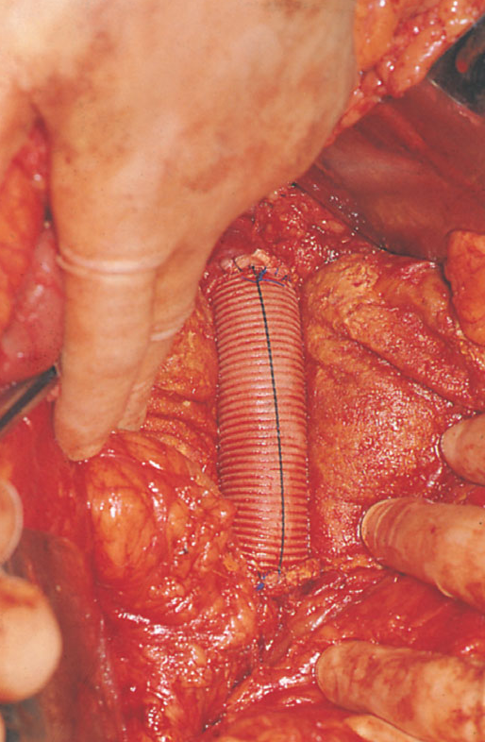
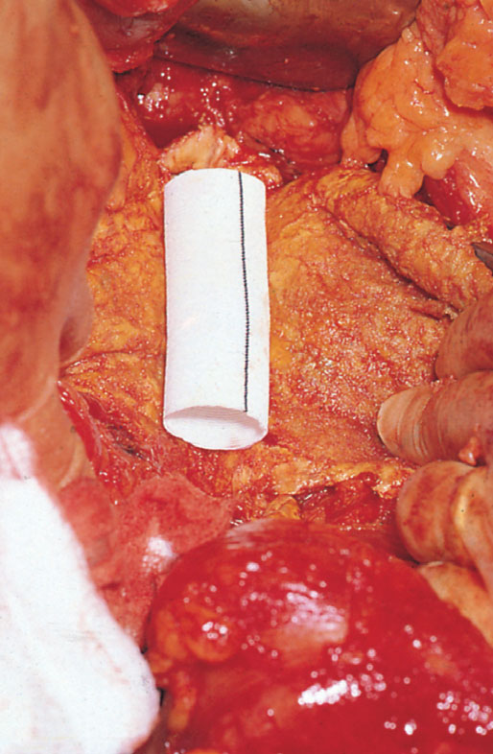

Slide 50
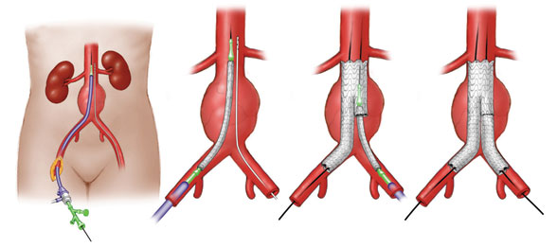
Endoluminal procedure (Endovascular stent graft)
It is generally indicated in older, high-risk patients or patients unfit for open repair
The aorta is accessed via the common femoral arteries, which are exposed surgically.
Under radiological control, a delivery system is guided up into the aorta and an endovascular prosthesis (often termed a ‘stent graft’) placed within the aortic sac.

Slide 51
Postoperative complications
The most common complications after open repair are respiratory (lower lobe consolidation, atelectasis and ‘shock lung’) and cardiac (ischaemia and infarction).
A degree of colonic ischaemia because of lack of a collateral blood supply occurs in about 10% of patients but fortunately this usually resolves spontaneously

Slide 52
Renal failure and infection of the graft are rare events after elective procedures but they may complicate procedures undertaken for rupture.
Neurological complications include sexual dysfunction and spinal cord ischaemia.
An aortoduodenal ﬁstula is an uncommon but treatable complication of abdominal aortic replacement surgery. It should be suspected whenever haematemesis or melaena occurs in the months or years after operation.
Prosthetic infection also occurs uncommonly and may require removal of the graft, limb revascularisation being achieved by simultaneous insertion of an axillo-bifemoral bypass.
Cardiac, respiratory, renal and neurological complications occur less often with the endovascular method but they are not obviated entirely by this minimally invasive technique. In the longer term, ﬁstula and prosthetic infection remain rare but signiﬁcant problems

Slide 53
Ruptured Aortic aneurysm

Slide 54
EMERGENCY
AAA rupture is an important cause of unheralded deaths in people older than 55 years.
Less than 50% of patients survive to reach the hospital.
Operative mortality 50%, overall combined mortality (community and hospital) is around 80-90%.
Rupture occur either anteriorly into the peritoneal cavity (20%) or posteriorly into the retroperitoneal space (80%).
Anterior rupture results in free bleeding into the peritoneal cavity; very few patients reach hospital alive.
Posterior rupture on the other hand produces a retroperitoneal haematoma. Often a brief period ensues when a combination of moderate hypotension and the resistance of the retroperitoneal tissues arrests further haemorrhage. The patient may remain conscious but in severe pain.

Slide 55
Risk of Rupture :
Size :
Aneurysm > 5cm 6-16% and > 7cm 33% annual rupture rate.
Wall stress analysis.
Saccular aneurysm have higher rate of rupture.
HTN, COPD, active smoking are independent predictors of rupture
(+) family hx tend to rupture
Expansion rate <0.5 /6 mo

Slide 56
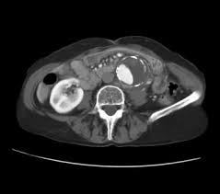
If there is doubt about the presence of an aneurysm an ultrasonogram may help, but this test is not of use to detect rupture.
If there is doubt about rupture a CT scan is of more help, but it is still far from being foolproof.
In practice, most diagnoses are reached on clinical grounds alone, without imaging.

Slide 58
Good venous access is needed for infusion of saline or volume expanding ﬂuids, but the systolic blood pressure should not be raised any more than is necessary to maintain consciousness and permit cardiac perfusion (<100mmHg). Elevation into the normotensive range may provoke further uncontrolled haemorrhage.
A urinary catheter is passed.
If the patient appears stable, surgery may be delayed until cross-matched blood is ready but the patient should still be transferred immediately to the operating room so that the procedure can commence immediately if haemodynamic instability develops. Always remember that the treatment of ruptured aneurysm is operation, not monitoring and resuscitation

Slide 60
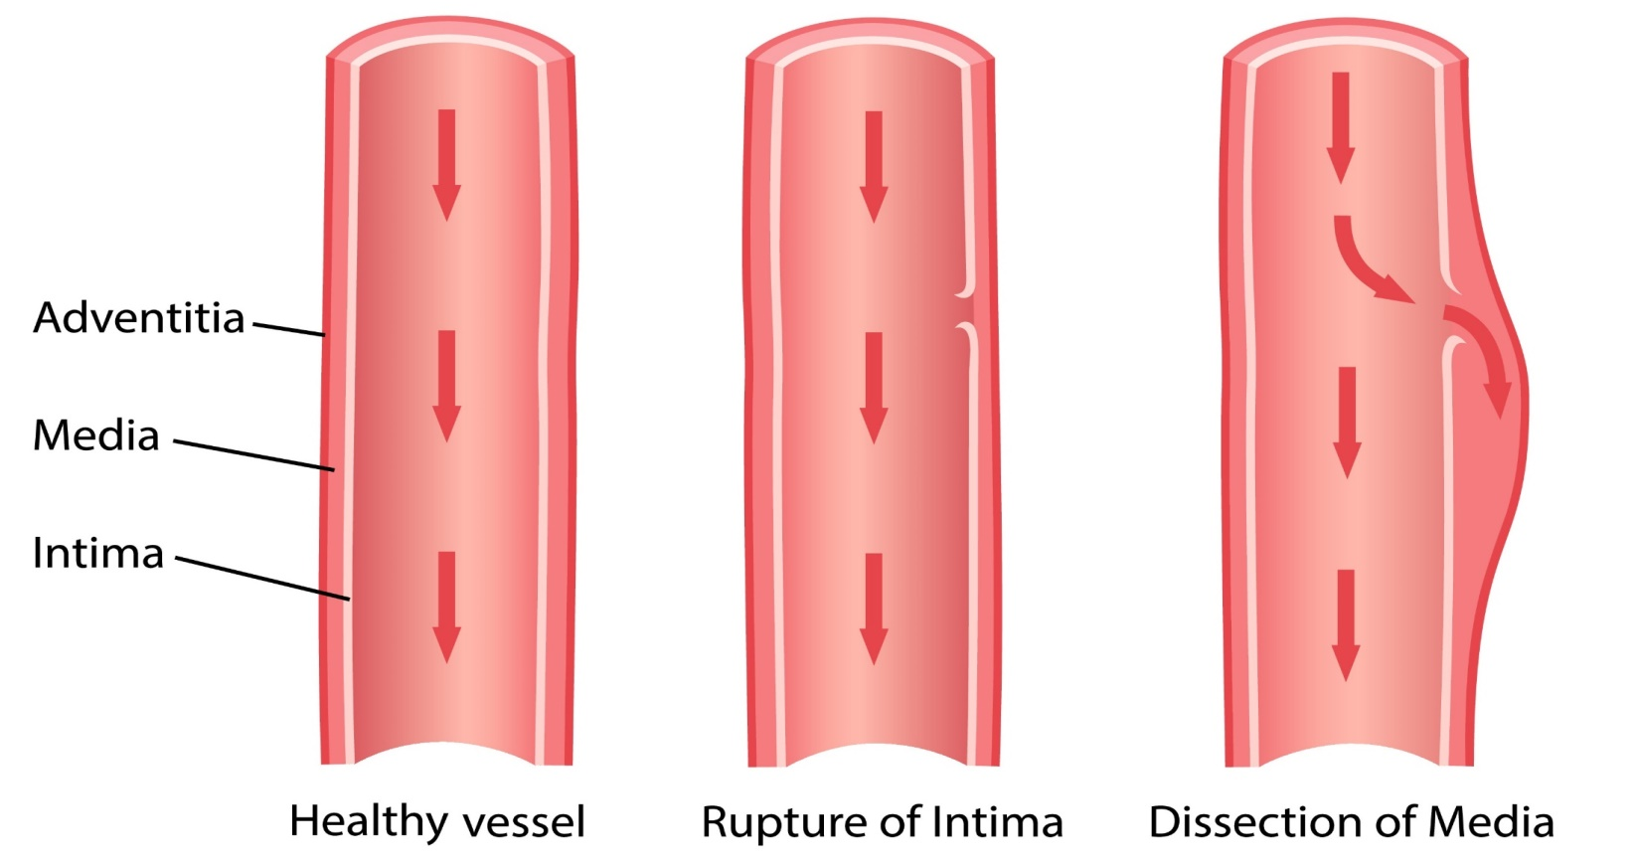
Aortic Dissection
DONE BY: MOHANAD AL-HADDADIN

Slide 61
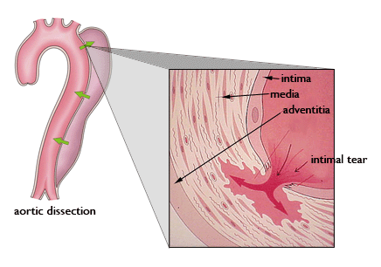
DEFINITION
It is a tear in the intima allowing blood to travel between the intima and the media resulting in the creation of two flow channels: the true lumen and the “false lumen “. (double-barreled aorta)

Slide 62
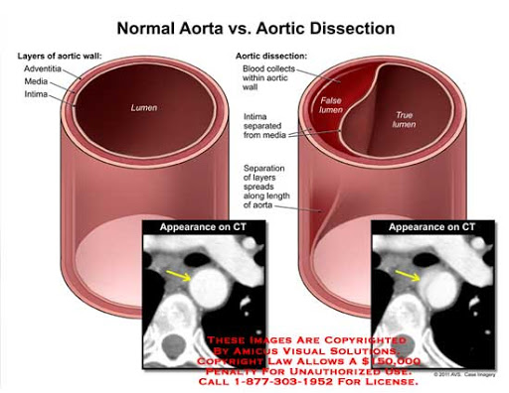
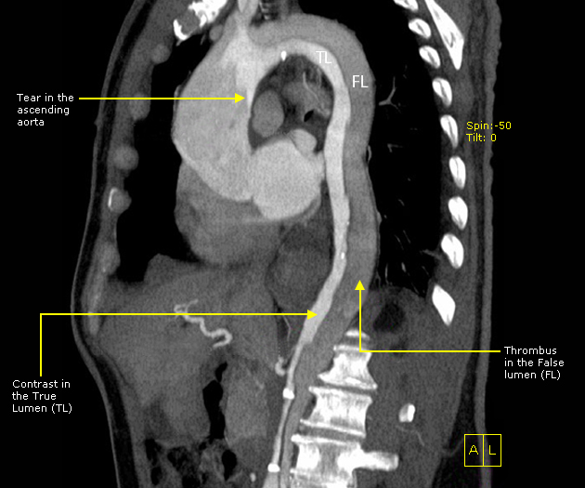

Slide 63
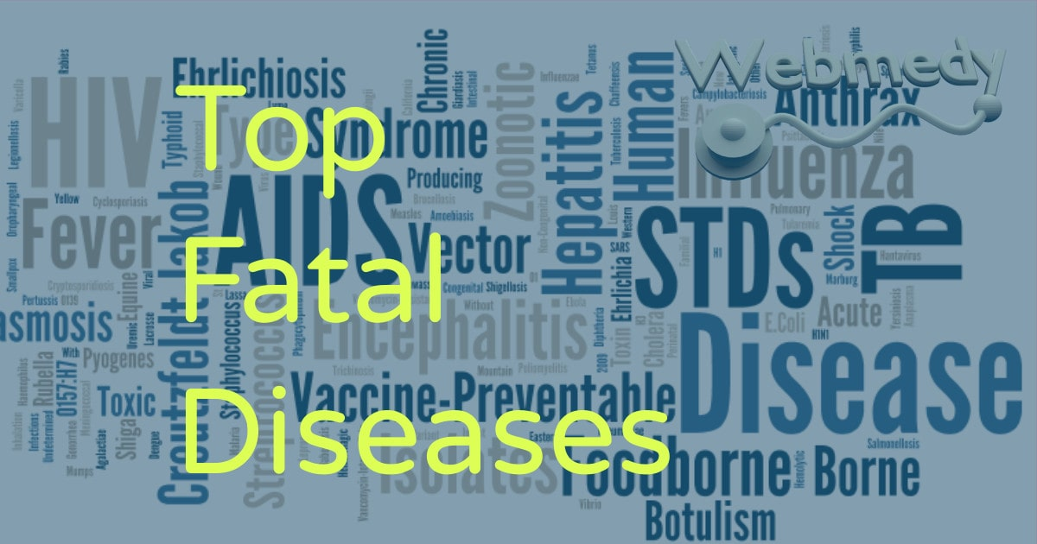
EPIDEMIOLOGY
The incidence is ~30 cases per million individuals per year and the natural history is marked by a high mortality rate, as high as 1% per hour over the first 24 hours.
The most common site of dissection is the first few centimeters of the ascending aorta, with 90% occurring within 10 centimeters of the aortic valve.
It is also more common in men ( 50-70yr)
Between 5% and 10% of dissections do not have an obvious intimal tear.

Slide 64
Etiology
Long-standing systemic HTN (70% of patients)??hypertension results in hyaline arteriolosclerosis of the vasa vasorum,decreased flow causes atrophy of the media
Connective tissue diseases (Marfan’s syndrome ,Ehlers-Danlos syndrome)??lead to weakness of the connective tissue in the media –cystic medial necrosis-
Coarctation of the aorta
Atherosclerosis (Dyslipidemia ,smoking)
Cocaine due to its effect on aortic connective tissue and produce abrupt and severe hypertension
Iatrogenic (Aortic catheterization ,Aortic valve surgery)
Trauma (deceleration injury)
Aging. With aging, degenerative changes lead to breakdown of the collagen, elastin, and smooth muscle cells that contribute the intima, media, and adventitia
g

Slide 65
Clinical features
1.severe,tearing/ripping/stabbing pain, typically abrupt in onset, either in the anterior or back of the chest (often the interscapular region)
A.anterior chest pain is more common with proximal dissection(type A)
B.interscapular back pain is more common with distal dissection (type B)
2.diaphoresis
3.most are hypertensive,but some may be hypotensive
4.pulse or BP asymmetry between limbs

Slide 66
5.aortic regurgitation (especially proximal type) so we could auscultate murmur
6.Syncope :due to sever pain ,aortic baroreceptor activation
7.Hypotention and Tachycardia indicate active bleeding

Slide 67
The extent of arterial dissection may produce widespread symptoms and signs:
If extend distally down the aorta may involve:
Renal a. (renal pain and renal failure)
Mesenteric a. (abdominal pain and bowel ischemia)
Spinal a. (paraplegia)
Iliac a. (leg pain,pallor,loss or reduced pulses and limb ischemia )
If track proximally :
Head and Neck vessels(TIA , stroke)
Coronary vessels (MI/angina)
Aortic root (aortic regurgitation.)
If Ruptured externally into the pericardium (cardiac tamponade) or to the medaistinum (Lt hemothorax)

Slide 68
Classification
DeBakey Classification(according to origin)
Type I: start in the ascending and extend at least to the thoracic arch or beyond(most common).
Type II: start and confined to ascending aorta.
Type III: start in the distal aorta
1)Type IIIA confined to the thoracic aorta
2) Type IIIB extend below the diaphram
Stanford Classification(according to ascending aorta involvement)
Type A: involve the ascending aorta (most common 60%)
Type B: Confined to the descending aorta(distal to the left subclavian).

Slide 69
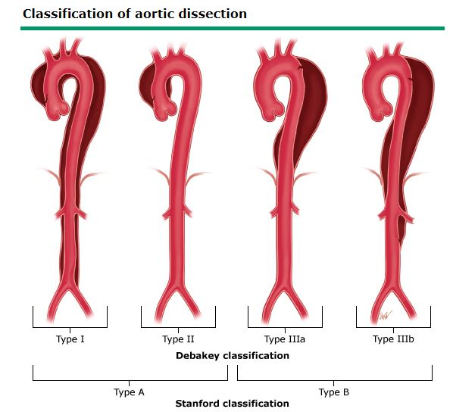

Slide 70
Diagnosis
CXR: shows widened mediastinum(>8cm on AP view) .occurs in approximately 60% of all aortic dissections, Lt pleural effusion is common.
ECG: ischemic changes present in 20% of acute type A dissections (Acute inferior MI , Aortic insuffeciency)
Absence of ECG changes usually helps distinguish dissection from angina .

Slide 72
If CXR suggests dissection, Tracheoesophageal echocardiogram (TEE/TOE),CTA ,MRA is done immediately after stabilization . (Presence of intimal flap and double lumen )
TEE : done at the bed side ,in <20min ,not require contrast and noninvasive.
CTA :is typically the first line imaging modality
MRA : 100%specificty and sensitivity but time consuming and ill-suited for emergency
aortic angiography : is invasive, but is the best test for determining the extent of the dissection for surgery.

Slide 74
management
Admission to ICU
BP monitoring
Urine catheter Insertion
Blood group and cross match for 4 -6 units when surgery is likely
If hemodynamically unstable>>intubation

Slide 75
Initial Management
1- Place two large bore IV cannulas.
2- Control heart rate and blood pressure. -Maintain heart rate <60 BPM -systolic blood pressure between 100 and 120 mmHg.
3- Administer IV esmolol or labetolol .>> To lower the heart rate and diminish the force of left ventricular ejection - If beta blockers are not tolerated, alternatives are verapamil, diltiazem, or nicardipine. Which are calcium channel blockers.
4- give IV vasodilator therapy. (nitroprusside, nicardipine) IF the systolic blood pressure remains above 120 mmHg, should not be used without first controlling heart rate with beta blocker to prevent reflux tachycardia.
5- Give IV opioids for analgesia (eg, fentanyl).
6-Place Foley catheter for assessment of urine output and kidney perfusion

Slide 76
Management according to the type
Type A (emergent surgery)
The high mortality rate is due to the feared progression of retrograde dissection ,hemopericardium,and cardiac tamponade,MI,aortic regurgitation.
The main objectives of operation are to remove the intimal tear site, to replace diseased or dilated aorta as necessary, to obliterate the false lumen and redirect blood flow into the true lumen, and to correct associated valvular insufficiency or coronary ischemia.
The technique includes internal replacement of the dissected aortic segment with a Dacron graft.
- OPEN REPAIR surgery is still the standard of care.

Slide 77
Type B:
Conservative if it is uncomplicated
Admit to the ICU for medical management of hypertension including beta blockers.
Long term antihypertensive regimens
Surgery if it is complicated
Surgery is indicated if complication occur(malperfusion , persistant HTN or pain ,rapidly enlarging aortic diameter ,extension of the dissection and rupture )
ENDOVASCULER coverage repair which is a minimally invasive procedure using catheter to access the aorta and seal the tear using a cloth-covered stent graft.
According to the latest updates endovascular coverage of the intimal tear in uncomplicated type B dissections has become the standard of treatment.

Slide 78
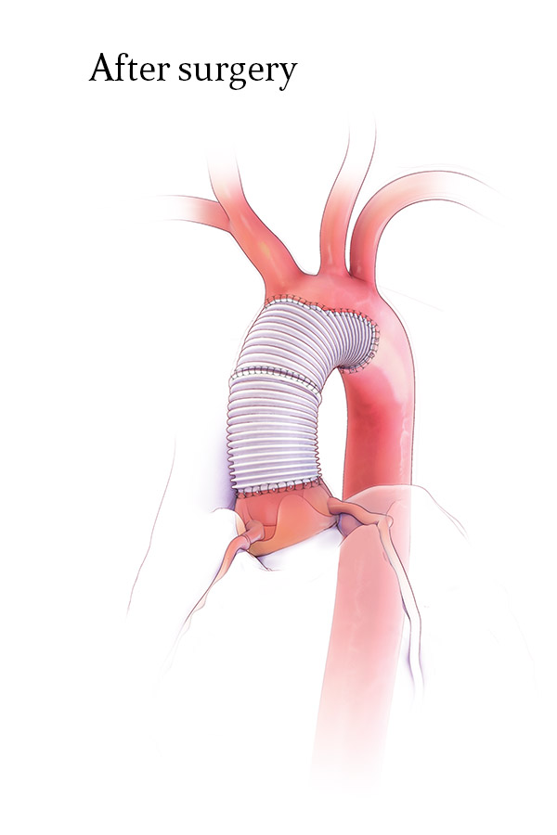
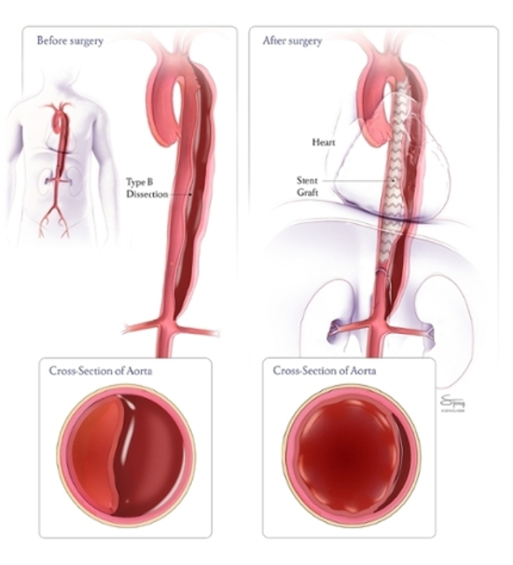
Dacron graft type A surgery
Endovascular surgery type B

Slide 79
Surgical outcome
Mortality if untreated is
-50% within 48 hrs of dissection
- 75% within 1-2 weeks.
Almost all patients with type A dissection will die if not operated on, whereas patients with type B dissection have better prognosis
Spontaneous healing of dissection is uncommon

Slide 80
A 50 Y/O man arrives at ER complaining of sudden severe tearing chest pain for 1 h that radiates to his back. He is sweating profusely and feels nauseous.
Vitals are HR 130, BP 150/90(right arm) 120/85 (left arm), RR 19, T 37C
ECG within normal limits, Troponin : negative
CBC, Serum chemistries, BUN, Creatinine, and Amylase are within normal limits
The most likely diagnosis is :
MI
Tension Pneumothorax
Aortic dissection
Acute pancreatitis

Slide 81
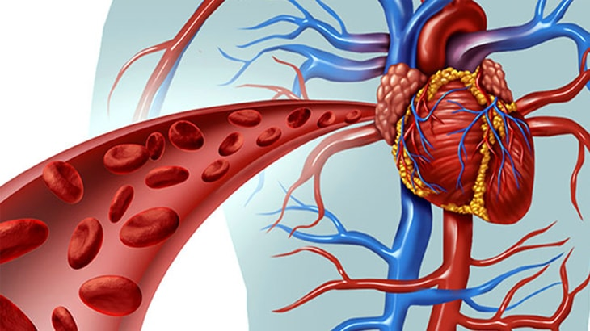
THANK YOU

