Slide 1
DISORDERS OF SKELETAL MUSCLES
Dr. Omar Hamdan
Gastrointestinal and liver pathologist Mutah University School of Medicine-Pathology Department Undergraduate Lectures 2023

Slide 2
Introduction
The principal component of the motor system is the motor unit, which is composed of one lower motor neuron together with the associated axon, its neuromuscular junctions, and the skeletal muscle fibers it innervates.
Skeletal muscle consists of different fiber types broadly classified as slow twitch type I and fast twitch type II fibers

Slide 4
Introduction
A number of proteins and protein complexes are crucial for the unique structure. These include proteins that make up the sarcomeres and the dystrophinglycoprotein complex.

Slide 6
Myopathy
Definition : a clinical disorder characterized by primary dysfunction of skeletal muscle.
Etiology and epidemiology:
Infancy: Mitochandrial and congenital myopathy e.g. nemaline myopathy.
Childhood: e.g. Duchenne and Becher muscular dystrophy.
Adulthood: endocrine myopathies and inflammatory myopathies.

Slide 7
Classification
Inherited:
Dystrophy (Duchenne, Becker and fascioscapulohumeral)
Congenital (nemaline)
Metabolic
Mitochanderial
Channelopathies
Acquired:
Inflammatory (dermatomyositis and polymyositis)
Infective (viral)
Toxic (medication)
Systemic (Endocrine disease)

Slide 8
Pathophysiology
Metabolic
Mitochondrial myopathies: mutation in mitochondrial and nuclear genome proteins involved in oxidative phosphorylation Impaired ATP production, excess free radical production and lactic acidosis in muscles and other tissue.
Muscular dystrophy
X-linked defect Absence of dystrophin Poor structure stability of Dystroglycan complex Persistent depolarization and calcium influx Degradation of muscle fibers.
Thyrotoxic
Reduce levels of acetylcholinesterase Overstimulation of muscle fibers

Slide 9
Myopathy versus neuropathy
Primary muscle diseases or myopathies have to be distinguished from secondary neuropathic changes caused by disorders that disrupt muscle innervation.
Both are associated with altered muscle function and morphology, but each has distinctive features

Slide 10
Myopathy versus neuropathy
Myopathic conditions are often associated with segmental necrosis and regeneration of individual muscle fibers. Some myopathies are also associated with other morphologic features, such as inflammatory infiltrates or intracellular inclusions.
Disruption of muscle by endomysial fibrosis and fatty replacement is reflective of disease chronicity that can occur both in myopathic as well as neuropathic conditions.
Both neuropathic and myopathic processes cause muscle fiber atrophy.

Slide 11
Myopathy Vs Neuropathy

Slide 12
Inherited Disorders of Skeletal Muscle
In some of these disorders, skeletal muscle is the main site of disease, while in others multiple organs are involved.
There is not a simple one-to-one correspondence between genotypes and phenotypes. Instead mutations in several different genes can, for example, present as autosomal recessive limb-girdle muscular dystrophy; conversely different mutations in a single gene (such as dystrophin) can lead to very different clinical phenotypes, as illustrated by Duchenne and Becker types of muscular dystrophy.

Slide 13
Dystrophinopathies: Duchenne and Becker Muscular Dystrophy
The most common muscular dystrophies are X-linked and are caused by mutations that disrupt the function of a large structural protein called dystrophin. Duchenne muscular dystrophy (DMD) and Becker muscular dystrophy (BMD) are the two most important diseases in this group.
DMD has an incidence of about 1 per 3500 live male births and follows an invariably fatal course. It becomes clinically evident in early childhood; most patients are wheelchair-bound by the time they are teenagers and are dead of their disease by early adulthood.
The Becker type of muscular dystrophy is less common and less severe.

Slide 15
Dystrophinopathies: Duchenne and Becker Muscular Dystrophy
The histologic alterations in skeletal muscles affected by DMD and BMD are similar, except that the changes are milder in BMD.
The hallmarks of these as well as other muscular dystrophies are ongoing myofiber necrosis and regeneration. Progressive replacement of muscle tissue by fibrosis and fat.
Muscles typically show marked variation in myofiber size and abnormal internally placed nuclei as a result of ongoing repair.
Both DMD and BMD also affect cardiac muscles, which show variable degrees of myocyte hypertrophy and interstitial fibrosis.

Slide 17
Pathogenesis
Both DMD and BMD are caused by mutations disrupting the function of the dystrophin gene located on the short arm of the X chromosome (Xp21). Dystrophin is a very large protein (427 kD in molecular weight) found in skeletal and cardiac muscle, brain, and peripheral nerves; it is part of the dystrophin-glycoprotein complex.
This complex stabilizes the muscle cell during contraction and may be involved in cell signaling through interactions with other proteins. Dystrophin-glycoprotein complex defects are thought to make muscle cells vulnerable to transient membrane tears during contraction that lead to calcium influx, and they may also disrupt intracellular signaling.
The result is myofiber degeneration that with time outpaces the capacity for repair. The dystrophin-glycoprotein complex also is important for cardiac muscle function; this explains why cardiomyopathy eventually develops in many patients.

Slide 18
Dystrophin gene
The dystrophin gene spans roughly 2.4 megabases (about 1% of the X chromosome), making it one of the largest human genes. Its large size may make it more prone to sporadic mutations
The most common mutations are deletions. Patients with DMD usually show complete absence of dystrophin on a muscle biopsy. Patients with BMD often have point mutations and make residual but defective forms.
The severity of disease correlates with genotype and extent of dystrophin deficiency.

Slide 19
Clinical Features: DMD
Often the first symptoms of DMD are clumsiness and an inability to keep up with peers because of muscle weakness.
The weakness typically begins in the pelvic girdle and next involves the shoulder girdle.
Enlargement of the calves, termed pseudo hypertrophy, is an early physical finding.
The increased muscle bulk initially stems from myofiber hypertrophy, but as myofibers progressively degenerate, an increasing part of the muscle is replaced by adipose tissue and endomysial fibrosis.

Slide 22
Clinical Features: DMD
Cardiac muscle damage and fibrosis may lead to heart failure and arrhythmias, which may prove fatal.
Cognitive impairment also may occur and may be severe enough to be classified as mental retardation.
High serum creatine kinase levels are present at birth and persist through the first decade of life but fall as muscle mass is lost as the disease progresses.
Death results from respiratory insufficiency, pneumonia, and cardiac decompensation.

Slide 23
Clinical Features: BMD
BMD becomes symptomatic later in childhood or adolescence and progresses at a slower and more variable rate.
Many patients live well into adulthood and have a nearly normal life span.
Cardiac involvement may be the dominant clinical feature and may result in death, even in the absence of significant skeletal muscle weakness.

Slide 24
Treatment
Treatment is challenging.
Current treatment consists primarily of supportive care.
Definitive therapy requires restoration of dystrophin levels in skeletal and cardiac muscle fibers.
Genetic approaches to accomplish this are being tested in clinical trials.

Slide 25
Other X-Linked and Autosomal Muscular Dystrophies
Share features with DMD and BMD but have distinct clinical, genetic, and pathologic features.
Myotonic dystrophy: Myotonia, the sustained involuntary contraction of a group of muscles, is the cardinal neuromuscular symptom in myotonic dystrophy. Patients often complain of stiffness and difficulty in relaxing their grip, for example, after a handshake.

Slide 26
Myotonic dystrophy
a nucleotide repeat expansion disease, inherited as an autosomal dominant trait. More than 95% of patients with myotonic dystrophy have mutations in the gene that encodes the dystrophia myotonica protein kinase (DMPK). In normal subjects, this gene contains 5 to 37 CTG repeats, whereas affected patients usually carry 45 to several thousand.
Characterized by worsening of the disease manifestations with each passing generation because of further trinucleotide repeat expansion.
The CTG repeat is located in the 3′ untranslated region of the DMPK mRNA.

Slide 28
Clinical
Myotonic dystrophy often manifests in late childhood with gait abnormalities due to weakness of foot dorsiflexors, with subsequent progression to weakness of the intrinsic muscles of the hands and wrist extensors, atrophy of the facial muscles, and ptosis.
Involvement of other organ systems results in potentially fatal cardiac arrhythmias, cataracts, early frontal balding, endocrinopathies, and testicular atrophy.

Slide 29
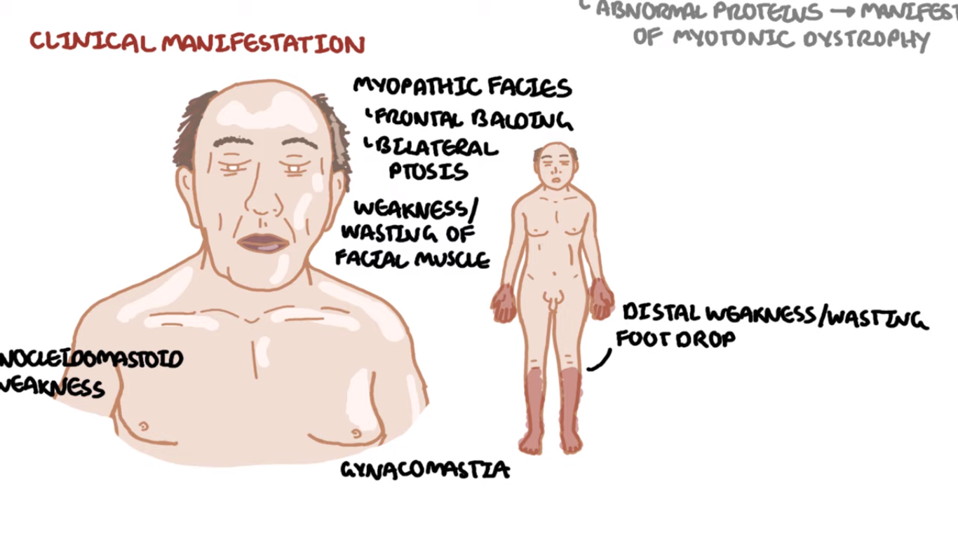

Slide 30
Limb-girdle muscular dystrophies
These preferentially affect the proximal musculature of the trunk and limbs.
Their genetic basis is heterogeneous.
The growing list includes at least 7 dominant subtypes and 15 autosomal recessive subtypes.
Some of the responsible mutations affect components of the dystrophin-glycoprotein complex other than dystrophin. Others affect proteins involved in vesicle transport and repair of cell membrane after injury (caveolin-3 and dysferlin), cytoskeletal proteins, or posttranslational modification of dystroglycan, a component of the dystrophin-glycoprotein complex.

Slide 31
Emery-Dreifuss muscular dystrophy (EMD):
A genetically heterogeneous disorder caused by mutations affecting structural proteins found in the nucleus.
An X-linked form results from mutations in the gene encoding the protein emerin, whereas an autosomal dominant form is caused by mutations in the gene encoding lamin.
It is hypothesized that defects in these proteins compromise the structural integrity of the nucleus in cells that are subjected to repetitive mechanical stress (e.g., cardiac and skeletal muscle).

Slide 32
Emery-Dreifuss muscular dystrophy (EMD):
These proteins may also regulate chromatin structure and there by affect gene expression patterns.
The clinical picture is characterized by progressive muscle weakness and wasting, contractures of the elbows and ankles, and cardiac disease. The cardiac involvement is severe, being associated with cardiomyopathy and arrhythmias that lead to sudden death in up to 40% of patients.

Slide 33
Facioscapulohumeral dystrophy:
Autosomal dominant form of muscular dystrophy that is caused by complex genetic changes that allow expression of the transcription factor DUX4 that is normally repressed in mature tissues.
Thought to be caused by over expression of DUX4 target genes.
Most patients become symptomatic by the age of 20 years, usually owing to weakness in the facial muscles and the shoulder.
weakness in the lower trunk and the dorsiflexors of the foot.
Most affected persons have a normal life expectancy.

Slide 34
Acquired Disorders of Skeletal Muscle
A diverse group of acquired disorders may manifest with muscle weakness, muscle cramping, or muscle pain.
These include inflammatory myopathies, toxic muscle injuries, post-infectious rhabdomyolysis, and muscle infarction in the setting of diabetes.
In most instances these are disorders of adults with acute or subacute onsets.

Slide 35
Inflammatory Myopathies (Polymyositis)
Autoimmune disorder associated with increased expression of MHC class I molecules on myofibers and predominantly endomysial inflammatory infiltrates containing CD8+ cytotoxic T cells.
The autoimmune attack leads to myofiber necrosis and subsequent regeneration.
Patients with polymyositis are often successfully treated with corticosteroids or other immunosuppressive agents.

Slide 36
Dermatomyositis:
The most common inflammatory myopathy in children, in whom it appears as an isolated entity.
In adults, it often manifests as a paraneoplastic disorder. In both contexts, it is believed to have an autoimmune basis.
The disease is typically associated with skin manifestations, as implied by the name, and may also have systemic manifestations such as interstitial lung disease.
On microscopic examination and ultrastructural studies, it is associated with perivascular mononuclear cell infiltrates with plasma cells, “dropout” of capillaries, the presence of so-called “tubuloreticular inclusions” in endothelial cells, and myofiber damage.

Slide 37
Dermatomyositis:
As with some other autoimmune diseases such as SLE, type 1 interferon-induced gene products are strongly upregulated in affected muscles
Some patients have autoantibodies that are relatively specific for dermatomyositis; these include antibodies against Mi-2 (a nuclear helicase) and p155 and p140, proteins with uncertain functions.

Slide 38
Gottron's papules. Discrete erythematous papules overlying the metacarpal and interphalangeal joints in a patient with juvenile dermatomyositis

Slide 39
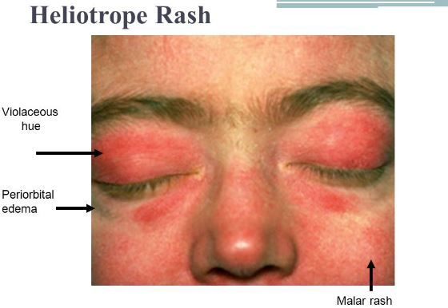

Slide 41
Inclusion body myositis:
The most common inflammatory myopathy in patients older than 60 years of age.
The morphologic hallmark of inclusion body myositis is the presence of rimmed vacuoles that contain aggregates of the same proteins that accumulate in the brains of patients with neurodegenerative diseases—hyperphosphorylated tau, amyloid derived from β-amyloid precursor protein, and TDP-43 leading some to speculate that this is a degenerative disorder of aging. Other features typical of chronic inflammatory myopathies, including myopathic changes, mononuclear cell infiltrates, endomysial fibrosis, and fatty replacement, also are evident.
The disease follows a chronic, progressive course and generally does not respond well to immunosuppressive agents, another feature suggesting that inflammation is a secondary event.

Slide 43
Toxic Myopathies
A number of causative insults including intrinsic factors (e.g., thyroxine) and extrinsic factors (e.g., acute alcohol intoxication, various drugs).
Drug myopathy can be produced by a variety of agents. For example, myopathy is the most common complication of statins (e.g., atorvastatin, simvastatin, pravastatin), occurring in approximately 1.5% of users. Two forms of statin associated myopathy are recognized: (1) toxicity of the drug and (2) statin-induced HMG-CoA reductase autoantibodies causing an immune mediated myopathy.

Slide 44
Thank you
Your questions

