Slide 1
Polycystic kidney disease 12/10/2022 by : Ahmad Alhusami , auwid alshraah , Khalil alsoud

Slide 2
Anatomy
The two kidneys lie on the posterior wall of the abdomen, outside the peritoneal cavity.
▪ The kidney is surrounded by thin, but tough capsule.
▪ The renal artery, vein, lymphatics, nerve supply and ureter enter the kidney at the hilum on its medial side
▪ The renal mass is divided into 2 major regions: outer cortex and inner medulla

Slide 3
Overview kidney function
The kidneys have several major regulatory functions, which include:
regulation of water and electrolyte balance: - For regulation of homeostasis
excretion of metabolic waste products
Endocrine function of the kidney: a. Regulation of erythrocyte production:
4- regulation of arterial blood pressure: renrenin-angiotensin aldosterone system.
5- regulation of acid-base balance
6- gluconeogenesis: - The kidneys synthesize glucose from amino acids during prolonged fasting and add it to the blood. - This helps to maintain blood glucose concentration.
7- Secretion of prostaglandins (PGE2, PGI2) and bradykinins. - These act as paracrine hormones that play important role in the regulation of the renal blood flow.

Slide 4
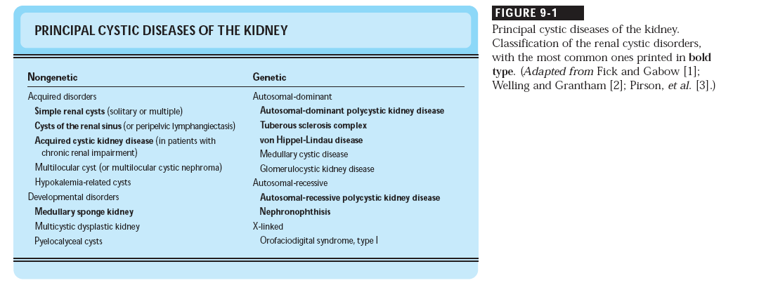

Slide 5
Simple renal cysts
The most common renal masses
Solitary, multiple and bilateral
Occur most often over age 50
Often seen on screening ultrasound exam
Range in size from less than 1cm to 10cm
Usually do not compromise renal function
Notes:
Serous filled, no septation or division of the cyst (sig malig)

Slide 6
Simple renal cysts
Usually one epithelial layer without renal elements
Differential diagnosis: rule out more serious disorders
Polycystic kidney disease: family history, bilateral, gross hematuria, infection
Loculated cystic disease: is an uncommon, non-familial, non-progressive disease characterized by clusters of cysts within the normal renal parenchyma unilateral
Malignancy: thickened irregular walls, septae, enhance with contrast, multilocular mass
Notes:
Rule out PKD with family history, history of chronic urine infections, and blood in the urine

Slide 7
Simple renal cysts
Treatment: Usually none required
Pain: rare,> Acetaminophen, NSAIDs short course if renal function preserved
Not commonly to aspirate the cyst and do surgery
Infection: Rare
Notes:
Cysts do not usually get large enough to cause pain
If they do aspirate them

Slide 8
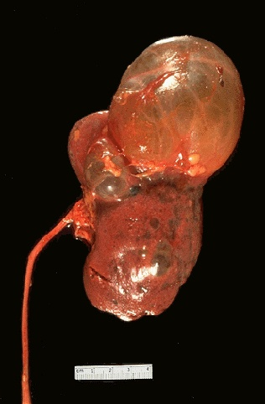
Simple Cyst
Notes:
Clear, smooth
Only on the cortex, not the medulla

Slide 9
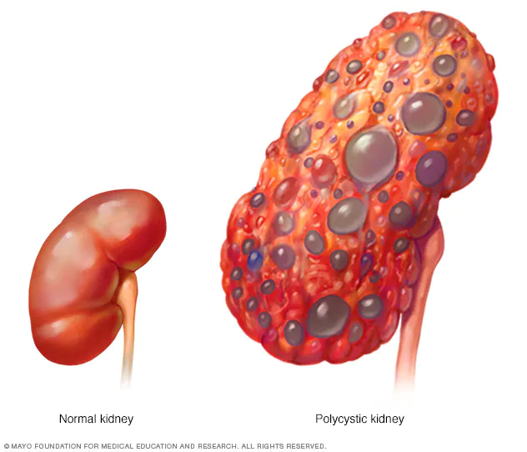
Polycystic kidney disease
Autosomal dominant polycystic kidney disease
Autosomal recessive polycystic kidney disease

Slide 10
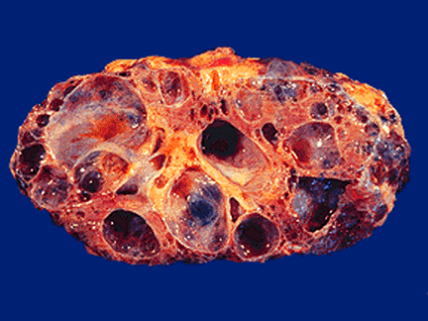
Autosomal dominant polycystic kidney disease
Definition
Autosomal dominant polycystic kidney disease (ADPKD) : is a multisystem disorder characterized by multiple, bilateral renal cysts and associated with cysts in other organs, such as liver, pancreas, and arachnoid membranes.
It is a genetic disorder caused by mutations in Caused by mutations identified in
1) germline and somatic PKD1 and/or PKD2 mutations,
(2) mutations of genes (e.g., SEC63, SEC61B, GANAB, PRKCSH, DNAJB11, ALG8, and ALG9) in the endoplasmic reticulum protein biosynthetic pathway,
or (3) somatic mosaicism.
Although benign (nongenetic) renal cysts are common with aging, an underlying inherited disease should be suspected in patients with multiple bilateral renal cysts, even if the renal function is normal.

Slide 11
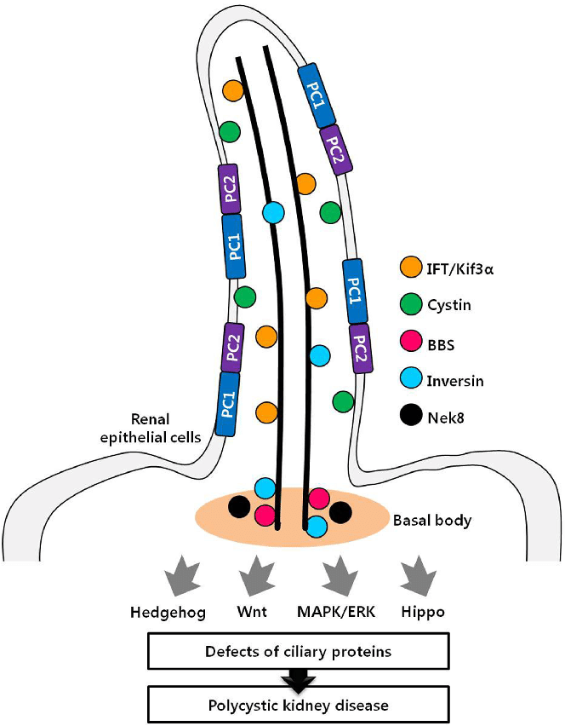
ETIOLOGY AND PATHOGENESIS
The common ADPKD proteins, polycystin-1 and polycystin-2, play a critical role in the normal function of the primary cilium that is essential to maintaining the differentiated phenotype of tubular epithelium.
Genetic Mechanisms
ADPKD is genetically heterogeneous with two common genes, PKD1 (chromosome 16) and PKD2 (chromosome 4). Recently, mutations in a third gene, GANAB, have been identified in families with mild polycystic kidney and more variable polycystic liver disease (PLD).
Polycystic Kidney Disease Proteins Polycystin-1 (PC1; PKD1 protein) and polycystin-2 (PC2; PKD2 protein) belong to a subfamily of transient receptor potential (TRP) channels
The course is variable, but ESRD commonly develops in 50% of the patients (by late 50s or 60s); the remainder have a normal lifespan. Renal failure occurs from cysts replacing renal parenchyma over time, as well as recurrent episodes of pyelonephritis and nephrolithiasis.

Slide 12
Polycystin-1
Polycystin-1 is localized in renal tubular epithelia, hepatic and pancreatic ducts, and all sites of cyst formation in ADPKD
It is an integral membrane protein, found primarily in plasma membranes
It is over-expressed in most but not all cysts in kidneys from patients with ADPKD
Notes:
A membrane protein → When overexpressed → secretes Na and Cl → allows cysts to get bigger and bigger → Eventually breaks of nephron and becomes its own entity

Slide 13
ADPKD pathophysiology
PKD 1 gene codes a large and complex protein (polycystin-1)
Polycystin 1 acts as a receptor that binds to and activates polycystin 2 leads to rapid flux of Ca++ through cell membrane cation channels
G- protein binding site is activated
Normal tubular morphogenesis and growth
Mutations in the polycystic gene with promote abnormal growth of cysts
A second “hit” or somatic mutation of the allele inherited from the normal parent is required for cyst formation
Notes:
Thought to be second hit mutation

Slide 14
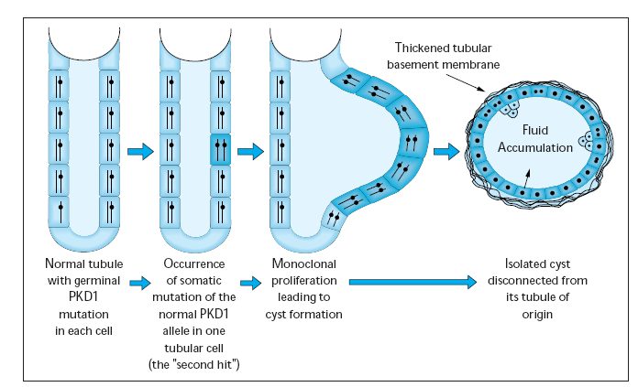

Slide 15
It has been proposed that the high-sodium cysts might derive from the proximal tubule (particularly in cysts with a sodium concentration similar to that in the plasma) while the low-sodium cysts might derive from the distal nephron (the site at which a low urine sodium concentration is normally achieved)

Slide 16
EPIDEMIOLOGY
ADPKD occurs worldwide and in all races, with a prevalence of genetically affected individuals at birth estimated at 1 in 400 to 1 in 1000
The proportion of end-stage renal disease (ESRD) caused by ADPKD is less among African Americans than among Whites because of a higher incidence of other causes of ESRD.
Yearly incidence rates for ESRD caused by ADPKD in men and women, respectively, are 8.7 and 6.9 per 1 million (1998 to 2001, United States), 7.8 and 6.0 per million (1998 and 1999, Europe), and 5.6 and 4.0 per million (1999 and 2000, Japan).
recent genotype/phenotype studies suggest more progressive disease in men than in women.14,15 In recent studies, the age of onset of ESRD has increased in both genders; and all-cause mortality has decreased, possibly because of improved detection and control of hypertension

Slide 17
Clinical Features
1. Hematuria: usually visible and thought to be due to rupture of cysts into the
collecting system -May be macroscopic Incidence 35-50%
Macroscopic hematuria associated with worse outcome
2. Abdominal pain: sources include pyelonephritis, stones, and hemorrhaging into
cysts
3. HTN (in >50% of the cases)
4. Palpable kidneys on abdominal examination
5. Complications/associated findings
a. Intracerebral berry aneurysm (in 5% to 20% of cases)—most do not rupture
b. Infection of renal cysts; bleeding into cysts
c. Renal failure (late in the disease)
d. Kidney stones -Up to 20% of patients
>50% uric acid
Rest is mostly calcium oxalate

Slide 18
e. Heart valve abnormalities (especially mitral valve prolapse)
f. Cysts in other organs (liver, spleen, pancreas, brain)
g. Diverticula (colon)
h. Hernias (abdominal/inguinal

Slide 19
Extra-renal manifestations
Cerebral Aneurysms
4% young adults up to 10% in older patients
Role of screening uncertain (MRI vs CT angiogram)
High risk patients: family history, require anticoagulation, pre-op, high risk occupation, symptomatic patients
Hepatic cysts (most common extra-renal manifestation)
Occur later than renal cysts, increase with age
Cardiac valve disease: 25-35% of patients
Colonic diverticula: seen more in patients on dialysis
Abdominal wall inguinal hernias
Notes:
High risk pts for cerebral aneurysms
- Those with a fam hist of PKD and those who have had a massive stroke and died in their family

Slide 20
C. Diagnosis
1. Ultrasound is confirmatory—multiple cysts appear on the kidney.
2. CT scan and MRI are alternatives.
ADPKD: U/S Diagnostic Criteria

Slide 21
D. Treatment
1. No curative therapy is available.
2. Drain cysts if symptomatic.
3. Treat infection with antibiotics.
4. Control HTN and other cardiovascular risk factors

Slide 22
1. Inhibit fluid secretion to slow cyst growth:
Vasopressin V2 receptor antagonists (animals)
blocking sodium channels with the potassium-sparing diuretic amiloride (animals)
? Caffeine restriction (In vitro)
2. Inhibition of cell proliferation
No clinical studies are available
mTOR inhibitors reduces cyst formation and growth in animal models
Notes:
mTOR inhibitors – were used in transplantation
Not good tx options
If have HTN – ACES and ARBS first line

Slide 23
3. Control of hypertension: renoprotection and IC bleeding
4. Cyst drainage: pain control, not for renal function
5. Metabolic acidosis to prevent bone disease and muscle wasting
6. Protein restriction: no benefit
7. Trans arterial embolization/ Ethanol ablation
Notes:
Bone disease – renal osteodystrophy
7. Rarely done

Slide 24
No specific treatment proven to delay progression of ADPKD
Rigorous blood pressure control may slow progression of ESRD and decrease risk of cardiovascular mortality
If no contraindication, ACE-inhibitor should be first line therapy
Statin therapy to reduce risk of cardiovascular disease
Vasopressin receptor antagonists with some in vitro evidence
Increased fluid intake, suppress ADH, inhibit cyst growth
Inc fluids esp with stones
Hemodialysis favored over peritoneal dialysis
Notes:
peritoneal dialysis – do through Abdomen

Slide 25
Mortality
National registry data: similar to other patients with end-stage renal disease and most are due to cardiac causes
One report examined the cause of death in 129 pts
Cardiac 36%
Infection 24%
Neurologic 12% (rupture ICA and bleed)
Cancer 0%
Pregnancy
Fertility rate similar to unaffected family members
Hypertensive women at increase risk of fetal loss
Increase risk of ectopic pregnancy
Notes:
ESRD and ADPKD → cardiac failure most common cause of death

Slide 26
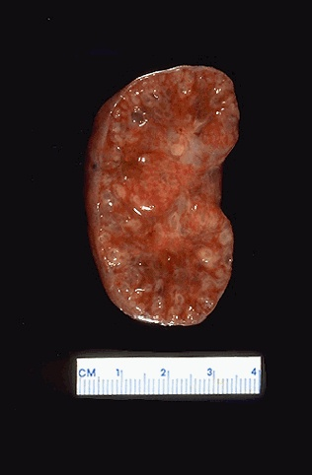
Autosomal Recessive Polycystic Kidney Disease
Definition ARPKD is a severe, typically early-onset form of cystic disease that primarily involves the kidneys and biliary tract. Affected patients have a spectrum of clinical phenotypes that depend in part on the age at presentation

Slide 27
Autosomal recessive PKD
Incidence 1:10,000 – 1:40,000
Always associated with hepatic involvement
Congenital hepatic fibrosis
More severe cases seen on ultrasound in utero
Less severe seen with enlarging kidneys after birth
Patients alive after 1st month have 80% chance of survival to 15 and beyond
Genetic defect on chromosome 6 – PKHD1 gene encodes protein fibrocystin
Found in cortical and medullary collecting ducts
Epithelial cells of bile ducts
Notes:
Already large kidney in utero
Portal HTN by 10yo
Many liver issues
Most common reason die in utero – pulm issues (push on lungs and they do not fully develop)

Slide 28
General Characteristics
1. Autosomal recessive polycystic kidney disease (ARPKD) was previously called
infantile polycystic kidney disease. It is characterized by cysts predominantly in
the renal collecting ducts as well as hepatic fibrosis.
2. It is less common compared to the ADPKD, though the true incidence is unknown
since many affected newborns die without proper diagnosis.
3. As with ADPKD, there is a wide variability in the level of renal impairment.
However, most patients ultimately will experience progressive renal failure.

Slide 29
B. Clinical Features
1. Liver involvement is always present, and may be the dominant clinical feature,
especially in older individuals.
a. Hepatic complications include portal HTN and cholangitis.
2. Kidneys are increased in size which may cause severe abdominal distension.
3. HTN
4. Pulmonary insufficiency secondary to pulmonary hypoplasia and enlarged
kidneys limiting diaphragmatic movement may be severe. Pulmonary
complications are the leading cause of morbidity and mortality in the neonatal
period.
5. Newborns with severe ARPKD may present with Potter syndrome, which is the
constellation of clinical features associated with decreased amniotic fluid
(oligohydramnios). Potter syndrome is characterized by hypoplasia of the lungs,
limb abnormalities (e.g., club feet), and characteristic abnormal facies.

Slide 30
Diagnosis
1-Some cases are detected prenatally due to the widespread use of ultrasound during.
pregnancy. Less severe cases may not be detected until much later.
2. Oligohydramnios during pregnancy usually indicates severe disease.
3. Ultrasound will show characteristic renal cysts in the absence of renal cysts in
either parent. Ultrasound will also show hepatomegaly and dilated bile ducts.
4. Molecular genetic testing may confirm the disease in cases where the diagnosis is
unclear.
D. Treatment
1. No curative therapy is available.
2. Manage respiratory issues in newborns, and treat ESRD with renal replacement
therapy.

Slide 32
acquired cystic kidney disease
ACKD develops as a result of end-stage renal disease or kidney failure. It is generally seen in people on hemodialysis or peritoneal dialysis.
The disease is characterized by the development of numerous cystic fluid-filled sacs that do not have a hereditary history.
Cysts can be mostly bilateral.
When the cyst ruptures, some amount of blood is lost in the urine, causing hematuria.
It can affect both children and adults with kidney failure and on dialysis. Kidney failure causes the development of cysts in the kidneys, and the risk of developing cysts increases with the number of years a person is on dialysis. Sometimes the cysts are harmless and require no treatment, whereas in some cases, there may be associated fever and pain.
These cysts are considered to be a source of dialysis-associated renal cell carcinoma
.

Slide 33
Acquired cystic kidney disease is generally asymptomatic
Symptoms include :
Hematuria - Loss of blood in the urine due to the rupture of cysts.
Uremia - Increase the level of urea in the blood due to kidney impairment.
Flank Pain - Pain in the side of the body is generally associated with the development of cysts.
Fever - The rupture of the cyst can cause the patient to feel pain and develop a fever.
Reduced Appetite - Reduced appetite can be due to renal insufficiency.
Anemia - A decrease in the number of red blood cells can cause anemia.
Weight Loss - Weight loss occurs due to reduced appetite.
Complications
Hemorrhage Into the Cyst - The cyst develops in the renal cortex and is present bilaterally. When the cyst bursts, it leads to loss of blood which then appears in the urine.
Development of Renal Carcinoma - The risk of developing renal carcinoma increases with the length of time a person experiences end-stage renal disease and is on dialysis. The frequency of occurrence is about 7% of the total cases.

Slide 34
Diagnosis
Blood Tests
Urine Tests
Kidney Ultrasound
Computed Tomography (CT) Scan
Magnetic Resonance Imaging (MRI)
Treatment
Treat Infections - The development of cysts can cause infection in the body. Antibiotic therapy is prescribed in order to treat the infection.
Treat Large Cysts - Large cysts can be treated without the need for surgery. The physician uses a long needle to reach a certain area and drain the cyst of its liquid. If a kidney cyst ruptures and causes bleeding in the body, surgery needs to be carried out to stop the flow.
Treat Cancerous Growth - Surgery needs to be done in order to remove the cancerous growth developing in the kidneys
Kidney Transplant - Renal transplant is the best method to avoid dialysis.

Slide 35
Thank you

