Slide 1
Primary Health Care (PHC)
Dr. Israa Al-Rawashdeh MD, MPH, PhD
Faculty of Medicine
Mutah University
2020

Slide 2
Introduction
Primary healthcare is the first contact a person has with the health system when they have a health problem.

Slide 3
Concept
“Essential health care based on scientifically sound and socially acceptable methods, universally accessible to individuals and families with their full participation at a cost that the community and country can afford in a spirit of self-reliance and self-determination”.
WHO 1978
The Alma-Ata declaration
HEALTH FOR ALL

Slide 4
Essential:
It meets the actual health needs of the community (Focus on priorities)
It is comprehensive: includes promotion, curative and rehabilitation care.
It forms continuous care of the population starting from the intra-uterine life to the end of life (from womb to tomb).

Slide 5
Principles of PHC
Equity
Acceptability
Accessibility
Community participation
Appropriate technology
Multi-sectorial approach

Slide 6
1. Equity
Equity is the absence of avoidable (unfair) differences among groups of people, whether those groups are defined socially, economically, demographically, or geographically.
Equitable distribution of healthcare means ‘universal access to health services irrespective of differences’. It also means investing more resources in areas where it is needed more. Higher priority needs to be given to high risk groups (e.g. under-privileged segments and under served areas)
Equitable distribution is the key to attain health for all

Slide 7
To ensure equity
Increase the number of health centers to cover all the population of the community.
Disperse the health services into the remote rural areas and under-served urban ones.
Improve the means of transportation.
Determine the population to be served in the catchment area of the PHC centers and identify the vulnerable groups to be reached through organized out-reach services (such as ethnic minorities , women, children, adolescents, older persons, persons with disabilities ,and populations in rural areas).

Slide 8
2. Acceptability
Acceptability: the extent to which people delivering or receiving a healthcare intervention consider it to be appropriate, based on anticipated or experienced cognitive and emotional responses to the intervention.
Political, economical and social(culture-sensitive) acceptability.

Slide 9
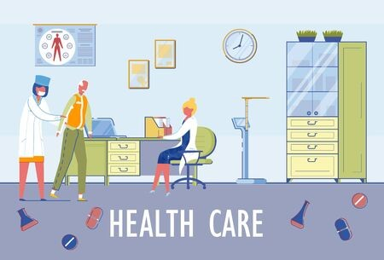
3. Accessibility
Physical accessibility
“is understood as the availability of good health services within reasonable reach of those who need them and of opening hours, appointment systems and other aspects of service organization and delivery that allow people to obtain the services when they need them”.

Slide 10
II. Economic accessibility, or affordability
“is a measure of people’s ability to pay for services without financial hardship. It takes into account not only the price of the health services but also indirect and opportunity costs (e.g. the costs of transportation to and from facilities and of taking time away from work).”
Affordability is influenced by the wider health financing system and by household income.

Slide 11
III. Information accessibility
“Includes the right to seek, receive and impart information and ideas concerning health issues”.
This access to information, however, “should not impair the right to have personal health data treated with confidentiality”.

Slide 12
4. Community participation
The involvement of individuals, families, and communities in promotion of their own health and welfare is an essential ingredient of primary health care.
PHC coverage cannot be achieved without the involvement of community in planning, implementation and maintenance of health services.

Slide 13
4. Community participation
Financial supply to cover the cost of some activities of the PHC (equipment, drugs, audiovisual aids, furniture, etc)
Through adopting healthful behaviours, people can participate in prevention of communicable diseases and in management of non-communicable disease. Examples?

Slide 14
4. Community participation
Appropriate utilization of health services especially maternity care, child care, reporting of births and deaths, curative services at appropriate time), etc.

Slide 15
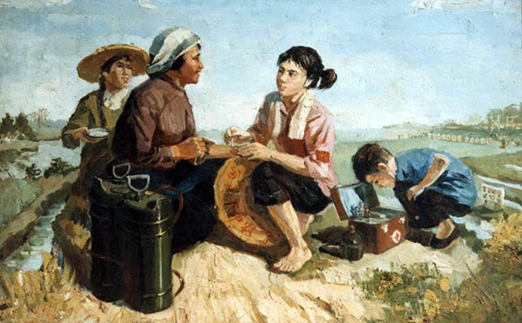
“barefoot doctors” China 1957

Slide 16
Benefits of community participation
People are more likely to accept preventive health care.
It addresses the felt health needs of the people.
It ensures social responsibility among the community.
Increase health awareness of the population.
Community participation is an additional resource to those provided by government so decreases the burden on the government.
It is considered a great support to health care workers.

Slide 17
5. Appropriate technology
Technology that is scientifically sound, adaptable to the local needs, and acceptable to those who apply it and those for whom it is used and can be maintained by the people themselves with the resources of the community and country can afford.

Slide 18
Examples of appropriate technology
ORS instead of expensive intravenous replacement of fluids in mild and moderate dehydration.
Breast feeding in spacing between pregnancies.
Growth charts: these can be maintained by health workers
Vaccine Vial Monitor (VVM) instead of lab testing of potency of vaccine due to possible exposure to heat.
A first-aid kit needs to be devised using appropriate materials easily available locally
Simple safe water measures: o Chlorination with tablets in individual houses in water containers. These are very cheap and available. o Educating the mothers to boil water- ·at least, the water that is to be used for the babies and children under 5 years of age.

Slide 19
6. Multi-sectorial collaboration
In addition to the health sector, all related sectors and aspects of national and community development, in particular education, agriculture, food, industry, education, housing, public works and communication, social development. To achieve cooperation, planning at country level is required to involve all sectors.

Slide 20
Team approach
PHC needs a variety of personnel mainly medical, paramedical and non medical
The team is a group of persons with different levels of knowledge, experience and skills who work together to provide comprehensive services to the individuals, families and community.

Slide 21
Watch
https://www.youtube.com/watch?v=QX7Q0a8GxaA
In Arabic: https://www.youtube.com/watch?v=3MPUs5rMmrc

Slide 22
Who provides PHC?
1. Medical personnel: one or more physician(s) for each center or unit, and a dentist in some centers.
2. Paramedical personnel: nurses, nurse midwives, health visitors, and technicians.
3. Health related personnel: Persons from health related sectors available in the catchment area of the PHC center (agriculture, municipality, school…etc), social workers, sanitarians, food inspectors.
4. Community members including religious leaders, school teachers and social workers..

Slide 23
Elements of PHC
1. Immunization
An increasing number of infectious diseases can be prevented by vaccinations example-measles, Meningitis, Pertusis, tuberculosis, yellow fever etc
2. Maternal and child care
Pregnant women and women of child bearing age (15-49 years) are the target group for special care. Children under 5yrs of age are also vulnerable to childhood killer disease.
3. Essential drugs
The most vital drugs should be available and affordable at all levels.
4. Food and Nutrition
The family’s food should be adequate, affordable and balanced in nutrients.

Slide 24
Elements of PHC
5. Education
The community should be informed of health problem and methods of prevention and control.
6. Illness and injury
Adequate provision of curative services for common illnesses and injuries should be available to the community.
7. Water and sanitation
A safe water supply and the clean disposal of wastes are vital for health.
8. Vector and reservoirs
Endemic infection diseases can be regulated through the control or eradication of vectors and animal reservoir

Slide 25
Significant health gains achieved since the introduction of PHC.
Decrease both infant and under five mortality.
Increase life expectancy for males and females.
Increase vaccination coverage.
Slight improvement in the environmental conditions.

Slide 26
THANK YOU

