Slide 1
بسم الله الرحمن الرحيم
Nervous system histology lap
وَلاَ تَهِنُوا وَلاَ تَحْزَنُوا وَأَنتُمُ الأَعْلَوْنَ إِن كُنتُم مُّؤْمِنِينَ

Slide 2
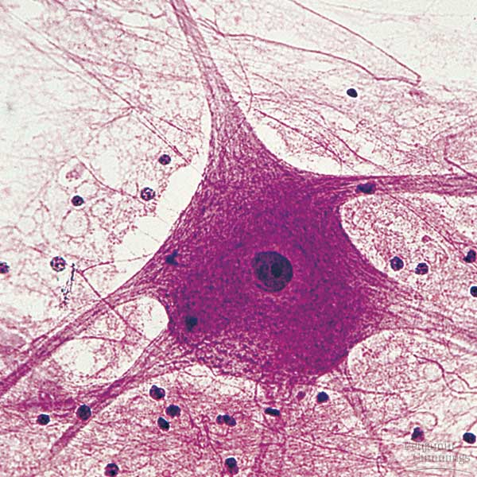
Nerve cell (Neuron) (body)

Slide 3
neuron

Slide 4
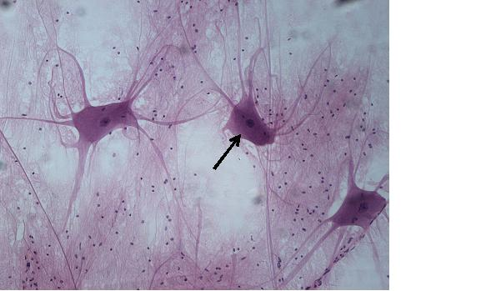
neuron

Slide 5
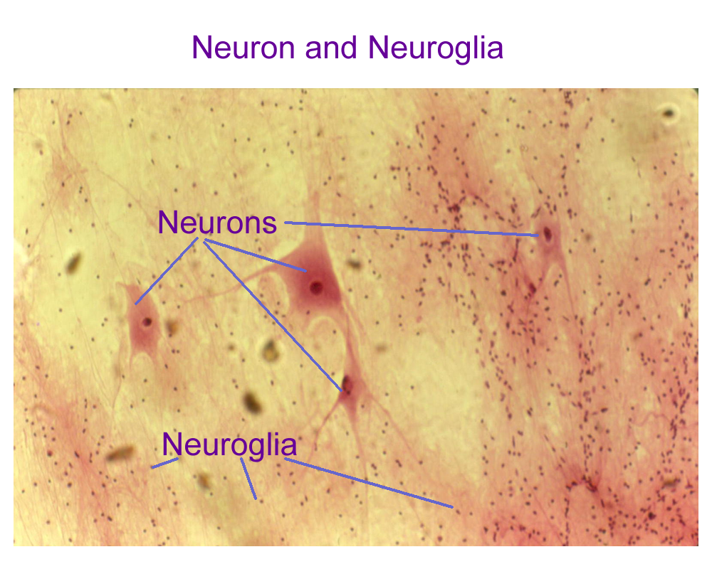
Neuron and surrounded with neuroglia (small nuclie)

Slide 6
Neuron in the spinal card

Slide 7
Neuron notice nissl bodies (in dark color inside the neuron’s body)

Slide 8
Axons and myelin sheath in PN (peripheral nerve) (longitudinal section)

Slide 9
Nerve cross section p:perineurium ma :multi axons

Slide 10
Nerve cross section

Slide 11
Nerve cross section

Slide 12
Nerve cross section H&E stain

Slide 13
Nerve cross section

Slide 14
Nerve cross section osmium fixation stain (van gieson)

Slide 15
Nerve cross section

Slide 16
Nerve cross section

Slide 17
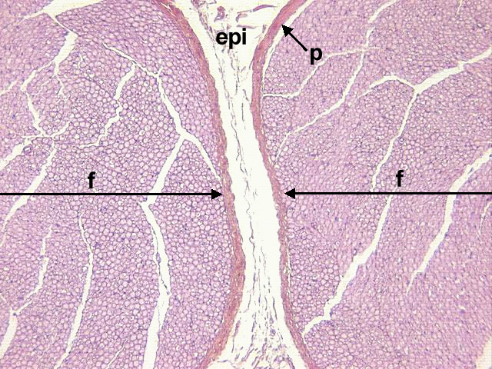
Nerve cross section

Slide 18
Spinal cord cross section

Slide 19
Spinal cord cross section

Slide 20
Neuron in lumber region (spinal cord cross section) gray matter containing the neurons (on left side) white matter on right side

Slide 21
Spinal cord

Slide 23
dh: dorsal horn vh: ventral horn drg: dorsal root ganglion

Slide 24
dorsal root ganglion

Slide 25
A ganglion is a discrete structure, with a well-defined CT outer capsule (C). Inside the ganglion are neuron cell bodies. Neurons have to be wired into the system, of course, so nerve fibers (NF) are always present.

Slide 27
Nerve cross section

Slide 28
Dorsal root ganglia

Slide 29
Sensory ganglia (capsule )

Slide 30
Sensory ganglia

Slide 33
Brain (Cerebrocortical neurons)

Slide 34
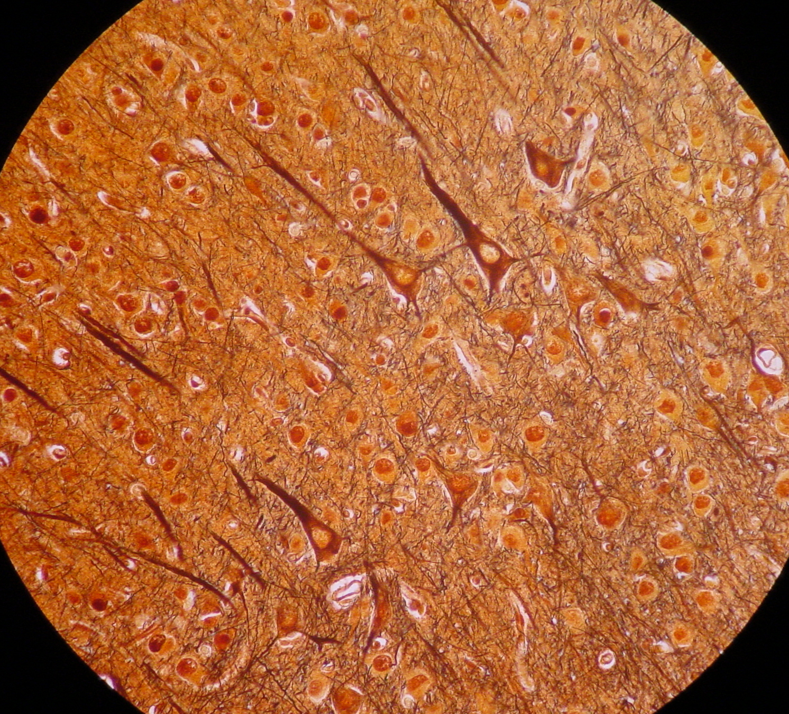
cerebrum

Slide 35
Cerebellum cross section : Purkinge cell

