Slide 1
Presented by:
Mohammed Maaitah
Hala Tarawneh
Mohanad Shabatat
Emad Omari
supervised by:
Dr. Saad azzawi

Slide 2
Skin embryology
A. Epidermis: Ectoderm
B. Dermis: Mesoderm
C. Other cells
1. Melanocytes: Neural crest
2. Merkel cells: Neural cells
3. Langerhans cells: Mesenchymal

Slide 3
Skin histology
A. Epidermis
1. Keratinocytes
a. Primary cell in epidermis
b. Start in basal layer (stratum germinativum or basale)
2. Melanocytes
a. Found in basal layer
b. Protect against ultraviolet (UV) radiation
3. Merkel cells: Mechanoreceptors
4. Langerhans cells: Antigen-presenting cells in stratum spinosum

Slide 4
B. Dermis
1. Cell types: Fibroblast, macrophage, and mast cell
2. Papillary dermis
a. Similar thickness to epidermis
b. High content of type III collagen, less type I
c. Site of collagenase activity.
d. Intertwines with the rete ridges of the epidermis.
e. Contains terminal networks of Meissner corpuscles and capillaries.
3. Reticular dermis
a. Majority of the dermal layer
b. Mostly type I collagen bundles with elastic fibers between
c. Contains roots of the hair, sebaceous glands, sweat glands, receptors, nails, and blood vessels

Slide 5
Skin malignancies
A. Generally grouped into three types (listed from most common to least)
B. Basal cell carcinoma (BCC)
C. Squamous cell carcinoma (SCC)
D. Melanoma
E.Merkel Cell Carcinoma

Slide 6
Basal Cell Carcinoma (BCC) (rodent ulcer)
Incidence
Basal cell carcinoma represents the most common tumor
diagnosed in the United States,with an estimated one million
new cases occurring each year. and the nodular variant is
the most common subtype.

Slide 7
Epidemiology
the most common form of skin cancer in white people. It occurs usually in elderly subjects, in males twice as commonly as in females
The strongest predisposing factor to BCC is ultraviolet radiation.
It occurs in the middle aged or elderly with 90 per cent of lesions found on the face

Slide 9
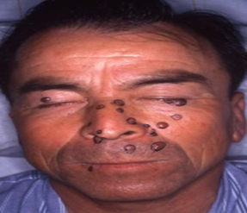
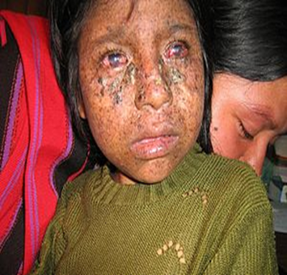
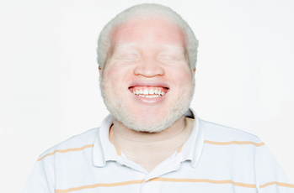

Slide 11
Pathology
Macroscopic, the tumour has raised, rolled but
not everted edges. It consists of pearly nodules over
which fine blood vessels can be seen to course (telangiectasia)
BCC can be divided into localised *(nodular, nodulocystic ,
cystic, *pigmented and naevoid) and generalised lesions. These
lesions can be superficial (multifocal or superficial spreading) or
infiltrative (*morphoeic, ice pick and cicatrising)
Nodular and nodulocystic variants account for 90 per cent of BCC.

Slide 12
A nodulocystic basal carcinoma (BCC). Note the characteristic pearly papules with telangectasia
*An ulcerating BCC on
the lower eyelid.

Slide 13
A recurrent morphoeic BCC

Slide 14
Prognosis
There are ‘high risk’ and ‘low risk’ BCCs.
High-risk BCCs are:
1. Large (>2 cm);
2. Located at sites where direct invasion gives access to the cranium (near the eye, nose and
ear)
3. Recurrent tumours
4. Tumours forming in the presence of immunosuppression;
5. Micronodular or infiltrating histological subtypes.

Slide 15
Treatment can be surgical or non-surgical.
Treatment of BCC varies according to size, location, type, and high- or low-risk. Treatment options include surgical excision, medical, or destructive therapies. Surgical excision should include 4 mm margins for small, primary BCC on cosmetically sensitive areas, and 10 mm margins otherwise.
Mohs’ micrographic surgery : Sequential horizontal excision with immediate frozen section testing by dedicated Mohs dermatopathologist.
Indications include morpheaform BCC and/or lesions in aesthetically sensitive areas (nose, eyelid, lip,ears, etc.)

Slide 16
Other destructive techniques include cryosurgery and laser ablation.
Radiation therapy can be used as adjuvant therapy following
surgery, or as primary therapy in poor surgical candidates with
low-risk lesions,deeply invasive BCC
Topical Pharmaceuticals
Topical imiquimod or 5-fluorouracil have been used for
periods of 6 to 16 weeks for small, superficial BCC of the neck,
trunk or extremities.

Slide 17
2. Squamous cell carcinoma
Second most common skin cancer after BCC.
It is strongly related to cumulative sun exposure, especially in white people, it is more common in men than in women.
It is a malignant tumor, has direct, blood and lymphatic spread.

Slide 18
Risk factors :
1. UV radiation: Sun exposure and tanning booth use, PUVA therapy for psoriasis. 2. chronic inflammation (burns, pressure ulcers, chronic sinus tracts, pre-existing scars, osteomyelitis,) Marjolin’s ulcer: SCC arising in a chronic wound 3. Viral infection: Some types of human papillomavirus (HPV16,18);
herpes simplex virus...especially in oral cavity 4.Chemical carcinogens: such as coal tar, and arsenic . 5. Radiation : Ionizing R 6. Immunosuppression : HIV 7. Genetic predisposition : albinisim, xeroderma pigmentosum. 8. smoking.

Slide 19
Variants of SCC

Slide 20
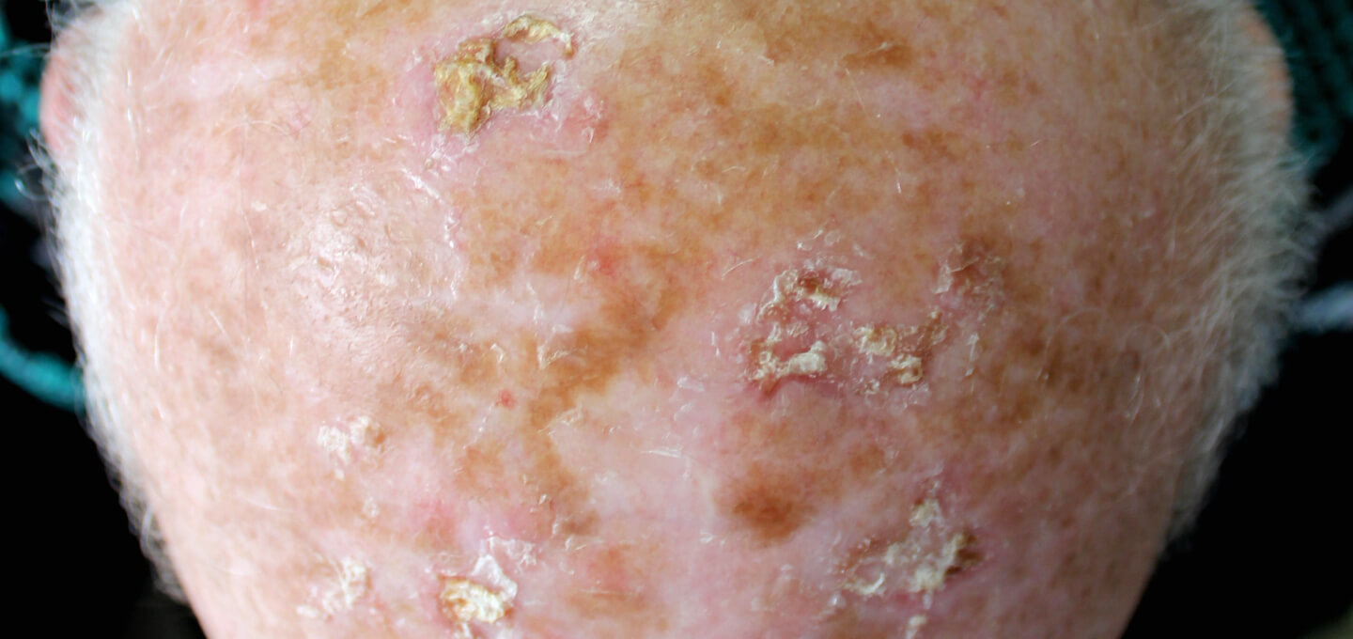
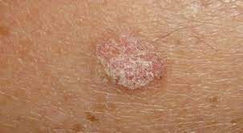
1. Actinic keratoses (AKs, or solar keratoses) - The most common in situ variant of SCC is actinic keratosis
Erythematous macules and papules with coarse, adherent scale and seen in sun exposed areas especially the face, forearms, dorsa of hands, lower legs and bald scalp.
- Histologically resembles SCC (biopsy needed for diagnostic confirmation)
- It is estimated that approximately 10% of actinic keratoses will transform into invasive squamous cell carcinoma, in turn, 60-65% of all SCC arise from sites of Aks

Slide 21
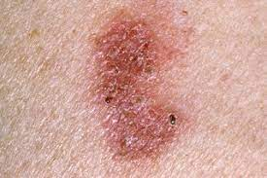
2. Bowen’s disease (SCC in situ)
Bowen’s disease is an SCC confined to the epidermis, and is common below the knees in elderly women Exhibits full-thickness cytologic atypia of the keratinocytes Usually, a solitary patch of red scaly skin, although multiple areas may occur; Bowen’s disease is asymptomatic .

Slide 22
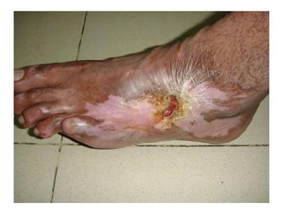
3. Marjolin’s ulcer
SCC arising in areas of chronic wounds (burn, pressure ulcer, fistula, osteomyelitis tracks) are known as Marjolin’s ulcers.
Commonly metastasize to lymph nodes.
- The period between the initial injury and the development of marjolin’s ulcer is 10 - 25 year .(acute majorline ulcer is extremely rare)
Ulcer in post burned lesion

Slide 23
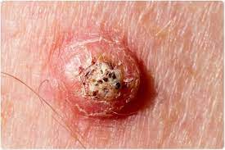
4. Keratoacanthoma - It is now being accepted as a subtype of SCC that is characterized by a rapidly growing nodule with a central keratin plug. - usually found on the face or limbs of chronically sun-damaged 50- to 70-year-old white-skinned individuals -Etiology is unknown but they may be caused by HPV in a hair follicle during the growth phase and are also associated with smoking and chemical carcinogen exposure
-Typically has a rapid 6-week growth phase followed by involution over the next 6 months. However, can progress to SCC in 5% to 10% of cases.
Tx :excision

Slide 24
Macroscopically:
The appearance of SCC may vary from smooth nodular, verrucous, papillomatous to ulcerating lesions. All ulcerate eventually as they grow. The ulcers have a characteristic everted edge and are surrounded by inflamed, indurated skin.

Slide 25
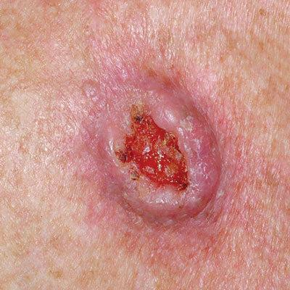
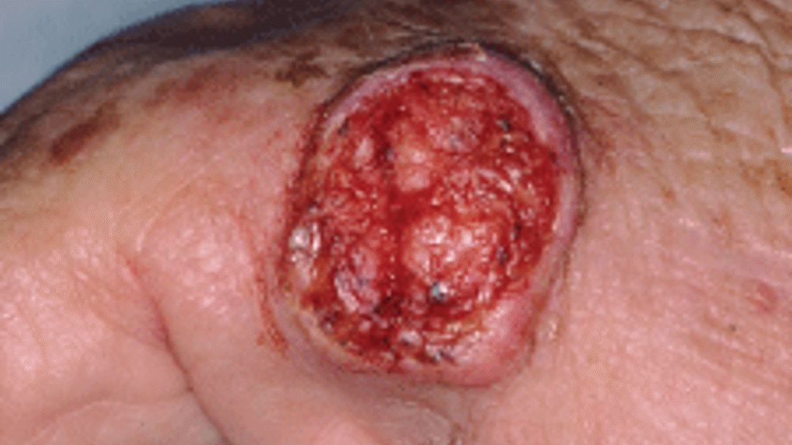
Ulcerative scc ( most common)
- Grows rapidly and is locally invasive.
Has very aggressive growth, raised borders, and central ulceration.
<50% 5-year survival if spread to lymph nodes in the head and neck
SCCs arising spontaneously (de novo) begin as small nodules on the skin. As they enlarge, the center becomes necrotic, sloughs, and the nodule turns into an ulcer.

Slide 26
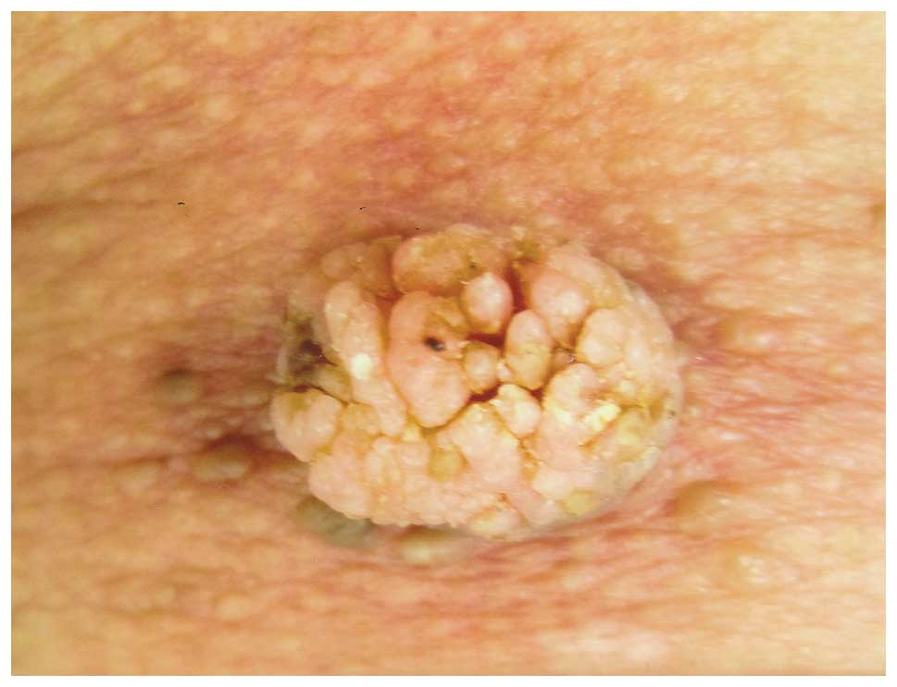
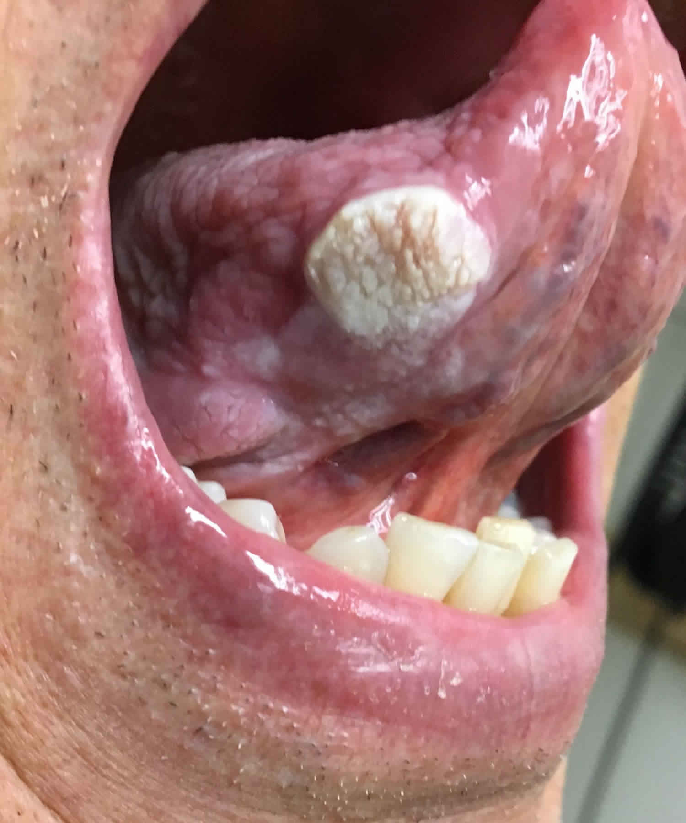
Verrucous scc
Slow-growing, exophytic, and less likely to metastasize.
The most frequently affected site is the oral cavity.

Slide 27
Prognosis
There are several independent prognostic variables for SCC:
1 Invasion:
a. Depth: the deeper the lesion, the worse the prognosis.
For SCC <2 mm, metastasis is highly unlikely; whereas
if >6 mm, 15 per cent of SCCs will have metastasised.
b. Surface size: lesions >2 cm have a worse prognosis than
smaller ones.
2 Histological grade: the higher the Broders’ grade, the worse
the prognosis.
3 Site: SCCs on the lips and ears have higher local recurrence
rates than lesions elsewhere and tumours at the extremities
fare worse than those on the trunk.
4 Aetiology: SCCs that arise in burn scars, osteomyelitis skin
sinuses, chronic ulcers and areas of skin that have been irra- diated have a higher metastatic potential.
5 Immunosuppression: SCC will invade further in those with impaired immune response.
6 Microscopic invasion of lymphovascular spaces or nerve tissue carries a high risk of metastatic disease.

Slide 28
The overall rate of metastasis is 2 per cent for SCC – usually to regional nodes –

Slide 29
Treatment
Surgical excision : is the only means of providing accurate information on histology and clearance. The margins for primary excision should be tailored to surface size in the first instance.
- 4-mm clearance margin should be achieved if the SCC measures <2 cm;
- 1-cm clearance margin if the SCC measures >2 cm
- 95% of local recurrence and regional metastases occur within 5 years, thus follow-up beyond this period is not indicated
2. Mohs surgery : Sequential horizontal excision with frozen section testing.
Highest cure rate for SCC: 94% to 99%.
Indications, include recurrent, high-risk SCC, and/or lesions in aesthetically sensitive areas (nose, eyelid, lip, etc.)

Slide 30
3. Field therapies
are used much less in SCC than in BCC treatment, because of higher risk associated with missed deep tumor portions, and the risk of scarring obscuring SCC recurrences.
Radiation therapy is typically reserved as primary therapy for those who are poor surgical candidates (unresectable lesions or for the very elderly), and as adjuvant therapy after surgical resection for large, high-risk tumors. When used as primary therapy, cure rates may approach 90%. Cosmetic damage and long-term risk of radiation must be considered.

Slide 31
Regional lymphadenectomy
1. Indicated for clinically positive (palpable) nodes.
2. FNA: Confirm spread of SCC to palpable lymph node.
3. ELND: Indicated for a tumor extending down to parotid capsule or a large lesion contiguous with a draining nodal basin.
4. SLN biopsy: Sentinel lymph node dissection may be used in
high risk cases with clinically negative nodal disease
Adjuvant radiation therapy: Used postexcision for high-risk cutaneous SCC.

Slide 32
3 Melanoma
Least common ,most aggressive

Slide 33
Risk factor
1. Phenotypic include : fair skin, freckling, light eye color, and light hair color (stronger risk factor than eye color).
Darker skin is protective against melanoma.
2. Geographic: High altitudes, lower latitudes have increased UV exposure, therefore increased risk
3. Gender: Females have lower risk and better prognosis
4. Race: for African-Americans Incidence is lower, but prognosis is worse, due to delayed diagnosis and/or worse disease subtype
5. Previous melanoma

Slide 34
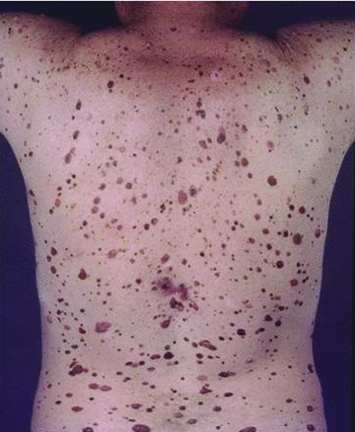
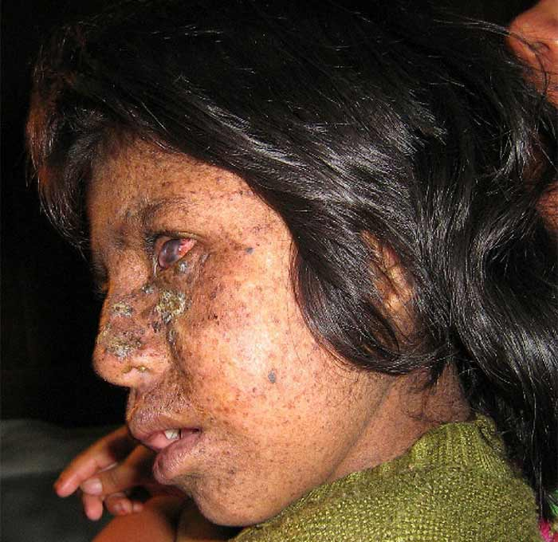
Family history: Vast majority of melanomas are sporadic; however, some
hereditary forms exist
Familial melanoma (aka hereditary melanoma):
Two or more cases of melanoma in first-degree relatives may indicate familial melanoma, autosomal dominant transference with variable penetrance.
b. Dysplastic nevus syndrome (also known as familial atypical multiple mole and melanoma [FAMMM] syndrome):
Patients have a first- or second-degree relative with malignant melanoma and typically have at least 50 melanocytic nevi. Mutations in CDKN2A typical. Patients need vigilant screening.
c. Xeroderma pigmentosum (XP)
i. Heterogeneous group of syndromes; due mutations in various DNA repair genes.
ii. DNA damage by UV leads to early death secondary to metastatic spread
of skin tumors.
iii. Typically presents in childhood with multiple BCCs; SCCs and melanomas
typically cause death.

Slide 35
Precursor lesion
1- Congenital nevi
2-acquired melanocytic nevi
3-dysplastic atypical nevi
4- Melanoma in situ / atypical junctional melanocytic hyperplasia (AJMH)
5- Spitz nevus

Slide 36
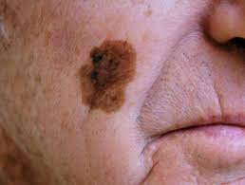
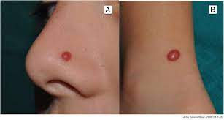

Slide 37
genetic basis of melanoma?
mutation in BRAF gene
germline mutations in CDKN2A and CDK4 gene
Mutation in MC1R gene

Slide 38
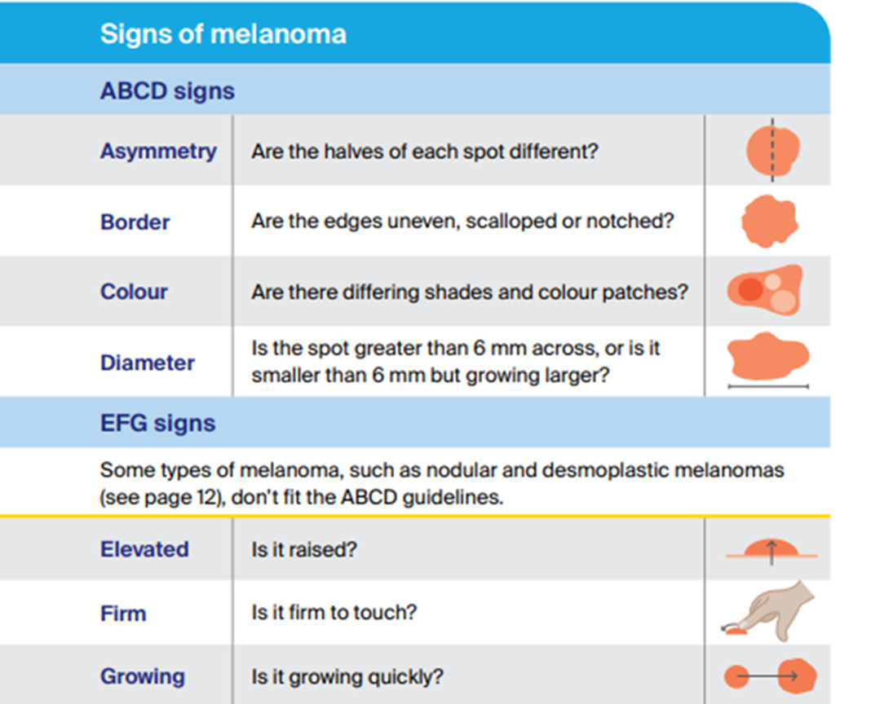

Slide 39
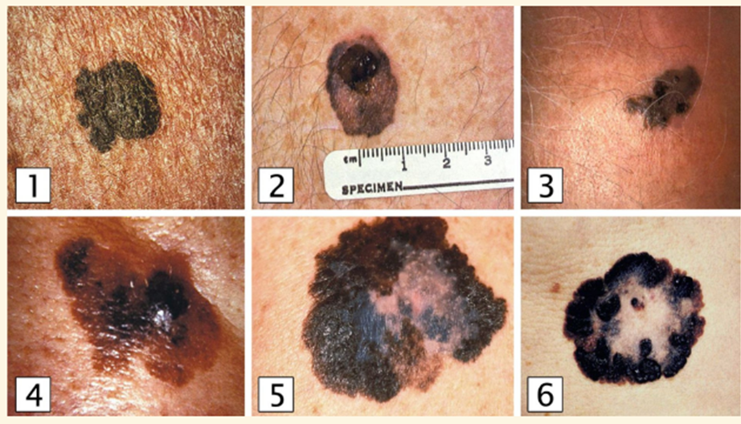
Classification of melanoma types
1. Superficial spreading melanoma
This accounts for 50% to 70% of melanomas and typically arises from a precursor melanocytic nevus.
Affects both genders equally
. Median age at diagnosis is 50 years
Upper back in men and lower legs in women are most common sites
Radial growth phase early, vertical growth phase late
Superficial spreading melanoma can have a variable presentation. According to the ABCDE criteria, these include irregular margins and subtle asymmetry (image 1). In images 2–6, prominent findings are irregular pigmentation and an expanding lesion.

Slide 40
Nodular melanoma
Second most common: 15% to 30% cases
. Most aggressive type
Typically do not arise from preexisting nevi
. Men are affected twice as frequently as women
Median age at diagnosis is 50 years
No clear association with sunlight exposure
Resemble blood blisters or other non-cancerous lesions
Have regular, symmetrical borders
They typically appear as blue/black papules, 1–2cm in diameter, and because they lack the horizontal growth phase, they tend to be sharply demarcated. Up to 5% are amelanotic
Vertical growth phase is a hallmark feature; no radial growth

Slide 41
Lentigo maligna melanoma (LMM)=
Lentigo maligna = is an in situ cutaneous melanoma
that has invaded the dermis or beyond (i.e., that is no longer in situ), is known as lentigo maligna melanoma
was previously also known as Hutchinson’s melanotic freckle
They are positively correlated with prolonged, intense sun exposure, affecting women more than men. They account for between 5% and 10% of MM. LMM are thought to have less metastatic potential than other variants as they take longer to enter a vertical growth phase. Nonetheless, when they have entered the vertical growth phase their metastatic potential is the same as any other melanoma.
The median age at diagnosis is 70 years.
Usually greater than 3 cm in diameter; irregular, asymmetric with color
variegation, areas of regression may appear hypopigmented.
most common location is the cheek.

Slide 42
Acral lentiginous melanoma
LM is the most common subtype of melanoma in darker skinned populations,
affects the soles of feet and palms of hands. It is rare in white-skinned individuals (2–8% of MM) but more common in the Afro-Caribbean, Hispanic and Asian population (35–60%).
It usually presents as a flat, irregular macule in later life. 25% are amelanotic and may mimic a fungal infection or pyogenic granuloma.
d. Irregular pigmentation, large size (>3 cm) common
e. Most common site is great toe or thumb
f. Long radial growth phase, transition to vertical growth phase occurs with high risk of metastasis.

Slide 44
Diagnosis and staging of melanoma
A. Physical examination is only 60% to 80% sensitive for diagnosing melanoma.
Full-body photography to monitor atypical nevi may increase sensitivity.
B. Common clinical features of melanoma lesions: (ABCDE)
1. Asymmetry
2. Border irregularity
3. Color variation
4. Diameter >6 mm
5. Enlarging/evolving lesion

Slide 45
Diagnosis of primary melanoma is made by histologic analysis of full-thickness
biopsy specimens
Excisional biopsy is preferred for lesions <1.5 cm in diameter. If possible, excise lesion with 1- to 3-mm margins.
Incisional biopsy is appropriate when suspicion is low, the lesion is large (>1.5 cm) or is located in a potentially disfiguring area (face, hands, and feet),or when it is impractical to perform complete excision. Incisional biopsy does not increase risk of metastasis or affect patient survival.
Permanent sectioning is used to determine tumor thickness
Avoid shave biopsies, since they forfeit the ability to stage the lesion based on thicken
Clinically suspicious lymph nodes should undergo fine-needle aspiration (FNA)
Orientation of biopsy incisions should also take definitive surgical therapy into consideration.
Extremity biopsies should use longitudinal incisions.
Transverse incisions are sometimes preferable for preventing contractures over joints.
Head and neck incisions should be placed within relaxed skin tension lines,keeping facial aesthetic units in mind.

Slide 46
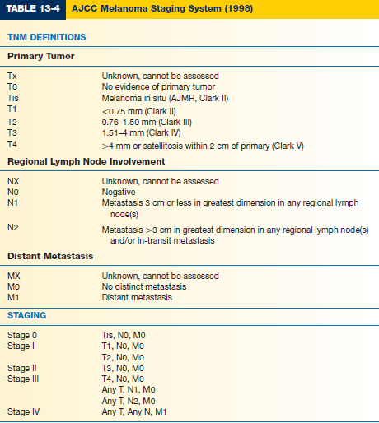
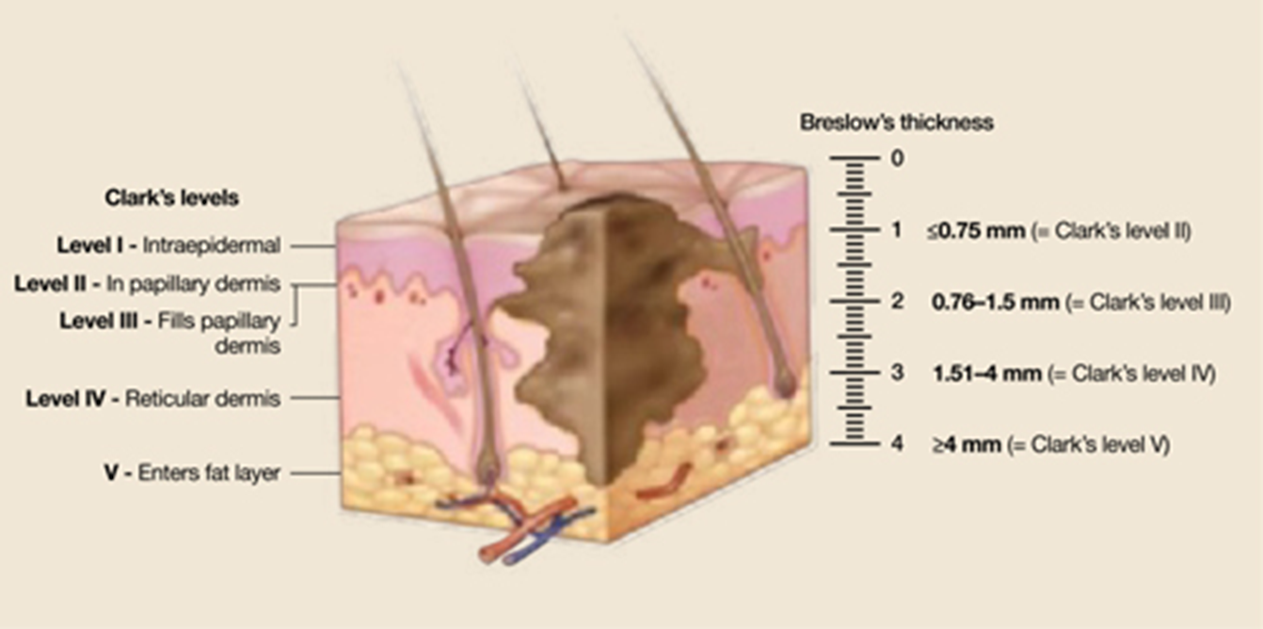
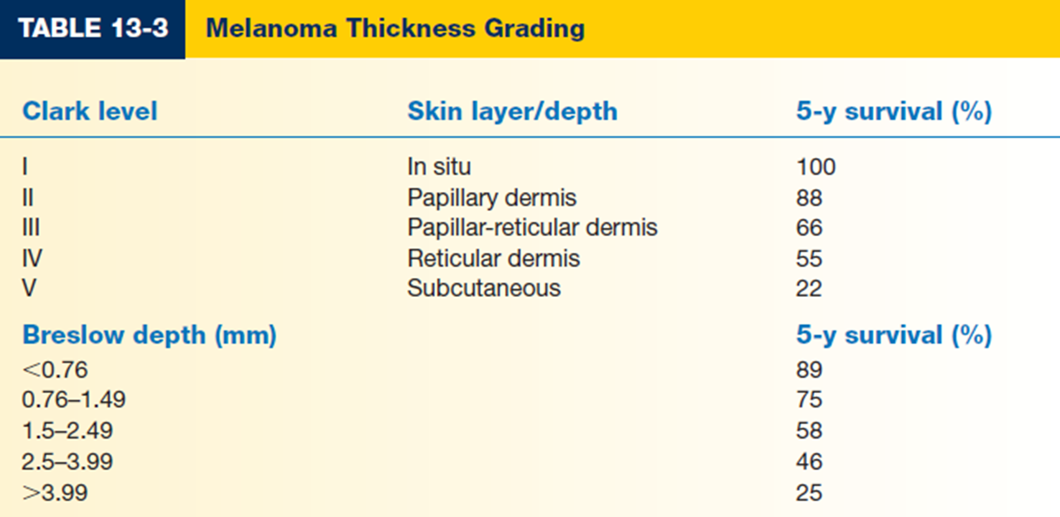
Major prognostic factors:
*TNM : Tumor thickness, Nodal status, and Metastases
Clark level is based on invasion through the histologic layers of the skin; it is more subjective
Breslow thickness is reported in millimeters; thus, it is more accurate and reproducible than Clark level and is a better prognostic indicator.

Slide 47
Other prognostic factors
1. Anatomic location: Trunk lesions generally carry worse prognosis than those
on the extremities.
2. Sex: For a given melanoma, women generally have a better prognosis; women
are also more likely to have extremity melanomas which carry a better prognosis.
3. Ulceration is a poor prognostic sign
4. Lymph node involvement or in-transit metastases are more significant than
any other prognostic factors.

Slide 48
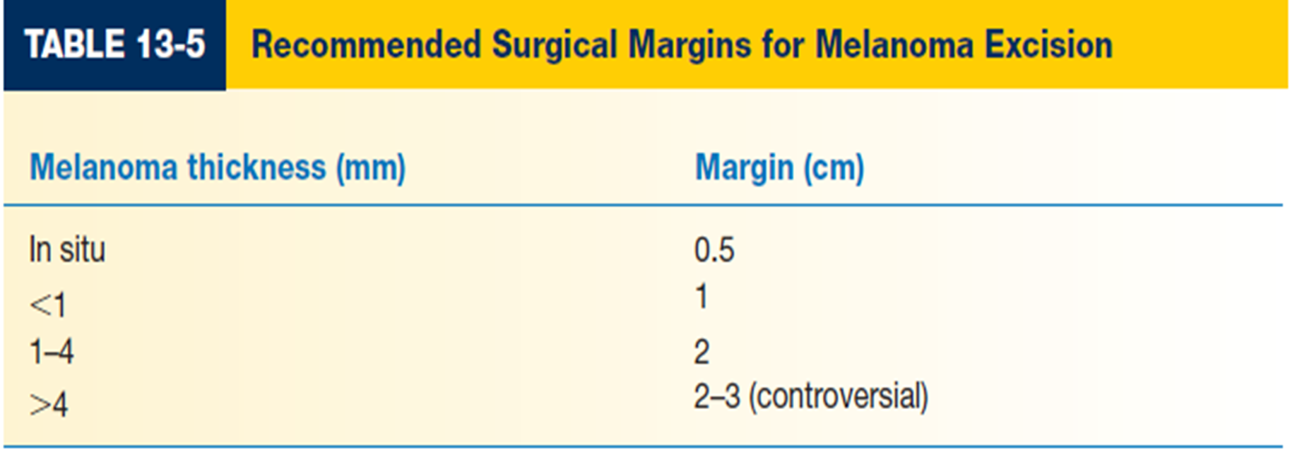
melanoma treatment
Definitive management of melanoma :
1. Wide local excision is the treatment of choice.
2. Recommended surgical margins depend on tumor thickness
3. Subungual melanoma requires amputation proximal to the DIPJ for fingers and proximal to IP joint for the thumb.

Slide 49
Sentinel lymph node biopsy (SLNB)
SLNB is performed in conjunction with wide local excision of the primary tumor. Lymphatic mapping is performed to determine the first lymph node that drains the primary tumor site (sentinel node).
SLNB-positive patients undergo staged regional lymphadenectomy and may be candidates for adjuvant therapy.
Preoperative nuclear imaging is performed with radiolabeled colloid solution (technetium-99) injected intradermally at the primary tumor. This can be done on the day of or day prior to surgery. Lymphoscintigraphic imaging localizes the sentinel node basin(s) (some tumor sites can drain to multiple basins).

Slide 50
In the operating room, a lymphangiography dye (lymphazurin or methylene blue) can be injected intradermally at the periphery of the primary tumor site prior to excision of the primary tumor.
i. Mark edges of the lesion before injection to avoid obscuring them with the dye and take care with the dye because spills are difficult to manage.
ii. Potential sentinel nodes will appear blue when exploring the nodal basin, giving secondary confirmation to localization with Geiger counter detection of Tc99.
iii. Dye injection may briefly interfere with pulse-oximeter readings; alert anesthesiologist at the time of injection.
iv. Caution: Risk of allergy or anaphylaxis with dye injection
f. Following excision of the primary tumor All radioactive (“hot”) and/or blue nodes are excised.
g. Histologic analysis of sentinel node with immunohistochemical staining identifies micrometastases. Permanent sections are required; frozen sections cannot reliably differentiate normal from neoplastic melanocytes.

Slide 51
Chemotherapy:
Complete remission is rare. a. Dacarbazine (DTIC), carmustine , cisplatin, and tamoxifen in combination are most frequently used.
Isolated hyperthermic limb perfusion for extensive cutaneous disease(melphalan and tumor necrosis factor) is used at some centers
Cytokine :
therapy has been demonstrated to produce relatively high levels of tumor response, albeit transient. FDA-approved regimens include interferon-α (IFN-α) for stage III disease and interleukin-2 (IL-2) for stage IV disease; however, these therapies demonstrate little or no improvement in overall survival.

Slide 52
Immunotherapy
Immunotherapy drugs called checkpoint inhibitors use the body’s own immune system to fight cancer. Some people who use checkpoint inhibitors have had very encouraging results, but they do not work for everyone with advanced melanoma .
Targeted therapy
Selective cell-signaling inhibitors (e.g., vemurafenib
If a person has a BRAF mutation, they will get both a BRAF inhibitor and a MEK inhibitor. commonly used combinations include vemurafenib and cobimetinib
Drugs for NRAS and C-KIT mutations may be available through clinical trials

Slide 53
The most common sites of recurrence are the skin, subcutaneous tissues, distant lymph nodes, then other sites (lung, liver, brain, bone, GI tract).
Mean survival with disseminated disease is 6 months. Respiratory failure and CNS complications are the most common causes of death

Slide 54
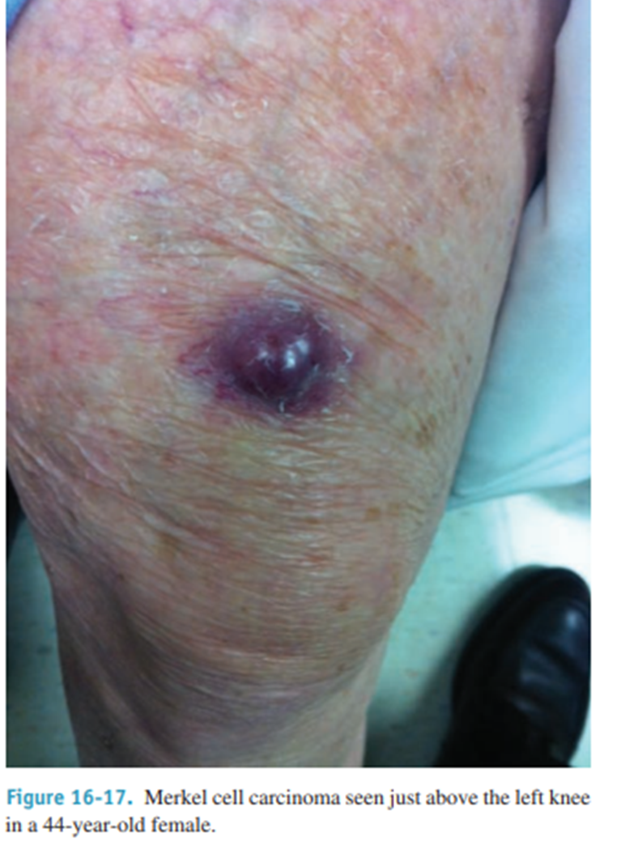
Less common skin cancers
Merkel cell (dermal mechanoreceptor) tumour This is an aggressive malignant tumour of Merkel cells and usually affects the elderly. It is four times more common in women than men
Risk factors include age over 65; history of extensive sunlight exposure; fair skin; and immunosuppression (HIV; organ transplants).
Recent research has implicated Merkel cell polyomavirus in 80% of MCC cases
Presents as a purple to red papulonodule or indurated plaque; 50% involve the head and neck, 40% the extremities, and 10% the trunk.
MCC is aggressive, with radial spread, high local recurrence, and regional and systemic metastasis.
Treatment involves local excision with wide (up to 3 cm) margins; SLN biopsy, and postoperative radiation started several weeks later.
Poor prognosis; 50% survival at five years.

Slide 55
THANK YOU
Sources and references :
‪Schwartz’s Principles of Surgery eleventh edition.
Bailey & Love's Short Practice of Surgery
uptodate
Past material

