Slide 1
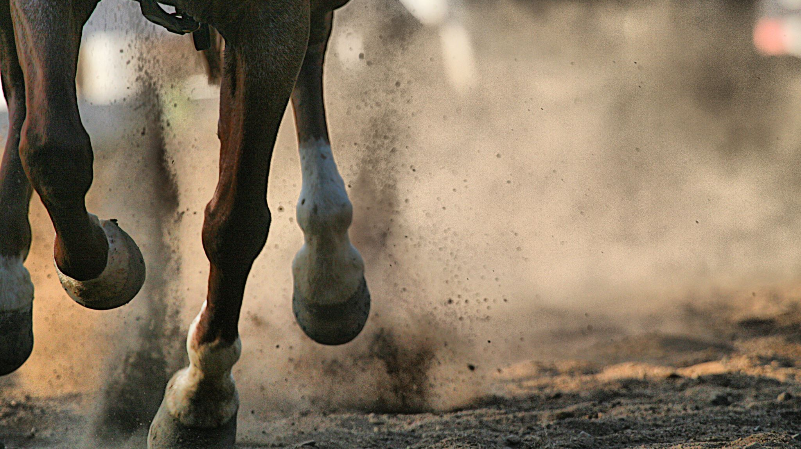
NERVES OF THE LOWER LIMBOF THE LOWER LIMB
Dr. Amal Albtoosh

Slide 2
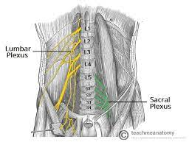

Slide 3
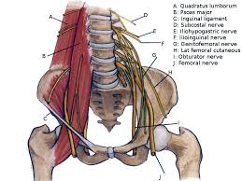
Lumbar plexus
Is formed by the union of the ventral rami of the first three lumbar nerves and a part of the fourth
lumbar nerve.
(other references: It is formed by the divisions of the first four lumbar nerves (L1-L4) and from contributions of the subcostal nerve (T12), which is the last thoracic nerve.
Lies anterior to the transverse processes of the lumbar vertebrae within the substance of the psoas muscle.

Slide 4
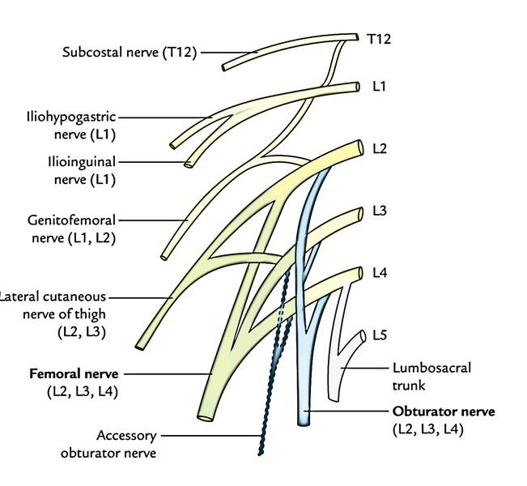

Slide 5
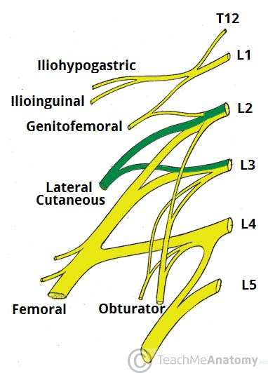
Lateral Cutaneous Nerve of the Thigh
This nerve has a purely sensory function. It enters the thigh at the lateral aspect of the inguinal ligament, where it provides cutaneous innervation to the skin there.
Roots: L2, L3
Motor Functions: .
Sensory Functions: Innervates the anterior and lateral thigh down to the level of the knee.

Slide 6
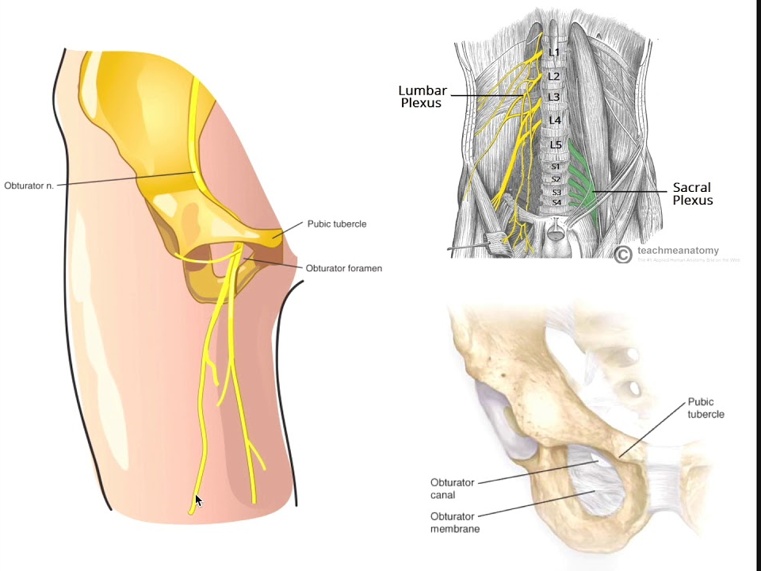
Obturator nerve (L2-L4)
Arises from the lumbar plexus and enters the thigh through the obturator foramen.
Divides into anterior and posterior branches.
1. Anterior branch
• Descends between the adductor longus and the adductor brevis muscles.
• Innervates the adductor longus, adductor brevis, Gracilis, and pectineus muscles.
2. Posterior branch
• Descends between the adductor brevis and the adductor magnus muscles.
• Innervates the anterior obturator externus, adductors brevis and magnus, as well as the knee joint.
An accessory obturator nerve (L3, L4) is present
almost 10% of the time. It parallels the medial border of the psoas, anterior to the obturator nerve, crossing superior to the superior pubic ramus in close proximity to the femoral vein.

Slide 7
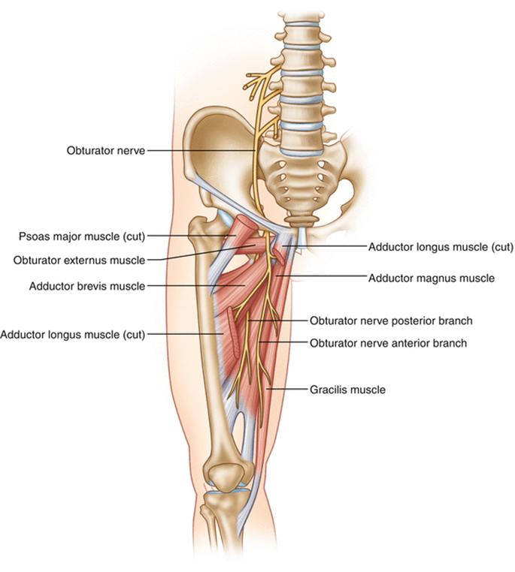
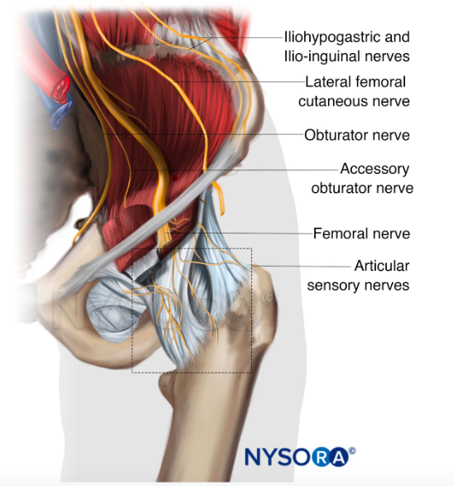

Slide 8
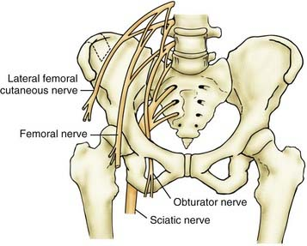
Femoral nerve (L2-L4)
• Arises from the lumbar plexus within the substance of the psoas major, emerges between the iliacus and psoas major muscles, and enters the thigh by passing deep to the inguinal ligament and lateral to the femoral sheath.
• Gives rise to
muscular branch;
articular branch to the hip and knee joints;
and cutaneous branches, including the anterior femoral cutaneous nerve and the saphenous nerve, which descends
through the femoral triangle and accompanies the femoral vessels in the adductor canal.

Slide 9
The lumbosacral trunk (L4, L5) passes over the ala (wing) of the sacrum and descends into the pelvis to participate in the formation of the sacral plexus with the anterior rami
of S1–S4 nerves

Slide 10
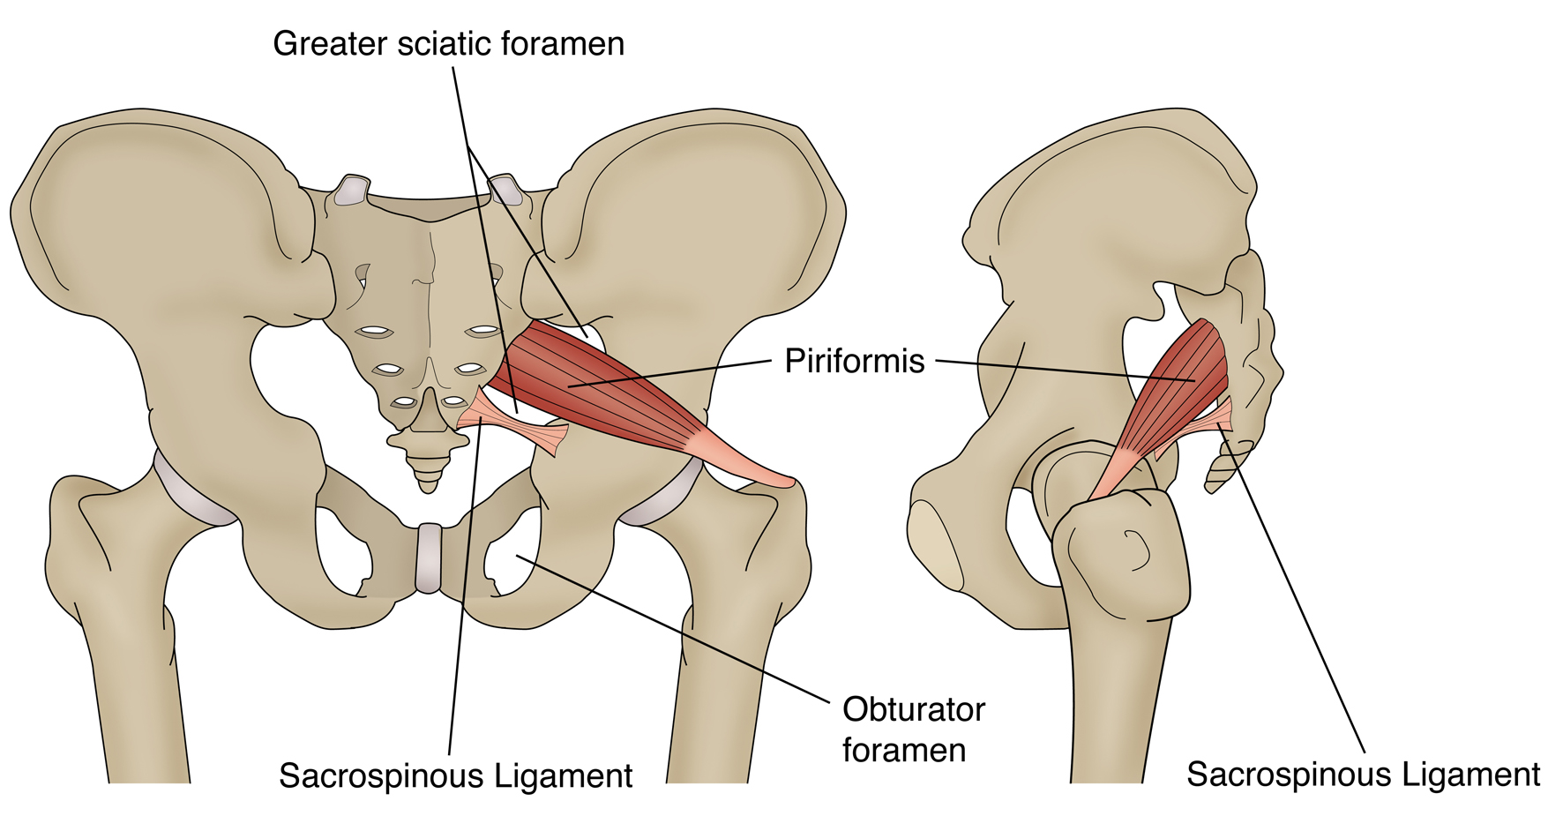
Sacral plexus
The sacral plexus is located on the posterolateral wall of the lesser pelvis.
Most branches of the sacral plexus leave the pelvis through the greater sciatic foramen
Roots: ventral rami of L4- S3 (or S4)

Slide 11
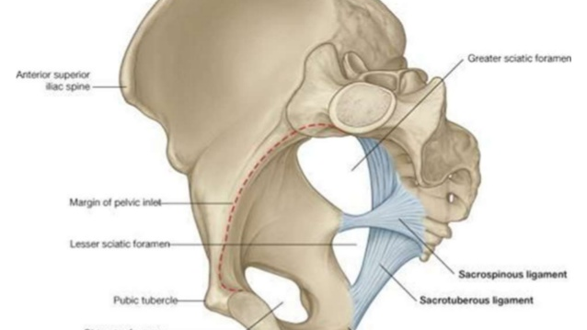

Slide 12
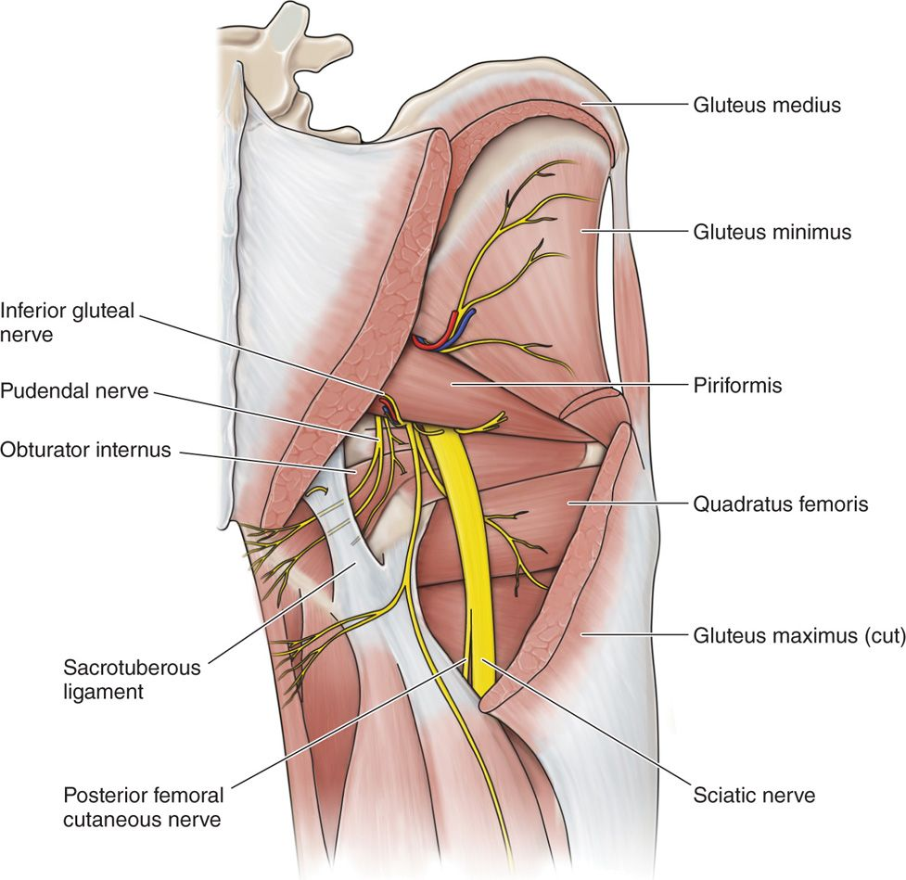
Superior gluteal nerve (L4-S1)
Arises from the sacral plexus and enters the buttock through the greater sciatic foramen above the piriformis.
• Passes between the gluteus medius and minimus muscles, dividing into numerous branches.
Innervates the gluteus medius and minimus, the tensor fasciae latae, and the hip joint

Slide 13
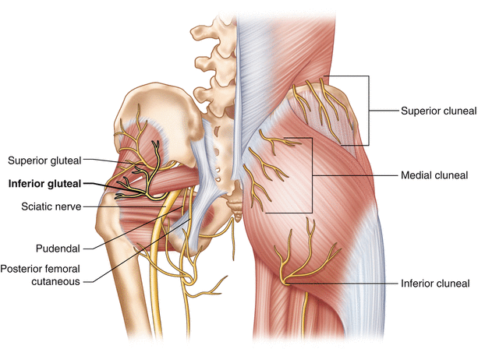
Inferior gluteal nerve (L5-S2)
• Arises from the sacral plexus and enters the buttock through the greater sciatic foramen inferior to the piriformis.
Divides into numerous branches.
• Innervates the overlying gluteus maximus.

Slide 14
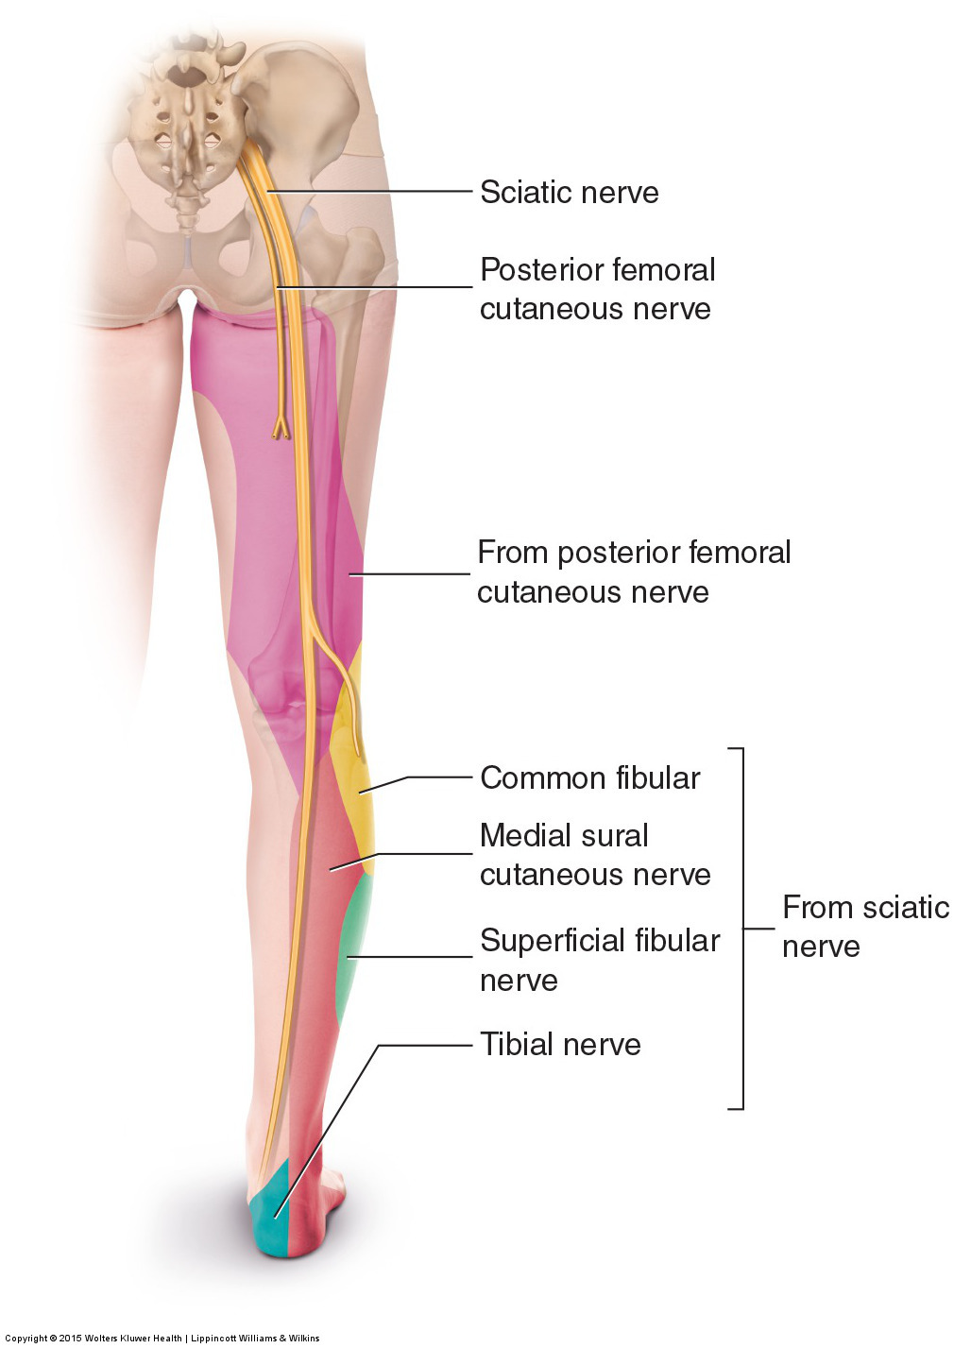
Posterior femoral cutaneous nerve (S1-S3)
• Arises from the sacral plexus and enters the buttock through the greater sciatic foramen below the piriformis.
Runs deep to the gluteus maximus and emerges from the inferior border of this muscle.
Descends on the posterior thigh.
• Innervates the skin of the buttock. thigh, and calf as well as the scrotum or labia majora.

Slide 15
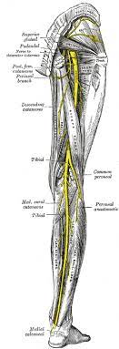
SCIATIC NERVE (L4-S3)
• Arises from the sacral plexus and is the largest nerve in the body.
Enters the buttock through the greater sciatic foramen INFERIOR to the piriformis.
• Descends over the obturator internus, gemelli, and quadratus femoris muscles between the ischial tuberosity and the greater trochanter.
Divides at the superior border of the popliteal fossa into the TIBIAL NERVE, which runs through the fossa to disappear deep to the gastrocnemius,
and THE COMMON FIBULAR NERVE, which runs along the medial border of the biceps femoris and superficial to the lateral head of the gastrocnemius.

Slide 16
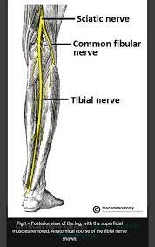
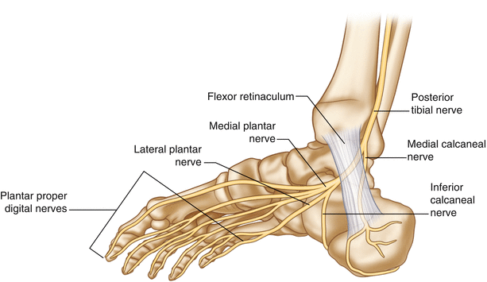
Tibial nerve (L4-S1)
Descends through the popliteal fossa and then lies on the posterior surface of the popliteus muscle.
Gives rise to three articular branches, which accompany the medial superior genicular; middle genicular, and medial inferior genicular arteries to the knee joint.
Gives rise to muscular branches to almost all posterior muscles’ compartments of the thigh and leg.
Gives rise to THE MEDIAL SURAL CUTANEOUS NERVE, the MEDIAL CALCANEAL BRANCH to the skin of the heel and sole, and THE ARTICULAR BRANCHES TO THE ANKLE JOINT.
Terminates deep to the flexor retinaculum where it divides into the MEDIAL AND LATERAL
PLANTAR NERVES.

Slide 17
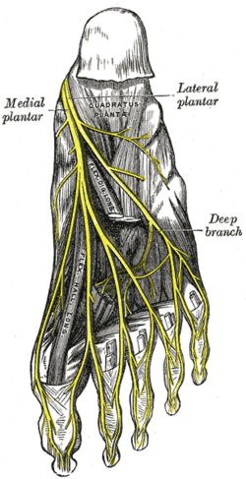
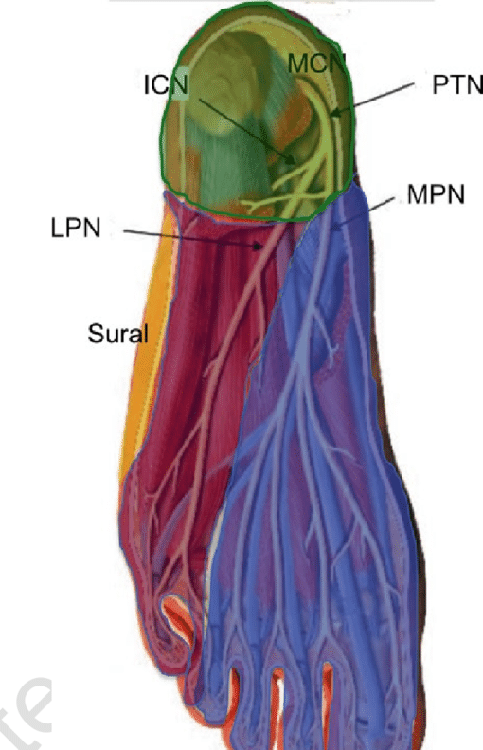
TIBIAL NERVE
(A) MEDIAL PLANTAR NERVE
Arises beneath the flexor retinaculum deep to the posterior portion of the abductor hallucis muscle, as the LARGER terminal branch from the tibial nerve.
Passes distally between the abductor hallucis and the flexor digitorum brevis muscles to innervate them.
Gives rise to common digital branches that divide into proper digital branches, which supply the flexor hallucis brevis, the first lumbrical muscle,
Innervates the skin of the medial three and one half toes.

Slide 18
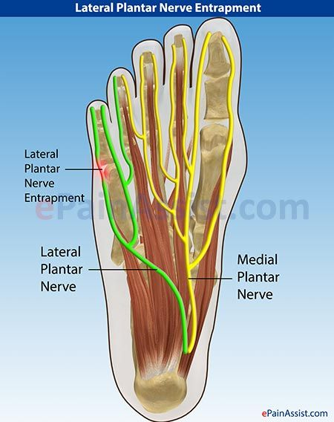
TIBIAL NERVE
B) LATERAL PLANTAR NERVE
Is the SMALLER terminal branch of the tibial nerve.
Runs distally and laterally between the quadratus plantae and the flexor digitorum brevis
Innervating the quadratus plantae and the abductor digiti minimi muscles.
Divides Into a superficial branch, which Innervates the flexor digiti minimi brevis,
and a deep branch, which innervates the plantar and dorsal interossei, the lateral three lumbricals, and the adductor hallucis.

Slide 19
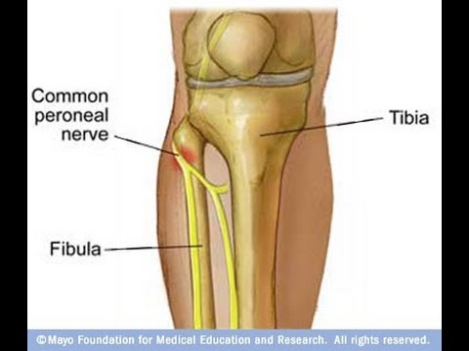
SCIATIC NERVE
COMMON FIBULAR(PERONEAL) NERVE (L4-S2)
Arises as the smaller terminal portion of the sciatic nerve at the apex of the popliteal fossa, descends through the fossa, and superficially crosses the lateral head of the gastrocnemius muscle.
Passes behind the head of the fibula, then winds laterally around the neck of the fibula,
pierces the fibularis longus, where it divides into the DEEP fibular and SUPERFICIAL fibular nerves.
It is vulnerable to injury by it winds around the neck of the fibula, where it also can be palpated.
• Gives rise to the lateral sural cutaneous nerve, which supplies the skin on the lateral part
of the back of the leg, and the recurrent articular branch to the knee Joint

Slide 20
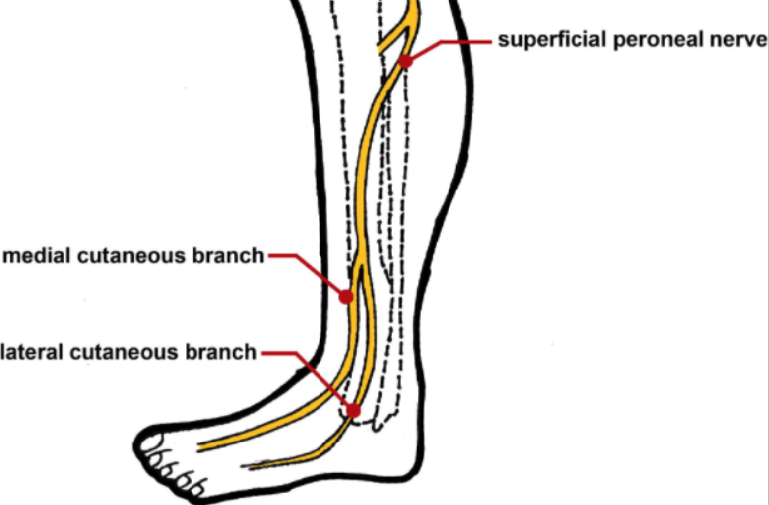
COMMON FIBULAR NERVE
Superficial fibular (peroneal) NERVE
• Arises from the common fibular nerve in the substance of the FIBULARIS LONGUS on the lateral side of the neck of the fibula (where it is vulnerable to injury but less vulnerable than the common fibular nerve).
Innervates the fibularis longus and brevis muscles and then emerges between the two muscles by piercing the deep fascia at the lower third of the leg to become subcutaneous.
• Descends in the lateral compartment and Innervates the skin on the lateral side of the lower leg and the dorsum of the foot

Slide 21
COMMON FIBULAR (PERONEAL) NERVE
B) DEEP FIBULAR (PERONEAL) NERVE
Arises from the common fibular nerve in the substance of the fibularis longus on the lateral side of the neck of the fibula (where it Is vulnerable to Injury but less vulnerable than the common fibular nerve).
Enters the anterior compartment by passing through the extensor digitorum longus muscle.
It then descends deep to the extensor digitorum
longus muscle, first lying lateral, then anterior, and finally
lateral to the anterior tibial artery
The nerve
passes behind the extensor retinacula.
Innervates the anterior muscles of the leg and then divides into a LATERAL BRANCH, which supplies the extensor hallucis brevis and extensor digitorum brevis, and
a MEDIAL BRANCH, which accompanies the dorsalis pedis artery to supply the skin on the adjacent sides of the first and second toes.

Slide 22
