Slide 1
NSII 2021-2022 Group B Streptococcus (galactiae) Mycobacterium Leprae
Dr. Mohammad Odaibat
Mutah university
Faculty of Medicine

Slide 2
Group B streptococcus (Streptococcus Agalactiae )
Characteristics:
Facultative anaerobic encapsulated gram-positive coccus
Produces a narrow zone of β-hemolysis on blood agar
Most strains are bacitracin resistant / hydrolyze hippurate
9 Serotypes: type 3 is commonly associated with neonatal sepsis
Normal flora of throat, colon, urethra and, and in 10-40% of women vagina.
Major virulence factors:
Haemolysin (including CAMP factor)
Polysaccharide capsule
Peptidase and hyaluronidase enzymes

Slide 3
Group B streptococcus (Streptococcus Agalactiae )
Clinically:
1. Non pregnancy associated:
Pneumonia, UTIs, meningitis, infective endocarditis and soft tissue infection (multisystem involvement)
2. Sepsis and septic shock
usually in unhealthy people e.g chronic illnesses,
immunocompromised and elderly

Slide 4
Group B streptococcus (Streptococcus Agalactiae )
Clinically:
2. Pregnancy associated:
MOT (mode of transmission):
Vertical (Ascending from vagina to placenta)
During delivery and birth canal passage of the baby (intrapartum)
Clinically:
Chorioamnionitis
Abortion
Neonatal sepsis: early and late sepsis

Slide 5
Clinical picture / neonatal sepsis
Group B streptococcus (Streptococcus Agalactiae )
Early sepsis:
Risk factors
Group B streptococcus genitally colonized mother
prematurity
Prolonged rupture of membrane (PROM)
Prolonged labour
Maternal Chorioamnionitis, leukocytosis and fever
Previous delivery with GBS disease
Source of bacteria: Ascending or during delivery
Occurs in the first week of life, though most present within the first 48 hrs.
Nonspecific signs (lethargy, cyanosis, apnoea and respiratory distress).
Meningitis, pneumonia and septic shock are common.

Slide 6
Clinical picture / neonatal sepsis
Group B streptococcus (Streptococcus Agalactiae )
Late sepsis:
Absent history of complicated delivery
Usually hospital acquired (medical staff, visitors and mother)
1 week – 3months?
Clinically:
Purulent meningitis is more common than in early
Other systems may also be involved leading to:
Pneumonia, arthritis, endocarditis, osteomylitis, sinusitis and
septic shock and multiorgans failure

Slide 7
Neonatal sepsis / Diagnosis
Group B streptococcus (Streptococcus Agalactiae )
Diagnosis:
1. Clinically
2. Septic work up:
Full Blood Count (FBC), liver function test (LFT), C-reactive protein and CXR
Blood, CSF, appropriate swabs: Culture and stain (CSF protein, cell count and glucose)

Slide 8
Neonatal sepsis / treatment
Group B streptococcus (Streptococcus Agalactiae )
Treatment:
If the mother had a risky delivery then give IV intrapartum antibiotics (Intrapartum antibiotic prophylaxis was defined as adequate when the initial dose of IAP was given at least four hours prior to birth).
Continue antibiotics for 12-24 hrs with the baby and stop if asymptomatic and cultures negative
If the baby is symptomatic / cultures positive, then 2-3 weeks of IV antibiotics and stop pending improvement
Ampicillin + Gentamicin > IV
Cefotaxime, Ceftrixone or clindamycin are alternatives.

Slide 9
Group B Streptococcus M. leprae
Dr. Mohammad abu Lubad
Mutah university
Faculty of Medicine

Slide 10
Objectives
Causative agent.
Background.
Epidemiology
Clinical features & complications.
Diagnosis.
Reservoir, incubation period & transmission.
Treatment .
Control .
Elimination.

Slide 11
What is leprosy
Infectious bacterial disease of the skin, peripheral nerves and mucosa of the upper airway.
Chronic, granulomatous.
Only few from who exposed to infection develop the disease.
Causative agent
Mycobacterium leprae.
Acid fast, rod shaped bacillus.
Stain with Ziehl Neelsen carbol fuchsin.

Slide 12
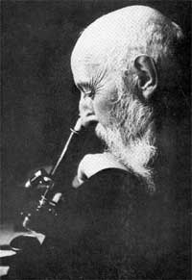
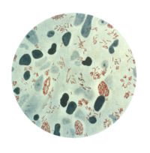
Background
Gerhard Henrik Hansen was a physician who first identified Mycobacterium leprae as the cause of leprosy in 1873
7/29/1841-2/12/1912

Slide 13
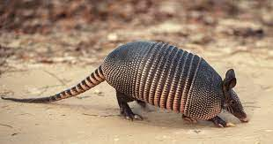
Transmission…
Airborn, contact with infected soil, and insect vectors.
Leprosy is not known to be either sexually transmitted or highly infectious.
People are no longer infectious after as little as two weeks of treatment.
Two exit routes are the:
Skin
Nasal mucosa
The entry routes are the:
Skin
The upper respiratory tract are most likely.
Reservoir: Human being, only known. Similar organisms detected in wild armadillo. History of handling armadillos reported.
Notes:
contact with infected soil, and even insect vectors have been considered the prime candidates.

Slide 14
Epidemiology
Age: All ages, from early infancy to very old age.
Youngest age reported is 1 and a half months.
Sex: Both. Males more than females, 2:1 (equal in Africa).
Risk group: children, people living in endemic areas, in poor conditions, with insufficient diet, or have a disease that compromises their immunity (ie HIV).
People who live in the areas where leprosy is endemic (parts of India, China, Japan, Nepal, Egypt, and other areas)

Slide 15
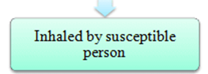
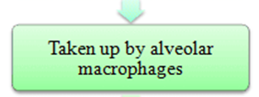
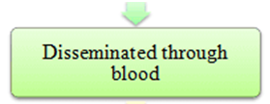
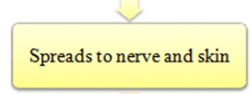
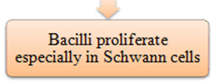
pathogenesis

Slide 16
pathogenesis
The incubation period:
Can vary between 2 and 40 years, although it is generally 5–7 years in duration
M. leprae causes granulomatous lesions resembling those of tuberculosis, with epitheloid and giant cells
The organisms are predominantly intracellular and can proliferate within macrophages, like tubercle bacilli.
Leprosy is distinguished by its chronic slow process and by its damaging lesions.
The organism has a preference for skin and nerves.
Notes:
The incubation period prior to manifestation of clinical disease can vary between 2 and 40 years, although it is generally 5–7 years in durationhis long incubation period is probably, at least in part, a consequence of the extremely long doubling time for M. leprae (14 days in mice versus in vitro doubling times of 1 day and 20 min for M. tuberculosis and Escherichia coli, respectively).

Slide 17
Pathophysiology
M. Leprae
X
Phagocytosis
No fusion
Macrophage
Lyosome
IL-12
T-Helper
IL-2
IFN-gamma
IL-4, 5, 10, 13
Th 1
Th 2
Tc
B cells
Destroy infected cells
with bacteria
Antibodies
Tuberculoid
Lepromatous

Slide 18
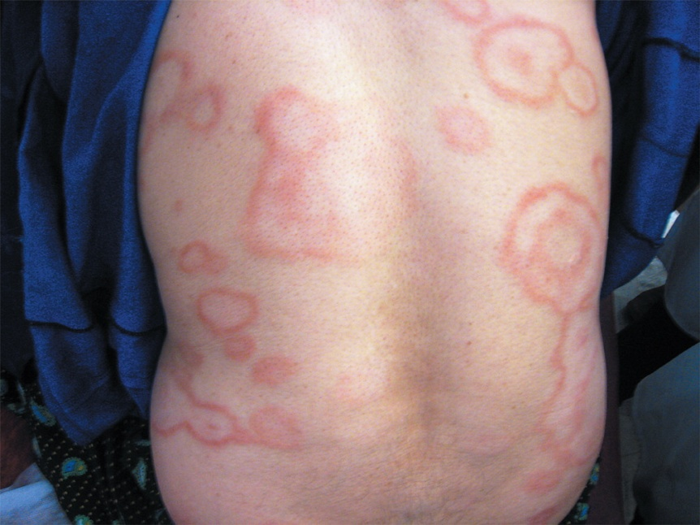
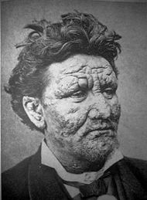
pathogenesis
Tuberculoid form
.
Lepromatous form (Leonine face)

Slide 19
pathogenesis
Tuberculoid leprosy
Skin lesions typically develop in areas of nerve damage.
The skin ulcers occur by
direct action of Mycobacterium leprae on the peripheral nerves, with changes in the sensory, autonomic and motor fibers (neuropathic ulcers).
direct invasion of bacilli in the vascular endothelium, causing vasculitis, cutaneous necrosis and ulcer.
These lesions may have raised and erythematous border with a dry scaly appearance in the center with complete anesthesia.
The skin lesions are commonly found on the face, limbs, buttocks, or elsewhere but are not found in the axilla, perineum, or scalp.
Neuritis leads to patches of anesthesia in the skin.

Slide 20
pathogenesis
Tuberculoid leprosy
The organisms grow and cause thickening in nerve sheaths.
These thickened nerves can be felt through the skin, a characteristic of leprosy.
Damage of the nerve can result in wrist drop or foot drop.
There are few bacteria in the lesions also called as paucibacillary.
The patient mounts a strong cell-mediated immune response and develops delayed hypersensitivity, which can be shown by a skin test with lepromin, a tuberculin-like extract of lepromatous tissue.

Slide 21
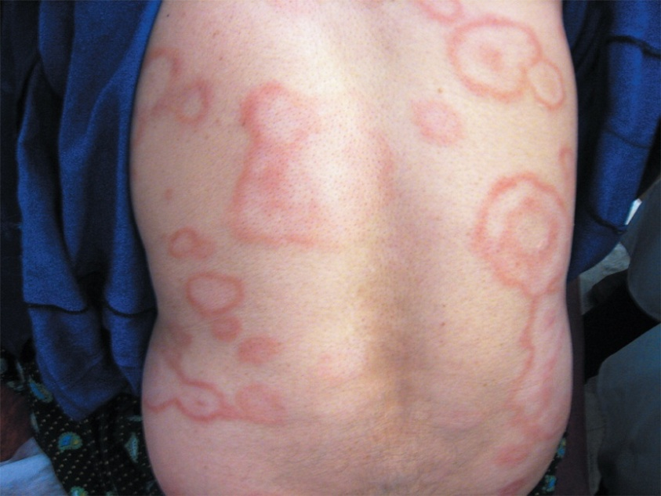
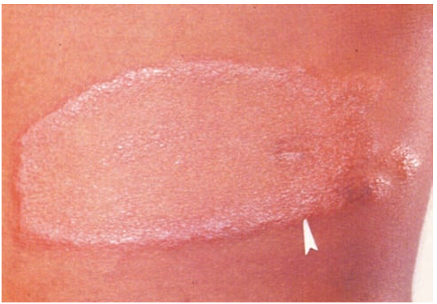
pathogenesis
Tuberculoid leprosy
The infected individuals to exhibit large flattened patches with raised and elevated red edges on their skin. These patches have dry, pale, hairless centers, accompanied by a loss of sensation on the skin. The loss of sensation may develop as a result of invasion of the peripheral sensory nerves.
A well-defined, hypopigmented, anesthetic macule with anhidrosis and a raised granular margin (arrowhead).
exhibit large flattened patches with raised and elevated red edges on their skin. These patches have dry, pale, hairless centers, accompanied by a loss of sensation on the skin.

Slide 22
pathogenesis
Lepromatous form
This form of the microbe proliferates within the macrophages at the site of entry.
Bacilli are numerous in the skin (as many as 109/g), where they are often found in large clumps , and in peripheral nerves, where they initially invade Schwann cells, resulting in foamy degenerative myelination and axonal degeneration
patients present with symmetrically distributed skin nodules ,raised plaques, or diffuse dermal infiltration, which results in lion face appearance.
Extensive penetration of this microbe may lead to severe body damage; for example the loss of bones, fingers, and toes.
Notes:
The suppressor T-cells that are induced are numerous, however the epithelioid and giant cells are rare or absent.

Slide 23
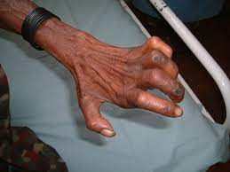
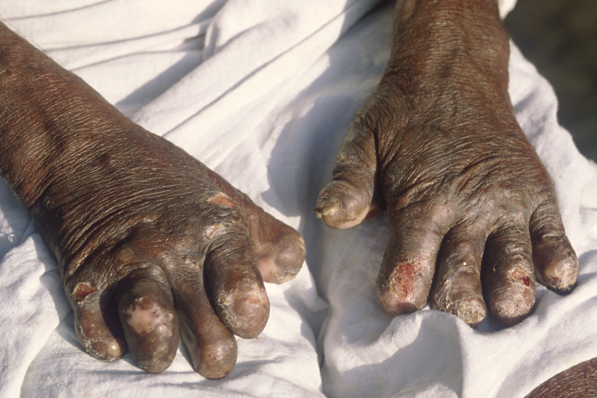
pathogenesis
deformity
Lepromatous form
Loss of fingers

Slide 24
Case definition
(WHO operational definition):
Is a person having one or more of the following
Hypopigmented or reddish skin lesion(s) with definite loss of sensation
Involvement of the peripheral nerves (definite thickening with loss of sensation)
Skin smear positive for acid-fast bacilli.

Slide 25
Diagnosis
Diagnosis of leprosy is most commonly based on the clinical sign and symptoms.
In an endemic country or area, an individual should be regarded as having leprosy if shows ONE of the following cardinal signs :
skin lesion consistent with leprosy and with definite sensory loss, with or without thickened nerves
Positive skin smears.
Lepromin positive test.

Slide 26
Diagnosis
Lepromin test:
Method:
Injection of a standardized extract of the inactivated bacilli intradermally in the forearm.
Positive reaction: 10 mm or more induration after 48 hrs/ or 5 mm or more nodule after 21 days.
Negative In lepromatous leprosy because of humoral immunity not cell mediated.

Slide 27
Treatment
Infection caused by M. leprae is characterized by persistence of the microorganism in the tissues for years, necessitates very prolonged treatment to prevent relapse.
For many years dapsone, a sulphone derivative has been used. This drug has the advantage that it is given orally and it is cheap and effective.
However, widespread use as monotherapy has resulted in the emergence of resistance and multidrug regimens are therefore preferable. Rifampicin can be combined with dapsone. Alternatively clofazime is active against dapsone-resistant M. leprae, but it is expensive.

Slide 28
Case presentation

Slide 29
Case presentation
A 20-year-old man reported a large single, hypopigmented, well defined anaesthetic lesion on his left thigh extending to his knee which had been present for 2 years.
There was no other nerve involvement.
Clinical diagnosis was tuberculoid leprosy
Six months of multidrug treatment was advised immediately.

