Slide 1
Collagen fiber
Collagen fiber H&E
EM of Collagen fiber

Slide 2
Elastic CT (H&E)

Slide 3
Elastic CT VVG

Slide 4
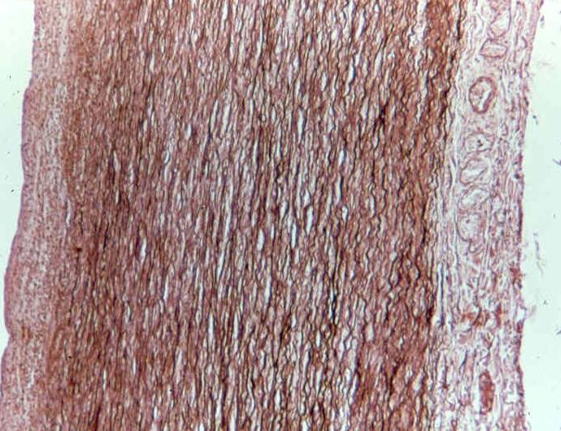
Elastic C.T. (orcein stain )

Slide 5
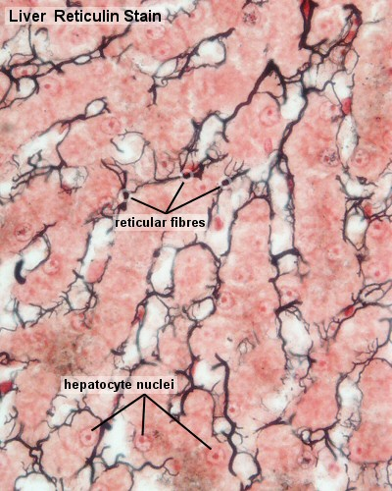
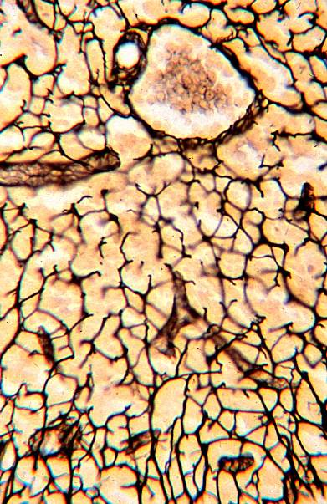
Reticular CT

Slide 6
Fibroblast& Fibrocyte
Smaller cells
with darker
nuclei
Larger cells
with paler
nuclei

Slide 7
EM: Fibroblast& Fibrocyte

Slide 8
Adipocytes H&E

Slide 9
Adipocytes osmic acid

Slide 10
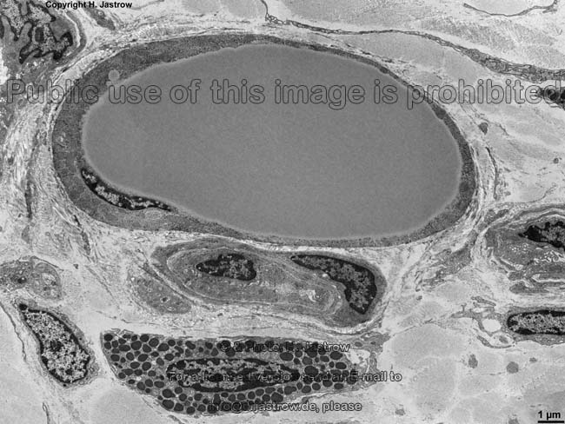
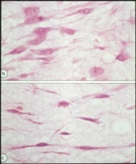
EM: Adipocyte

Slide 11
Multilocular Adipose Tissue (H&E stain)

Slide 12
AdiposeTissue (multilocular & unilocular) H&E stain

Slide 13
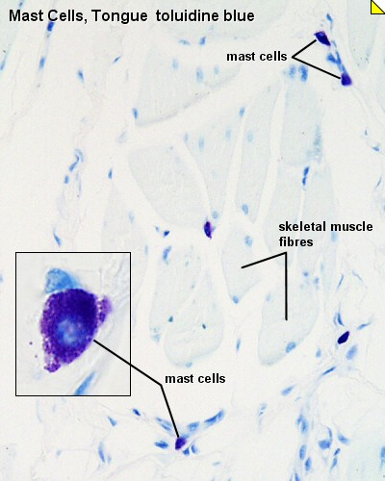
Mast Cells (Touldine Blue)

Slide 14
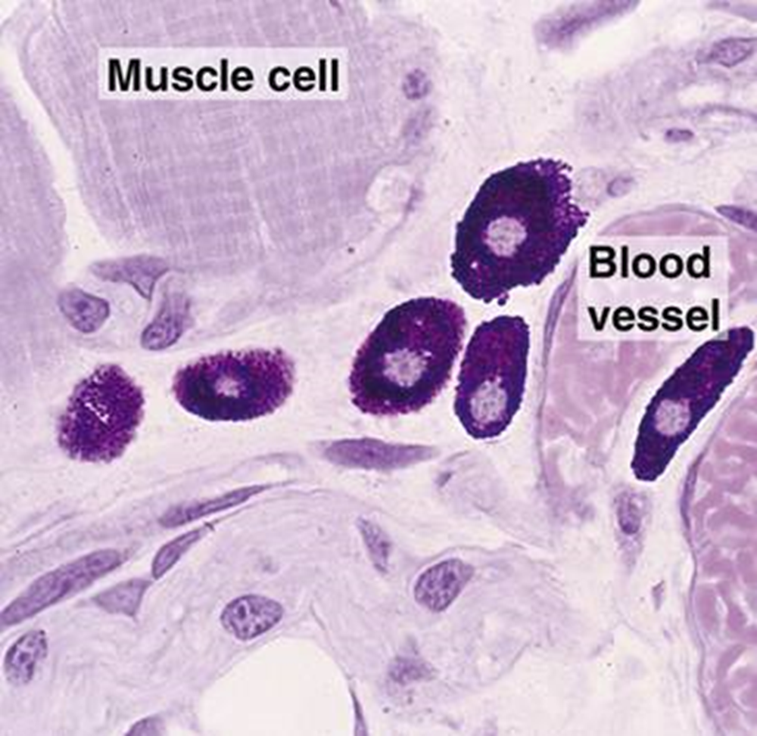
Mast Cell

Slide 15
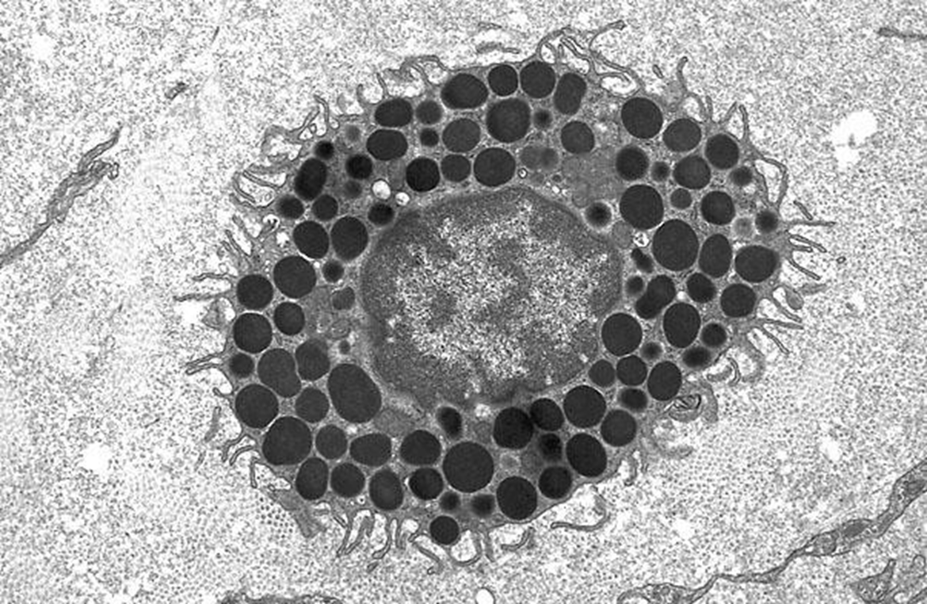
EM: Mast Cell

Slide 16
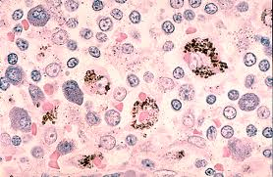
LM: Macrophage

Slide 17
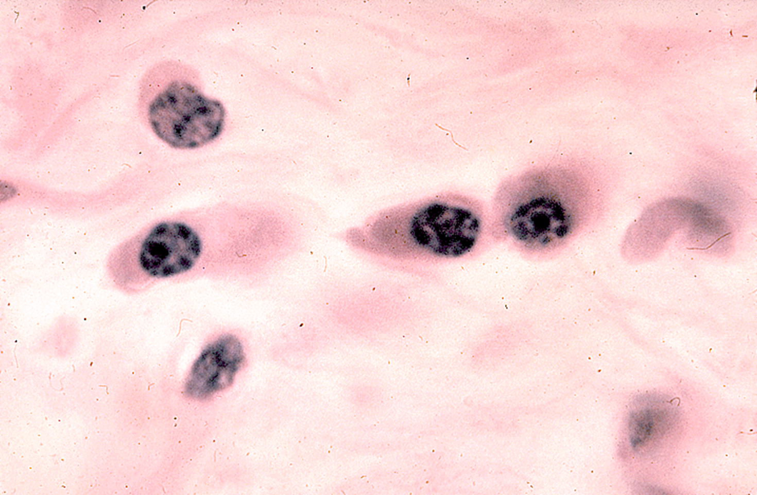
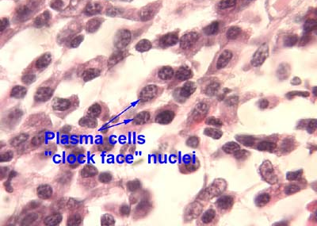
LM: Plasma Cells

Slide 18
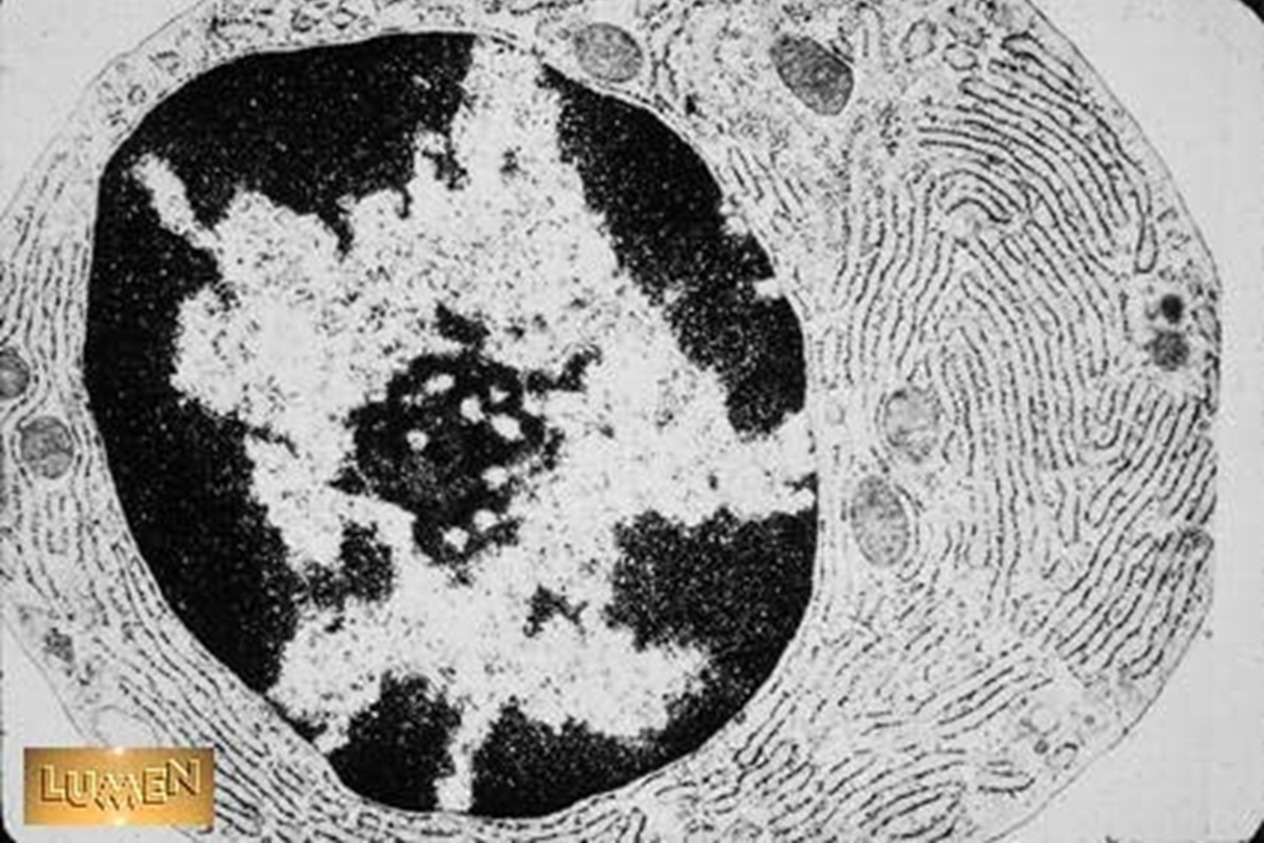
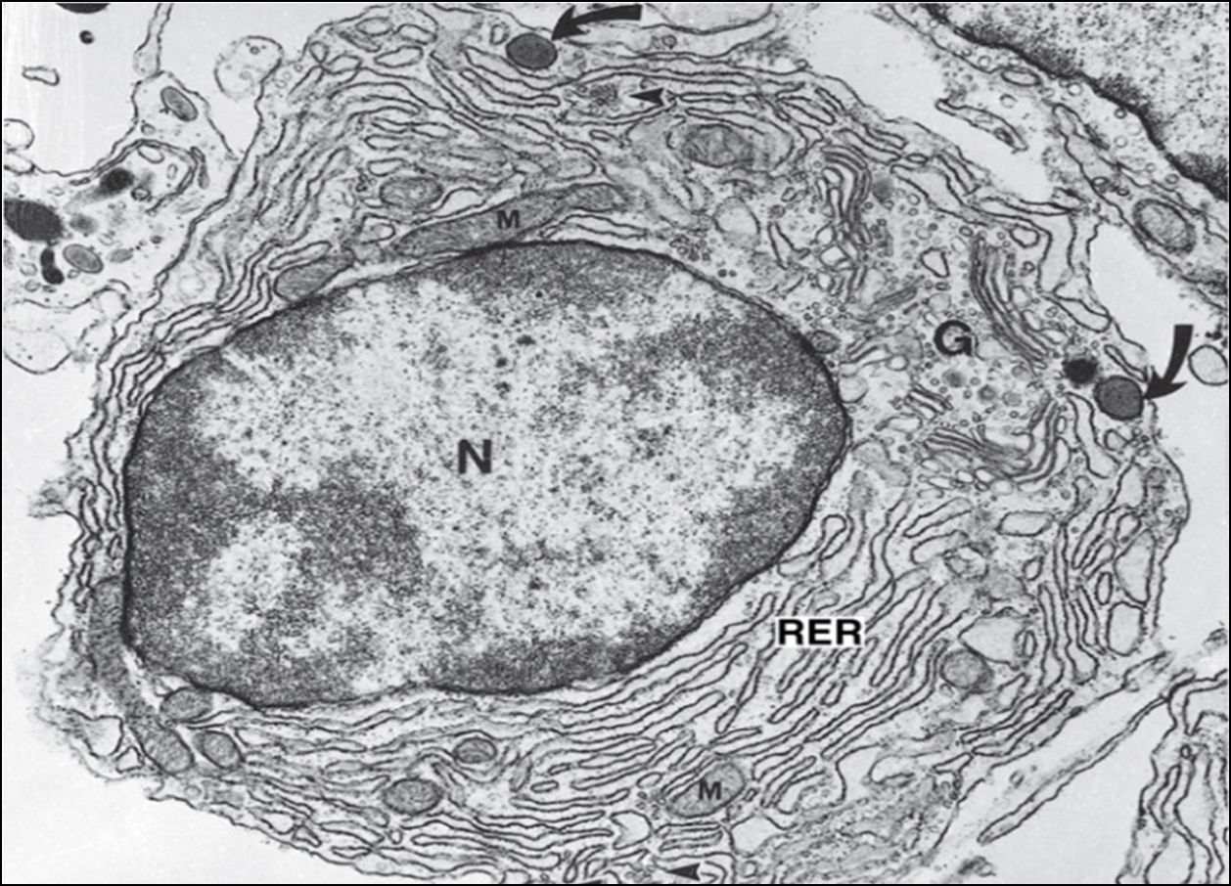
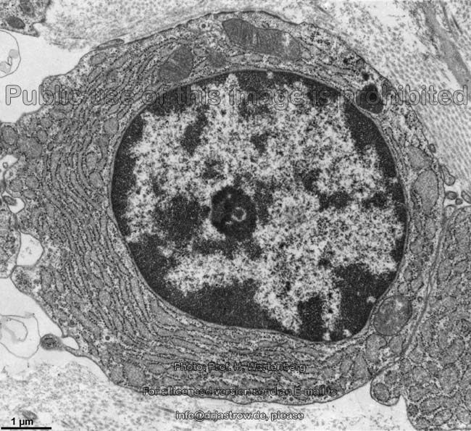
EM: Plasma Cell

Slide 19
Mucoid CT
Sites:
Umbilical cord (Wharton's jelly).
Pulp of growing teeth.
Vitreous humor of the eye.
Structure:
Jelly like matrix rich in mucin.
Young fibroblasts, (UMCs).

Slide 20
Mucoid C.T. Umblical cord

Slide 21
Mucoid C.T.

Slide 22
Loose Areolar CT

Slide 23
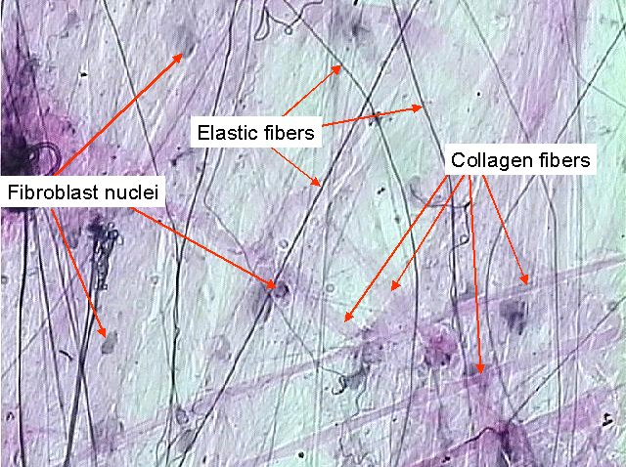
Loose Areolar CT

Slide 24
Loose Areolar CT

Slide 25
Adipocytes H&E

Slide 26
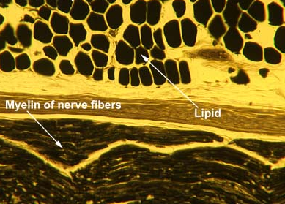
Adipose C.T. (osmic acid stain)

Slide 27
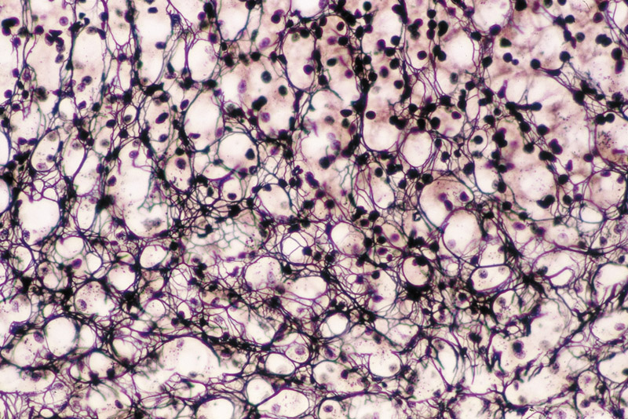
Reticular CT
Sites: liver ,Lymph node , Bone marrow
Structure: Formed mainly of reticular fibers and fibroblasts (reticular cells).
Stainsilver stain
Functions…?

Slide 28
Reticular CT (in liver) Silver stain

Slide 29
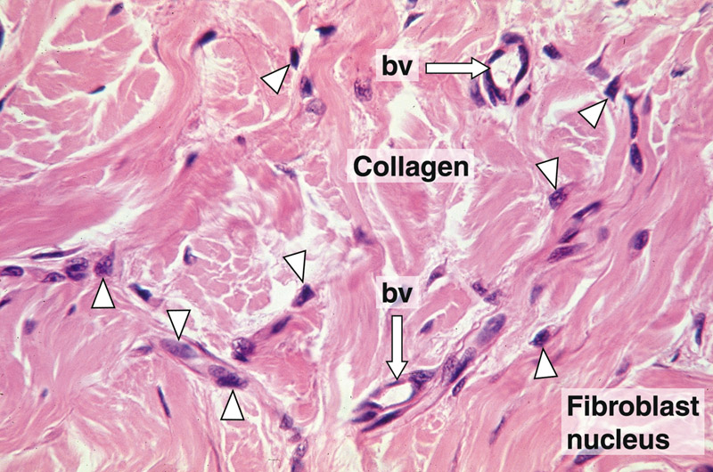
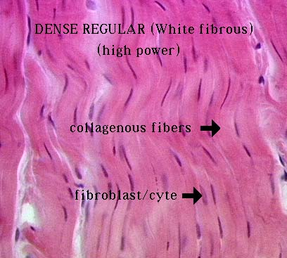
White fibrous CT
1-Regular : tendons , ligaments & cornea (substantia propria).
2-Irregular : dermis of skin , capsules of organs ,periostium & perichondrium.
Irregular CT

Slide 30
White Fibrous CT(in tendon)

Slide 31
Elastic CT (H&E)

Slide 32
Elastic CT (H&E)

Slide 33
Elastic CT VVG

Slide 34
Elastic C.T. (orcein stain )

