Slide 1
Anti-Coagulant therapy
Made by : safa’a olimat
Janat mahadeen
Hana’a aljaloudi

Slide 2
Homeostasis
Hemostasis is the physiological process by which a bleeding stops. Its final result is a thrombus (blood clot), which consists of blood cells (RBCs , platelet ) and fibrin strands.

Slide 3
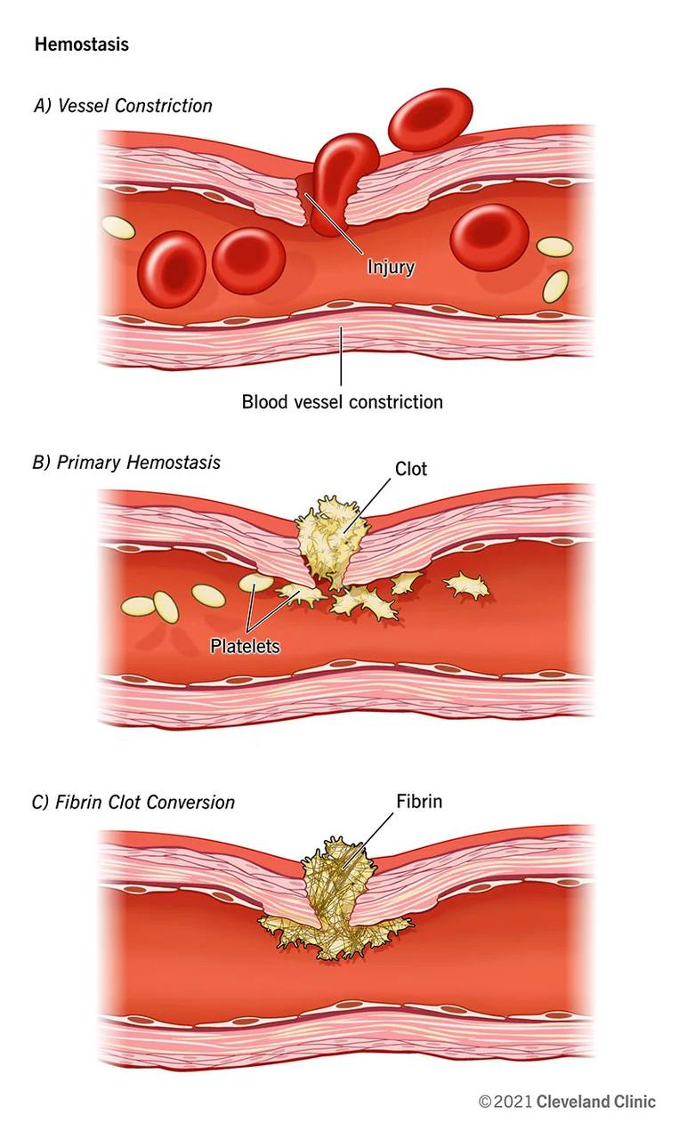
Hemostasis involves the following mechanisms:
Primary hemostasis
◦ Vascular hemostasis: transient vasoconstriction and von Willebrand factor activation following endothelial injury .
Platelet hemostasis: adhesion, activation, and aggregation of platelets, which results in the formation of a platelet plug (white thrombus)
• Secondary hemostasis: activation of the coagulation cascade, which results in the formation of a fibrin clot (red thrombus)

Slide 4
◦ Coagulation cascade: a sequence of events triggered by the activation of the intrinsic or extrinsic pathway of coagulation that results in the formation of a stable thrombus.
◦ Coagulation factors :
▪ Substances that interact with each other to promote blood coagulation.

Slide 5
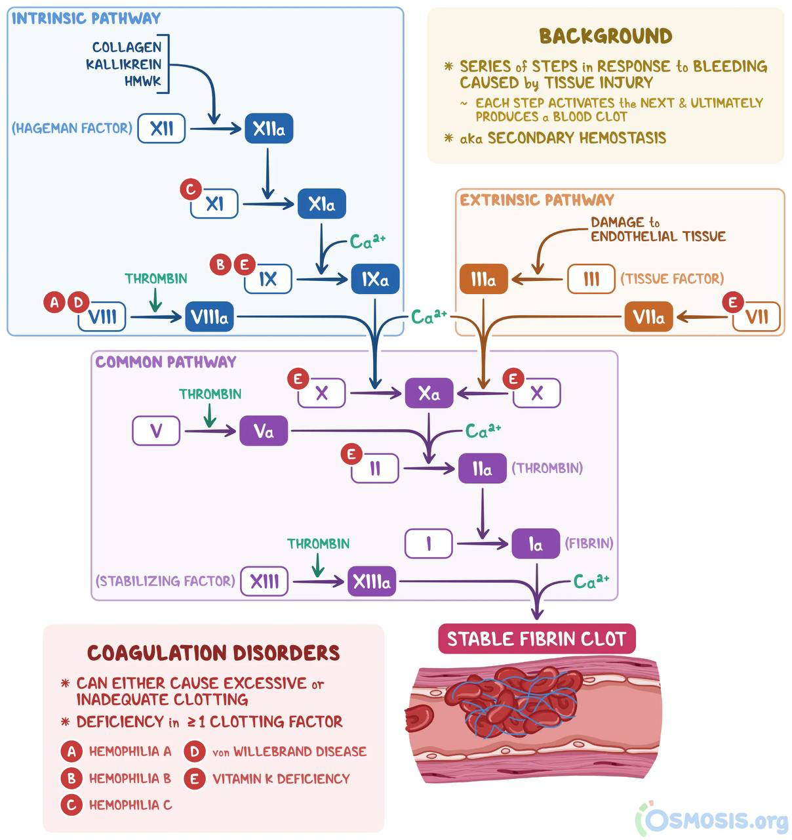

Slide 6
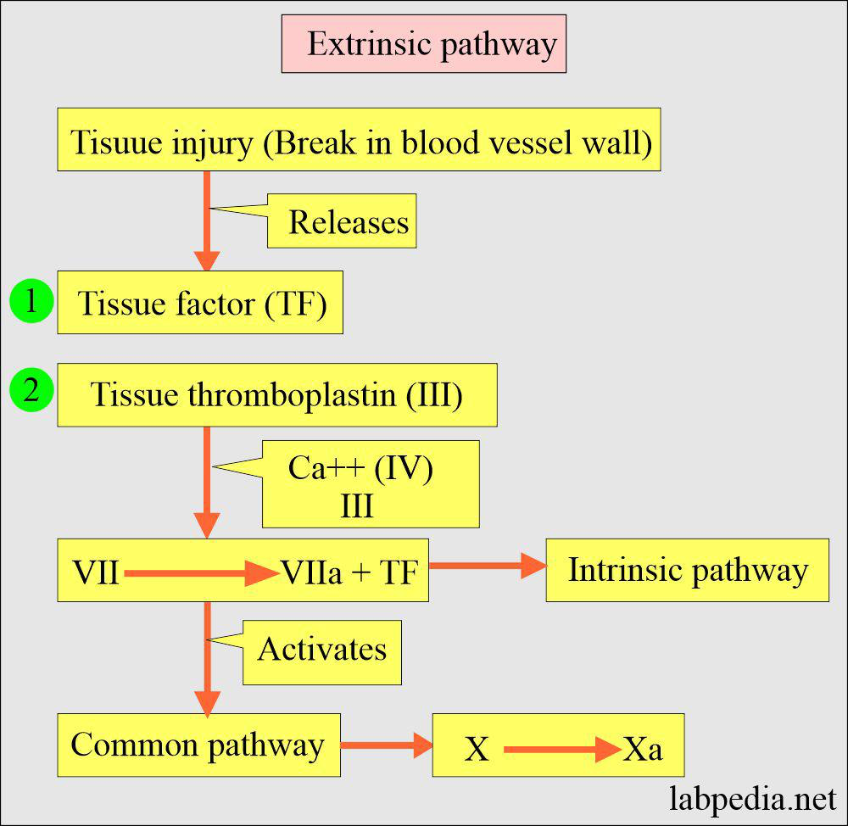
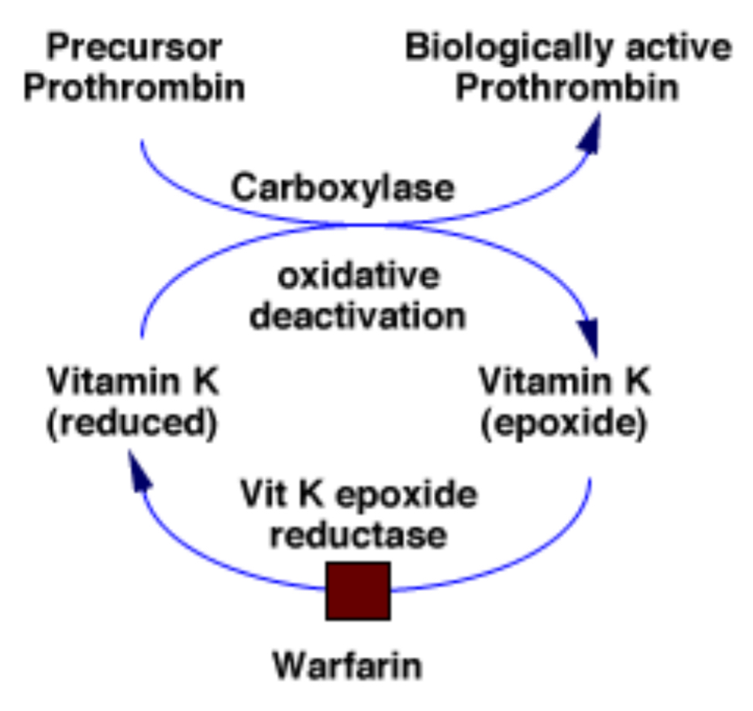
Extrinsic pathway of coagulation: triggered by endothelial injury
Tissue factor (factor III) activates factor VII.
▪ Tissue factor is expressed on the surface of subendothelial muscle cells and fibroblasts.
▪ Factor VII: vitamin K-dependent coagulation factor produced by liver.

Slide 7
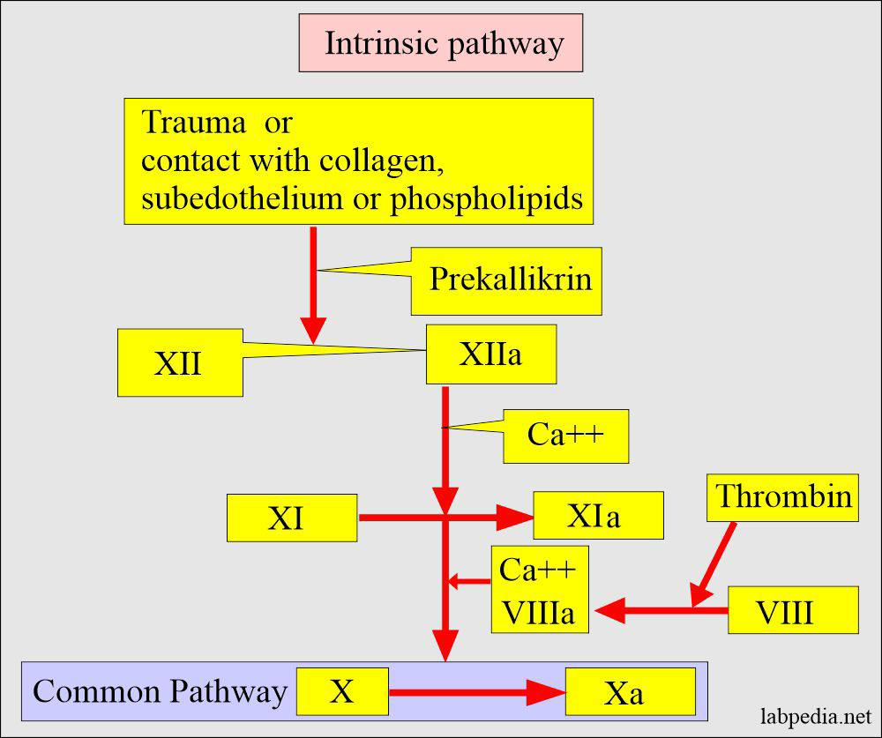
Intrinsic pathway of coagulation
◦ Exposed collagen, kallikrein, and kininogen (HMWK) activate factor XII.
▪ Factor XIIa activates factor XI.
◦ Thrombin activates factor XI and factor VIII.
◦ Factor XIa activates factor IX.
◦ Factors VIIIa and IXa form a complex (mediated by calcium) that activates factor X.
◦ This causes a positive feedback loop of factor X and thrombin activation via the intrinsic pathway.
• Common pathway of coagulation: The extrinsic and intrinsic pathway both end in the common pathway.
1) Factor Xa and factor Va form a complex (mediated by calcium) that cleaves prothrombin (factor II) to thrombin (factor IIa).
2) Thrombin cleaves fibrinogen (factor I) into insoluble fibrin (factor Ia)

Slide 8
* Important deactivators of coagulation :
1- Antithrombin l is produced in liver and circulate in plasma, activated by healthy endothelial cells and inhibits factors, II,IX,X.
2- Protein C and S is glycoproteins synthesized in liver . Protein C is a zymogen (inactive) , its active form called activated protein C (APC).APC requires protein S as a co-factor (not a zymogen) to inactivate factors Va and VIllaIf protein C and S are deficient, the patient will be in a hypercoagulable state.
3- Tissue factor pathway inhibitor inactivates Xa.
4- Plasminogen is synthesized in liver, converted to plasmin which breakdown.

Slide 9
The prothrombin time measures the time taken for fibrin to form via the extrinsic pathway.
The normal range is 9-12 seconds. Factors measured include factor VII; factor X; factor V; prothrombin and fibrinogen.
The activated thromboplastin time measures the time taken for fibrin to form via the intrinsic pathway.
The normal range is 23-38 seconds. Factors measured include factor XII, factor XI, factor IX, factor VIII, factor X, factor V, prothrombin and fibrinogen.

Slide 10
Thrombotic disorder
1- Deep vein thrombosis (DVT).
3- acute ischemic stroke .
4-transient ischemic attack.
5- pulmonary embolism.
6- phlebitis .

Slide 11
ANTI THROMBOTIC DRUGS
Anti-thrombotic drugs are typically classified into several categories based on their mechanisms of action and clinical uses. Here are some common classifications:
1. **Anticoagulants:** These drugs prevent the formation of blood clots by inhibiting the clotting cascade. They are further divided into:
Heparins
warfarin
Direct Oral Anticoagulant
2. **Antiplatelet Agents:** These drugs inhibit platelet aggregation and are used to prevent arterial thrombosis. Common examples include aspirin.
3. **Thrombolytic Agents:** Also known as fibrinolytics, these drugs break down existing blood clots. Examples include alteplase and streptokinase.

Slide 12
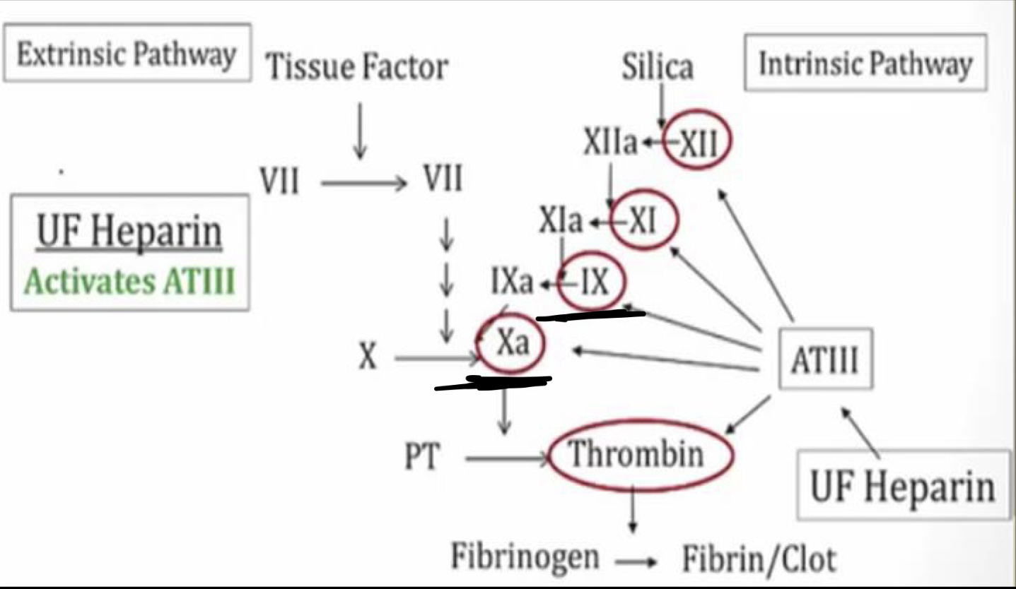
Anti coagulant : HEPARIN
- Unfractionated heparin (UFH) "Standard heparin"
Mechanism of Action: Potentiates the action of antithrombin III to primarily inhibit clotting factors Ila and Xa, preventing conversion of fibrinogen to fibrin.
onset:immediate
duration:short(2-4h)
Administration
Therapeutic →intravenously as an initial bolus followed by continuous IV infusion.
Prophylactic → subcutaneous
indications for Use HEPARIN
Venous thromboembolism (e.g., DVT, PE).
Atrial fibrillation in acute setting.
Acute coronary syndromes (e.g., unstable angina, myocardial infarction).
DVT prophylaxis in hospitalized patients.

Slide 13
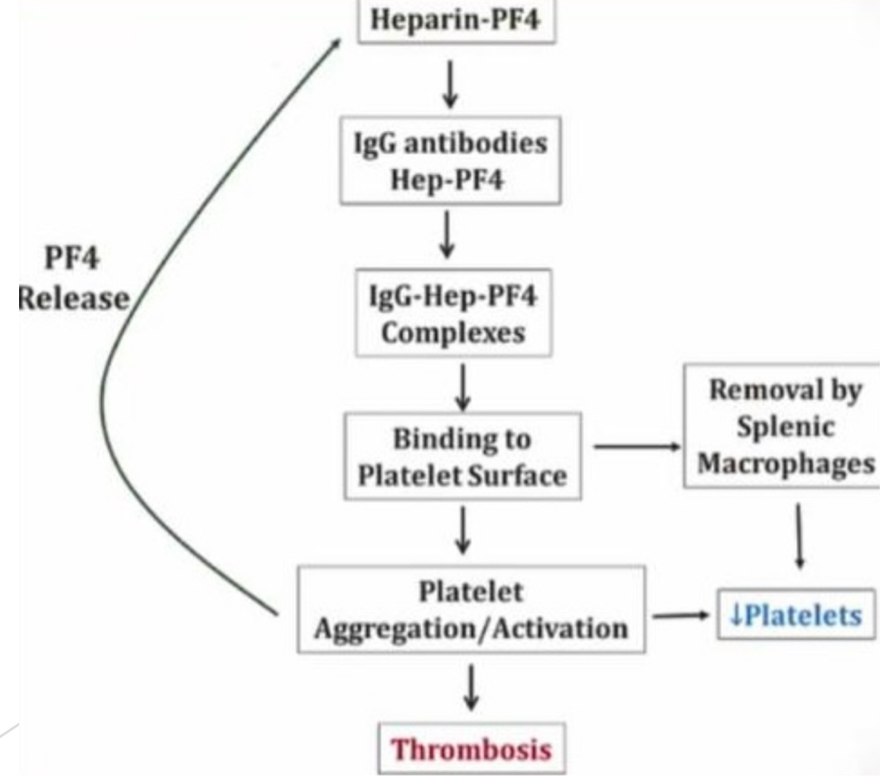
UnFractionated HEPARIN :
Monitoring during therapy
PTT or antifactor Xa levels and platelet count.
therapeutic PTT is usually 60 to 90 seconds, although this varies depending on the clinical situation.
Adverse Effects
Bleeding
heparin-induced thrombocytopenia HIT
(development of IgG antibodies against heparin-bound platelet factor 4 (PF4) that typically occurs 5-10 days after heparin administration. Antibody-heparin-PF4 complex binds and activates platelets→ removal by splenic macrophages and thrombosis→↓↓ platelet count.)
Osteoporosis with chronic use, lower incidence with LMWHs.
contraindication
History of HIT
Active bleeding (e.g., Gl bleeding, intracranial bleeding).
Severe thrombocytopenia.
Use with caution in severe HTN or after recent surgery (especially of eyes, spine, brain).

Slide 14
Clearance
hepatic (preferred agent for patients with renal insufficiency).
Reversing the Effects of Heparin
Antidote protamine sulfate (a positively-charged protein that can neutralize negatively-charged heparin by forming inactive complexes).
Administer FFP if severe bleeding occurs.

Slide 15
LOW MOLECULAR WEIGHT HEPARIN
Drugs: enoxaparin, dalteparin, tinzaparin, nadroparin, certoparin
Administration :subcutaneous
Mechanism of Action
activate anti thrombun III which primarily inhibit factor Xa (equivalent inhibition of factor Xa as standard heparin, but less inhibition of factor lla [thrombin]
Monitoring during therapy
anti-factor Xa activity can be assessed in specific cases.
Cannot be monitored by PT or PTT because they do not affect either.

Slide 16
Indications for Use :
Similar to standard heparin (e.g., DVT/PE, ACS, DVT prophylaxis) Used with increasing frequency as compared to standard heparin due to greate convenience (e.g., subcutaneous administration, less frequent monitoring) and decreased risk of side effects (e.g., HIT, osteoporosis)
More expensive than standard heparin, but often more cost-effective in the lon run due to reduced testing, nursing time, and length of hospital stay.
Preferred anticoagulant in patients with malignancy
Contraindications:
Similar to standard heparin
(e.g., history of HIT, active bleeding, severe thrombocytopenia)
Clearance :renal (Use with caution in patients with renal dysfunction-LMWH excreted via kidneys).
Antidote :
Protamine sulfate (partial reversal Protamine antagonizes 50% of the effect of LMWH).

Slide 18
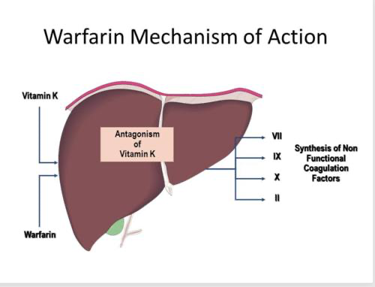
Warfarin
Mechanism of Action
□ Inhibits action of vitamin K epoxide reductase, an enzyme required for the hepatic synthesis of vitamin K-dependent coagulation factors, leading to a decrease in factors II, VII, IX, X, and proteins C and S

Slide 19
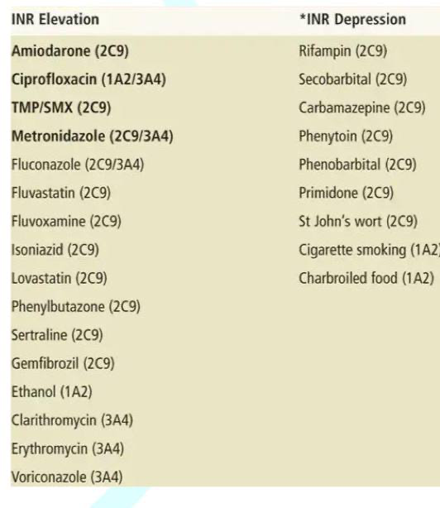
Administration
□ Given orally
□ Broad range of interactions
□ Requires periprocedural bridging anticoagulation (heparin).
□ Once PTT is therapeutic on heparin alone, initiate warfarin.
□ Continue heparin for at least 4 days after starting warfarin.
□ Once INR is therapeutic on warfarin, stop the heparin.
Monitoring during therapy (routinely monitored)
□ Prothrombin time (PT)/ INR (in most cases, INR of 2 to 3 is therapeutic. In patients with mechanical Heart valves have goal INR of 2.5 to 3.5)
□ no change to PTT or TT.

Slide 20
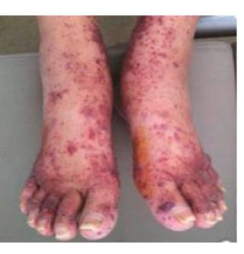
Indications for Use WEPT: Warfarin Extrinsic pathway PT
□ Thromboembolism prophylaxis (e.g., DVT/PE, stroke secondary to atrial fibrillation).
□ Preferred anticoagulant for patients with mechanical heart valves or antiphospholipid antibody syndrome.
Adverse Effects
□ Bleeding
□ Skin necrosis—rare but serious complication caused by rapid decrease in protein C (a vitamin K–dependent inhibitor of factors Va and VIIIa)

Slide 21
Reversing the Effects of Warfarin
□ Discontinue warfarin → takes 5 days to correct due to the long half-life of warfarin.
□ Administer vitamin K → takes 12 to 24 hours to correct due to the time required for the liver to synthesize new clotting factors.
□ Transfuse FFP → may take up to 8 hours to correct due to the time required for transfusion.
□ Administer unactivated prothrombin-complex concentrates (PCC) → replaces vitamin K-dependent coagulation factors and corrects within 10 minutes of administration.

Slide 22
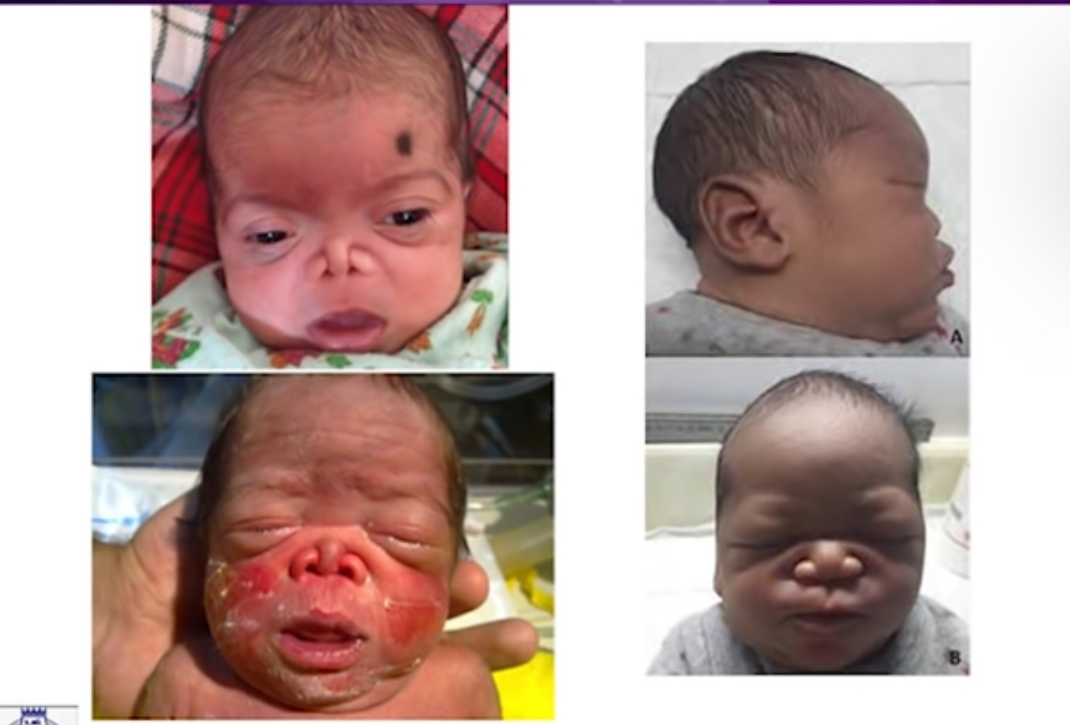
Contraindications
□ Active bleeding.
□ Pregnancy (warfarin is a teratogen), use in breastfeeding women is not contraindicated.
□ Use with caution in alcoholics or any patient prone to frequent falls due to potential for intracranial bleeding.

Slide 24
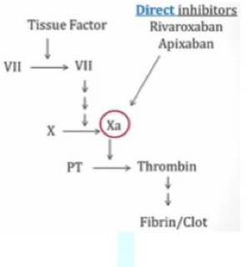
Direct Oral Anticoagulants (DOA)
Direct factor Xa inhibitors
□ Rivaroxaban, Apixaban, Edoxaban. RivaroXaban, apiXaban, and edoXaban are factor Xa inhibitors.
□ Selective and direct inhibition of factor Xa (as opposed topotentiating AT III like heparin).
□ Prolonged PT and PTT, unchanged thrombin time (not routinely monitored).
□ Currently approved for treatment of DVT/PE, DVT/PE prophylaxis, and stroke prophylaxis in patients with atrial fibrillation.

Slide 25
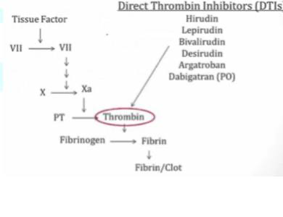
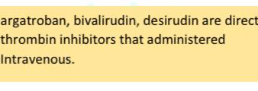
Direct thrombin (factor II) inhibitors
□ Lepirudin, Argatroban, Dabigatran.
□ Selective thrombin antagonist inhibit thrombin directly.
□ Prolonged thrombin time (TT), no change to PTT or PT (not routinely monitored).
□ Currently approved for treatment of heparin induced thrombocytopenia HIT.

