Slide 1
Bariatric Surgery Complications
Supervised by Dr Mohammed Nofal
Presented By:
Ali M. Al Khawaldeh
Ahmad O. Al Khatib

Slide 2
Classification of Bariatric Surgery
Restrictive | Malabsorptive
Horizontal gastroplasty Vertical banded gastroplasty (VBG) Adjustable gastric band Sleeve gastrectomy Roux-en-Y gastric bypass | Jejunoileal bypass Biliopancreatic diversion (Scopinaro) Biliopancreatic diversion w/ duodenal switch

Slide 3
Cholelithiasis
Cholelithiasis occurs in about one-third of patients who undergo bariatric surgery.
The rapid post-surgical weight loss is a significant contributor to the development of gallstones as is the pre-surgical obesity.
Patients usually do not have any symptoms unless there is acute inflammation of the gallbladder or impaction of a stone within the biliary system.
Patients present with nausea, vomiting, and biliary colic localized to the epigastrium and right upper quadrant.
Diagnosis is confirmed with ultrasound or CT imaging

Slide 4
Venous Thromboembolism (VTE)
Includes DVT & its complication, Pulmonary Embolism
Common cause of morbidity and mortality after bariatric surgery.
The most used pharmacological prophylaxis for VTE prevention after bariatric surgery was Enoxaparin 40 mg subcutaneously
Given twice daily for 10–14 days after hospital discharge
Consider an IVC FILTER for any patient with prior history of DVT/PE.
There were no reported cases of bleeding or VTE related mortality after 3 months.

Slide 5
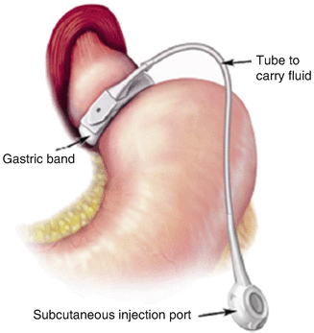
Lap Adjustable Gastric Band
Specific complications include:
Prolapse
Slippage
Band erosion
Port and tubing problems

Slide 6
1. Prolapse
The lower stomach is pushed upward and trapped within the lumen of the band.
most common emergent complication that requires reoperation after LAGB, with incidence generally being 3% approx.
Postoperative vomiting predisposes to this problem.
Symptoms include immediate dysphagia, vomiting, and inability to take oral food or liquid.
The initial evaluation for prolapse involves obtaining a plain film radiograph. If the band is in a horizontal position, prolapse must be strongly suspected.

Slide 7
1. Prolapse
Initial treatment for a prolapse is to remove all the fluid from the system. This often allows reduction of the prolapse and resolution of symptoms.
If symptoms resolve, the necessity of performing an upper gastrointestinal series is lessened.
If they do not, an upper gastrointestinal series is indicated, and if prolapse persists, then reoperation laparoscopically to reduce the prolapse and resuture the band in place is indicated.

Slide 8
2. Slippage
May present with vomiting due to pouch outlet distortion.
Diagnosis confirmed using plain abdominal films, upper GI series, or abdominal CT scan.
Treatment initially involves fluid removal from the band to relieve symptoms, followed by surgical revision of the band.
Slippage has been greatly reduced by the (Pars Flaccida) technique.
Operative need for repair now occurs in about 3% of cases in most series of short-term follow-up.
Longer-term follow-up rates may show higher rates of prolapse.

Slide 9
3. Band Erosion
Band erosion is uncommon, reported in 1% to 2% of most series.
Patient usually looks ill, developing either a port-site infection or systemic fever & low-grade abdominal inflammatory sepsis.
Endoscopy can be diagnostic.
Unexplained free air on CT should alert us to the diagnosis.
Laparoscopic removal of the band is indicated, with repair of any gastric perforation.
The perforation is usually sealed by the inflammatory process, if not the proper measures should be taken to seal it.

Slide 10
4. Port and tubing problems
Port and tubing problems occur in approximately 5% of patients undergoing LAGB.
These require revision of the port/tubing system due to perforation, leaking or kinking of the tubing or turning of the port such that access to the surface of the port for adding fluid is precluded.
Usually, a procedure under local anesthesia is all that is required to repair or realign the tubing or port.

Slide 11
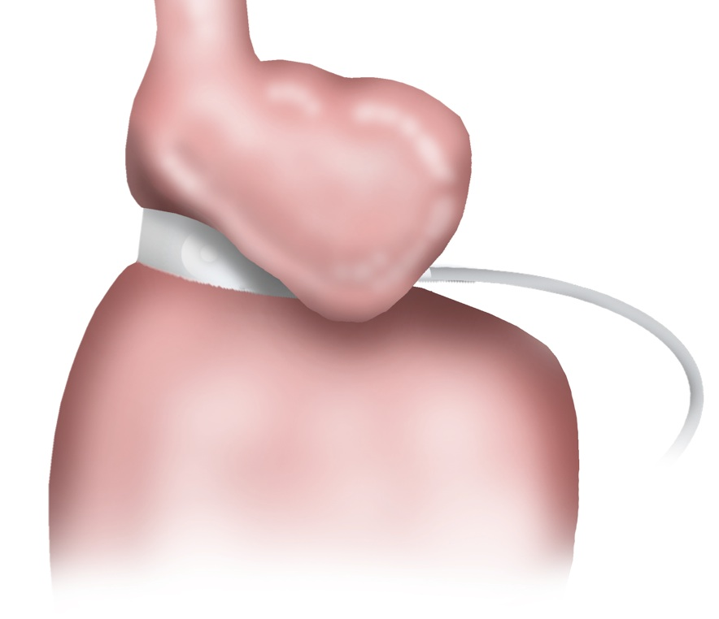
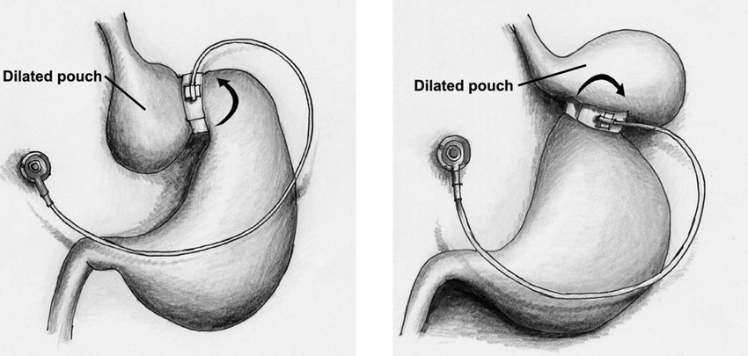
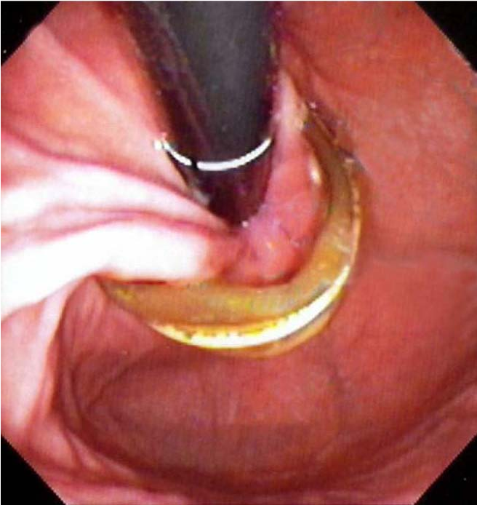

Slide 12
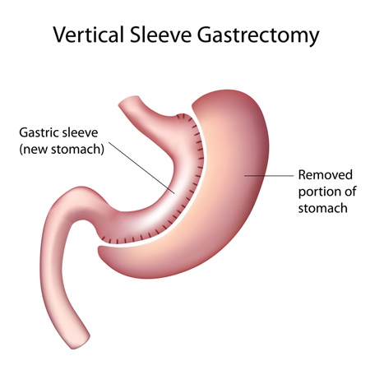
Sleeve Gastrectomy
Specific complications include:
Early complications:
1. bleeding
2. staple line leak.
Late complications:
1.Gastric sleeve stricture.

Slide 13
1. Bleeding
Usually occurs in the first 24-48hrs, incidence less than 1%.
Can be deﬁned by the presence of hematemesis or melena, and persistent large bloody output from a surgical drain, with or without the presence of tachycardia, hypotension, oliguria, and a decreasing hemoglobin and haematocrit.
Postoperative bleeding can be classiﬁed based on bleeding site into intraluminal bleeding or intra-abdominal bleeding.
In gastric sleeve patients, bleeding is mainly related to the long staple line closure where the stomach has been divided, short gastric vessel pedicles, or trocar sites.

Slide 14
1. Bleeding
Initial therapy:
1. May include resuscitation with fluids and blood products and monitoring of urinary output.
Definitive treatment:
1.Intraluminal bleeding: Controlled using endoscopic techniques; surgical exploration is reserved for failed endoscopic therapy.
2.Intraperitoneal bleeding: requires surgical exploration to control haemorrhage site.

Slide 15
2.Staple Line Leak
It occurs when a hole or gap develops somewhere along the staple line closure allowing stomach juice to escape into the abdominal cavity,
Leakage usually appears as an acute complication (within 7 days).
Causing tachycardia, tachypnea, and fever very early on.
Diagnosis:
1. Physical examination (abdominal): Unreliable; peritonitis is a late finding.
2. Abdominal CT: best diagnostic modality for stable patients.
3. Surgical exploration: definitive diagnostic tool and mandatory for diffuse peritonitis.

Slide 16
2.Staple Line Leak
Treatment:
1. Fluid resuscitation, broad-spectrum antibiotics.
2. Wide peritoneal drainage of the leak site: surgically or percutaneously with image guidance; first-line treatment.
3. Direct repair of the leak site: occasionally successful and used in conjunction with wide drainage.
4. Endoscopic techniques: used to seal leaks, typically in conjunction with drainage.

Slide 17
3. Stricture
Most common symptoms are nausea and vomiting
Patient was initially able to tolerate solid foods, but after a few weeks he starts to vomit solids but could handle liquids.
Diagnosis:
1. Physical examination: Usually unremarkable. Epigastric pain, if present, is mild.
2. Radiologic evaluation: abdominal CT , upper GI series, and upper endoscopy.
Treatment:
1. Endoscopic stenting and surgical stricturoplasty: successful in some cases.
2. Conversion to gastric bypass: usually the best option.

Slide 18
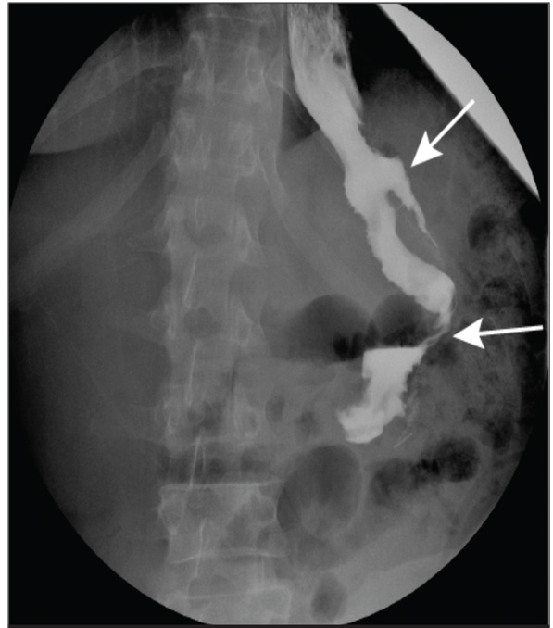
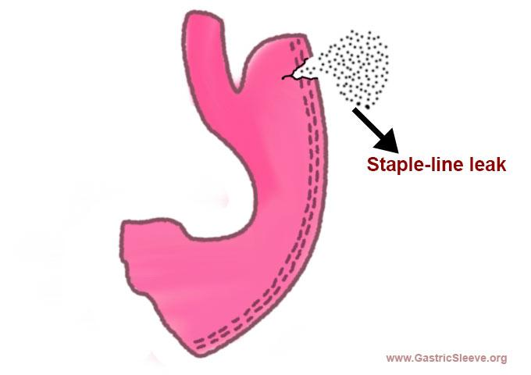

Slide 19
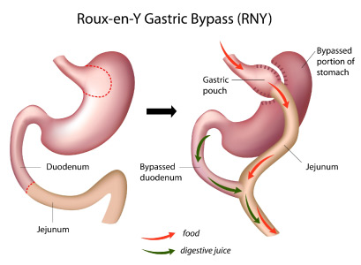
Roux-en-Y Gastric Bypass Surgery
Major complication as small bowel obstruction, major leak, abscess, anastomotic stricture, fistulae.
Minor complication :marginal ulcer ,pancreatitis, esophagitis, splenic abscess, cholithasis
Early complication less than one month.
Late complication more than one month.

Slide 20
1. Anastomotic or Staple Line Leaks
Potential sites: gastrojejunostomy (most common site), gastric pouch staple line, gastric remnant staple line, Roux limb staple line and jejunojejunal anastomosis.
The diagnosis of ASL is based on a high clinical suspicion.
Symptoms are nonspecific and variable including tachycardia, fever, abdominal pain, nausea, and vomiting and purulent drain output.
Radiographic studies are occasionally helpful and may show fluid collection adjacent to the pouch, diffuse abdominal fluid or rarely, intraperitoneal air
Definitive investigation is made via CT scan with contrast.

Slide 21
1. Anastomotic or Staple Line Leaks
Conservative management can be effective in non-septic, hemodynamically stable patients with contained leaks.
Includes intravenous antibiotics, monitoring of secretions through drains, nasoenteral nutrition or total parenteral nutrition.
If the leak is contained and accessible, a percutaneous treatment can be performed
If the patient is haemo-dynamically unstable, has a complicated leak, or signs of sepsis, an operative treatment is mandatory.
operative goals are to confirm and repair the leak, remove gastrointestinal contents from the abdominal cavity and place closed suction drains.

Slide 22
1. Anastomotic or Staple Line Leaks
The repair of the leak would be the ideal situation, but often suturing the place of the leak can be challenging, as the acutely inflamed tissues might not be amenable to suture placement. In such cases, the removal of gastrointestinal contents and placement of drainage tubes may be the safest option.
Maintain the nutrition is mandatory to allow healing the tissues in the place of the leak. To achieve this, the placement of a feeding gastrostomy into the gastric remnant or a feeding jejunostomy is considered. This would allow for continued enteral nutrition while bowel rest is maintained at the site of the leak.

Slide 23
2. Gastrointestinal Bleeding
GIB after laparoscopic RYGB can be intraperitoneal (bleeding into the abdominal cavity) or intraluminal (occurs into the lumen of the digestive tract) and most commonly originates at one of the five potential staple lines mentioned earlier.
Can be life threatening if not recognized and treated early.
The presence of pallor, dizziness, confusion, tachycardia, hypotension, hematemesis, bright red blood per rectum, drop in the hemoglobin level, large quantity of bloody fluid from the abdominal drains and low urine output should alert the surgeon to ongoing postoperative bleeding.
Confirmed endoscopically or surgically.

Slide 24
2. Gastrointestinal Bleeding
The treatment depends on the timing of onset and the clinical presentation. In cases of late presentation (>48h) of bleeding after surgery, it can be managed conservatively, especially with no acute clinical symptoms. In these cases, discontinuation of DVT chemoprophylaxis and watchful waiting with supportive therapy can be successful.
Early postoperative bleeding, occurring within a few hours after the surgery, manifested by hematemesis or bright red blood per rectum in the presence of clinical signs of bleeding is a clear indication for urgent surgical intervention.

Slide 25
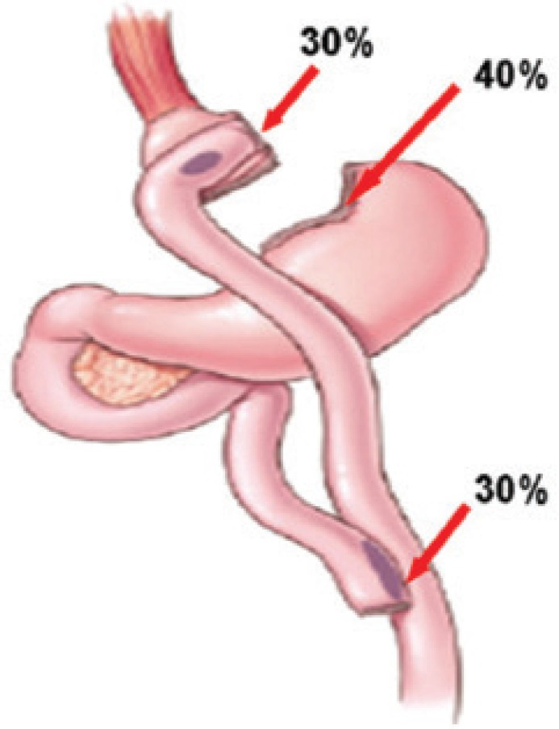
2. Gastrointestinal Bleeding
If is suspected that the bleeding source is proximal intraluminal the best treatment option is an endoscopic intervention, which is invaluable in controlling bleeding from the gastric pouch or gastrojejunostomy.
Thermal coagulation, injection of vasoconstrictors, and clipping are all effective ways of controlling bleeding from these sites.

Slide 26
3. Gastrojejunal Stricture
Stricture of the proximal anastomosis, or gastro-jejunostomy, is a common Complications.
The typical stricture patient present 4–6 weeks after surgery with solid food intolerance progressing to liquid intolerance as the stricture narrows.
Symptoms of a gastrojejunal stenosis are usually acute onset nausea, vomiting, dysphagia to solid and liquid and abdominal pain, meanwhile in stenosis developing more distally, the symptoms may be more gradual in onset.

Slide 27
3. Gastrojejunal Stricture
The diagnosis of stricture can usually be made based on history alone and conﬁrmed with upper endoscopy.
Upper endoscopy is the primary diagnostic modality of choice, as it allows both rapid diagnosis and therapeutic intervention via balloon dilatation.
When the stenosis is at the gastrojejunal anastomosis, balloon dilation with an EGD can be used.
In cases of a stenosis at the jejunojejunal anastomosis a single balloon enteroscope can be used to dilate the stenotic area.

Slide 28
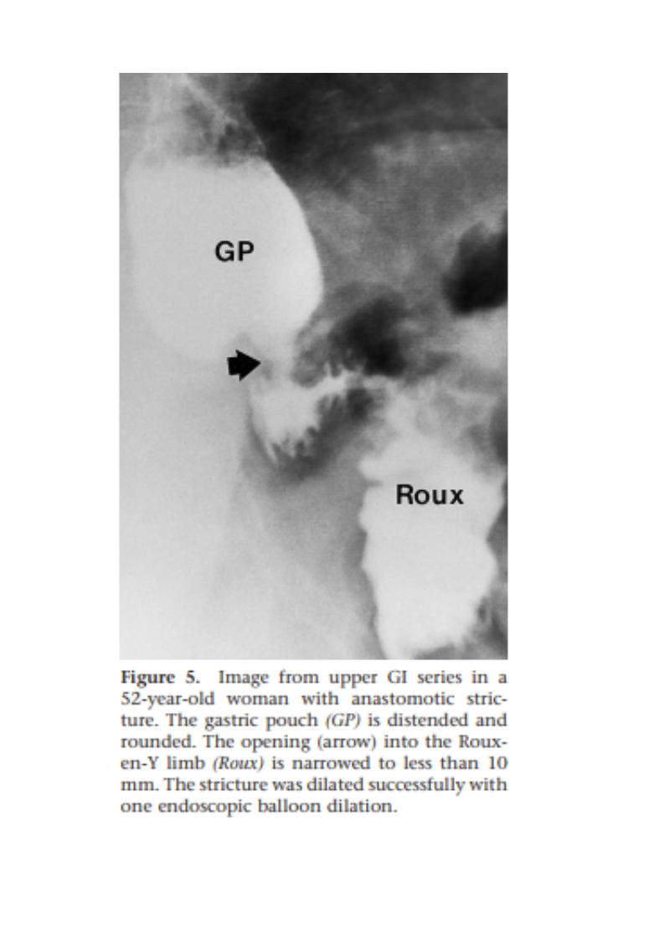

Slide 29
4. Hernia
Internal hernias are relatively common after gastric bypass and may result in bowel obstruction, intestinal ischemia, or both.
Distal anastomosis mesenteric hernia—this space is bordered by the divided mesentery of the biliopancreatic limb and the mesentery of the Roux limb at the distal anastomosis.
Petersen hernia—the space between the mesentery of the Roux limb and the mesocolon/colon.
Typically, patients complain of intense pain in the mid epigastrium, often radiating to the back. The pain may occasionally be relieved by leaning forward or getting “down on all fours”

Slide 30
4. Hernia
Computed tomography (CT) scan may demonstrate ﬁndings such as the “swirl sign,” a spiraling of the mesentery.
Deﬁnitive diagnosis of internal hernia can only be achieved through surgical exploration.
Cases of internal hernias and ventral hernias that are not incarcerated can be electively repaired, any case of incarcerated bowel requires emergent surgery due to risk of strangulation, ischemia, and perforation.

Slide 31
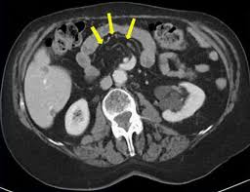

Slide 32
5. Intussusception
Small bowel intussusceptions may be transient or fixed and may result in an SBO after gastric bypass surgery.
They typically occur at or near the jejunojejunal anastomosis, with the staple line at the anastomosis presumably acting as the lead point for the intussusception.
Intussusception may occur months or years after gastric bypass and is associated with nausea, persistent vomiting, abdominal pain, and bowel obstruction.
CT scan may reveal a “target sign” or dilated excluded stomach, but these findings are relatively insensitive

Slide 33
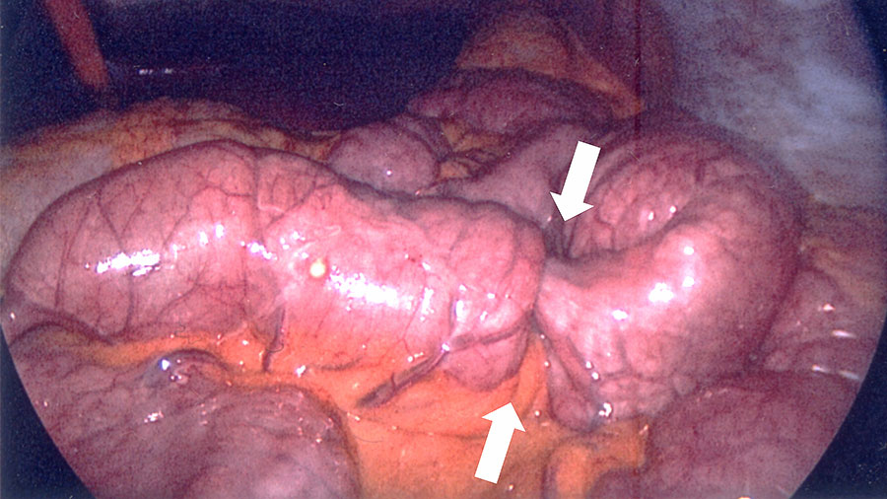
5. Intussusception
A high level of clinical suspicion is usually the impetus for surgical exploration. Strangulation mandates resection of the affected area.
In the absence of strangulation, resection or reduction and plication are accepted approaches.

Slide 34
6. Fistulas
A gastro-gastric fistula (GGF) is an abnormal communication between the gastric pouch and the excluded stomach.
The most common cause is secondary to incomplete gastric transection at the original surgery.
The most common symptom is inadequate weight loss or weight gain. Patients may also present with epigastric pain and/or worsening acid reflux secondary to the new connection with the remnant stomach.
Diagnosis is made via endoscopy of the fistulous tract or via imaging with oral contrast.

Slide 35
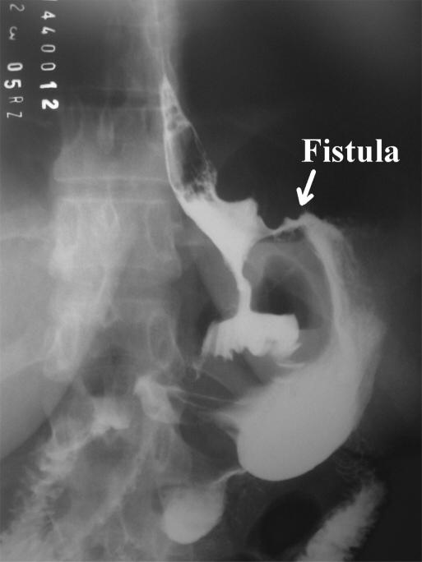
6. Fistulas
Asymptomatic fistulous tracts are usually not a concern.
However, symptomatic fistulous tracts can be closed endo-scopically using specialized large Endo clips to approximate the tissue surrounding the fistula.

Slide 36
7. Nutritional Deficiencies
Alterations of gastrointestinal anatomy and physiology after gastric bypass elicit imbalances owing to reduced oral intake or excessive losses secondary to reconfiguration of GI motility, pH and enzymatic profile
Anaemia is the most common complication.
Patients may be asymptomatic or present with symptoms manifesting a particular nutritional deficiency.
Patients with anaemia may present with dyspnea, fatigue and inability to concentrate. Zinc deficiency can result in hair loss and low calcium levels can result in osteoporosis and fractures.

Slide 37
7. Nutritional Deficiencies
Blood work is recommended to detect and monitor vitamin and mineral deficiencies
Patients who undergo gastric bypass require a referral to a registered dietician for nutrition counselling, and lifelong vitamin and mineral supplementation is recommended.

Slide 38
8. Dumping Syndrome
Effect of altered gastric reservoir function, abnormal postoperative gastric motor function, and pyloric emptying mechanism.
Dumping occurs when the patient eats refined high sugar concentration following gastric bypass, this causes symptoms of rapid heartbeat, N&V, tremor and faint feeling, sometimes followed by diarrhea.
Includes:
1. Early Dumping Syndrome.
2. Late Dumping Syndrome.

Slide 39
Early Dumping Syndrome
it is an uncontrolled rapid emptying of hypertonic chyme into small intestine.
Fluid moves rapidly from intravascular space into intraluminal space producing acute intravascular volume depletion.
Symptoms occurs 15-30 minutes after a meal.
Anxiety, extreme weakness, tachycardia, diaphoresis, palpitations, and desire to lie down. Osmotic Diarrhea is common.
As simple sugars are absorbed, and dilution of hypertonic solution occurs the symptoms decreased and disappear gradually.

Slide 40
Early Dumping Syndrome
Dietary modification should be the initial approach and is beneficial in most patients. Patients should be counseled to reduce portions, chew slowly and thoroughly, not drink fluids before an interval of 30 min after a solid meal. They should also be instructed to reduce the content of simple carbohydrates and select protein-rich foods.
somatostatin analogues such as octreotide and pasireotide may be an effective option.
Surgical interventions: Surgical options include gastric tube placement in the excluded stomach (if present), gastric outlet restriction and gastric bypass reversal.

Slide 41
Late Dumping Syndrome
Symptoms begin 3 hours after meals.
Rapid changes in serum glucose and insulin levels.
Large glucose-bolus containing chyme presented to small intestine has a lot of glucose in it, glucose is absorbed faster than when the intact pylorus controls emptying of stomach.
This causes high levels of serum glucose shortly after meal and causes a big released of insulin.
Insulin response exceeds what is necessary to clear glucose from blood and hypoglycemia symptoms happens.

Slide 42
Late Dumping Syndrome
Sudden anxiety, diaphoresis, tachycardia, palpitations, weakness, fatigue, and desire to lie down, No diarrhea.
Treatment is dietary avoidance of Foods that are high in concentrated sugar content, small frequent meals , Usually symptoms will resolve with time

Slide 43
9. Blind Loop Syndrome
Associated with bacterial overgrowth in the limb of the intestine excluded (not functioning) from the flow of chyme.
This limb has bacteria that proliferate and interfere with folate and Vit B12 metabolism.
This causes malabsorption of bile salts, also as a result, no absorption the fat-soluble vitamins A, D, E and K and Ca.
B12 deficiency leads to megaloblastic anemia
Abdominal pain, distention, diarrhea, weight loss, weakness, anemia .

Slide 44
9. Blind Loop Syndrome
Empirical antibiotic.
surgical management is reserved for fixing anatomical causes of bowel obstruction that interfere with normal function once they are amenable to such intervention.
These conditions include:
1. Strictures
2. Fistulae
3. Diverticula

Slide 45
10. Afferent loop syndrome
Blockage of the afferent limb of loop causing the bile and pancreatic secretions to collect in the afferent limb with increasing pressure these enter the stomach and become dilated.
Causing projectile bilious vomiting not containing food and relieves symptoms .
Investigate with upper endoscopy and radio nucleotide scan.

Slide 46
11. Efferent loop syndrome
Usually from internal herniation of limb behind anastomosis, when we create gastrojejunostomy anastomosis we make cut on jejunum and Lift it up to site of anastomosis (gastric pouch), so we need to cut the mesentery of Small Bowel to make it possible, subsequently when we make this defect in mesentery (space), which make the intestines more susceptible to internal herniate through this defect.
Upper quadrant pain colicky in nature , bilious vomiting and abdominal distension .
Investigation – CT abdomen
New guideline for treatment is to make the anastomosis higher up(at level of esophagus).

Slide 47
Biliopancreatic Diversion
Involves resection of the distal half to two-thirds of the stomach and creation of an alimentary tract of the most distal 200 cm of ileum, which is anastomosed to the stomach.
The biliopancreatic limb is anastomosed to the alimentary tract either 75 or 100 cm proximal to the ileocecal valve
This procedure is the most effective with 75-85 % excess weight loss but at the expense of the highest mortality of 1-2%
Additionally, if the patient does not adhere to their vitamins and micronutrients supplementation regimen, they are at severe risk of many deficiency syndromes .

Slide 49
BPD ± Duodenal Switch
The Duodenal switch variation of the BPD was designed to reduce the need for taking Vit B12 and reduce the incidence of anastomotic stricture at the gastrojejunal anastomosis.
In the standard BPD, approximately two-third of the distal stomach is removed while in the duodenal switch variation there is a vertical sleeve gastrectomy.
In the duodenal switch variation, the anastomosis is made to the first part of the duodenum rather than the stomach as the standard BPD.

Slide 50
BPD ± Duodenal Switch
Average weight loss after BPD and DS was over 72%
Resolution of type 2 diabetes 98%
Resolution of HTN 8%
Improvement in dyslipidemia 100%
Mortality rate of 1.1%
Complication rate of 27% to 33%
Nutritional complication rate of 40% to 77%
Intraoperative complications:
1. Bleeding
2. Injury (bowel, liver, spleen, esophagus)
Immediate post operative complications:
1. Bleeding
2. DVT with or without pulmonary embolism
3. Infection
4. Abscess formation
5. Bowel obstruction
6. Anastomotic leaks

Slide 51
BPD ± Duodenal Switch
Long term complications:
1. Internal Herniation
2. Bowel obstruction
3. Osteopenia
4. Diarrhea
5. Malodorous bowel motions and flatus
6. Marginal ulcer in 2.8% of patients.
7. Stomal ulcer .
8. Gall stones .
Nutritional complications:
1. Iron deficiency anemia rate of less than 5%.
2. Alopecia from inadequate protein absorption
3. protein malnutrition rate of 7%
4. Night blindness from a lack of vitamin A

Slide 52
Malnutrition
The most severe and life-threatening. When it is diagnosed, the treatment is parenteral nutrition.
Two episodes of required parenteral nutrition are usually considered adequate indication to lengthen the “common channel” of ileum.
Fat-soluble vitamins must be supplemented in parenteral form. Careful monitoring of protein intake .
Thorough preoperative and postoperative counseling by a nutritionist versed in the operation and potential nutritional deficiencies is essential.
Vitamins and mineral supplements must be taken regularly on follow-up, including oral supplements for iron, calcium, and vitamin B12 and a multivitamin.

Slide 53
References
Schwartz principles of surgery 10th edition.
The ASMBS Textbook of Bariatric Surgery
NMS surgery 6th edition.
Dr Mohammed Nofal’s bariatric surgery lecture.

Slide 54
Thank You

