Slide 1
Diverticular disease of GI system Supervised by : Dr. Emad abo rajooh Presented by :Tasneem Mohamad , Juman Riyad , Sara Alazzeh , Tasneem Hasan

Slide 2
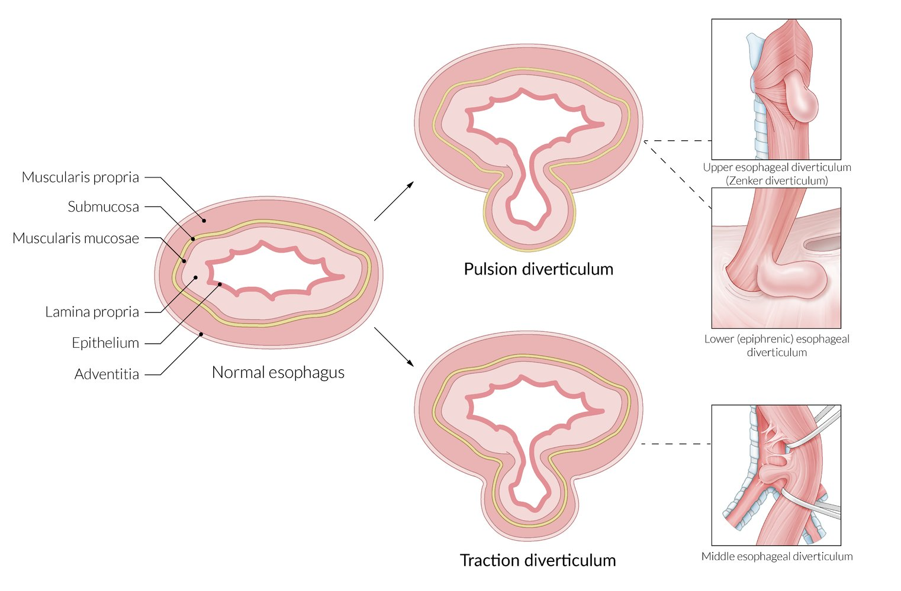
Diverticuli : hollow out-pouching are a common structural abnormality
Classified as
1- true :all three layers of the bowel are present in the wall of the diverticulum
ex: meckl's disease
2- False : there is no muscularis layer present in the diverticulum
ex: sigmoid diverticular disease
Acquired diverticulum have two types according to mechanism of it's formation into :
pulsion type
traction type

Slide 3
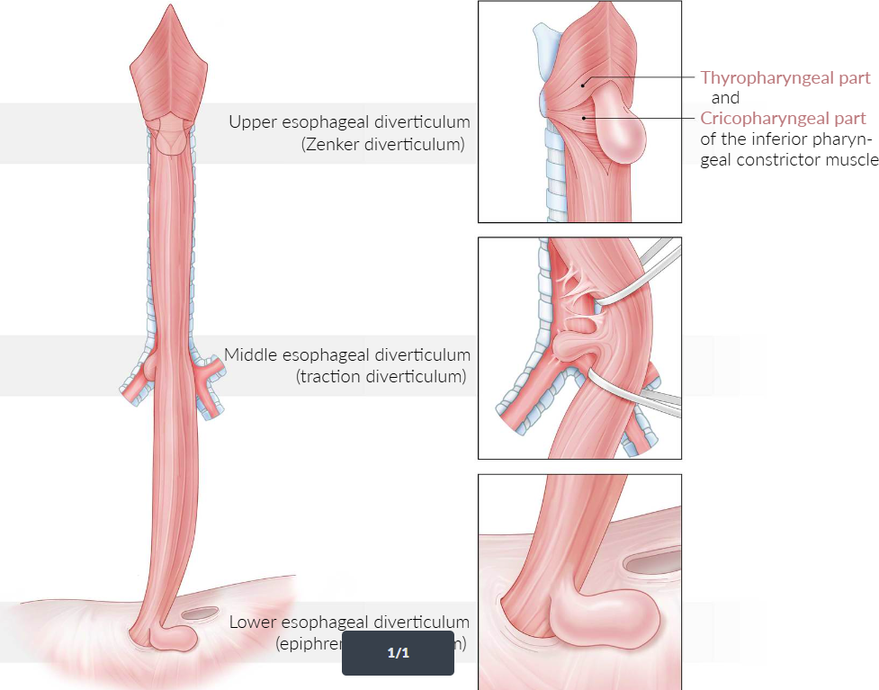
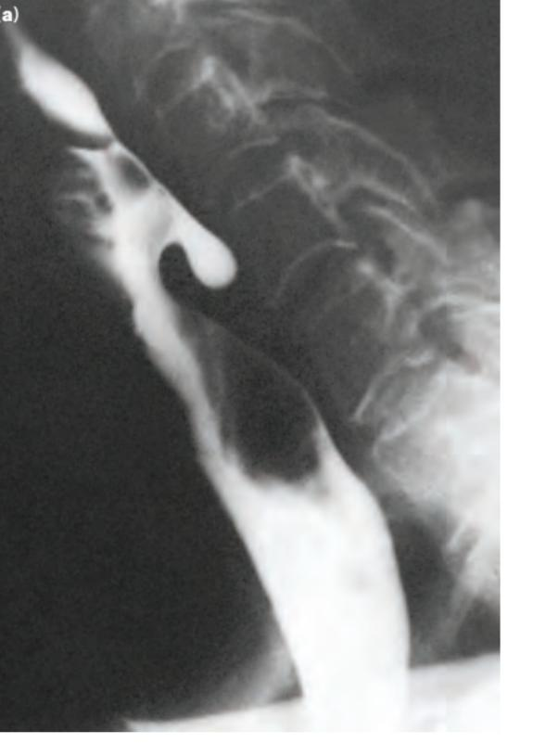
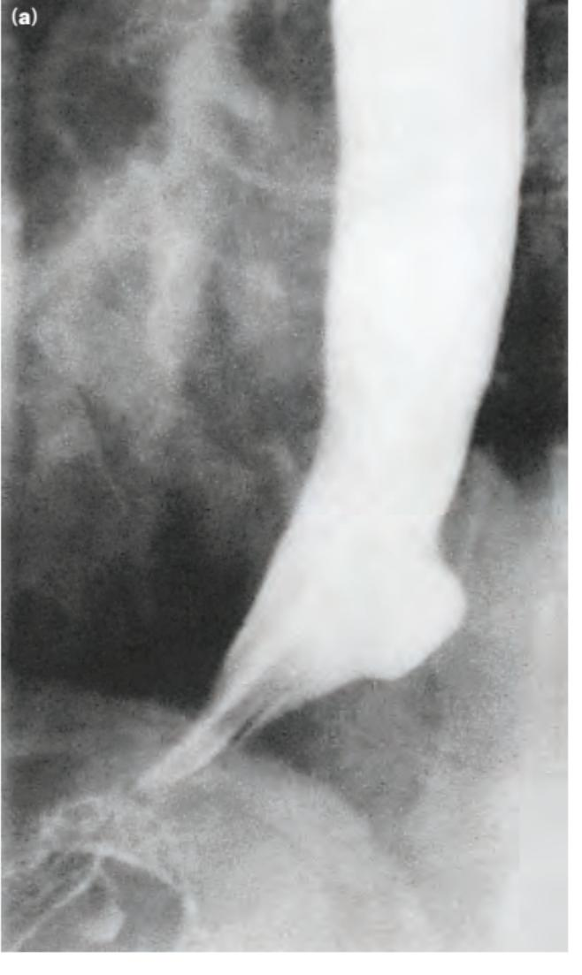
Esophageal diverticulum
Definition: A diverticulum is an abnormal pouch that forms in the esophageal wall.
Types:
1. Zenker’s Diverticulum: Located above the upper esophageal sphincter. 2. midesophageal diverticular (Traction Diverticulum: )Typically found in the mid-esophagus due to inflammation or scarring and more common in TEF 3. Epiphrenic Diverticulum: Found just above the lower esophageal sphincter.

Slide 4
Symptoms:
• Difficulty swallowing (dysphagia) • Regurgitation of undigested food • Coughing or aspiration • Halitosis (bad breath)
Diagnosis:
Barium swallow, endoscopy, and imaging.
Treatment:
Dietary modifications, endoscopic techniques or surgical intervention for severe cases.

Slide 5
Gastric diverticulum
Definition & Incidence
Gastric diverticula (GD) are rare outpouchings of the stomach wall, mostly forming in the fundus.
They are the least common type of gastrointestinal diverticula, often discovered incidentally.
Equally affects men and women, typically seen in ages 50-70.
Symptoms
Most individuals with GD are asymptomatic.
Symptomatic cases may experience:
Epigastric pain, nausea, vomiting, dyspepsia, early satiety
Postprandial fullness, belching, halitosis, anorexia, and dysphagia
Complications: Ulceration, bleeding , perforation, and possible malignant transformation.
Types of GD
Congenital: True diverticula, involving all layers; more common (70%).
Acquired: False diverticula, involving mucosa and submucosa; less common (30%).

Slide 6
Diagnosis & Management
Investigation
Often found incidentally during diagnostic exams for gastrointestinal symptoms.
Diagnostic approaches:
Radiological: Upper GI contrast radiography, abdominal CT with oral contrast.
Endoscopy: Essential for suspicious GD to check for malignancy risk, with biopsy for raised/irregular borders.
Management
Asymptomatic: No treatment required.
Symptomatic: Begin with medical management (PPI, antacids).
Surgical Indications:
GD larger than 4 cm, persistent symptoms after PPI therapy, or presence of complications.
Surgical options: Laparoscopic (preferred) or open approach, involving resection of GD or affected stomach part.

Slide 7
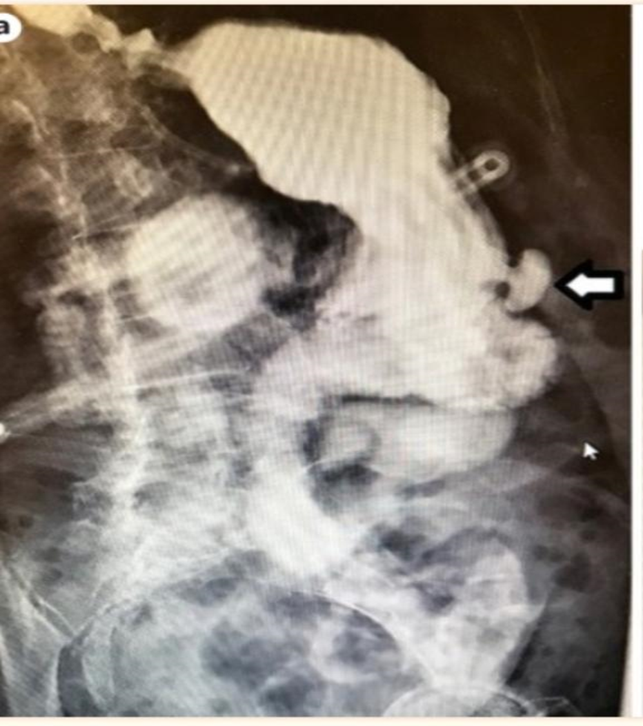
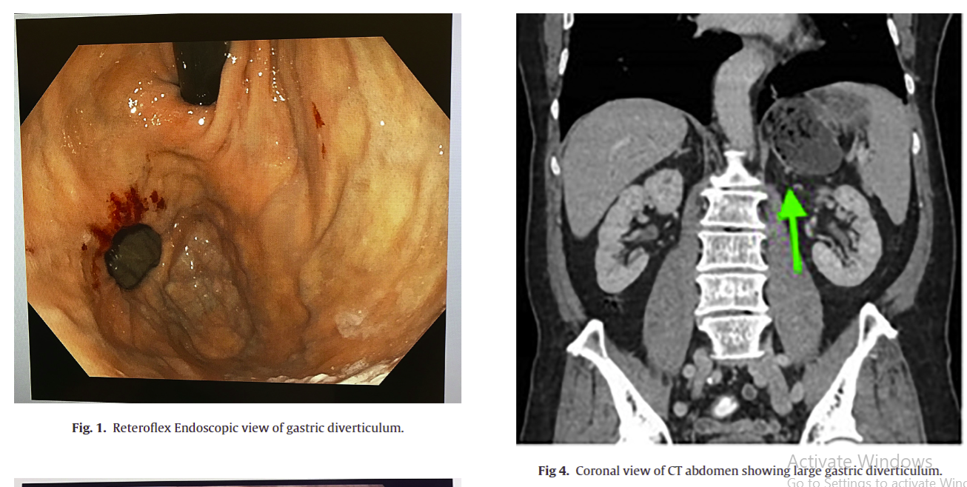
Large symptomatic gastric diverticula: Two case reports and a brief review of literature
https://pmc.ncbi.nlm.nih.gov/articles/PMC3785636/

Slide 8
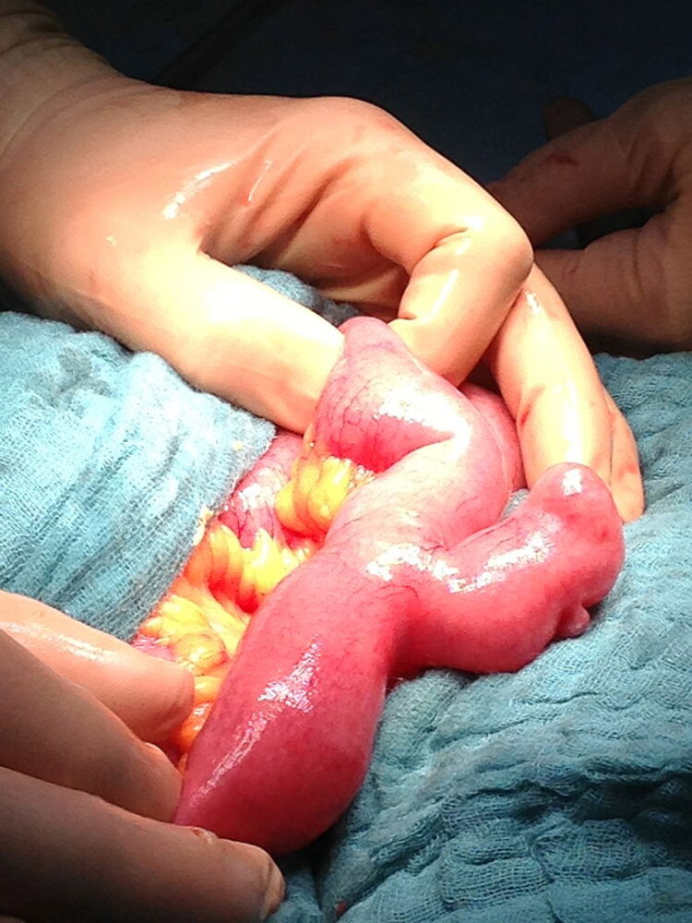
Small bowel diverticulum
Its less common than larg bowel even they can affect both at the same time
*** Classification
- Congenital : true type as meckels ( patent vitelline duct ) Rule of 2 (2%of population ) 2 cm in diameter , 2 inches in length , 2feet of iliocecal valve 2 time more in male n 2 hypertrophic tissue , Symptoms befor 2 years
- Acquired : false diverticulum(mainly couse by increase lntra abdominal pressure more located in deudonum

Slide 9
*** Clinical features : Mostly asymptomatic incedantly finding in endoscopy Cane come which complication like : obstructions Haemorrhage Malabsorption Perforation *** Dignosis by : enteroscopy and barium Ct and MRI for complications ***Management life style modification(increase fiber diet and physical activity) If no symptoms no need to intervention Diverticulitis ( antibiotic and IVF + NPO) Surgical mangment for complication

Slide 10
Colonic diverticula
● Colonic diverticula are more commonly found in the sigmoid but can affect the whole colon , rarely affect the rectum .
● this condition mostly a symptomatic ( diverticulosis ) but can also can be symptomatic ( diverticulitis ) or present as sepsis , hemorrhage ( complications ) .
● some of the risk factors are : low fiber diet / aging / smoking / obesity .
● inflammed or infected diverticula >> diverticultitis

Slide 11
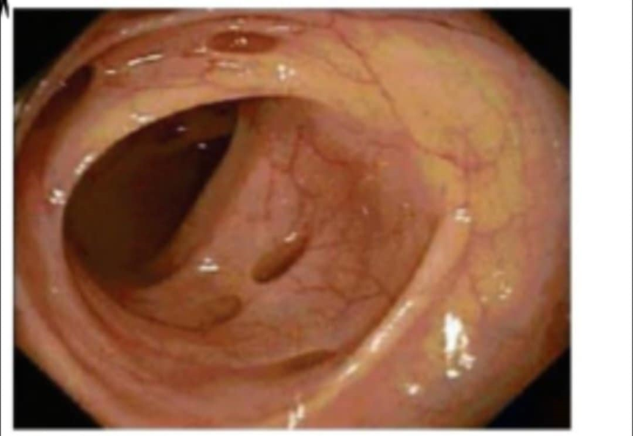
Clinical Presentation of Diverticulitis :
Symptoms:
Abdominal pain (typically lower left quadrant) Fever Nausea and vomiting Changes in bowel habits (diarrhea or constipation) Bloating and gas
Signs Physical Examination Findings: Tenderness in the lower left abdomen Guarding or rebound tenderness in severe cases Possible palpable mass in cases of abscess.

Slide 12
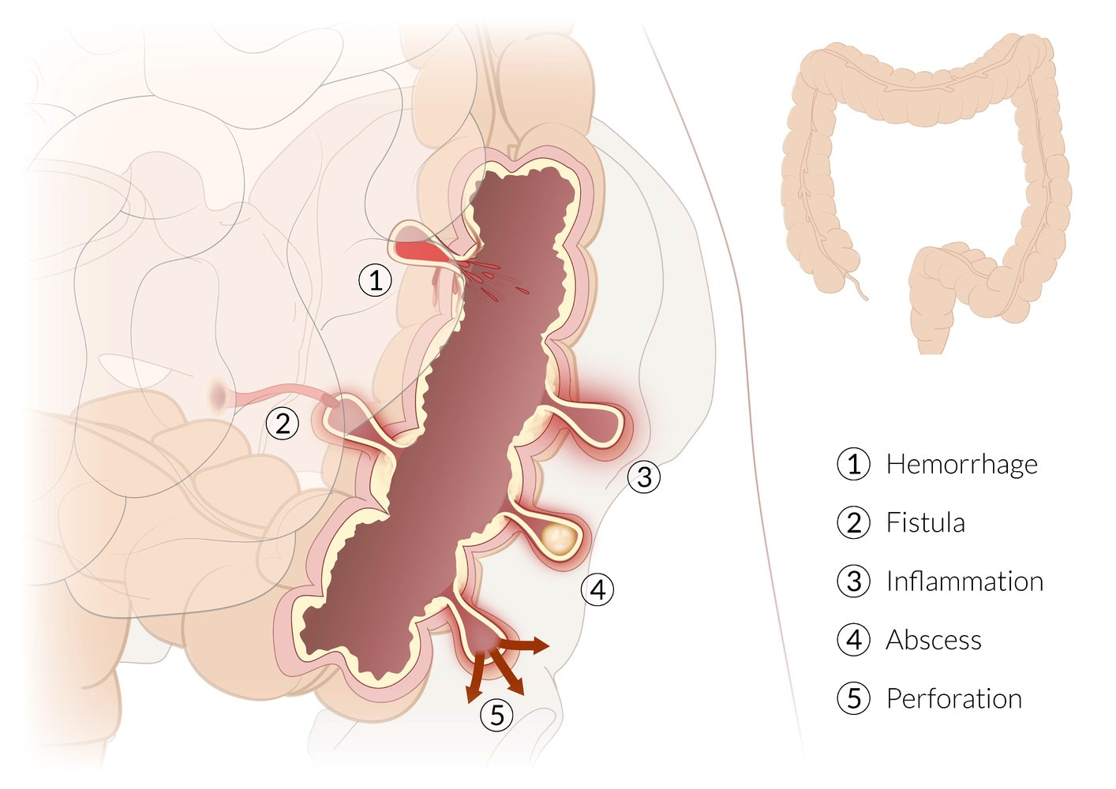
Diagnostic Indicators :
Elevated white blood cell count (leukocytosis)
- Imaging (colonoscopy \\ CT scan) shows diverticula, inflammation, or complications (abscess, perforation)

Slide 13
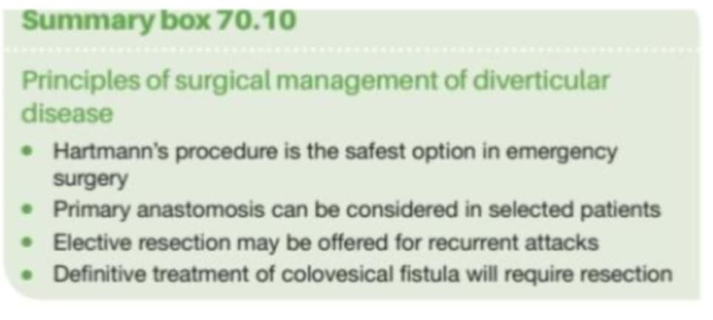
Management of Diverticulitis
1. Mild Cases (Outpatient Treatment): Dietary modifications: clear liquid diet initially, progress to low-fiber as tolerated. Oral antibiotics (e.g., ciprofloxacin and metronidazole). 2. Moderate to Severe Cases (Inpatient Treatment): NPO (nothing by mouth) status; IV fluids for hydration. IV antibiotics (broad-spectrum). Monitor for complications (abscess, perforation). 3. Surgical Intervention: Indicated for recurrent diverticulitis, complications, or failure of medical management. Options include resection or drainage of abscess. 4. Post-Recovery: Gradual reintroduction of a high-fiber diet. Regular follow-up to prevent recurrence.

