Slide 1
Inflammation Lecture 2
Dr.Bushra Al-tarawneh

Slide 2
Morphologic patterns of acute inflammation
Serous Inflammation.
Fibrinous Inflammation.
Suppurative Inflammation.
Membranous Inflammation.

Slide 3
Serous inflammation
Characterized by the outpouring of a watery, relatively protein-poor fluid that, depending on the site of injury, derives either from the plasma or from the secretions of mesothelial cells lining the peritoneal, pleural, and pericardial cavities.
Fluid in a serous cavity is called an effusion.
End with respiratory or cardiac impairment.
The skin blister resulting from a burn or viral infection is a good example of the accumulation of a serous effusion either within or immediately beneath the epidermis of the skin .

Slide 4
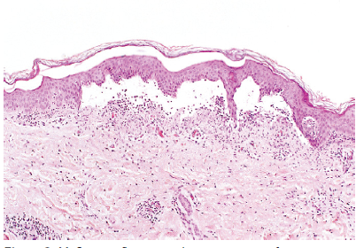
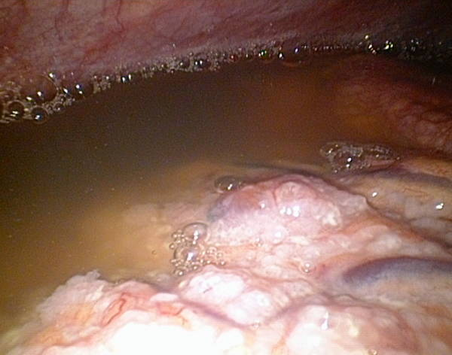
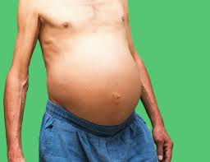
Serous pleural inflammation (Ascites)
Skin blister showing the epidermis separated from the dermis by a focal collection of serous effusion.

Slide 5
Fibrinous inflammation
Occurs in sever injuries.
There will be increase vascular permeability lead to exudation of large molecules (such as fibrinogen) passing the endothelial barrier.
Histologically, the accumulated extravascular fibrin appears as an eosinophilic meshwork of threads.
Exudates ► Resolution:
Degraded by fibrinolysis and the accumulated debris is removed by macrophages.
Exudates ► Organization ► Scarring.
Failure of removing fibrin completely ► ingrowths of fibroblasts and blood vessels.

Slide 6
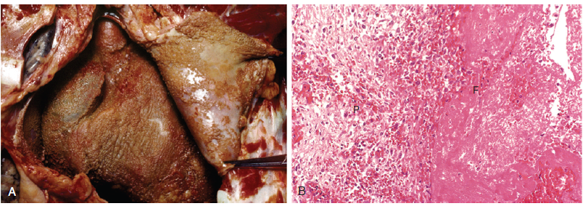
Organization of fibrinous pericardial exudate forms dense fibrous scar tissue that bridges or obliterates the pericardial space and restricts myocardial function.

Slide 7
Suppurative (purulent) inflammation
These are manifested by the collection of large amounts of purulent exudate (pus) consisting of neutrophils, necrotic cells, and edema fluid.
Certain organisms (e.g., staphylococci) are more likely to induce such localized suppuration and are therefore referred to as pyogenic (pus-forming).
Presented as abscess or ulcer.

Slide 8
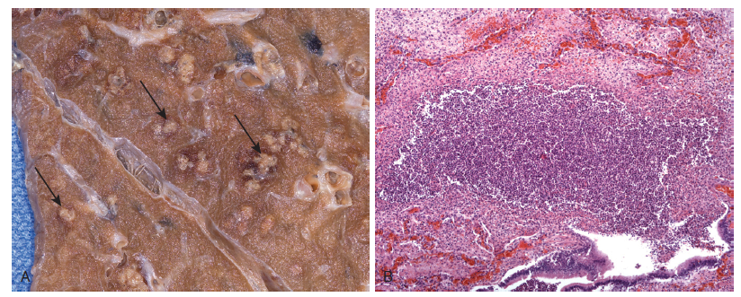
Abscess :Focal collection of pus caused by pyogenic organisms or by secondary infections of necrotic foci.
Composed of: Large amounts of purulent exudate (pus) consisting of neutrophils, necrotic cells and edema fluid.

Slide 9
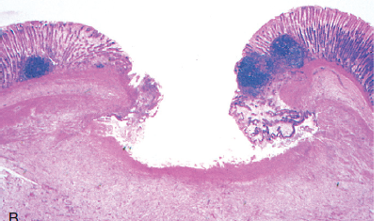
Ulcer: It is local defect, or excavation, of the surface epithelium produced by sloughing (shedding) of inflammatory necrotic tissue.
Ulcers are most commonly encountered in:
The gastrointestinalor genitourinarytract
The subcutaneous tissue.

Slide 10
Pseudomembranous inflammation of mucous membranes
Severe injury with extensive epithelial necrosis → sloughing → large shallow ulcers covered by false or pseudomembrane (white or creamy color layer).
Composed of: Fibrin, dead epithelium, neutrophils, red blood cells and bacteria.
Ex.:
Diphtheria and pseudomembranous colitis.

Slide 11
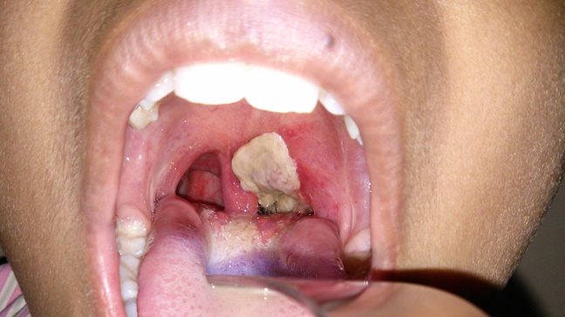
Pseudomembranous colitis : Inflammation of mucous membranes of colon.
Pseudomembrane
in Diphtheria

Slide 12
Categories of Chronic Inflammation
Chronic inflammation is inflammation of prolonged duration (weeks to years) in which continuing inflammation, tissue injury, and healing, often by fibrosis, proceed simultaneously.
It is either:-
1- Progression of acute inflammation to chronic.
Occurs when the acute response cannot be resolved due to:-
A. Persistence of the injurious agent.
B. Interference of normal healing process.
2- Chronic inflammation from the onset.
(e.g. Some viral infections)

Slide 13
Causative agents of chronic inflammation
1- Low-grade, persistent irritant agents that are unable to penetrate deeply or spread rapidly.
2- Moderate to low virulent microbes like viruses, certain bacteria, fungi, and larger parasites that are difficult to eradicate like:-
Mycobacteria Tuberculosis
Treponema pallidum Syphilis
Actinomyces Actinomycosis
3- Foreign bodies such as talc, silica, asbestos, and surgical suture materials.

Slide 14
Features of chronic inflammation
Long duration: Persists for weeks, months or years.
Tissue destruction: Greater than in acute inflammation (Induced by products of the inflammatory cells).
The inflammatory infiltrate is a mixture of mononuclear cells: Macrophages, lymphocytes and plasma cells.
Productive rather than exudative: Production of fibrous tissue through formation of granulation tissue.
Healing will occur by proliferation of large number of fibroblasts end with fibrosis. (Scar)

Slide 15
Microscopical features of chronic inflammation:
1.Infiltration by mononuclear cells:
Lymphocytes: B-lymphocytes→ plasma cell→ Ab.
T-lymphocytes → sensitized→ cytokines.
Plasma cells : Antibody-producing cells.
Macrophages: Blood monocytes when
extravasated it became activated macrophages.
Eosinophiles and mast cell: Specially presents in
allergic reaction.
2.Tissue destruction induced by infl. Cells.
3. Healing by granulation tissue composed of
macrophages, new blood vessels & fibroblasts.

Slide 16
Classification of chronic inflammation
1- Nonspecific chronic nflammation.
2- Granulomatous inflammation.

Slide 17
1. Nonspecific Chronic Inflammation
Infection
Chemotaxis.
Macrophages & lymphocytes infiltration
Fibroblast proliferation
Scar formation (Fibrosis)

Slide 18
2. Granulomatous inflammation
Granulomatous inflammation is a distinctive pattern of chronic inflammation characterized by aggregates of activated macrophages with scattered lymphocytes.
These macrophages will be activated and modified
to be similar to epithelial cells so called:
Epithelioid cells.
Many epithelioid cell united together forming:
Giant cell.
A dense membrane of connective tissue encapsulates
the lesion and isolates it.

Slide 19
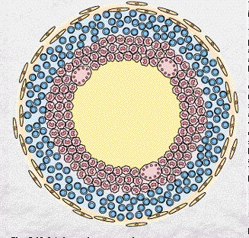
Diagram of typical TB granuloma
Multinucleated GC
Epithelioid cells
Caseation necrosis
Lymphocytes
Firoblasts

Slide 20
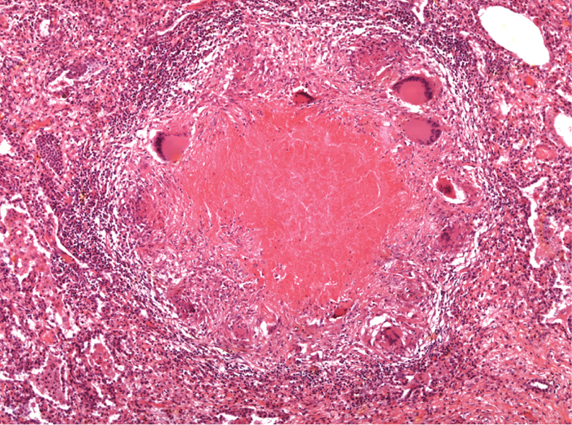

Slide 21
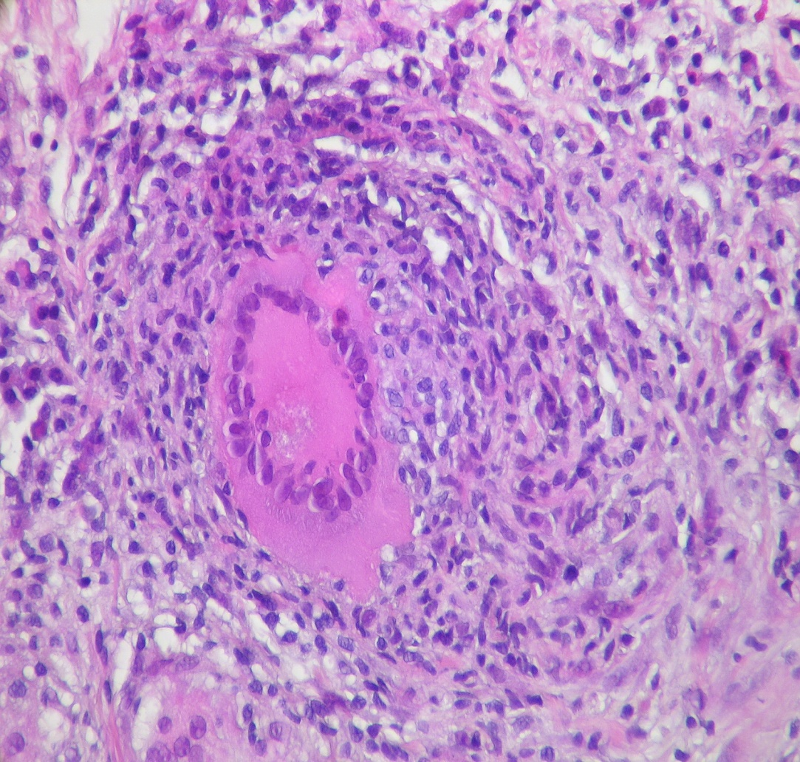
Giant cells
The epithelioid cells coalesce, forming a large, multinucleated giant cell that attempts to surround the foreign Agent.
.

Slide 22
Examples of granulomatous inflammation:

Slide 23
Chronic Inflammatory Cells
Chronic inflammatory cells:
Macrophage.
Lymphocytes:-
T & B lymphocytes
Eosinophils cells.
Mast cells.

Slide 24
Macrophages
It is the dominant cells of chronic inflammation derived from circulating blood monocyte after their emigration into the tissue forming tissue macrophage that scattered in all connective tissues.
1- Liver: Kupffer cells
2- Spleen and lymph nodes: Sinus histiocytes
3- Central nervous system: Microglial cells
4- Lungs : Alveolar macrophages

Slide 25
In all tissues macrophages act as:-
1. Filters for microbes.
2. Senescent cells to alert the immune system to
injurious stimuli. (T and B lymphocytes).
Activation of Macrophage:
Macrophages are activated by:-
1- Nonimmunologic stimuli like bacterial endotoxin.
2- Cytokines from immune-activated lymphocytes.

Slide 26
Differences between Activated macrophage and blood monocyte:
Increased cell size.
Increased content of lysosomal enzymes.
More active metabolism.
Greater ability to kill ingested organisms.
Longer half-lives.
Greater capacity for phagocytosis than monocytes.

Slide 27
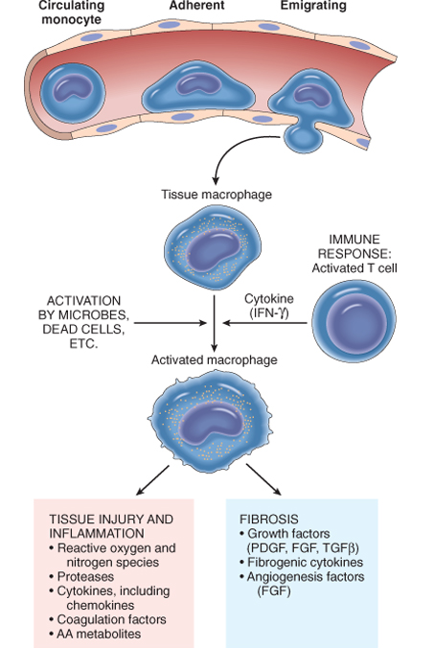
Macrophage Activation

Slide 28
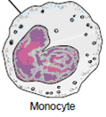
Macrophage Lymphocytes interaction
Lymphocytes & macrophages interact in a bidirectional way resulting in a cycle of cellular reactions that play an important role in chronic inflammation.
Macrophages produce cytokines (IL-12) activate T-lymph.
Activated
T-lymph.
activate macrophages
Produce cytokines (IFN-γ)
promoting more antigen presentation and cytokine secretion.

Slide 29
Lymphocyte
During chronic inflammation both T and B lymphocytes migrate into inflammatory sites
Activation of T and B lymphocytes
Activated T-Lymphocyte
Activated B-Lymphocyte
Plasma cells
Cytotoxic T-Lymphocyte
Natural Killer cells
Immunoglobulins

Slide 30
Plasma cells
Plasma cells produce antibodies directed against:
1- Persistent antigens in the inflammatory site.
2- Altered tissue components.
In some strong chronic inflammatory reactions the
accumulation of :-
Lymphocytes
Macrophages
Plasma cells
Have morphologic features of lymphoid organs, so appear
as lymph nodes.

Slide 31
Eosinophils
Eosinophils are found in:
1- Inflammatory sites around parasitic infections.
2- Part of immune reactions mediated by IgE,
associated with allergies.
Eosinophil granules contain major basic protein, a highly charged cationic protein that is toxic to parasites but also causes epithelial cell necrosis.

Slide 32
Mast cells
Widely distributed in the connective tissues throughout the body. Seen in acute & chronic inflammation.
In individuals prone to allergic reactions:
Mast cells are bounded with IgE antibody specific for certain antigens IgE-armed mast cells Release infl. Mediators Early vascular changes of inflammation.
IgE-armed mast cells are central players in allergic reactions, including anaphylactic shock.

Slide 33
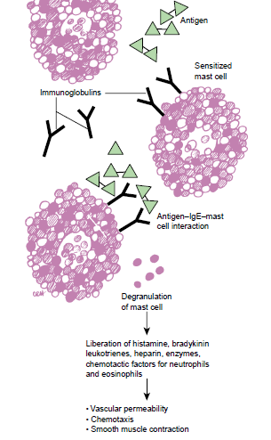
IgE

Slide 34
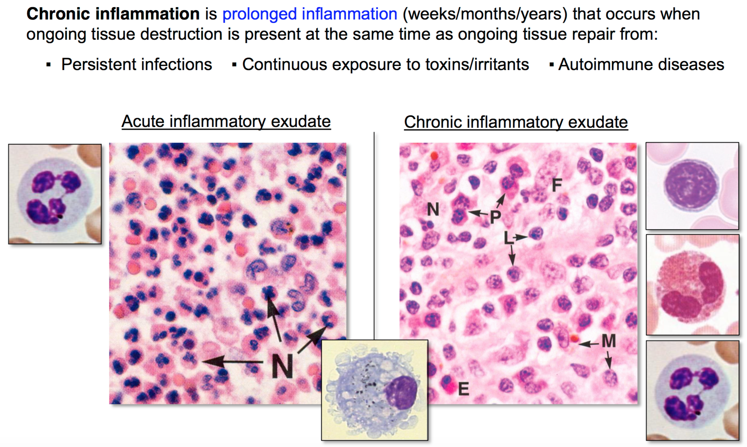

Slide 35
The components of acute and chronic inflammation

Slide 36
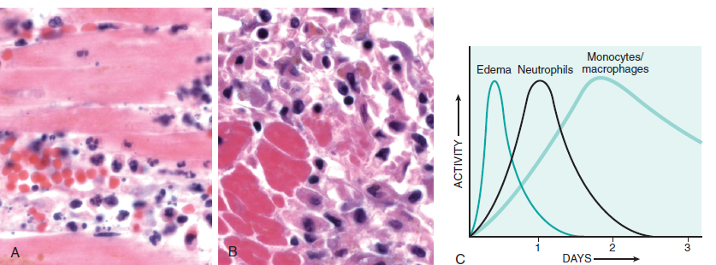
Thank You
Acute chronic

