Slide 1
Hemodynamic Disorders II
Hemostasis
Ghadeer Hayel, MD
Histopathologis 21/12/2020

Slide 2
Hemostasis
Hemostasis is a precisely orchestrated process occurs at the site of vascular injury & culminates in the formation of a blood clot, to prevent or limit the extent of bleeding.
involves platelets, clotting factors, & endothelium.
The arrest of bleeding – Hemo = Blood , Stasis = stop, slow
It is essential for life and deranged in many disorders, divided in two main groups:
Hemorrhagic disorders: excessive bleeding, hemostatic mechanisms are either blunted or insufficient to prevent abnormal blood loss.
Thrombotic disorders: blood clots (called thrombi) form within intact (non-traumatized) blood vessels or within the chambers of the heart.
2

Slide 3
Endothelium
Platelets
Clotting factors
Hemostasis
Clotting
Bleeding
Balance

Slide 4
The general sequence of events leading to hemostasis..
Arteriolar vasoconstriction
Primary hemostasis: the formation of the platelet plug
Secondary hemostasis: deposition of fibrin
Clot stabilization and resorption
4

Slide 5
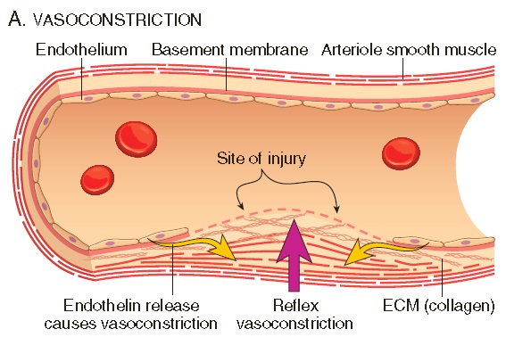
Arteriolar vasoconstriction
Occurs immediately & markedly reduces blood flow to the injured area .
mediated by: reflex neurogenic mechanisms & augmented by the local secretion of factors such as endothelin.
Endothelin a potent endothelium-derived vasoconstrictor.
This effect is transient → bleeding would resume if not for activation of platelets & coagulation factors.

Slide 6
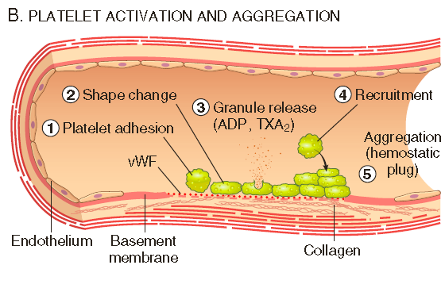
Primary hemostasis: the formation of the platelet plug
Disruption of the endothelium exposes subendothelial von Willebrand factor (vWF) & collagen.
Which Promote platelet adherence & activation →
A dramatic shape change (small rounded discs → flat plates with spiky protrusions that markedly increased surface area).
The release of secretory granules.
secretory granules products recruit additional platelets in minutes → aggregate to form a primary hemostatic plug

Slide 7
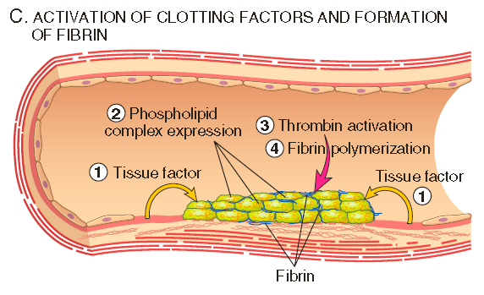
Secondary hemostasis: Deposition of fibrin.
Vascular injury also exposes tissue factor at the site of injury.
Tissue factor is a membrane-bound procoagulant glycoprotein , normally expressed by subendothelial cells in the vessel wall (smooth muscle cells & fibroblasts).
It binds & activates factor VII → a cascade of reactions → thrombin generation → Thrombin cleaves circulating fibrinogen → insoluble fibrin → creating a fibrin meshwork
Fibrin is a potent activator of platelets, leading to additional platelet aggregation
These events create the initial platelet plug.

Slide 8
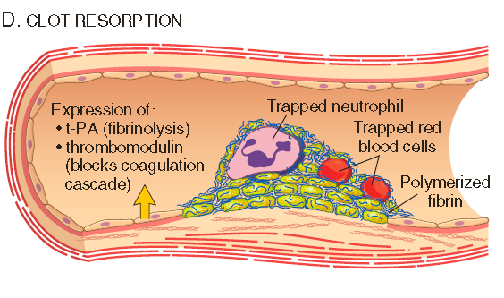
Clot stabilization & resorption
Polymerized fibrin & platelet aggregates undergo contraction to form a solid, permanent plug that prevents further hemorrhage.
At this stage, counter regulatory mechanisms (e.g., tissue plasminogen activator, t-PA made by endothelial cells) are set into motion that limit clotting to the site of injury.
This mechanisms eventually lead to clot resorption & tissue repair.

Slide 9
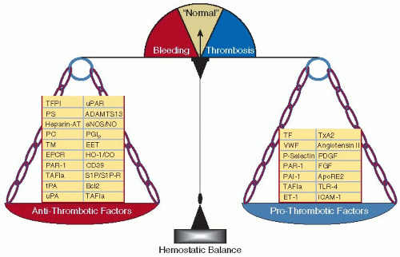
Endothelial cells are central regulators of hemostasis; balance between anti-thrombic & prothrombotic activities of endothelium determines whether thrombus formation, propagation, or dissolution occurs.
Normal endothelial cells express a variety of anticoagulant factors that inhibit platelet aggregation & coagulation, & promote fibrinolysis.
Trauma, microbial pathogens, hemodynamic forces, & a number of pro-inflammatory mediators shift the balance, & endothelial cells acquire numerous procoagulant activities.
Endothelium modulates the functions of platelets and can trigger coagulation.
9

Slide 10
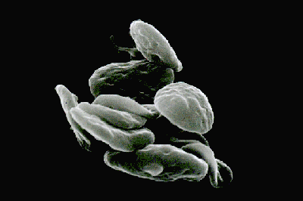
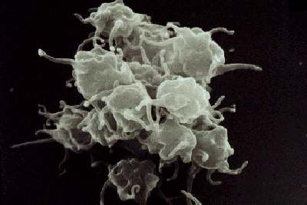
Platelets
Critical role in hemostasis by (1) forming the primary plug → initially seals vascular defects & (2) providing a surface that binds &concentrates activated coagulation factors.

Slide 11
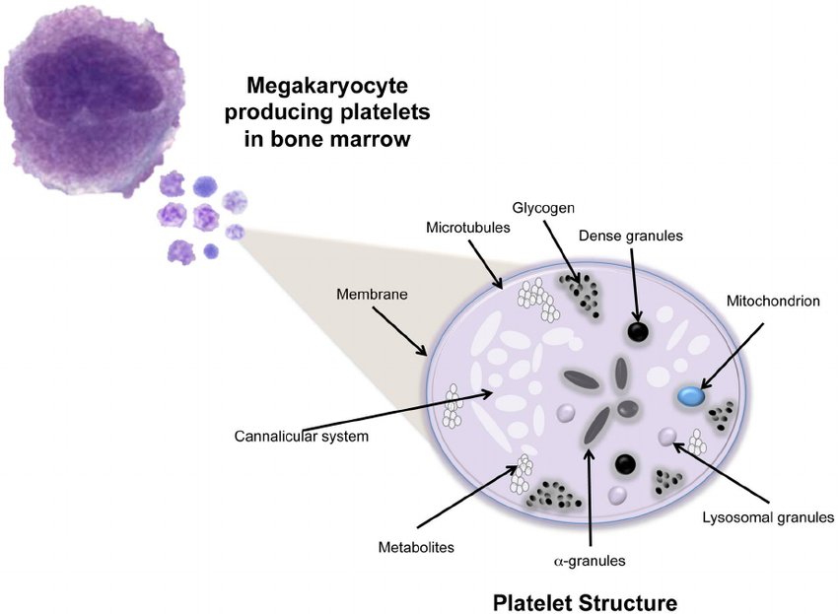
Platelets are disc-shaped anucleate cell fragments
Shed from megakaryocytes in bone marrow to the blood.
Their function depends on several glycoprotein receptors, a contractile cytoskeleton, & two types of Cytoplasmic granules:

Slide 12
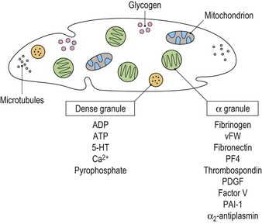
α-Granules: Adhesion molecule P-selectin on their membranes. Contian coagulation proteins (fibrinogen, coagulation factor V, & vWF), also wound healing proteins (fibronectin, platelet factor 4,platelet-derived growth factor (PDGF), transforming growth factor-β).
Dense (δ) granules: Contain ADP, ATP, Ca+2, serotonin , & epinephrine.

Slide 13
After a traumatic vascular injury → platelets encounter vWF & collagen → Four events in the formation of a platelet plug:
Platelet adhesion
Platelet activation
Platelet aggregation
Fibrin formation & support of local coagulation

Slide 14
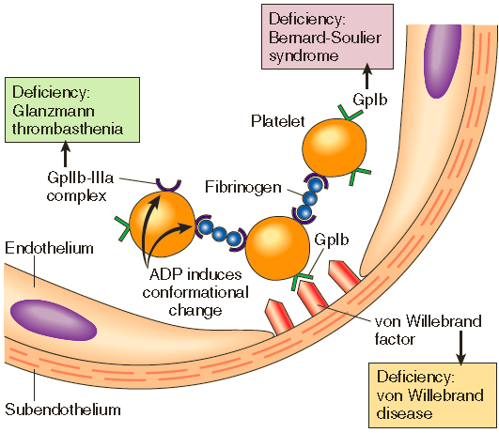
Platelet adhesion
Is mediated mainly via interactions with vWF → acts as a bridge between the platelet surface receptor glycoprotein Ib (GpIb) and exposed collagen.
Genetic deficiencies of vWF (vonWillebrand disease) or GpIb (Bernard-Soulier syndrome) result in bleeding disorders.

Slide 15
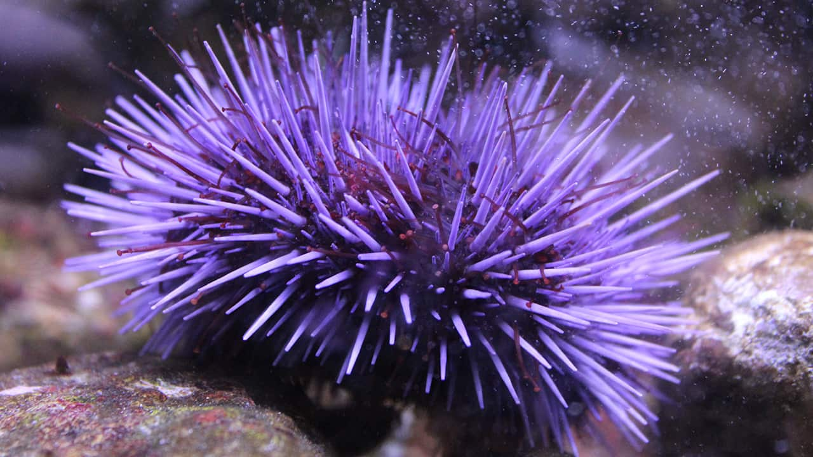
Platelet activation
+ Platelets rapidly change shape following adhesion → from smooth discs to spiky “sea urchins” → greatly increased surface area.
+ alterations in glycoprotein IIb/IIIa that increase its affinity for fibrinogen,
+ the translocation of negatively charged phospholipids (particularly phosphatidylserine) to the platelet surface. (bind calcium & serve as sites for the assembly of coagulation factor complexes).
+ Secretion (release reaction) of granule contents occurs with changes in shape; these two events referred to together as platelet activation

Slide 16
Platelet activation
Platelet activation triggered by a number of factors:
+ Thrombin activates platelets through protease-activated receptor (PAR)
+ ADP causes additional rounds of platelet activation (recruitment).
+ Activated platelets also produce the prostaglandin thromboxane A2 (TXA2), a potent inducer of platelet aggregation.
+Aspirin inhibits platelet aggregation & produces a mild bleeding defect by inhibiting cyclooxygenase, a platelet enzyme that is required for TXA2 synthesis.

Slide 17
Platelet aggregation
Conformational change in glycoprotein IIb/IIIa occurs with platelet activation allows binding of fibrinogen
Fibrinogen, a large bivalent plasma polypeptide that forms bridges between adjacent platelets → aggregation.
Inherited deficiency of GpIIb-IIIa results in a bleeding disorder called Glanzmann thrombasthenia.

Slide 18
The initial wave of aggregation is reversible, but concurrent activation of thrombin stabilizes the platelet plug → causing further platelet activation & aggregation & by promoting irreversible platelet contraction.
Platelet contraction is dependent on the cytoskeleton & consolidates the aggregated platelets.
In parallel, thrombin also converts fibrinogen into insoluble fibrin, cementing the platelets in place & creating the definitive secondary hemostatic plug.

Slide 19
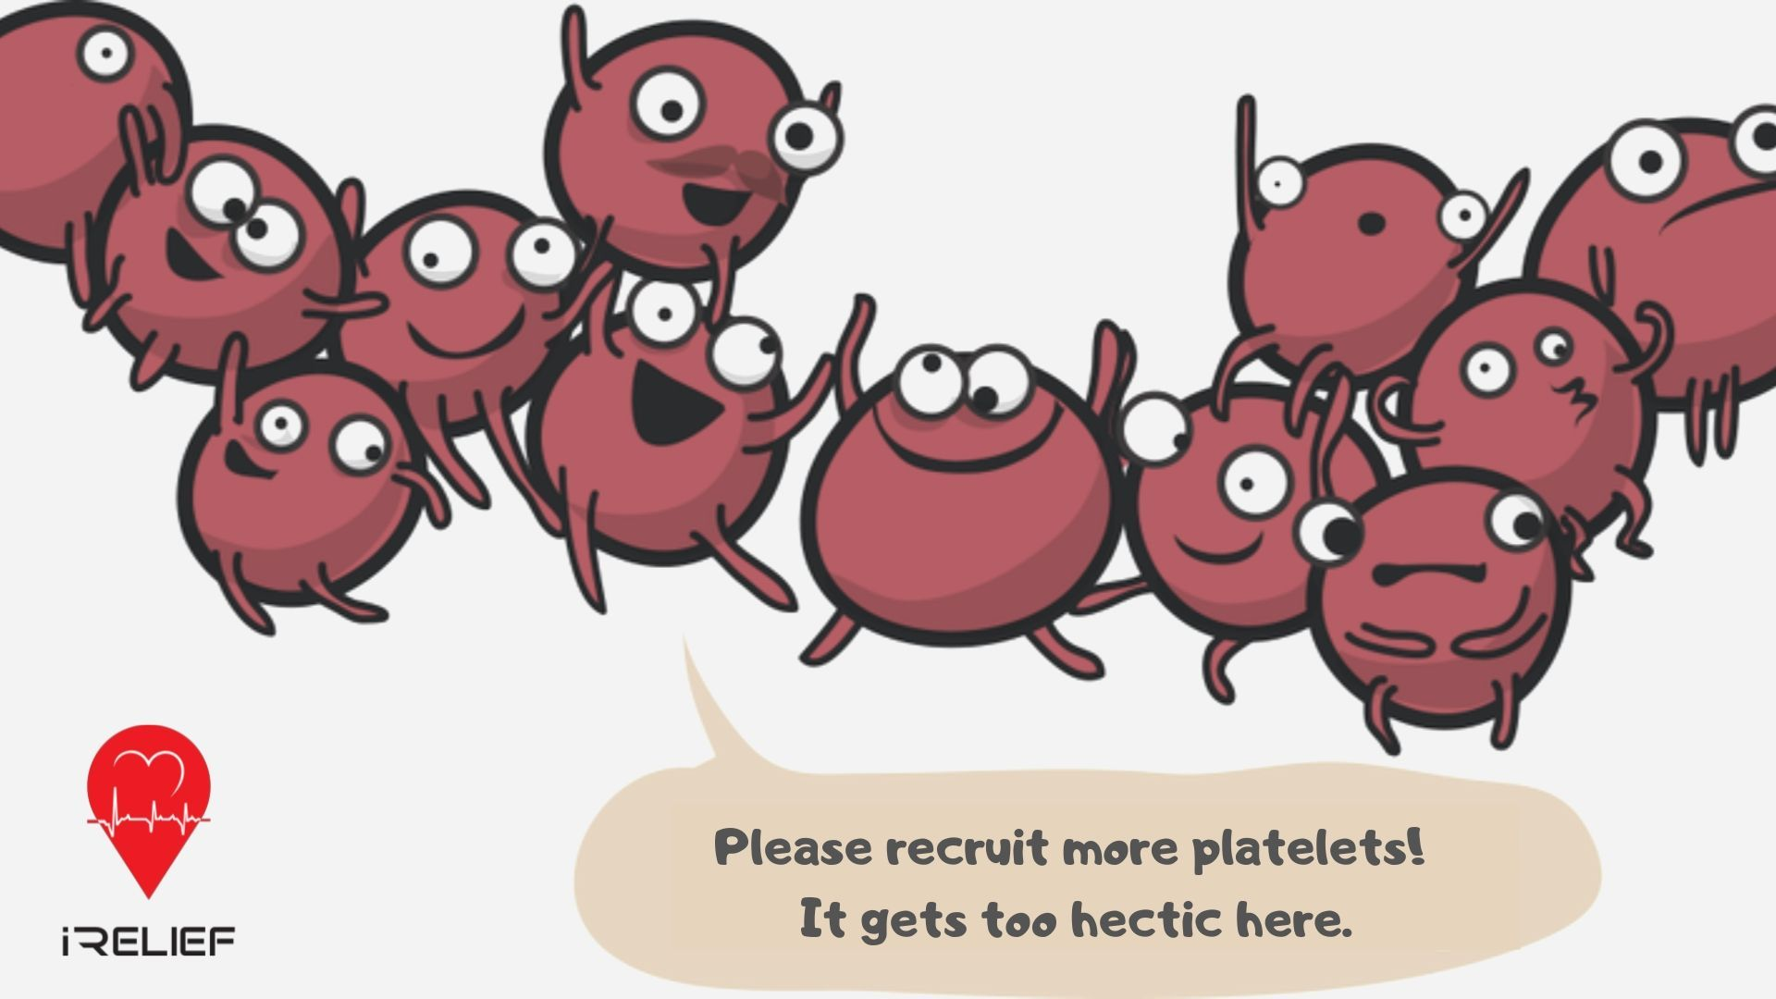
Thank You!
19

