Slide 1
Restrictive lung diseases
Dr. Omar Hamdan M.D
Anatomical Histopathologist
Mutah University
Faculty of Medicine
Respiratory pathology lectures 2020

Slide 8
Restrictive lung disease
These are a heterogeneous group of disorders characterized by inflammation and pulmonary interstitial tissue fibrosis involving alveolar walls; many have unknown causes.
The clinical and functional changes are those of restrictive lung disease; diffusing capacity, lung volumes, and compliance are all compromised without evidence of airway obstruction.
Secondary pulmonary hypertension and cor pulmonale are long-term sequelae. Although the early stages of the different entities can often be distinguished histologically, there is substantial morphologic overlap, and most devolve to a common end-stage marked by parenchymal destruction and scarring, called honey-comb lung.

Slide 9
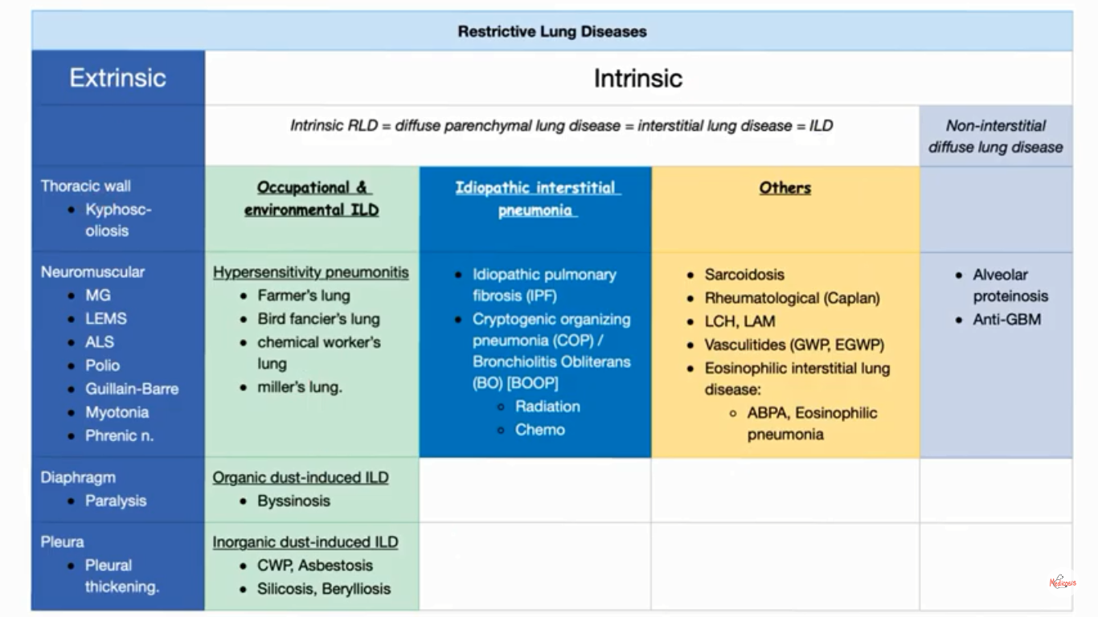

Slide 13
Idiopathic pulmonary fibrosis
Idiopathic pulmonary fibrosis is a disorder of unknown cause characterized by progressive pulmonary interstitial fibrosis.
Pathogenesis:
Repeated cycles of epithelial activation/injury by some unidentified agent are postulated to cause abnormal “wound healing,” resulting in excessive fibroblast proliferation; transforming growth factor-b1 (TGF-b1) is the likely driver, both by inducing fibrosis and also by promoting epithelial cell apoptosis.

Slide 14
Morphology:
Patchy interstitial fibrosis has a characteristic subpleural and interlobular septal distribution, as well as lower lobe predominance.
There is heterogeneity of the histologic changes; new cellular fibroblastic foci with moderate inflammation coexist with older, more densely fibrotic areas.
Destruction of the alveolar architecture leads to honeycomb lung with dense fibrosis and cystic spaces lined by hyperplastic type II pneumocytes.

Slide 15
Clinical Course:
The disease typically has an insidious onset between ages 40 and 70 years marked by dyspnea and a dry cough.
The course progression is unpredictable in any given patient, but most have a gradual deterioration with hypoxemia and cyanosis despite anti-inflammatory and anti-proliferative therapies.
Mean survival is 3 years or less; lung transplantation is the only definitive therapy.

Slide 21
Nonspecific Interstitial Pneumonia
Nonspecific interstitial pneumonia (NSIP) is a diffusely fibrosing disease of unknown etiology, patient presented with chronic dyspnea and cough.
The histologic pattern shows either moderate interstitial inflammation or interstitial fibrosis without the temporal heterogeneity seen in UIP.
The prognosis for NSIP is better than for UIP.

Slide 25
Cryptogenic Organizing Pneumonia
Formerly called bronchiolitis obliterans organizing pneumonia (BOOP), cryptogenic organizing pneumonia (COP) has an unknown etiology. Patients presented with cough and dyspnea, with patchy subpleural or peribronchial consolidation.
Histologically, there are loose fibrous tissue plugs (Masson bodies) within bronchioles, alveolar ducts, and alveoli, but there is no interstitial fibrosis or honeycombing.
Patients can spontaneously recover, although most require steroid therapy.

Slide 31
Pulmonary Involvement in Connective Tissue Diseases
Pulmonary involvement in connective tissue diseases (e.g., systemic lupus erythematosus, rheumatoid arthritis, and scleroderma) is common.
patterns include NSIP, UIP, vascular sclerosis, organizing pneumonia, and bronchiolitis.
Prognosis is variable (depending on the underlying disease) but is better than for idiopathic UIP.

Slide 32
Pneumoconiosis
Pneumoconiosis are the non-neoplastic lung responses to inhaled aerosols, including mineral dusts, organic dusts and fumes.
In general, only a small percentage of an exposed population develops a respiratory disease, suggesting a genetic predisposition in those affected.

Slide 33
Pathogenesis:
Amount of dust retained.
duration of exposure and effectiveness of clearance mechanisms.
Size and shape of particles: Particles between 1 and 5 mm are the most dangerous because they can reach terminal alveoli and settle in their linings.
Physicochemical reactivity (toxicity) and particle solubility: Highly soluble particles may rapidly cause toxicity; insoluble particles may persist and cause a chronic fibrosis.
Additional effects of other irritants (e.g., cigarette smoking)

Slide 34
COAL WORKERS’ PNEUMOCONIOSIS
The spectrum of pulmonary effects of carbon dust varies from asymptomatic anthracosis to simple coal workers’ pneumoconiosis (CWP) without significant pulmonary dysfunction to complicated CWP or progressive massive fibrosis (PMF) with compromised lung function.
The factors underlying the progression from simple CWP to PMF are not understood; possibilities include the duration and magnitude of exposure, contaminants in the carbon (e.g., silicates), and the propensity of an individual’s coal dust–laden macrophages to produce fibrogenic cytokines.

Slide 35
Morphology:
In anthracosis: Inhaled carbon is taken up by alveolar and interstitial macrophages, which then accumulate in lymphatics and lymphoid tissues.
In simple CWP: 1 to 2 mm coal macules are composed of dust filled macrophages; slightly larger coal nodules also contain delicate networks of collagen. These are located primarily adjacent to respiratory bronchioles.
In PMF: Large, blackened collagenous scars (often with central ischemic necrosis) replace substantial portions of the lung.

Slide 36
Clinical Course:
CWP usually causes little functional abnormalities; PMF will develop in less than 10%, with associated respiratory insufficiency and pulmonary hypertension, and it may be progressive even without further exposures.

Slide 38
SILICOSIS
Prolonged inhalation of silica particles produces a chronic, progressive, nodular fibrosis.
Pathogenesis:
Crystalline forms of silica (vs. amorphous forms) are most fibrogenic; ingestion by macrophages causes their activation, with release of oxidants, cytokines, and growth factors that ultimately cause fibroblast proliferation and collagen deposition.
Interestingly, silica mixed with a variety of other minerals (e.g., iron) is less fibrogenic.

Slide 39
Morphology:
Collagenous nodules start in the upper lung, becoming larger and more diffuse with disease progression. Lesion coalescence forms large areas of dense scar. Calcification or concomitant blackening by coal dust often occurs. Eggshell calcification in nodes on x-ray may be seen.
Microscopically, there are hyalinized whorls of collagen with scant inflammation. Polarized light reveals birefringent silica particles.

Slide 40
Clinical Course:
Dyspnea is not usually present until progressive massive fibrosis has developed; the disease can progress even after exposure ends. Silicosis is associated with increased susceptibility to tuberculosis, likely due to depressed cell-mediated immunity.

Slide 42
Thank you ????
STAY HOME----STAY SAFE

