Slide 1
Anatomy &Physiology of erection and ejaculation

Slide 2
The penile shaft is composed of 3 erectile columns, the 2 corpora cavernosa and the corpus spongiosum, The single corpus spongiosum lies in the ventral groove between the 2 corpora cavernosa. The urethra passes through the corpus spongiosum

Slide 3
The erectile tissue within the corpora contains arteries, nerves, muscle fibers, and venous sinuses lined with flat endothelial cells, and it fills the space of the corpora cavernosa.

Slide 4
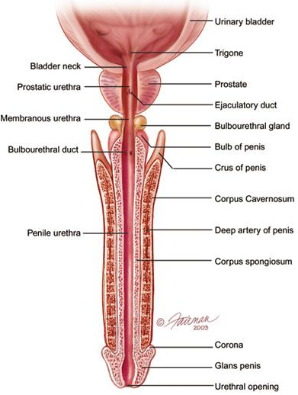
Anatomy of the penis
Notes:
.

Slide 5
Arterial supply
The blood supply to deep structures of the penis is derived from a continuation of the internal pudendal artery, after it gives off the perineal branch. Three branches of the internal pudendal artery flow to the penis, as follows:

Slide 6
The artery of the bulb (bulbourethral artery) passes through the deep penile (Buck) fascia to enter and supply the bulb of the penis and penile (spongy) urethra
The dorsal artery travels along the dorsum of the penis between the dorsal nerve and deep dorsal vein and gives off circumflex branches that accompany the circumflex veins; the terminal branches are in the glans penis
The deep penile (cavernosal) artery is usually a single artery that arises on each side and enters the corpus cavernosum at the crus and runs the length of the penile shaft, giving off the helicine arteries, which are an integral component of the erectile process

Slide 7
Blood supply to the skin of the penis is from the left and right superficial external pudendal arteries, which arise from the femoral artery

Slide 8
Arterial supply
main artery is from the internal iliac : internal pudendal artery
Accessory arteries : Obturator artery vesical arteries femoral arteries
Notes:
internal pudendal artery branches : Inferior rectal artery Perineal artery Posterior scrotal branches Artery of bulb of penis Dorsal artery of the penis Deep artery of the penis Blood supply to the skin of the penis is from the left and right superficial external pudendal arteries, which arise from the femoral artery

Slide 9
venous drainages
The penis is drained by 3 venous systems, the superficial, intermediate, and deep
Superficial veins are contained in the dartos fascia on the dorsolateral surface of the penis and coalesce at the base to form a single superficial dorsal vein, which usually drains into the great saphenous veins via the superficial external pudendal veins.

Slide 10
Dorsal penile veins ????
These are the veins are going to be compressed to prohibit blood from draining

Slide 11
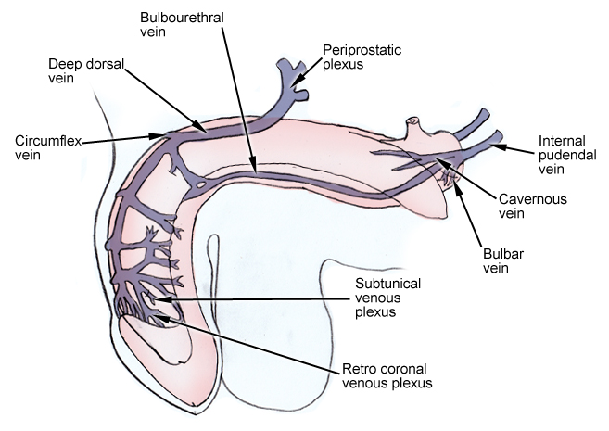
Venous drainage
Notes:
The penis is drained by 3 venous systems, the superficial, intermediate, and deep Veins are compressed as the sinusoides expand …… this inhibit drainage of the penus …… it stays erect

Slide 12
Lymphatic drainage
Lymphatic drainage from the glans penis drains into large trunks in the area of the frenulum. These lymphatic vessels then circle to the dorsum of the corona and unite, coursing proximally beneath the deep penile (Buck) fascia, terminating mostly in the deep inguinal nodes of the femoral triangle. Some lymphatic drainage is to the presymphyseal lymph nodes and to the lateral lymph nodes of the external iliac lymphatics.

Slide 13
Notes:
Libido = desire Dopamine increase sexual activity in parkinson disease ….. cell death in the brain's basal ganglia (affecting the dopamine secreting neurons) ….. Decrease dopamine …. decrease libido and diminished sexual response Serotonin decrease sexual activity SSRIs (antidepressant) …. Increase serotonin ….. Side effect : decrease libido and diminished sexual response

Slide 14
Mechanism of erection
Neuroendocrine signals from the brain, created by audiovisual or tactile stimuli, activate the autonomic nuclei of the spinal erection centre . Signals are relayed via the cavernosal nerve to the erectile tissue of the copora cavernosa, activating the veno-occlusive mechanism
Notes:
*Humans are highly visual in their sexual responsiveness - on the average males are more responsive to visual releasing stimuli than females - studies using brain imaging showing that for visually sexually eraosing material that not only men on the average subjectively more responsive , but also get more activation of dopamine and dopamine pathways in men than in women - what is interesting also is that men uniquely get activation of the amigdala and other areas of the brain on visually sexual stimuli * tactile stimuli is also very important in the sexual responsivness - what is clear that tactile receptors responsivness to stimuli will change according to your hormon level - that is more noticed and obvious in women for example the tactile stimulation evokes more dopamine activation when the women is ovulating *another interesting stimuli is the olfactory stimuli (phermons) has a small role in humans compared to other species

Slide 16
Corpus cavernosa
Notes:
Veins are compressed as the sinusoides expand …… this inhibit drainage of the penus …… it stays erect

Slide 17
Innervation
1-stimulation (somatic) - stimulation of genitals - sensed by pudendal nerve - conducted to S2-S4 via pudendal nerve 2-erection is caused by (parasympathetic) - parasympathetic arise in the (lateral horns grey matter of S2-S4) -and then the pelvic splanchnic go to pre-aortic and prostatic plexuses go to penis - NO causes vasodilation of deep penile arteries - blood fill erectile tissue
- compression of veins
s
Notes:
NO : nitric oxide

Slide 18
Innervation
3-emission (sympathetic) is the beginning part of ejaculation and it is initiated by
sympathetic (lateral horns of T11-L2) - lumber and sacral splanchnic to pre-aortic plexuses to spermatic tubes and then synapse and
- NE causes : peristaltic contractions of the ductus deferens , seminal vesicle , prostatic gland contracts and then ???>? you get contraction of the internal urethral sphincter
Notes:
- semen don’t mix with urine - semen don’t go retrogradely into the urinary bladder - in kaplan its considered in the emission phase (that’s to say that ejaculation is purely somatic) but I followed Toronto because its our main reference

Slide 19
- semen don’t mix with urine
- semen don’t go retrogradely into the urinary bladder

Slide 20
4-ejaculation (sympathetic + somatic) - constriction of internal urethral sphincter (sympathetic) - impulse arising from ventral horn S2-S4 - pudendal nerve conducts the motor impulse causing - rhythmic contractions of bulbospongiosus and ischiocavernosus muscles (somatic

Slide 21
Innervation
Central: medial preoptic area (MPOA) and paraventricular nucleus (PVN) in the hypothalamus are important centres for sexual function and penile erection.
Notes:
medial preoptic area this brain region is involved in the sexual behavioral phases appetitive phase : includes all male behaviors that will gain access to females and females gain info about the quality of the male (attracting / motivation) consummatory phase : If she selects him, copulation occurs. Sexually dimorphic nucleus is located in the MPOA

Slide 22
Phases of erectile process
description | term | phase
Cavernosal smooth muscle contracted; sinusoids empty; minimal arterial flow | Flaccid phase | 0
Increased pudendal artery flow; penile elongation | Latent (filling ) phase | 1
Rising intracavernosal pressure; erection forming | Tumescent phase | 2
Increased cavernosal pressure causes penis to become fully erect | Full erection phase | 3
Further increases in pressure + ischiocavernosal muscle contraction | Rigid erection phase | 4
Following ejaculation, sympathetic discharge resumes; there is smooth muscle contraction and vasoconstriction; reduced arterial flow; blood is expelled from sinusoidal spaces | Detumescence phase | 5

Slide 23
Thank you

Slide 24
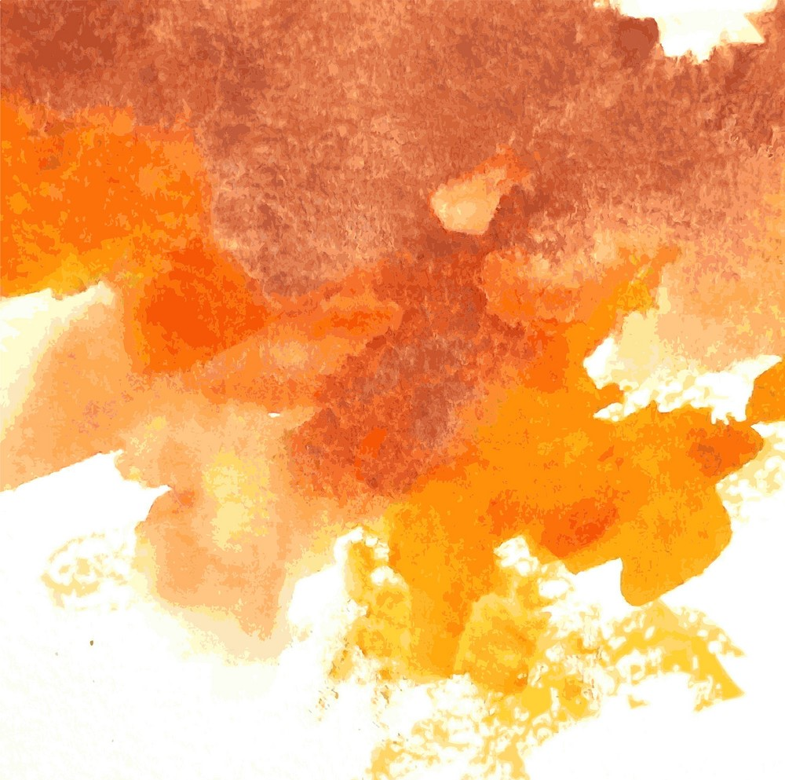
Erectile dysfunction evaluation & treatment
Fadi Abu-Tair

Slide 25
Definition
Erectile dysfunction (ED) (also called impotence) describes the ‘consistent or recurrent inability to attain and/or maintain a penile erection sufficient for sexual intercourse

Slide 26
Epidemiology
In men aged 40–70y
mild ED is found in 17%
moderate ED in 25%
complete ED in 10%
Incidence increases with age with complete ED affecting
15% of men in their 70’s
30–40% in their 80’s

Slide 27
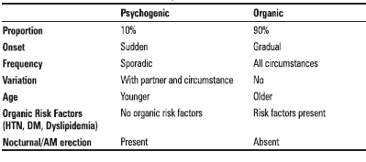
Aetiology
ED is generally divided into psychogenic and organic causes It is often multifactorial.
organic causes : Gradual onset (unless associated with an obvious cause such as surgery, where onset is acute)
Loss of spontaneous erections
Intact libido and ejaculatory function

Slide 28
Causes of IMPOTENCE
Inflammatory Iatrogenic | Prostatitis pelvic surgery/pelvic radiation
Mechanical | Peyronie's disease
Psychological | Depression; anxiety; relationship difficulties; lack of attraction; stress
Occlusive vascular factors | Arteriogenic: hypertension; smoking; hyperlipidaemia; diabetes mellitus; peripheral vascular disease
 | Venogenic: impairment of veno-occlusive mechanism (due to anatomical or degenerative changes)
Trauma | Pelvic fracture; spinal cord injury; penile trauma
Extra factors | Other: increasing age; chronic renal failure; cirrhosis
Neurogenic | CNS: multiple sclerosis (MS); Parkinson's disease; multi-system atrophy; tumour
 | Spinal cord: spina bifida; MS; syringomyelia; tumour
 | PNS: pelvic surgery or radiotherapy; peripheral neuropathy (diabetes, alcohol-related)
Chemical | Antihypertensives (beta-blockers, thiazides, ACE inhibitors)
 | Anti-arrhythmics (amiodarone)
 | Antidepressants (tricyclics, MAOIs, SSRIs)
 | Anxiolytics (benzodiazepine)
 | Anti-androgens (finasteride, cyproterone acetate)
 | LHRH analogues
 | Anticonvulsants (phenytoin, carbamazepine)
 | Anti-Parkinson drugs (levodopa)
 | Statins (atorvastatin – lipitor®)
 | Alcohol
Endocrine | Hypogonadism; hyperprolactinaemia; hypo and hyperthyroidism; diabetes mellitus
Note that this list of causes of impotence is not in the order of frequency. Key: MAOIs = monoamine-oxidase inhibitors; SSRIs = serotonin re-uptake inhibitors; BNF = British National Formulary.

Slide 29
History
Sexual: onset of ED (sudden or gradual); duration of problem; presence
of erections (nocturnal, early morning, spontaneous); ability to maintain
erections (early collapse, not fully rigid); loss of libido; relationship issues
(frequency of intercourse and sexual desire).
Sexual function symptom questionnaires: International Index of Erectile Function (IIEF)
Medical and surgical: enquire about risk factors, including diabetes mellitus (ED affects 50% overall and 30% of treated diabetics); cardiovascular disease; hypertension; peripheral vascular disease; endocrine or neurological disorders; pelvic and penile surgery, radiotherapy, or trauma (which damage innervation and blood supply to the pelvis and penis).
Psychosocial: assess for social stresses, anxiety, depression, coping problems, patient expectations, and relationship details.
Drugs: enquire about current medications and ED treatments already tried and their outcome.
Social: smoking, alcohol consumption.

Slide 30
Examination
Full physical examination (cardiovascular, abdomen, neurological)
DRE to assess the prostate; assess secondary sexual characteristics
external genitalia assessment to document foreskin phimosis, penile deformities and lesions (Peyronie’s plaques); confirm presence, size, and location of testicles.
The bulbocavernosus reflex can be performed to test integrity of spinal segments S2–4 (squeezing the glans causes anal sphincter and bulbocavernosal muscle contraction).

Slide 31
Investigation
Blood tests: fasting glucose; serum (free) testosterone (taken 8.00–11.00 a.m.); fasting lipid profile are basic work-up tests. SHBG; U&E; LH/FSH; prolactin; PSA; thyroid function test should be selected according to patient’s history and risk factor profile.
Nocturnal penile tumescence and rigidity testing: the Rigiscan device contains two rings that are placed around the base and distal penile shaft to measure tumescence and number, duration, and rigidity of nocturnal erections. Useful for diagnosing psychogenic ED and for illustrating this diagnosis to patients.
Penile colour Doppler USS: measures arterial peak systolic and end diastolic velocities, pre- and post-intracavernosal injection of PGE1.
Cavernosography: imaging and measurement of penile blood flow after intracavernosal injection of contrast and induction of artificial erection, used to identify venous leaks.
Penile arteriography: reserved for trauma-related ED in younger men. Pudendal arteriography is performed before and after drug-induced erection to identify those requiring arterial bypass surgery (although this is less commonly indicated now with the advent of modern penile prostheses).
- MRI: useful for assessing penile fibrosis and severe cases of Peyronie’s disease.

Slide 32
Nocturnal penile tumescence

Slide 33
treatment
Correct any reversible causes (i.e. alter lifestyle, stop smoking, change medication, etc.)
Psychosexual therapy
Aims to understand and address underlying psychological issues and provides information and treatment in the form of sex education, psychosexual counselling
instruction on improving partner communication skills
cognitive therapy and behavioural therapy (programmed relearning of couple’s sexual relationship).
Pharmacotherapy may be a useful adjuvant.

Slide 34
1-Phosphodiesterase type-5 (PDE5) inhibitors:
first-line therapies
sildenafil (ViagraR), tadalafil (CialisR), vardenafil (LevitraR)
enhance cavernosal smooth muscle relaxation
by blocking the breakdown of cGMP by phosphodiesterase.
Sexual stimulus is still required to initiate events.
Success is reported in up to 80%.
Early use of PDE5 inhibitors following radical prostatectomy can help optimize the return of spontaneous erections (penile rehabilitation).
Contraindications:
patients taking nitrates
recent myocardial infarction
recent stroke
hypotension
unstable angina, non-arteritic anterior ischaemic
optic nerve neuropathy (NAION).
Cautions: intermediate and high risk cardiovascular disease requires cardiac review prior to treatment
use with A-blockers, groups with predisposition to priapism.

Slide 35
2-Dopamine receptor agonist:
apomorphine (UprimaR)
taken sublingually
acts centrally on dopaminergic receptors in the paraventricular nucleus of the hypothalamus
enhance and coordinate the effect of sexual stimuli.
Side effects: nausea, headache, dizziness
Not commonly used

Slide 36
3-Intraurethral therapy:
second-line therapy when oral therapies have been ineffective.
A synthetic prostaglandin E1 (PGE1) pellet (alprostadil)
placed into the urethra via a specialized applicator (Medicated Urethral System for Erection (MUSE)TM device).
Once inserted, the penis is gently rolled to encourage the pellet to dissolve into the urethral mucosa fromwhere it enters the corpora.
PGE1 acts to increase cAMP within the corporal smooth muscle, resulting in muscle relaxation.
Side effects: penile and urethral pain, priapism, local reactions.

Slide 37
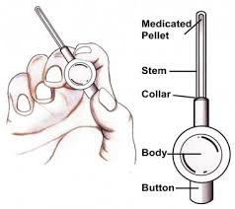

Slide 38
4-Intracavernosal injection therapy
Alprostadil (CaverjetTM).
Papaverine (PDE inhibitor).
Usually given in combination with either phentolamine (A-adrenoceptor antagonist) or PGE1
Who have failed oral or single-agent injectable therapies.
Training of technique and first dose is given by a health professional.
Needle is inserted at right angles into the corpus cavernosum on the lateral aspects of mid-penile shaft.
Discontinuation rates from penile injection techniques are high.
Contraindications: sickle cell disease or high-risk candidate for priapism.
Adverse effects: pain, priapism, haematoma

Slide 40
Vacuum erection device
Used when pharmacotherapies have failed.
It contains three components: a vacuum chamber, pump, and constriction band
The penis is placed in the chamber and the vacuum created by the pump increases blood flow to the corpora cavernosa to induce an erection.
The constriction band is placed onto the base of the penis to retain blood in the corpora and maintain rigidity.
Relative contraindication: anticoagulation therapy.
Side effects: penile coldness, bruising.
Microvascular arterial bypass and venous ligation surgery
Used in: specialist centres where there is a clear-cut diagnosis of a vascular disorder.
Acts to increase arterial inflow and decrease venous outflow.
Rarely used now as it is uncommon for success rates to exceed 50%.

Slide 41
Penile prosthesis
Semi-rigid, malleable, and inflatable penile prostheses
other therapies have failed or are unsuitable
Also indicated for Peyronie’s disease, trauma, and penile fibrosis (i.e. secondary to priapism).
The device is surgically implanted into the corpora to provide penile rigidity and generally has high satisfaction rates, up to 90%
Side effects: infection, erosion, mechanical failure, penile shortening, glans may not fully engorge.
Testosterone replacement therapy
Indicated for hypogonadism
available in oral, buccal, intramuscular, pellet, transdermal patch, and gel forms.
Most guidelines recommend PSA, Hb, and LFT checks before and after starting treatment
It can improve the results of PDE5 inhibitors in hypogonadal men.

Slide 42
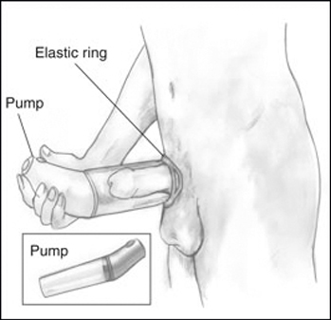
Penile prosthesis
Vacuum erection device

Slide 43
Peyronie’s disease
An acquired benign penile condition characterized by deformity of the
penile shaft secondary to the formation of a fibrous inelastic scar on the
tunica albuginea.
Epidemiology
Prevalence is 3–9%, predominantly affecting men aged 40–60y.
Pathophysiology
excessive connective tissue (fibrosis) and increased cellularity with random orientation of collagen fibres. Dorsal penile plaques are most common (66%).
The corpus cavernosus underlying the lesion cannot lengthen fully on erection, resulting in penile curvature.
The disorder has two phases:
Active phase (1–6 months)
Quiescent (stable) phase (9–12 months
Presented as
penile pain, a palpable lump (plaque),
penile curvature, ED (in 40%),

