Slide 1
ABDOMINAL INCISIONS
Supervised by: Dr Mohammad Nofal and
Dr. Anas Batikhi
Presented by: Mahmoud Qandeel and Shareef Marar

Slide 2
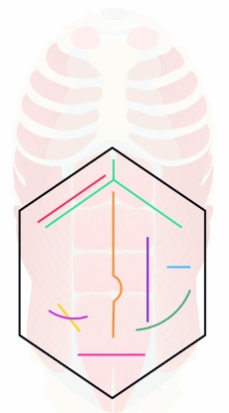
ABDOMINAL INCISIONS
An abdominal incision refers to a surgical cut made anywhere on the abdomen. This enables access to deeper tissue to facilitate an operation by gaining access to the intra-abdominal or intra-pelvic cavities.

Slide 3
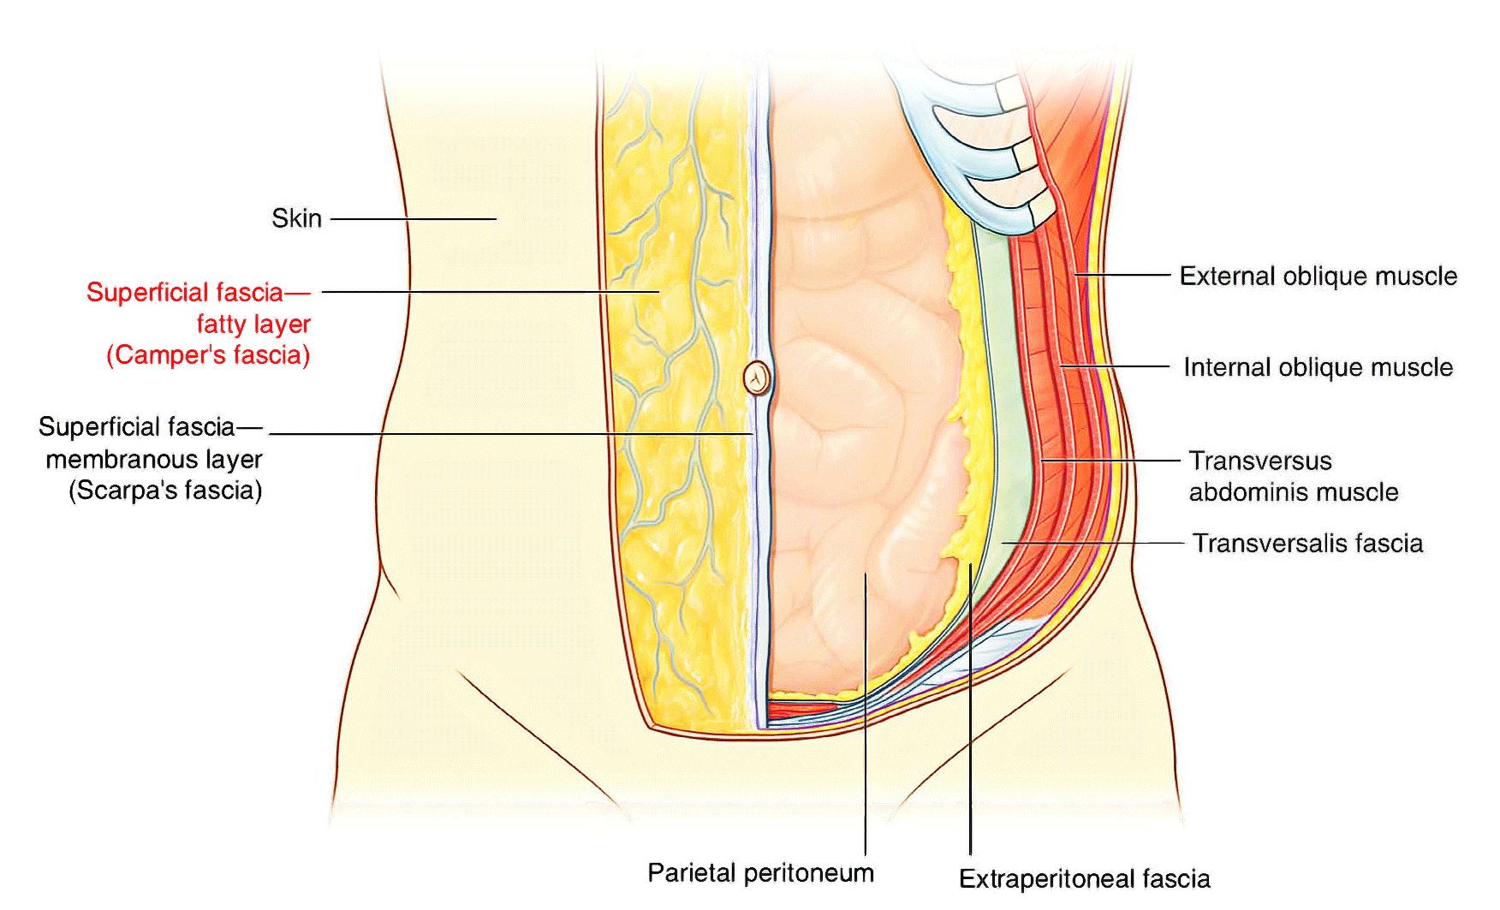
Abdominal wall layers
The abdominal wall is defined cranially by the xiphoid process of the sternum and the costal margins and caudally by the iliac and pubic bones of the pelvis.

Slide 4
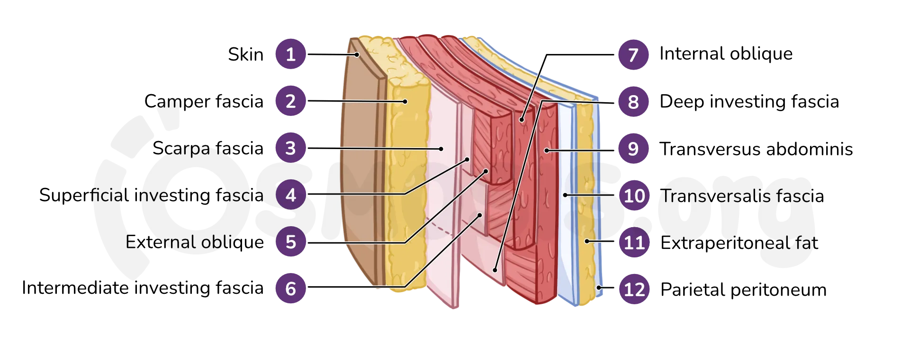
Abdominal wall layers

Slide 5
The ideal incision
The ideal incision should allow for consistently good access, following the langer lines for maximal wound strength and minimal scaring, muscles should be split not cut, and being easily opened and closed.

Slide 6
The langer’s lines
The langer’s lines are lines of skin tension parallel to the neutral orientation of the collagen fibers in the dermis and underlying muscle fibers.
Its surgical importance is that when aligning a surgical incision or excision with skin tension lines, it results in minimal tension across the closure of the defect, which leads to optimal scar formation and minimises wound contraction.

Slide 7
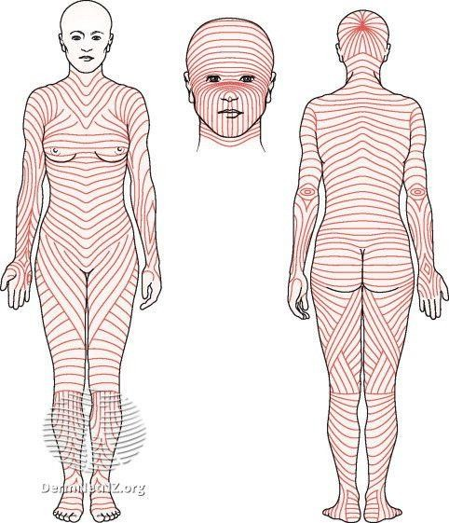
The langer’s lines

Slide 8
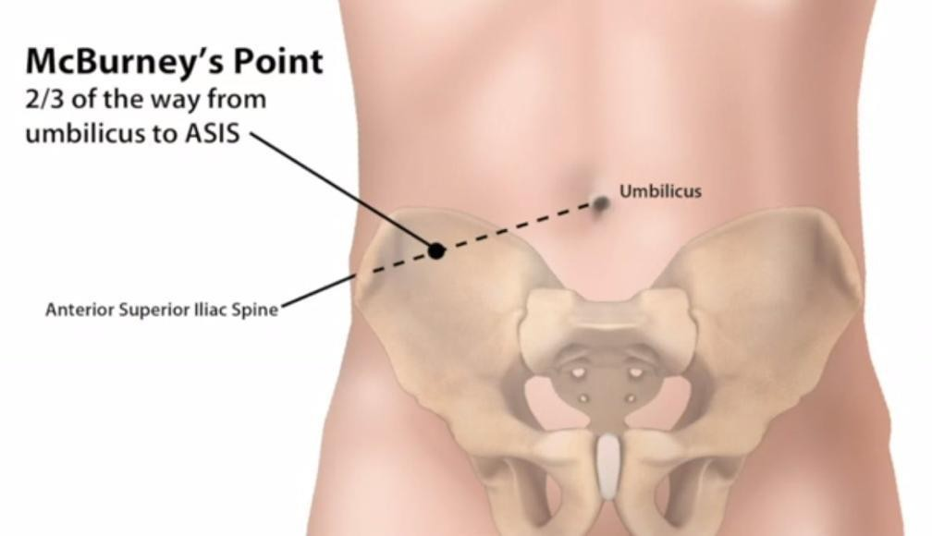
McBurney's point
This point corresponds to the base of the appendix where it is attached to the cecum (beginning of the large intestines)

Slide 9
Gridiron and Lanz Incisions
The Gridiron and Lanz Incisions are both incisions
that can be used to have an access to the appendix,
predominantly for appendectomy.
The lanz incision is a transverse incision while the gridiron
is oblique. While the Gridiron incision is oriented along the
Langer Lines, the lanz incision produces better exposure,
easier extension, when needed, and much more
aesthetically pleasing results.

Slide 10
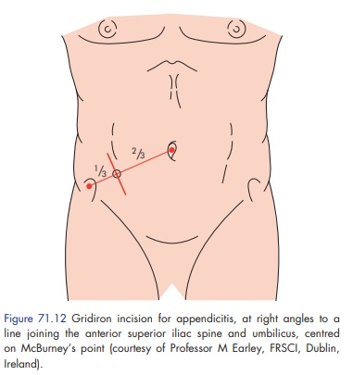
Gridiron Incision

Slide 11
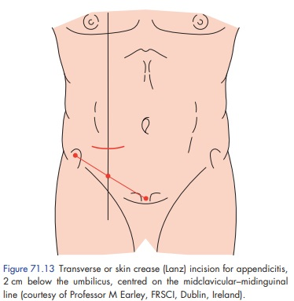
Lanz Incision

Slide 12
Gridiron and lanz incisions
Both incisions cut through:-
Skin
Subcutaneous fat and fascia
External and internal obliques
Transversus abdominis
Transversalis fascia.
Disadvantage of these incisions is that there is a risk of injury to the ilioinguinal and iliohypogastric nerves.

Slide 13
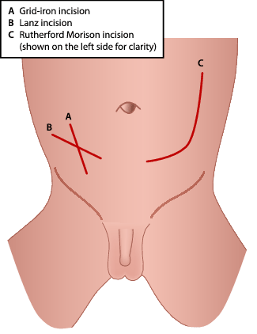
Gridiron and lanz incisions
If better access is required, it is possible to convert the gridiron to a Rutherford Morison incision by cutting the internal oblique and transversus muscles in the line of the incision.

Slide 14
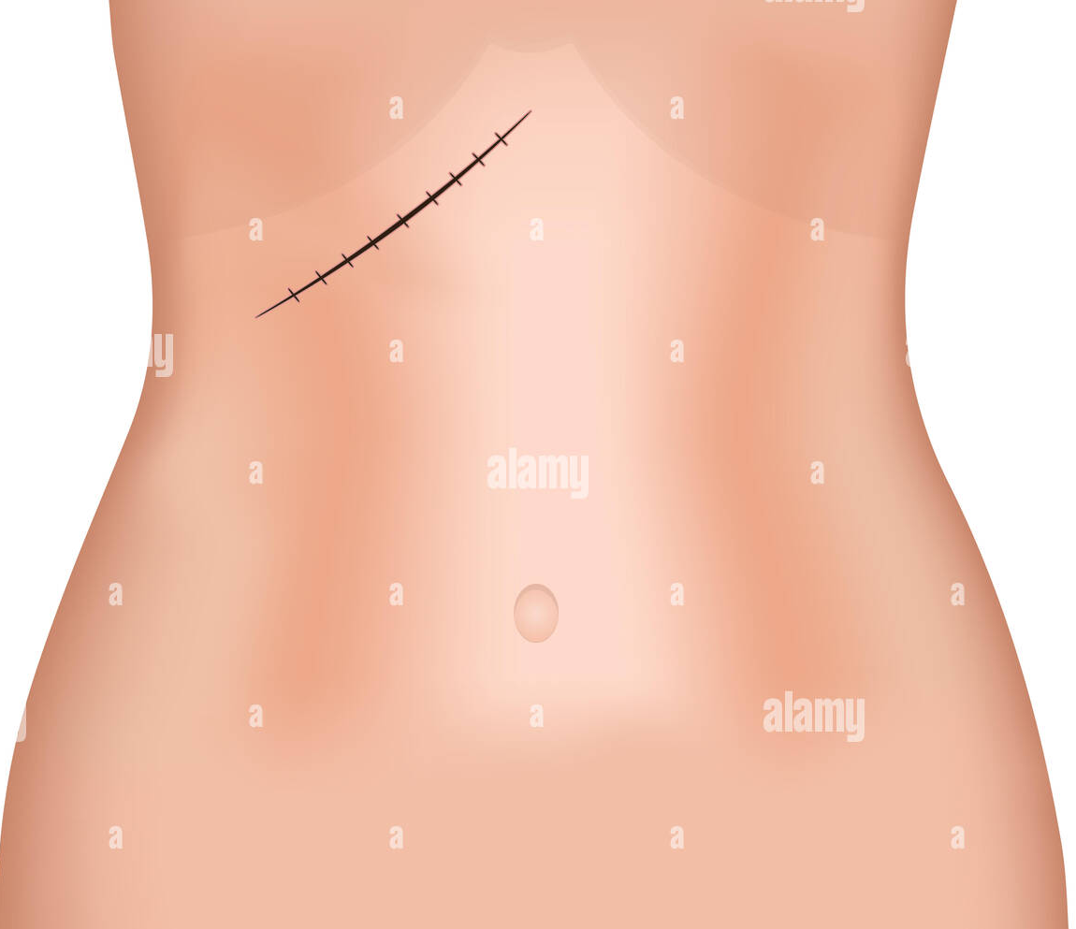
Kocher incision
Kocher incision is an abdominal incision made to get an access the underlying liver, gallbladder and biliary tree.
It is placed approximately 3 cm below and parallel to the costal margin.

Slide 15
Kocher incision
Kocher incision cut through:
Skin
Superficial fascia: I. Camper's fascia (fatty layer) 2. Scarpa's fascia
(Membranous layer)
Lateral half : External oblique / Internal oblique / Transversis abdominis
Medial half: anterior rectus sheath /Rectus abdominis/ posterior rectus sheath
Transversalis fascia
Extraperitoneal fat
peritoneum
Disadvantages include the risk of injuring the superior epigastric vessels, lateral extension of the incision and risks disruption of intercostal nerves.

Slide 16
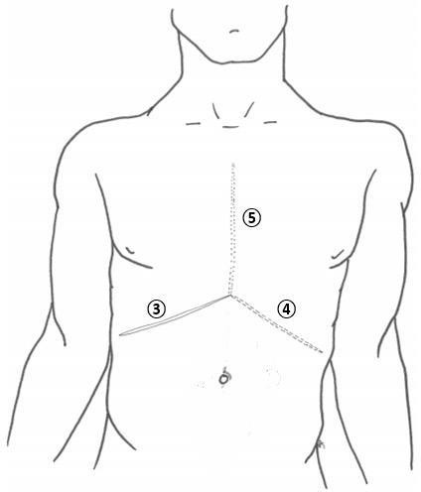
Chevron incision
Chevron incision is essentially an extension of the Kocher incision across the midline to involve the other side of the abdomen. (4 in picture)
It is important for gaining good access to the upper abdomen for major surgery
This incision may be combined with a sternotomy incision (5 in picture) during cardiac or liver surgery. This combined incision
is known as a 'Mercedes-Benz’
incision.

Slide 17
Indications of the Incisions
Indications of the kocher incision: gall bladder and biliary tract operation (usually open cholecystectomy).
Cheveron incisions may be used for oesophagectomy, gastrectomy, bilateral adrenalectomy, hepatic resections, or liver transplantation.
Mercedes benz may be used for the same indications as the Chevron incision, and diaphragmatic hernia, however classically seen in liver transplantation.

Slide 18
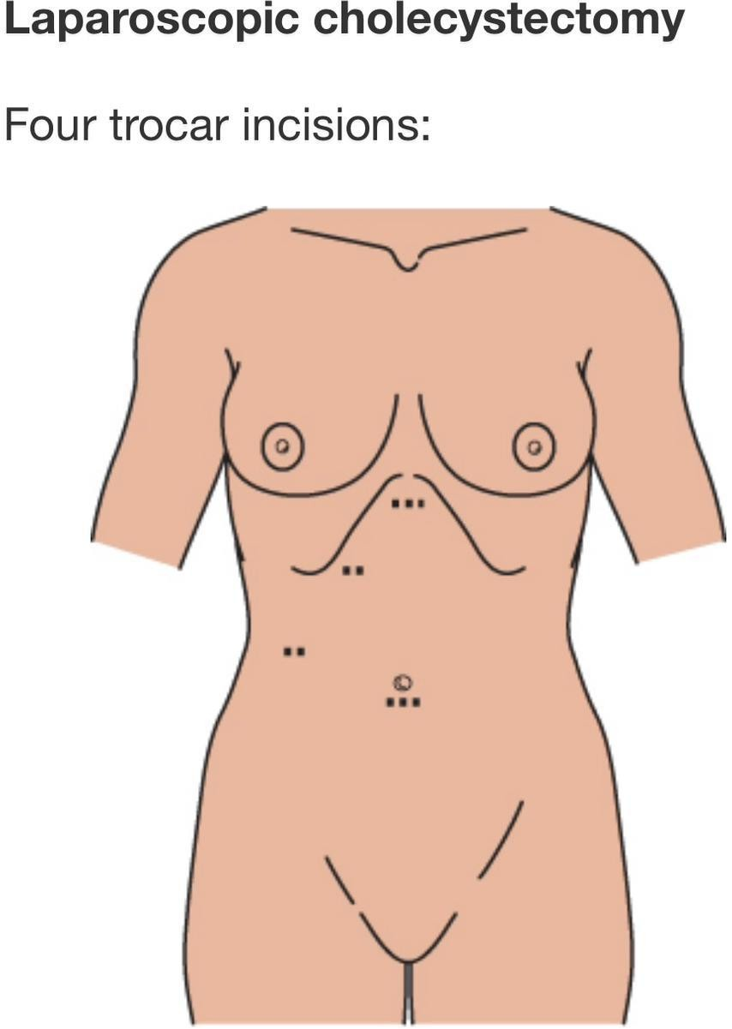

Slide 19
Midline laparotomy
This common approach may be used to access most intra-abdominal structures, including those of the retroperitoneum.
It utilizes the relatively avascular nature of the Linea alba to access the abdominal contents without cutting or splitting muscle fibers in the process, apart from the small pyramidalis muscle at the pubic crest.
It is often performed in an emergency as it provides the most rapid entry into the abdomen, such as (fecal peritonitis secondary to malignant intestinal perforation, ischaemic bowel, trauma etc.)

Slide 20
Midline laparotomy

Slide 21
Midline laprotomy
A midline incision will encounter the following layers of tissue:
Skin
Subcutaneous fatty layer (Camper’s fascia)
Membranous fascia (Scarpa’s)
Linea alba
Transversalis fascia
Preperitoneal fat
Parietal peritoneum
Disadvantages include that patients experiencing more pain than they would from a transverse incision, particularly during deep breathing postoperatively, and the incision is perpendicular to the Langer’s skin tension lines resulting in poorer cosmetic results.

Slide 22
Midline laprotomy
Immediate complications of a midline laparotomy incision may include:
Anaesthetic difficulties
Haemodynamic instability
Primary haemorrhage from cut vessels*
Iatrogenic injury to surrounding tissues and viscera
Linea alba generally lacks blood supply and innervation, but a few small blood vessels cross to the opposite side over its anterior surface.

Slide 23
Midline laprotomy
Wound dehiscence following midline laparotomy is a particularly distressing event for the patient, whereby classically a serosanguinous discharge is noted from the wound 7-10 days postoperatively, and a day or so later the whole wound may burst open and spill the patient’s intestines into their lap.
Risk factors for wound dehiscence can be:
Patient-specific (i.e. immunocompromised, smoking, obesity, jaundice, diabetes, steroid use, previous radiotherapy, vascular disease)
Procedure-specific (i.e. surgical technique, site and orientation of incision, intra-operative contamination, lengthy procedure)

Slide 24
Transverse incision
Transverse incisions will usually follow the natural skin tension lines leading to a better cosmetic result during closure. A variety of incisions can be made to perform both abdominal and pelvic surgery. They may be performed above or below the umbilicus.
Small transverse incisions may be used to form/close stomas or to extract laparoscopic resection specimens.
The Pfannenstiel incision is an example of a commonly employed transverse incisions.

Slide 25
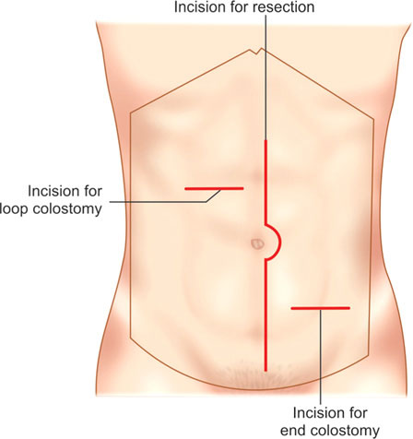
Transverse incision

Slide 26
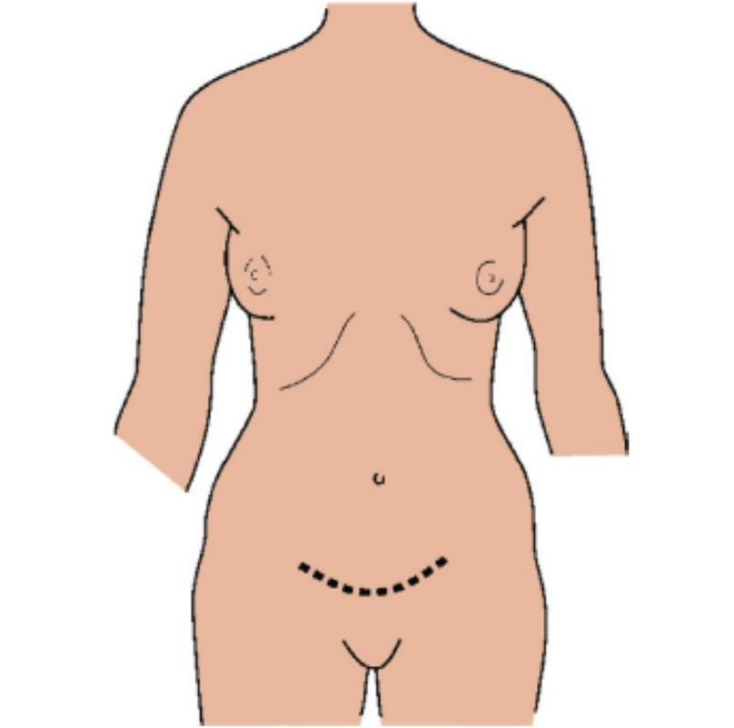
Pfannnestiel incision
The Pfannenstiel incision is a firm favourite of obstetricians for accessing the gravid uterus in which a curvilinear incision is made through the skin and subcutaneous fat, then a longitudinal incision made in the linea alba. It is also used by general and urological surgeons for some pelvic procedures such as radical open prostatectomy or cystectomy.

Slide 27
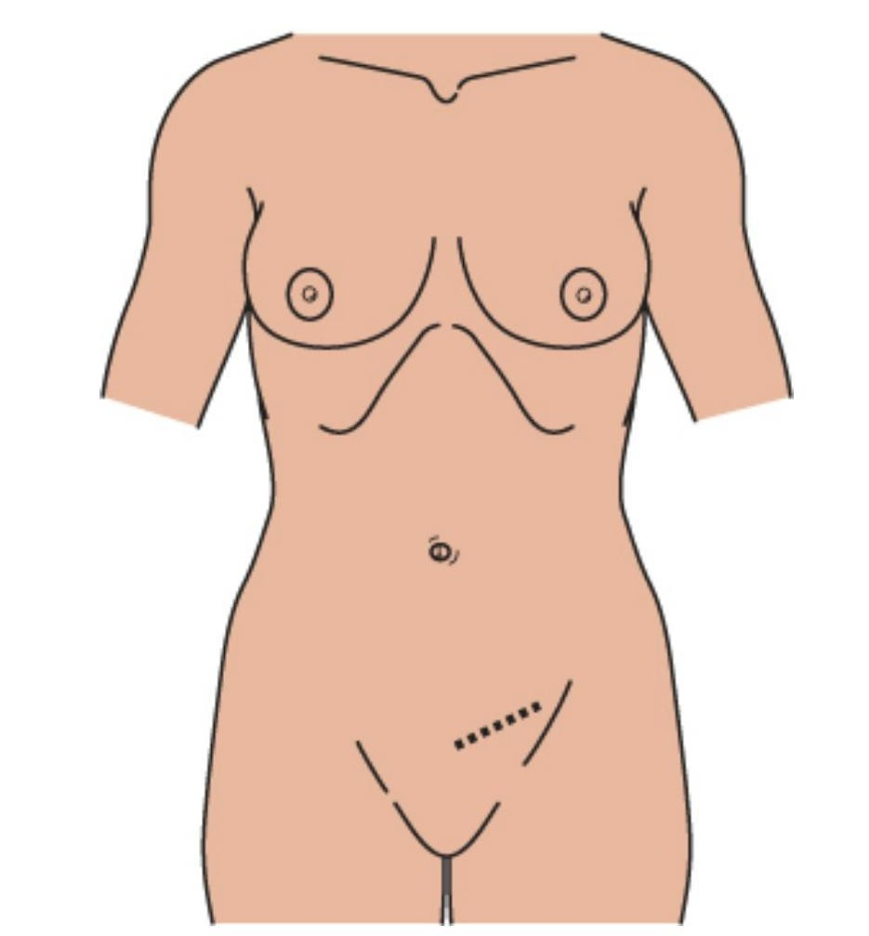
Inguinal Hernial repair incisions

Slide 28
Complications of abdominal surgical incisions
Complications are best considered in terms of specificity and chronicity; i.e. generic complications of surgery vs those specific to the operation, and presenting as immediate, early or late complications.
The incidence and nature of complications will be influenced by the patient’s comorbidities.

Slide 29
Complications of abdominal surgical incisions
Generic early complications declare themselves in the hours and days following the operation and may include atelectasis, postoperative pneumonia, urinary tract infection, oliguria, bedsores and deep vein thromboses.
Specific early complications include reactionary haemorrhage where small vessels ooze and intra-operative haemostasis fails once the blood pressure normalises, intra-abdominal collection, postoperative ileus and wound infection.

Slide 30
Complications of abdominal surgical incisions
Late complications include the development of an incisional hernia, where the underlying peritoneum and associated contents protrude through residual defects in the abdominal wall, and the formation of dense fibrotic intra-abdominal band adhesions.

Slide 31
Thank You

