Slide 1
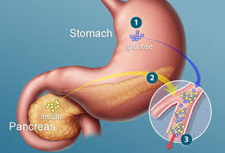
Glycolysis II
Dr. Nesrin Mwafi
Biochemistry & Molecular Biology Department
Faculty of Medicine, Mutah University

Slide 2
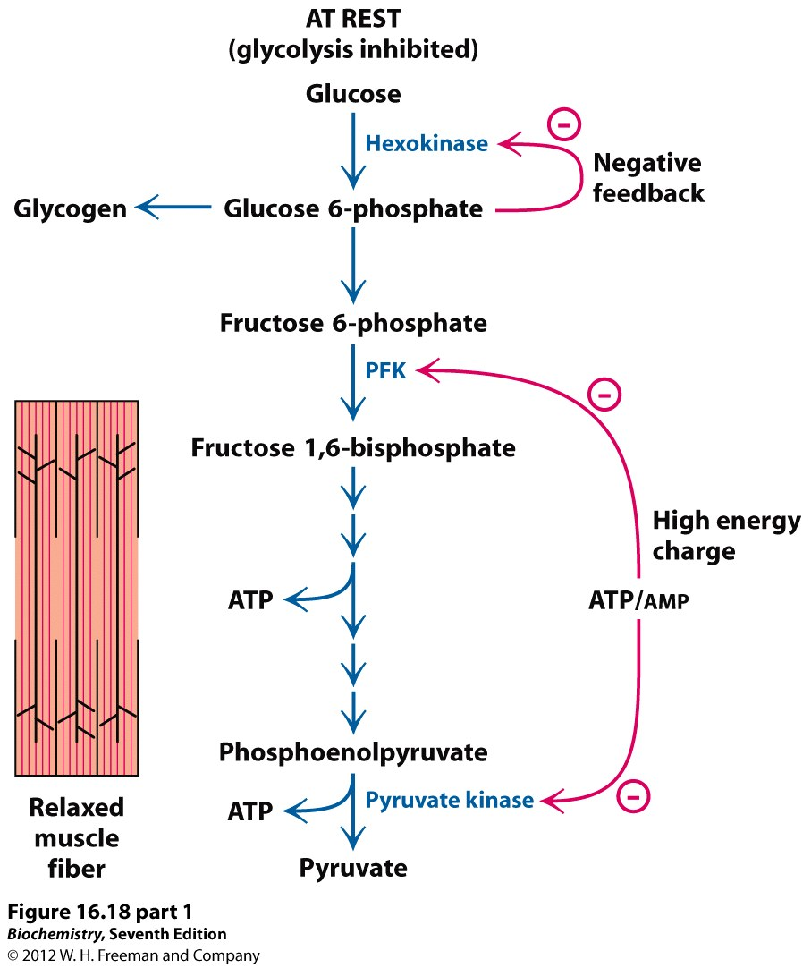
Glycolysis Regulation
glycogenolysis
G-6-phosphatase
1
Glycogen
Glucose 1-p
phosphoglucomutase
Pentose phosphate pathway
glycogenesis
*Molecules that have visa to move through double layer of mitochondria
Citrate ( initial substrate in krebs
pyruvate
PFK-2
Fructose 2,6-bisphosphate
PFK-1
+
3
*F.A oxidation : in mitochondrial matrix which excess Acetyl coA will move to cytosol by :
Citrate bind zalo celate
Break the previous bond & Acetyl coA will be in cytosol for fat synthesis
*beta (oxidation\ degradation) happens in the matrix and the synthesis in cytosol
and citrate
10
Fatty acids
oxidation
Acetyl CoA
Citric acid cycle

Slide 3
Glycolysis Regulation
Glycolysis can be controlled at 3 points:
Step 1 which is catalyzed by hexokinase enzyme (allosteric enzyme). Hexokinase isoforms (except glucokinase) are allosterically inhibited by excess G6P (Only in liver ,not in brain &sk.ms.)
Step 3 which is catalyzed by phosphofructokinase-1 enzyme. It is an allosteric enzyme. Two significant inhibitors are citrate and ATP whereas AMP/ADP and recently fructose 2,6-biphosphate (in liver) are activators. Actually this is the most important control point and it is considered as the main rate-limiting step in glycolysis
Step 10 which is catalyzed by pyruvate kinase enzyme. It is controlled by the level of ATP and Acetyl CoA (both are allosteric inhibitors). Accumulated Acetyl CoA in the cytosol is an indicator that the energy is now available from fat breakdown so no need to proceed in glycolysis ( Acetyl coA Will inhibit pyruvate kinase & glycolysis)

Slide 4
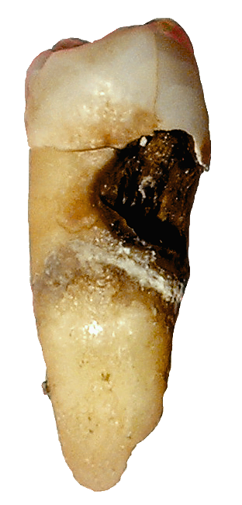
Fluoride as Inhibitor of Enolase
Oral bacteria depends on the food debris or dietary sugars found on the tooth surface as a primary source of energy. Acids are produced through fermentation process (harmful) (For the tissue of the teeth)
Fluoride is a competitive inhibitor of enolase enzyme catalyzing Step 9
Drinking fluoridated water or using a toothpaste containing fluoride inhibit the oral bacteria enolase activity. Consequently, this disrupts the bacteria glycolytic pathway and prevents formation of dental caries
Fluoride will inhibit pyruvate & consequently lactic acid

Slide 5
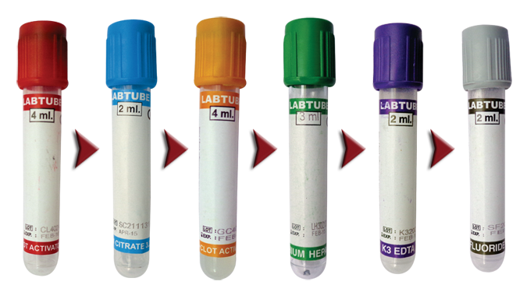
Fluoride as Inhibitor of Enolase
Sodium fluoride is known to have antiglycolytic effect that inhibits glycolysis by erythrocytes
NaF tubes (gray top) are widely used for blood collection for glucose measurement
Fluoride-containing tubes are suitable for blood collection if there is a long delay in blood separation following collection (false negative result) \ ** in diabetic patients for measuring blood-glucose level
- Fluoride do competitive inhibtion for enolase enzyme

Slide 6
Metabolic Fates of Pyruvate
Fates of Pyruvate
1
2
2
5
6
4
Oxaloacetate
3
Biosynthesis of amino acids
Malate
and
electron transport chain

Slide 7
Metabolic Fates of Pyruvate
2. Lactic Acid Fermentation: bacteria, RBCs and O₂-starved muscle cells
Anaerobic condition
Reduction
Oxidizing agent : Pyruvate
Reducing agent : NADH

Slide 8
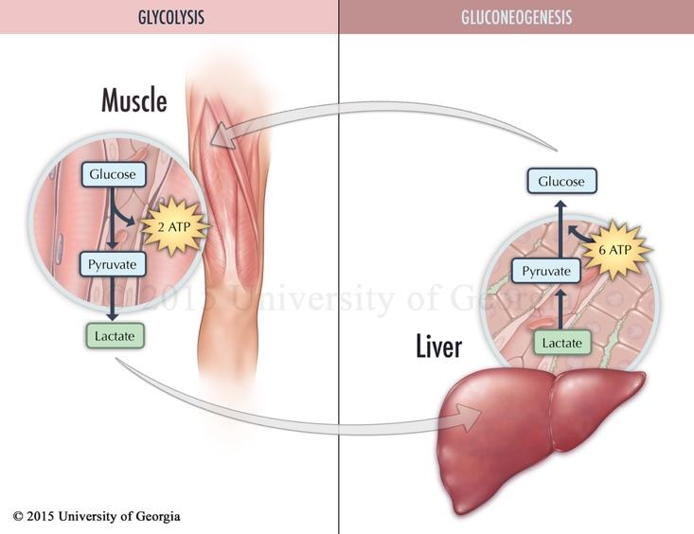
Cori Cycle
Cori cycle “lactic acid cycle” is the metabolic pathway in which lactic acid produced in muscles during the time of oxygen depletion is converted back to glucose in the liver by gluconeogenesis process (Non-
carbohydrate source)
**cori cycle is the way
To get rid of the acid

Slide 9
Metabolic Fates of Pyruvate
Fates of Pyruvate
1
2
2
5
6
4
Oxaloacetate
3
Biosynthesis of amino acids
Malate
and
electron transport chain

Slide 10
Metabolic Fates of Pyruvate
Fates of Pyruvate
1
2
2
5
6
4
Oxaloacetate
3
Biosynthesis of amino acids
Malate
and
electron transport chain

Slide 11
Metabolic Fates of Pyruvate
In aerobic conditions, pyruvate is converted to acetyl CoA which enters the citric acid cycle for further oxidation to CO₂ followed by oxidative phosphorylation
In anaerobic conditions like in lactic acid bacteria and some human cells (e.g. **RBCs and O₂-starved muscle cells), pyruvate is reduced to lactic acid with the concomitant oxidation of NADH to NAD⁺ (lactic acid fermentation) (e.g. when milk curdle into youghrt)
In anaerobic conditions like in some M.O’s (e.g. yeast), pyruvate is converted to ethanol (2 Steps)
Amino acid biosynthesis: pyruvate is a precursor of some amino acids like alanine
5. & 6. Pyruvate can be used for synthesis of oxaloacetate
or malate (both are TCA cycle intermediates)
**O-starved : excess ecxersize depend on glycolysis due to depletion of O2
**RBCs : absence of mitochondria (place of krebs &ETC)
X Krebs … X ETC

Slide 12
Glycolysis as Anabolic Pathway
Glycolysis acts as catabolic as well as anabolic pathway. Therefore, glycolysis is very important central metabolic pathway
Glycolysis intermediates with biosynthetic roles:
Nucleotides biosynthesis: G6P is an initial substrate in pentose phosphate pathway (metabolic pathway which generates pentoses)
Glycogenesis via G6P
Lipids biosynthesis: DHAP is converted to glycerol
Amino acids biosynthesis: pyruvate as precursor of alanine

Slide 13
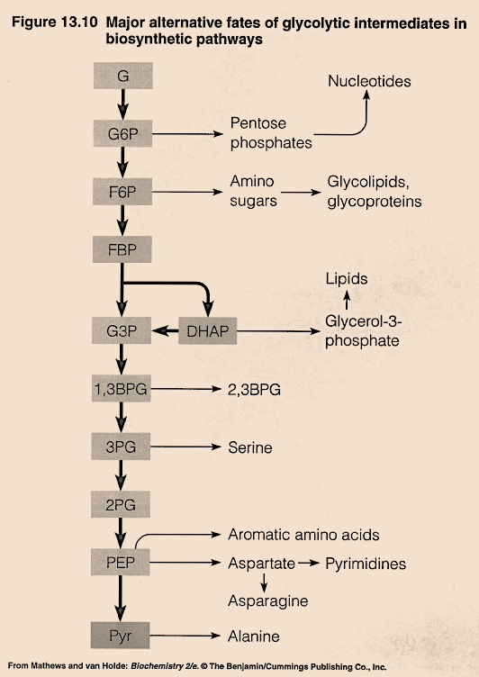
Glycolysis as Anabolic Pathway
2
1
Glycogenesis
3
4

Slide 14
Other substrates enter Glycolysis
مش مطلوبة
Glucose
Mannose
hexokinase
Galactose
Gal-1P
G1P
G6P
Mannose-6p
isomerase
Hexokinase
(extrahepatic tissues)
Fructose
F6P
in liver
FBP
Glyceraldehyde
F1P
DHAP
G3P
Glycerol
glycerol
kinase
Glycerol-3-P

Slide 15
Acetyl CoA Formation
In aerobic respiration, pyruvate (3C) joins the citric acid cycle after its conversion to acetyl CoA (2C)
Citric acid cycle occurs in the mitochondrial matrix. Shuttling of pyruvate from the cytosol is facilitated by a transporter protein embedded in the inner mitochondrial membrane called pyruvate translocase
*First the pyruvate is transported to mitochondrial matrix and then will turn to Acetyl coA
* Sources of Acetyl coA :
Pyruvate : turn to Acetyl coA to enter krebs cycle
Fatty acid oxidation

Slide 16
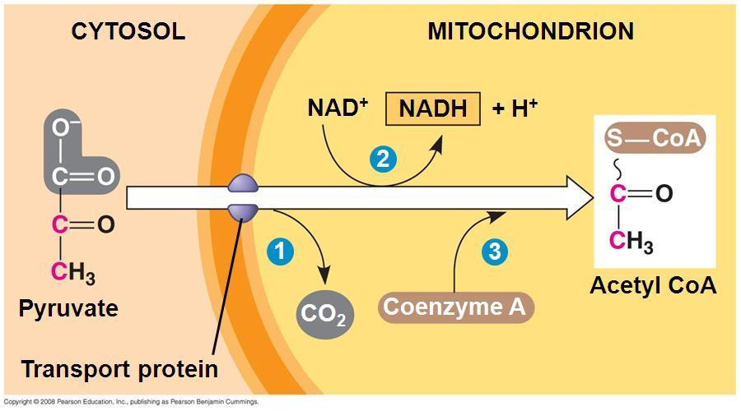
Acetyl CoA Formation
Pyruvate dehydrogenase complex

Slide 17
Acetyl CoA Formation
Pyruvate dehydrogenase complex (PDC) catalyzes the irreversible oxidative decarboxylation of pyruvate into Acetyl CoA with the release of CO₂
Energy-rich molecule “NADH” is also produced
Coenzyme A (CoA) acts as acetyl group carrier due to its free sulfhydryl (–SH) end capable of forming thioester bond to enter krebs cycle
PDC is a multi-enzyme system consists of three catalytic enzymes and five coenzymes (three of them are prosthetic groups as they are tightly bound to their corresponding enzymes)
Prosthetic ? The coenzyme is covalently attach with the enzyme

Slide 18
Pyruvate Dehydrogenase Complex
E1: pyruvate dehydrogenase
E2: dihydrolipoamide transacetylase
E3: dihydrolipoamide dehydrogenase
**Names of E1,2,3 مش مطلوبة
Coenzymes
Thiamine pyrophosphate (TPP) a prosthetic group of E1
Lipoic acid (lipoamide) a prosthetic group of E2
Flavin adenine dinucleotide (FAD) a prosthetic group of E3
Coenzyme A (CoA or CoA-SH)
Nicotinamide adenine dinucleotide (NAD⁺)
**Names of coenzymes مطلوبة & prosthetic group for which E

Slide 19
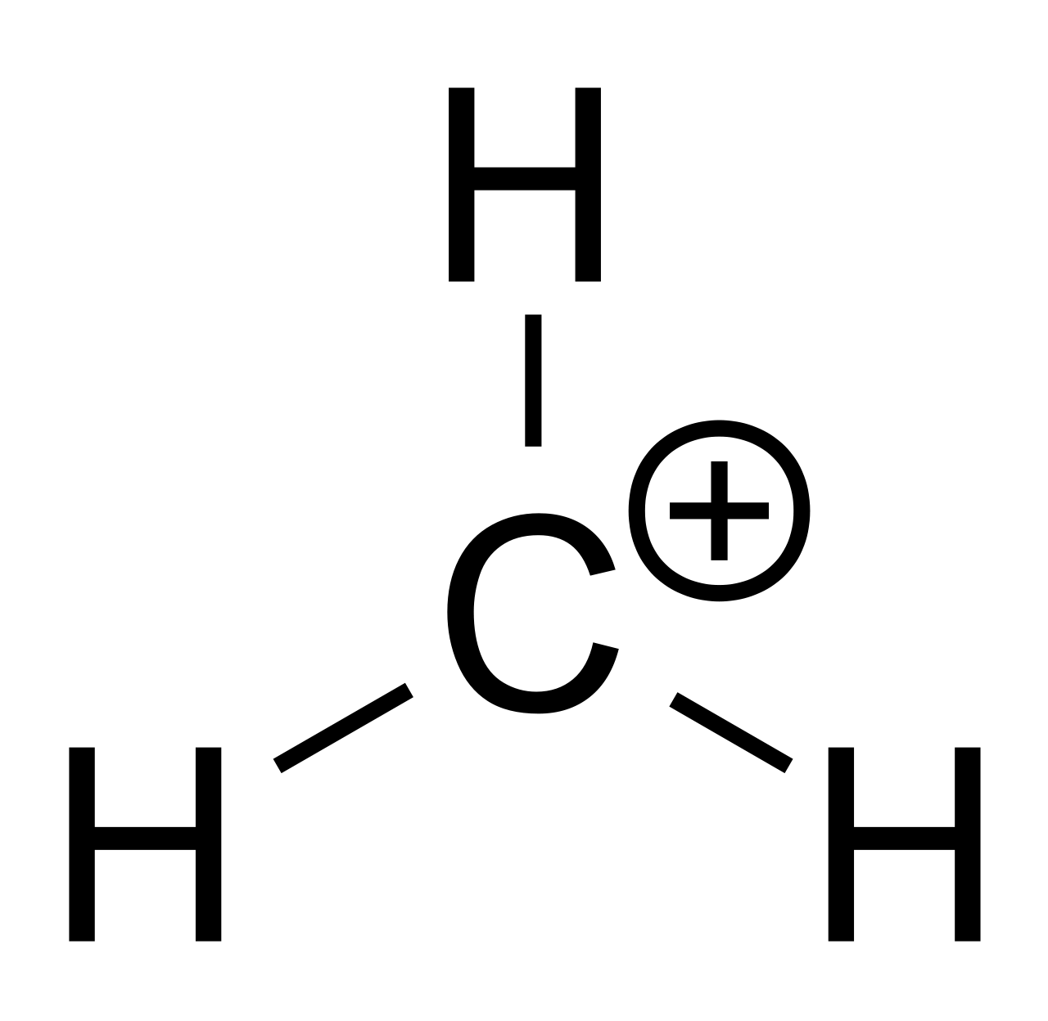
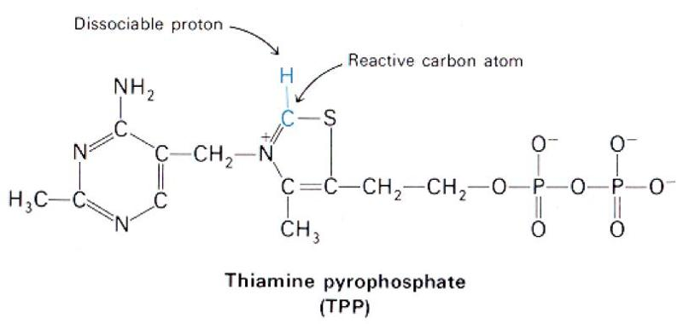
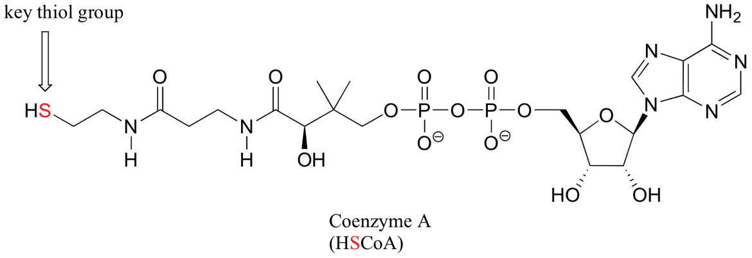
Coenzymes Structure
من بعد السلايد هاد مش مطلوب اشي
-
..

Slide 20
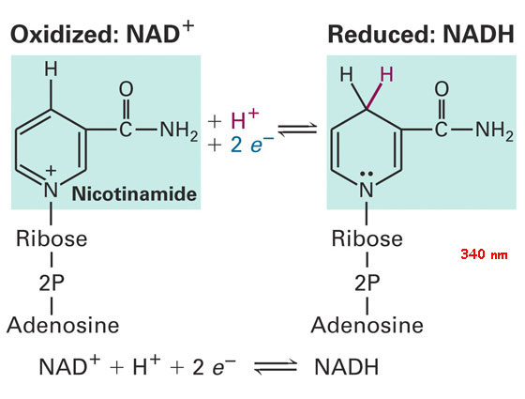
Coenzymes Structure

Slide 21
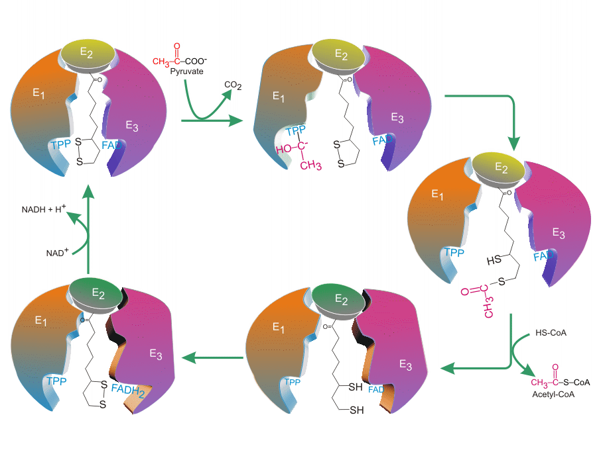
Pyruvate Dehydrogenase Complex
2
1
-H
Hydroxyethyl-TPP
5
3
4

Slide 22
Mechanism of PDC
The mechanism by which this complex catalyzes the reaction is complicated but the main processes involve (5 steps):
Decarboxylation of pyruvate and the release of CO₂ a reaction catalyzed by E1-TPP. The product of this reaction “Hydroxyethyl moiety” is a substrate for the next reaction
The transfer of Hydroxyethyl moiety from TPP of E1 to lipoic acid of E2. This step is mediated by an oxidation of Hydroxyethyl to acetyl group coupled with reduction of disulfide bond
Transfer of acetyl group from lipoamide to CoA forming thioester bond and consequently Acetyl CoA is produced

Slide 23
Mechanism of PDC
Regeneration of disulfide bond of lipoamide via FAD ( E3 prosthetic group) which is reduced to FADH2
Regeneration of FAD by NAD⁺ which is reduced to NADH with the electrons transferred during the reaction (originally from Hydroxyethyl oxidation)

