Slide 1
Ophthalmology History & physical examination
Presented By :
Othman ali
Salih al-omari

Slide 2
Patients profile:
Name of the patient
Age
Sex
Residence
Occupation
Date of admission

Slide 3
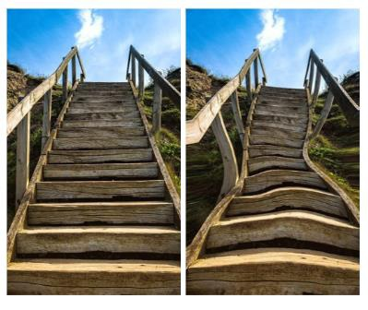
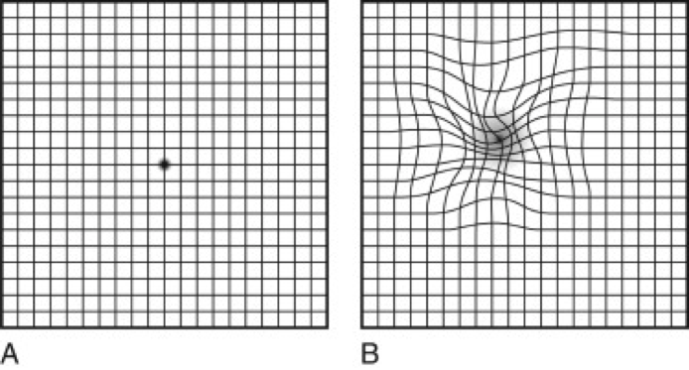
Chief complaint and the main Symptoms:
Blurring of vision.
Scotoma: are of partially
alteration in field of vision
(partially or entirely degenerated visual acuity )
2. metamorphopsia:
a syndrome in which the shape
of objects appears distorted .

Slide 4
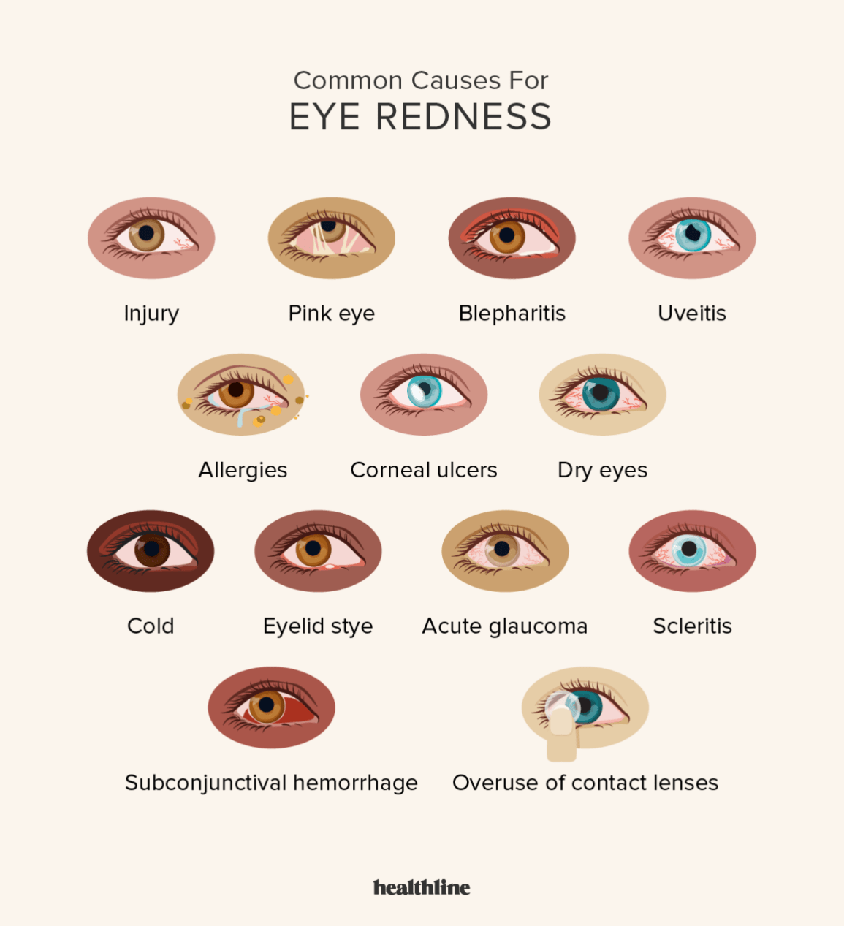
Chief complaint and the main Symptoms:
Eye pain
Eye itching
Eye redness

Slide 5
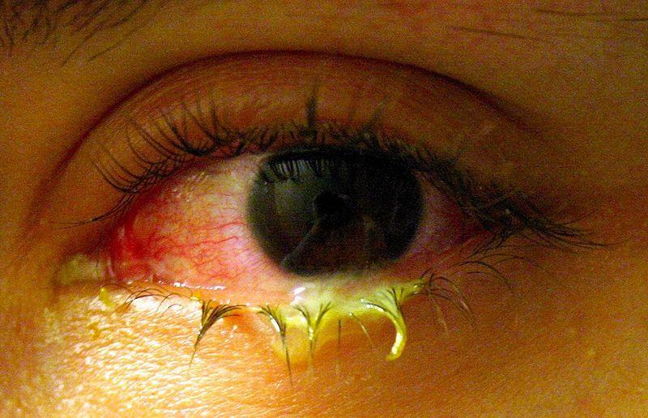
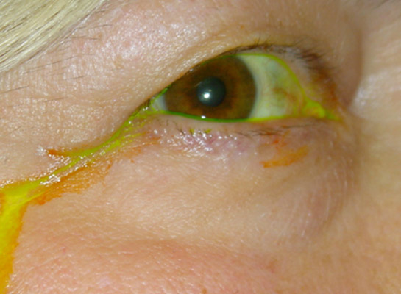
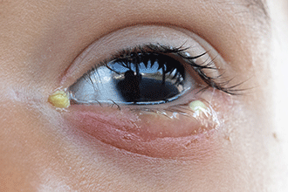
Chief complaint and the main Symptoms:
Eye lacrimation And discharge

Slide 6
Vision related symptoms
Ask:
-Onset :Did the change in vision start suddenly or gradually?
-How is the vision affected exactly? ( is it loss of vision? Cloudy vision?
Floaters? )
-Unilateral or bilateral?
-Whole or part of the visual field affected?
-If partial, which part of the visual field affected?

Slide 7
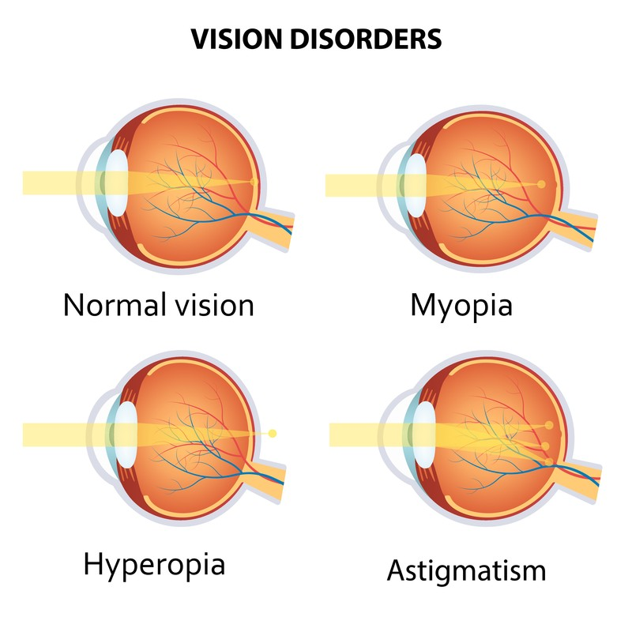
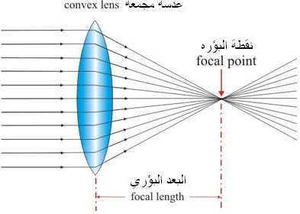
Blurring of vision:
Refractive error : (shape of eye keep the light form focusing on retina).
Organic problem in the eye (retina, vitreous , optic nerve disease)

Slide 8
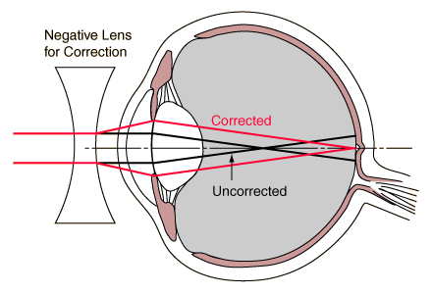
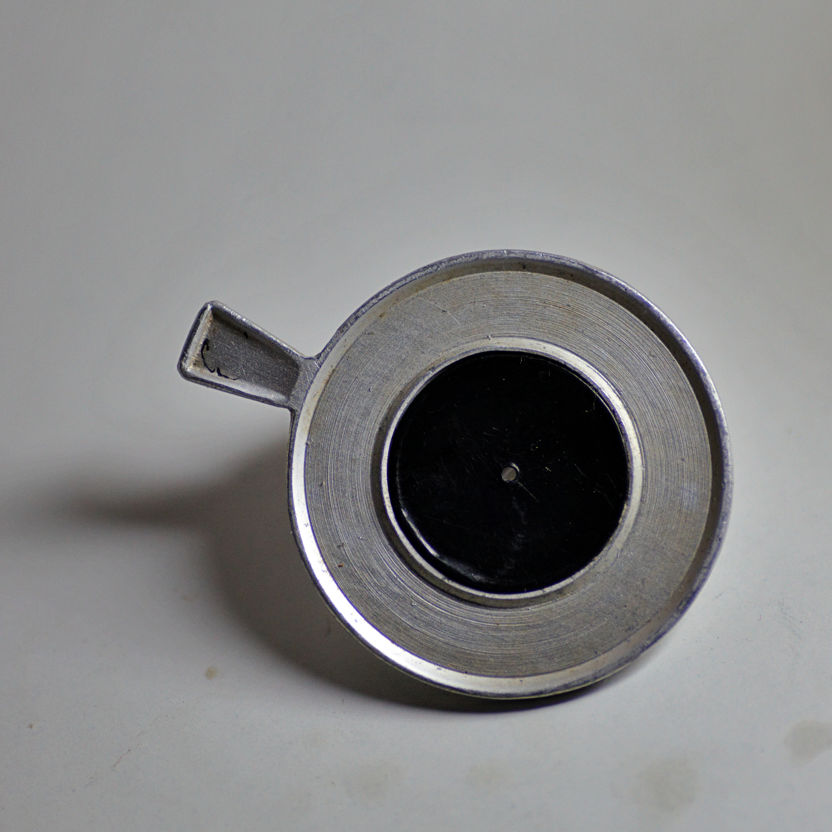
Blurring of vision:
How to differentiate:
Pinhole test:
(the test can correct +/- 4 Diopters)
Pinhole lens

Slide 9
Blurred vision:
With pain
Closed angle glaucoma
Keratitis
Without pain
Macular edema
Retinal artery occlusion
endophthalmitis
Uveitis
Retinal detachment
Retinal hemorrhage
Retinal vein occlusion
Optic neuritis!!

Slide 10
Ocular pain:
Site of pain
Onset of pain
Severity
Aggravating factors
Relieving factors
Radiation
Associated symptoms, Neusea, vomiting, fever, weekness,
headache.
History of associated trauma !!

Slide 11
Diplopia :

Slide 12
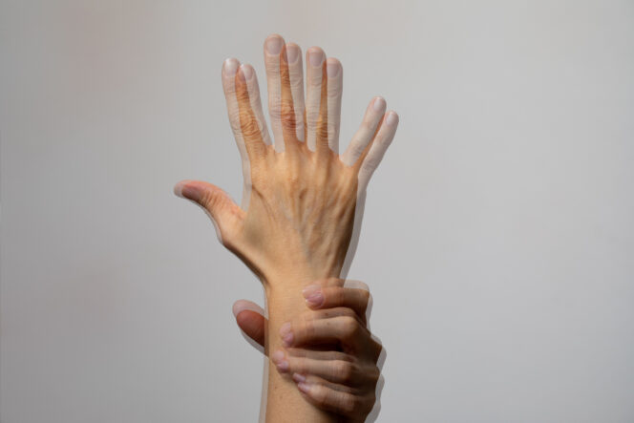
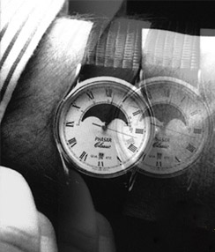
Diplopia :(double vision)
perception of two images of a single object that may be displaced horizontally or vertically in relation to each other.
Causes:
Abscess Antipsychotics (haloperidol, fluphenazine, chlorpromazine etc.) Brain tumor Damaged third, fourth, or sixth cranial nerves, which control eye movements Drunkenness Lasik complications Opioids Trauma Increased intracranial pressure

Slide 13
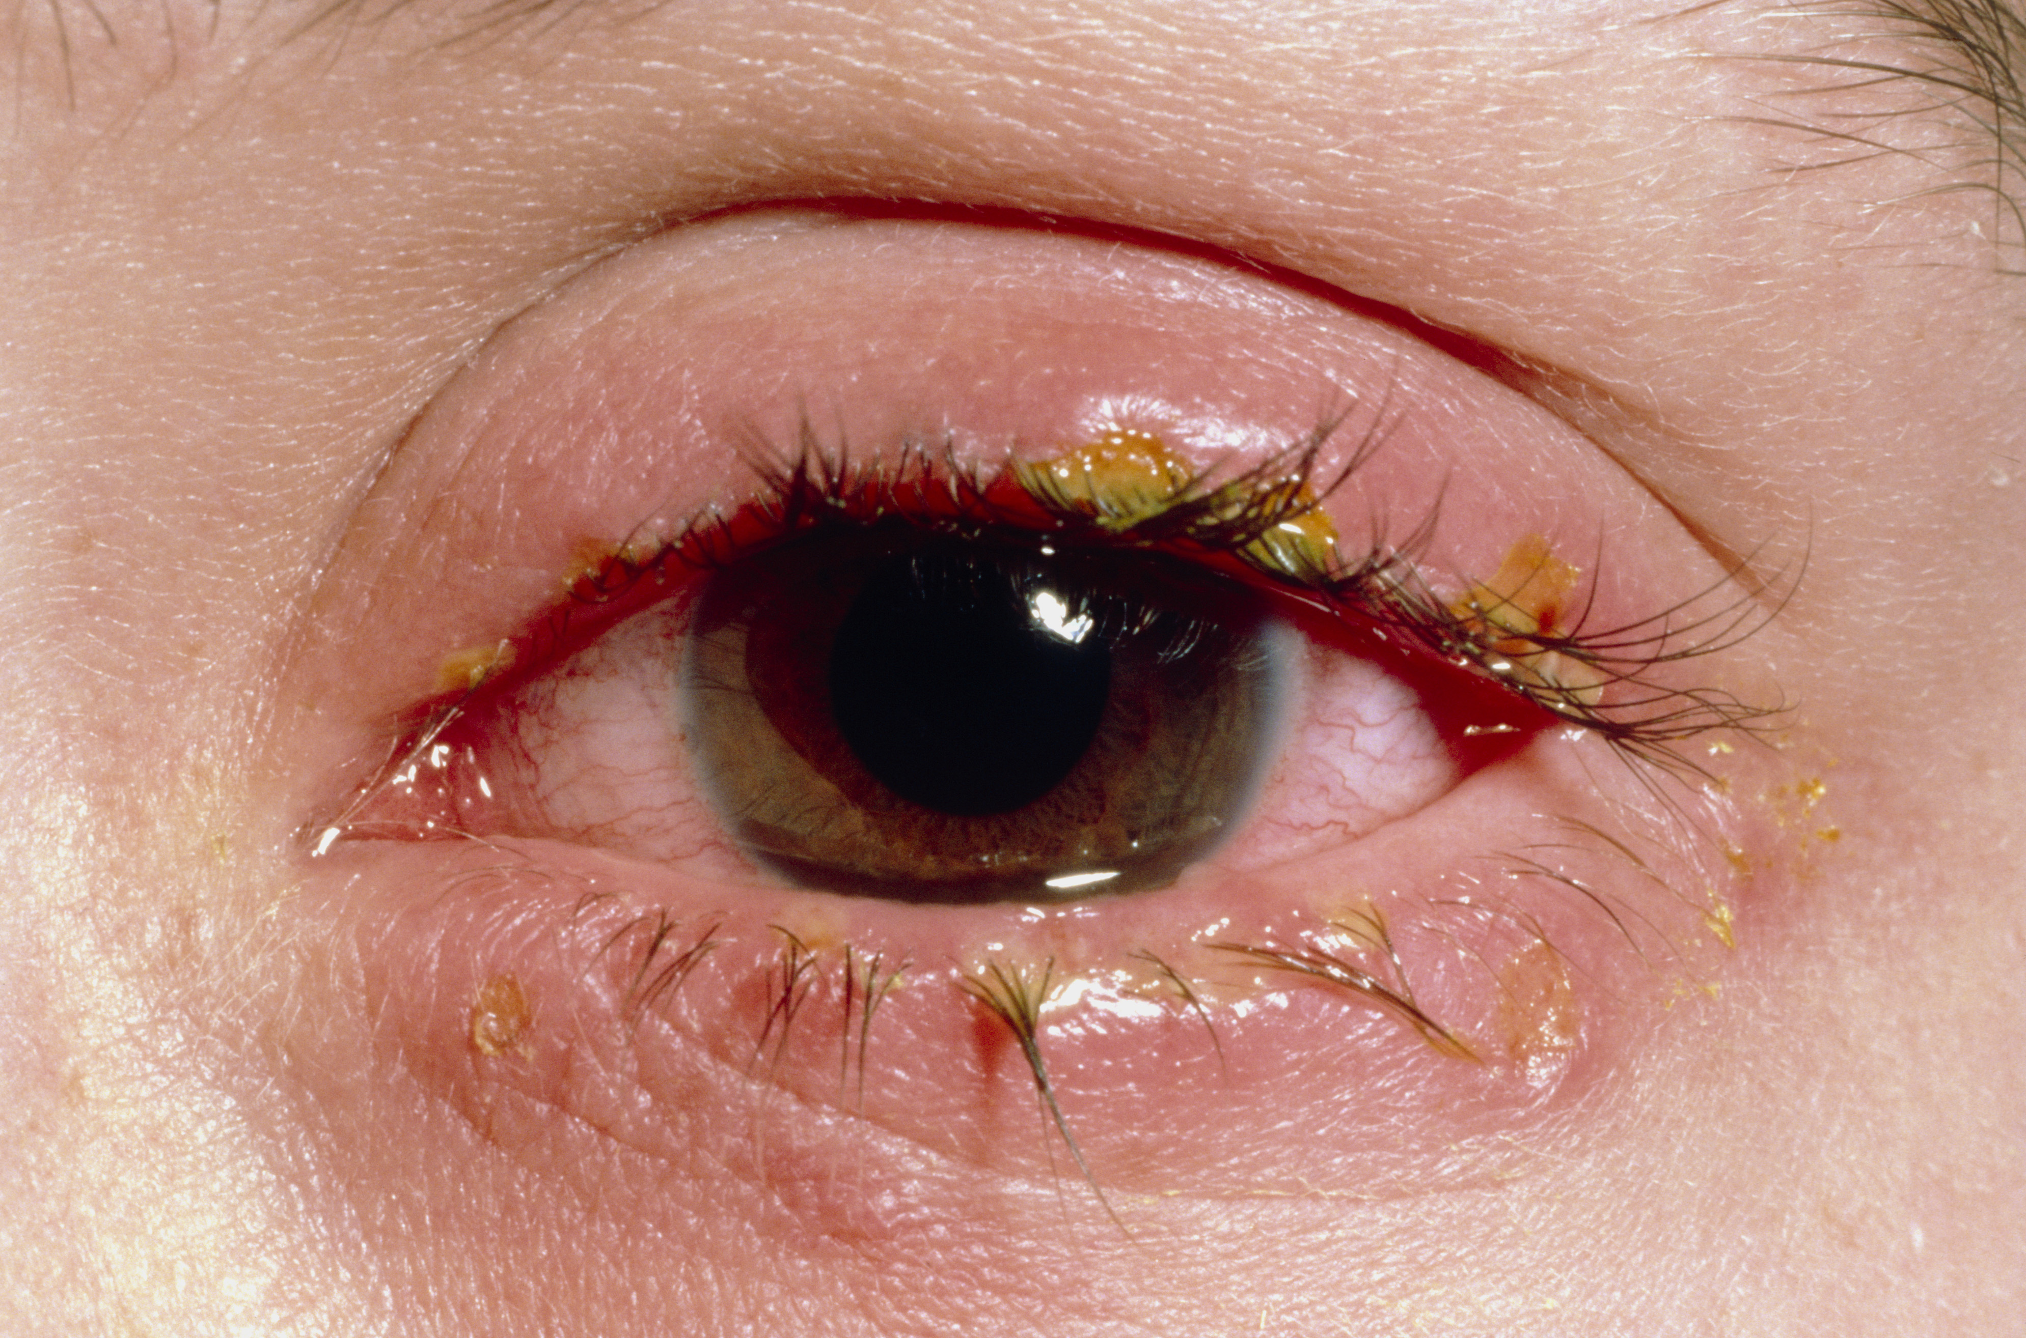
Eye itching:
Dryness (keratoconjunctivitis sicca )
Eye allergy
Contact dermatitis
Eyelid mass ( ex: sclerosing basal cell carcinoma)
Blepharitis (inflammation of eyelid)

Slide 14
Photophobia : eye discomfort in bright light .
Causes may include: Acute iritis or uveitis (inflammation inside the eye) Burns to the eye Corneal abrasion & ulcer Drugs such as amphetamines, atropine, cocaine . Excessive wearing of contact lenses, or wearing poorly-fitting contact lenses Migraine headache Recovery from eye surgery

Slide 15
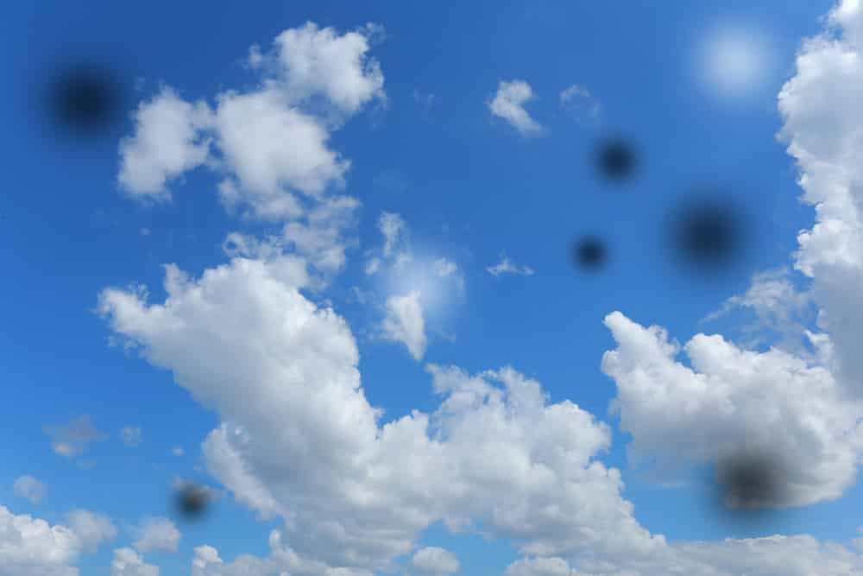
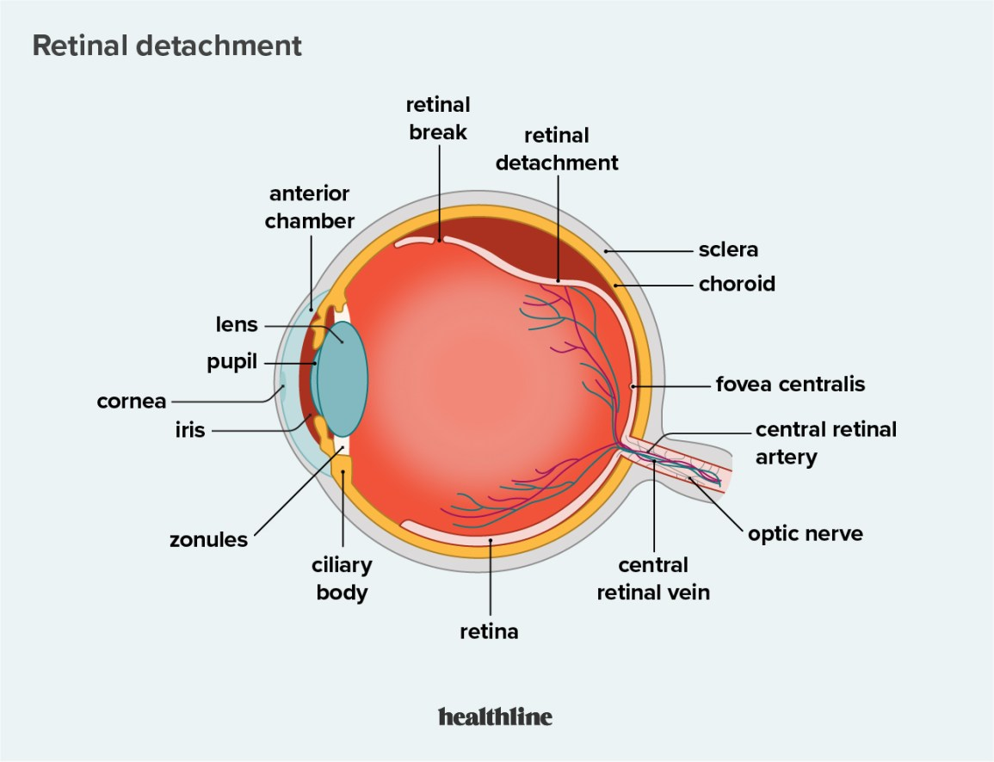
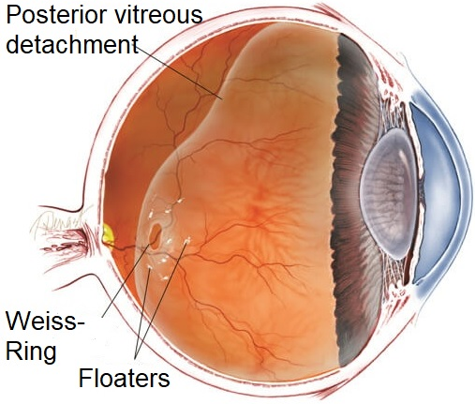
floaters
The sense of swimming flies or amorphous organism in space that are no sticking to one side of visual field, typically floaters change position with eye movement
Causes :
Uveitis
post. Vitreous detachment
Retinal detachment

Slide 16
Lacrimation and discharge
Ask :
- Is the discharge clear or opaque? Amount ?
- Associated pain? Foreign body sensation? Itchiness?
- Other symptoms (e.g. red eye)?

Slide 17
Past medical history:
History of D.M , Dyslipidemia , HT: ask about duration, control, complication, medications ( type and compliance)
Congenital diseases ( bleeding disorders)
Drug allergies
History of uveitis or any medical eye problems.
Drug history :
- Insulin
- HTN treatment
- Chlorquine > Retinal toxicity
- Isoniazide > Impaired visual function
- Steroids > ( Acute : Glaucoma , Chronic Use : cataract )

Slide 18
Social history:
Smoking and alcohol use: this may affect vascular and optic nerve function within the eye.
Socioeconomic status : examples trachoma is more prevalent in the poor . Gout is more prevalent in the rich
Occupation:
certain occupations are more likely to get injured in the eye more than others. Example: the act of welding, carpenters, black smiths.
certain professions, including drivers of heavy goods and pilots, require specific visual acuity criteria.
Visual impairment has a wide range of effects on daily life. Ask about:
Daily activities requiring good vision: reading, television, sport, hobbies and so on
Driving.

Slide 19
Past surgical history :
Previous surgeries
Previous use of eye glasses
Previous eye injections .
Previous laser to the eye.

Slide 20
Physical examination

Slide 21
Physical examination
General examination
Visual acuity
Pupils
Extra-ocular motility
Slit-lamp exam
IOP
Funduscopy
Visual field

Slide 22
General examination
Carefully and systematically examine:
-Posture and gait
-Head position
-Facial asymmetry and dysmorphic features
-Eyelid position and periocular skin
-Position and symmetry of gaze (any squint/strabismus?).

Slide 23
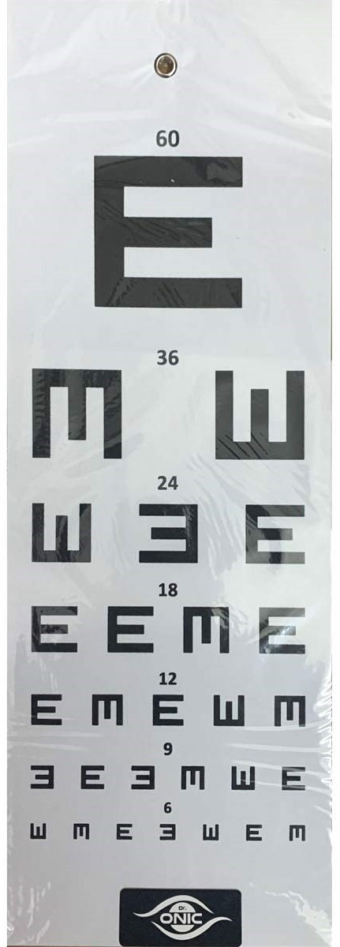
Visual acuity
Using Snellen chart, 6m away from the patient.
Test each eye separately.
If the patient cannot see the largest font, reduce the chart distance to 3m, then to 1m if necessary. If they still cannot see the largest font, document whether they can count fingers, see hand movement or just perceive the difference between light and dark.
Express visual acuity as the distance at which the text is read (6 metres) over the number of the smallest font line read correctly on the chart. Example: 6/60 means the patient can read the largest font line from 6 metres away, while someone with normal visual acuity can read the same font from 60 metres away.

Slide 24
Visual acuity cont.
If the patient cannot read down to the last line, place a pinhole directly in front of the eye. If the visual acuity does not improve, this indicates the presence of eye disease not related to the refractive apparatus alone, such as retinal or optic nerve pathology.
Phinole can correct up to +4to-4 of refraction
Assess near vision with a similar test using text of reducing font size held at comfortable reading distance.

Slide 25
How to take visual acuity for children? Children might be quite challenging . Some might be shy , others might have developmental delay or they might not up to the adequate age to cooperate with the examiner In this case we use the cover uncover test to see if the patient cries when one eye is closed . This is call objection sign Another important way of assessment is the use of cyclo - refration in children . the examiner rely on the clinical judgment to make adequate eye glasses for the child , it is very common to find a +2 refraction in those

Slide 26
Pupils
Pupil examination
The size and shape of the pupils are noted , and pupillary reaction to light is tested in each eye , one at a time , while the patient looks in the distance . Then the swinging flashlight test
test is done with a penlight to compare direct and consensual pupillary response There are 3 steps One pupil is maximally constricted by being exposed to .
light from the penlight for 1 to 3 sec
The penlight is rapidly moved to the other eye for 1 to 3 .
The light is moved back to the first eye.

Slide 27
Normally , a pupil constricts similarly when light is shone on ( direct response ) and when light is shone on the other eye . ( consensual response
However , if one eye has less light perception than the other , as caused by dysfunction of the afferent limb ( from the optic nerve to the optic chiasm ) or extensive retinal disease , then consensual response in the affected eye is stronger than the direct response
ACCOMMODATION REFLEX; You should observe constriction & convergence of the pupils

Slide 29
Extraocular motility
Ocular alignment and eye movements.
Detection of squint.
Ocular movements.

Slide 30
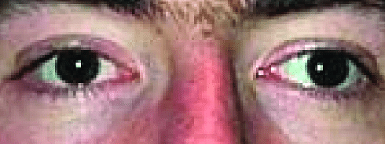
Detection of squint
Sit 1 metre away from the patient and hold a pen torch directly in front of them and instruct them to look at the light.
Observe the reflection of the light on the cornea in relation to the pupil. The reflections should be symmetrical between the two eyes.
Ask the patient if they see single or double light (seeing double light may indicate the presence of squint, but not seeing double does not exclude it).
.

Slide 31
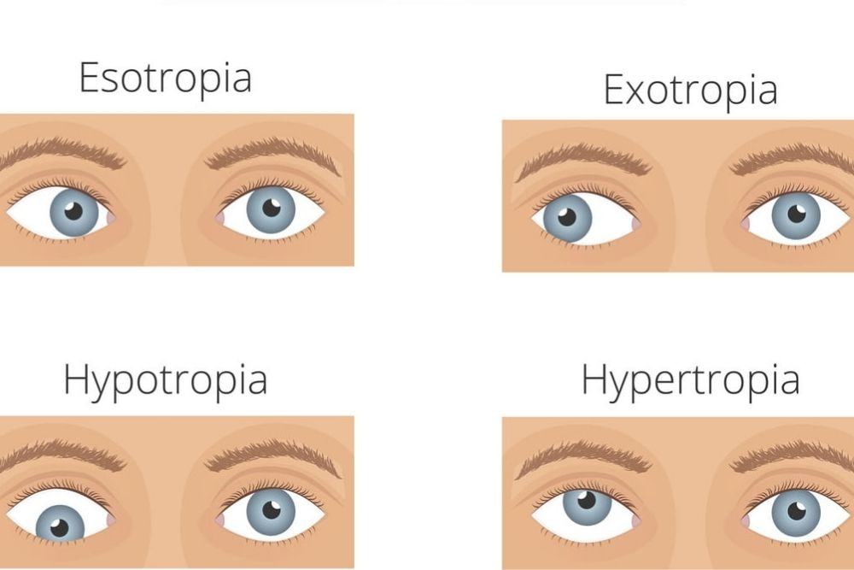
Ocular alignment and eye movement

Slide 32
Detection of squint cont.
To confirm the presence of squint, perform the cover/uncover test:
-Ask the patient to look at the pen torch at all times and then cover one eye.
-Look at the uncovered eye for any movement. It may be helpful to repeat this several times.
Esotropia is a form of strabismus in which one or both eyes turns inward
Exotropia is a form of strabismus where the eyes are deviated outward. It is the opposite of esotropia and usually involves more severe axis deviation than exophoria

Slide 33
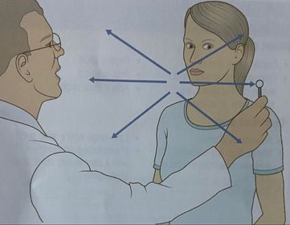
Ocular movements
In the same seating position, ask the patient to look at a target or pen-torch light about 50 cm away.
Ask them to say if and when they experience diplopia.
Starting from the primary position, move the target in the 8 positions of gaze.
If diplopia is present, ask whether this is horizontal, vertical or a combination of the two.
Determine where the image separation is most pronounced.
Look for nystagmus and determine whether the eye movement is smooth.

Slide 34
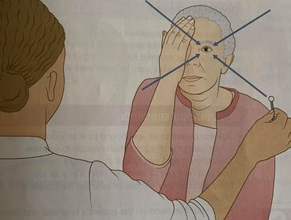
Visual fields
Sit directly facing the patient about 1 metre away, and ask the patient whether they have any difficulty seeing parts of your face.
Ask the patient to close or cover one eye, and cover yours too.
Hold your hands out and bring an extended finger in from the periphery towards the centre of the visual field. Ask the patient to point to it when they first see it. If the patient fails to notice your finger when it is clearly visible to you, their field is reduced in
that area.

Slide 35
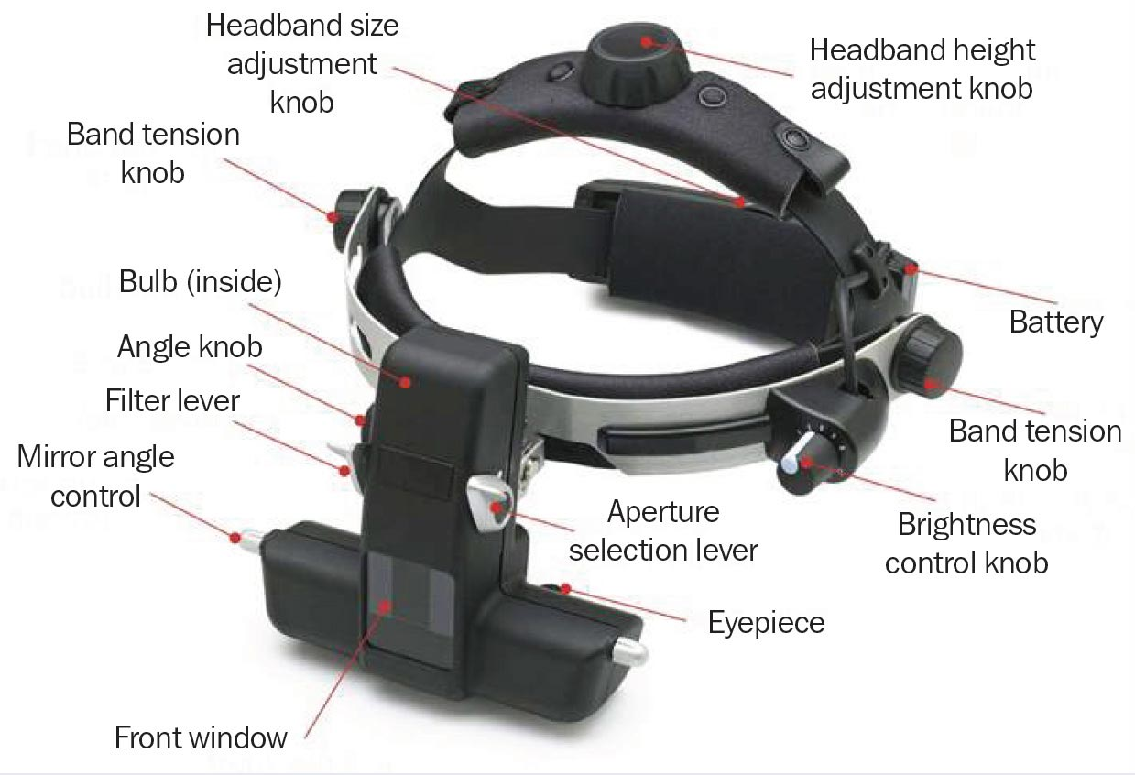
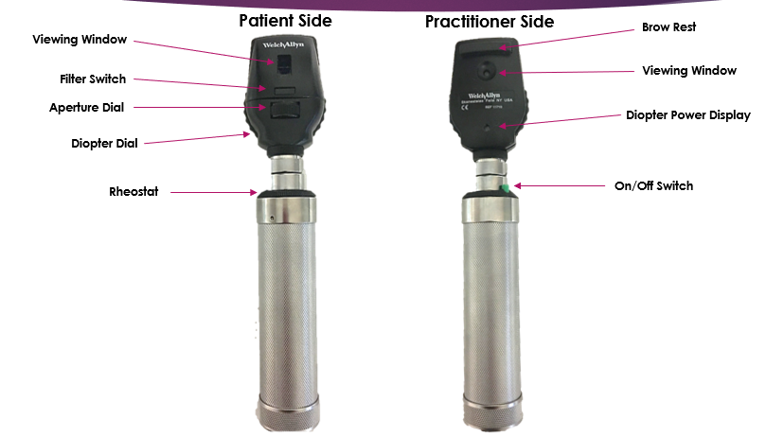
Ophthalmoscopy
Pharmacological pupil dilatation is essential for a thorough fundus examination.
Direct & indirect opthalmoscope.
Ophthalmoscopy can detect lens or vitreous opacities and identify retinal and vascular changes.

Slide 36
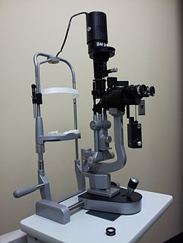
Slit-lamp examination
A slit lamp focuses the height and width of a beam of light for precise stereoscopic view of the eyelids , conjunctiva , cornea anterior chamber , iris , lens , and anterior vitreous . With a handheld condensing lens , it can also be used for detailed examination of the retina and macula
Identifying corneal foreign bodies and abrasions .
Measuring depth of the anterior chamber
Detecting cells ( RBCs or WBCs ) and flare ( evidence of protein ) in the anterior chamber

Slide 37
Identifying diseases such as macular
degeneration , diabetic eye disease ,
preretinal membranes , macular edema , and retinal tears ( when using a condensing lens )
Identifying scleral edema , which is seen
as a bowing forward of the slit beam

Slide 38
Intra-ocular pressure
Intraocular pressure (IOP) is the fluid pressure inside
the eye. It is normally between 9 and 21 mmHg.
Methods of measurement : Applanation, Indentation
Hand-held tonometers, noncontact air-puff tonometry,
Goldmann applantation tonometry. *Goldmann applantation tonometre is the most
accurate one but it requires practice as it is difficult
to use.

