Slide 1
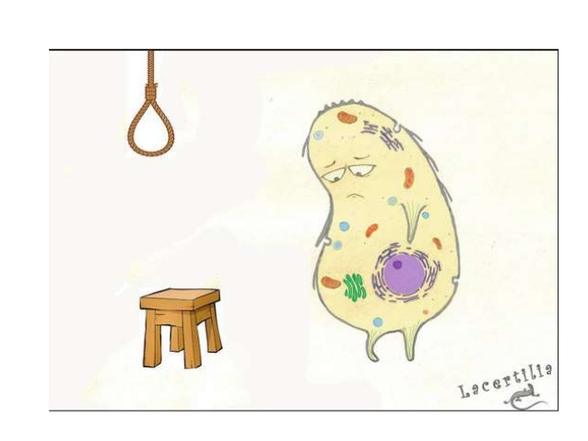
Cell Injury and Necrosis-3
Ghadeer Hayel, MD 21/10/2020

Slide 2
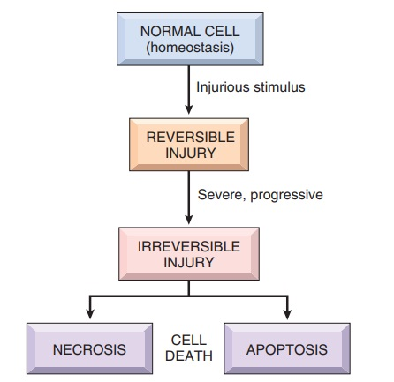

Slide 3
Apoptosis
+ Apoptosis - suicide - programmed cell death- regulated cell death.
+ is a pathway of cell death in which cells activate enzymes that degrade the cells’ own nuclear DNA and nuclear and cytoplasmic proteins.
+ Apoptosis = “falling off” Greek
+ Can be pathologic and physiologic
+ Doesn’t elicit inflammation.

Slide 4
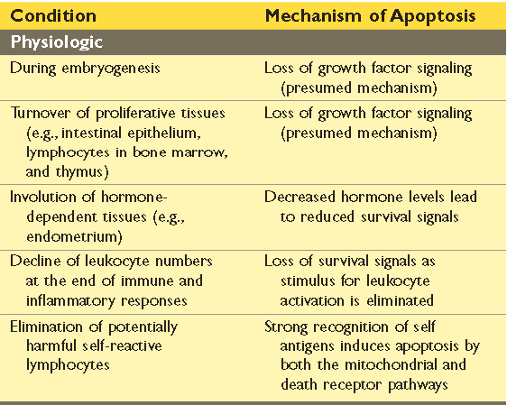
Can be physiologic:

Slide 5
During embryogenesis (implantation, organogenesis, developmental involution, separation of digits in limb development)
in adult multicellular organisms cell death is a regular occurrence. In humans EACH HOUR!!

Slide 6
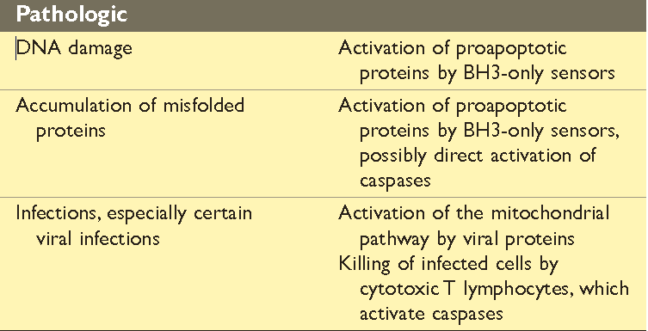
Can be pathologic:

Slide 7
+ The plasma membrane remains intact.
+ Apoptotic bodies (contain portions of the
cytoplasm and nucleus) become targets for
phagocytosis before their contents leak out.
+ Normally, there is a biochemical pathways that
control the balance of death- and survival-inducing
signals..
Apoptosis is regulated by this pathways → Activation of enzymes called caspases through two main pathways:
1- Mitochondrial pathway (intrinsic)
2- Death receptor pathway (extrinsic)

Slide 8
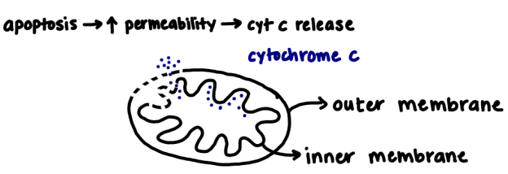
Intrinsic pathway; mitochondrial pathway
+ In most physiologic & pathologic situations.
+ Mitochondria contain several proteins capable of inducing apoptosis → Cytochrome c.
+ ↑ mitochondrial permeability → permeable membrane → cytochrome c leaks → triggering caspase 9 → activate apoptosis

Slide 9
Intrinsic pathway; mitochondrial pathway
BH3 protein : a group of sensors (called BH3 proteins because they contain the third domain seen in Bcl-family)
Activated when:
Cells are deprived of growth factors & survival signals.
Cells are exposed to agents that damage DNA
Cells accumulate unacceptable amounts of misfolded proteins.
They turn the shift of life-sustaining balance in favor of pro-apoptotic Bak and Bax.

Slide 10
Intrinsic pathway; mitochondrial pathway
A family of more than 20 proteins (prototype is Bcl-2) controls the permeability of mitochondria.
+ proapoptotic members of the family are Bax & Bak.
+ Activated by BH3 proteins (sensor)
+ when stimulated→dimerize →insert into mitochondrial → form channels →cytochrome c escapes into cytosol
+ Antiapoptotic members are BCL-2 & BCL-xL
+ produced in response to growth factors & survival signals.
+ maintain the integrity of mitochondrial membranes → holding proapoptotic in check.

Slide 11
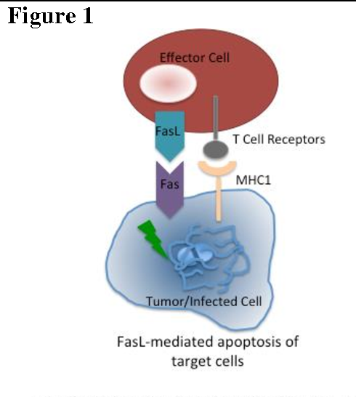
Extrinsic pathway; death receptor pathway
+ Tumor necrosis factor (TNF) receptor family.
+ The prototypic death receptors are the type I TNF receptor & Fas (CD95).
+ contain a cytoplasmic regions → “death domain,”
+ Fas ligand (FasL) : membrane protein expressed on activated T lymphocytes.
+ T cells recognize fas expressing target , fas molecules are cross linked by fasL to activate caspase 8

Slide 12
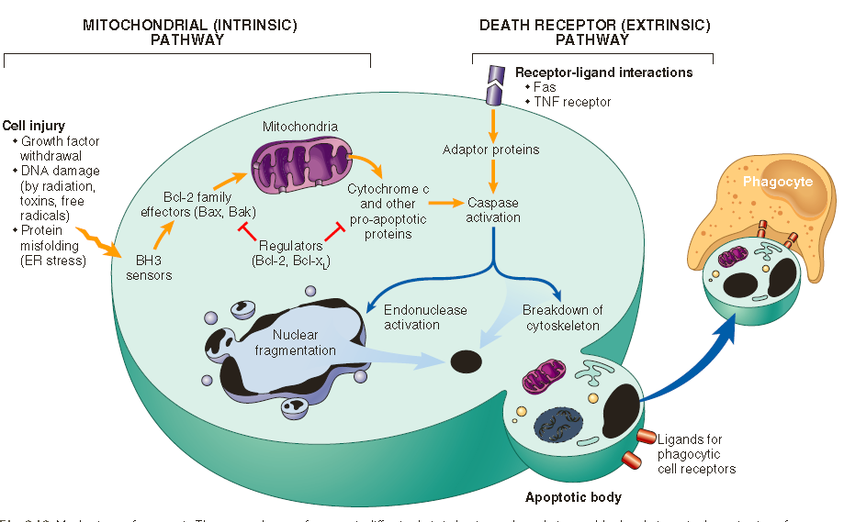

Slide 13
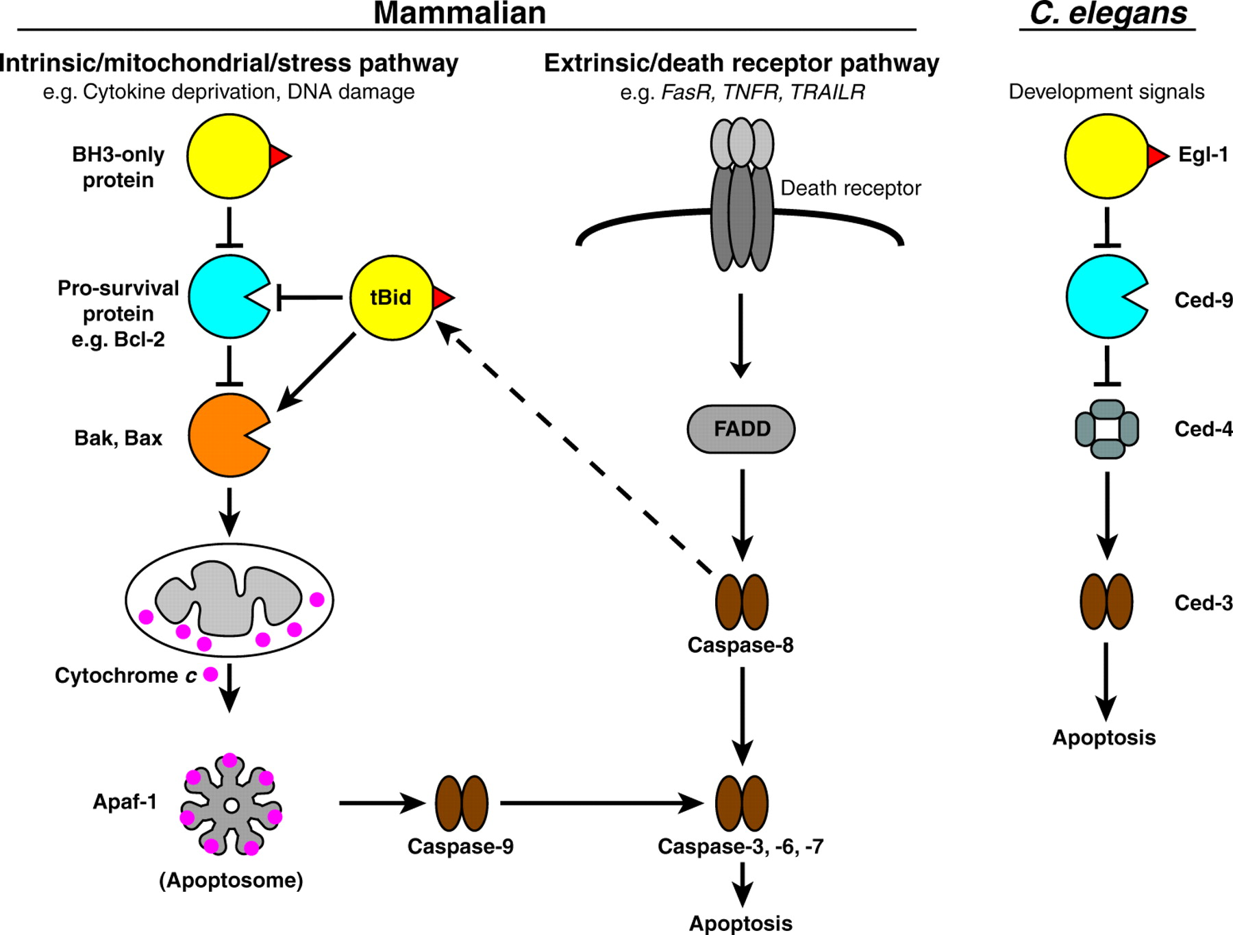
In Either pathway:
After caspase-9 or caspase-8 is activated → it cleaves & thereby activates additional caspases → that cleave numerous targets → activate enzymes that degrade the cells’ proteins & nucleus.
The end result is the characteristic cellular fragmentation of apoptosis.

Slide 14
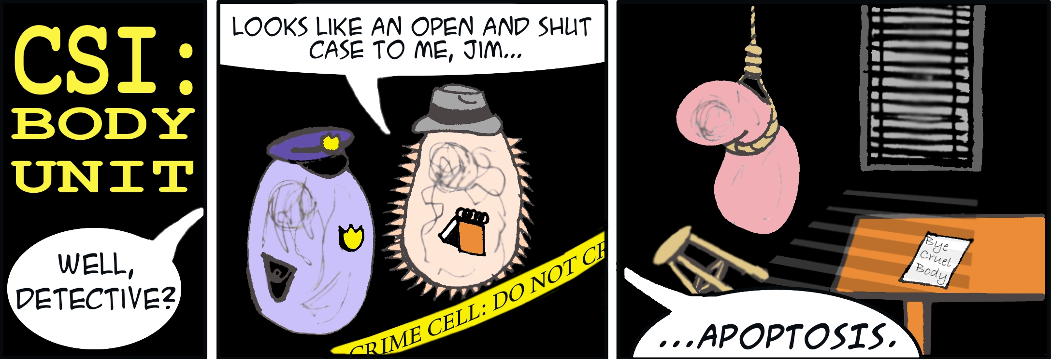
Clearance of apoptotic cells.
entice phagocytes by producing a number of
“eat-me” signals:
+ “flips” phospholipid to the outer leaflet, expose phosphatidylserine.
+ secrete soluble factors that recruit phagocytes.
Happens before the cells undergo membrane damage and release their contents… So no inflammation!

Slide 15
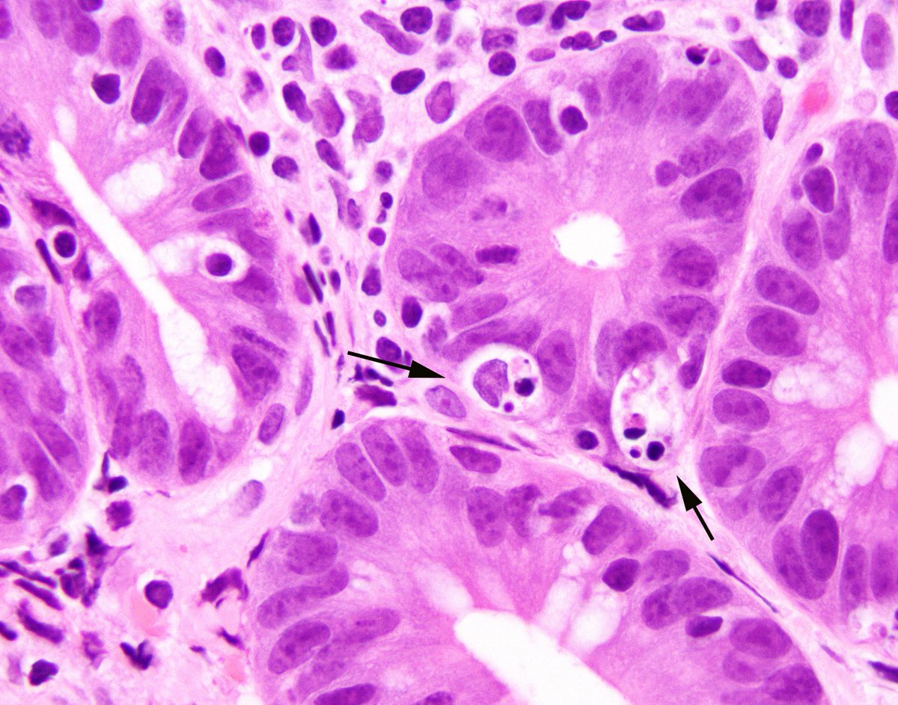
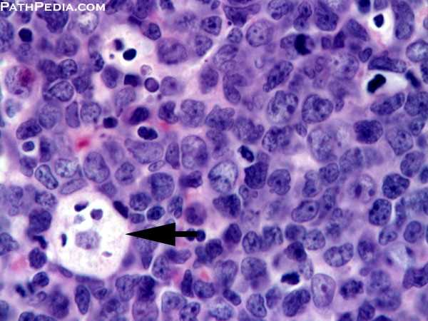
Morphology:
Involves single cells or small clusters
Cells shrink rapidly, retain intact plasma membrane
Formation of cytoplasmic buds
Fragmentation into apoptotic bodies
Apoptotic bodies phagocytized rapidly before inflammatory response.

Slide 16
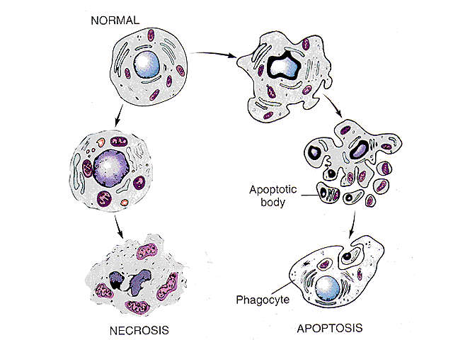

Slide 17
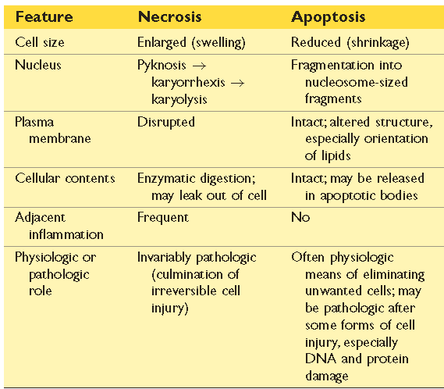
Necrosis Vs Apoptosis

Slide 18
Other Pathways of Cell Death:
Necroptosis
Features of both necrosis and apoptosis.
initiated by engagement of TNF receptors → receptor interacting protein (RIP) kinases are activated→ initiating dissolution of the cell like necrosis
Pyroptosis
activation of a cytosolic danger-sensing protein complex called the inflammasome.
Greek, pyro = fire
Used by infectious microbes
Fever + inflammation + apoptosis
Autophagy
(“self-eating”)
refers to lysosomal digestion of the cell’s own components.
Nutrient deprivation
Survival pathway

Slide 20
THANKS!
Any questions?
FEEL FREE TO ASK NOW, before it is too late ☺

